Slide 1
Do It Yourself
Hardware tools for
Software Testers
Nikita Nalyutin

Slide 2
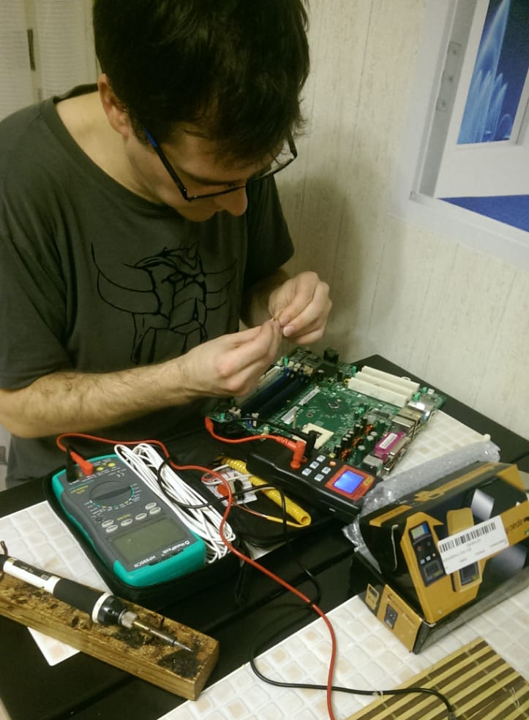

whoami
In software testing since 2002
Talking about testing since 2005
Writing books about testing since 2008
Talking about hardware since 2015
…got my first soldering iron at age of 5

Slide 3
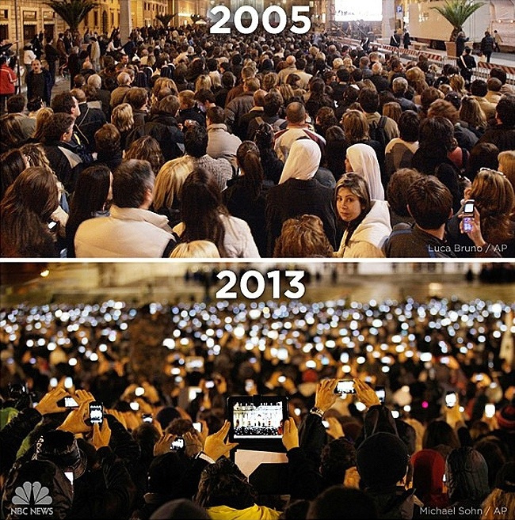
QR code warning
Lots of QR on the slides
Don’t just make photos, like in 2013, scan QR codes like in 2019

Slide 4
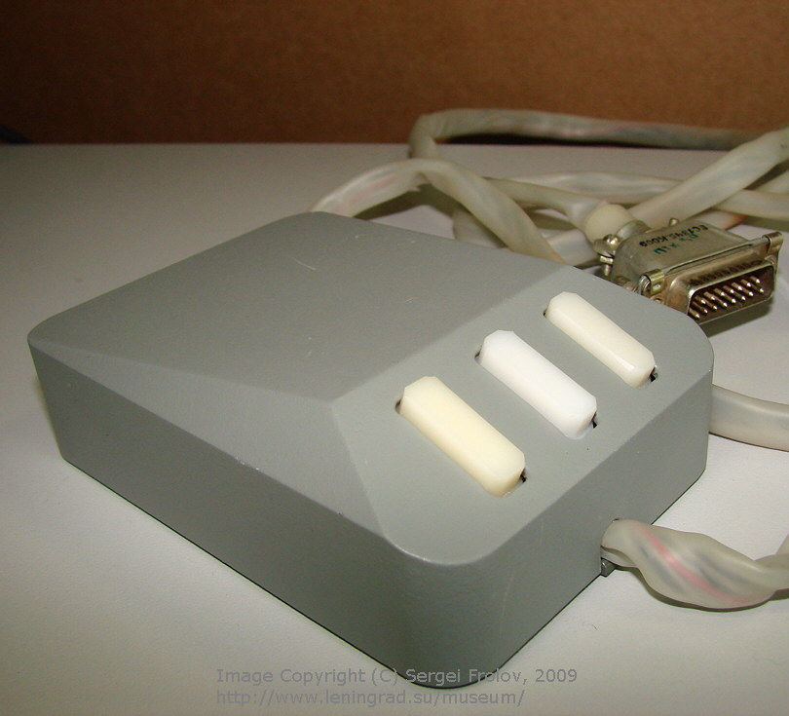
Mouse
Prevent PC from sleep
Fuzzy testing
Adding noise

Slide 5
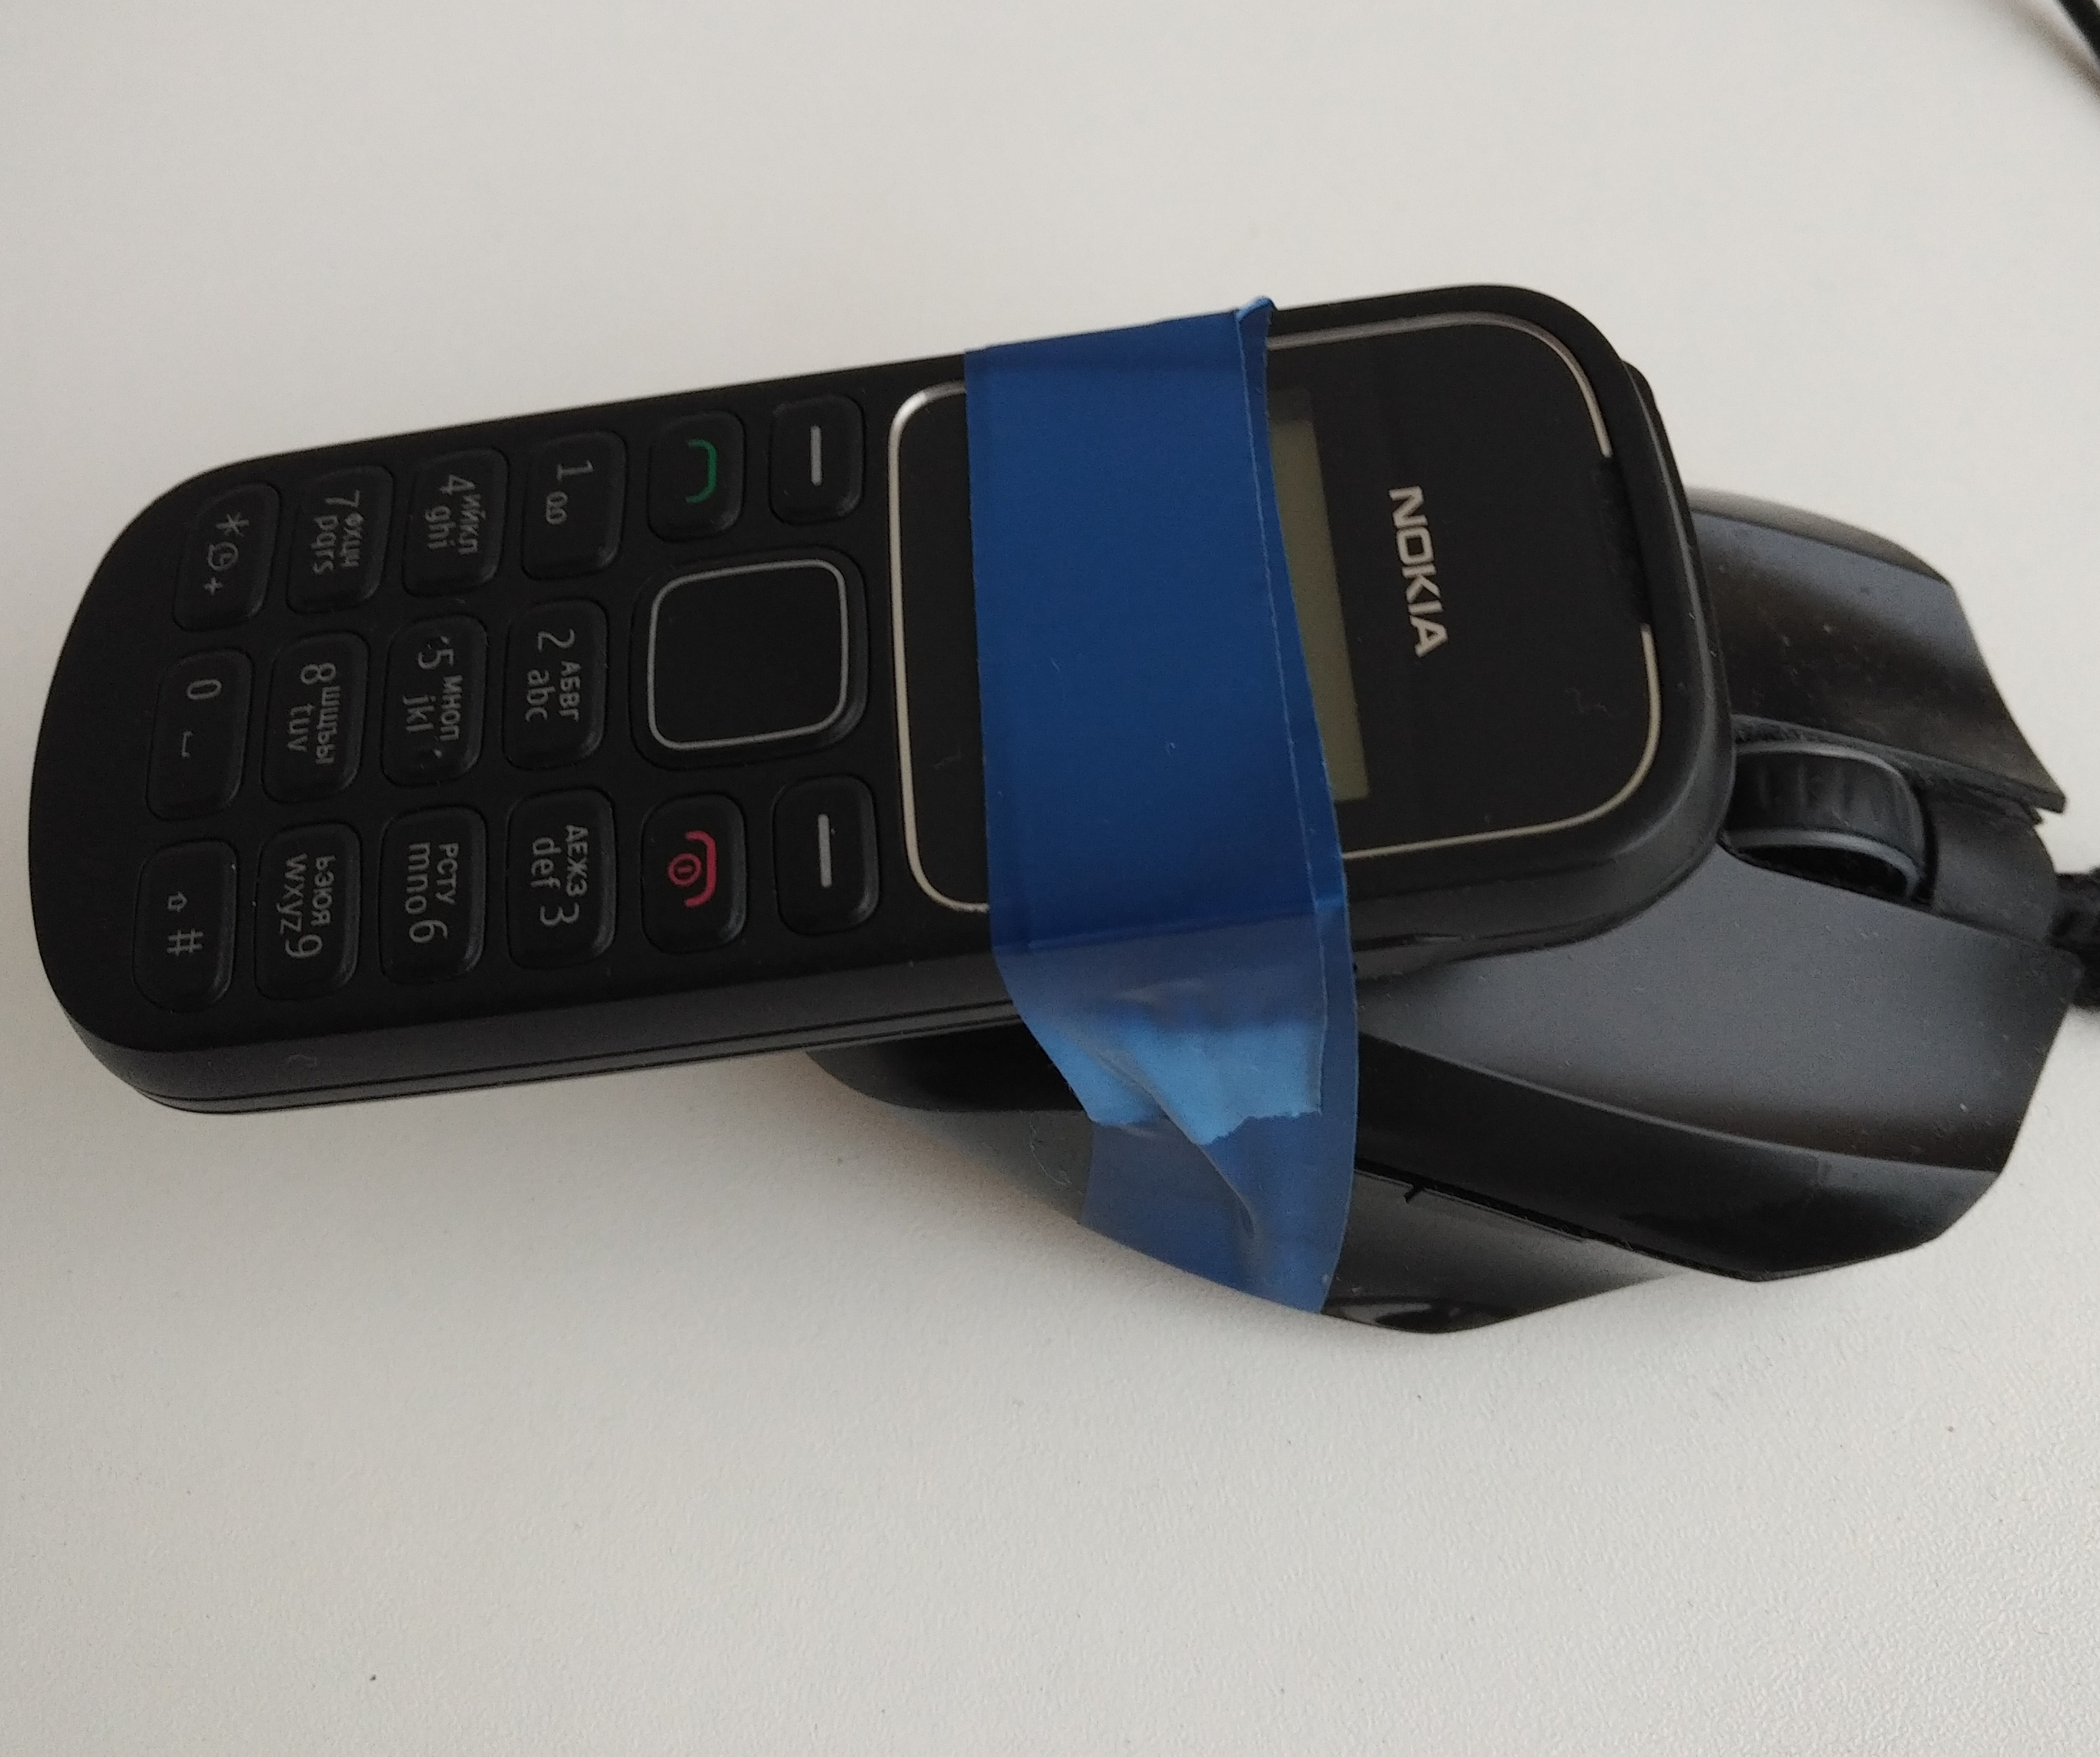
Mouse + phone
Very stupid
Erratic moves
Wake on call
Use auto redial!

Slide 6
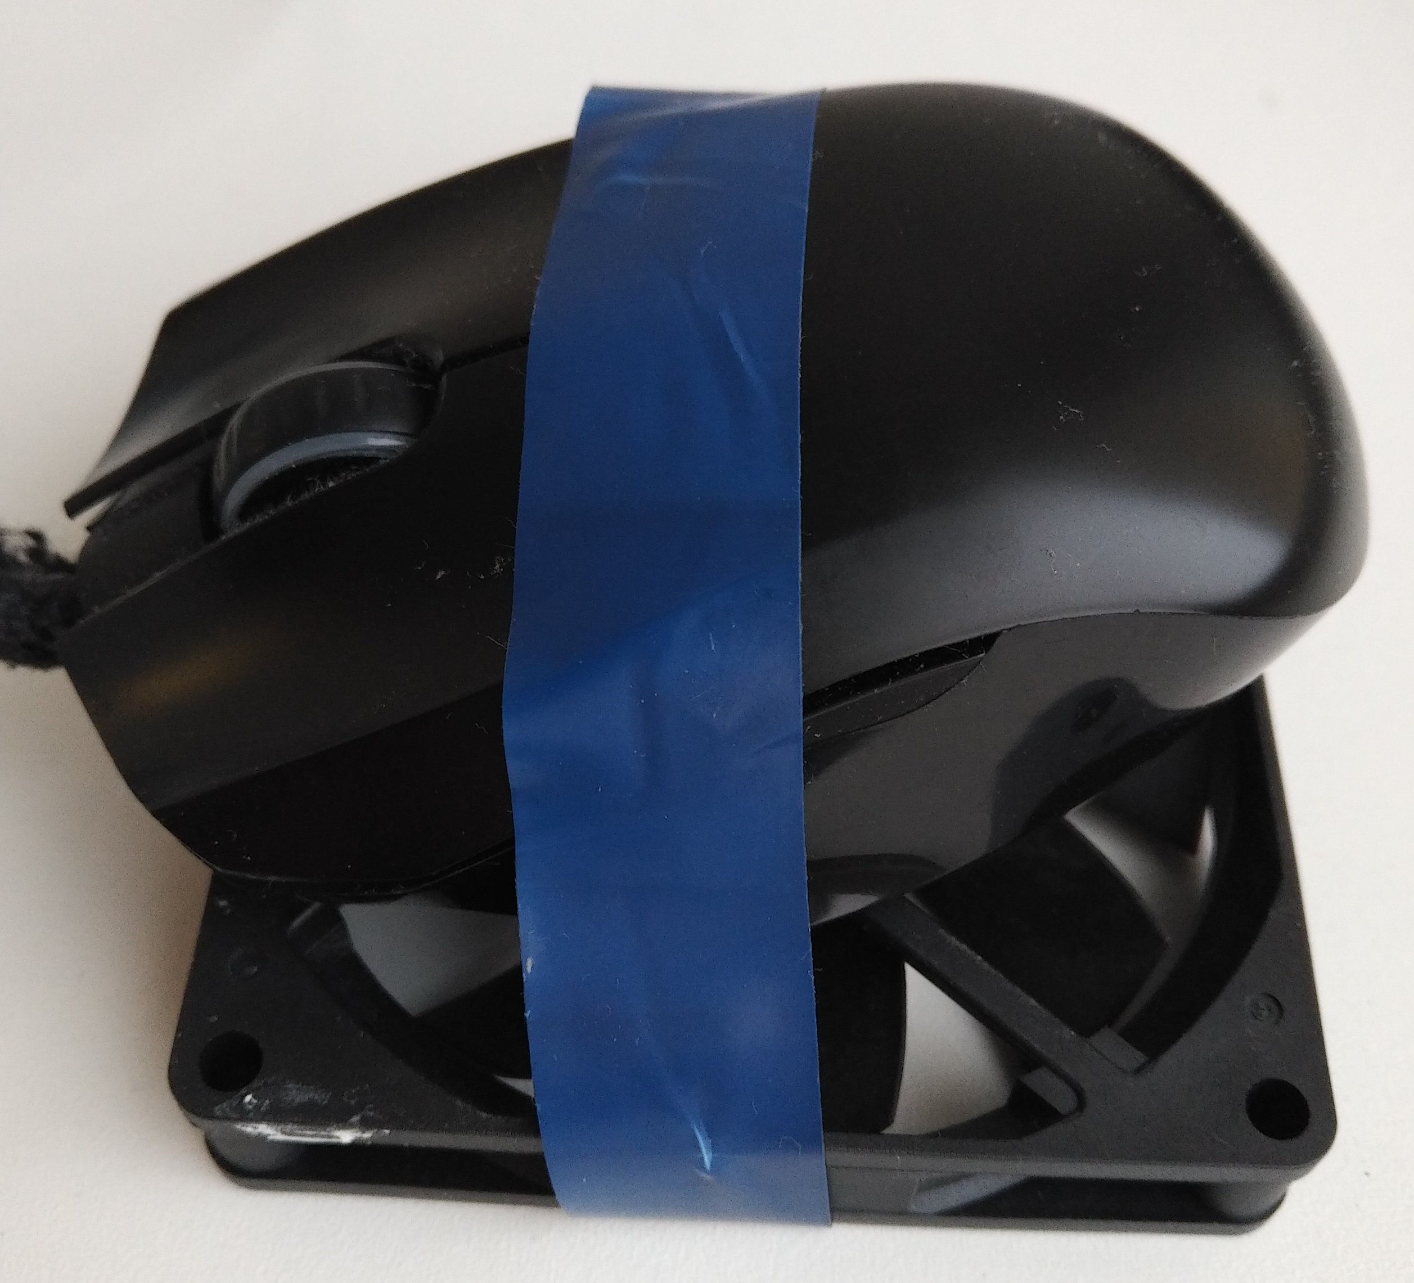
Mouse + fan
Somewhat stupid
Erratic moves
PC never sleeps
Use color fans!

Slide 7
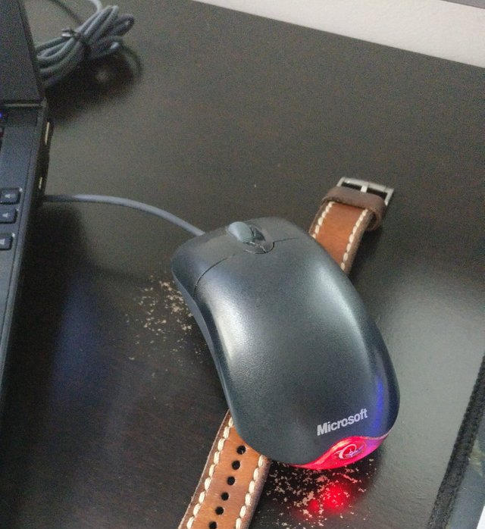
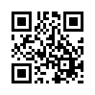
I’m not alone!
This thing is from Reddit
Rolex or Casio?
What about binary clock?

Slide 8
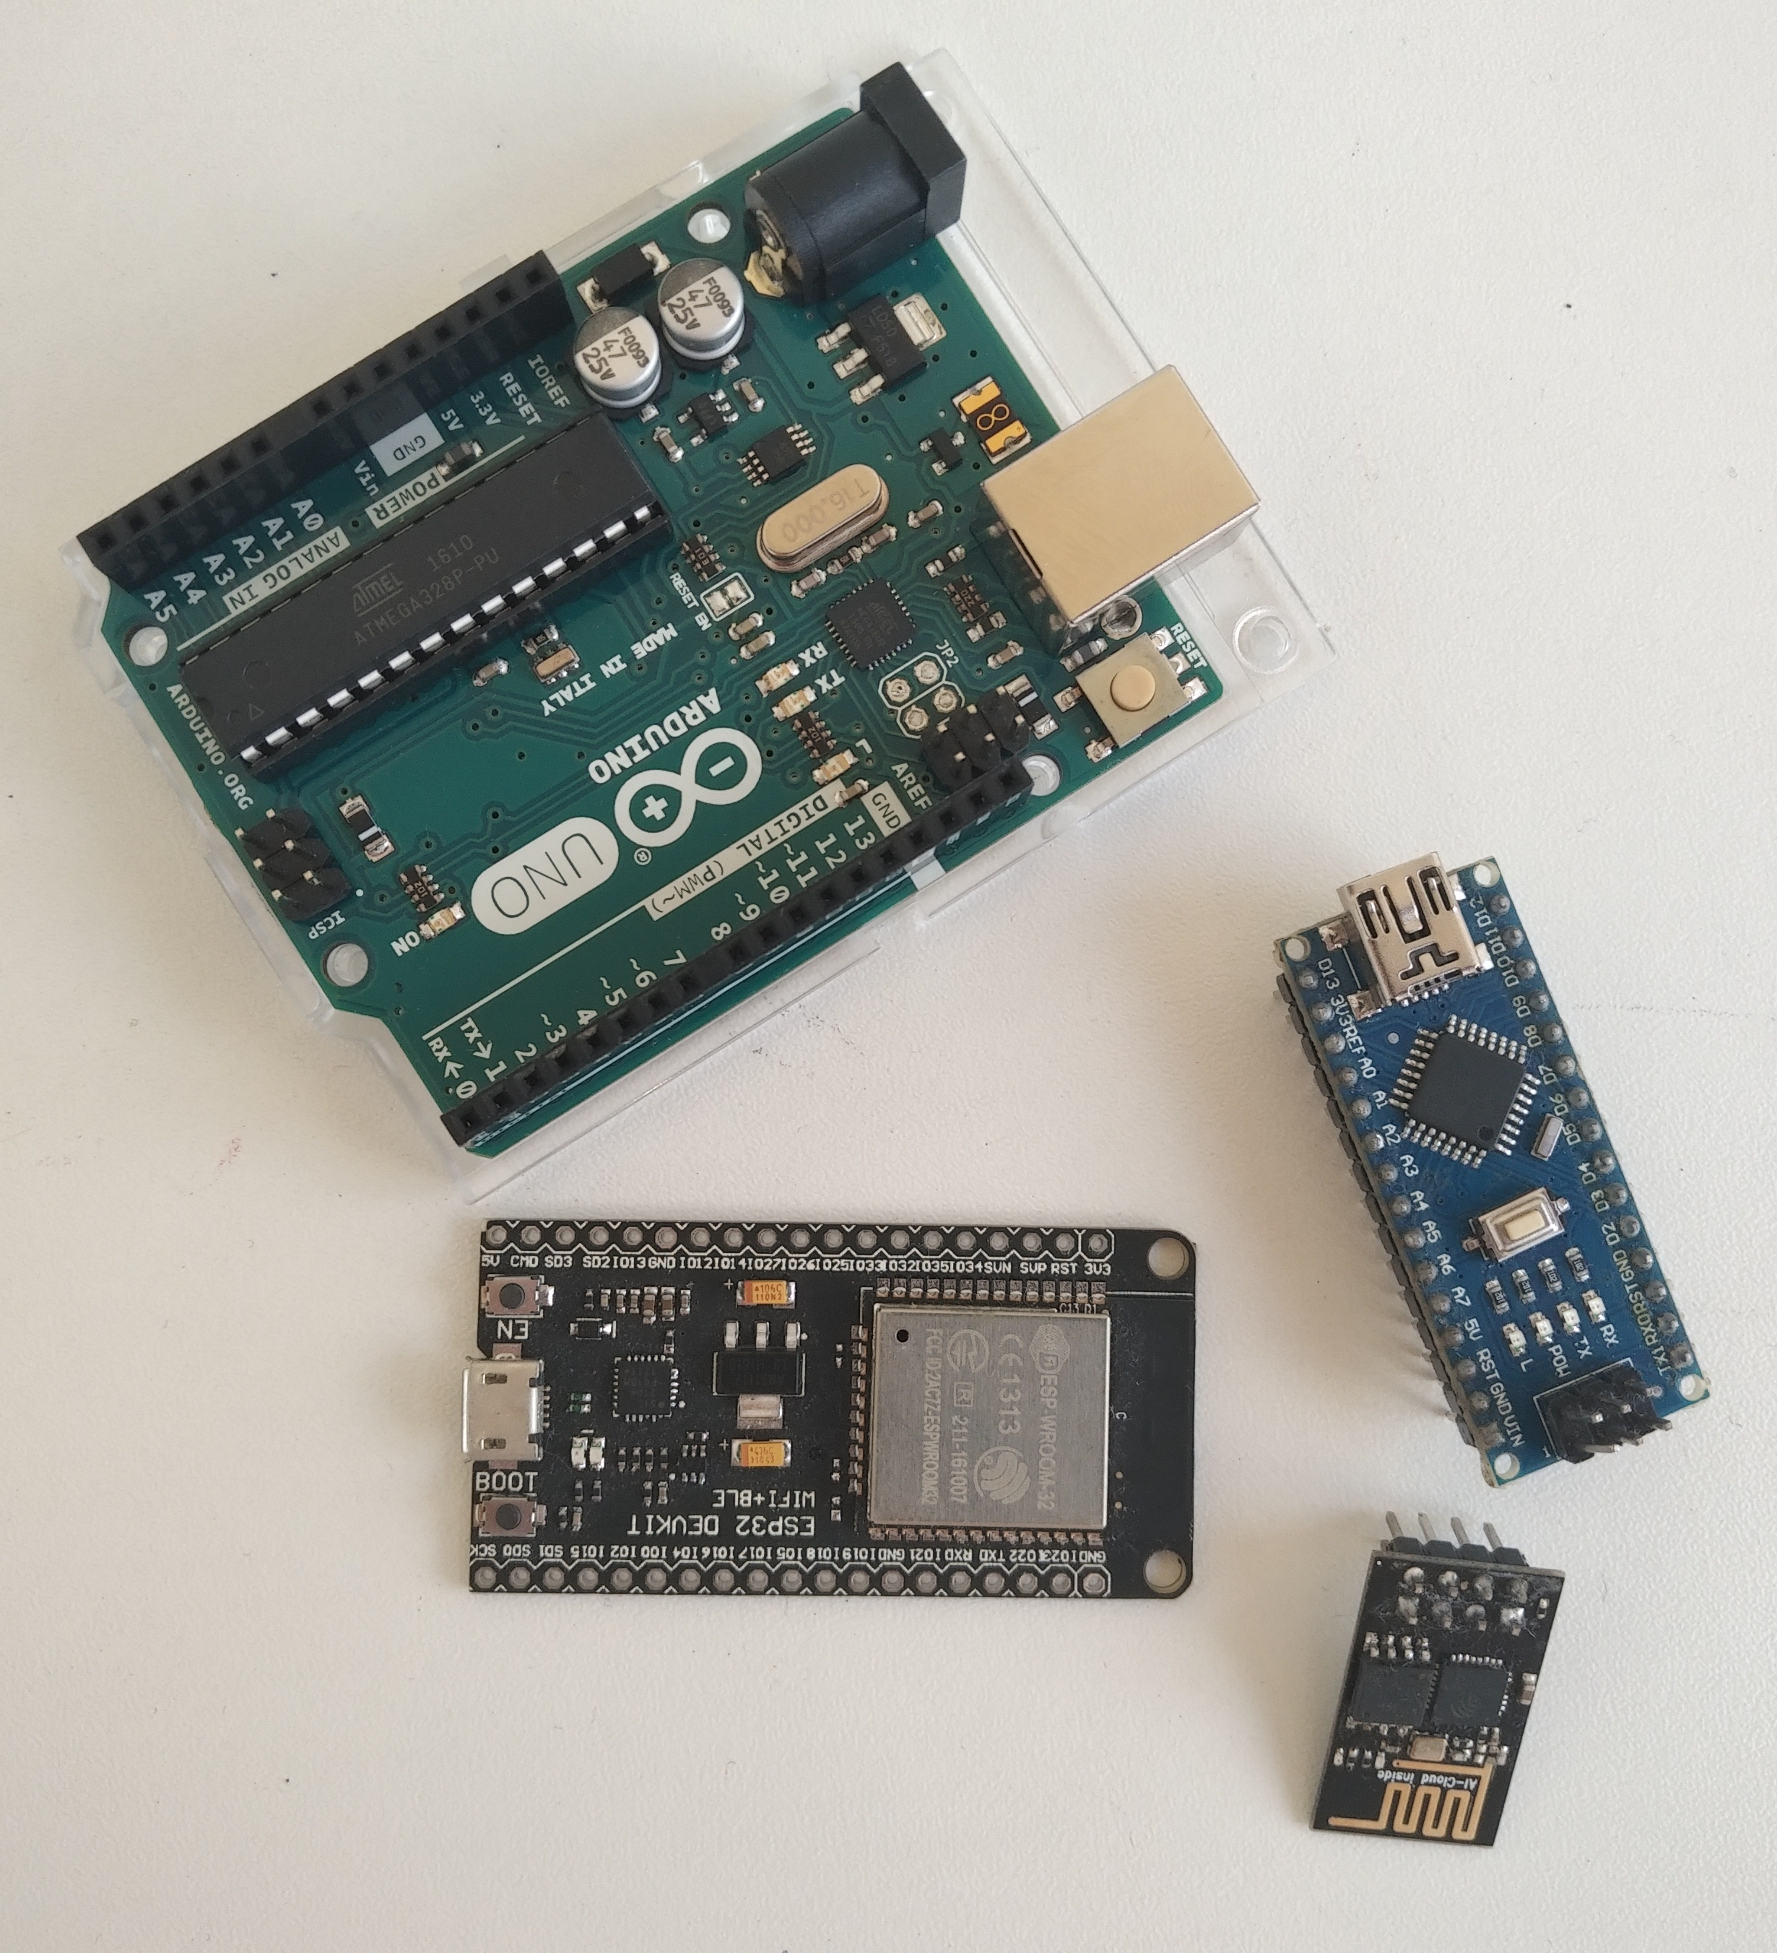
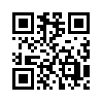
Arduino or ESP
Easy to code
Lots of types
Lots of clones
Great community
Super-fast to boot
Try to get difference between Micro and Pro Micro!

Slide 9
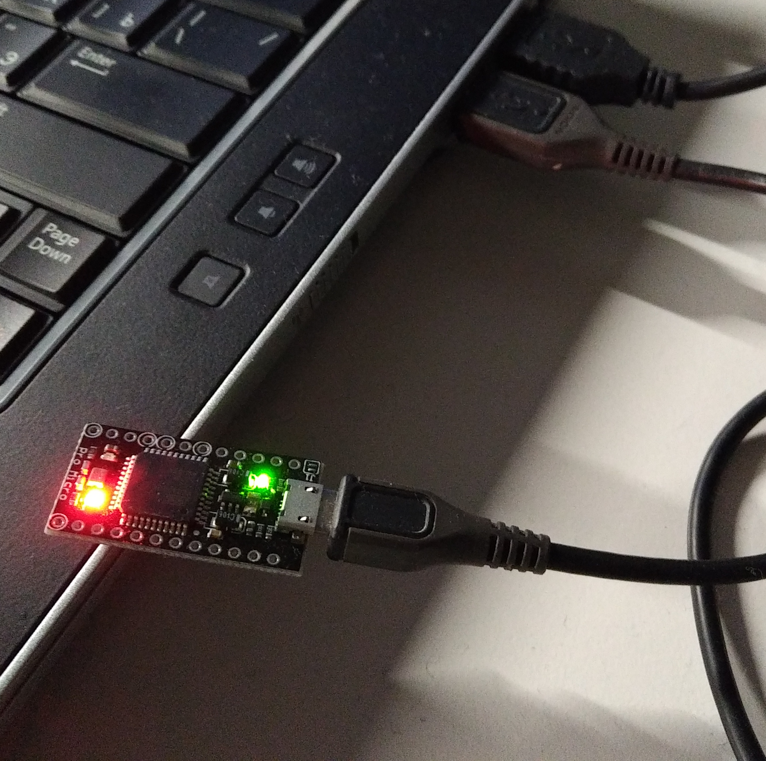
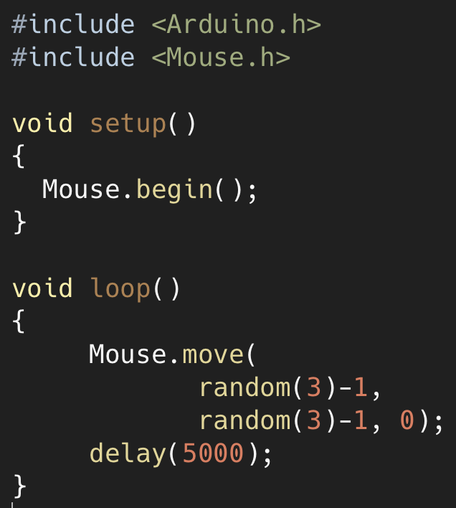
Arduino mouse
Not stupid at all
Require coding
Pro Micro!
Mouse sim
Keyboard sim
Fuzzy testing

Slide 10
Why use hardware?
easier to build
do something bad
do something stupid
simulate real life
organize stuff
… or just for fun

Slide 11

What for?
direct effect on platform,
affecting software (replacing
legit hardware with DIY)
indirect effect on platform
(affecting hardware with DIY)
effect on test environment
effect from test environment
Just to do something crazy
Notes:
Direct effect – replacing legit hardware
Indirect effect – giving effect on hardware by other hardware
Effect on environment
Effect on real world affecting environment

Slide 12
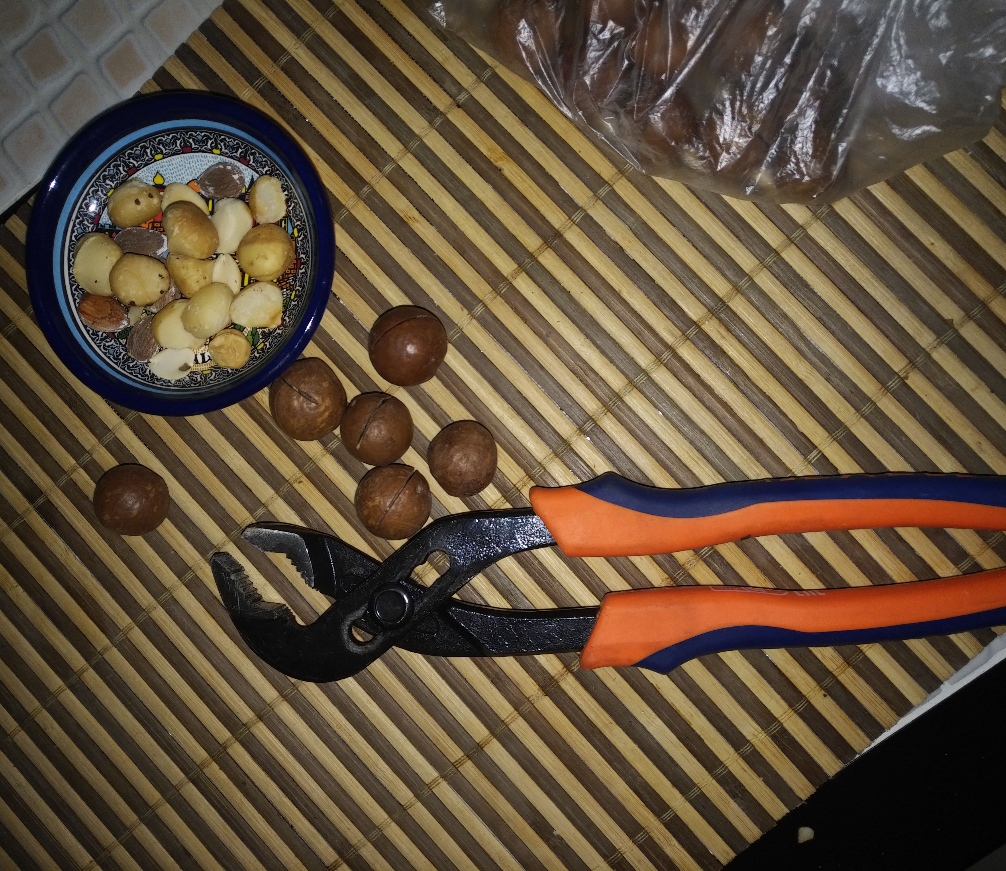
Tools we use
Pre-built modules
Own tools
WIRES
Soldering iron
Glue gun
Meters
Madness and creativity!

Slide 13

Keyboards
Transparent device connection
Fuzzy testing
Mobile and non-mobile connection
No code instrumentation

Slide 14
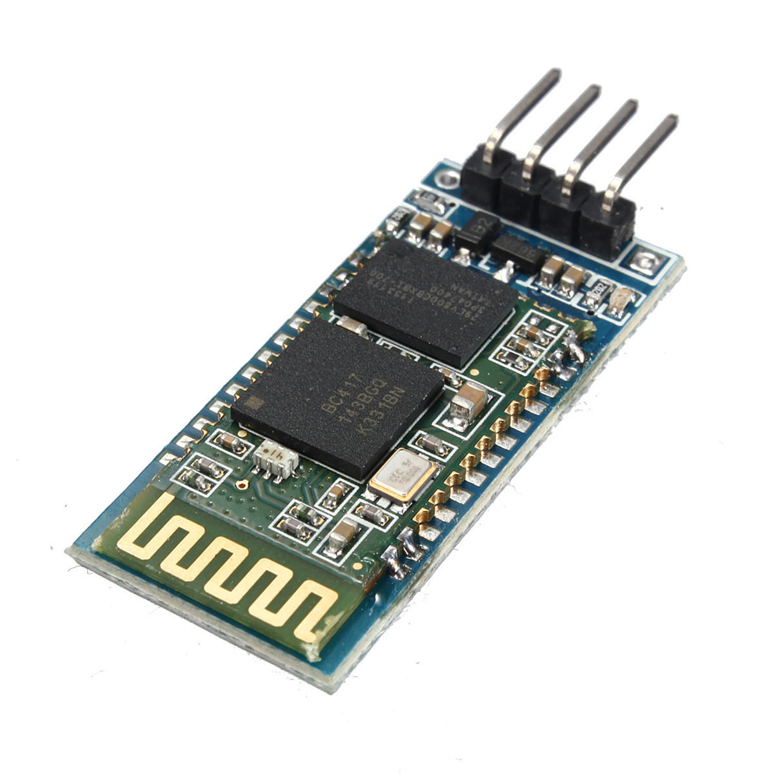
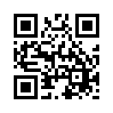
Bluetooth
Connect to phones
Simulate devices
Different modules:
RN-42, HC-05, HC-06
Cheap clones
May be embedded
Switch off your loud neighbor’s Smart TV!

Slide 15
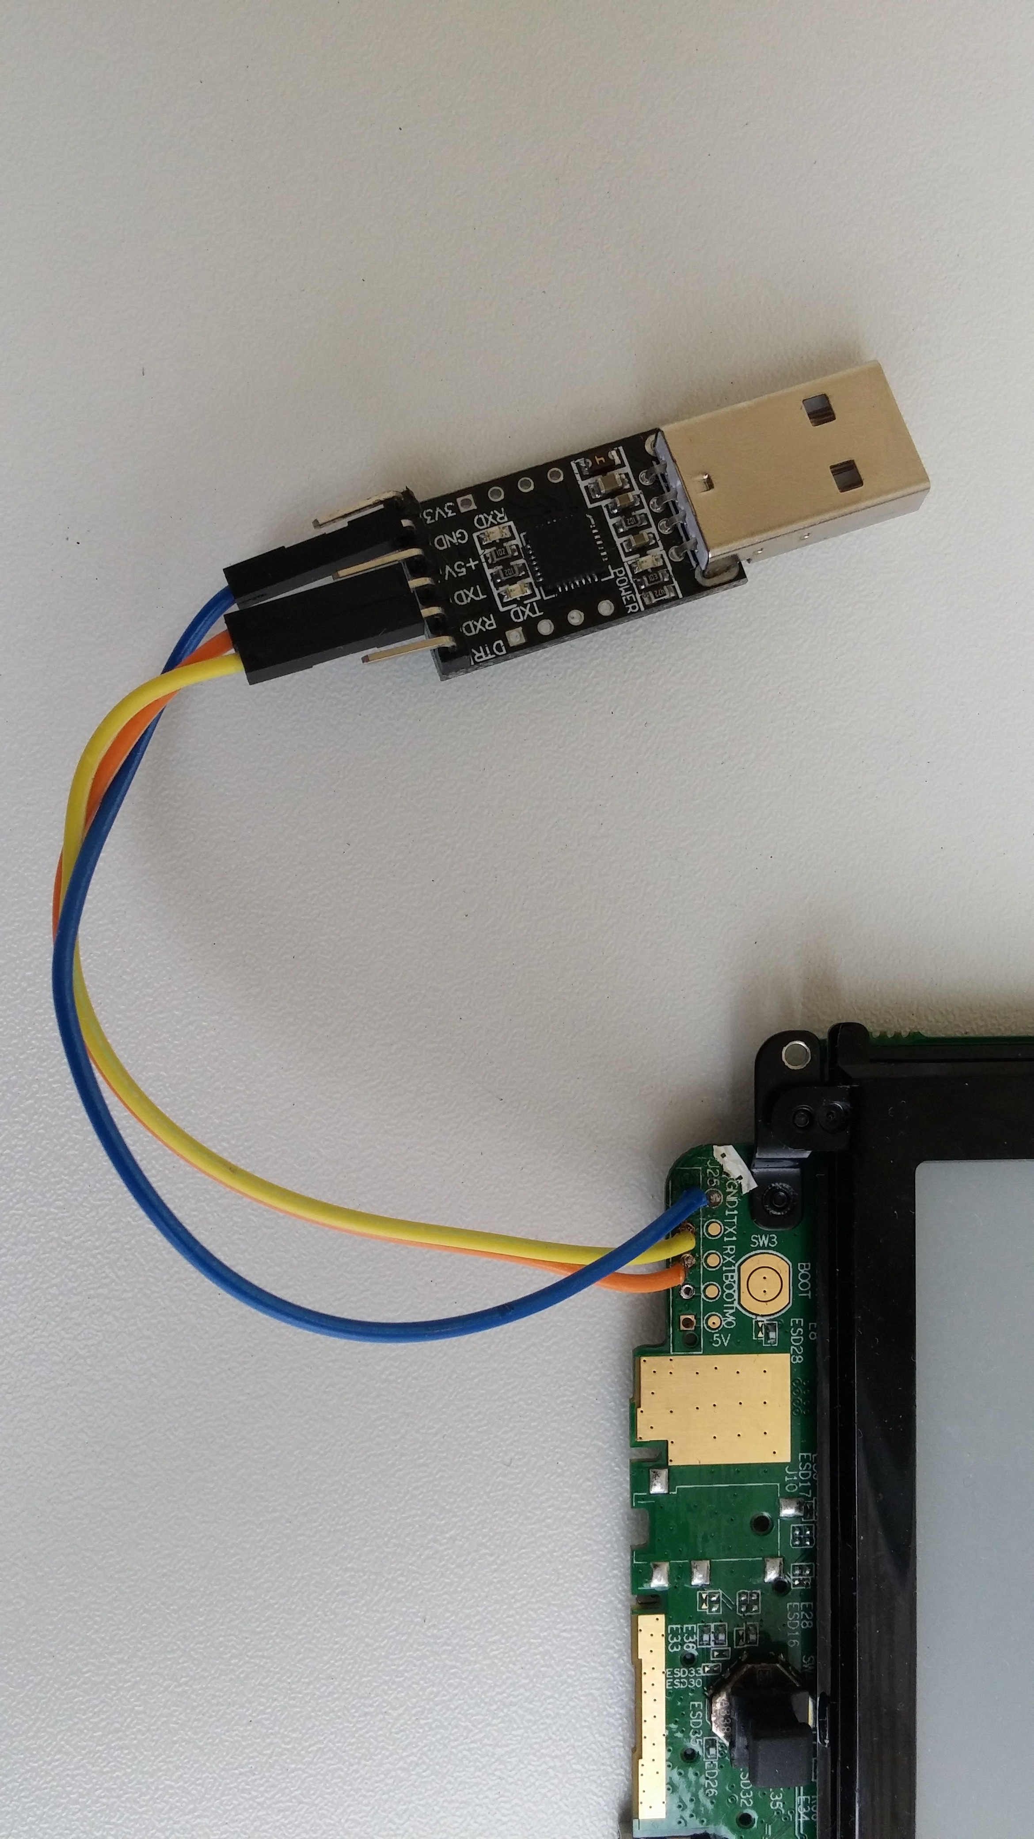
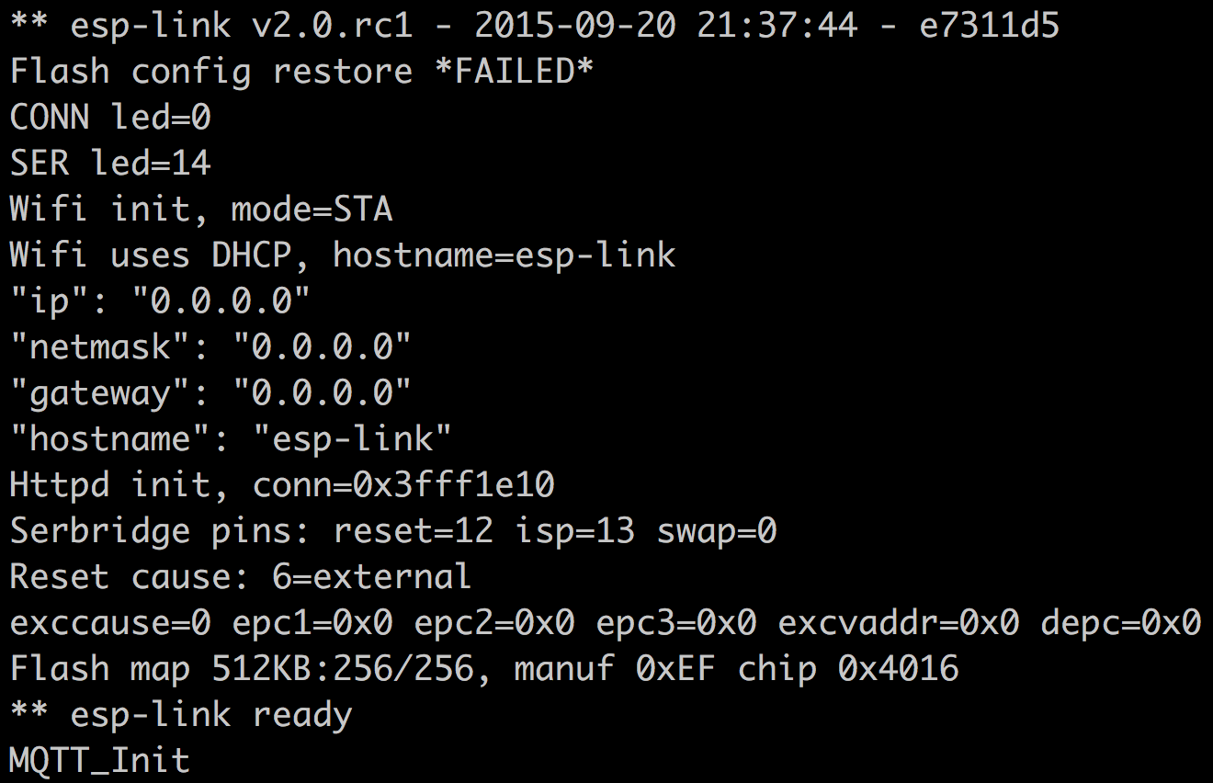
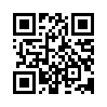
Serial port
Control of other stuff
You can get logs
Interface between PC and your devices
Try to find 4 dots on PCB!

Slide 16
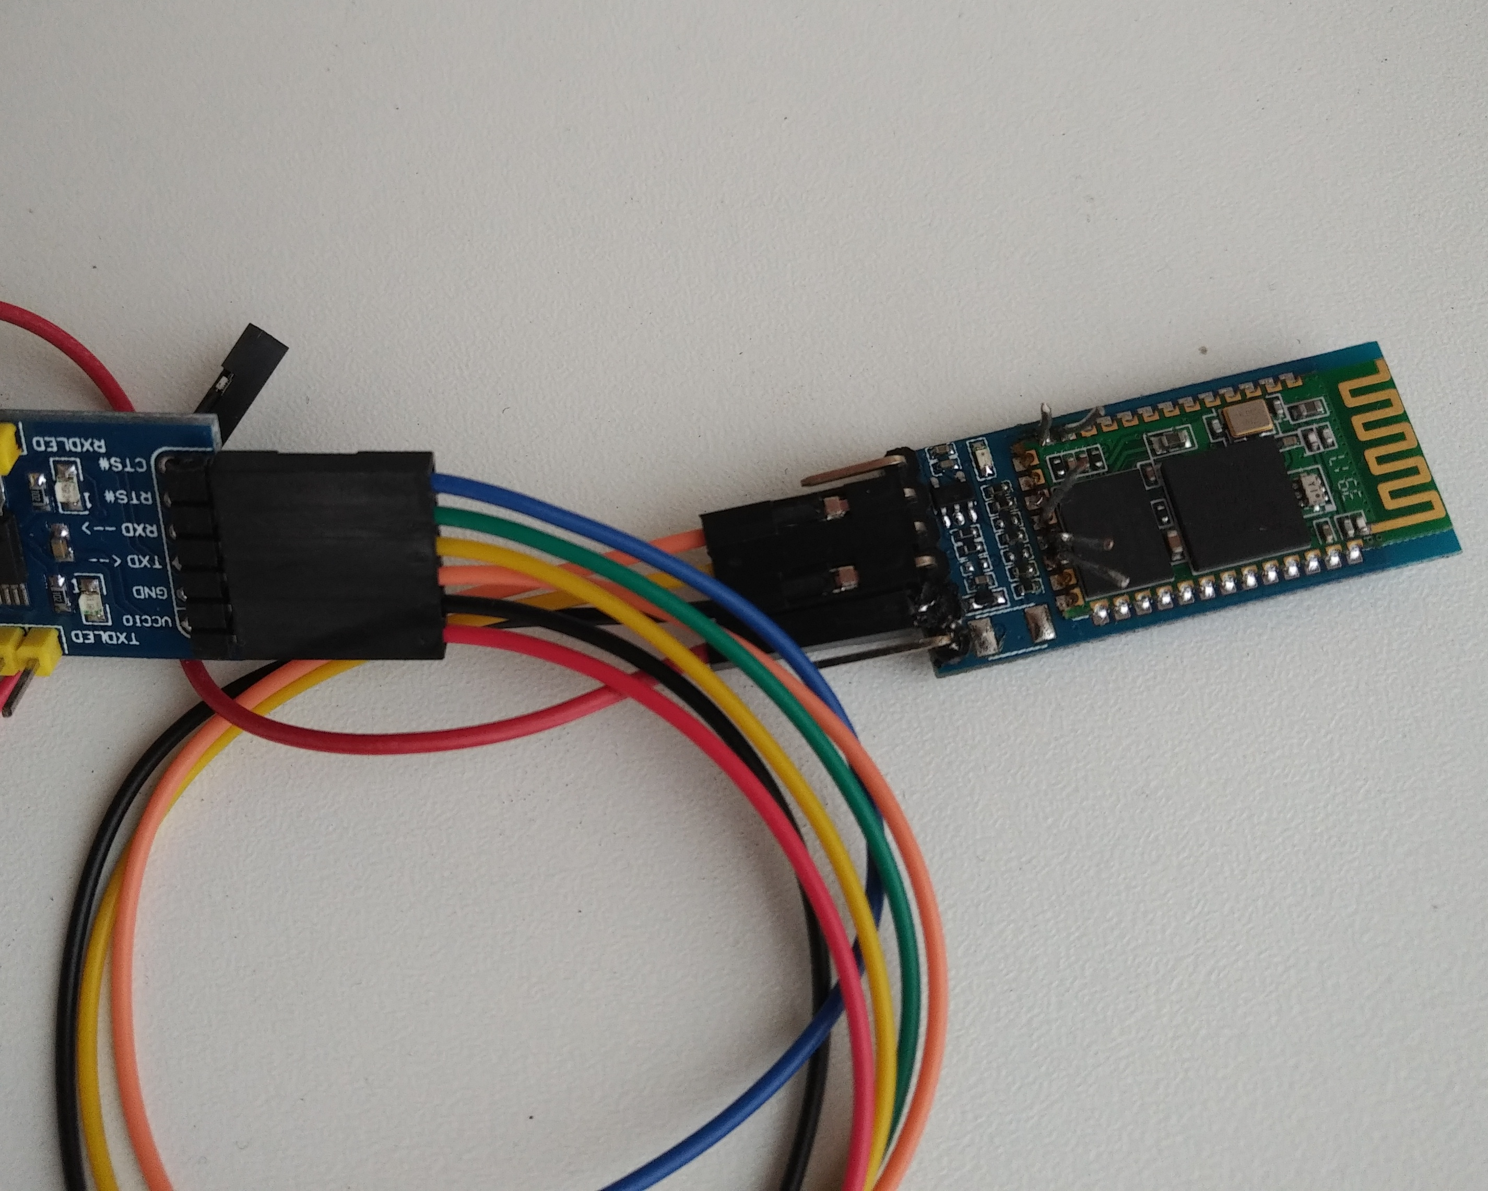
Bluetooth
RN-42
Require coding
Connect to mobile
Control from serial port

Slide 17
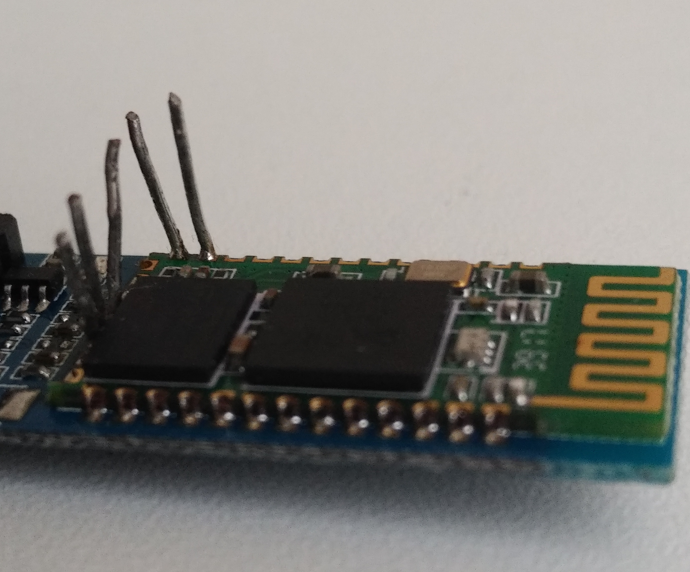
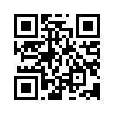
Cheaper?
RN-42 is expensive
Cheap HC-05 can be re-flashed

Slide 18
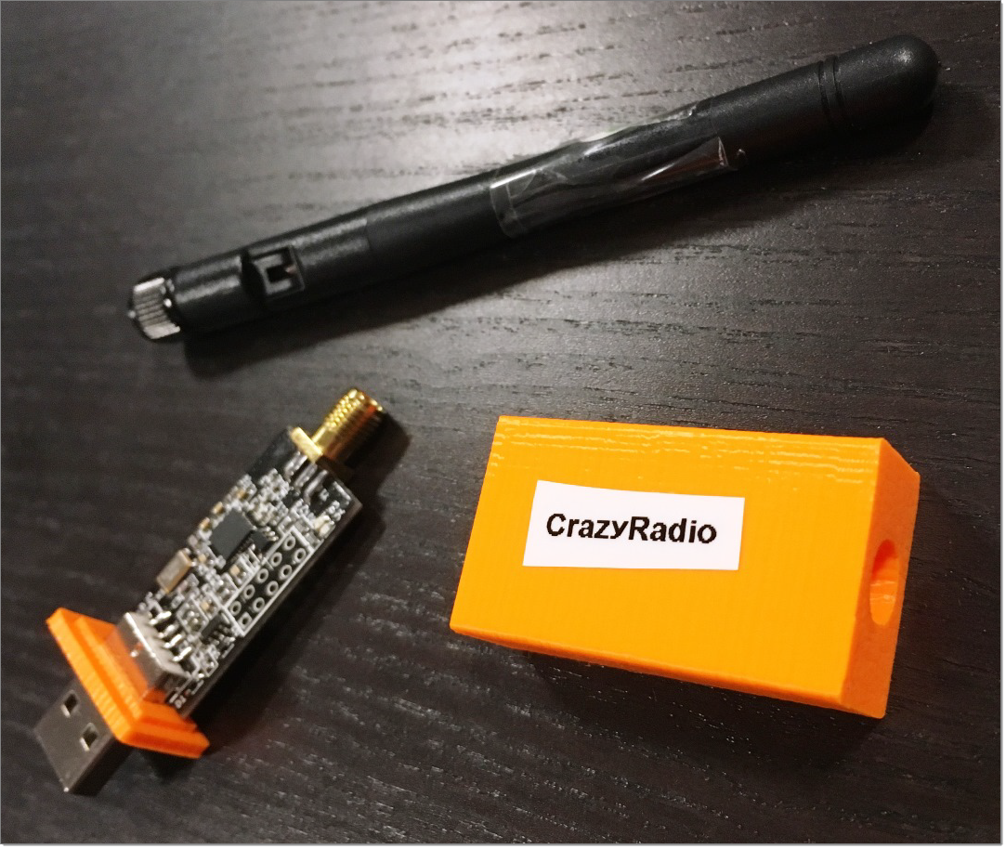
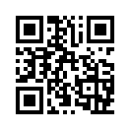
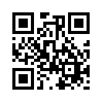
Alternatives?
Proprietary protocols reversing
Crazyradio
Bastille

Slide 19
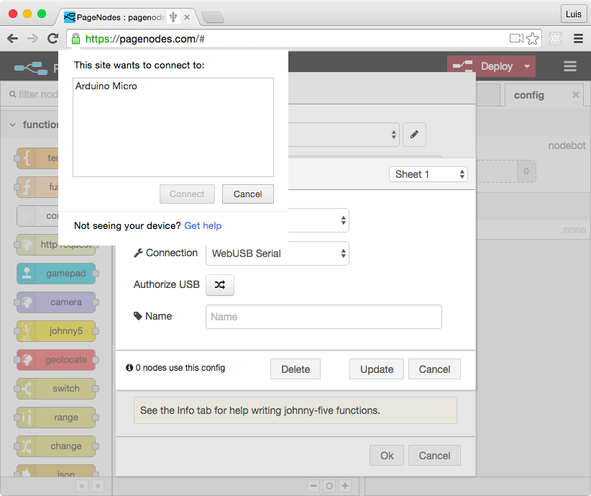
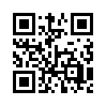
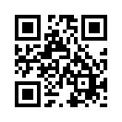
WebUSB
Control Arduino from web interface
Google W3C draft
b

Slide 20
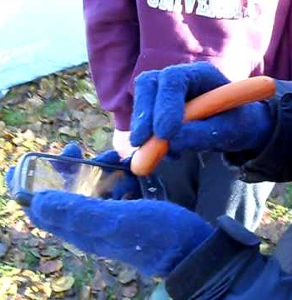
Touch screen sausage!
iPhone version is 100 % hipster and vegan-safe
Sausage +
stepper motor =
automation!
Make 100000 dislikes/hour!

Slide 21

Radios
RX: trigger test events
TX: influence devices
TX may be illegal!

Slide 22
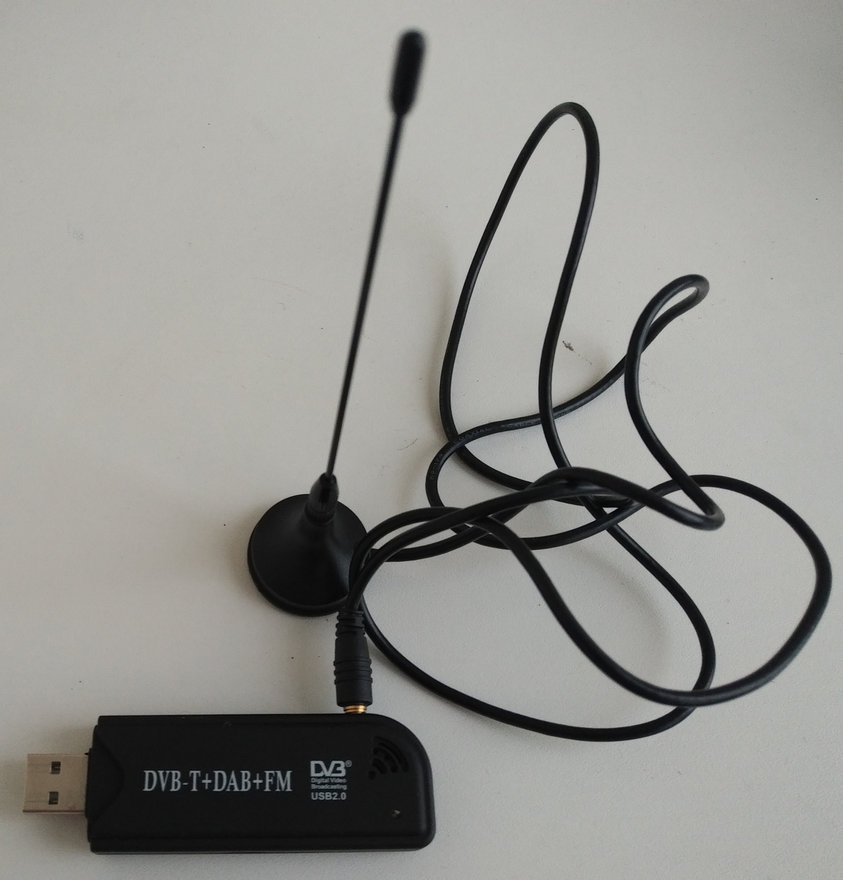
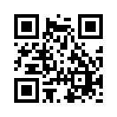
RTL SDR
Listen to radio
Analyze signals
Make radio-controlled stuff
Transmit low-power signals
Simulate GPS and GSM
Continue jamming your loud neighbor’s TV!

Slide 23
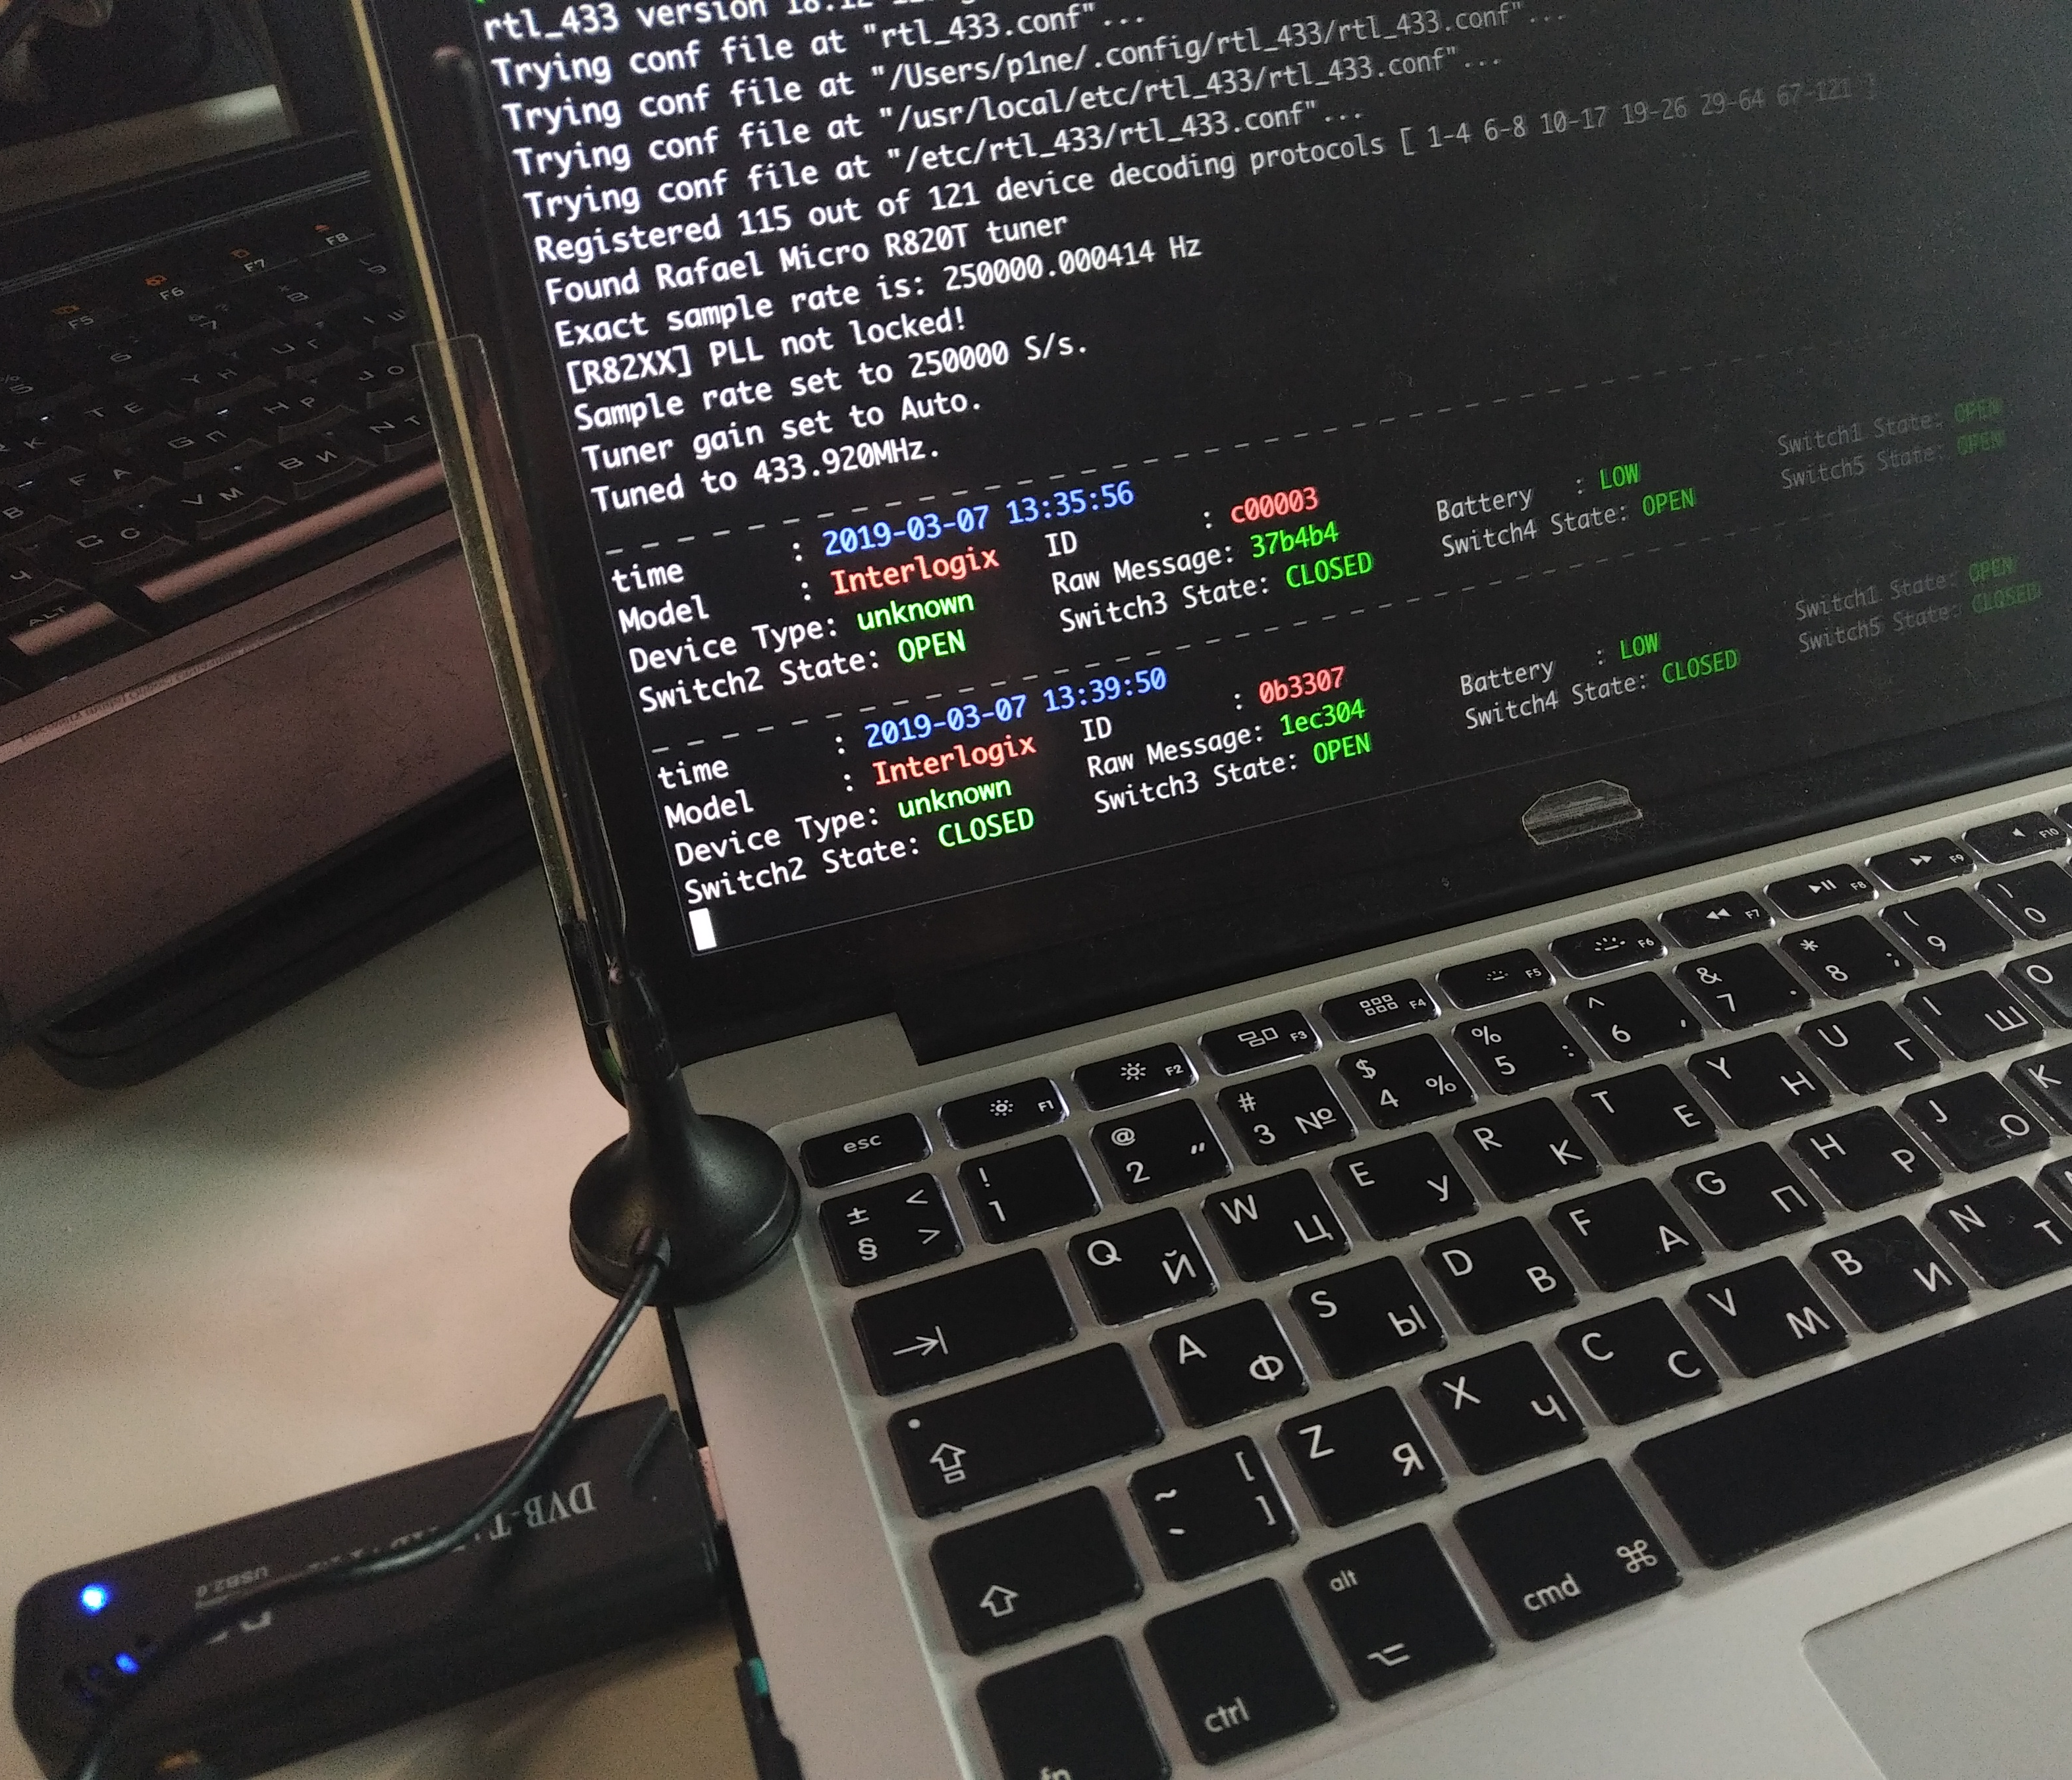
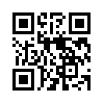
433 MHz
Frequency for home and office automation: motion sensors, fire alarms…
Testing starts when everyone leaves
rtl_433

Slide 24
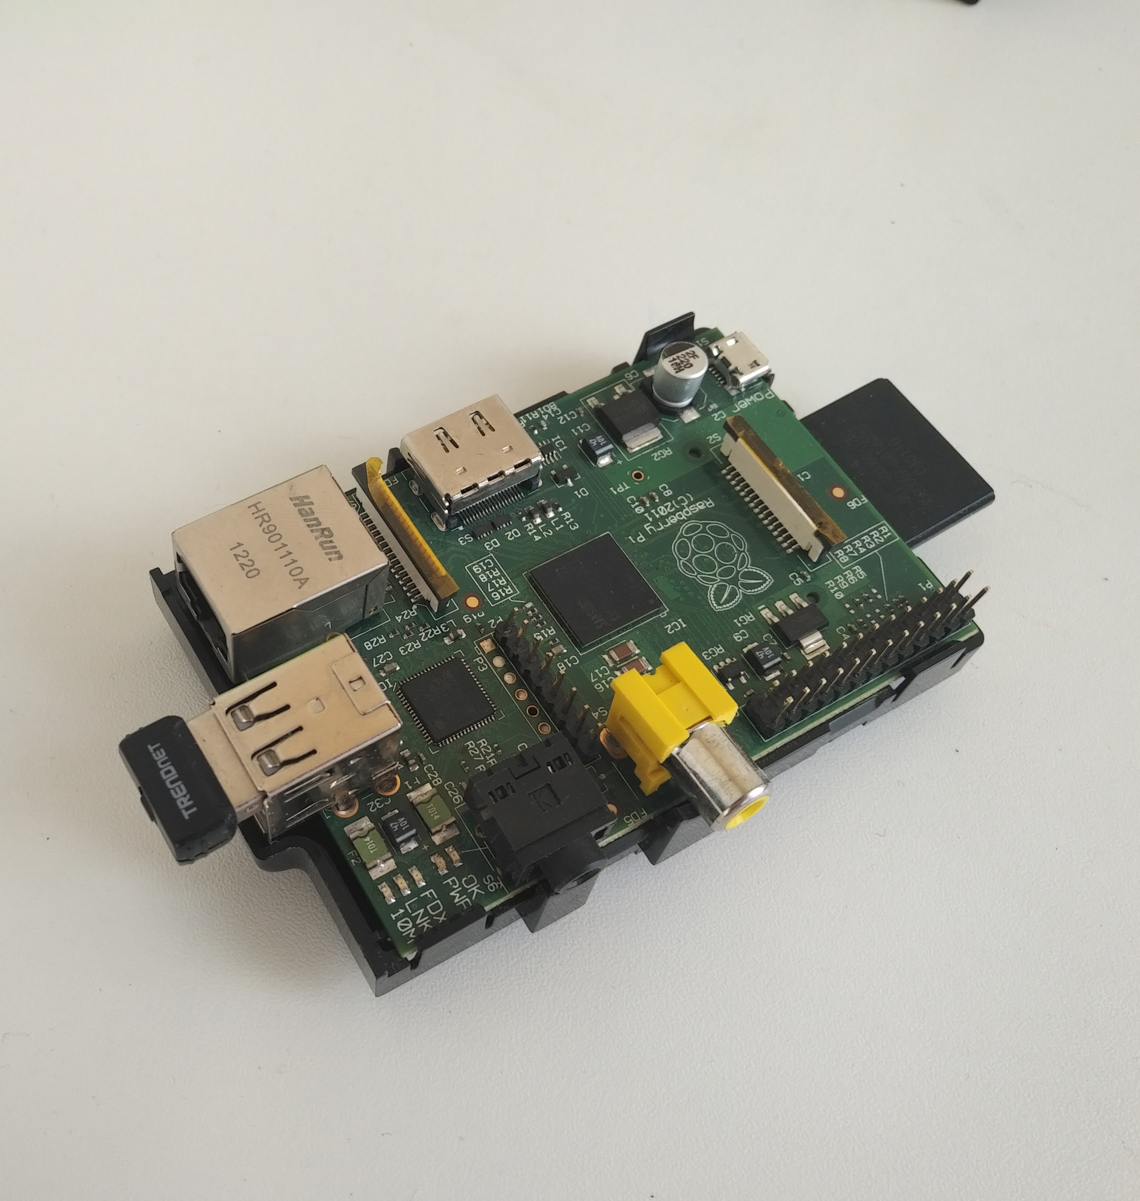
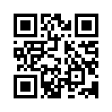
Raspberry PI
De-facto standard
Linux inside
GPIO interface
Great community
Lots of clones
Slow to boot

Slide 25
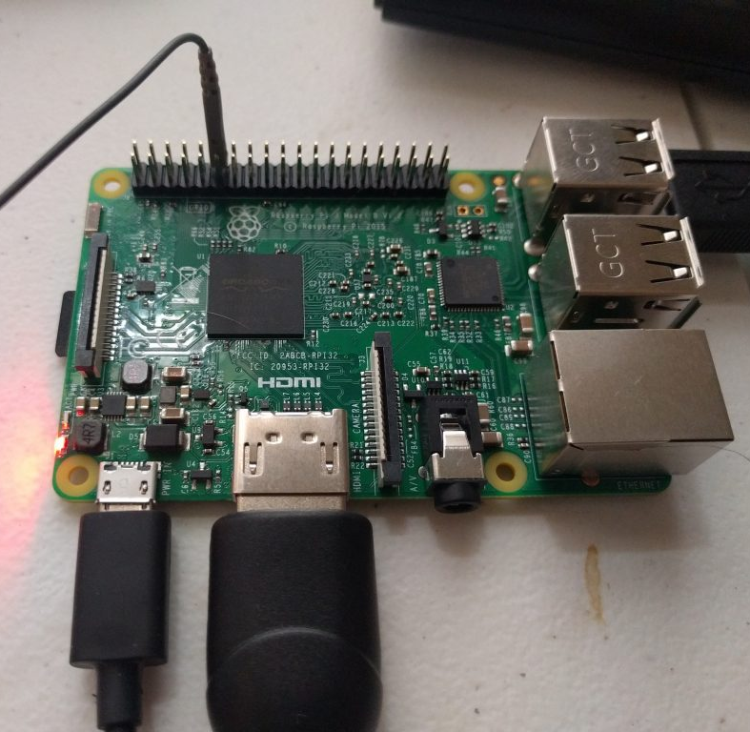
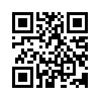
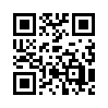
rpitx
Raspberry PI based radio transmitter
Voice message to your office guard walkie-talkie to come and reboot

Slide 26
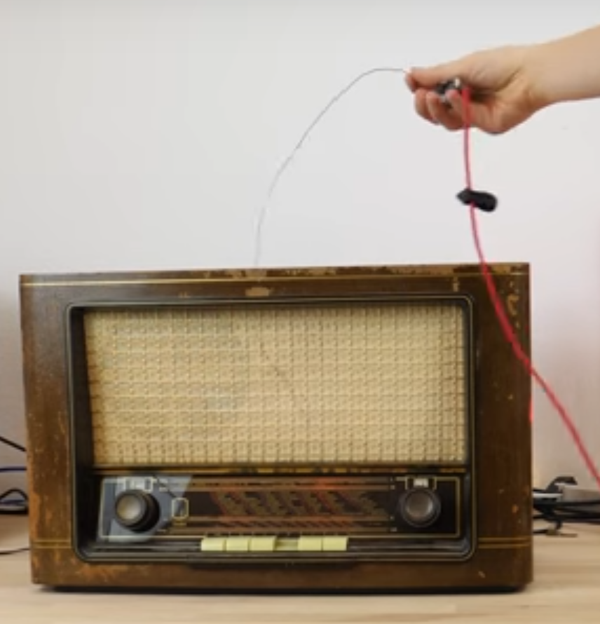
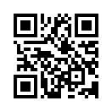
ESP32 AM radio
ESP32 can transmit AM
If your night guard is really old – you can transmit to his/her tube radio

Slide 27
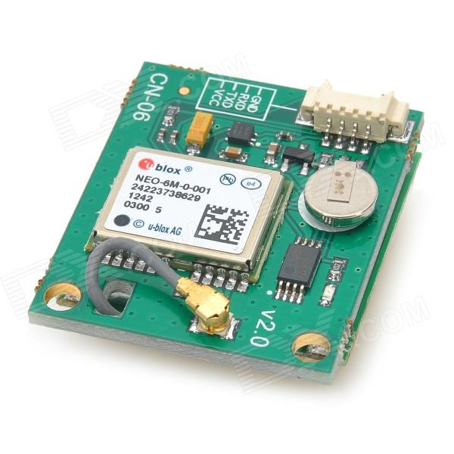
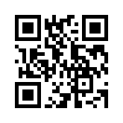
GPS receivers
Coordinates (latitude)
Coordinates (longitude)
Coordinates (altitude)
Not coordinates (time)
Your own atomic clock!

Slide 28
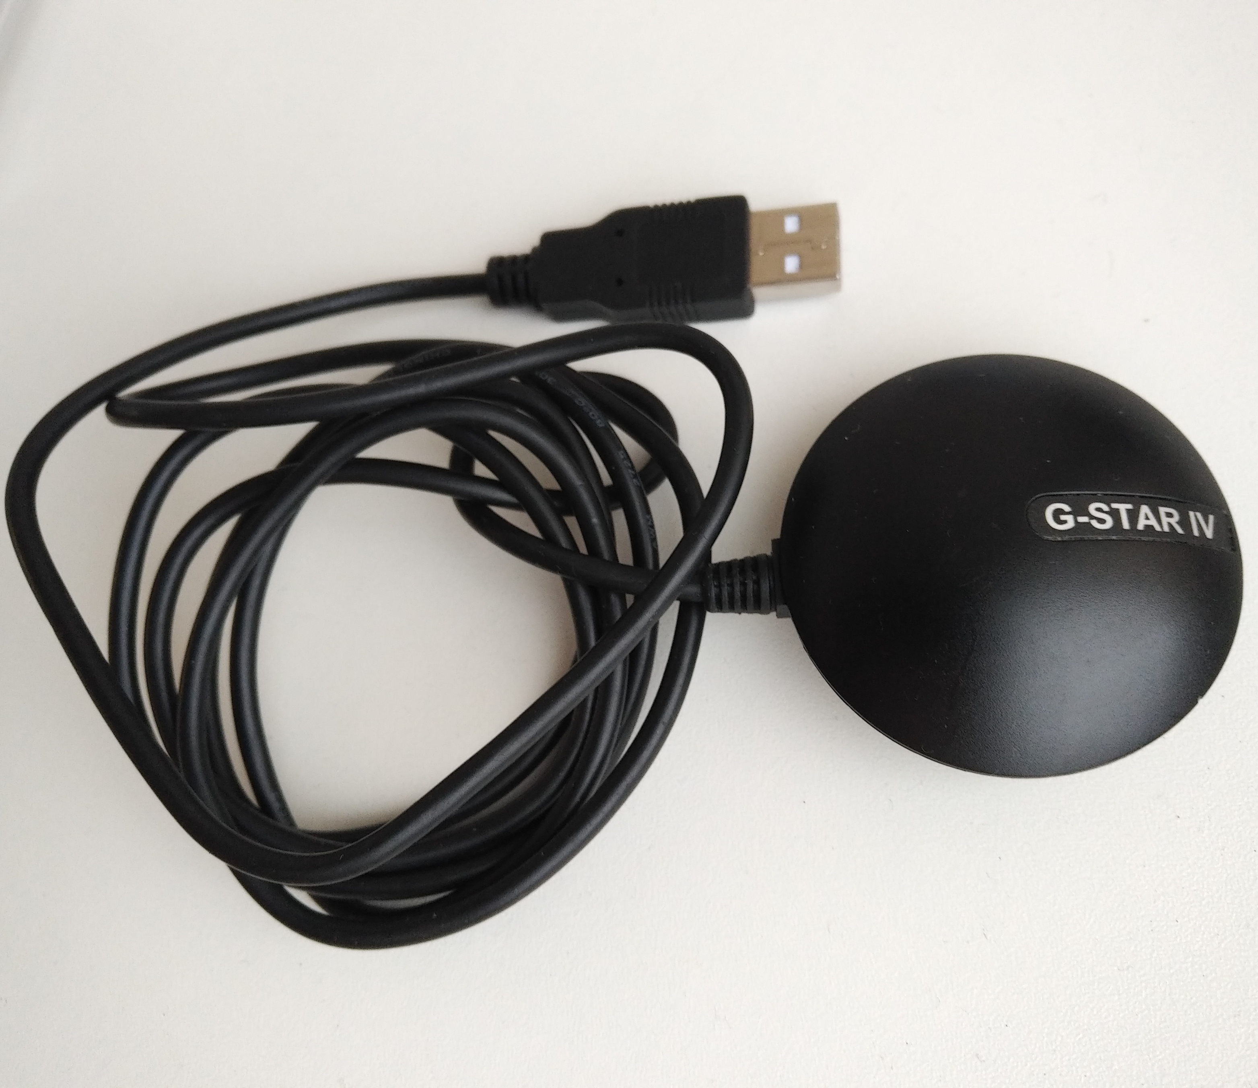
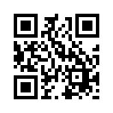
GPS receive
No Internet? No local NTP server?
Get time from the sky!
NMEA standard

Slide 29
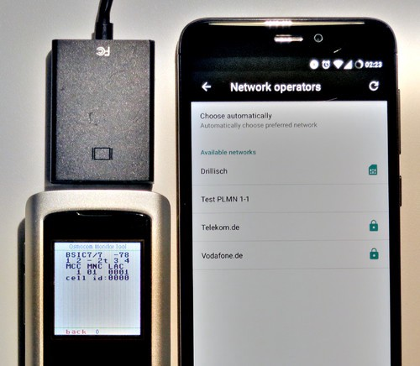
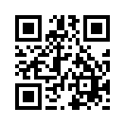
oscmocom_fl2k
Cheap USB-VGA converter
Simulate GSM cell presence
Simulate GPS coordinates

Slide 30
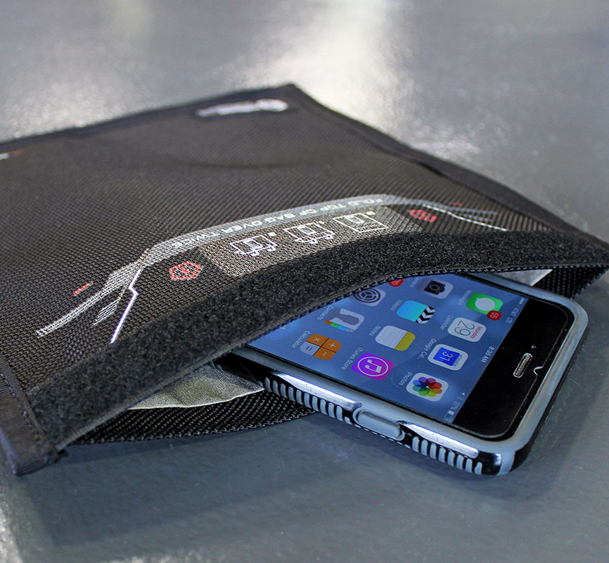
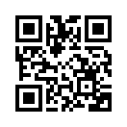
Passive Radio jamming
Faradei cage
Useful for mobile app stability test, mem leaks

Slide 31
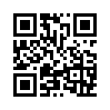

Active Radio jamming
May be illegal
Noise generators
Useful for unstable cell network conditions test

Slide 32

Temperature
Overheat
Freeze

Slide 33
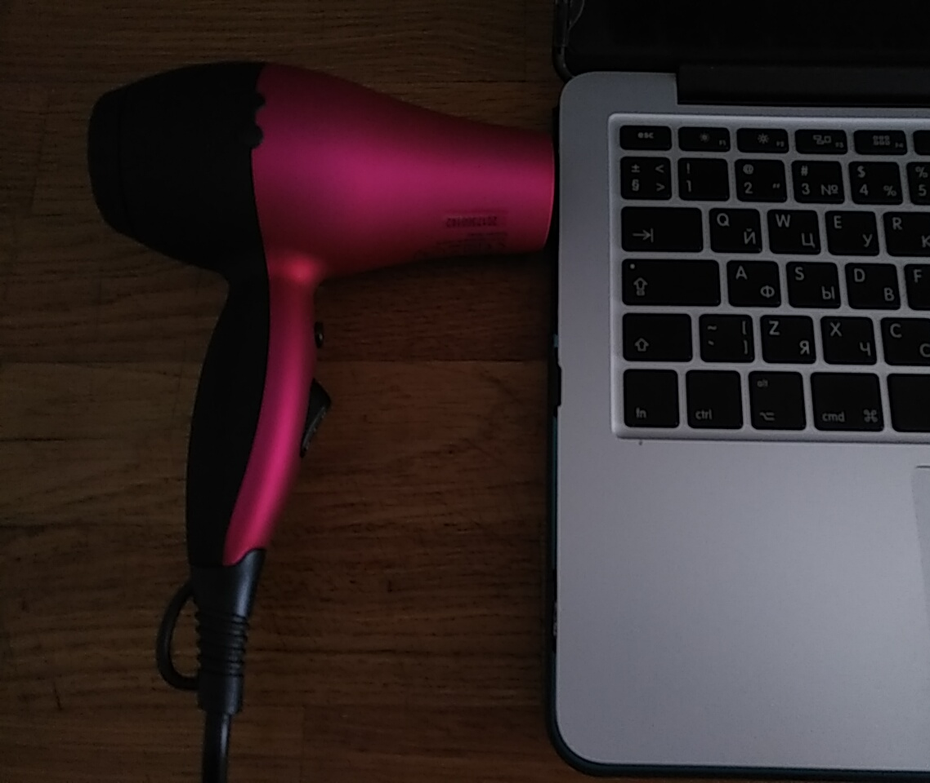
Hair dryer
Overheat
Stability testing
Monitoring
Trigger by Arduino and relays ☺

Slide 34
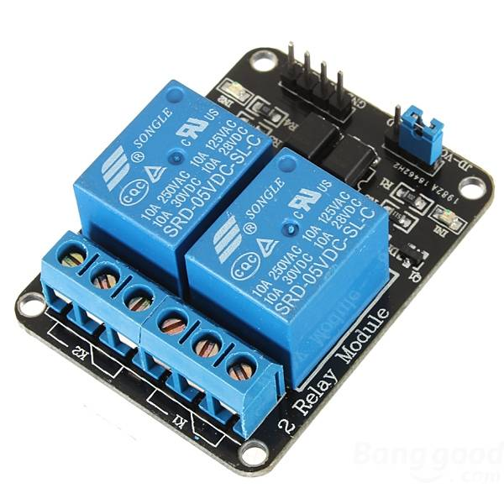
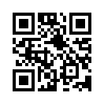
Relays
Switch things on and off
Control big ones with small ones
Make noise with each on/off event
Try to play music on relay!

Slide 35

Fridge
No lower than -18
May speed up
May give unexpected results
Avoid water on defrost

Slide 36

Still fridge
…And you can borrow ice cube makers from the freezer
What for? To hold mobile phones!

Slide 37
Modules
Arduino
Raspberry PI
Serial port
Bluetooth
Relays
RTL SDR
GPS

Slide 38


Standard interfaces
All modules are easy to connect, all interfaces are standard
GPIO
I2C
Serial port
SPI
I2S
...

Slide 39





Shops and brands
SparkFun
tindie.com
Ali Express :D
Crowd Supply

Slide 40





Community
Hackaday.io
Instructables
CoolTools
DIY or DIE

Slide 41
What all that was for?
Do not follow standard route
Solve problems indirectly
Don’t be scared by hardware stuff
Try to build your own secret lab
Use the Force, Luke ©
Notes:
Direct effect – replacing legit hardware
Indirect effect – giving effect on hardware by other hardware
Effect on environment
Effect on real world affecting environment

Slide 42




(Emergency) stop
That’s all folks
Questions?
Offline questions:

