Slide 1
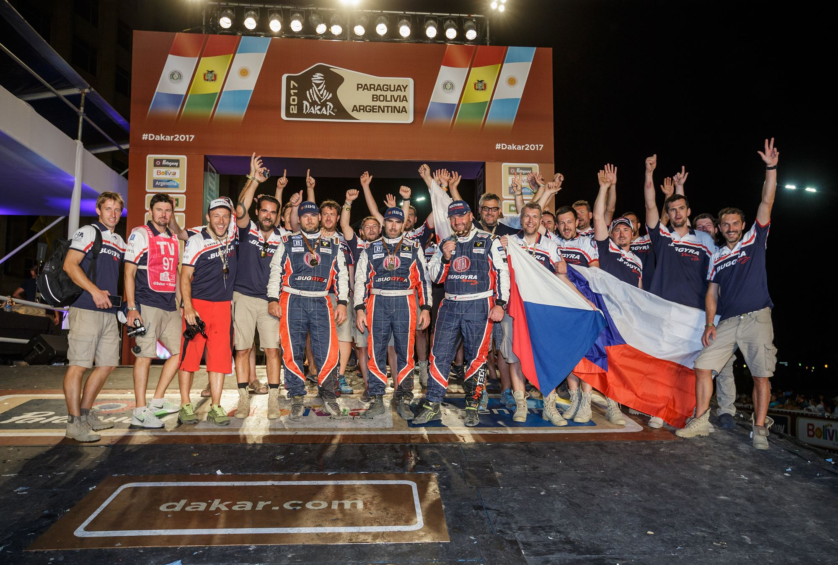
Agile and Rally Dakar
Vojtěch Barta
Notes:
Hello Everybody,
My biggest hobby is sport photography and one of my dreams is to shoot on Rally Dakar. However, it is still only the dream and all most of photos in this presentation were taken by Martin Kozak, one of the best czech sport photographers.
Back to the topic. People tend to see what they want to see instead of reality. It is natural for all of us but sometimes we imagine a world, which is not real, but we do not realize it anymore. That is why I recommend you to look at things from a totally different perspective and I offer you such a parallel between Agile Development and Rally Dakar.

Slide 2
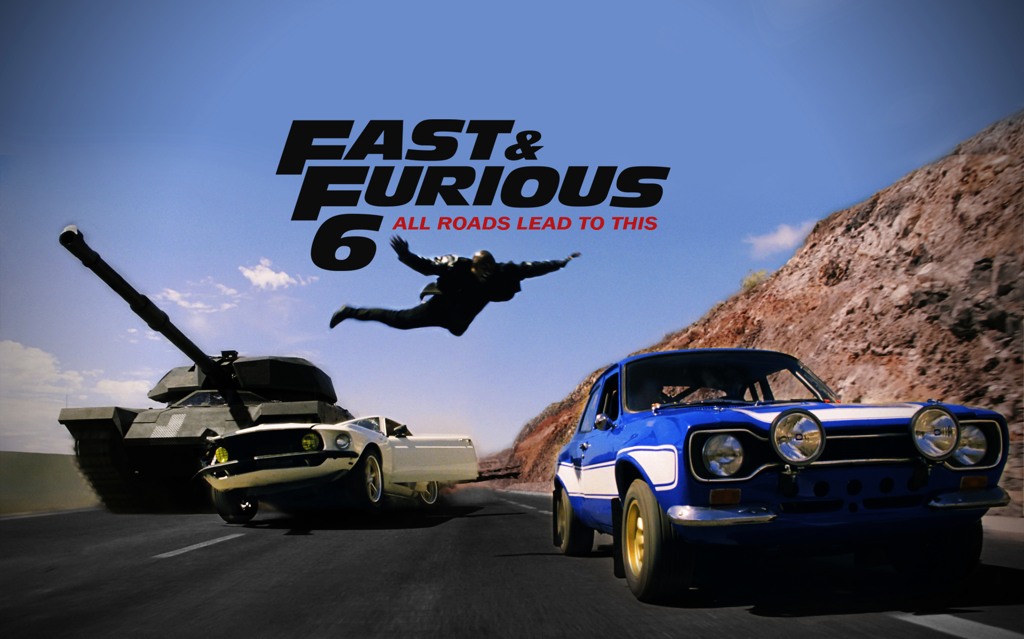
Fast, but not furious
Notes:
One of my favorite movie series is Fast and Furious. I should speak about Rally Dakar. I know. But at first I would like to define how agile often looks like. Unfortunately.
Everything is in this picture. That white Mustang is current ending iteration. Blue one is starting iteration. That man flying are us moving between them. Of course you can park your car safely and change a car as you should do. But that is boring and we are somehow used to to this in this more adrenalin way, are we not?
What about that tank? Customer? Technical depth? Defects? I will leave it on your imagination.
We have to be fast in software development world. But we should not be furious. That is where our story about Dakar starts.

Slide 3

Notes:
Dakar 2017 – The Odyssey. The second biggest racing event on entire world (after F1).
3 countries, 12 stages, nearly 9000 km with a goal to go from here, to Buenos Aires. But not this straight shortest way. Acceptance Criteria are quite strict. You have to follow this track. Every day you have to be in time limit and you are also competing with the others. Sounds challenging, right? That is the first similarity = it is not easy nor straight forward and it is not free for all. There are rules!!!
More than 300 vehicles ready to compete. Each team made by dozens of people. This his huge. As most of our software projects are.

Slide 4
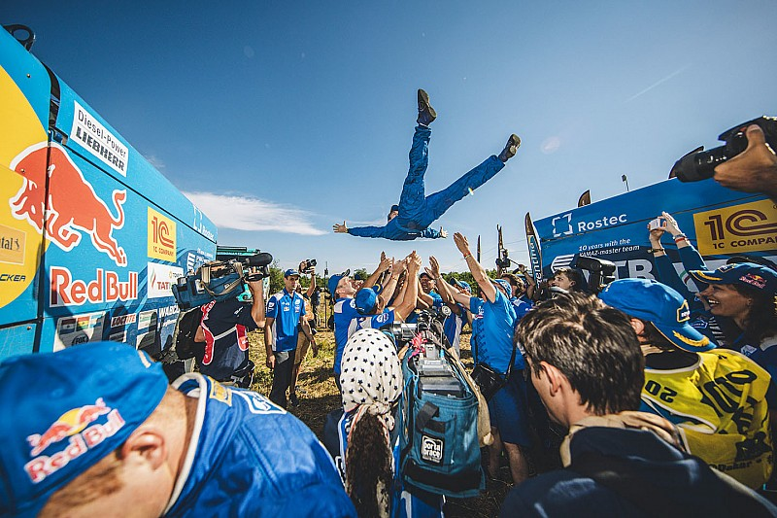
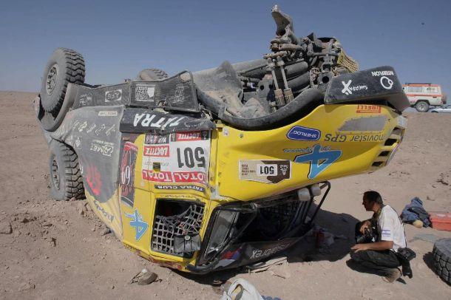
What makes
difference?
Notes:
There are winners, also the others who finish the race, which I consider to be the success. But we also have many who will not finish the race… And unfortunately time-to-time they pay the highest price.
So what makes the difference?
Luck? Of course, you need to be lucky… But if it would be only about luck why is Kamaz almost always on the winning stage and won 14 times during last 20 years? There needs to be something more…

Slide 5

Project
March - December
Jan
Jan
Notes:
It is about the team, cars, knowledge, and training and also about money. To simplify, it is about the long project with a lot of preparation. One Dakar ends in January and one or two months later it all starts again.
Every team prepares and tunes a new car. They need to think and agree on the strategy learning from the last year experience. Summer and autumn are about several races to test, improve and learn when the main goal is to be on the starting line of next Dakar prepared as well as possible.
Dakar is not about 2 weeks of racing. It is a one year project when January is kind of UAT.
It makes sense, right?

Slide 6
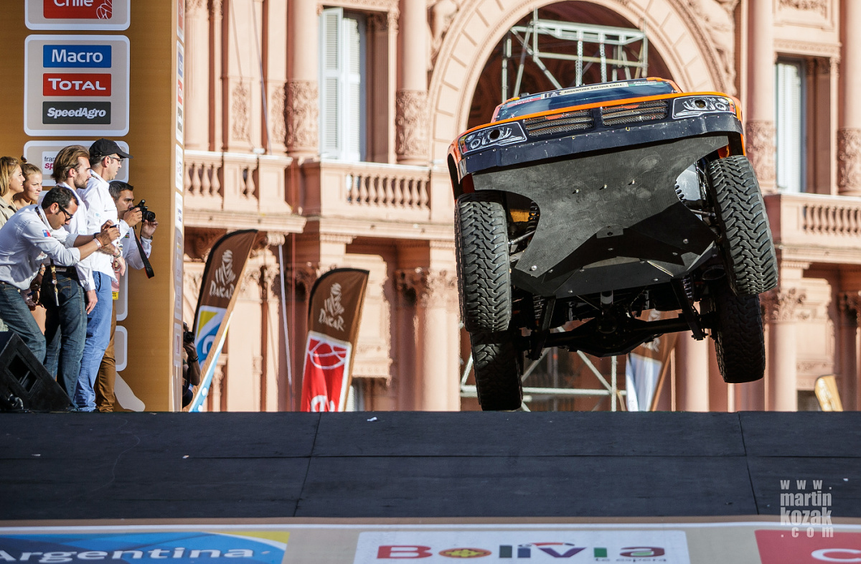
Just Go!
Notes:
Now I would like you to imagine your current project and how it looks there with preparation.
Do you really do the most to succeed in the race or you often do easy compromises? I often see compromises like
We do not understand what we should do… We do not know how to do it... Who cares... We gonna plan it to next iteration and we will see how it goes
We have dozens of open defects but we will focus on User stories and we gonna fix them later
Or my favourite one – it is not tested, but we believe it works so we will deliver it
Do you think these guys here can accept any compromises? Lets imagine you are as a spectator on a Dakar and somebody would ask you. Hey, or driver is sick, can you please drive instead of him? What would be your answer. Yes, why not, I have a driving license, it gonna be a lot of fun.

Slide 7
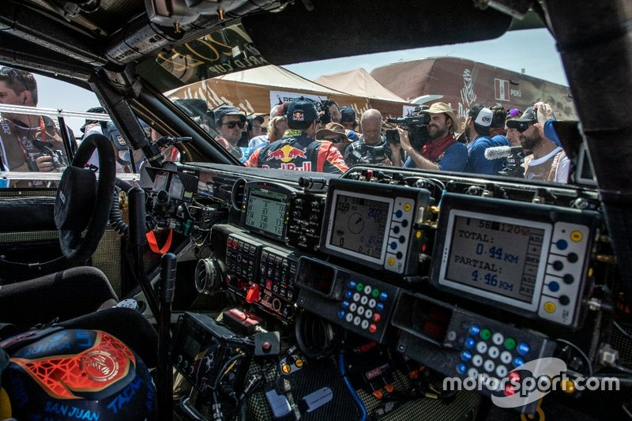
Really?
Notes:
This is how it looks in that car. Yes, there is still steering, pedals, etc. But to be honest, I would crash with that in few minutes. This is also similar to common user of computer - yes he knows how to use a computer for his need. It is a simple car, still requires a knowledge. But software development? That is a different story. My wife would agree that when I am talking about my job it looks similar like this to her.
So guys who sits in this car needs to know a lot and be well prepared. Are we also well prepared?
Lets have a quick survey here. Who things his work is simple? Who things he is well prepared to do his current assignment on the project?

Slide 8
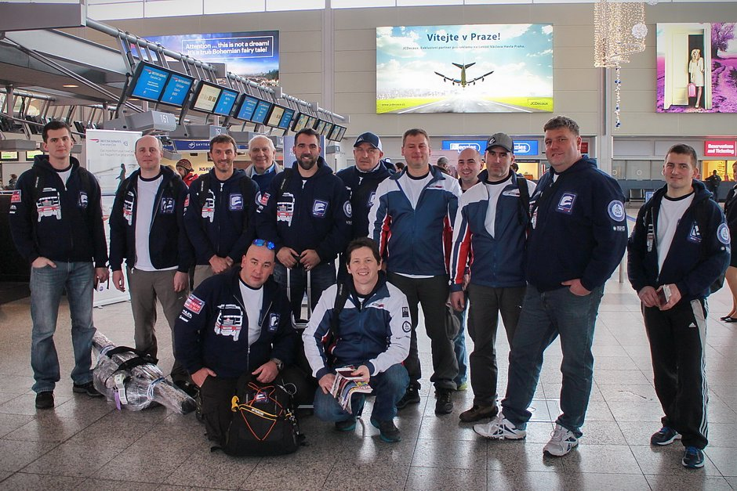
Process = Team Agreement
Notes:
But, it is not only about driver and navigator. It is about the entire team. There is the process every team member needs to respect and follow. I hate the word “Process”. Much better is to say “Agreement”. It is may sound as just semantics, but actually there is a huge difference. Agreement means something we agree with. If it was build, tuned and agreed by whole team then there is no reason to do not respect it, compromise it and other bull shits.
We made it. If it works follow it. If it does not work revise it and follow new one again.
Never ever do something you do not agree with. Or you do not understand. Otherwise you will not finish the race and you can harm the others.
There are many rules, strategies, plans, etc. to be considered and agreed on in the racing team. It is quite different from Software development team but Definition of Ready and Definition of Done is mandatory everywhere

Slide 9
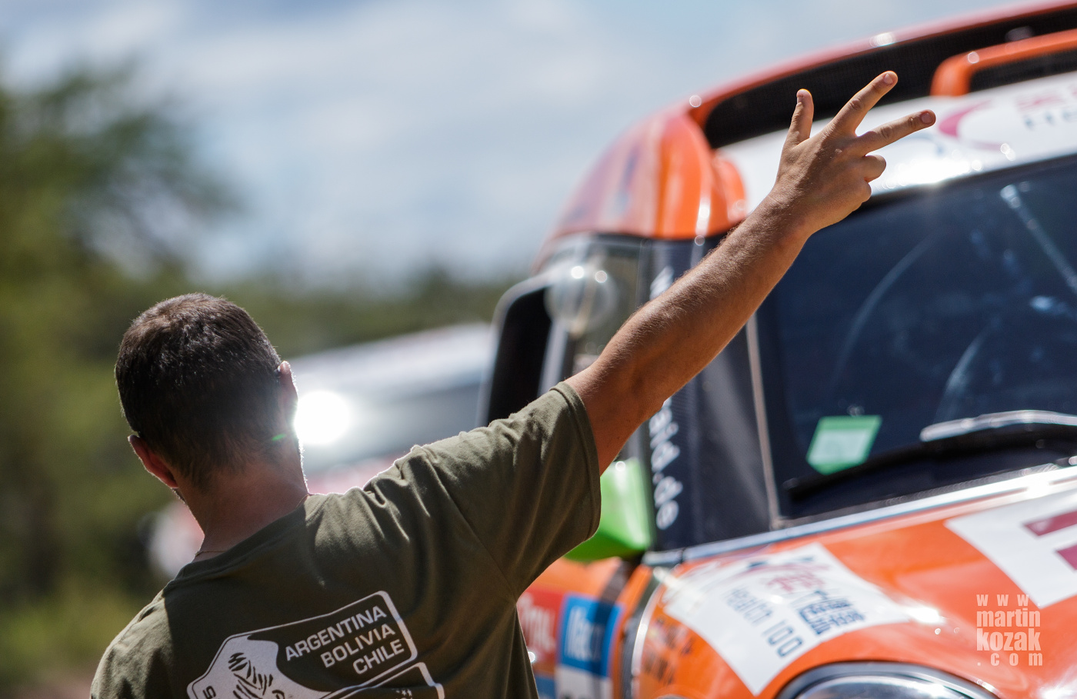
Definition of Ready
Notes:
Definition of Ready is checklist of things we need to do and achieve before we can start every race. Car needs to be well prepared, full fuel tank, navigation defined, etc.
In our world it means what has to be done before we start implementation of the requirement. Remember the race itself has to be fast but safe.

Slide 10
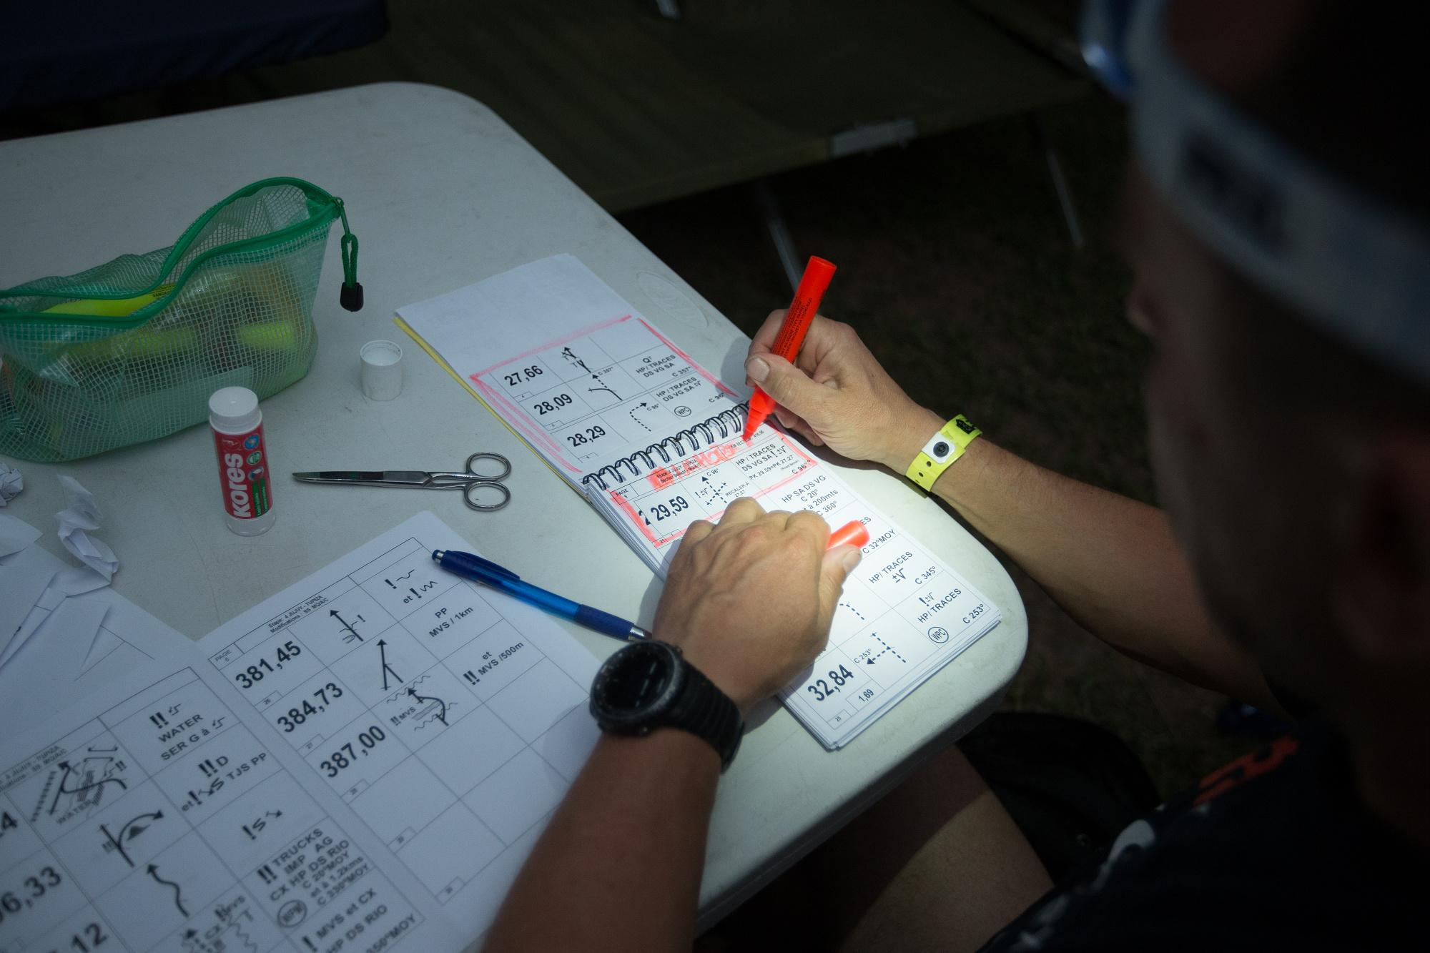
DoR in Software world
Groomed
Understood
Sized
Agreed
Notes:
Every team is different. That is why every Definition of Ready will be unique.
However there are some mandatory points you cannot skip.
Lets imagine you are on the start line, waiting for that “GO” signal. But you do not now how long is todays phase, what is the speed limit, what terrain you can expect.
That sounds crazy.
But we experienced that quite often when Sprint is starting. Just GO! No, thank you, I do not want to die.

Slide 11
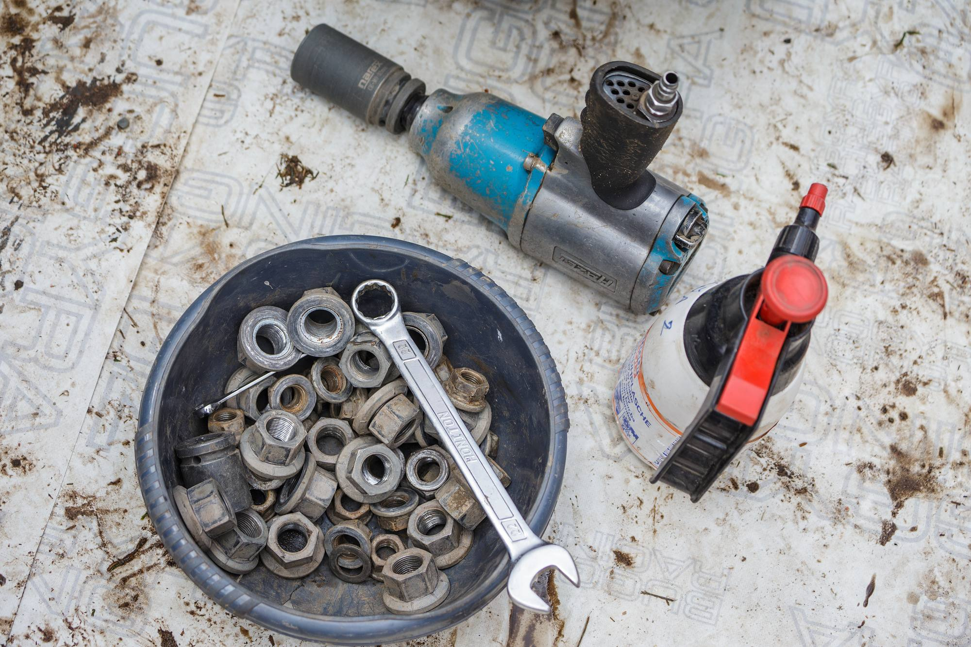
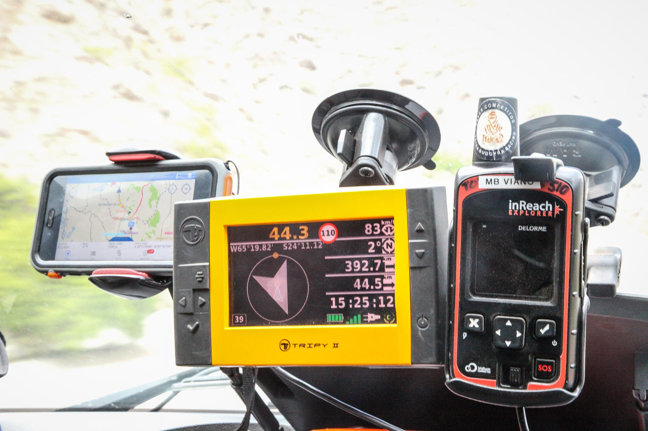
DoR in Details
Know
  Why
  Whom
  Value
Idea of
  Implementation
  Verification
Skills to
  Do it
  Learn it
Notes:
So what is really mandatory?
Every user story has a structure of “As somebody, I need something to achieve some goal.” All of these parts are important when “what part” should have the lowest priority. In other words - I need to understand why should I do something, for whom… Then I can start thinking about how… Not in different order.
Of course, I need to have the skills to do it or learn it. You should have realistic expectations. A junior driver needs years of practice before he can do Dakar.
When speaking about being realistic it is important to always ask yourself - is the goal still achievable. Even when we know what and why should be done, we have an idea how to achieve it, it is still a key question. Our goals should be challenging but if there is a feeling it is a bit too much, you have to say it up front otherwise you will pay the price later.
Let's assume you did everything right. Your checklist is completed. Ready to go.

Slide 12

Implementation
Notes:
Now it is the right time to be fast and may be even a bit furious. Because you are well prepared and now it is paying back. Also we should consider Sprint or Implementation columns of Kanban board to be the racing part. However you really need to be careful. Because even the best one makes mistakes.

Slide 13
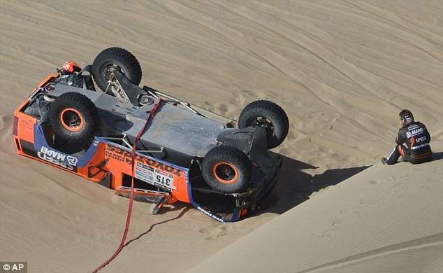
It could go wrong…
Notes:
And these guys are the best, they care about everything and still there are accidents on Rally Dakar.
Every team has few accidents, problems with car, etc. They are often capable to solve them and continue.
Some teams will not finish the race because you need a lot of luck too.
Unfortunately there were also some fatal accidents. I can imagine there would be much more of these if they start to do compromises.

Slide 14
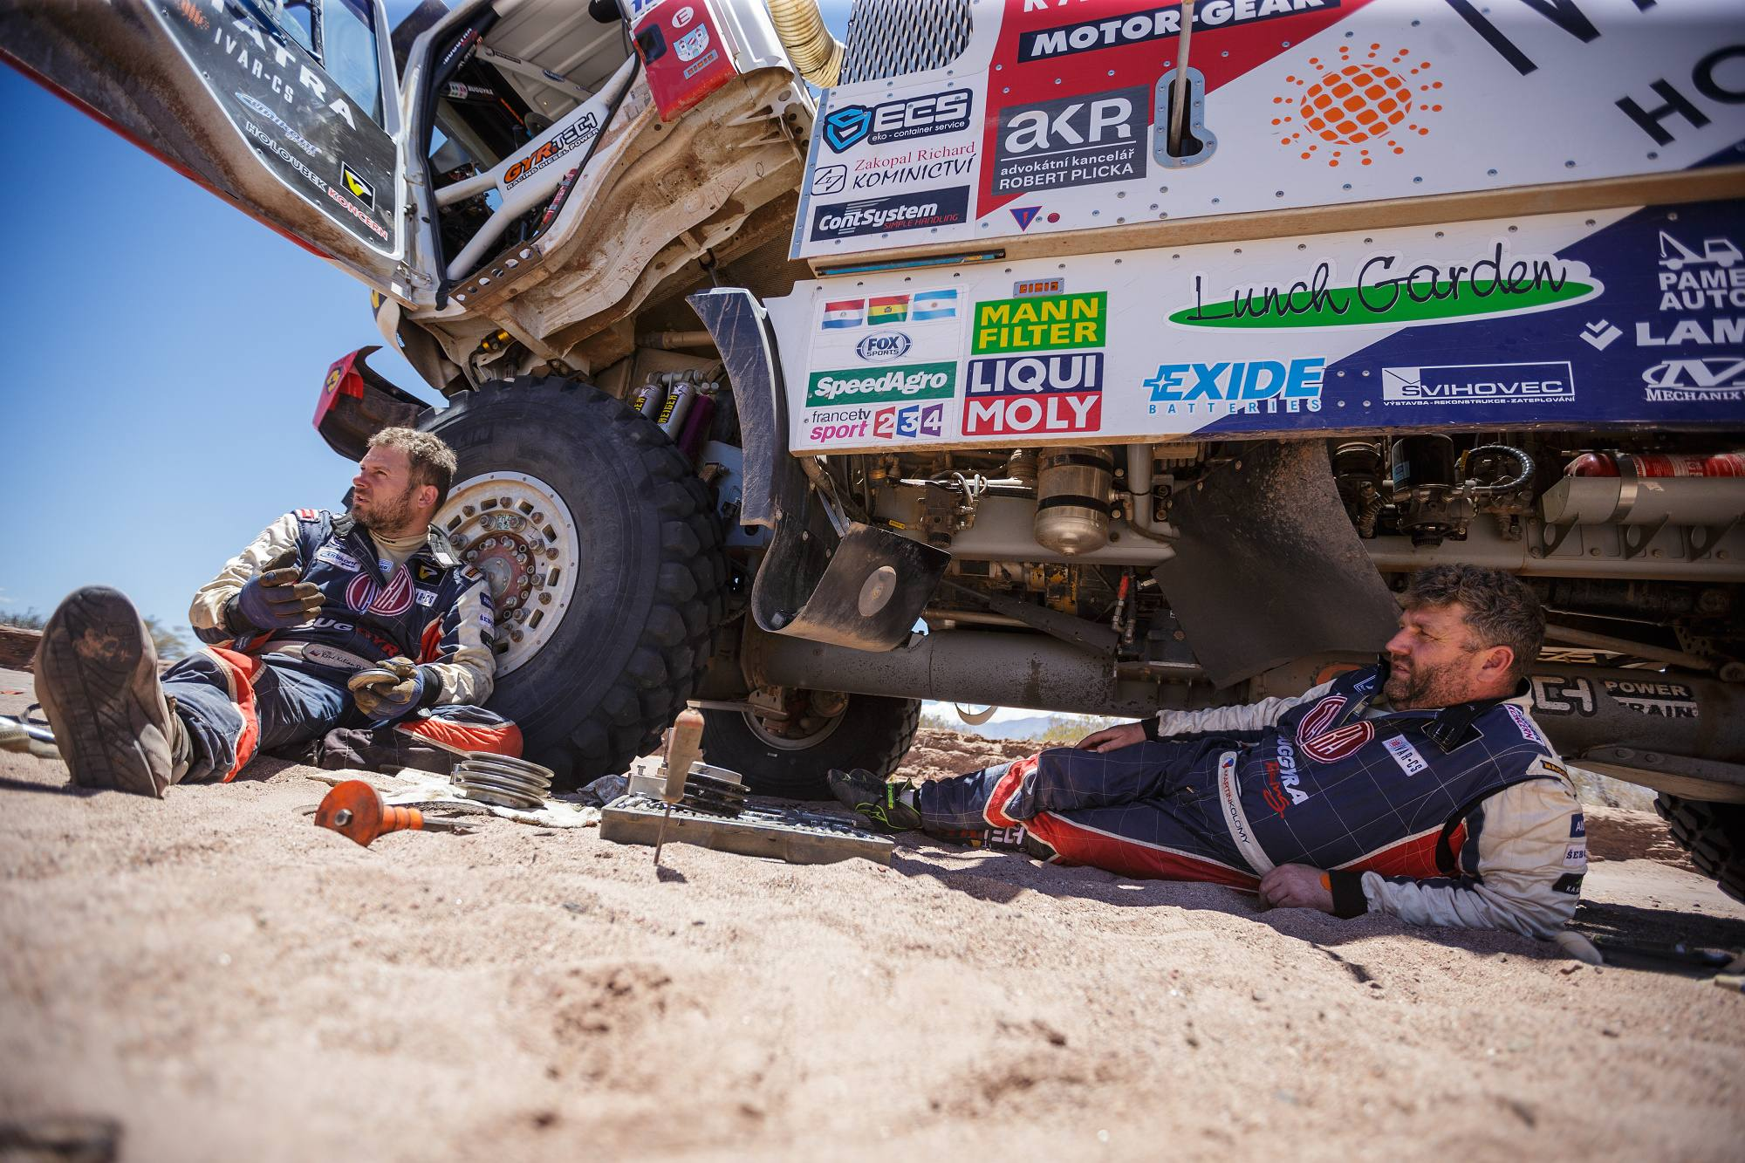
Surprises
Notes:
And there will always be some surprises. You cannot avoid them but you have to be prepared and think about all possibilities and what could go wrong. There are three men in the cabin of the Dakar truck – driver, navigator and mechanic. All of them knows the car to the last screw and they can fix most of the typical and even rare problems.
Knowledge and routine is again the key. Can you imagine finding something in manual when you have to fix breaks during the race? Every second counts.
Similar to sprint… We have to be fast and problem solving is our daily bread, but do we have the same perfect knowledge as these three there? And do we act in the same way as they do? I am talking about the racing spirit.

Slide 15
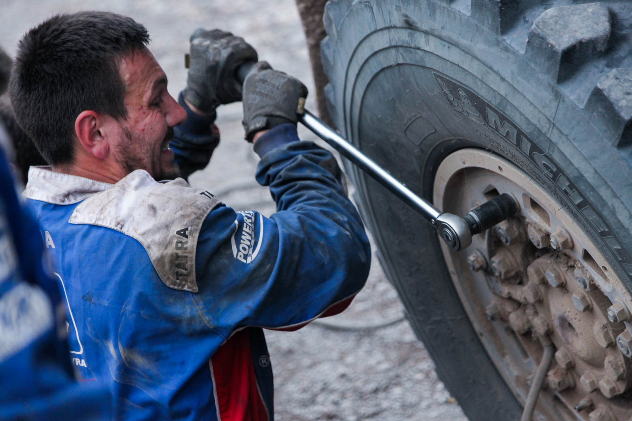
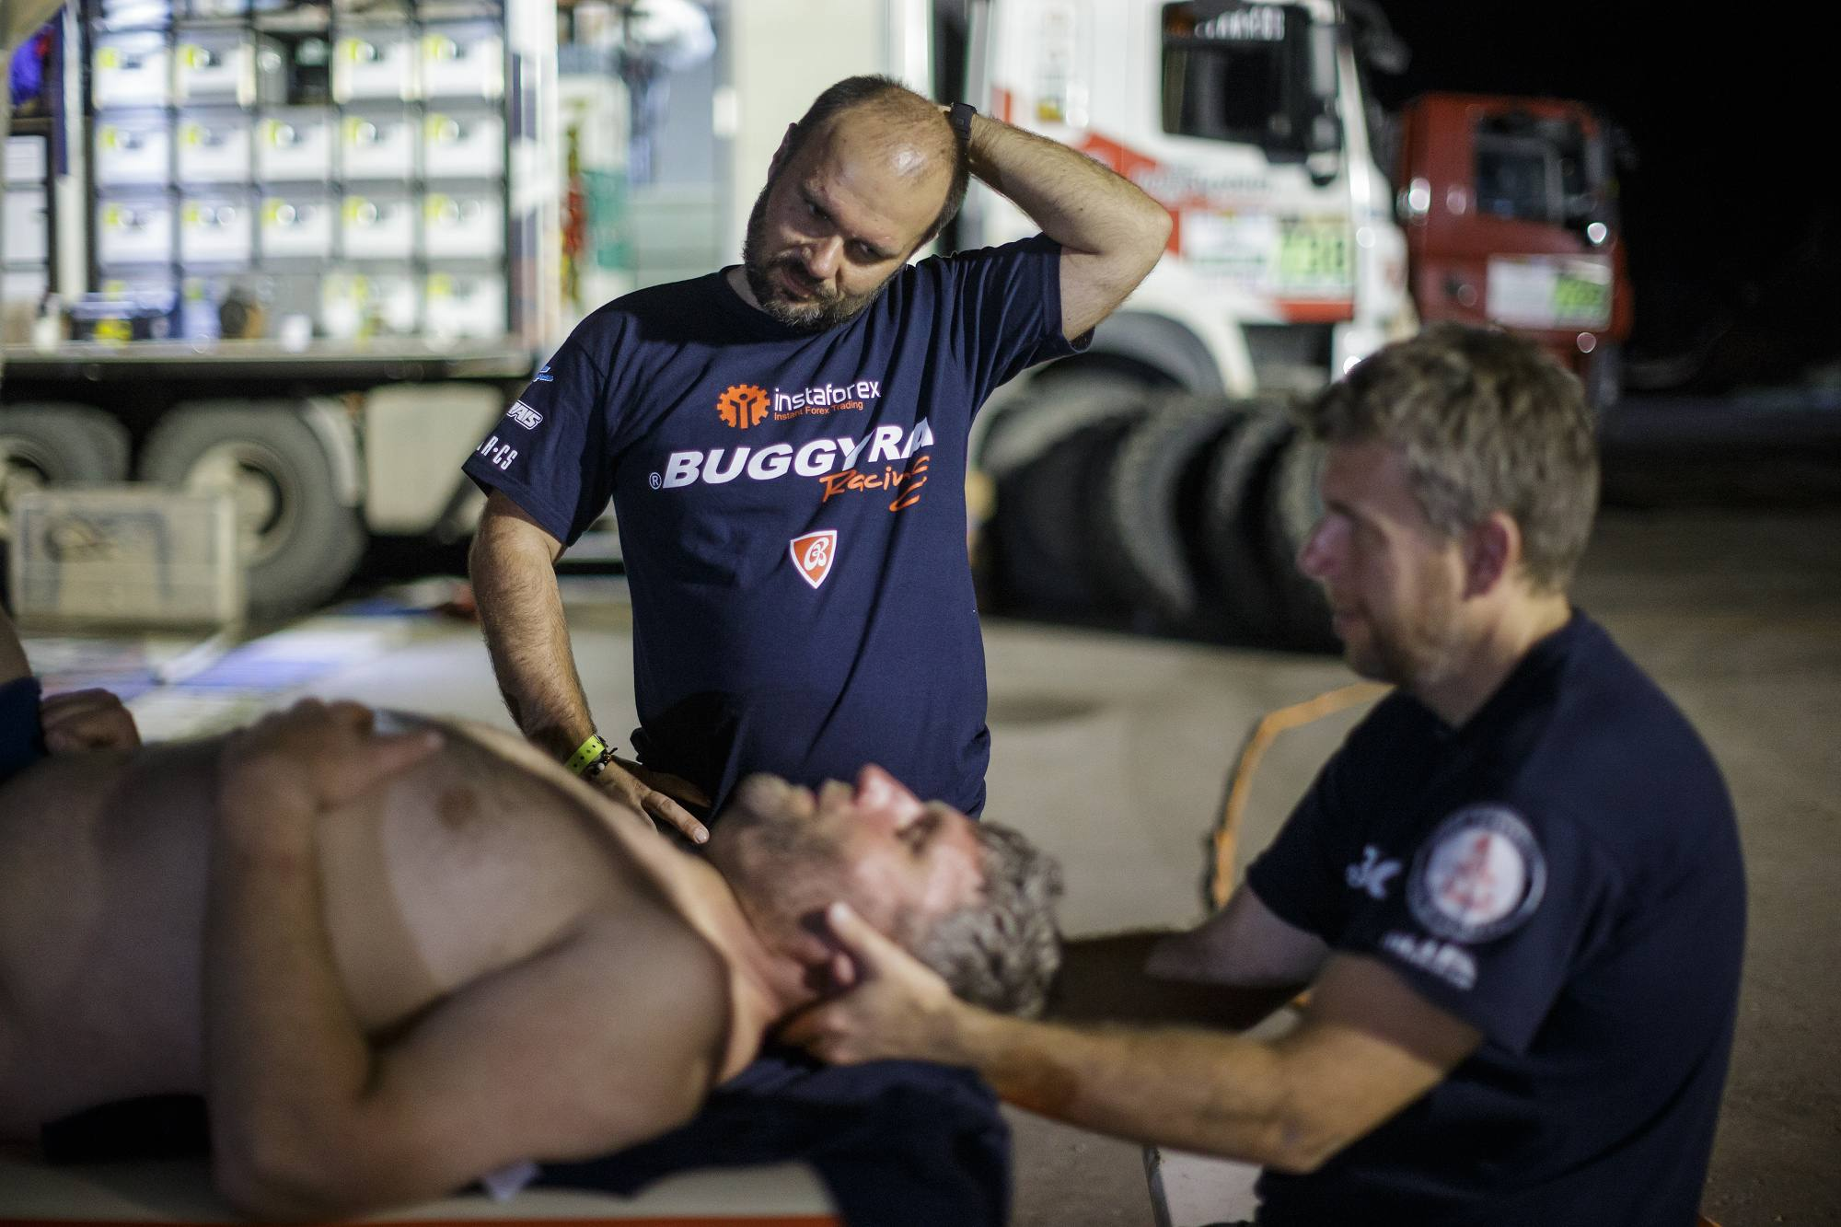
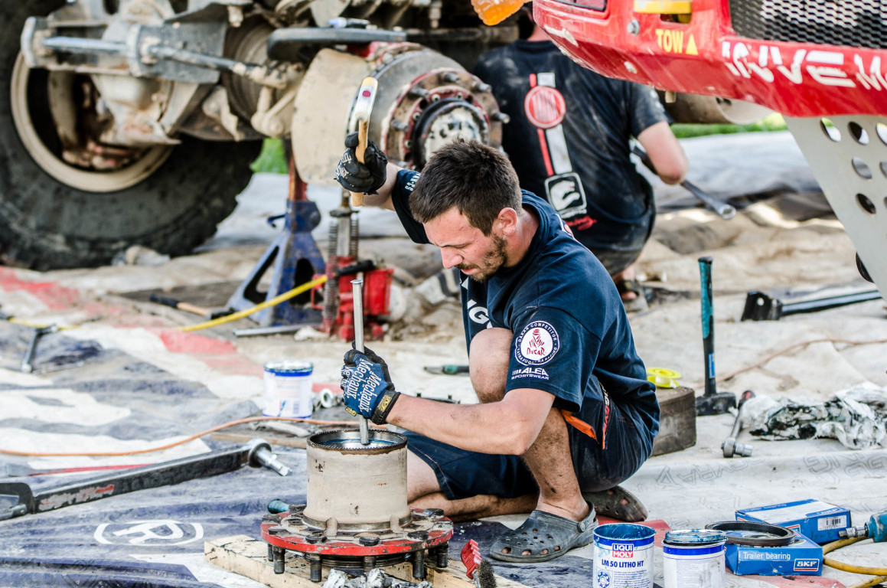
Definition of Done
Done when
  Implemented
  Tested
  Fixed
  Automated
  …
Notes:
When we can say we are done? It seems pretty straight forward in racing? It is when we cross the finish line. But there are 12 stages before the final one. Lets say that entire project is divided to 12 sprints. We have to deliver every single one.
But what does it mean to deliver when we know the next stage starts tomorrow morning. Car needs to be ready, crew needs to be prepared, etc.
Everything needs to be really done and that is why we have another checklist called Definition of Done. Again, every team is different at least:
It is really implemented
Unit tests are on place
Fully tested
Major and critical defects are fixed
May be automated, etc.
It is again agreement of whole team and nobody should cheat. Great idea is to split all of these activities over the sprint to have the smallest possible things to be done at the end. Even on Dakar there is quick assistance that can help during the race, there is at least some communication with a crew, so people in the dock knows what is happening, etc.

Slide 16
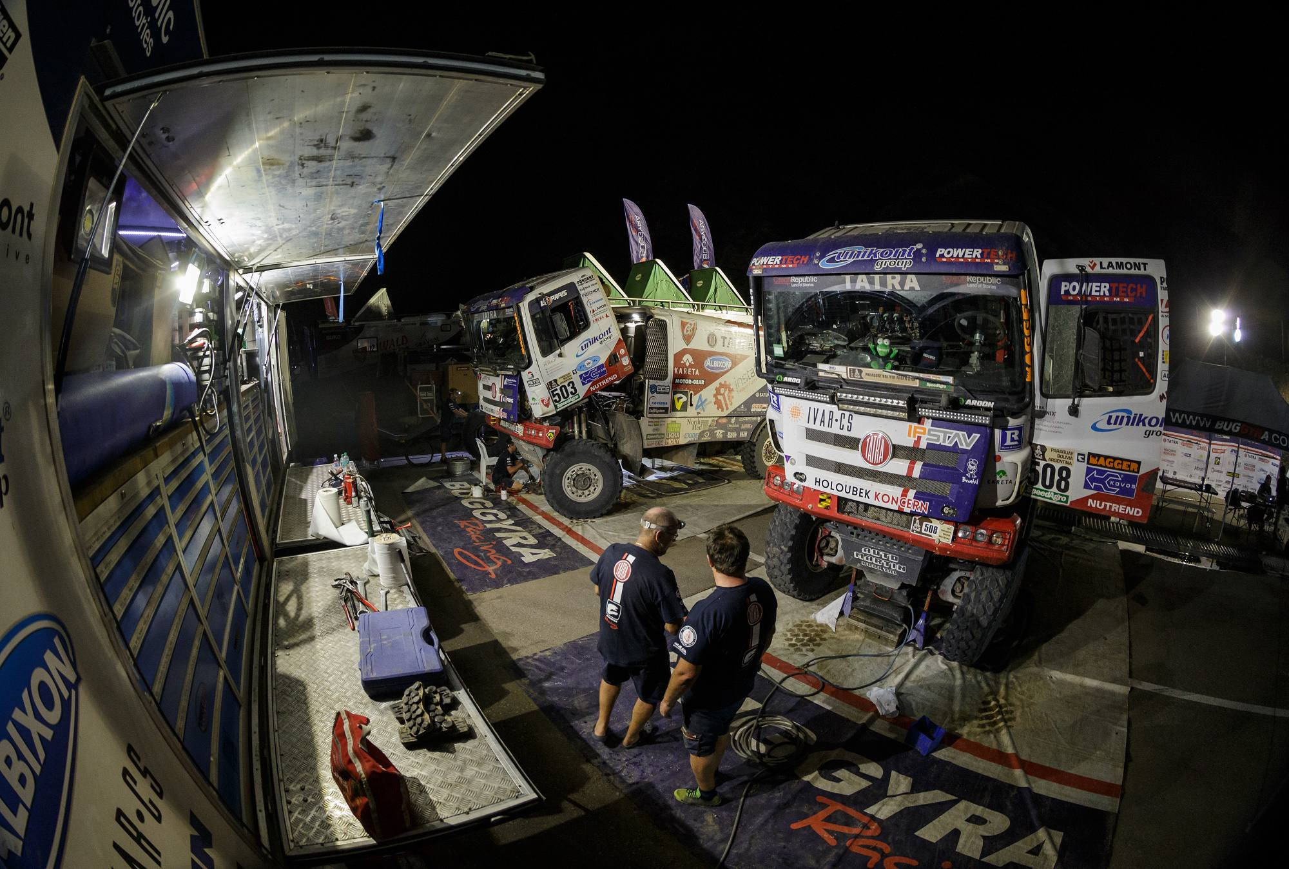
Definition of Done
Notes:
We all know we sometimes have to postpone something and there could be good reasons for that. For example refactoring.
There is free day in the middle of Dakar where Crews have one whole day to rest. It does not apply to mechanics. Actually this the hardest day for them because now they finally have a time to do complete service of the car. It is very long day but next morning the car is ready for second half of the race.
Some software projects are longer than few months. We should do the same. Every few sprints we have to inspect our technical depth, rests and we have to deal with it. Do refactoring, try different approaches, do some prove of concepts, etc.

Slide 17
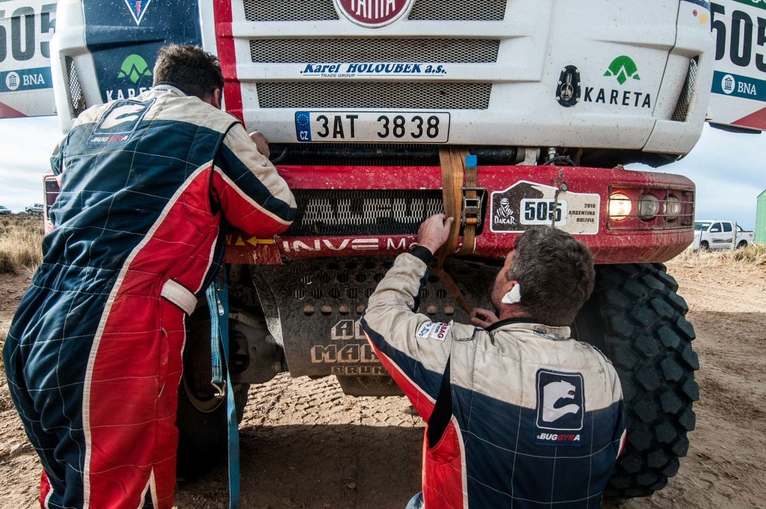
Dealing with defects
Notes:
We are all testers so defects are our daily bread. Everybody knows defects have to be fixed. We also understand that critical ones should be fixed as soon as possible.
But there is huge difference between ad-hoc (temporary) fixes and proper ones. Here you can see perfect example of temporary fix. It is creative and it works good enough to finish the stage. But everybody knows it is not sufficient for entire Dakar.
Now to be honest, how many of such temporary fixes you postponed or even how many of them survived it to you final deliver of your last project?
And what about the small ones? Lets skip the minors, these are cosmetic and you can fix them later or never. But what about these we call normal? At first, calling severity normal is kind of strange. But these are known as not critical but annoying. Should we fix them immediately or can we postpone them?
I generally vote for fixing them asap but if you would like to postpone them you should consider for how long. To the next sprint? I am pretty ok with it. To the next “Free day”? When it is? Can you guarantee you will really fix them there? It starts to smell.
Are you going to fix them by the end of project? That is very bad idea. 50 small defects are much worst than few bigger one. Moreover are you really sure they are all low severity or is there a risk you analyzed impact in a wrong way?
In other words. Am I still sure I am ready to go racing tomorrow knowing all of these small issues? Or is it starting to be too furious? We as a testers are the ones who should provide the answer and all of the necessary information to allow others to do the right informed decision.

Slide 18
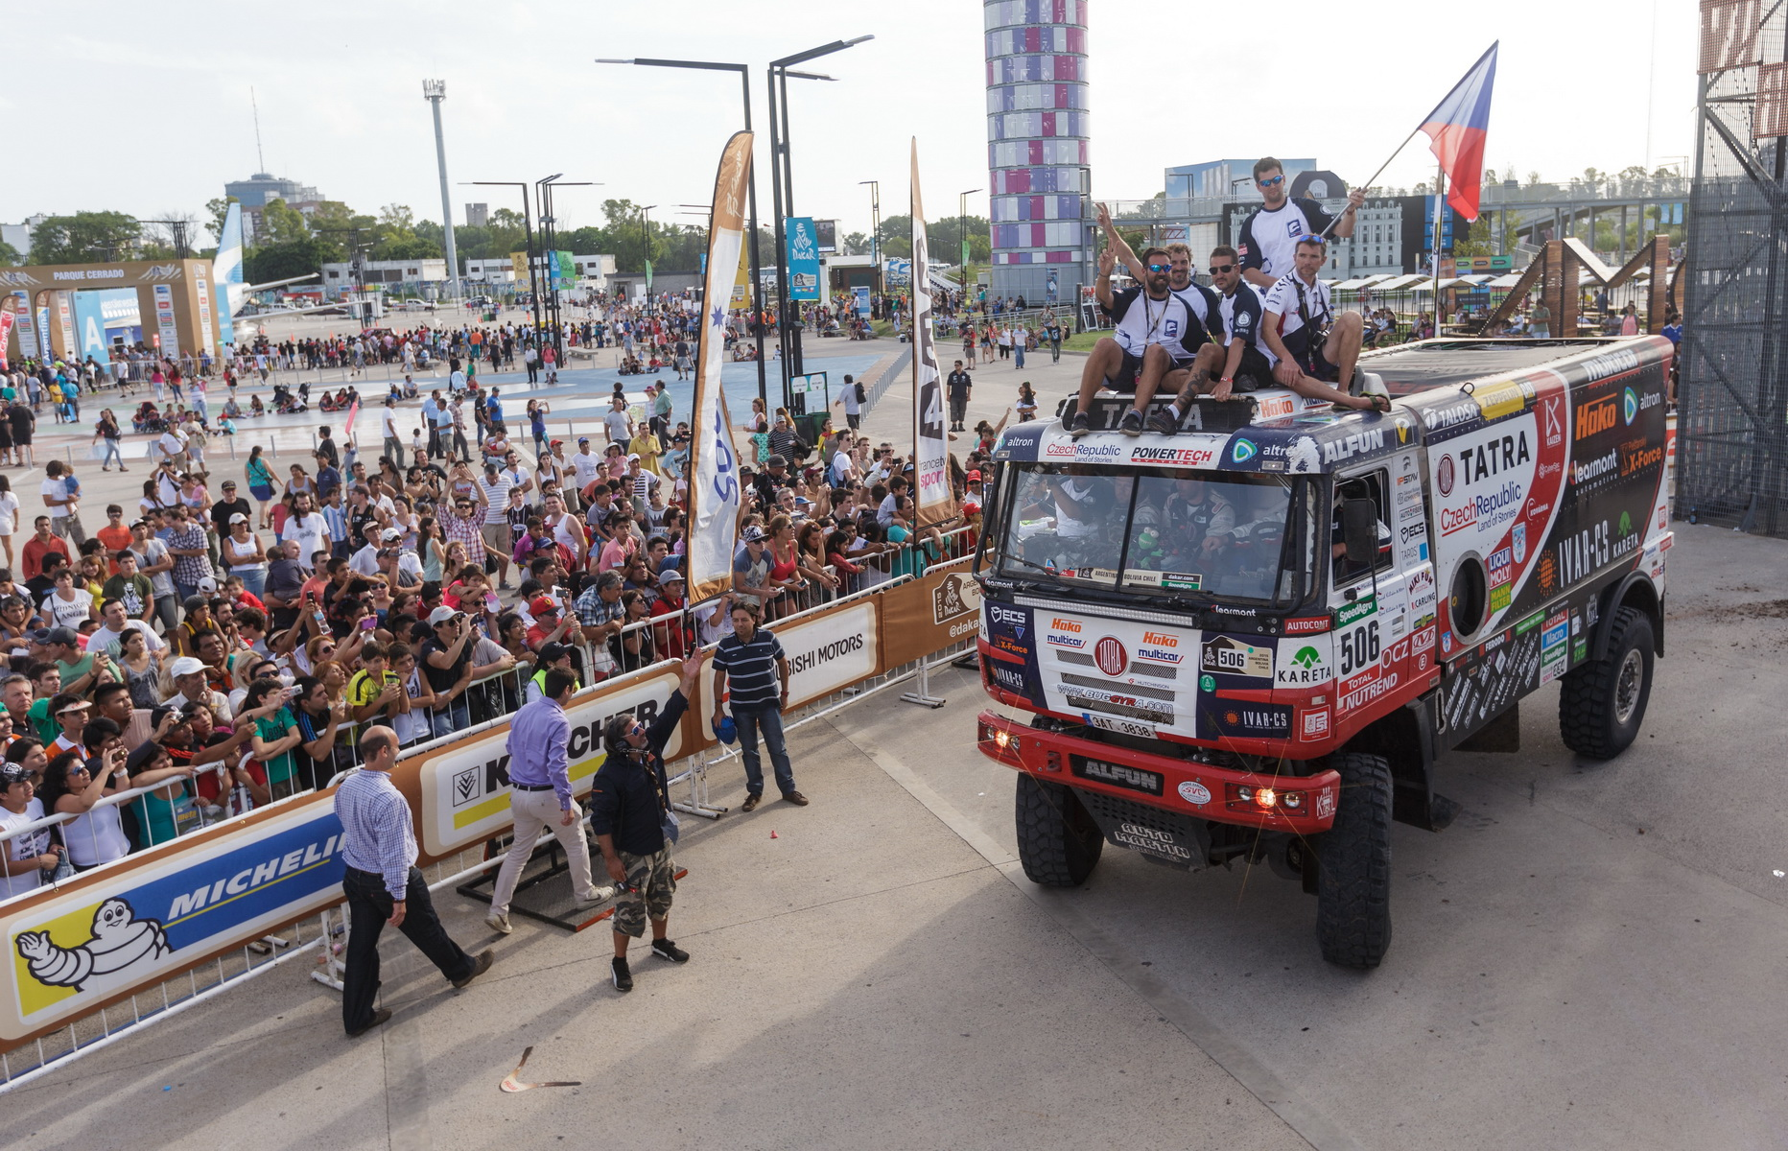
It is worth it
Notes:
It has to be amazing to be on this stage in Rio. I believe it is worth all of these hard days, long nights and pain.
It is also amazing to deliver the software project. I believe the best motivation in our world of software development is to deliver working software which really address customer needs and we can be proud we were part of the team who succeeded to deliver it.
Celebrate your success on your projects. It could be finishing the Sprint, aka a day race, or delivering entire project aka the end of the Rally.

Slide 19
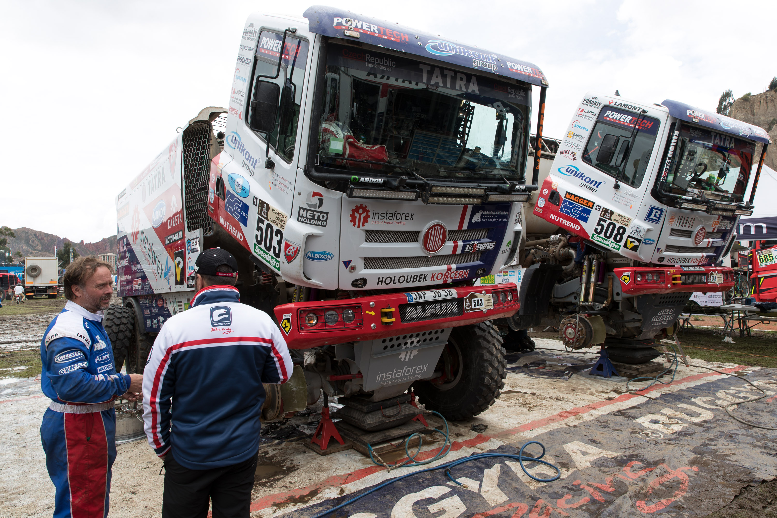
Done - Done - Done…
Notes:
So it is delivered, we succeeded but it does not end there. These trucks needs to be transported back, everything should be documented, etc.
We also need to do a lot of stuff after the last sprint before our software goes to production or even during the production. I always like saying “Do it in the way like you have to maintain it yourself for another few years”

Slide 20
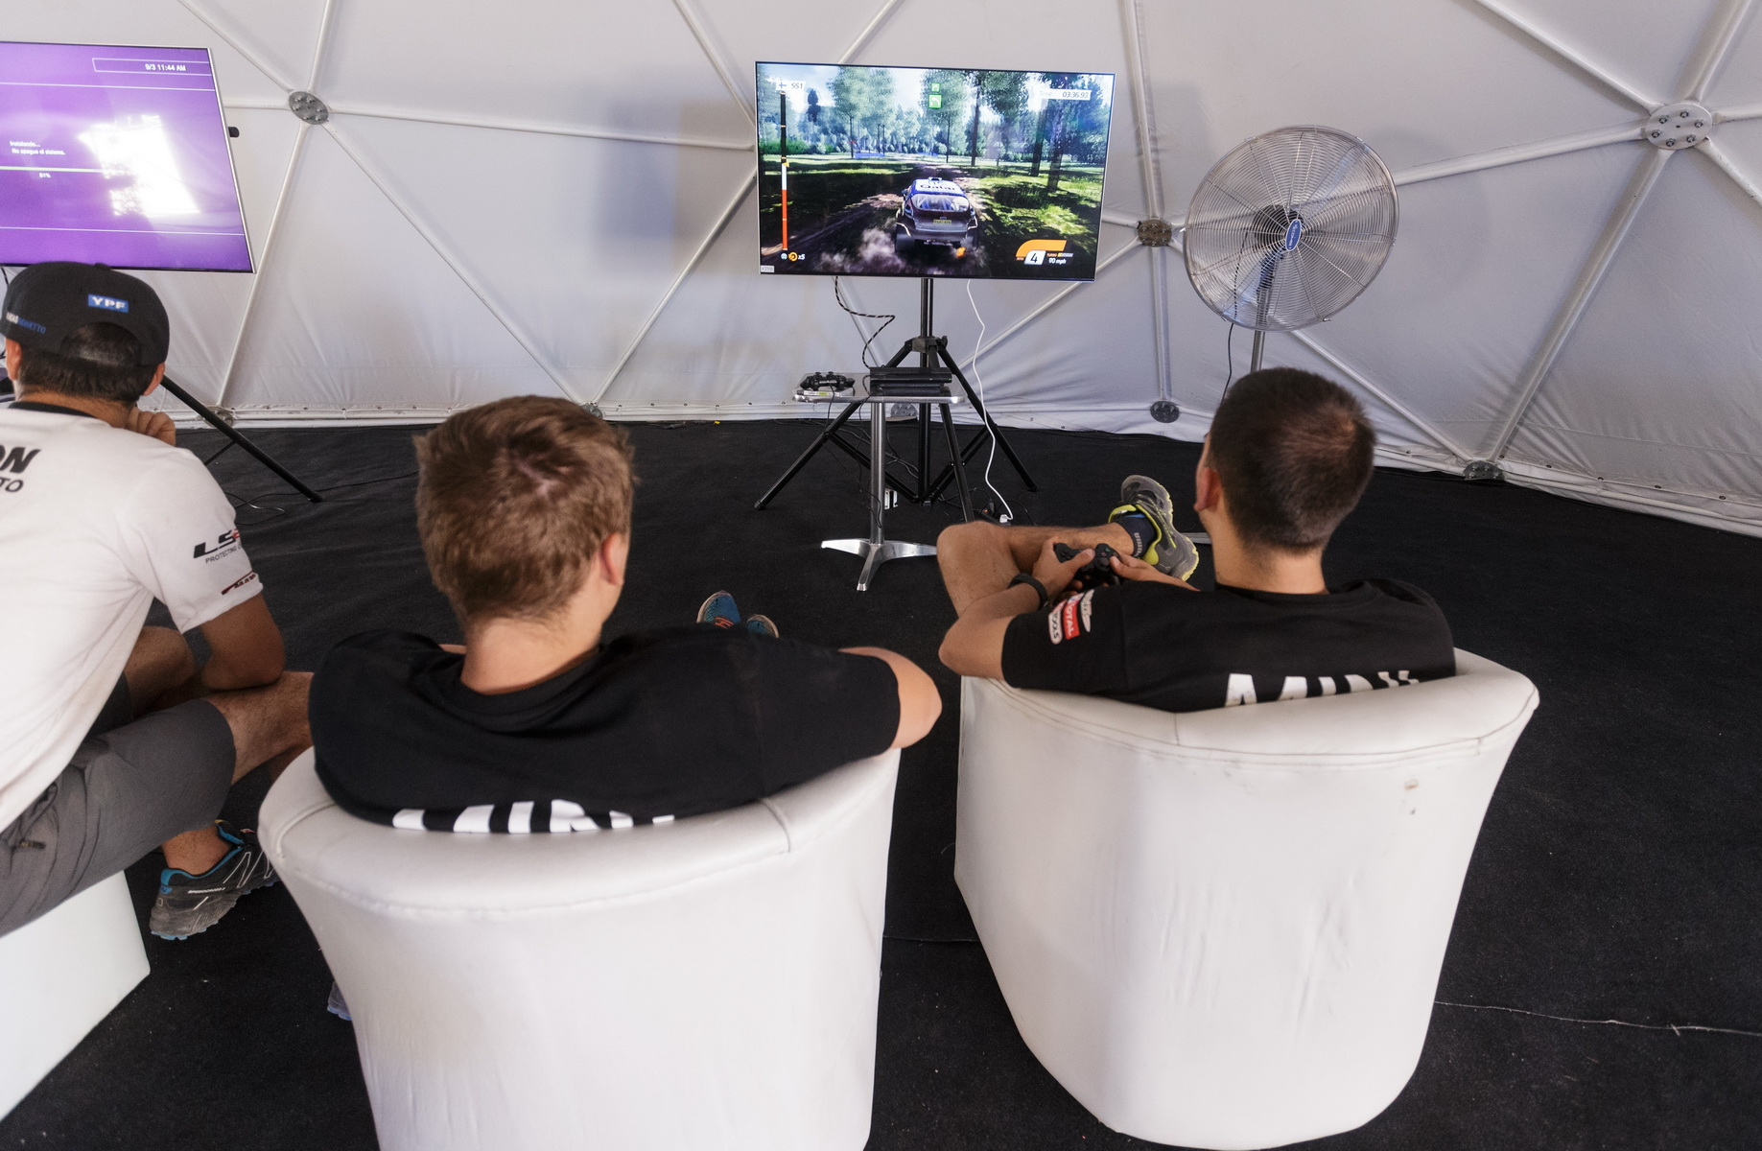
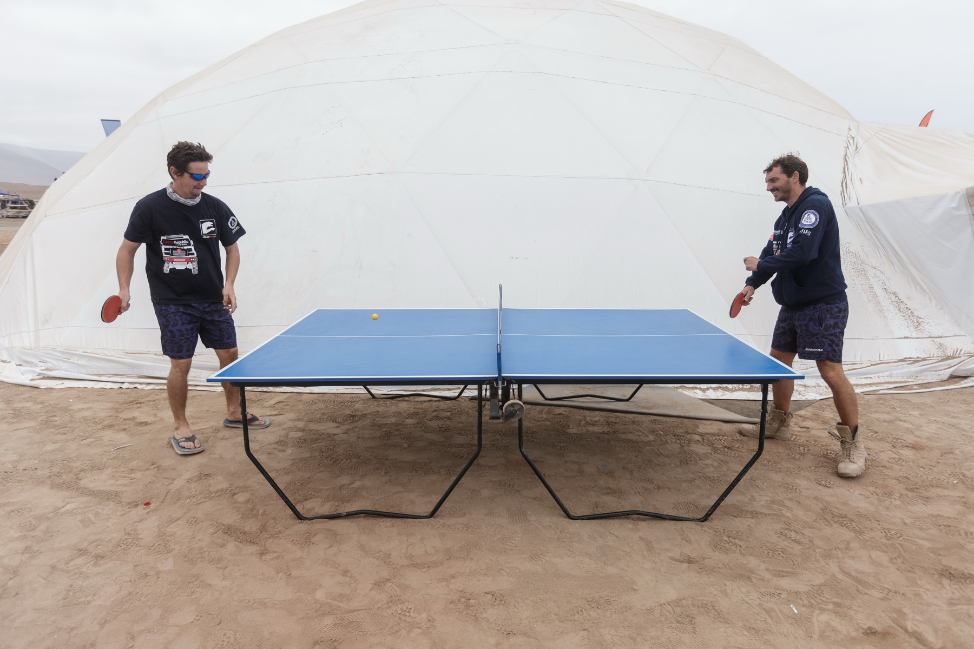
Have
Fun
Notes:
Dakar is incredibly hard but the biggest motivation for all of these people is the fact they really like it. They enjoy racing and it is fun.
We spent 8 hours at work every day. It is ¼ of our live. It is too much time to do something we do not like. My experience is that our live in IT usually stops to be fun when we forgot we are all here together. When process became rules and we do not understand it as team agreement.
There is never too late to stop, re-think and plan how I would like to do my work.
The worst think is resignation. People who resigned on their work are hardest to work with.

Slide 21
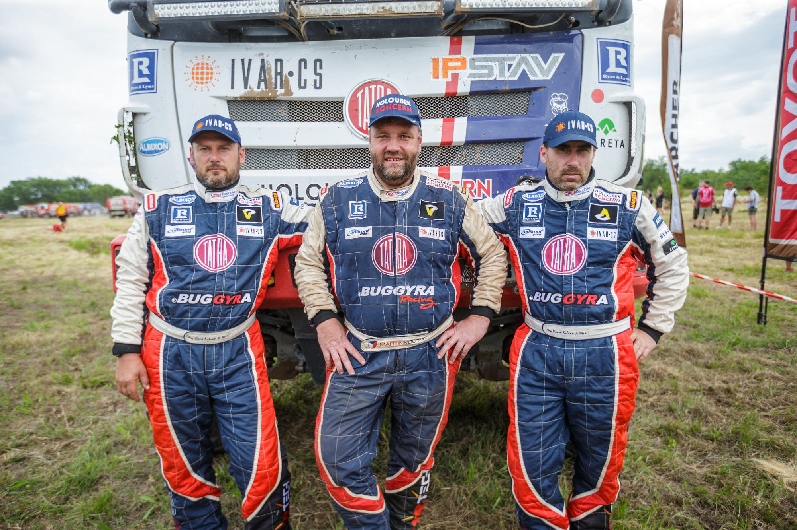
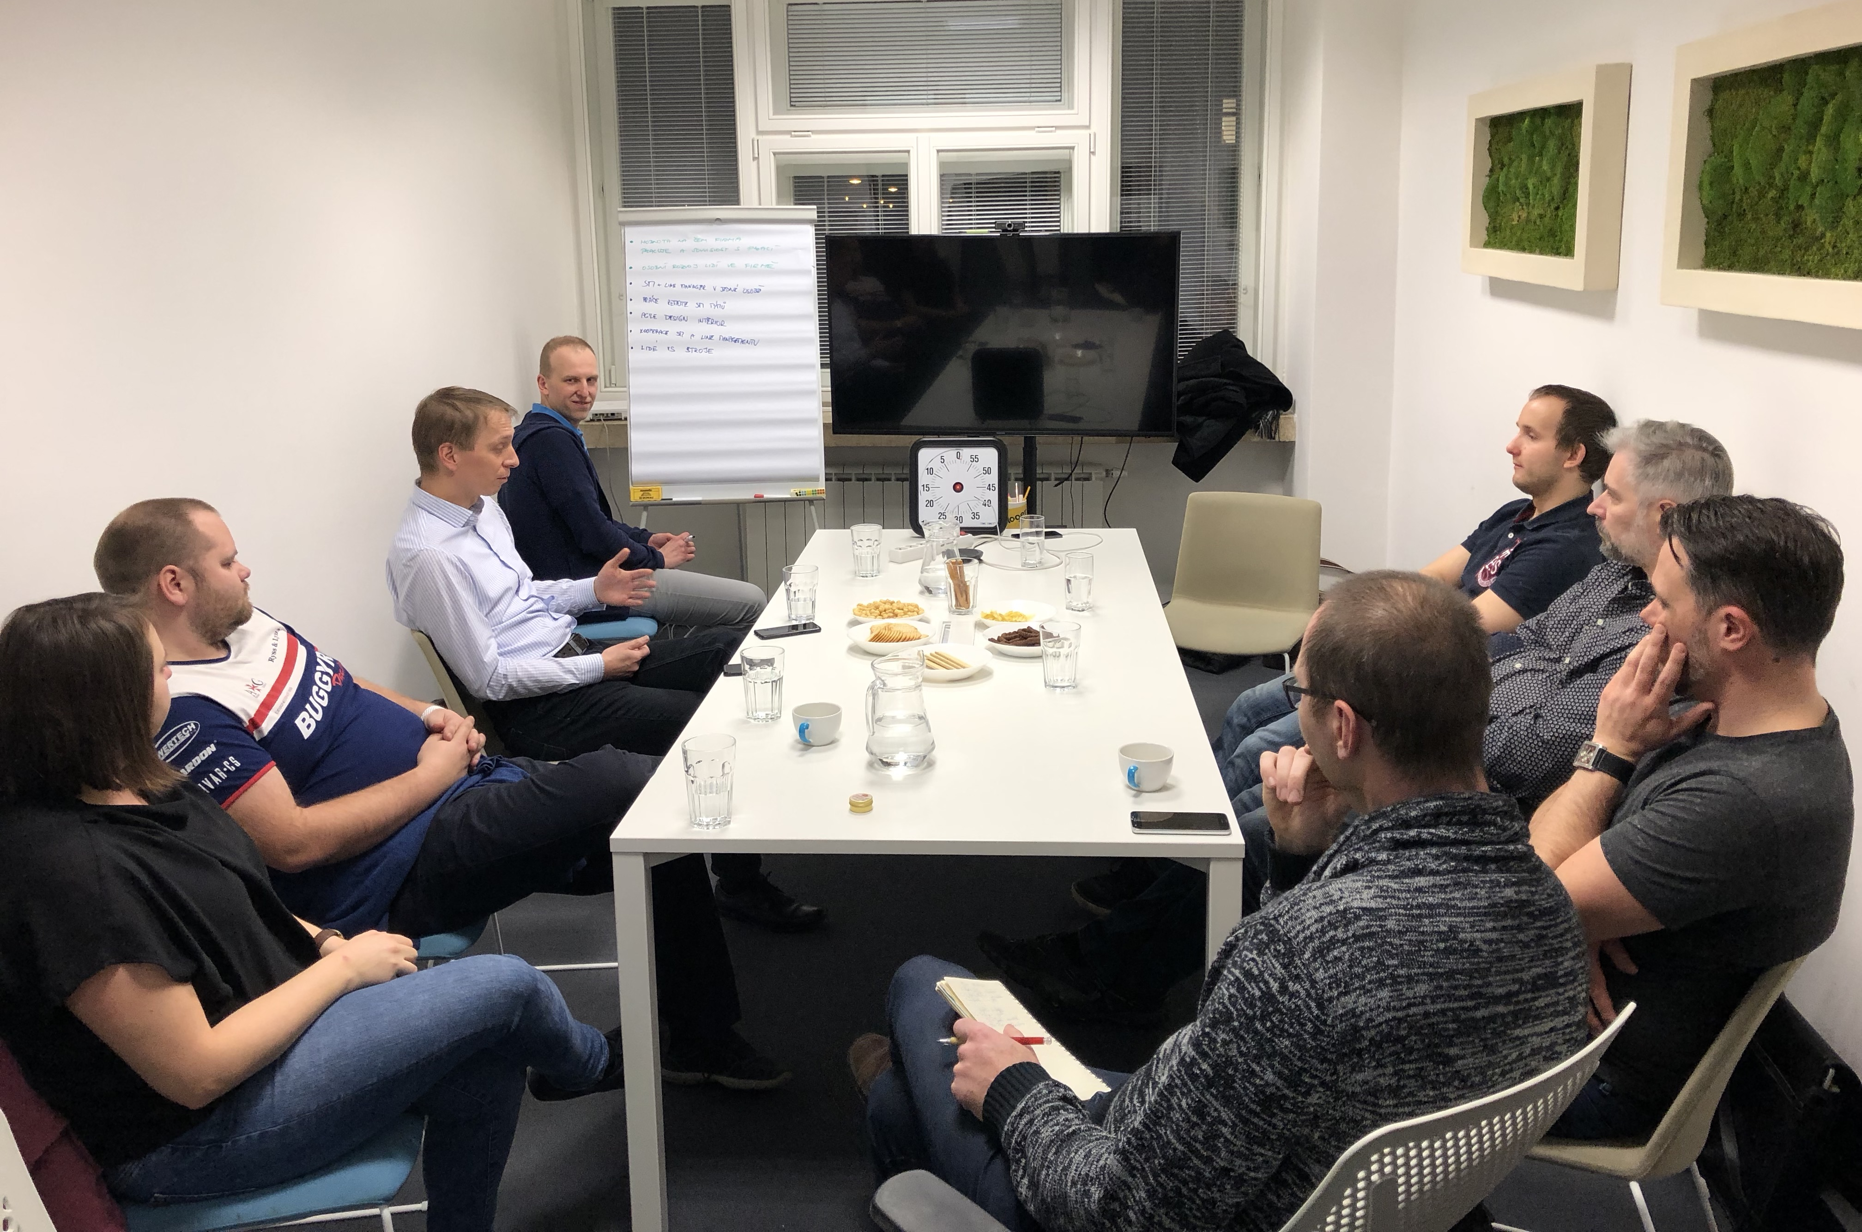
Power of a different Story
Notes:
This is the end of our story about Dakar and Agile. But I would like to share with you one more thing. We need stories in our world of software. These stories help us to know where we are, what we are doing, why, etc. Sometimes we need stories like Rally Dakar. It helps to re-thing our projects from different perspectives. We really often wear ping glasses or we are blind when we think inside our box, because we already heard a lot of stories about what we should do, how Agile can go wrong, but there is nothing new in these stories so we are not listening. This is our daily life. We do not have too much similar with guys on previous picture. But whenever I say “is it still safe to continue in the race” everybody in my team knows what am I talking about.

Slide 22
Evolution of DoR & DoD
Evaluation = I want to race next year again
DoR & DoD
Done = Dakar ends
Execution = Dakar is now
DoR & DoD
Preparation = to succeed
Decision = I will race on Dakar
Time
DoR & DoD
Idea = I want to race on Dakar
Notes:
I would like to share with you an idea about Evolution of Definition of Ready and Done. We have to understand that these definition are nothing else then set of questions to be answered before we can start or end some activity or stage. These questions are different based on the Phase of your project and you should apply the same approach to every important activity. Lets demonstrate again on Dakar.
Everything starts with an Idea, so here it is “I want to race on Dakar.” It is the very early phase, it is just an idea or wish. And you have to apply critical thinking on it and define clear Definition of Done, it means what has to be achieved to make idea real and start working on it. I will need money, strategy, some knowledge, time, etc. Many projects ends in this phase and it is fine. There are some projects which escapes this phase by cheating and they have usually huge problems, or they are very successful, you know, exceptions always exists.
Second phase is called a Preparation. I made a decision I will race on Dakar and I have to do a lot of thins before I can actually make it happen. Build a team, prepare cars, some trainings, some legal staff, etc. And the same should be on our projects. Before we start the implementation phase there should be some preparation with clear criteria like identification of stakeholders, defining responsibilities, vision and goals of the project, basic measures, impact mapping, etc. This phase is hugely underestimated.
Then you have the Race itself and that it what we already covered it and we are all familiar with this phase because it is the phase we all usually work. Leaving this phase has usually also some Done, Done criteria to close the project, etc. and than there is the last phase called evaluation which leads to a decision - continue or not?

Slide 23
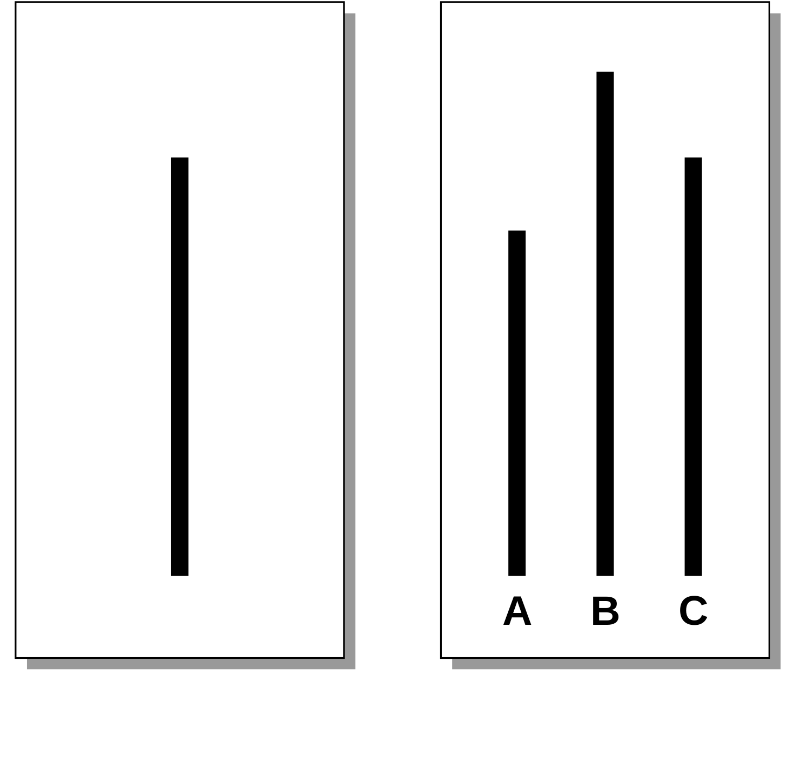
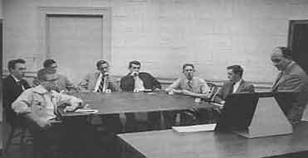
Asch conformity experiments
Overall 75% made at least one mistake in 12 rounds
https://en.wikipedia.org/wiki/Asch_conformity_experiments
Notes:
At the end I would like to share one experiment with you. It was developed in 1950s when a principle was a simple. You have group of 8 people sitting in the same room, but 7 of them are actors. So only one is the real subject of experiment. All of them has the same task to do. You have these two cards and you should decide which of the three lines on the right is the same length as the one on the left. All other rounds were similar exercise so you would expect correctness of answers to be near to 100%.
The guy who was not acting was always sitting in the position he answers the last. In first two rounds actors answer correctly and a subject too. But from the third round actors start to answer wrongly but all of the in the same way. So for example all of them would say Line C is the correct answer here. Subject was answering as the last.
Over all 75% subjects made at least one mistake in 10 rounds. Some of them much more. It demonstrates we would like to stay in our conformity and we tend to agree with a crowd. Do not do that please.

