Slide 1

International Conference of
Software Quality Assurance
I European international
Software quality assurance conference
sqadays.com
Ethics in software testing –
from theory to practice
Maik Nogens
MaibornWolff GmbH, Hamburg, Germany
@maiknog
Saint Petersburg, Russia. May 31-June 1, 2019
Riga. March 22–23, 2019
sqadays.eu

Slide 2

Schedule
Theory
Group work
Discussion
Repeat

Slide 3

Ethics
Ethics or moral philosophy is a branch of philosophy that involves systematizing, defending, and recommending concepts of right and wrong conduct.
As a branch of philosophy, ethics investigates the questions "What is the best way for people to live?" and "What actions are right or wrong in particular circumstances?

Slide 4

Ethics - schools
Consequentialism
“The outcome is important, not the action”
Deontology
“The action is important, not the outcome”
Virtue
“The person performing the action is important, not the action or its outcome”

Slide 5
Ethics vs. Moral
Ethics refer to rules provided by an external source, e.g., codes of conduct in workplaces or principles in religions.
Moral refer to an individual's own principles regarding right and wrong.
Notes:
For the sake of simplicity we will refer to ethics and morals with the same term “ethics”

Slide 6
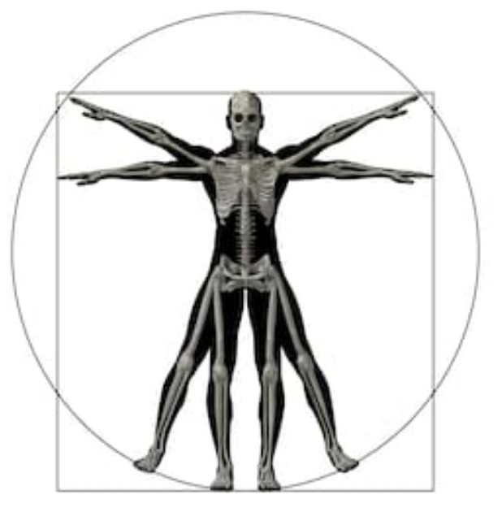
Ethics - contexts
Personal
Family
Society
Company
Moral
Notes:
Bessere Folie erstellen - erklären wie verschiedene Ethik-Richtlinien uns von außen beeinflussen und wie wir unsere Moral an äußere Einflüsse anpassen.
Question to audience? : Do you know more sources?
Religion? Books? Philosophy ?

Slide 7

Ethics need practice
It can be difficult to make an on-the-spot decision on ethically challenging issues
Practicing this can help to make the right decision
This is why you’re here, right?

Slide 8
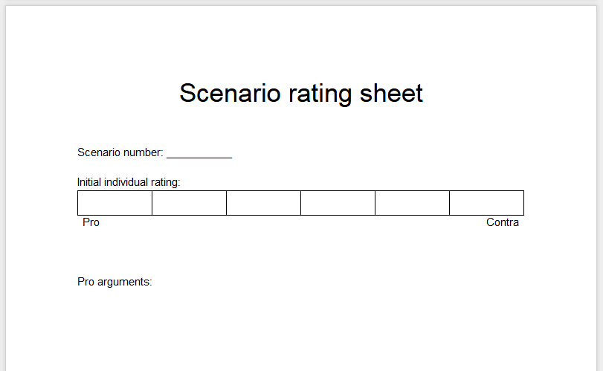
The rating sheet

Slide 9
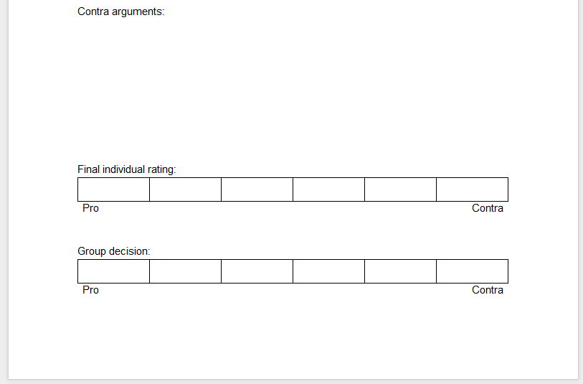
The rating sheet

Slide 10
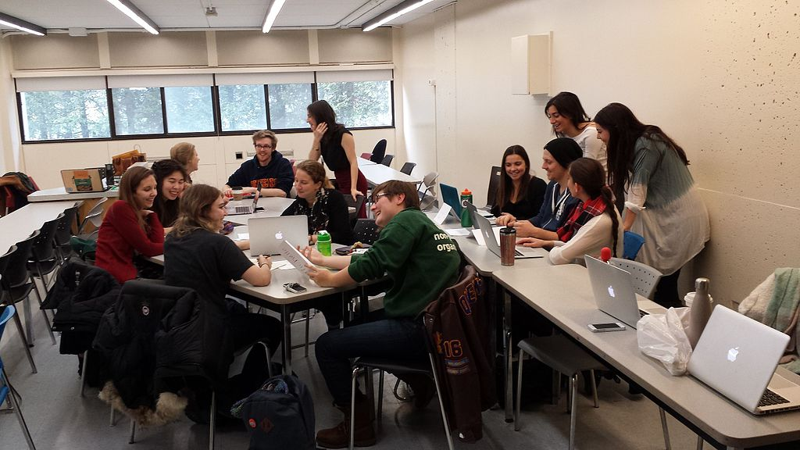
Let’s get to work

Slide 11

How to argue ethics
Data
Conclusion
Warrant
Rebuttal
Backing
Notes:
Toulmin Schema - https://lehrerfortbildung-bw.de/u_gewi/ethik/gym/bp2004/fb2/3_argument/1_stationen/l6/1_logik/ bzw. http://www.teachsam.de/deutsch/d_rhetorik/argu/arg_mod_toul_6.htm
Data = Fact
Conclusion = moral judgement
Warrant = moral norm which allows to draw the conclusion from the data
Backing = Reasons why exactly this norm applies
https://rowman.com/ISBN/9780739141380/Ethical-Argumentation
https://academics.umw.edu/speaking/resources/handouts/toulmin-argument-model/

Slide 12
Example
The software is used in military attack vehicles
People working on that software are murderers
Data
Conclusion
Killing humans is bad
Warrant
Rebuttal
It is only acceptable in self defense
Backing
The bible says so ☺
Notes:
Toulmin Schema - https://lehrerfortbildung-bw.de/u_gewi/ethik/gym/bp2004/fb2/3_argument/1_stationen/l6/1_logik/ bzw. http://www.teachsam.de/deutsch/d_rhetorik/argu/arg_mod_toul_6.htm
Data = Fact
Conclusion = moral judgement
Warrant = moral norm which allows to draw the conclusion from the data
Backing = Reasons why exactly this norm applies
https://rowman.com/ISBN/9780739141380/Ethical-Argumentation
https://academics.umw.edu/speaking/resources/handouts/toulmin-argument-model/

Slide 13
Let’s get to work

Slide 14

Coffee break!

Slide 15

Ethics are a team effort
It’s okay to be the ethics advocate but you’ll need the support of your team
  Don’t fight the fight alone
Agree on a common code of ethics in your area of influence
If possible: Make it legally binding

Slide 16

No need to invent your own
IEEE Code of Ethics
ACM Code of Ethics
ISTQB Code of Ethics
James Bach “Thoughts Toward
The Ethics of Testing”

Slide 17
Let’s get to work

Slide 18

How to escalate
Make sure you know how to escalate things before the need arises
Consider the consequences
Be clear about your goal - blowing it all up vs. fixing the system have different escalation paths
Get hard evidence safely and externally (see: Reality Winner)
Notes:
Many companies have an internal code of conduct with points of contact
Storing compromising emails in the work email account is not the best idea
Reality Leigh Winner (born December 4, 1991) is a former American intelligence specialist. In 2017, she was charged with "removing classified material from a government facility and mailing it to a news outlet.” The material referred to originated with the National Security Agency (NSA). She was in contact with the news outlet from her work computer via her private email account. Her browsing history at work also revealed that she had googled “can usb sticks be detected”

Slide 19
Possible escalation paths - Internal
Feedback channels (Suggestion box; Anonymous Feedback portal, …)
Team
Team Lead / Line Manager
Human Resources
Compliance Department / Data Protection Officer / Security Department
Employee committee / Workers council
CEO
Board of Directors

Slide 20

How to escalate externally
Consider the consequences again (see: Edward Snowden)
Get a lawyer
“European Commission proposes whistleblower protection law”
US whistleblowing protection
(see Wikipedia for more links: https://en.wikipedia.org/wiki/Whistleblower_protection_in_the_United_States)

Slide 21
Possible escalation paths - External
Consumer protection agency
Federal data protection department
Federal prosecutor
Newspaper
International organisations (e.g. UN, WTO, …) [depending on context]

Slide 22

If we don’t do it, someone else will
People standing up in one company creates a precedent for others (see Project Dragonfly at Google)

Slide 23
I European international
Software quality assurance conference
Thank you
Riga. March 22–23, 2019
sqadays.eu

