Slide 1
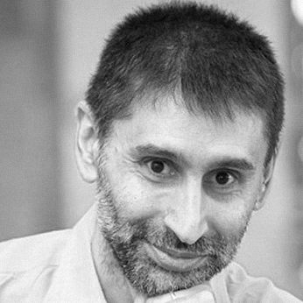
AI for Testers
The Future Today
by Joel Oliveira
Notes:
Artificial Intelligence (AI) is an emerging field, jumping from the imaginary of Hollywood movies into the reality of our daily activities.
Without exception, as AI becomes omnipresent, it will also impact the Software Testing with 3 main developments:
- AI systems to aid on software testing;
- Software testing of AI systems;
- Self-testing AI systems.
While testing of AI systems requires testers with AI expertise and self-testing AI systems will target not to require testers at all, the rest of us, testers, should benefit of the availability and use of AI systems designed to aid on the software testing.
Join this talk to review the actual state of the art on the AI based testing tools that are openly available today!

Slide 2

About Me?
Tester
Portugal
PSTQB
#TestingPortugal
#TesterJobsPT
The friendliest country in the world towards immigrants!

Slide 3
About Me?
I’m not
an
Artificial Intelligence
expert…
I’m just a tester!

Slide 4
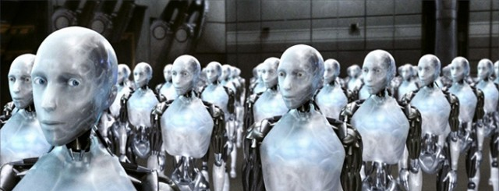
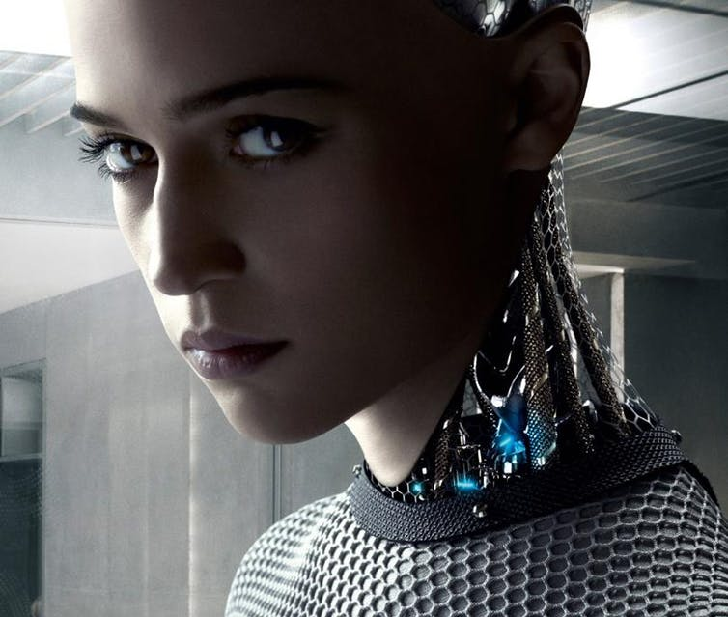
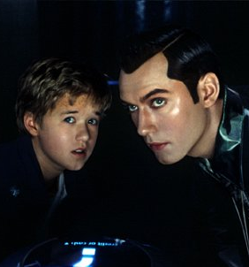
What is AI?
Imaginary from the Hollywood movies?

Slide 5
What is AI?
The art of creating machines that perform functions that require intelligence when performed by people. – Kurzweill, 1990
The theory and development of computer systems able to perform tasks normally requiring human intelligence, such as visual perception, speech recognition, decision-making, and translation between languages.
The capability of a machine to imitate intelligent human behavior.
The ability of a digital computer or computer-controlled robot to perform tasks commonly associated with intelligent beings.
Not just one definition!

Slide 6
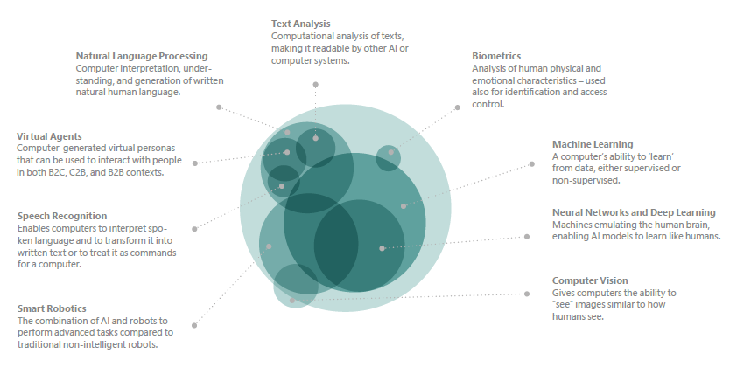
What is AI?
Not just one thing!
Artificial Intelligence in Europe
http://bit.ly/AI-in-Europe

Slide 7
Artificial Intelligence in Europe
http://bit.ly/AI-in-Europe

Slide 8
What is AI?
Narrow (“weak AI”)
Single task
Limited interactions
General (“strong AI”)
Ability to understand context
Make judgements
Cognitive (“supper AI”)
Conscious AI
Real AI?
Not just one AI!

Slide 9
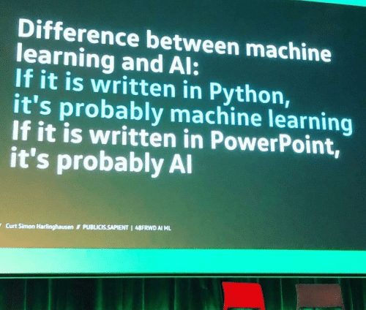
What is AI?
Hottest #BuzzWord

Slide 10
What is AI?
Reality vs. Hype?
AI is not real!
However…
You need to have it in your portfolio…
Even if you are just doing manual testing!
Hottest #BuzzWord

Slide 11
What is AI?
Not new (since 50s)
Why now?
Storage availability
Computing power
Data volume required for ML
  2.5 billion GB bytes of data created each day (in 2012)
  90% generated just in the last 2y
  IoT, Social Media, …
Hottest #BuzzWord

Slide 12
AI in Europe
Total investment $10.5bn
(in 10 years but with a six-fold
increase in activity in the last 5)
Hot topic for 71% at C-level
Seen as digital priority for 51%
Only 4% are actively using AI
Hottest #BuzzWord
Artificial Intelligence in Europe
http://bit.ly/AI-in-Europe

Slide 13
AI in Europe
40% of “AI startups” in Europe don’t actually use AI.
Startups that claim to work in AI attract between 15 and 50% more funding compared to other companies.
Hottest #BuzzWord

Slide 14
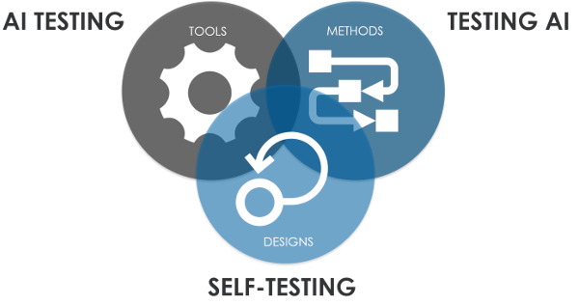
AI in Testing
Different skills for the different purposes!
Artificial Intelligence for Software Testing (AIST) Association
https://www.aitesting.org

Slide 15
AI in Testing
AI in testing is still in the initial stages but with 22% of IT budgets!
However, 57% said that they had projects involving the use of AI for QA and testing.
Intelligent automation in testing
Predictive analytics in testing
Descriptive analytics in testing
Current status?
World Quality Report 2018-19
http://bit.ly/WQR2018-19

Slide 16
Machine Learning
Can’t explain their “thinking”, so the algorithm could be performing well for the wrong reasons.
Because all it knows is the data provided for the learning, it might provide biased decisions.
It doesn’t have a common sense!
(like some humans)
(disclaimer)

Slide 17
AI based TT
Test Automation
Optimizing testcases/coverage
Reducing maintenance costs
Reducing flaky tests
Test result analysis
Risk based
Root Cause Analysis
Estimation (defect density)
Visual Testing
(AI as in Machine Learning)

Slide 18
AI based TT
Disclaimer
This is based on my own experience and opinion as a tester. I’m not affiliated in any way with any of these tool vendors.
The focus was only on the features. It excluded the ROI, fees and/or other costs.
Used Test Triangles for the analysis: https://joel-oliveira.appspot.com/triangles
(AI as in Machine Learning)

Slide 19

Applitools
https://applitools.com
How it works?
Captures visual differences via full-page screenshots
Compares visual differences across every platform using AI-powered computer-vision algorithms
Integrates with your toolchain/tests
Automates (visual) test maintenance
Cross device and browser tests
“AI powered visual testing and monitoring”

Slide 20
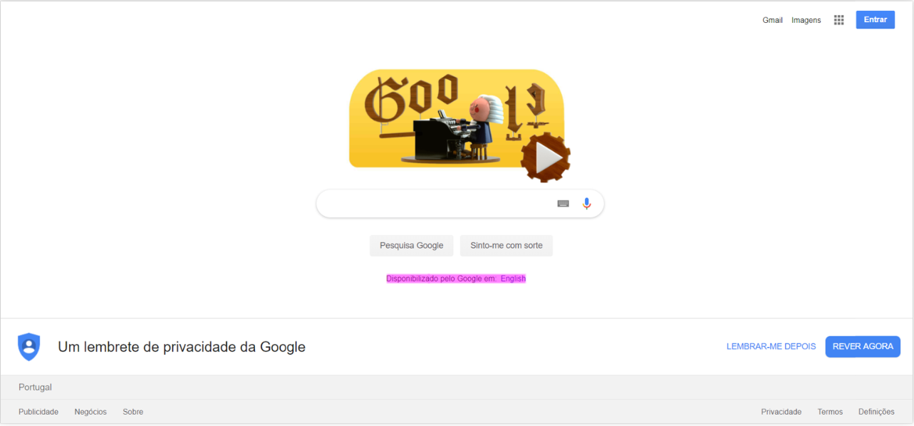
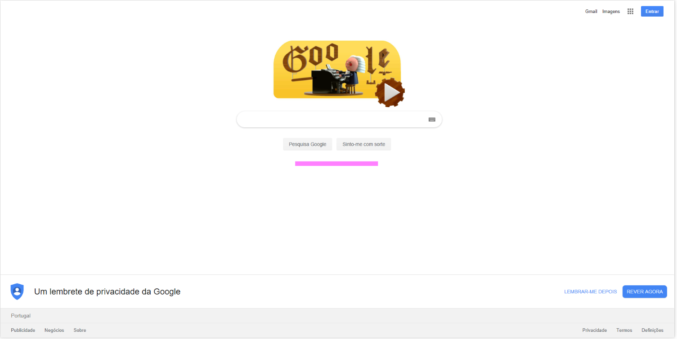
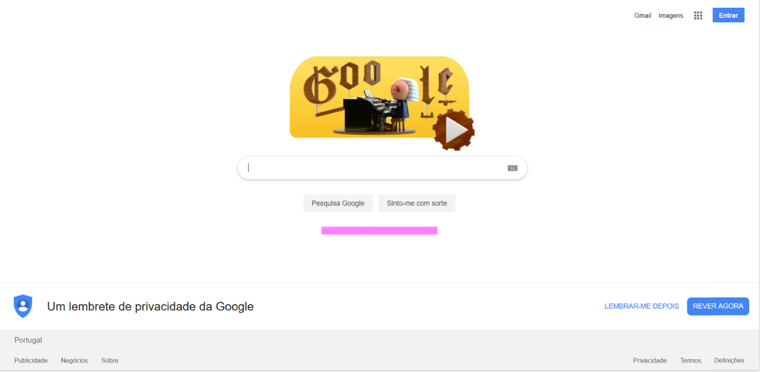
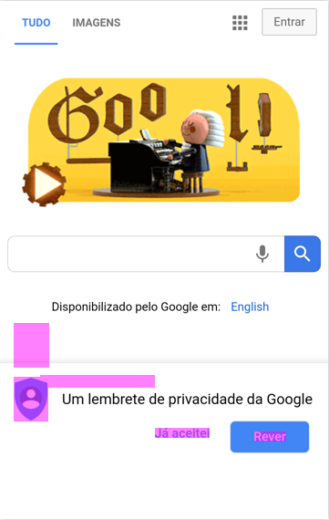
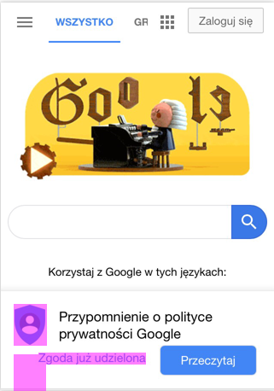

Slide 21
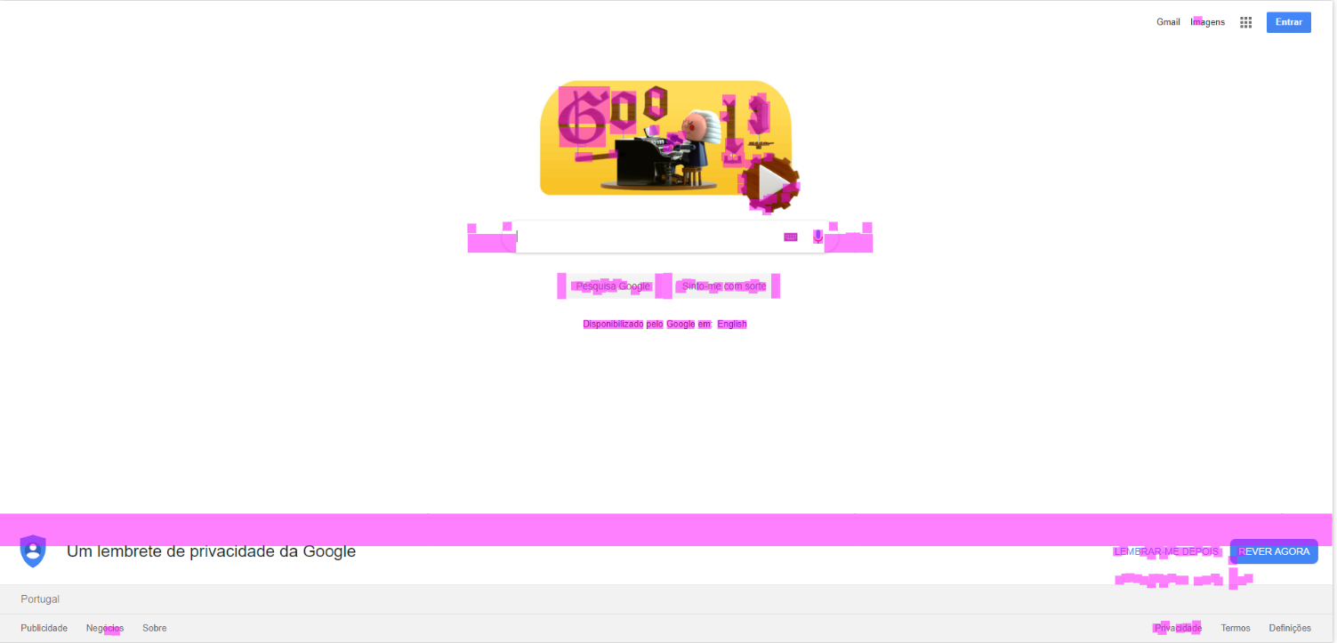
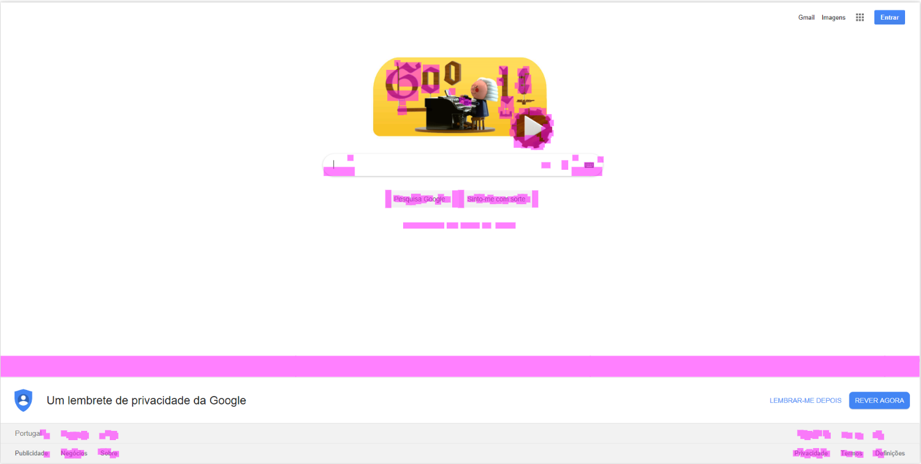

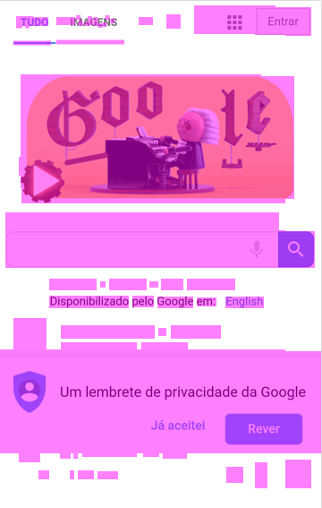
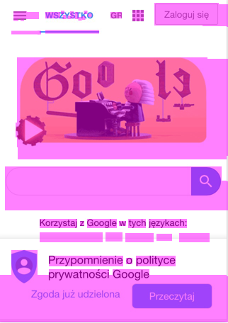

Slide 22

Applitools
https://applitools.com/tutorials
Very good documentation
Web, Mobile and language specific SDKs (C#, Java, JavaScript, PHP, Ruby, Python, Objective-C, Swift)
Tutorials per tool/language
RobotFramework fan?
https://github.com/joel-oliveira/EyesLibrary
Open, Check and Close Eyes
“AI powered visual testing and monitoring”

Slide 23

mabl
https://www.mabl.com
Easy to setup
Recorder (browser extension)
Advanced logic
Auto-healing tests
Comprehensive test output (step by step details, errors, JavaScript exceptions, screenshots
Visual anomaly detection (ML)
Performance regression testing
Cross browser testing
Data driven testing
“Advancing QA using ML”

Slide 24
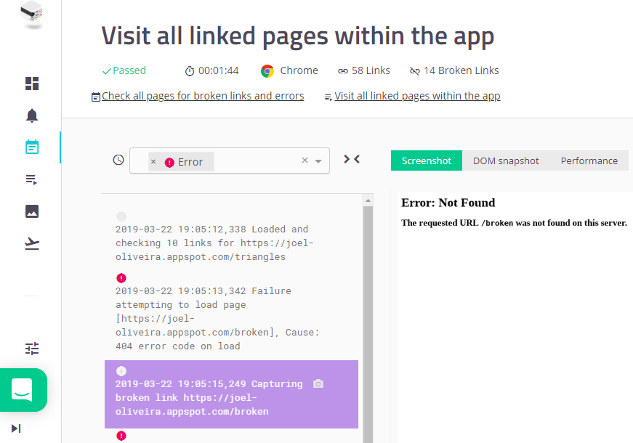

Slide 25
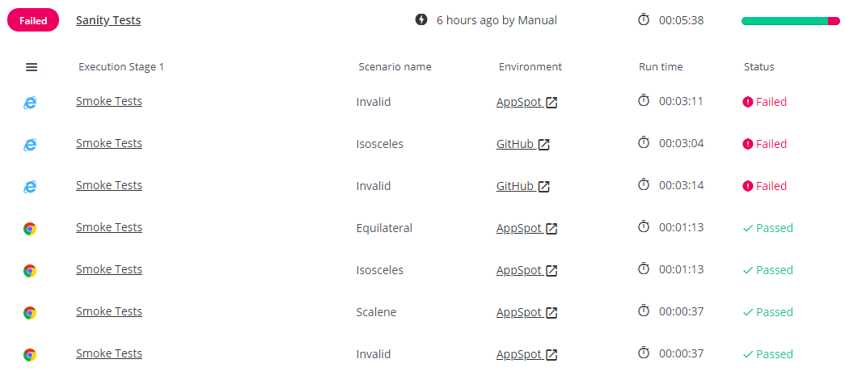

Slide 26
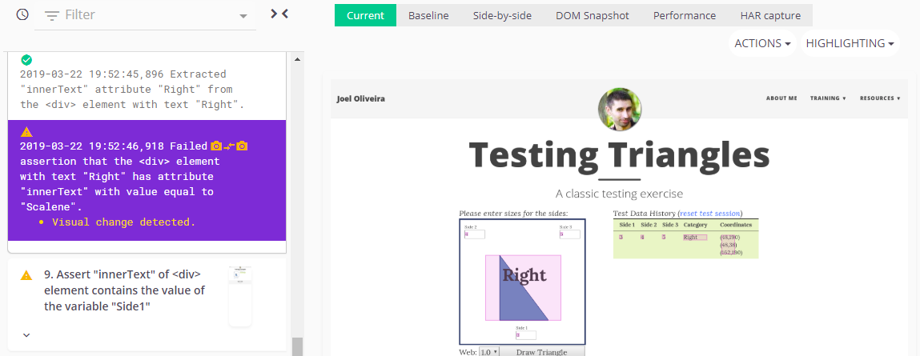

Slide 27
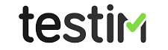
Testim
https://www.testim.io
ML Based Self-Maintenance (to reduce flaky tests)
Run on different browsers
Code & record (browser extension)
Reusable scenarios
Data driven (based on JSON)
Powered by Aplitools Eyes
Integrates with CI tools + Defect Management (Jira and Trello)
“Uses AI to speed-up the authoring, execution and maintenance of automated tests”

Slide 28
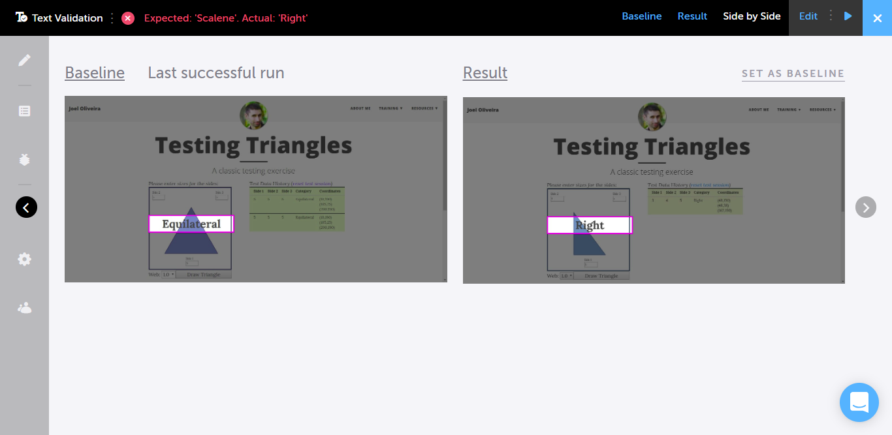

Slide 29
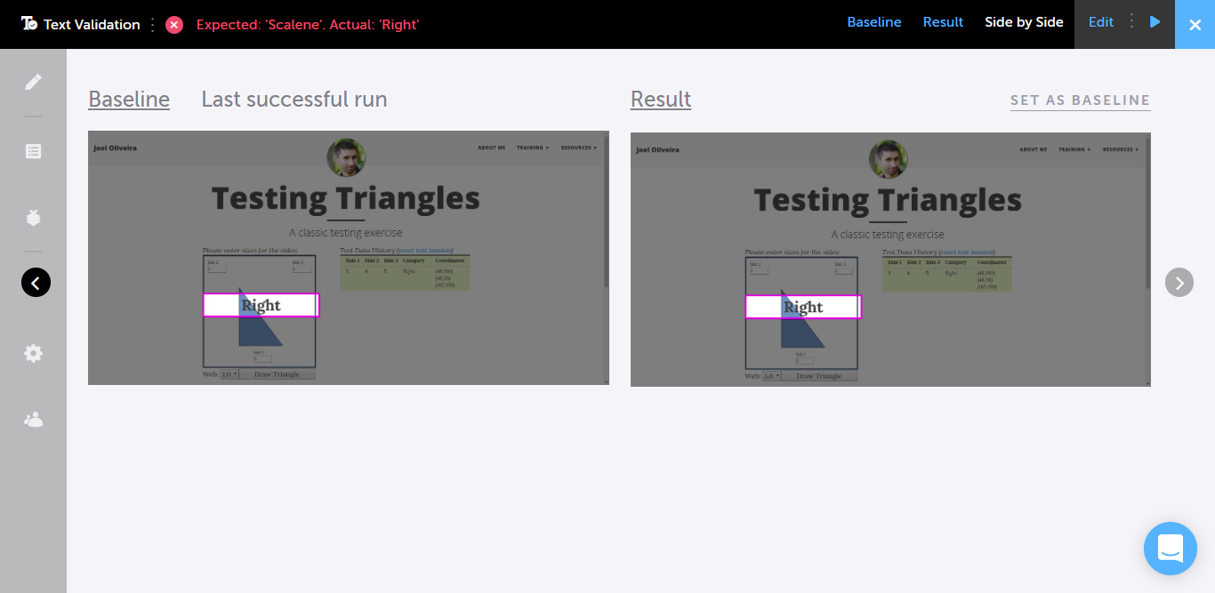

Slide 30
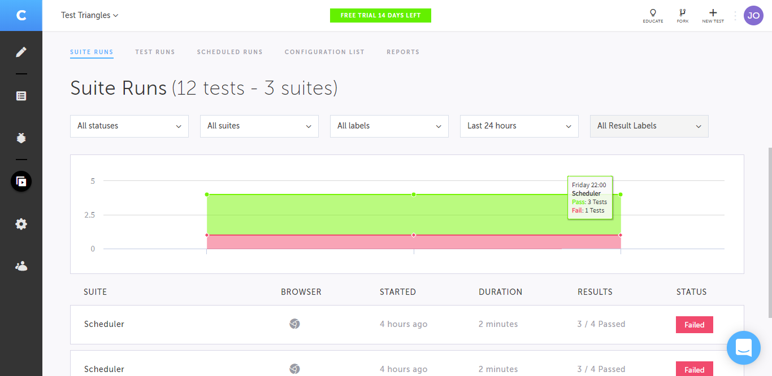

Slide 31
Where to go for more?
AI for Software Testing (AIST) Association
https://www.aitesting.org (dead end)
IEEE International Conference On AI Testing
http://www.ieeeaitests.com
Artificial Intelligence In Software Testing
https://www.testeryou.com/training/
Artificial Intelligence United (AiU)
https://www.artificialintelligence-united.com

Slide 32
Afraid?
The technological singularity is the idea that technological progress, particularly in artificial intelligence, will reach a tipping point to where machines are exponentially smarter than humans.
Technological singularity is imminent?

Slide 33
Afraid?
I’m not afraid of AI evolution…
but
I’m afraid of human regression!

Slide 34
Afraid?
New research claims that 25% of Europeans would rather trust AI to make important decisions about
the running of their country than humans!
Same research highlights that 56% fear that robots may substitute most human jobs!
European Tech Insights 2019
http://docs.ie.edu/cgc/European-Tech-Insights-2019.pdf

Slide 35
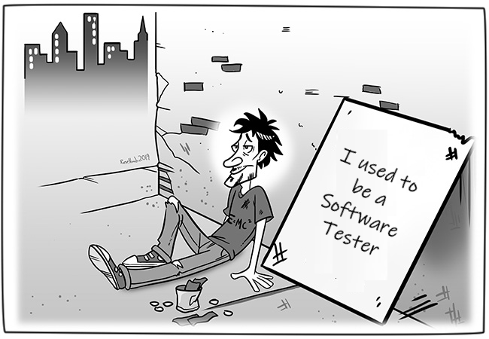
Afraid?
Losing the job?
Based on the “Career Obsolescence” by Roelbob

Slide 36
Afraid?
Is it the first time that you need to adapt to a new reality/change as a tester?!
New roles will emerge: AI QA strategist, QA Data Scientist, AI Test Expert, …
Where are you? In the 80% or 20% of the added value?
Losing the job?

Slide 37
Afraid?
AI is learning!
What about you?
For a tester, to think is not optional!
Losing the job?

Slide 38
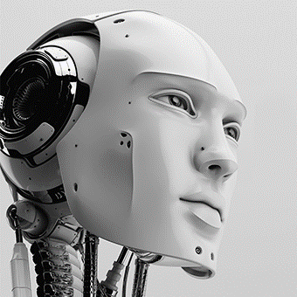
https://www.linkedin.com/in/joeloliveira/ https://joel-oliveira.appspot.com/ oliveira.joel@outlook.com skype:o_joel
@Joel_0liveira
Thank You!
Obrigado!
Paldies!

