Slide 1

Building
Automated Testing
for the Internet of Things

Slide 2

About me
Maxim Aliseiko
Senior QA Engineer @ Klika Tech
8 years in QA
Specialization: Linux-based projects, IoT

Slide 3
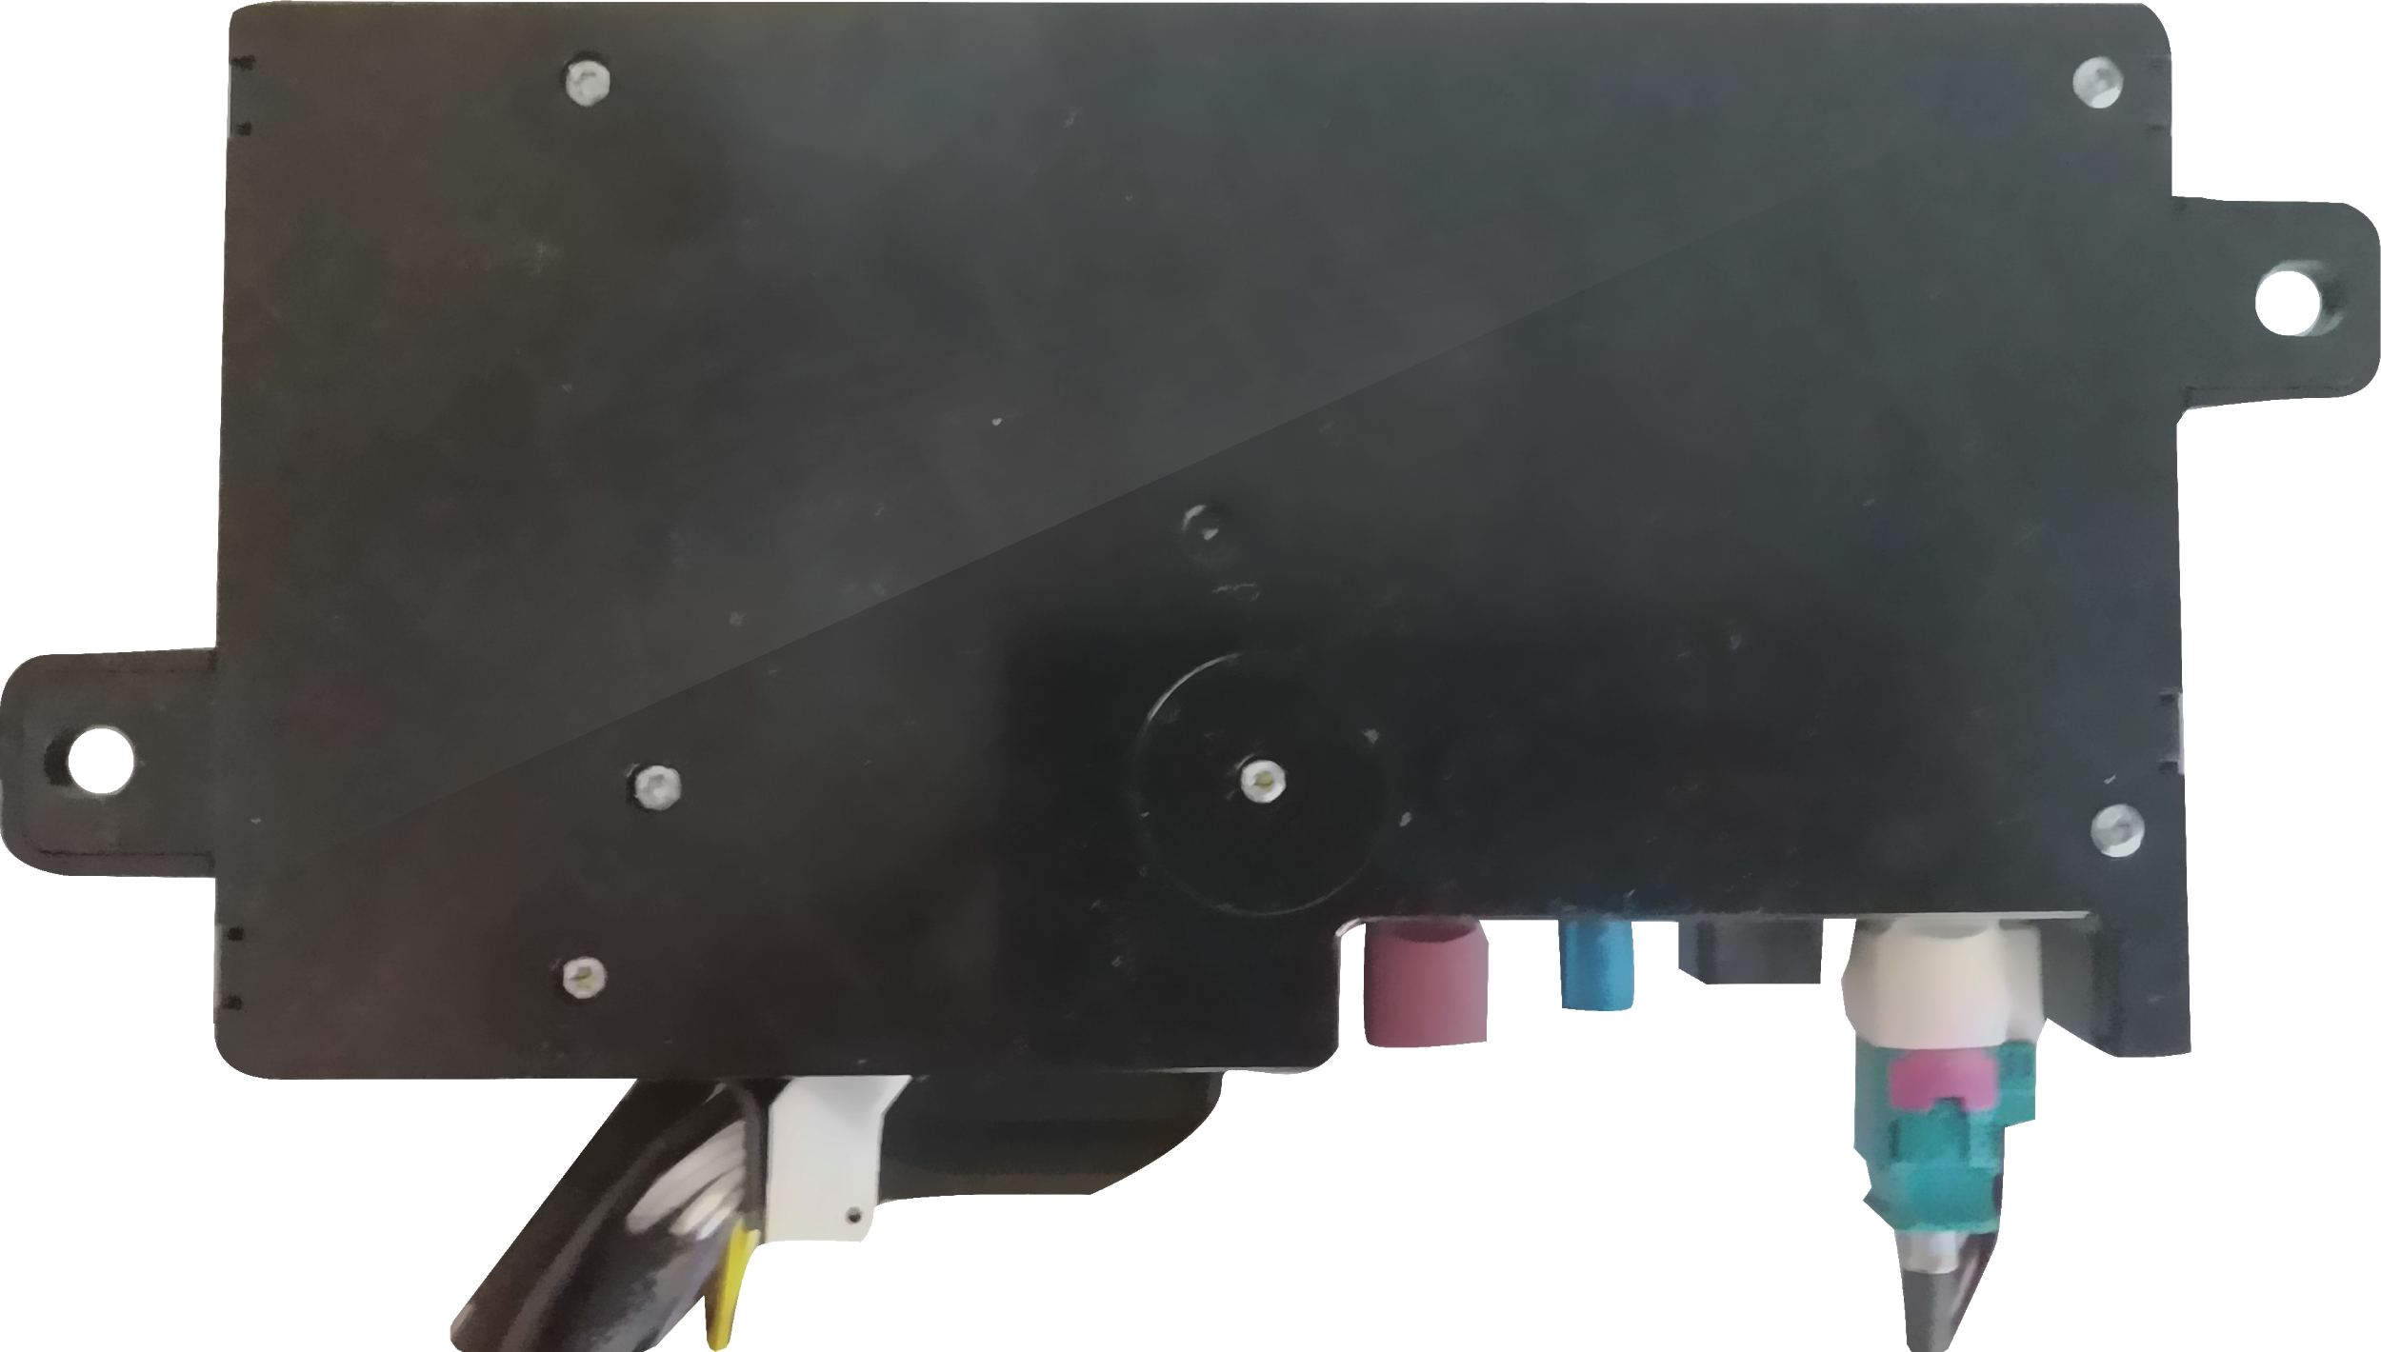
Automotive onboard logical unit
Onboard logical unit running on Linux

Slide 4



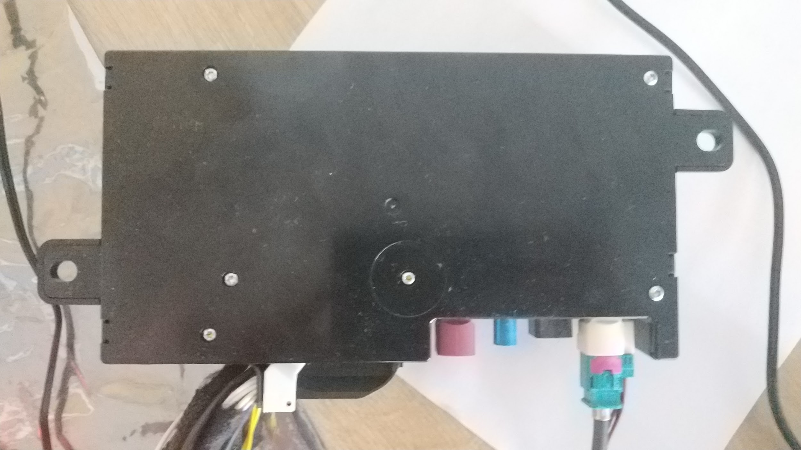

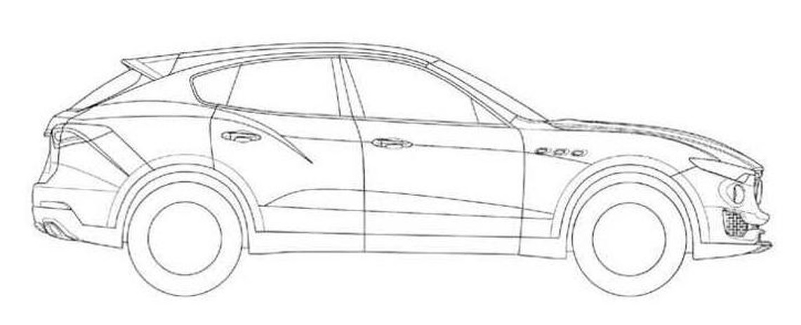
Automotive onboard logical unit
Cloud
Onboard logical unit running on Linux
CAN

Slide 5
Automotive onboard logical unit
Onboard logical unit running on Linux

Slide 6
Automotive onboard logical unit
Onboard logical unit running on Linux
CAN

Slide 7
Automotive onboard logical unit
Onboard logical unit running on Linux
CAN

Slide 8
Automotive onboard logical unit
Cloud
Onboard logical unit running on Linux
CAN

Slide 9
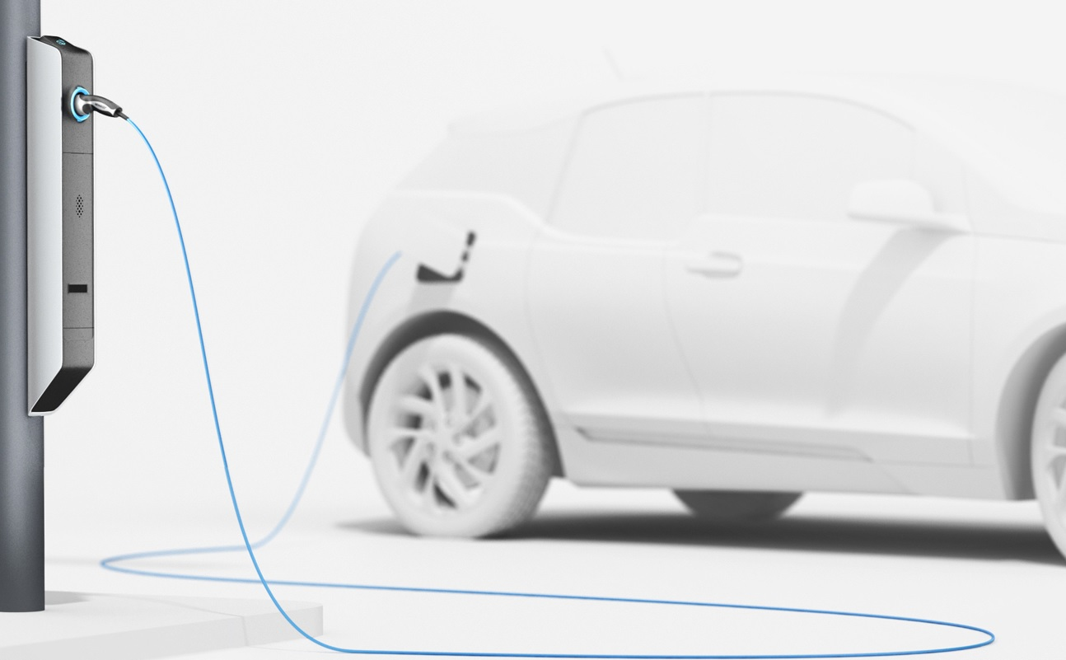
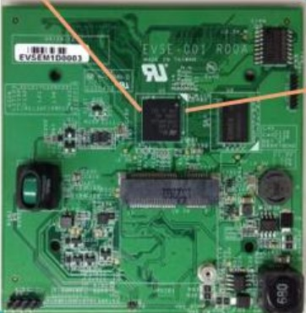
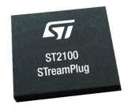
Electric chargers
EVSE PCB with ST2100 Embedded Linux

Slide 10

Electric chargers
Serial, I2C
EVSE Hardware (Meter, etc.)
Serial
EV (ISO 15118)
PLC line
EVSE PCB with ST2100 Embedded Linux

Slide 11
Electric chargers
Serial, I2C
EVSE Hardware (Meter, etc.)
Cloud
Serial
EV (ISO 15118)
PLC line
EVSE PCB with ST2100 Embedded Linux

Slide 12
What’s the problem?

Slide 13
What’s the problem?

Slide 14
Interview task
Advertising device
Gateway Box
Cloud
Embedded Linux

Slide 15
What is IoT ?
Internet
Things
Notes:
Вместо ST плату, которая обозначает железяку

Slide 16
Complexity and why do we need automation

Slide 17
Class 1: Outer world emulation

Slide 18
Class 1: Outer world emulation
Home-grown hardware emulators/simulators

Slide 19
Class 1: Outer world emulation
Home-grown hardware emulators/simulators
Mocks / Stubs

Slide 20
Class 1: Outer world emulation
Home-grown hardware emulators/simulators
Mocks / Stubs
3rd-party hardware/software emulators/simulators

Slide 21
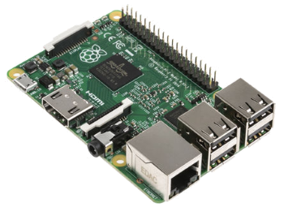
Bluetooth
Connect from / to device under test (DUT)
Scan peripheral
Read / write characteristiс
….
Test Framework

Slide 22
GPS
DUT
Test Framework
WebSocket
GPS mock
Set GPS coordinates:
{
"alt": 10.1,
"climb": 123.1,
"lat": 11.1,
"lon": 11.2,
"speed": 10
}
Core business services

Slide 23
CAN / VIS - using mock
Test Framework
WebSocket
VIS mock
Set VIS signals:
Signal.Cabin.Door.Row1.Left.IsOpen=True
Signal.Vehicle.Odometer=5000
Core business services

Slide 24
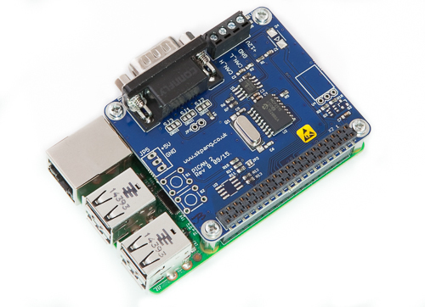
CAN / VIS - replay recorded traces
RPi w/ CAN Bus
SSH
CAN
VIS service
Test Framework

Slide 25

CAN / VIS - using Vector
3rd party car simulator
The most precise simulation
Expensive
Hard to share
CAN

Slide 26
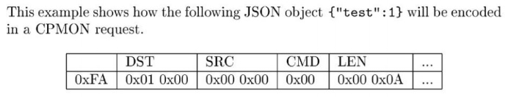

Serial: Test vectors generators
CPMON “decoder”
Serial
pyserial
json
PyCRC.CRCCCITT
EVSE PCB with ST2100
Embedded Linux

Slide 27
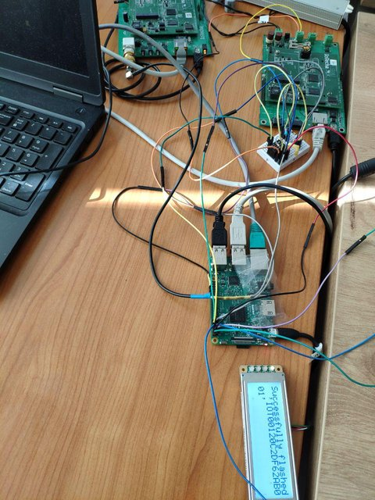
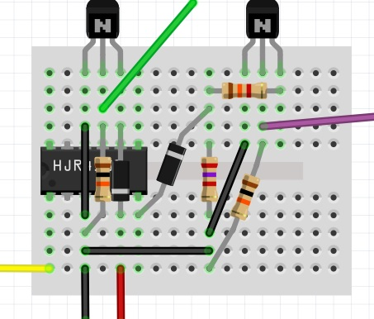
ISO 15118
EV Emulator
DUT
PLC line
ssh
Test Framework
ssh
Raspberry
Breadboard

Slide 28
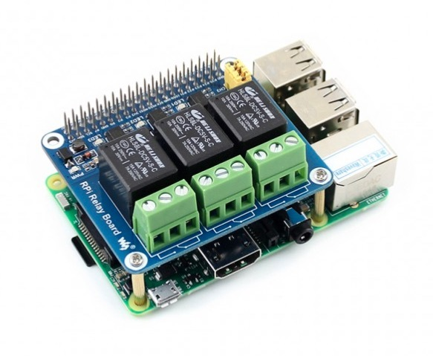
Class 2: Power Management
Test Framework
SSH
+
Power source
DUT
RPi w/ Relay Board
-

Slide 29
Class 3: Network Connectivity
Edge cases
Harsh environment simulation
./tc qdisc change dev inm0 root netem \
delay 1000ms 250ms \
rate 100kbit
DUT
Network Scheduler kernel module
Test Framework
SSH
Traffic control utility

Slide 30
CI integration
GitLab CI server
Worker 1
Worker 2
Cloud
DUT 1
DUT 2

Slide 31
Conclusion
Hardware control device - RPi bluetooth, CAN shield, GPIO, Serial port

Slide 32
Conclusion
Hardware control device - RPi bluetooth, CAN shield, GPIO, Serial port
Use mocks if hard to simulate hardware: GPS mock, VIS mock

Slide 33
Conclusion
Hardware control device - RPi bluetooth, CAN shield, GPIO, Serial port
Use mocks if hard to simulate hardware: GPS mock, VIS mock
Don’t forget specific edge cases automation - Power Management control using RPi Connectivity using kernel module

Slide 34
Thank You
maxim.aliseiko@gmail.com

