Slide 1
Mobile testing with Appium
Dusanka Lecic, Levi9 IT Services, Serbia

Slide 2
About speaker
Test Developer
Presenting knowledge on conferences
PhD of Technical Science
Four languages

Slide 3
Agenda
Mobile testing
Tools for mobile testing
Appium
Automation tests in Appium
Avoid pitfalls
Conslusions

Slide 4
Mobile testing
What is mobile testing?
Types of mobile testing
Key challenges
Mobile testing tools

Slide 5
Appium
What is Appium?
How does Appium work?
Limitations of Appium
Setup project in Appium

Slide 6
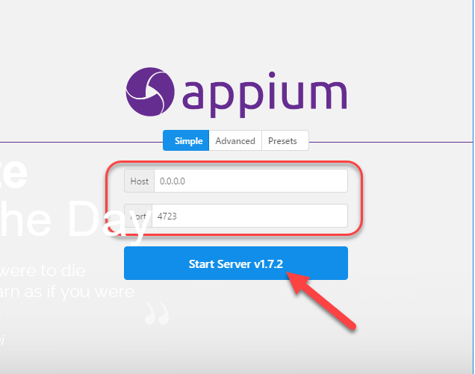

Slide 7
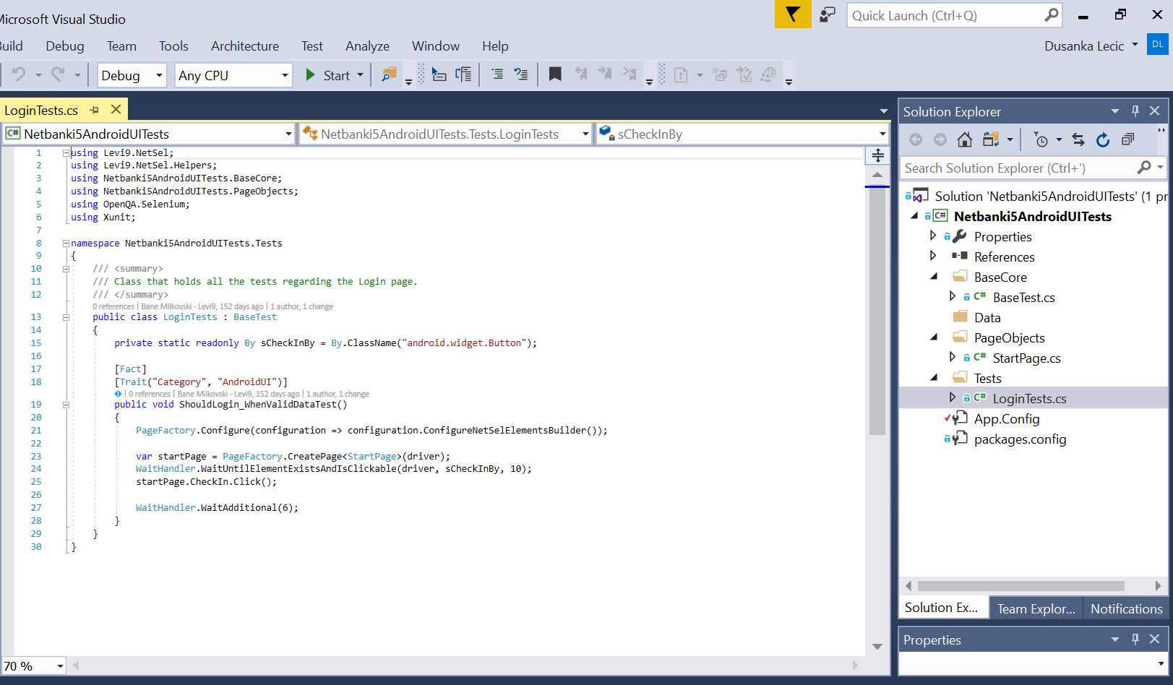

Slide 8

Avoid pitfalls in Appium

Slide 9


Conclusions

Slide 10
THANK YOU!
E-mail: d.lecic@levi9.com
Linkedin: https://www.linkedin.com/in/dusanka-lecic/
Twitter: https://twitter.com/DuskaLecic

