Slide 1


Survey of Automated Test Model
Notes:
Hello! We will talk about automated test models. This topic will cover things which seems obvious, yet I’ve met the same misunderstanding and mistakes on dozen of projects. And today I welcome you all at our clinic.

Slide 2

Chief of IT-medicine
Dmitrii Leontev
Notes:
My name is Dmitry and I’ll be your attending doctor for the next 40 minutes.

Slide 3

Table of Contents
Chapter I : Symptomatology
Chapter II: Analysis and Diagnosis
Chapter III: Therapy
Chapter IV: Recurrence and Preventive Treatment
Notes:
In our medicine scheme I’ll go through major points, divided into chapters which are: Symptomalogy, Diagnosis, Therapy and prophylactics.

Slide 4

Symptomatology
Notes:
First of all, the symptoms. Most of the teams I used to lead or have been summoned as a consult actually had a feeling that they have some problems. Yet they were in denial of the impact on the project. It’s like a overweight, you see. You don’t mind it until you loose some kilos.

Slide 5

Major Symptoms
> 20% of time for maintenance
> 20% of the test model is broken
> 20% technical debt ratio
More than one night to launch automated tests
More than one day to create a new a-test
Notes:
Than now… lets see if this concerns you. Here is this list of symptoms:
-If you spend more than 20% of time to maintain the existing tests just too keep them working.
-One fifth of you tests is just ignored during testing, since there is no way to get it to work every time, and there, you just ignore it.
->20% tech debt ratio. We will talk about it later.
-It takes more than one night to launch full automated regression. Including analyze, by the way.
-> more than one day is needed to create a new a-test
So… anyone felt unease right now? Than, lets continue on what to do with it.

Slide 6




Who is in the team?
External
Expert
Team
Lead
Manager
Stakeholders
Rescue team
Notes:
All right, turn on an epic music… from rescue rangers.
First, we should gather a rescue team. Oh, cmon, you already pushed yourself to the bottom. Yep, those symptoms are baaad. So you need some help!
-Lets start with an external expert. It shouldn’t be the House M.D. in the flesh, it’s just a guy who has some consciousness about automation. Its just a fresh look from outside. Deal with it!
-Second there should be a person who is responsible for the result. Usually it’s a teamlead, but if you don’t have one… well, just point at someone.
-Third… well, there are some problems which require communications. Basically, it’s a work for the manager. If you don’t have one, the same story, choose someone.
-And, of course, the stakeholders. Those who use your tests. Those who develop and run them.
And so we begin!

Slide 7

Analysis and Diagnosis
Notes:
In this chapter we will talk on how to collect the data to localize the problem and state the right diagnosis.

Slide 8
Problem Types
ADMINISTRATIVE
Environment-related
Critical settings
Blockers
Integrations
TECHNICAL
Automation instruments (Frameworks, Drivers, etc.)
Automation management and execution instruments (Zephyr/ALM/Jenkins, etc.)
Environment problems that can be solved by technical means
MODEL
Copy-paste
Small coverage
Lots of checks in one test
Notes:
First of all, lets team up our experts and all the people we mentioned before and write down all the problems. Also divide problems from the start, that would be easier rather then classify them later, because participators will already know from where the roots of the problems are coming from. So, which types of problems do we have?

Slide 9

Expert Evaluation
Team up and write down the problems dividing them into the following groups:
Management
Technical
Model
Notes:
Different people of different role should solve different types of problems. So, once again, lets summarize our “brainstorm event” goals.

Slide 10
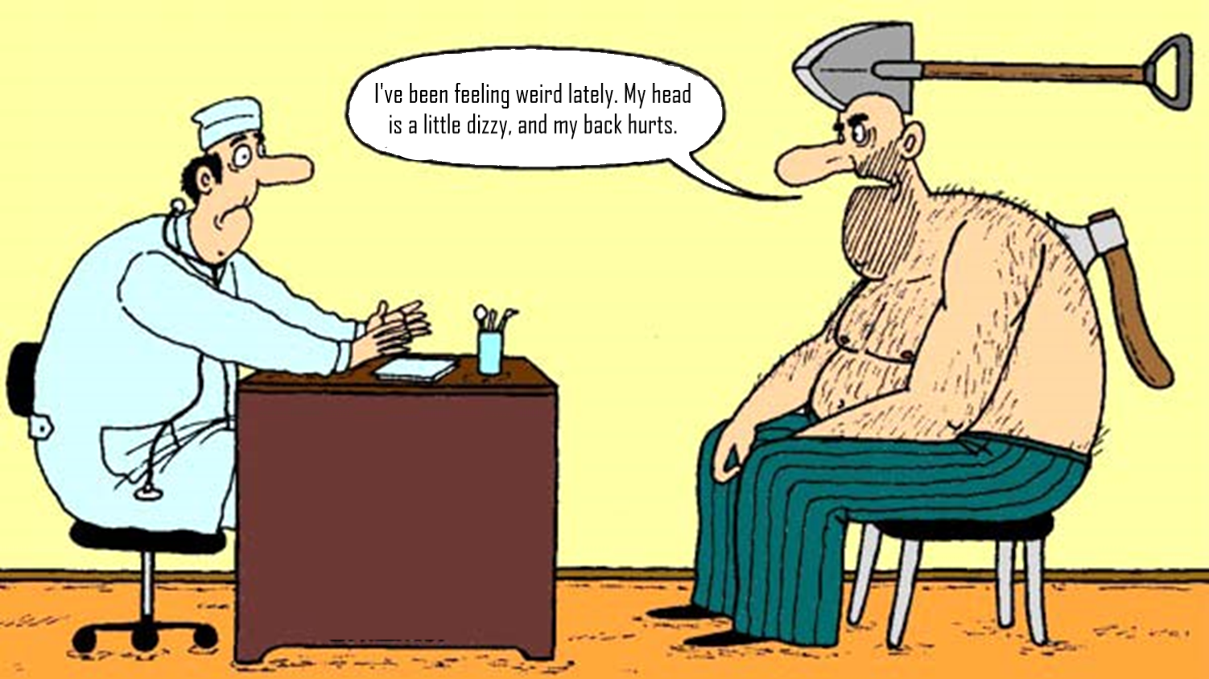
Notes:
Experts are good, yet the numbers are better. Opinion is often very subjective. I met both situations: when people got used to a serious problem and stopped noticing it AND when people got overexited about the smallest of small problems which is creeping on them right now.

Slide 11

Analysis Tools
Task-tracking tools (Jira, RedMine, Trello, etc.)
Static code analysis tools (Sonar, IntelliJ, etc.)
Metric aggregators (various dashboards)
Notes:
And so we need some instruments to dig in. There are a lot of them, but I will talk about few I used more often.

Slide 12
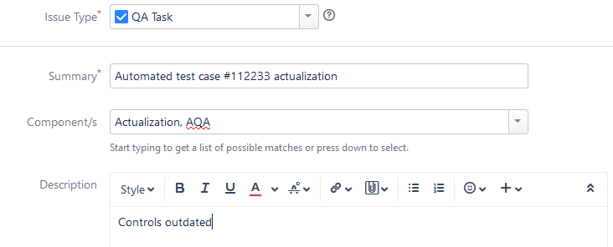
Task Logging
Notes:
Log your time on the task. Here is the example: it’s a task for autotest actualization. It is a mandatory to leave a reason for this fix, or, even better – create a special dropdown list of typical causes. I’ll show how its gonna help us later.

Slide 13
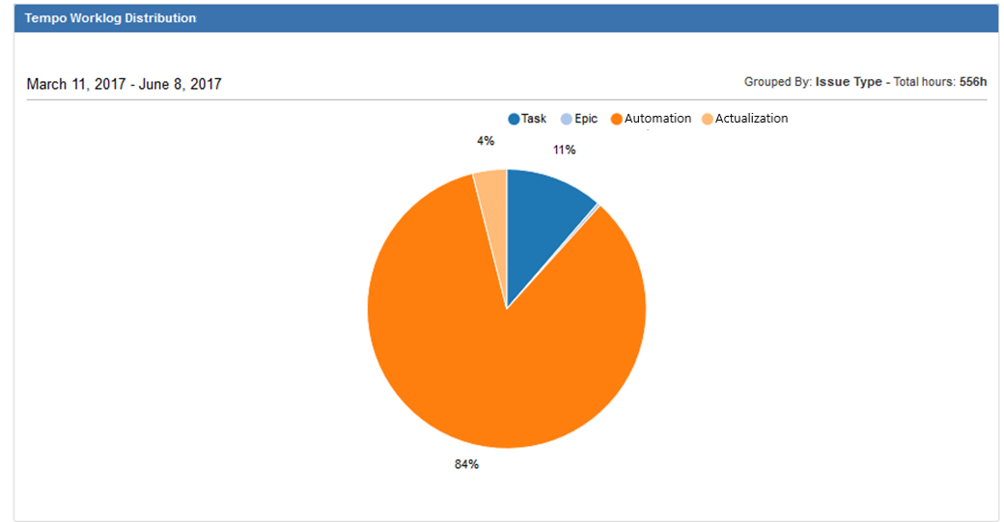
Jira Dashboard
Notes:
Well. Here we are. A beautiful dashboard. We can see here that we’ve spent only 4% of overall time for maintenance. Remember the numbers from the beginning? It’s a proper way to see your project trends.

Slide 14
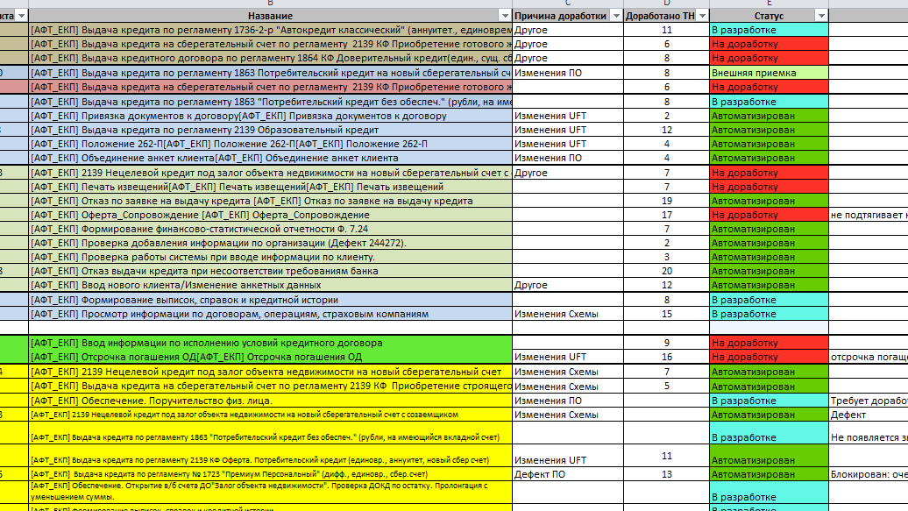
And what if I don’t have any tool at all?
Notes:
Don’t mind this picture please! It is here, because In my practice there were some projects without ANY task tracking system AT ALL. And it was forbidden to install one. So I used excel with VB addons I wrote. Just saying… Though I would recommend to find a freeware task-tracking system, there are plenty.

Slide 15
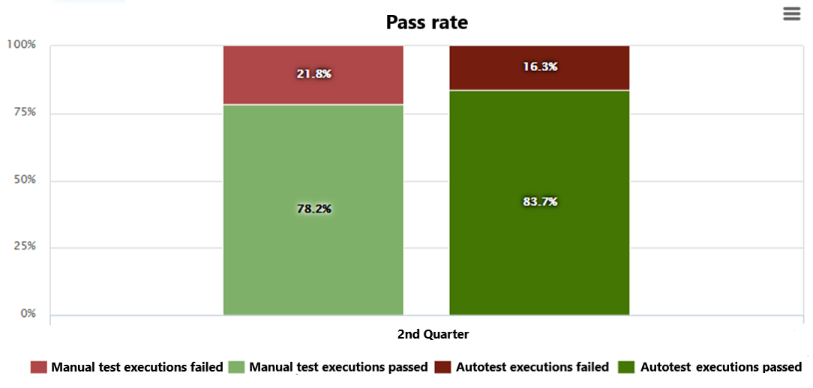
Metric Aggregator
Notes:
Also you should collect simple stats, like QA/AQA execution stats. Here we see more than 80 percentage passrate, which is fine. But It’s also near the fireline. So we should keep an eye on the progress.

Slide 16


SonarQube – Static Code Analyzer
The review is a lie,
but the QUBE is forever!
Notes:
Static code analyzers. Nothin’s better than a good ol robo! Never lies, always blames.

Slide 17
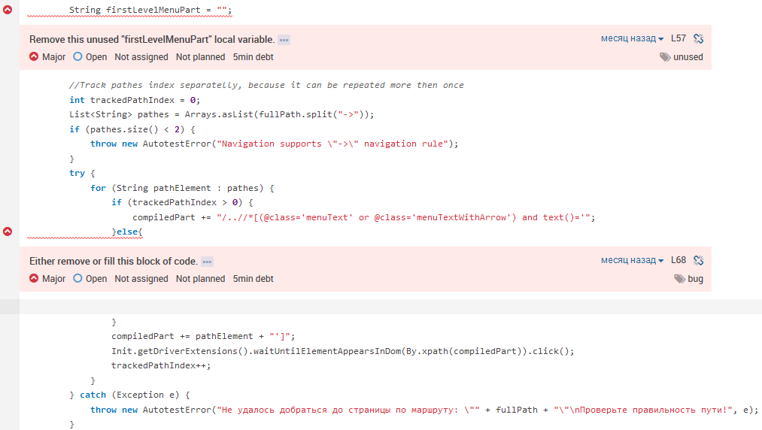
Example of the rules application
Notes:
This is an example of the rules application.
First error: local var firstLevelMenuPart is never used.
Second one: empty else block of code.
Actually you can manage severity level and turn on/off as many rules as you like and even create your own. That’s easy, just some reg exp rules related to you project.

Slide 18
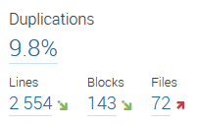
Core Metrics
Core metrics provided by instrument:
Duplications
Technical Debt
Technical Debt Ratio
Notes:
Sonar gathers all your code metrics for you. Here we see a summary. Core metrics are: Duplications, Tech. debt, Tech debt ratio.

Slide 19
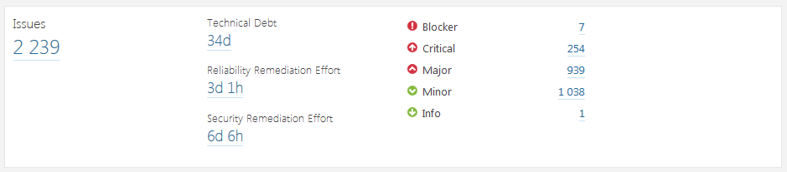
Technical Debt
Technical Debt counts in Sonar are based on SQALE (Software Assessment based on Lifecycle Expectations) methodology. Technical debt measurement is determined by summarizing technical debt points of every issue.
Amount of technical debt points for every issue is equivalent to its criticalness level.
Notes:
So, about tech. debt. It is an approximate time, which you’d have to spend to fix the issues you have in your code.

Slide 20
Technical Debt Ratio
Technical Debt Ratio: to put it simply, it is a ratio of efforts needed to get rid of technical debt VS efforts needed to rewrite the project from scratch. The last number is calculated based on amount of code lines and overall complexity. Project also gets SQALE rating based on this ratio:
А (0 – 5%)
B (6 – 10%)
C (11 – 20%)
D (21 – 50%)
E (lower than 50%)
Notes:
And tech debt ratio – is a ratio of the project development time to the technical debt. In other words, if it reached 100%, it’ll take less time to create new project from the scratch rather than refactor the old one.

Slide 21
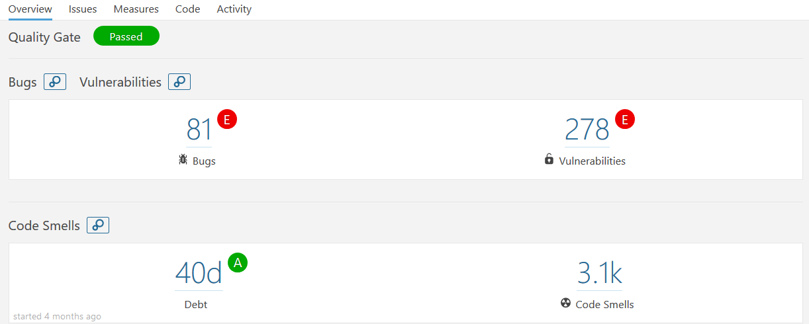
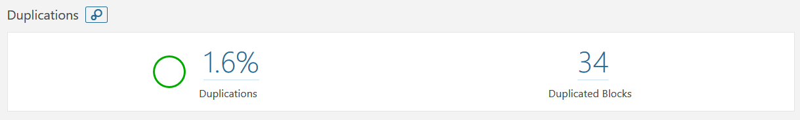
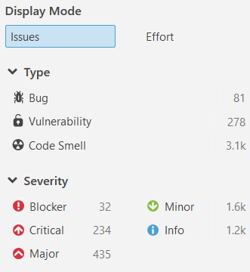
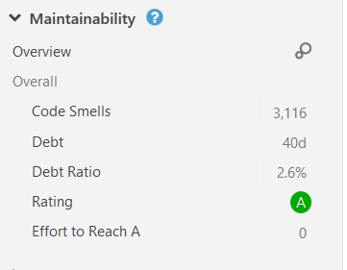
Project Example
Notes:
Here is another sonar dashboard example. You can click on any issue line and see matching line of code with an error in git. But it’s easier to stop those issues from getting in the code in the first place, right? So lets integrate SONAR scanner into the project merge request job.

Slide 22
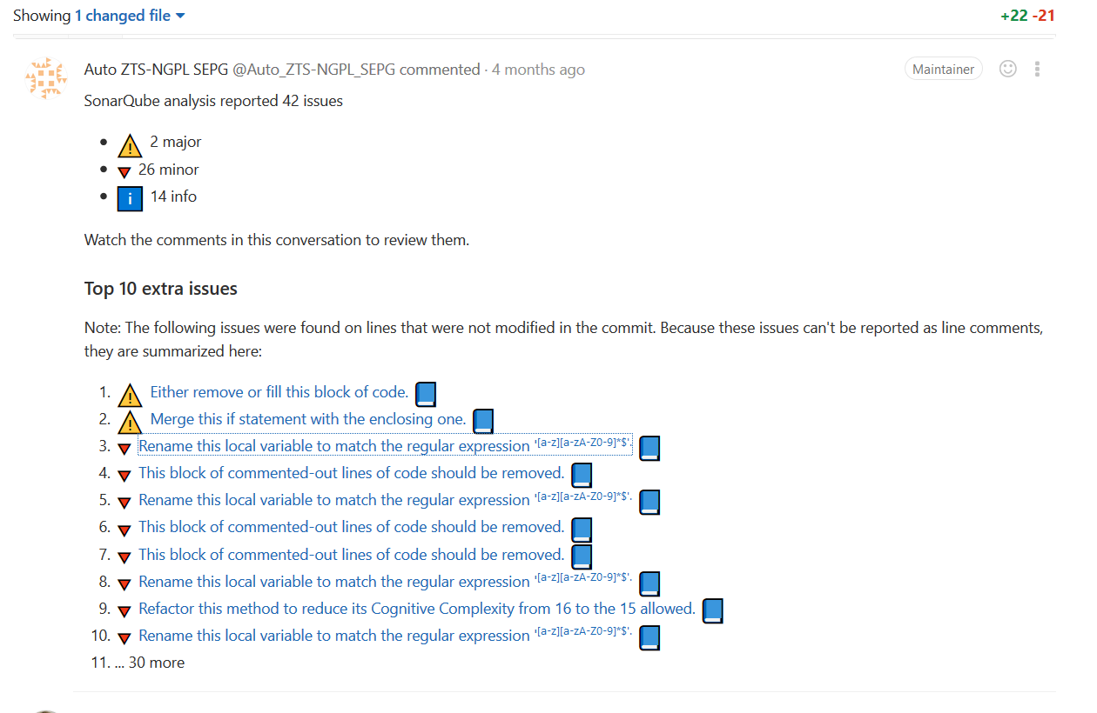
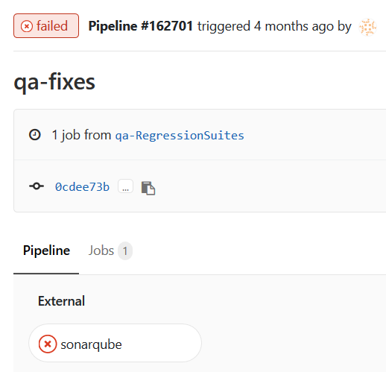

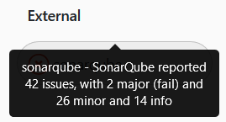
You shall not pass!
Notes:
That’s a merge request blocked by sonar. We can see some details. And most important, we can click on the list of issues. And see every issue representation RIGHT INSIDE the git. Easy and transparent. Of course, there are ways to trick sonar and merge the lame code no matter what… but just don’t do it, ok?) Sonar will find those in the code anyways, and I’ll find who did it!

Slide 23

Analyses Activities
Provide expert evaluation, divide problems by types
Gather statistics about the time loss on issues. Analyze the results
Notes:
Lets summarize our analysis chapter.

Slide 24

Therapy
Notes:
And here we came to problem solving. We have our diagnosis on our hands, so, where to start?

Slide 25

Problem Solving
Create backlog with tasks
Provide estimates
Plan first sprint
Review the result
Notes:
*Just read it*

Slide 26

PRIORITY= $\frac{Issue expenses for the period}{Estimated fix complexity}$
Notes:
Obviously, as we have stats about the time we are spending for every issue and estimated every issue fix complexity (in story points, I would recommend), we can just use this ratio as priority.

Slide 27

Problems and Solutions
Notes:
We’ve gathered some data. Lets put it to a good use. Next we’ll go though different types of problems with some typical examples of each one.

Slide 28
Administrative
Problem examples | Solution examples
Automation takes more than 6 hours on one VM | Order additional VMs
Manual QA team interferes with critical environment settings | Usually it’s a question of change windows. Also bring in the practice of prior team notifications, restrict access to the settings
Uncoordinated deployment breaks QA process | Change windows again, also its better to get special separate QA environment
Consolidation and communications
Environment management
Time management
Notes:
That’s for the manager of someone with communication skills. Those problems are about proving the necessity, arguing and reaching agreements. *mostly reading next*

Slide 29
Technical
Problem examples | Solution examples
Browser related problems | There is no common solution…
Problems with test model execution | Mostly it’s a test management system problems. Sometimes it is worth to replace it entirely. Sometimes its better to fix/replace your automation framework for better compatibility
Autotests passage takes too much time | Try to optimize code, avoid or replace with direct SQL/API calls the most time-consuming steps
Tool selection
Development
Refactoring
Notes:
Tech-are for engineers. Refactoring, pilots, tools developing. Honestly, there is no point to bring here any examples as there are unlimited number of unlimited variabilities. Yet I brought as few just to make things clear. *reading now*

Slide 30
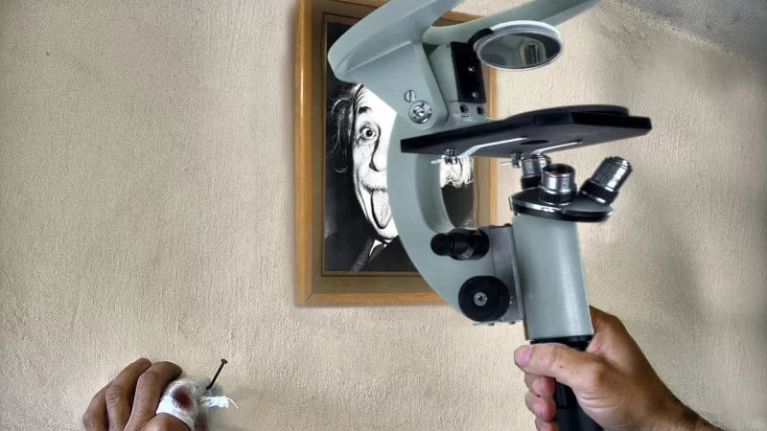
Choose your instruments!
Notes:
It is a COMMON delusion to use inproper tool due to political reasons… or a duck syndrome. For example, if you have a REACT-JS UI application it is better to automate it with Java-Script based framework rather than stick to a well-known java-selenium. Because there will be specific tools, it’ll be easier to maintain it and you won’t face a great deal of problems you would otherwise! Yet… You’d have to fight through heavy resistance from both engineers and management side. So that’s on you and your resOlve.

Slide 31
Model
Problem examples | Solution examples
There are more than 36 elementary actions in one test | Model decomposition
Lack of initial test data | Special tests for test data generations should be created
Small coverage | Test parametrization
Multiple verifications or asserts in one test | Select atomic operations, decompose tests
Lots of repeating actions | Universalize tests, make them reusable
Decomposition
Universalization
Parametrization
Notes:
Now this problem is usually equally related to both AQA and Manual QA test model. Changing approach may drastically lessen the time expenses on the testing process. *Reading now*

Slide 32
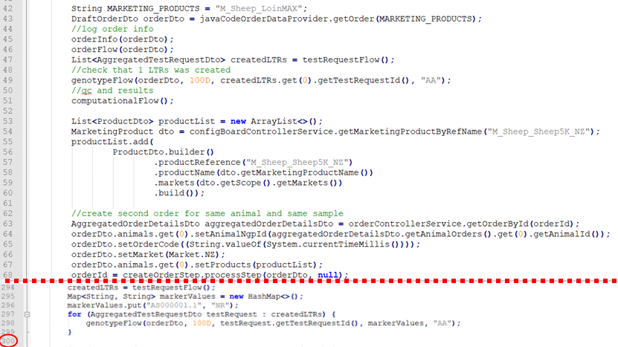
300
It was like this
Notes:
Let’s see how model-technical approach fix worked. Here we have a project and:
It’s unreadable
There are 300 lines of code (which means according amount of support time)
When I came to this project, engineers already had a solution in mind. So, basically, I did nothing but told “Hey, why don’t we give it a try?”. That’s why external expert and the initial brainstorm is so important.
The solution was to upgrade the framework and model to data-driven approach. Replace the hardcode with JSONs.

Slide 33
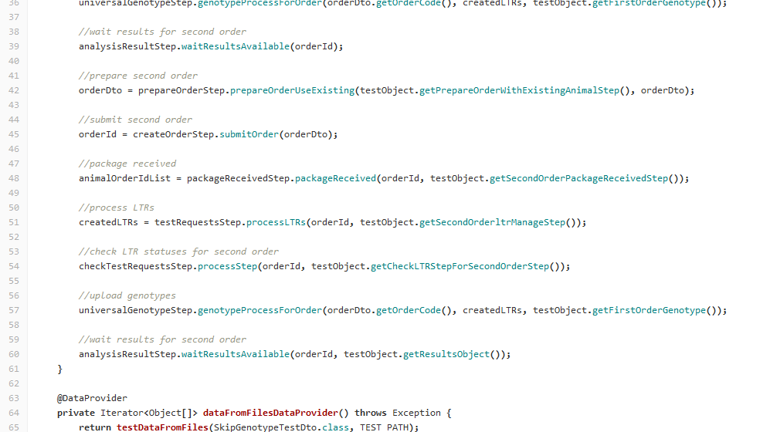
65
Now it is like this!
Notes:
And here is what we’ve got!
Easy to read
65 lines of code. Almost 5 times less. And that’s just one file, so multiply the result by the whole project.
Test coverage actually expended. We can create new JSON with test parameters whenever we want, testing more things.

Slide 34
January
April
February
Start a world war
Refactoring
Delete duplicates
Code optimization
Class Universalization
Model works
Model review
Test decomposition
Roadmap
Communications
Create change windows
Order new VMs
Notes:
Just one note: create the roadmap before you start. It should be high-leveled, as it would be changed in the process, but it is good when you have some goals and dates. Check the results on retro and see if you achieved the goal and did it bring the profit you expected.
This kind of activity we are talking about fits agile like no other, so you can change the goals according to the previous results. But to change the goals, you have to have them.
So go ahead and create a simple plan, it’ll take only about 10 minutes.

Slide 35
Therapy Activities
Task prioritizing
Draft RoadMap preparation
Appointing responsibilities, works organization
Fix it, fix it, fix it!
Notes:
Summary on therapy

Slide 36

Recurrence and Preventive Treatment
Notes:
About the recurrence. That is my personal pain.

Slide 37




Half a year after the survey
Year after the survey
Notes:
You see, first time I made a survey… Well, I took the feedback six months later. And it was brilliant. 600 human hours per month spent on support changed to 200. Time to develop new tests reduced and test coverage multiplied. Worked like magic!
But… a year after! Universal tests were broken. 50% of automated tests were unsuable. Copypaste, custom technical solutions, everything’s gone to hell!
I see you wonder what happened? The answer was simple: team rotation. New people came and broke down everything. The more system is complex, the more it is effective, but it is easier to break it or misuse it at the same time.

Slide 38

Documentation
Write down the rules on how to work and develop your system the right way, system capabilities, and create an intuitive Handbook
Save all best-practices on the handbooks pages
Create a registry!
Notes:
And so CREATE DOCUMENTATION. *Mostly reading*

Slide 39

Code Review
Ensure that everyone follows agreements. Watch for yourself and for “that guy”
Perform cross review on merge-requests
Notes:
“TODO should be done by thursday” – Two year ago I found this comment in repo. It was a 2013th comment.
To evade such problems we have code review practice. Don’t be scared to perform junior-senior and vice versa code review. As practice shows, junior often finds senior mistakes by simply asking “why did you do this?”. He is also learning at the same time. So… watch for yourself and for the “that guy”.

Slide 40

Healthcare
Regularly check the system state. Any deviation might quickly infect the whole project (by code and instruments which will rely on it, by other people taking example on it or simply by the copy-paste means)
Reserve at least 20% of all project time for maintenance
Notes:
*mostly reading*

Slide 41
Preventive Treatment Activities
Write down the agreements
Document the system
Keep track of its development
Recheck it on regular basis
Notes:
Summary

Slide 42

Summarizing!
Collect statistics
Watch the symptoms
Build a team if needed
Classify and prioritize problems
Focus on main problems
Check the results on retro
Write down best practices and agreements
Notes:
Final summary.

Slide 43
Questions?
Dmitrii_Leontev@epam.com
Leontyevdmitrya@gmail.com
Notes:
Links

