Slide 1

JDI LIGHT
FEEL THE POWER OF THE JDI LIGHT

Slide 2





ROMAN IOVLEV
Chief QA Automation
JDI Evangelist
Almost 14 years in Testing
More than 12 years in Test Automation
http://roman-iovlev.info/
roman.Iovlev
roman.Iovlev.jdi@gmail.com
2

Slide 3


JDI Framework
JDI Light
Simple to use test Automation Framework
Based on UI Elements (Buttons, Forms etc.)
Fast and stable tests execution
User friendly logs and reports with no effort
[since 2015]
JDI Dark
Web Services testing Framework powered by Rest Assured
JDN
Simple and modern
Page Objects Generator
JDI Mobile
UI Test Framework for Mobile
JDI Desktop
UI Test Framework for Desktop
3

Slide 4
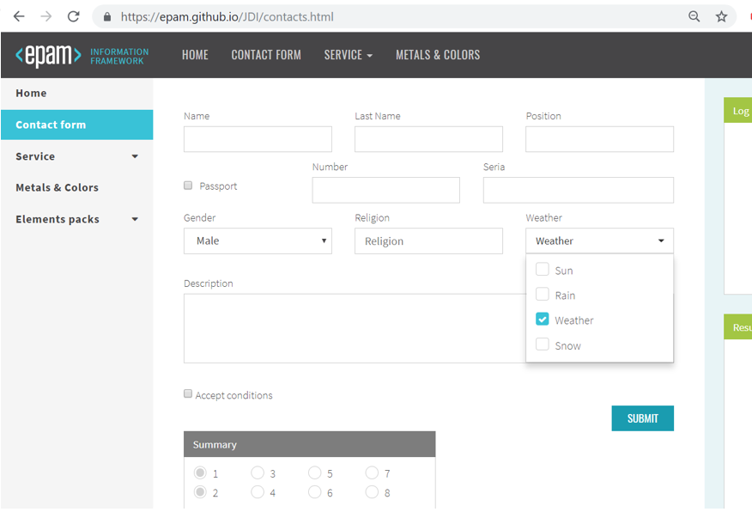
PAGE OBJECTS
Composite
Header
Main Section
Complex
Menu
Odd Radio buttons
Weather Multiselect
Simple
Name Textfield
Passport checkbox
Description textarea
4

Slide 5
UI PAGE OBJECTS
@JSite( “https://epam.github.io/JDI/ ")
public class EpamSite {
@Url ("/index.html”)
public static HomePage homepage;
public static ContactPage contactPage;
}
@BeforeSuite(alwaysRun = true)
public static void setUp() {
initElements(EpamGithubSite.class);
}
@Url("/contact/%s”) @Title(“Contact Form")
public class ContactPage extends WebPage {
@FindBy(id=“#Name”) public TextField name;
@Css(“#LastName”) public TextField lastName;
@UI(“[‘Submit’]”) public Button submit;
}
open()
back()/ forward()
refresh()/ reload()
clearCache()/ addCookie()
String getHtml()
zoom(double factor)
5

Slide 6
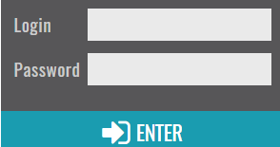

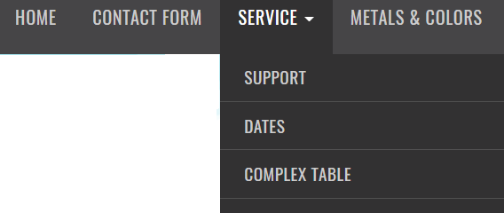
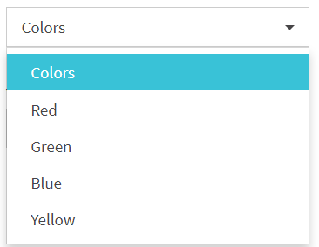
UI ELEMENTS
@FindBy(id = “jdi-logo”)
public static Image jdiLogo;
public class LoginForm extends Form<User> {
TextField login, password;
Button enter;
}
@Css(“#colors”) public Dropdown colors
@XPath(“//*[@id=‘nav’][text=‘%s’]”)
public Menu navigation;
@UI(“#nav[‘%s’]”) public Menu navigation;
6

Slide 7


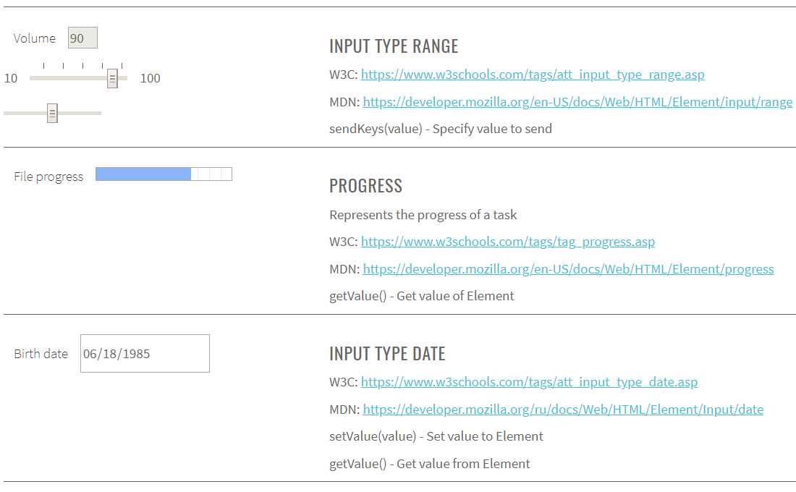
HTML ELEMENTS
HTML elements pack
Bootstrap elements
Angular collections
React collections
Vue collections
Telerik (KendoUI)
https://epam.github.io/JDI/html5.html
7

Slide 8
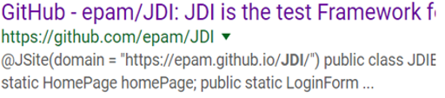
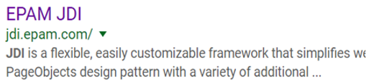
List OF SECTIONS
public class SearchResult extends Section {
@Title public WebElement label;
public WebElement link;
public WebElement description;
…
}
List<Section> = Elements in JDI
T get(String name/int index)
MapArray<String, T> getMap()
List<E> asData(Class<E> entityClass)
Get Section by name/index
Get all elements as Map
Get All elements as List of Sections
8

Slide 9
List OF SECTIONS EXAMPLES
@UI(“.g”) List<SearchResult> results;
Assert.assertContains(results.get(5).description.getText(), “JDI some text”);
results.get(“EPAM JDI”).link.click();
results.assertThat().value(expetedValue);
results.assertThat().any(e -> e.name.toLowerCase().contains(“epam jdi"));
results.assertThat().each(e -> e.name.toLowerCase().contains("jdi"))
|| e.description.contains(“jdi"));
results.assertThat().onlyOne(e -> e.name.contains("EPAM JDI"));
results.assertThat().noOne(e -> e.name.contains("SELENIDE"));
9

Slide 10

ELEMENT ASSERTS
redButton.assertThat().text(is(“Submit”));
notification.is().displayed();
teaser.assertThat().text(containsString(“JDI is Awesome"))
.cssClass(is(“jdi-teaser")).attr("type", is(“submit"));
results.is().notEmpty();
results.assertThat().values(hasItem(“JDI"));
Powered by Hamcrest
No more waits!
Compare to Selenide and Selenium asserts
10

Slide 11
NO PAGE OBJECTS STYLE
@Test
public void nonPageObjectTest() {
WebPage.openUrl("https://epam.github.io/JDI/index.html");
$("img#user-icon").click();
$("form #name").input("epam");
$("form #password").input("1234");
$("form [type=submit]").click();
Assert.assertEquals(WebPage.getUrl(), "https://epam.github.io/JDI/index.html");
}
11

Slide 12



1
Reduce AMOUNT OF CODE in 5-30 times

Slide 13
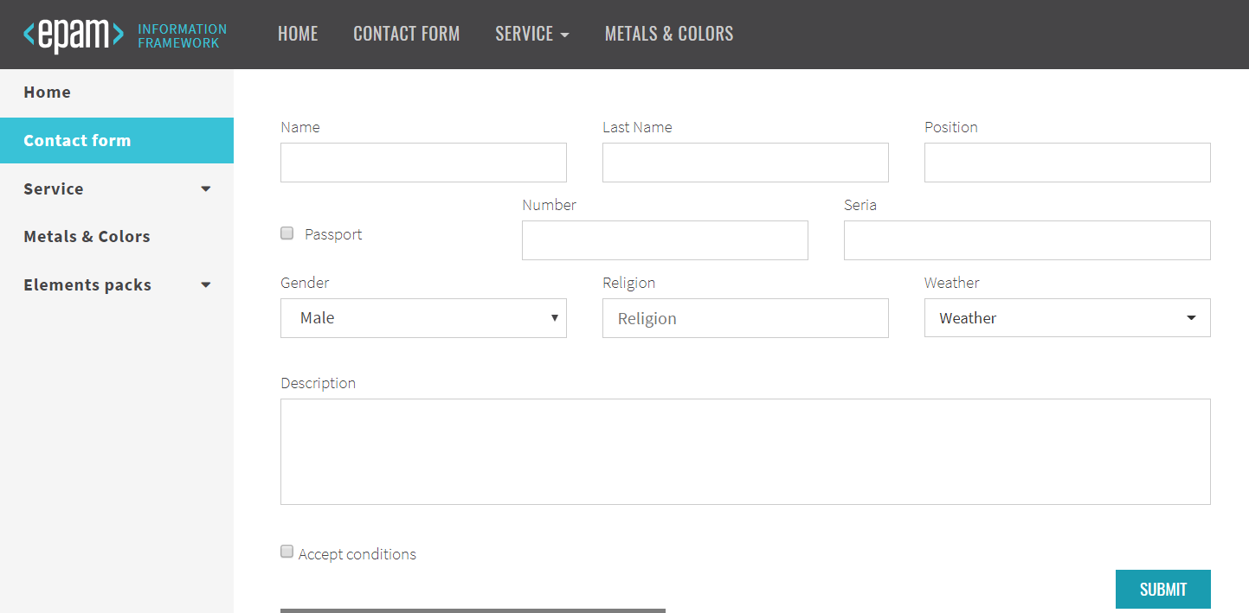
FORM EXAMPLE
13

Slide 14

Reduce AMOUNT OF CODE
public class ContactForm {
@FindBy(xpath = "//div[contains(@class,'contacts')]//*[text()='Name']")
public WebElement name;
@FindBy(xpath = "//div[contains(@class,'contacts')]//*[text()='Family Name']")
public WebElement familyName;
@FindBy(xpath = "//div[contains(@class,'contacts')]//*[text()='Passport Id']")
public WebElement passId;
@FindBy(xpath = "//div[contains(@class,'contacts')]//*[text()='Passport Number']")
public WebElement passNum;
...
@FindBy(xpath = "//div[contains(@class,'contacts')]//*[text()=‘Accept’]")
public WebElement accept;
@FindBy(xpath = "//div[contains(@class,'contacts')]//button[text()='Submit']")
public WebElement submitButton;
public void submit(String name, String familyName, String passportId,
String passportNumber, ...., Boolean accept) {
this.name.sendKeys(name);
this.familyName.sendKeys(familyName);
this.passportId.sendKeys(passportId);
this.passportNumber.sendKeys(passportNumber);
...
if (accept && !this.accept.isSelected() ||
!accept && this.accept.isSelected())
this.accept.click();
submitButton.click();
}
}
14

Slide 15


Reduce AMOUNT OF CODE
public class ContactForm {
public void submit(String name, String familyName, String passportId,
String passportNumber, ...., Boolean accept) {
$("//div[contains(@class,'contacts')]//*[text()='Name']").sendKeys(name);
$("//div[contains(@class,'contacts')]//*[text()='Family Name']").sendKeys(familyName);
$("//div[contains(@class,'contacts')]//*[text()='Passport Id']").sendKeys(passportId);
$(“//div[contains(@class,'contacts')]//*[text()='Passport Number']").sendKeys(passportNumber);
...
SelenideElement accept = $("//div[contains(@class,'contacts')]//*[text()=‘Accept’]")
if (accept && !this.accept.isSelected() ||
!accept && this.accept.isSelected())
$("//div[contains(@class,'contacts')]//button[text()='Submit']") .click();}
}
public void check(String name, String familyName, String passportId,
String passportNumber, ...., Boolean accept) {
assertEquals($("//div[contains(@class,'contacts')]//*[text()='Name']").getText(), name);
assertEquals($("//div[contains(@class,'contacts')]//*[text()='Family Name']").getText(), familyName);
assertEquals($("//div[contains(@class,'contacts')]//*[text()='Passport Id']").getText(), passportId);
assertEquals($(“//div[contains(@class,'contacts')]//*[text()='Passport Number']").getText(), passportNumber);
15

Slide 16


Reduce AMOUNT OF CODE
?
Ability to fill and submit form of 10 elements
And verify that this form filled correctly takes
40-45 lines of code
16

Slide 17
Reduce AMOUNT OF CODE
public class ContactForm {
@FindBy(xpath = "//div[contains(@class,'contacts')]//*[text()='Name']")
public WebElement name;
@FindBy(xpath = "//div[contains(@class,'contacts')]//*[text()='Family Name']")
public WebElement familyName;
…
}
…
public void submit(String name, String familyName, String passportId, ...., Boolean accept) {
this.name.sendKeys(name);
this.familyName.sendKeys(familyName);
...
if (accept && !this.accept.isSelected() ||
!accept && this.accept.isSelected())
this.accept.click();
submitButton.click();
}
}
17

Slide 18
Reduce AMOUNT OF CODE
public class ContactForm extends Form<Contacts> {
@FindBy(xpath = "//div[contains(@class,'contacts')]//*[text()='Name']")
public WebElement name;
@FindBy(xpath = "//div[contains(@class,'contacts')]//*[text()='Family Name']")
public WebElement familyName;
…
}
@FindBy(css = “div.contacts")
public ContactForm contactForm;
public class ContactForm extends Form<Contacts> {
@FindBy(xpath = "//*[text()='Name']") public WebElement name;
@FindBy(xpath = "//*[text()='Family Name']") public WebElement familyName;
…
}
18

Slide 19

Reduce AMOUNT OF CODE
public class ContactForm extends Form<Contacts> {
@UI("['Name']") WebElement name;
@UI("['Family Name']") WebElement familyName;
…
}
public class ContactForm extends Form<Contacts> {
UIElement name = $("['Name']");
UIElement familyName = $("['Family Name ']"); …
…
}
public class ContactForm extends Form<Contacts> {
@XPath("//*[text()='Name']") WebElement name;
@XPath("//*[text()='Family Name']") WebElement familyName;
…
}
submitContactForm(“Roman”, “Iovlev”, “123456”, ... , true);
contactForm.submit(ROMAN);
19

Slide 20


Reduce AMOUNT OF CODE
public class ContactForm {
@FindBy(css = "//div[contains(@class,'contacts')]//*[text()='Name']")
public WebElement name;
@FindBy(css = "//div[contains(@class,'contacts')]//*[text()='Family Name']")
public WebElement familyName;
@FindBy(css = "//div[contains(@class,'contacts')]//*[text()='Passport Id']")
public WebElement passId;
@FindBy(css = "//div[contains(@class,'contacts')]//*[text()='Passport Number']")
public WebElement passNum;
...
@FindBy(css = "//div[contains(@class,'contacts')]//*[text()=‘Accept’]")
public WebElement accept;
@FindBy(css = "//div[contains(@class,'contacts')]//button[text()='Submit']")
public WebElement submitButton;
public void submit(String name, String familyName, String passportId,
String passportNumber, ...., Boolean accept) {
this.name.sendKeys(name);
this.familyName.sendKeys(familyName);
this.passportId.sendKeys(passportId);
this.passportNumber.sendKeys(passportNumber);
...
if (accept && !this.accept.isSelected() ||
!accept && this.accept.isSelected())
this.accept.click();
submitButton.click();
}
}
4X
20X
public class ContactForm extends Form<Contacts> {
@UI("['Name']") WebElement name;
@UI("['Family Name']") WebElement familyName;
@UI("['Passport Id']") WebElement passtId;
@UI("['Passport Number']")WebElement passNum;
...
@UI("['Name']") WebElement accept;
@UI(“['Submit']") WebElement submitButton;
}
public class ContactForm extends Form<Contacts> {
WebElement name, familyName, passtId, passNum,
... accept, submitButton;
}
10
40-45
2
20

Slide 21
SMART LOCATORS
public class Contacts extends Form<User> {
@Css(“#name”) WebElement name;
@Css(“#last-name”) WebElement lastName;
@Css(“#gender”) WebElement gender;
@Css(“#city”) WebElement city;
@Css(“[ui=address]”) WebElement address;
@Css(“[ui=state]”) WebElement state;
@XPath(“#submit-button”) WebElement submitButton;
}
public class Contacts extends Form<User> {
TextField name, lastName, gender, city,
address, state;
Button submitButton;
}
public class Contacts extends Form<User> {
WebElement name, lastName, gender, city, address, state, submitButton;
}
21

Slide 22
IN ELEMENT ACTIONS
ACTIONS
new Actions(driver)
.clickAndHold().release()
.build().perform();
myInput.doActions(a ->
a.clickAndHold().release());
new Actions(driver)
.moveToElement(myInput)
.click().keyDown(Keys.SHIFT)
.sendKeys("hello")
.build().perform();
myInput.do(a ->
a.click().keyDown(Keys.SHIFT)
.sendKeys("hello"));
Java SCRIPT
((JavascriptExecutor) driver).executeScript
("arguments[0].click();", myButton);
myButton.jsExecute(“click()”)
22

Slide 23
ALSO Reduce CODE
Remove all Thread.sleep / waitUntil / waitPageLoad etc.
Reduce code for Tables, Dropdowns and other Complex elements
Remove most of logger strings in code
Simplify locators
Driver Manager: Auto-download driver
23

Slide 24

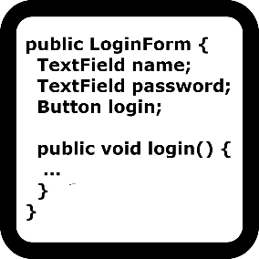

2
JDN: UI OBJECTS GENERATOR
WRITE TESTS in MINUTES

Slide 25
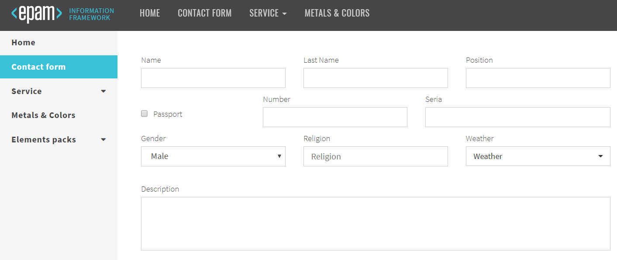
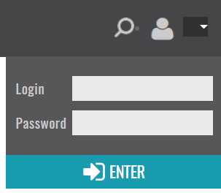
JDN
25

Slide 26
JDN DEMO
1. Open EpamGithub site https://epam.github.io/JDI
2. Click user icon
3. Login as User (name: epam, password: 1234)
4. Select Contacts page in sidebar menu
5. Check that Contacts page opened
6. Submit contacts form with:
gender = "Male"; religion = "Other"; wheather = "Sun, Snow"; passport = "true"; name = "Roman"; lastName = "Iovlev"; position = "QA Automation"; number = "4321"; seria = "123456"; description = "JDI awesome";
7. Check that contact form filled with expected data:
gender = "Male"; religion = "Other"; wheather = "Sun, Snow"; passport = "true"; name = "Roman"; lastName = "Iovlev"; position = "QA Automation"; number = "4321"; seria = "123456"; description = "JDI awesome";
26

Slide 27

GUESS HOW LONG IT WILL TAKE FOR YOU
> 8h
1-2 h
4-8 h
< 1 h
2-4 h
10-20 min
27

Slide 28
JDN DEMO
28

Slide 29
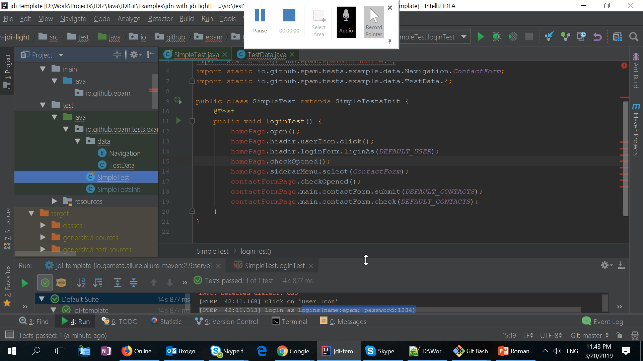
JDN DEMO
27

Slide 30
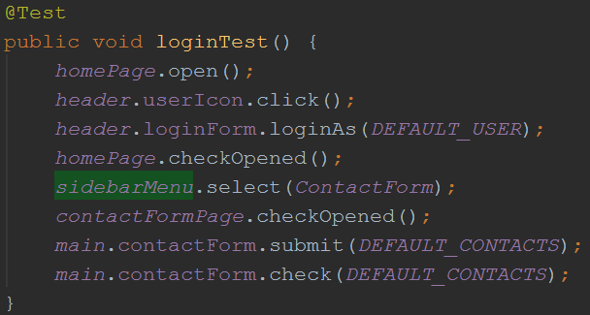
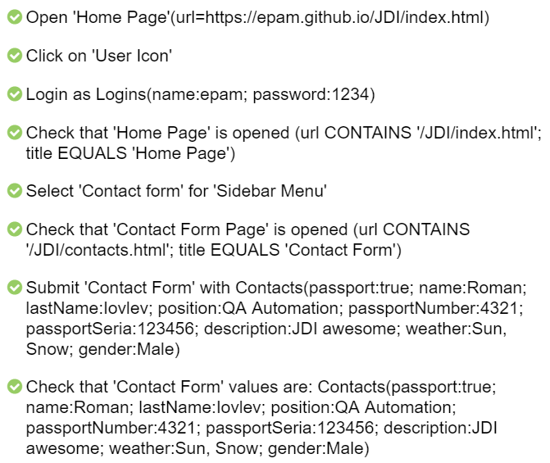
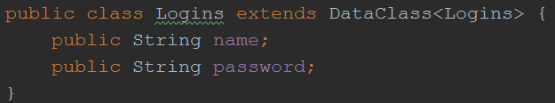
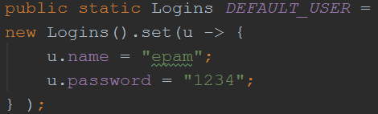
BEFORE GENERATION
30

Slide 31
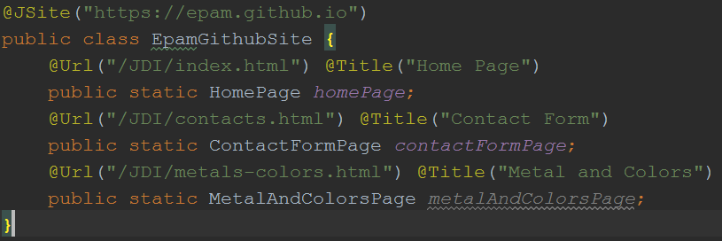
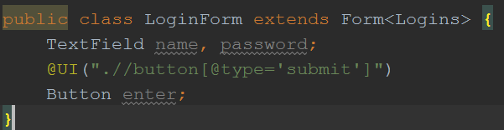
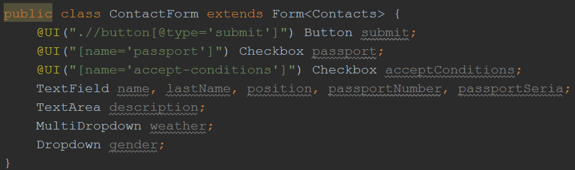
GENERATED PAGE OBJECTS
31

Slide 32
WRITE TESTS IN MINUTES
Generate PageObjects via JDN and place in appropriate folder
Add test data (DEFAULT_USER, DEFAULT_CONTACTS)
Write simple test code
15 sec
2-3 minutes
1-2 minutes
@Test
public void loginTest() {
homePage.open();
header.userIcon.click();
header.loginForm.loginAs(DEFAULT_USER);
homePage.checkOpened();
leftMenu.select(ContactForm);
contactFormPage.checkOpened();
main.contactForm.submit(DEFAULT_CONTACTS);
main.contactForm.check(DEFAULT_CONTACTS);
}
< 5 mins
32

Slide 33
RULES
Rules
<input type=“button” value=“Next”>
<input type=“button” value=“Previous”>
<button class=“btn”>Submit</button>
"type":"Button",
"name": “value",
"css": “input[type=button]“
"type":"Button",
"name": “text",
"css": “button.btn"
@Findby(css=“input[type=button][value=Next]”)
public Button next;
@Findby(css=“input[type=button][value=Previous]”)
public Button previous;
@Findby(xpath=“//button[@class=‘btn’
and text()=‘Submit’]”)
public Button submit;
33

Slide 34

3
Business LOGS and
REPORTS
GET CLEAR AND OBVIOUS RESULTS

Slide 35

LOGS AND REPORTING
LOGS
[ STEP 53:25.314] : Open 'Home Page'(url=https://epam.github.io/JDI/index.html)
[ STEP 53:29.616] : Click on 'User Icon'
[ STEP 53:29.760] : Login as User(name:epam; password:1234)
[ STEP 53:30.307] : Check that 'Home Page' is opened (url CONTAINS '/JDI/index.html'; title EQUALS 'Home Page')
[ STEP 53:30.330] : Select '[Contact form]' in 'Left Menu'
[ STEP 53:31.176] : Check that 'Contact Form Page' is opened (url CONTAINS '/JDI/contacts.html'; title EQUALS 'Contact Form')
[ STEP 53:31.202] : Submit 'Contact Form' with Contacts(gender:Male; weather:Sun, Snow; passport:true; name:Roman; lastName:Iovlev; position:QA Automation; passportNumber:4321; passportSeria:123456; description:JDI awesome)
[ STEP 53:33.043] : Check that 'Contact Form' values are: Contacts(gender:Male; weather:Sun, Snow; passport:true; name:Roman; lastName:Iovlev; position:QA Automation; passportNumber:4321; passportSeria:123456; description:JDI awesome)
35

Slide 36
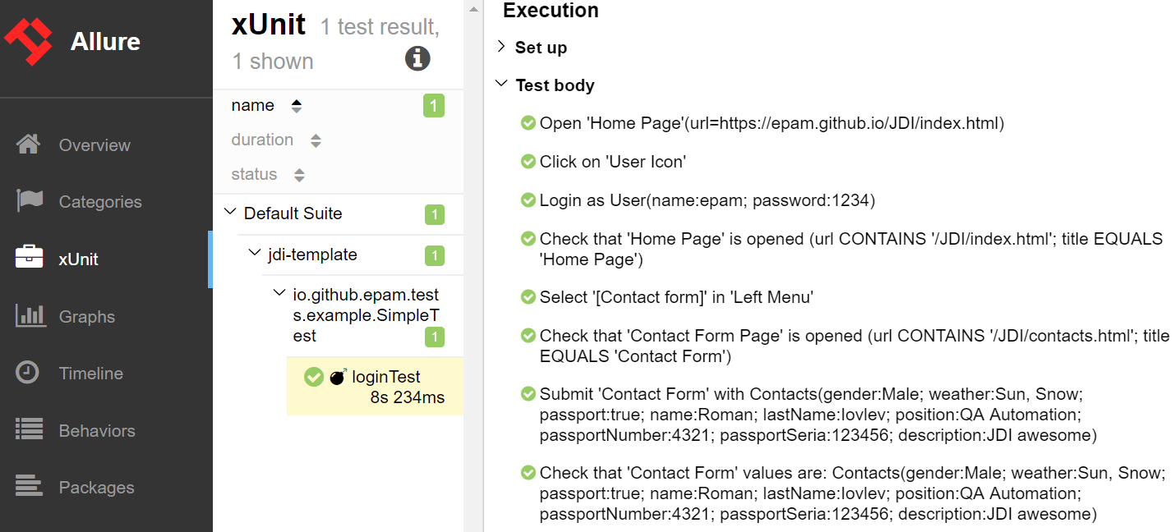
LOGS AND REPORTING
36

Slide 37


4
STABLE AND FAST
INCREASE TRUST TO RESULTS
REDUCE MAINTENANCE EFFORT

Slide 38






STABLE
1. No more false negative
Write Less code
2. No Thread sleeps or
other waits
Increase trust to your tests and to testing as practice
Saves up to 50-80% of waste engineers effort on bug analyses
Increase tests execution speed
38

Slide 39
FAST TEST EXECUTION
?
Textarea input 3000 symbols
Dropdown 300 values
Table with 400 rows (4 columns)
https://epam.github.io/JDI/performance.html - for login use epam/1234
39

Slide 40



FAST TEXTFIELD AND DROPDOWN
…
JDIPerformanceTests.CS
Textarea input 3000 symbols
170X
~96ms
~17 seconds
Dropdown with 300 values
50X
~250ms
~12,5 seconds
40

Slide 41
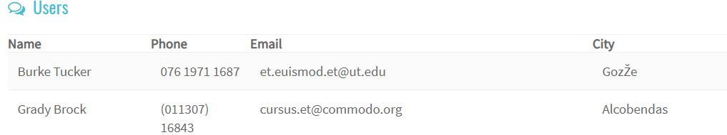
FAST TABLE EXAMPLE
https://epam.github.io/JDI/performance.html
JDIPerformanceTests.CS
400
~5 seconds
usersTable.assertThat().hasRowWithValues(
containsValue(“Brock", inColumn("Name")),
containsValue(".org", inColumn("Email")));
5X
~900ms
41

Slide 42


5
Jdi is simple

Slide 43
SIMPLE TO START FROM SCRATCH
Simple to setup
  Just add dependency in your project or use predefined Project Templates
Simple to learn and write tests
  Native UI Elements based interface
  Well documented (will be available at April-May 2019)
  Lot of real examples
Simple to maintain
  Native tests, No false negatives, No waits, detailed logs and reporting
Simple to customize
  Flexible to customization on all levels
Simple to integrate
  Templates for integration with popular tools
43

Slide 44


SIMPLE TO IMPROVE SELENIUM PROJECTS
Already have thousands of Selenium tests?
1. Change dependency
<dependency>
<groupId>com.epam.jdi</groupId>
<artifactId>jdi-light</artifactId>
<version>RELEASE</version>
</dependency>
dependencies {
compile 'com.epam.jdi:jdi-light:+'
}
2. Init your page objects with JDI Light
import static com.epam.jdi.light.ui.html.PageFactory.initElements;
PageFactory.initElements(driver, HomePage.class);
See https://github.com/jdi-examlples/jdi-selenium > branch switch-selenium-to-jdi
44

Slide 45
JDI Light
HIGHLIGHTS
45

Slide 46
JDI LIGHT HIGHLIGHTS
Simple to start and use. Simple to switch from Selenium
Cool typified elements that native for your application and has a lot of cool unique features out of the box
Stable and predictable test results
Good logs and reports out of the box
Helps to reduce amount of code (LOC) in times
Increase test’s development speed and test run’s performance
46

Slide 47


START AND INTEGRATION
Our projects: https://github.com/jdi-testing/
Templates: https://github.com/jdi-templates/
Examples: https://github.com/jdi-examples/
Documentation: https://jdi-docs.github.io/jdi-light/ (will be available at April-May 2019)
Powered by Selenium
Use Hamcrest, log4j and Allure
Easy integration with Selenium Grid, Selenoid, BrowserStack etc.
Hamcrest matchers
47

Slide 48

JDI PRODUCTS
https://github.com/epam/jdi
JDI original
Since 2015
https://github.com/jdi-testing/jdi-2.0
JDI 2.0
Autumn 2017
https://github.com/jdi-testing/jdi-light
JDI Light
Spring 2018
https://github.com/jdi-testing/jdi-http
JDI Dark
Autumn 2017
https://github.com/jdi-testing/jdi-flash-pages
JDN
Spring 2018
https://github.com/jdi-testing/jdi-lightsaber
JDI LightSaber
Since 2016
48

Slide 49

ULTIMATE GOAL
Use AI for PageObjects generation and self-healing; test cases and test data generation; smart tests execution and analyzes
Increase testing tool efficiency and reduce time on routines dramatically
I hope you’ll join us
Imagine there's no, time wasting
It isn't hard to do
No matter what are you testing
And logs are clear too
Imagine all applications tested by AI…
You-u-u-u
You may say I'm a dreamer
But I'm not the only one
I hope someday you'll join us
And the world will have a fun
49

Slide 50

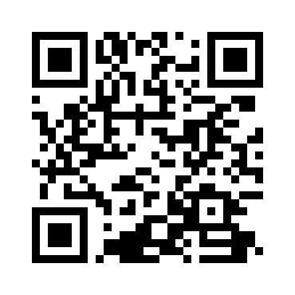


Q & A
http://roman-iovlev.info/
roman.Iovlev
https://join.skype.com/u2Cel0MWHkAO
roman.Iovlev.jdi@gmail.com
https://jdi-docs.github.io/jdi-light
50

Slide 51


X
APPENDIX:
MORE COOL FEATURES

Slide 52
XPATH OR CSS LOCATORS?
@FindBy(xpath = “…”)
@FindBy(css = “…”)
//*[contains(@class,’user’)]//*[@value=‘Roman’]
//div[@name=’product’]//*[contains(class(),‘toast’)]
//*[@id=’product’]/*[@type=‘checkbox’]
//*[@class=’ice-cream’]//*[@type=‘text’]
.user [value=Roman]
div[name=product] .toast
#product [type=checkbox]
.ice-cream [type=text]
BUT…
52

Slide 53
UI LOCATORS
@FindBy(xpath = “…”)
@UI(“…”)
//*[contains(@class,’user’)]//*[text()=‘Roman’]
//div[@name=’product’]//*[contains(text(),‘Toast’)]
//*[@category=’product’][2]
//*[text()=’Ice Cream’]/..//*[type=‘checkbox’]
.user[‘Roman’]
div[name=product][*‘Toast’]
[category=product][2]
[’Ice Cream’]<[type=checkbox]
public void selectMenu(String value) {
driver.findElement(
By.cssSelector(“[value=“ + value + ”]”)).click();
}
selectMenu(“About”)
@Css(“[value=%s]”) WebElement menu;
menu.select(“About”)
53

Slide 54
MANAGE WINDOWS
WindowsManager
WindowsAndFramesTests.cs
getWindows()
newWindowIsOpened()
setWindowName(String name)
windowsCount()
switchToNewWindow()
openNewTab()
originalWindow()
switchToWindow(int number)
switchToWindow(String name)
closeWindow()
closeWindow(String name)
return all WindowHandles
return true if new window opened
Set specific name for current window
return count of opened windows
switches to latest opened window
open new window
switch to first window
switch to window by number
switch to window by name
close current window
close window by name
54

Slide 55
MANAGE ALERTS
WindowsManager
WindowsAndFramesTests.cs
acceptAlert()
declineAlert()
getAlertText()
sendKeysInAlert(String text)
Alert alert()
accept alert
decline alert
get alert text
Input text in alert text field
get alert instance
55

Slide 56

UI ELEMENTS
UIElement = WebElement
jsClick();
setText(String value);
getText();
input(String text);
setAttribute(String name, String value);
select(String name);
setValue(String value);
show();
hover();
scrollUp/Down/Left/Right(int value)
higlight() / higlight(String color)
find(By) / find(String) / finds(String)
printHtml()
isDisabled() / isHidden()
dragAndDropTo(WebElement) (x, y)
doubleClick()
rightClick()
select() -> new Select(myElement)
56

Slide 57
Web LIST FILTERS
WebList = List<WebElement>
WebElement get(String)
void select(String/Int)
String getValue()
Get element by text value
Click on element with text/int value
Print list values
public void HeaderLine {
@Css(“#navigation”) public List<WebElement> menu;
@Css(“#navigation[item=%s]”) public WebList menu;
@Css(“#navigation”) public WebList menu;
}
57

Slide 58
WEB LIST FILTERS
WebList = List<WebElement> + stream()
WebElement first/last()
T first/last(JFunc1<T, Boolean> condition)
List<T> where/filter(JFunc1<T, Boolean> condition)
<R> List<R> select/map(JFunc1<T, R> transform)
void ifDo(JFunc1<T, Boolean> condition, JAction1<T> action)
List<R> ifSelect(JFunc1<T, Boolean> c, JFunc1<T, R> t)
void foreach(JAction1<T> action)
boolean any(JFunc1<T, Boolean> condition)
boolean all(JFunc1<T, Boolean> condition)
List<T> listCopy(int from[, int to])
List<R> selectMany(JFunc1<T, List<R>> func)
Get first/last element
Get first/last element by condition
Filter elements by condition
Transform all elements using template
Do action in case of condition true
Transform all elements that suit to condition
Do action for all elements
True if at least one of elements suit condition
True if all elements suit condition
Copy part of list
Transform List of list to list
58

