Slide 1

PRISMA®
Practical Risk-Based Testing
also for Agile projects
Erik van Veenendaal www.erikvanveenendaal.nl

Slide 2

Testing Challenges
Increasing importance and size of software in society as a whole
High Competition
Testing often takes 30 - 40% of project costs
Risk-based testing deals with both effectiveness and efficiency

Slide 3

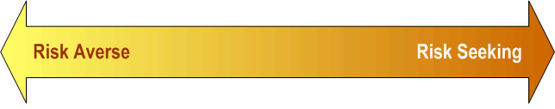
What is Risk?
“A factor that could result in a future negative consequence; usually expressed as impact and likelihood” (ISTQB)
Identify the risks and provide status information

Slide 4

Testing = Risk Management
Most feasible coverage
effective usage of limited resources & optimize test effort
Right level and type of coverage on the right parts at the right time
Always applicable!
Staffing, Time Configurations

Slide 5
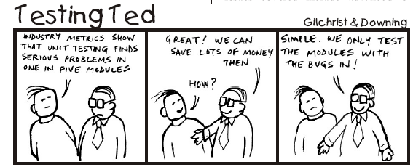
The Challenge….
if only we knew !!

Slide 6
Risk-Based Testing
Risk identification what the risks are and where they are
Risk analysis critical, complex and error prone areas
Build tests to mitigate the risks
Monitor and report regarding the risks

Slide 7








Practical Experiences
7

Slide 8
Risk Identification
Split up in functional and/or technical items
Higher level test according to requirements
Lower levels test according to components
Agile: backlog items for next sprint
Risk item 1 | Functionality
Risk item 2 | Security
Risk item 3 | Functionality
Risk item 4 | Interoperability

Slide 9
Risk Analysis
Risk = impact x likelihood
Determine factors based on previous projects, e.g., defect patterns
Business
Defects
Likelihood
technical risk
You already know this !
Impact – business risk

Slide 10

Exercise Factors
What factors affect risk?
a) What factors do you think affect the likelihood of defects in a (part of a) product? Discuss and make a list ….
b) What factors do you think affect the business importance of a (part of a) product, e.g., the impact of a defect? Discuss and make a list …

Slide 11
Factors From Practice
defect patterns / history
Likelihood
complexity
new development (level of re-uses)
interfacing
number of changes
technology
geographical spread
inexperience (of team)
Impact
business importance (“selling item”)
financial (or other) damage (e.g., safety)
usage intensity
external visibility
cost of rework
Customization
required
Weightings
can be applied

Slide 12

Risk Assessment - Nutshell (1)
Stakeholder analysis: Assigning Factors
Individual scoring
 | Business importance | Usage intensity | Safety
Item 1
Item 2
Item 3
Item 4
Item 5
5
5
they shall make choices
5
4
5
4
5
2
1
4

Slide 13
Risk Assessment - Nutshell (2)
Consensus meeting
Position the risk items in a Product Risk Matrix
 | Likelihood |  |  |  |  |  | Impact
 | Complexity | New development | Interfacing | Technology | Experience level |  | Business import. | Usage intensity | Safety
Item 1 | 5 | 3 | 2 | 1 | 5 | 16 | 5 | 4 | 1 | 10
Item 2 | 2 | 1 | 2 | 1 | 2 | 8 | 3 | 3 | 1 | 7
Item n

Slide 14
Product Risk Matrix
25
Medium
High
Low
Medium
Risk
focus of development testing
X1
focus of acceptance testing
15
Likelihood
X2
5
3
9
15
Impact

Slide 15

Differentiated Test Approach !!
Test design techniques
Reviews
Test design start-up meetings
Reviews of test design
Level detail test cases
Exit (DoD) criteria, e.g., coverage
Level of independence
More time & effort
Most experienced person
Priority setting
Regression testing
Re-testing
without this a risk session
doesn’t make much sense !!

Slide 16
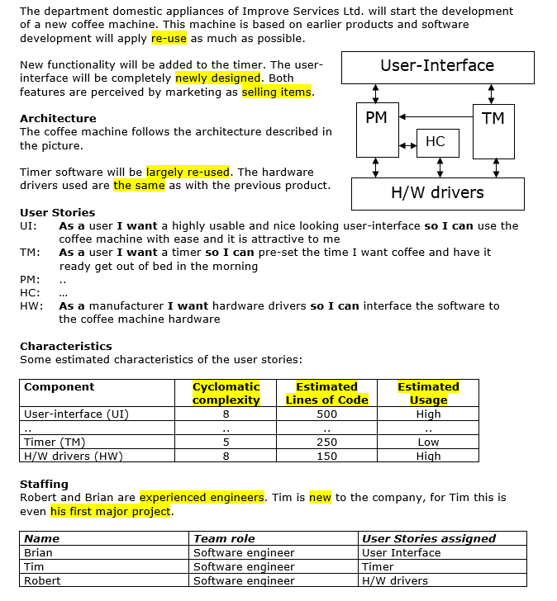
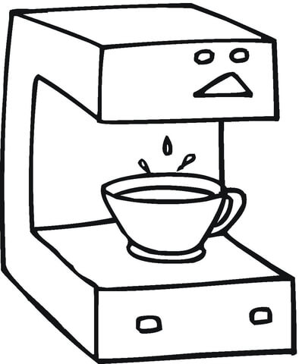

Slide 17
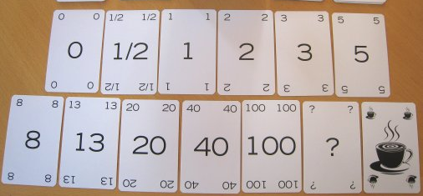


Agile - Play Card Game: Risk Poker
Planning Poker / Wide Band Delphi based
Bottom-up estimation
commitment of people involved
collective experience of the team
wide variance in estimates

Slide 18


Planning Poker (WBD)
User Story
Moderator
Estimator
Explain
Estimates
Collect
OK?
Share info
OK?
Final estimate
Improve IT Services BV
18

Slide 19












Risk Poker the same, but…
Scoring separately for likelihood and impact
Discussion shall be factor based
Limited number of cards for each value (color)
Product owner (impact) and lead-developer (likelihood) as tie breakers
Improve IT Services BV
19

Slide 20
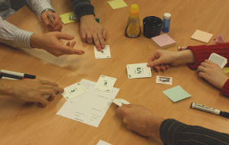



Let’s Play
Example User Story (FO) As as bank account holder, I want a yearly financial overview of my accounts, so that I can submit my taxes
Impact ? Likelihood ?
Impact:
Likelihood:

Slide 21
Agile Product Risk Matrix
FO

Slide 22
Benefits
Risk-Based Testing

Slide 23

Key learning points
A structured and practical approach for risk-based testing is available
Make it Agile, but use the formal rules
Efficient, Effective and Attractive
Define a risk-based differentiated test approach

Slide 24



More Information
Full PRISMA white paper (e-book)
Paper: 10 Recommendations on Risk-Based Testing
Paper: Product Risk Assessments in Agile Projects (Risk-Poker)
Email to acquire the PRISMA tool (freeware)
Book “Practical Risk-Based Testing; The PRISMA Approach”

Slide 25

www.erikvanveenendaal.nl
erik@erikvanveenendaal.nl
@ErikvVeenendaal

Slide 26



