Slide 1
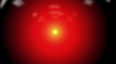
When Will AI Take My Job
as a Tester?
Dr. Jeremias Rößler
https://retest.de
Notes:
As some of you have probably noticed, there’s been some buzz going on and some AI hype. And those who heard, maybe have this question. When will AI take my job as a tester? And it seems to be a common theme that this is a “when”, not an “if” … and that it will happen rather sooner than later. So let’s talk about that a little bit.

Slide 2
Who of you
is a professional tester?
has ever tested?
has ever spotted a bug?
… uses Windows?
Notes:
Now I want to know my audience better: Please raise your hands if you are a professional tester. Keep them raised. Raise your hands if you have tested at least once. Keep them raised. Raise your hands if you have spotted a bug once. Keep them raised. Raise your hands if you use Windows. Now all hands are raised.

Slide 3
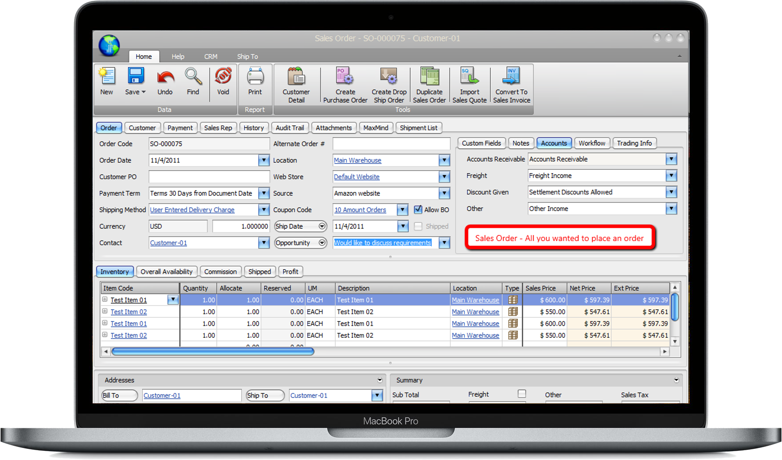

Notes:
(Make a bit of a show to stress the point)
Now that we have established credibility, I have a simple question for you: Is the marked value correct?
No one? Is it too easy?
(Point to someone) Can you answer it?
Now, come on! You are testers. This is your daily business. How come you can’t answer that? It’s a simple question!
Of course you can’t answer that. This problem is called the oracle problem. And it is arguably the most difficult problem of all.

Slide 4
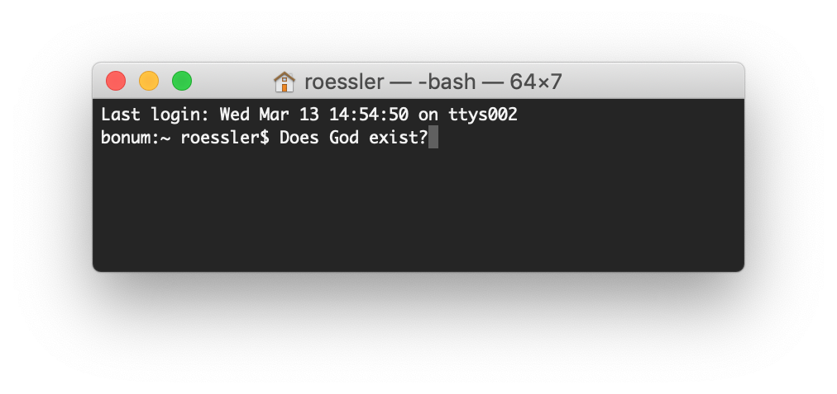
Notes:
It is not only the most difficult problem, it also has a strange fancy name. Because if I could create a general oracle, that for any given program could tell me wether the program is correct or not, I would then write a program that gives me an answer to this question. Then the general oracle would have to know, whether God exists or not. This is the reason for that fancy name. And problem can be turned into the oracle problem.
Next time, when somebody asks you what you do in your job, instead of saying “I am a tester” you now can say “Everyday, I try to solve the most difficult problem of humanity”. ;-)

Slide 5
Notes:
But jokes aside, not every instance of the oracle problem is as hard as this. As a practical guy, for me it suffices if a heuristic can solve 80% of all instances.

Slide 6
How could you know?
Decide
Understand someone else’s Decision
Notes:
So for most of software development, there are two alternatives: Either you have to decide on your own, or you have to understand fom what someone else told you.

Slide 7
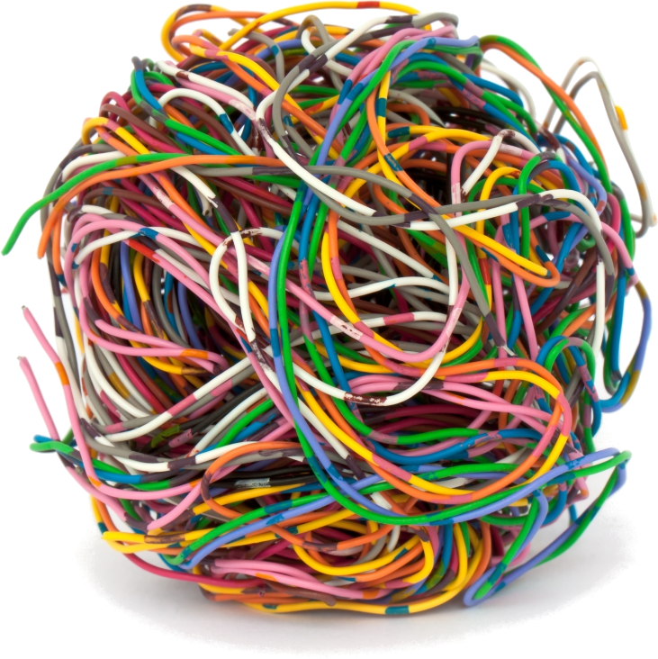
Problem
Pain
Fuzzy Need
Unknown Desire
complexity
Notes:
So we have a complex problem. A fuzzy need. A customer pain. Or a soon to be created desire that not even the customer knows about yet. In order to be able to decide how it should be, you have to master the complexity of that problem.
You have to understands the problem and decide about the best possible solution.

Slide 8
Problem
understand
Domain-Knowledge
complexity
Notes:
By mastering that complexity you create domain knowledge. You now know something about the problem domain. And that knowledge incorporates the knowledge

Slide 9
Problem
understand
Domain-Knowledge
decide
Plan
complexity

Slide 10
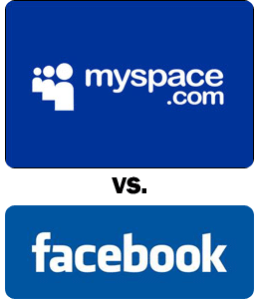


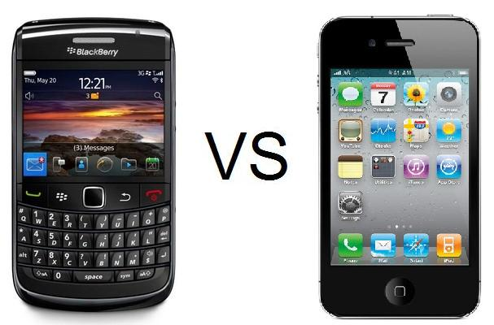


Notes:
Imagine to let the AI decide on its own… This is the hard decision. To “Decide how it should be”. This is what separates facebook from myspace, Whatsapp from Skype, … This is the hard decision, the last frontier. If AI can solve that, all other is a piece of cake. Ok, maybe it’s not equivalent to the oracle problem, but … you know. It’s still a hard decision.

Slide 11
How could you know?
Decide
Understand someone else’s Decision
Notes:
So we are down to the last option. AI has to understand someone else’s decision, and maybe fill in the gaps from “common sense”.

Slide 12
Problem
understand
Domain-Knowledge
decide
Plan
communicate
complexity
Solution-Knowledge
Notes:
The complexity of the problem wanders. First it is complex how it should be. Then, because the one who decides how it should be is usually not the one implementing it (think product owner, or CEO), this decision needs to be communicated. So it is complex to understand how it should be.

Slide 13
Problem
understand
Domain-Knowledge
decide
Plan
communicate
complexity
Solution-Knowledge
formalize
Code
Notes:
Then it is complex to code how it should be. This is were Software developers come in. They first have to understand the devised solution. Then they must master that complexity and turn that solution into code. Then the complexity resides in the actual code.
I call it plan here to make it clear that it’s a devised solition in contrast to an implemented and usable solution.

Slide 14
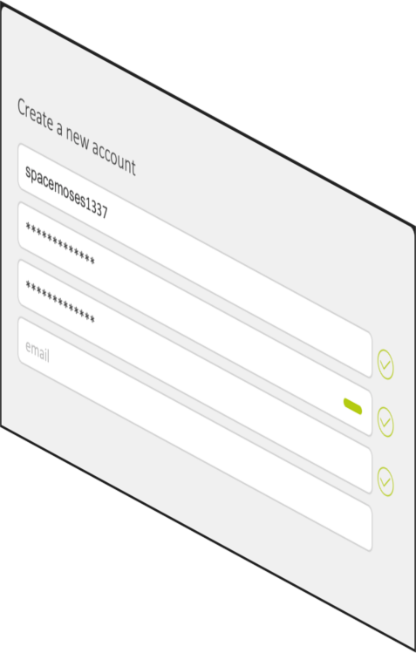

User
UI
Software
complexity
simple
intuitive
easy-to-use
Notes:
This is what Software does. It takes something complex, tedious or boring and does it for you. It hides the complexity of the actual task away.

Slide 15
The purpose of software: Make your life easier
Notes:
This is literally the purpose of software. To make your life easier by solving a complex, complicated or tedious task for you.

Slide 16
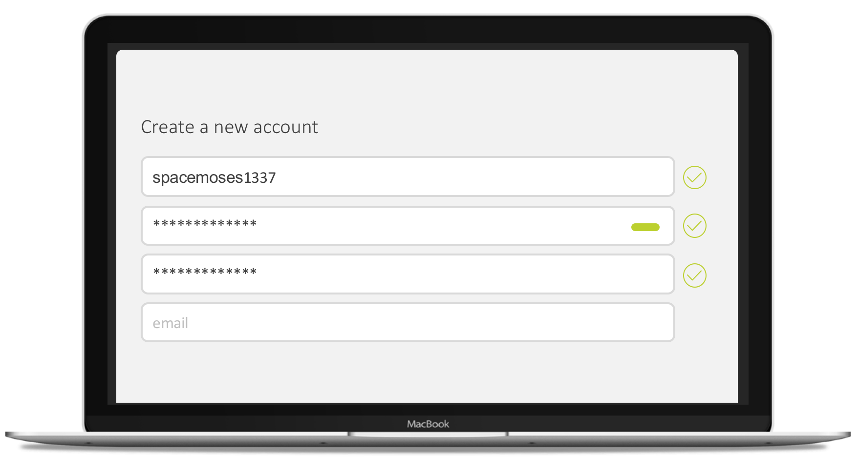

Slide 17
User
UI
Software
GUI (HTML)
layout
component recognition
data persistence
enter text (action)
data model
click button (action)
glue code
architecture
username (text)
cryptographic algorithm
password (text)
logging
scalability
load balancing
Notes:
This is what Software does. It takes something complex, tedious or boring and does it for you. It hides the complexity of the actual task away.

Slide 18
Tester
UI
Software
GUI (HTML)
layout
component recognition
data persistence
enter text (action)
data model
click button (action)
glue code
architecture
username (text)
cryptographic algorithm
password (text)
logging
scalability
load balancing
Notes:
This is what Software does. It takes something complex, tedious or boring and does it for you. It hides the complexity of the actual task away.

Slide 19
Tester
UI
Software
complexity
simple
intuitive
easy-to-use
Notes:
And this also is the reason for a lot of the problems testers encounter, when they have to advocate for their job. Developers see that the testers are on the easy side of things. They have it simple. The complexity is only where the developers are. Therefore, testing cannot be a demanding job. This how developers often see the role of testers, as something that can be done by “everybody” and is not very challenging. As such, it should be easiy to automate using AI.

Slide 20
Tester
UI
Software
complexity
simple
intuitive
easy-to-use
Notes:
So I witnessed it, and I want to know how big of a problem that is.
Who of you has ever witnessed developers or managers being condescending, or looking down on manual testing or talking about it like it was inferior in any way?
Like this is something that is rarely talked about, but something that I think is permeating a lot of our daily interactions.

Slide 21
Tester
Solution-Knowledge
complexity
formalize
test
Code
Notes:
But what developers usually forget is that in order to be able to verify that the code actually does what it should do, the tester has to understand what it should do. The tester also has to master the complexity of the problem. And this is also, what makes for a good tester: Someone how truly mastered the complexity of the problem and can critically challenge the solution or find tricky bugs.

Slide 22
Coordinating testing
Breaking things
Documentation
Exploratory testing
Asking questions
Managing bugs
Usability testing
Load testing
Discussing business processes
Assessing and exposing risk
Discovering broken assumptions
Stress testing
Raising bugs
Functional testing
Knowledge gathering
Generating test data
Understanding users
test strategies
Performance testing
Security testing
Researching known issues
Reporting
Identifying the cause of problems
Investigating technology
test plans
Regression testing
Root cause analysis
Turning user scenarios into test scenarios
Source: https://dojo.ministryoftesting.com/dojo/lessons/what-do-software-testers-do-version-0-1
Notes:
This is a summary of what testers do in their daily work. And while all of that is correct in some way, I think the underlying common theme is understanding the users and improve the product from their perspective. Like from the problem perspective.

Slide 23
Problem
understand
Domain-Knowledge
decide
Tester
Plan
communicate
complexity
Solution-Knowledge
test
formalize
Code

Slide 24

Problem
understand
Domain-Knowledge
decide
AI
Plan
communicate
complexity
Solution-Knowledge
test
formalize
Code
Notes:
This essentially means, that the AI in order to be able to test, has to understand what the software should do. And that means, it needs to master the complexity of the task that is to be automated. And that often includes a lot of communication, because the desired solution is often not fully documented and a lot of communication and question asking needs to take place in order to understand the desired solution.

Slide 25
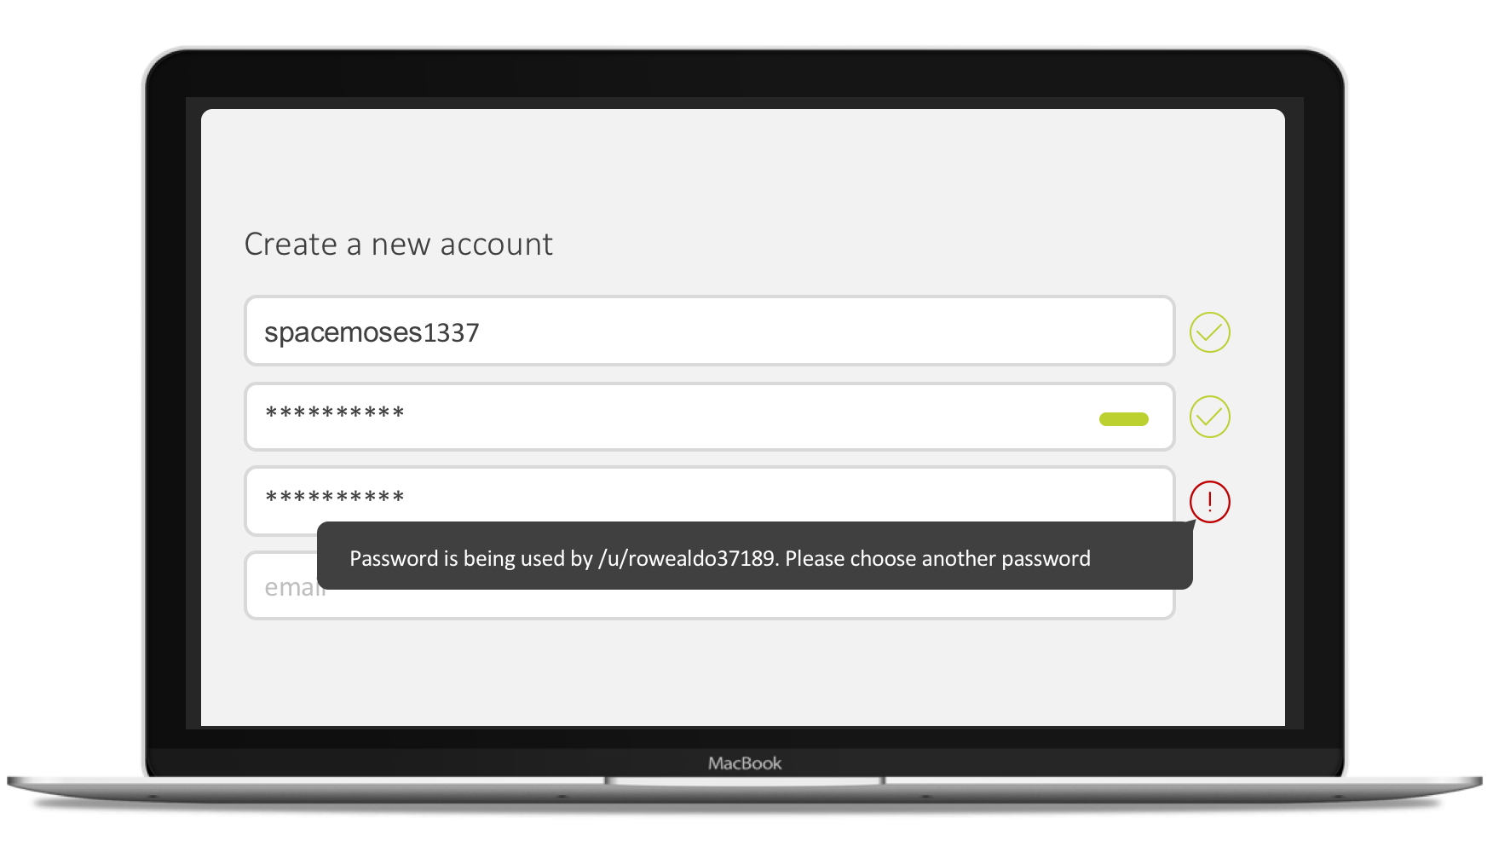
Notes:
If you don’t fully understand the problem that the solution tries to solve, this actually looks like a good idea…

Slide 26
Problem
understand
Domain-Knowledge
decide
AI
Plan
communicate
complexity
Solution-Knowledge
test
formalize
Code
Notes:
So we essentially need a human-level, or “general” AI.

Slide 27
Plan
communicate/
understand
AI
Solution-Knowledge
complexity
formalize
test
Code
Notes:
Even if you say that you don’t need to solve all problems at once. Let’s say you only start at the lowest level. You want AI just to verify that the solition-knowledge was correlty formalized. Than you still need human-level AI. Because how do you arrive at the solition-knowledge? You need to communicate with stakeholders or understand some sort of written specification.

Slide 28
If AI masters the complexity of the problem,
why not have it create the software in the first place,
error free?
Notes:
But if we have an AI that is that mighty, it just doesn’t make sense to use it for testing. If it understands the requirements AND is general, instead let it program and receive an “error free” program. Is “error free” possible at all?

Slide 29
Solution-Knowledge
AI
error-free™
complexity
formalize
Code
Notes:
This means, that the AI now creates a fully correct representation of its understanding of the problem. Like a compiler generates a fully correct machine-code representation of the source code. You can even proof mathematically, that a compiler is correct. But of course, that still doesn’t mean that the resulting software is correct, only that it is a faithful transformation. But it still means garbage in—garbage out.

Slide 30
Tester
Plan
revise
communicate
Solution-Knowledge
AI
error-free™
complexity
formalize
Code
Notes:
This means, that the AI now creates a fully correct representation of its understanding of the problem. Like a compiler generates a fully correct machine-code representation of the source code. Now imagine how wonderful that would be: You explain to a machine what you want, and you receive a software out of that explanation, that you can test.

Slide 31
Tester
UI
Software
GUI (HTML)
layout
component recognition
data persistence
enter text (action)
data model
click button (action)
glue code
architecture
username (text)
cryptographic algorithm
password (text)
logging
scalability
load balancing
Notes:
But that is the stuff of science fiction, right?
So when we take our example from before, where we said, that the complexity now is inside the code. And this is why developers are so proud of their work … because they do all the hard work. Well, guess what? They shouldn’t.

Slide 32
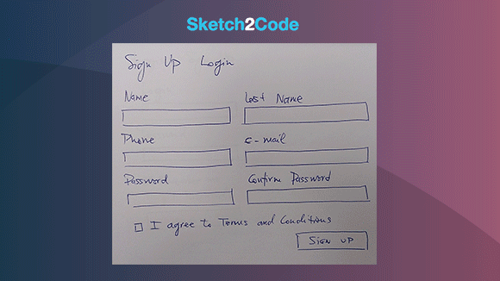
https://airbnb.design/sketching-interfaces/
https://github.com/tonybeltramelli/pix2code
https://github.com/Microsoft/ailab/tree/master/Sketch2Code

Slide 33
Tester
UI
Software
GUI (HTML)
layout
component recognition
data persistence
enter text (action)
data model
click button (action)
glue code
architecture
username (text)
cryptographic algorithm
password (text)
logging
scalability
load balancing
Notes:
So when we look at that again … where we clearly see that writing the software is much harder than testing it … well. Let’s remove GUI and layout, because as you just saw, it is possible to generate that from paper sketches.
Let’s think about the rest.

Slide 34
Make or Buy? | Make | Buy
Code Quality
Tests
Documentation
Price/Value
Specialization
Notes:
This is a slide from a talk about clean code. Essentially what it says is … don’t implement something yourself, until what you need is so special, that you really, really have to.
Which is seldom the case.

Slide 35
Tester
UI
Software
component recognition
data persistence
enter text (action)
data model
click button (action)
glue code
architecture
username (text)
cryptographic algorithm
password (text)
logging
scalability
load balancing
Notes:
Now data persistence, essentially means a database. Data model can be generated from the fields. For cryptography you take a library. For scalability and load balancing, you take service. … and so on. Eventually all you are left with, what the developer _really_ has to do, is glue code. The glue code

Slide 36



Notes:
And here are some examples of companies that try to making gluecode easier and connect different apps and functionalities. Expect to see more of these in the future, and within companies.

Slide 37
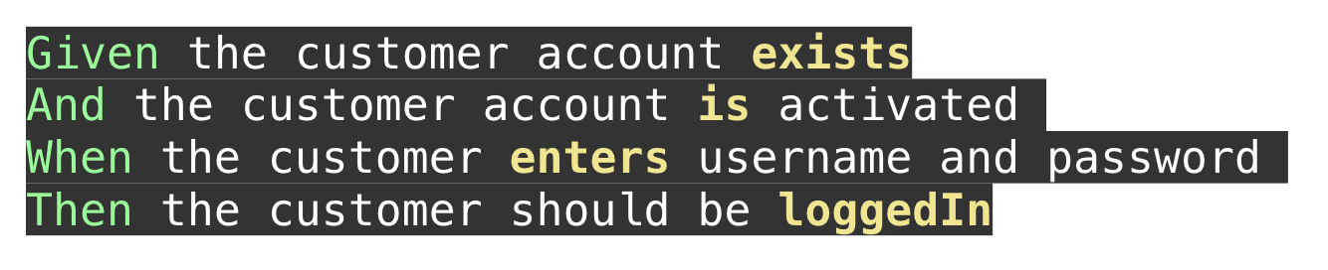
Notes:
And this could be how to formalize the test like BDD. Then what do you think is easier to do … come up with this test by reading a prose description or come up with the code that makes that test pass?

Slide 38
Tester
UI
Software
component recognition
enter text (action)
click button (action)
glue code
username (text)
password (text)
Notes:
So in an ideal world, this is what software development should look like. You use ready-made building blocks of functionality and glue them together, to get the application that you want.
And then you use a tester to review the devised solution from a users perspective and tweak it where needed.

Slide 39
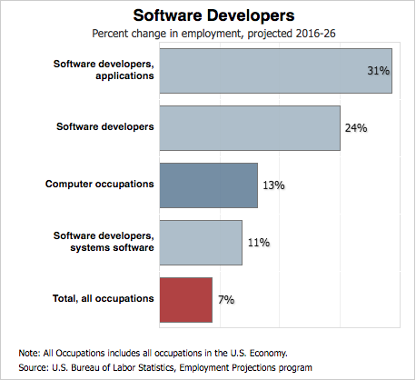

Notes:
And this is massively needed. Because there is a huge and surging demand for developers.
Just to get me clear. This doesn’t work for hardware-connected programming of cars, planes, drones, etc. It doesn’t work for non-standard functionality like image recognition, AI, internet of things. But it does work great for your normal CRUD software: CRM, ERPs, your normal website. Anything that only creates, stores and shows data really. Which is currently a lot of software.
https://www-bizjournals-com.cdn.ampproject.org/c/s/www.bizjournals.com/bizjournals/news/2018/01/10/software-developer-bumps-health-care-for-best-job.amp.html
https://www.bls.gov/ooh/computer-and-information-technology/software-developers.htm#tab-6

Slide 40
Tester
Plan
revise
communicate
Solution-Knowledge
AI
error-free™
complexity
formalize
Code

Slide 41
So we can’t bring AI
into Testing?

Slide 42
Tester
UI
Software
complexity
simple
intuitive
easy-to-use
Notes:
This on the other hand shows a great thing: once we have verified the functionality is correct manually, we can now use AI to automate regression testing.

Slide 43
Tester
UI
Software
component recognition
enter text (action)
click button (action)
complexity
username (text)
password (text)
Notes:
So when we look at that again … where we clearly see that writing the software is much harder than testing it … well. Let’s remove GUI and layout, because as you just saw, it is possible to generate that from paper sketches.
Now data persistence, essentially means a database. Data model can be generated from the fields. For cryptography you take a library. For scalability and load balancing, you take service. … and so on. Eventually all you are left with, what the developer _really_ has to do, is glue code. The glue code

Slide 44

Tester
UI
Software
complexity
Notes:
This on the other hand shows a great thing: once we have verified the functionality is correct manually, we can now use AI to automate regression testing.
This, by the way, is what we do with our current startup, retest.

Slide 45


Infinite-Monkey-Theorem:
A monkey hitting keys at random on a typewriter
for a long enough time
will type the complete works of William Shakespeare.
Notes:
Nun die Preisfrage: Wie generiert man überhaupt Testfälle?
Wer von Ihnen kennt das Infinite-Monkey-Theorem?
Dieses Theorem wiederum ist nur eine bildhafte Veranschaulichung des Borel-Cantelli-Lemmas. Man könnte auch sagen, dass der Affe nicht nur alle Werke, sondern auch alle Versionen aller Werke in allen Sprachen, sowie eigentlich alle anderen Bücher die jemals geschrieben wurden oder jemals noch geschrieben werden enthält. Die Unendlichkeit ist schon ziemlich groß…

Slide 46

We replace the typewriter with a computer…
Notes:
Aber was hat das mit Testen zu tun?
Nun wir könnten die Schreibmaschine mit einem Computer ersetzen und dann erzeugt der Affe ”zufällige Eingaben”. Beim bekannten Fall vom Android Monkey erzeugt der Monkey eine Reihe von pseudo-zufälligen Benutzeraktionen wie Klicks, Touches, Gesten und System-Ereignissen. Dabei sucht der Monkey nach Crashes, unbehandelten Exceptions und danach, dass die Anwendung nicht mehr reagiert. All dies wird dem Entwickler dann gemeldet.

Slide 47


Slide 48
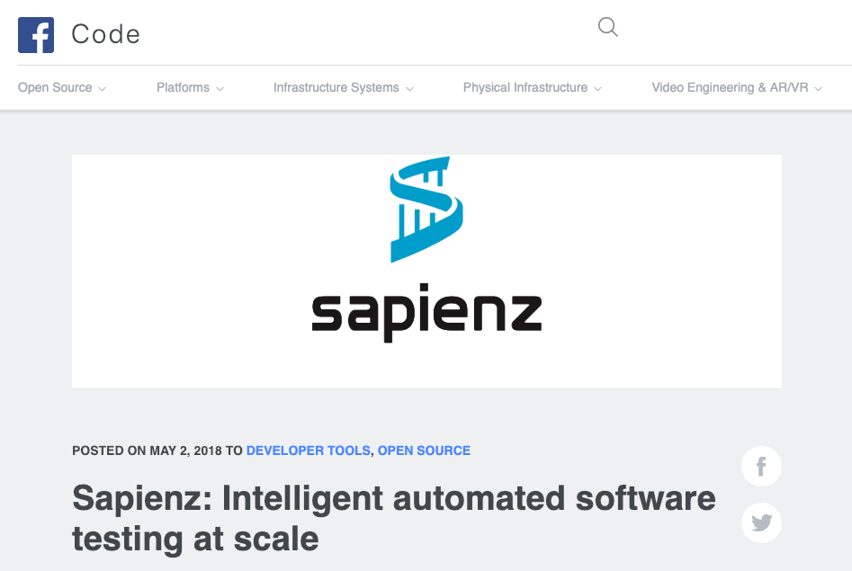
https://code.fb.com/developer-tools/sapienz-intelligent-automated-software-testing-at-scale/

Slide 49




Testing
Test Execution
Comparison Expected vs Actual
No Difference
Actual wrong
Done
Bug
Notes:
With manual test execution, this is what happens:
You execute a test, either exploratory or from script or whatever … it really doesn’t matter.
If there is no difference between what you want to see and what you see, all is well.
If there is a difference, you have to analyze and understand where that difference comes from. Because as we just saw, it could also be that the expected is wrong. Maybe you didn’t understand the software or the documentation, specification, tutorial, whatever is outdated. In that case, you have to update the test, specification, documentation, mental model, whatever. Only if you are sure that what the test says is still correct can you file a bug.

Slide 50


Testing
Test Execution
Comparison Expected vs Actual
No Difference
Difference
Done
Evaluate Difference
Expected wrong
Actual wrong
Update Expected
Bug
Notes:
With manual test execution, this is what happens:
You execute a test, either exploratory or from script or whatever … it really doesn’t matter.
If there is no difference between what you want to see and what you see, all is well.
If there is a difference, you have to analyze and understand where that difference comes from. Because as we just saw, it could also be that the expected is wrong. Maybe you didn’t understand the software or the documentation, specification, tutorial, whatever is outdated. In that case, you have to update the test, specification, documentation, mental model, whatever. Only if you are sure that what the test says is still correct can you file a bug.

Slide 51
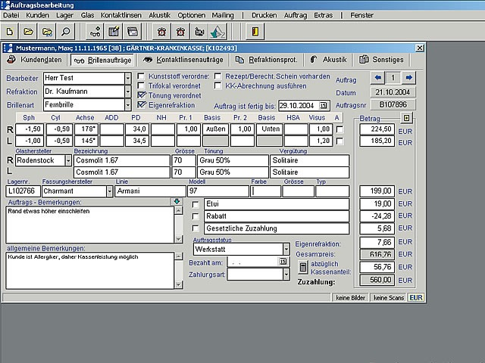
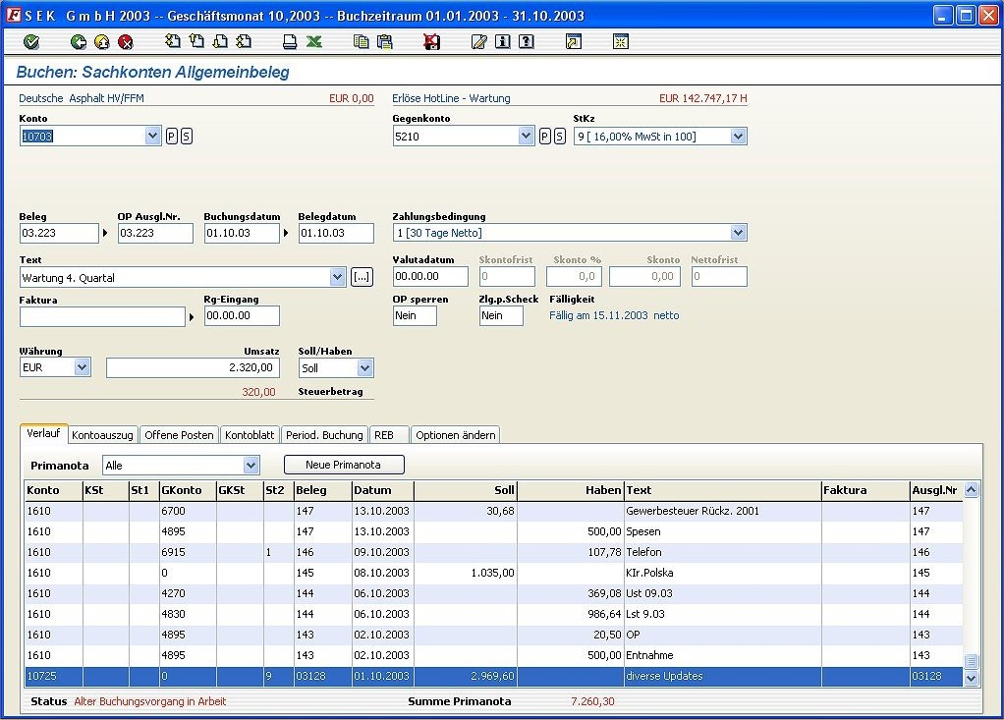
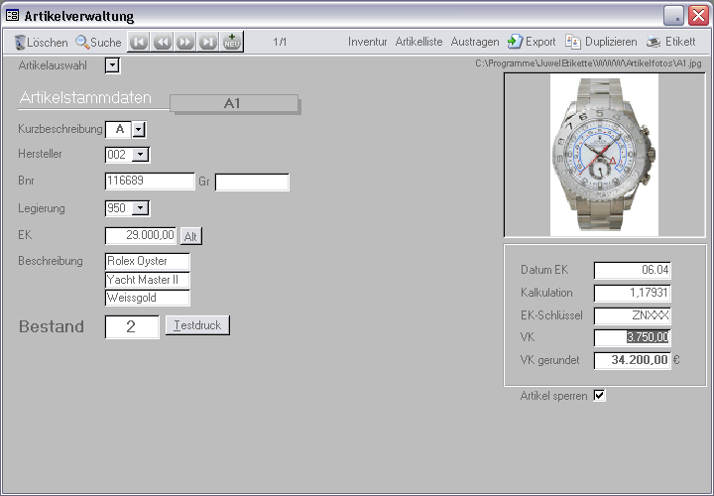
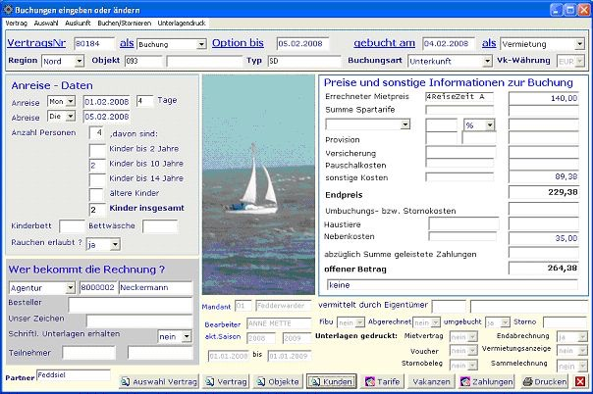
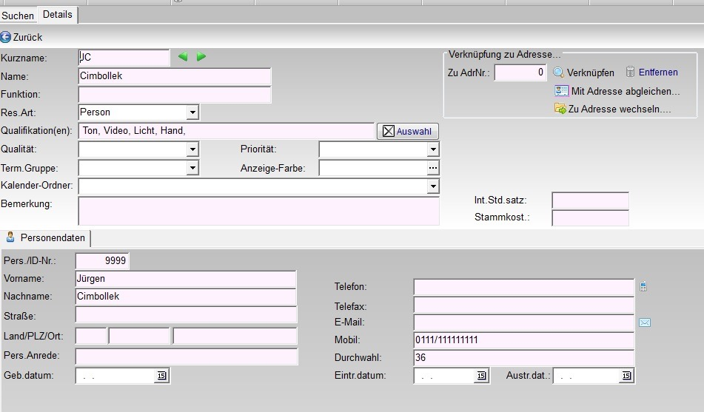
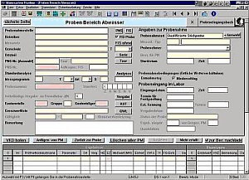
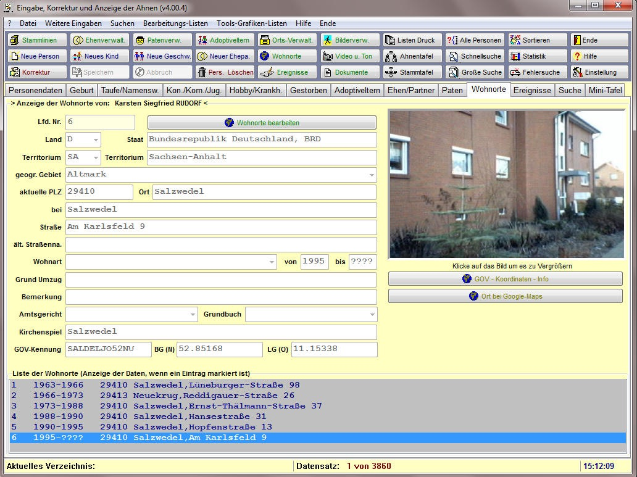
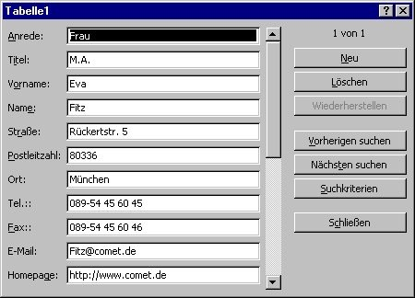
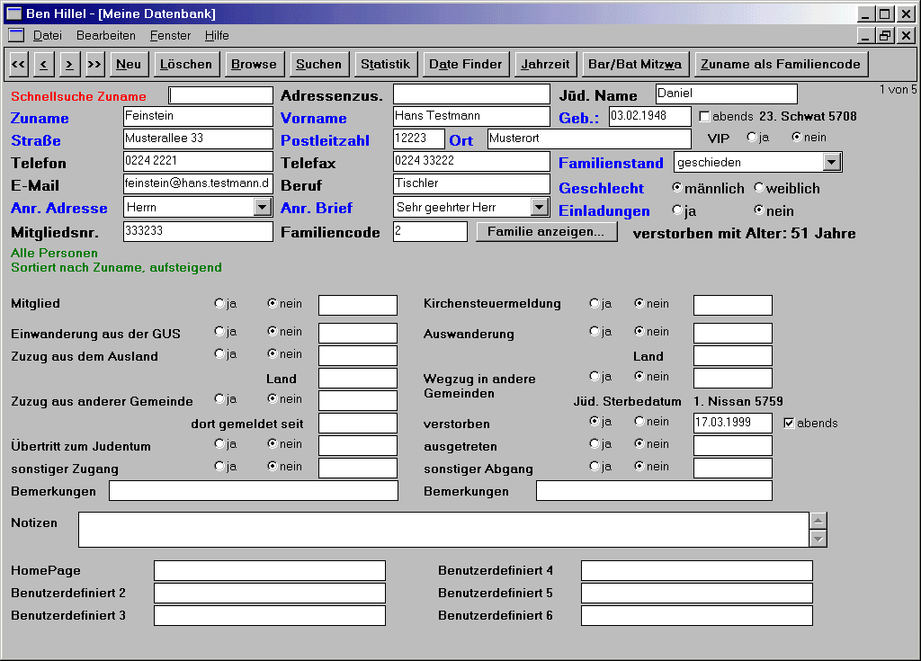
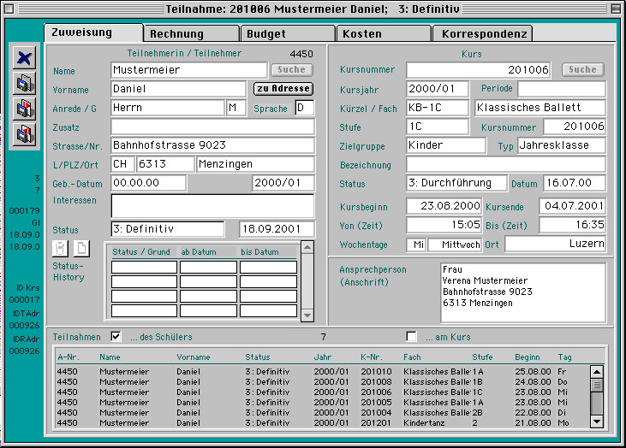
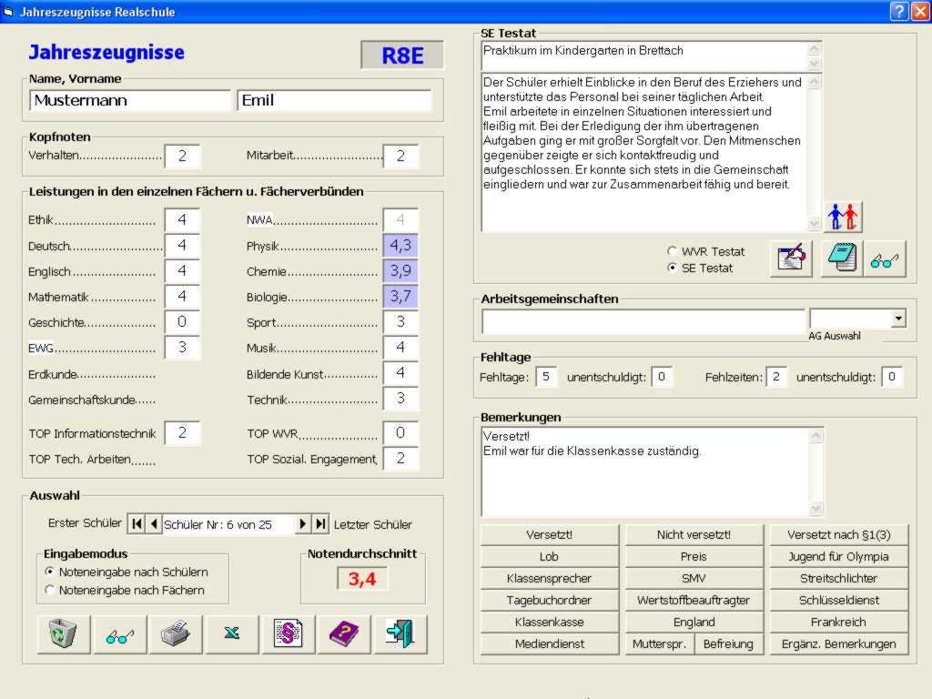
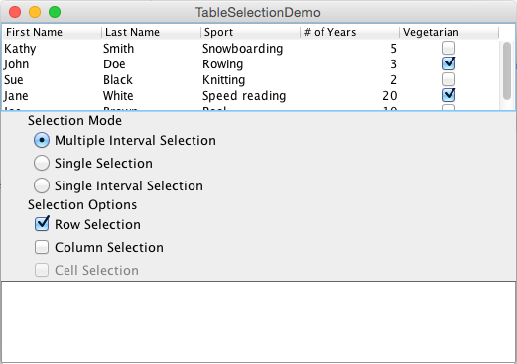
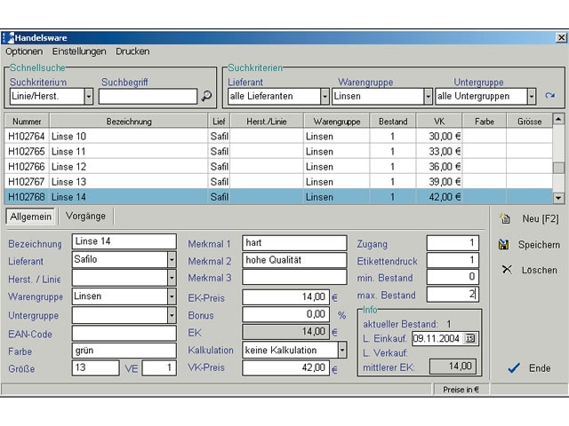
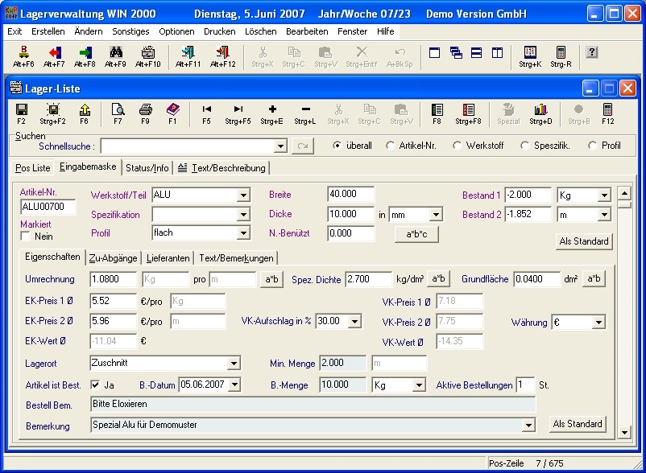
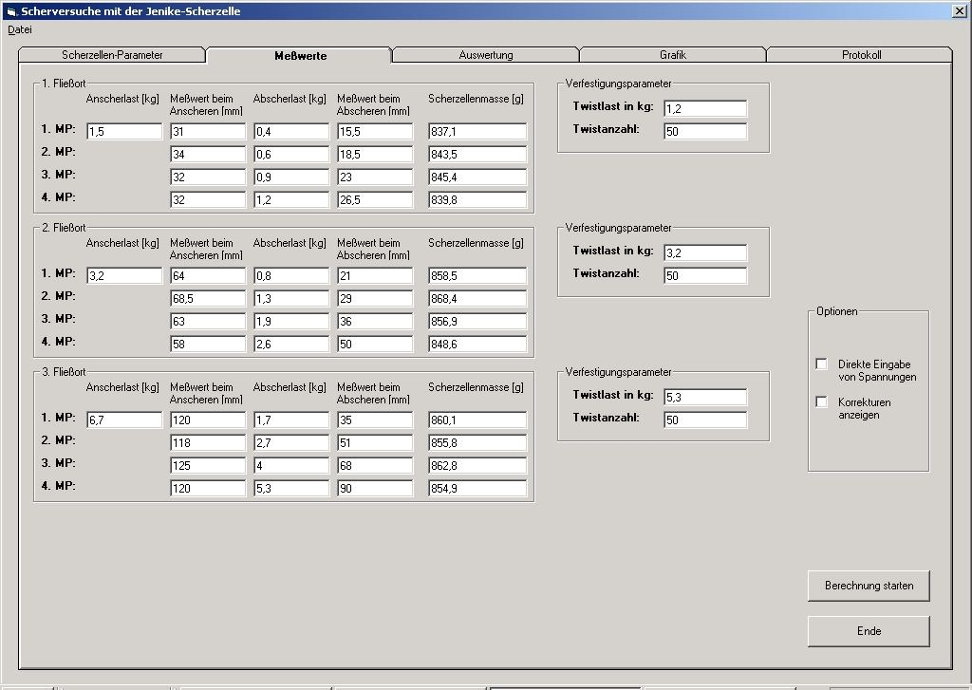
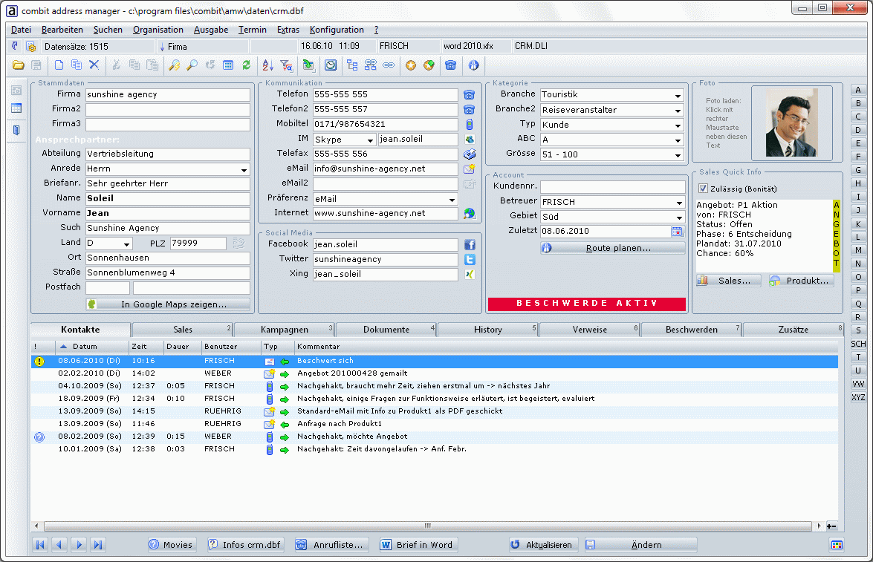
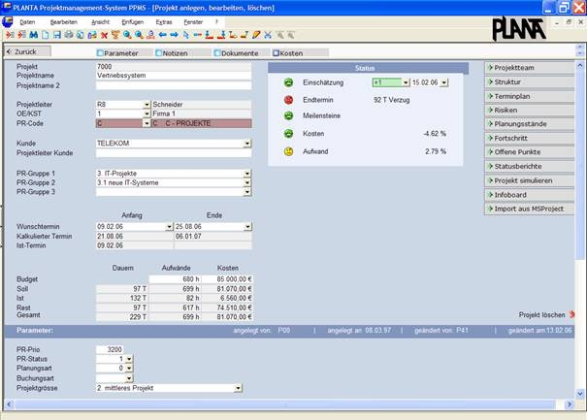
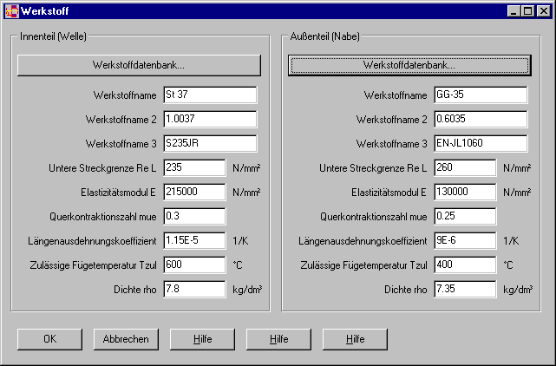
Notes:
Sie ändern ja aber selten die ganze Software. In den aller meisten Fällen reicht es völlig sicherzustellen, dass sich nichts geändert hat. Wenn man diese wenigen Änderungen herausdestilliert, und nur die dann eben manuell entscheiden muss, hat man bereits eine riesengroße Aufwandsersparnis!
Stellen Sie sich vor Sie haben eine Anwendung mit 100 Masken.

Slide 52
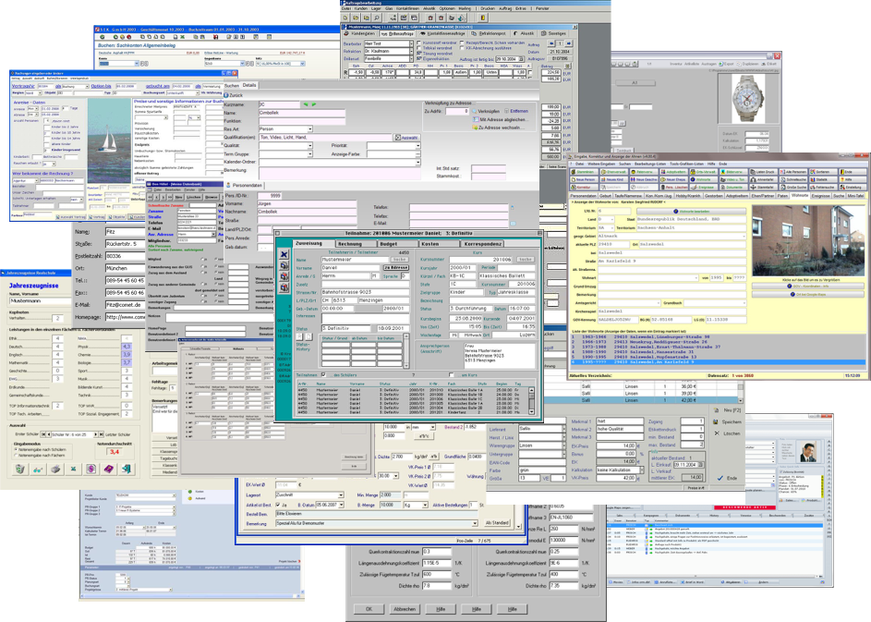
Notes:
Und sie ändern eine davon. Und sagen wir die Änderung wäre etwas tiefgreifender und aufwändiger, aber sie betrifft nur diese 1 Maske. Eigentlich. Sollte sie. Aber man weiß ja nie.
Testen Sie die anderen 100 Masken auch? Jetzt egal ob manuell, automatisch oder sogar mit nur die Funktionalität die dahinter steht mittels JUnit. Wer von Ihnen würde nicht den Nightly Build oder die Continous Integration abwarten, sondern nach einem Test der 1 neuen Maske sofort ausliefern? Hand hoch!
Und wer von ihnen würde die Masken wirklich auf GUI-Ebene testen wollen, egal ob automatisch oder manuell?
Aber warum? Es sind doch alte Masken. Sie haben sie doch schon getestet und sie sind konform zur Spezifikation. Warum also nochmal testen?

Slide 53
automated
regression test
≠
test
Notes:
Das Ziel eines Regressionstests besteht eben nicht darin Fehler zu finden. Aber wenn ein Regressionstest gar nicht wirklich ein Test ist, was ist es dann?

Slide 54
automated
regression test
=
version control
Notes:
Wir von ReTest sind der Meinung ein Regressionstest ist vielmehr eine Erweiterung des Versionskontrollsystems in 3D. In das Verhalten der Software.

Slide 55
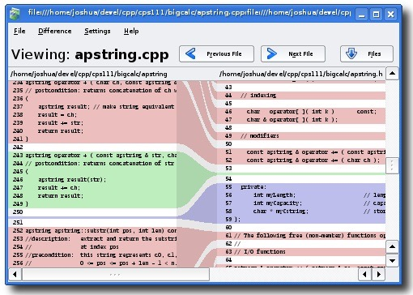
Notes:
If you know about version control, it allows something like this: a direct comparison with the previous and the new or current version, highlighting the changes.
The great thing is: if something didn’t change, you don’t have to bother reviewing it.
Imagine a code base with 1 million lines of code. No one would make a code review of everything. In a code review, you only review changes.

Slide 56
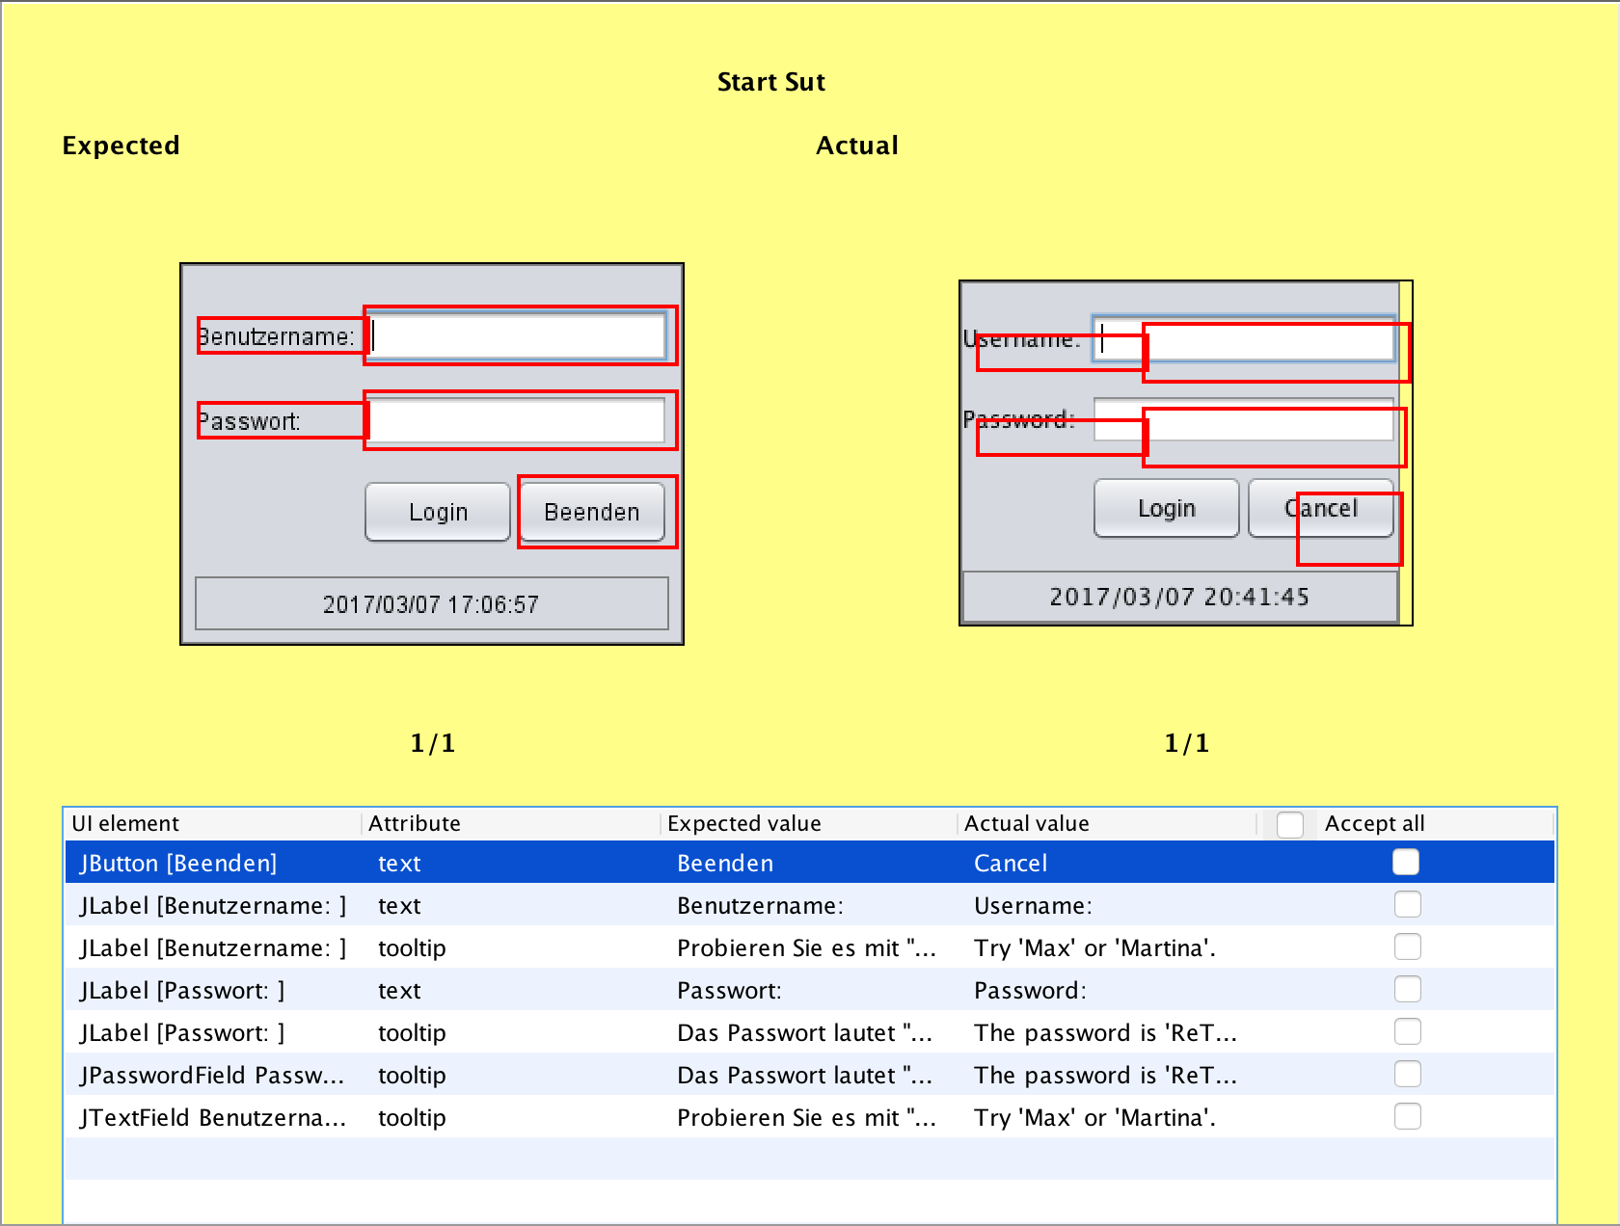
Notes:
And this is what we would like to have for software also. The software changed? Great, show me where and I can decide whether it is a good change or a bad change.

Slide 57
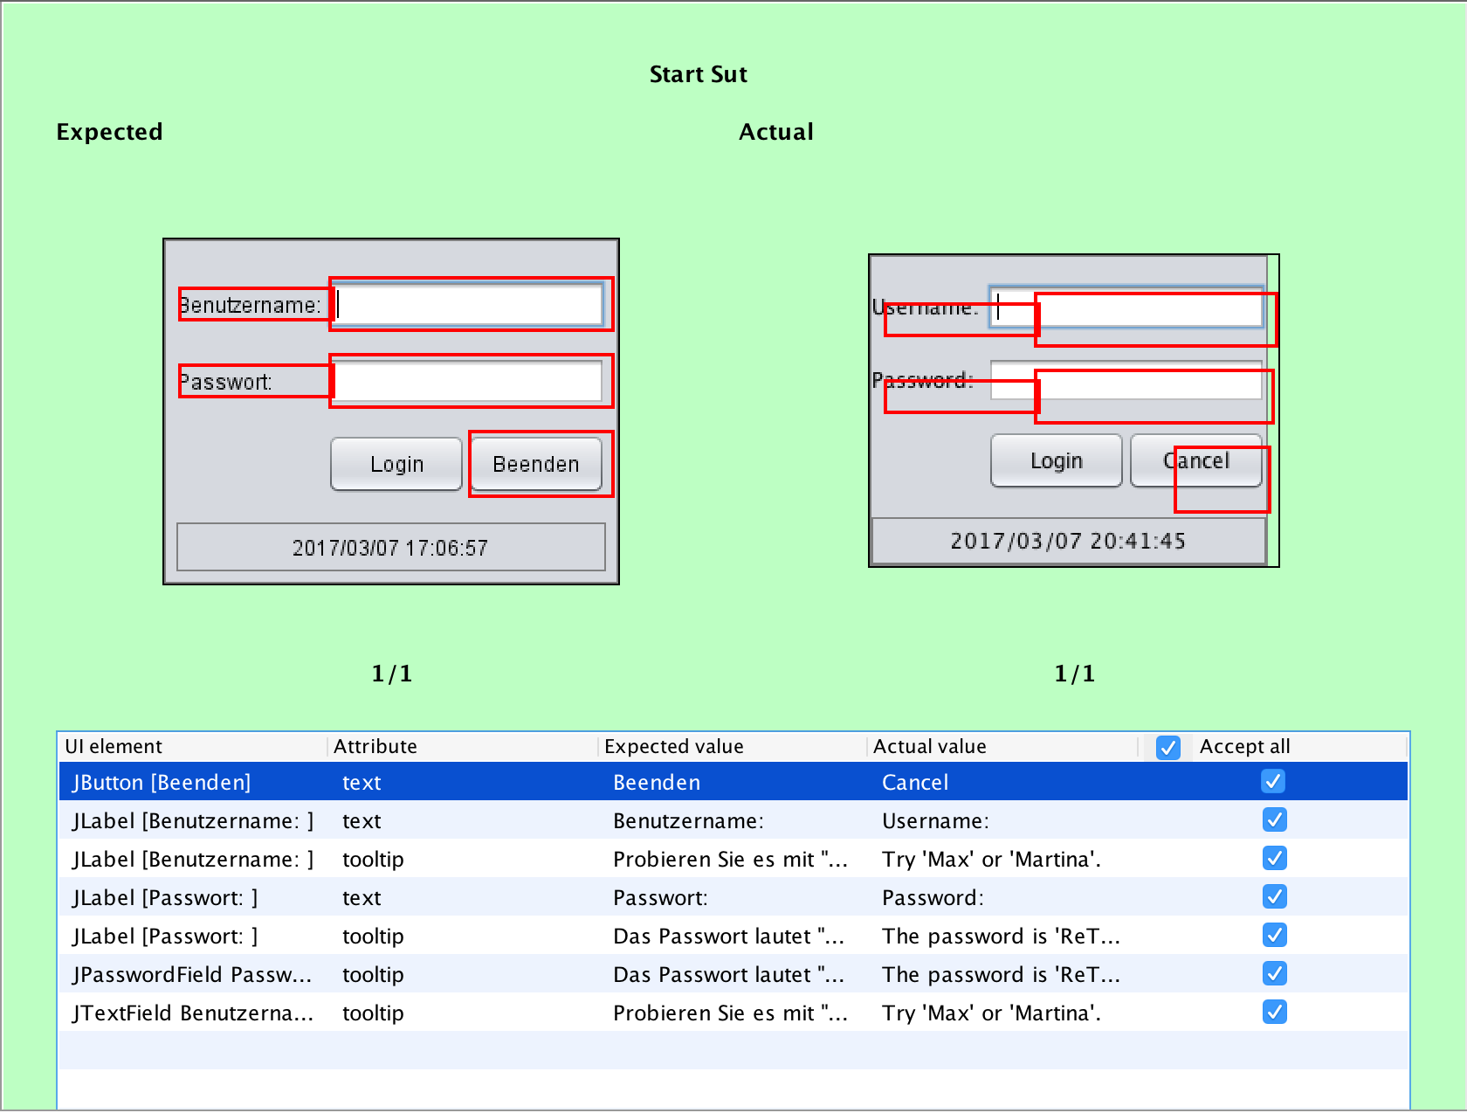
Notes:
And best part: You can even accept the change with a single click. Because if it is a good change, you just need to tell the system to copy from left to right.

Slide 58
















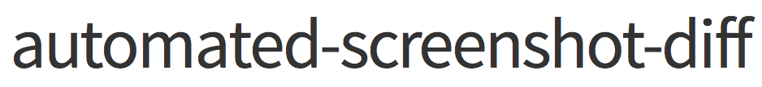







Notes:
There are already tools for that, like ApprovalTests and TextTest for simple text and many others for screenshot comparison.
Both of these types of tools are not semantic. This means he problems ignore and mass-accept
Hier fehlt noch Gojko Adzics Tool, welches er in der Keynote gestern erwähnt hat. Approval-Style testing ist der neue Weg des automatischen Testens.

Slide 59
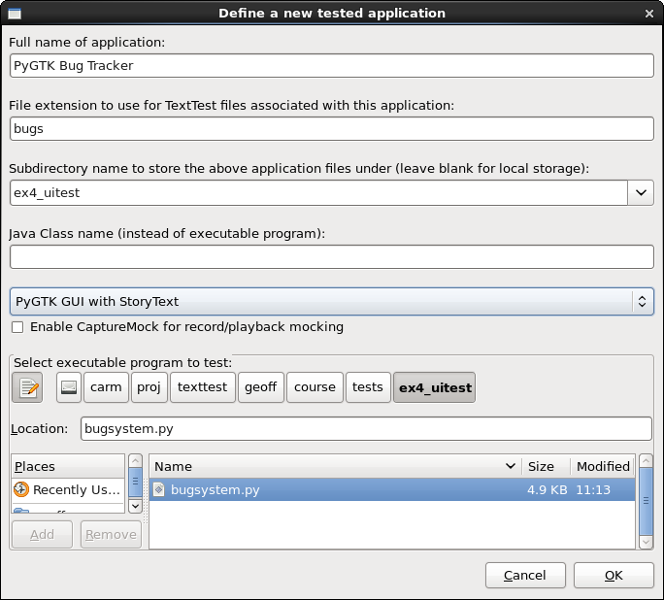


Slide 60

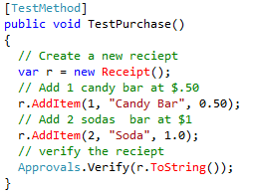


Slide 61
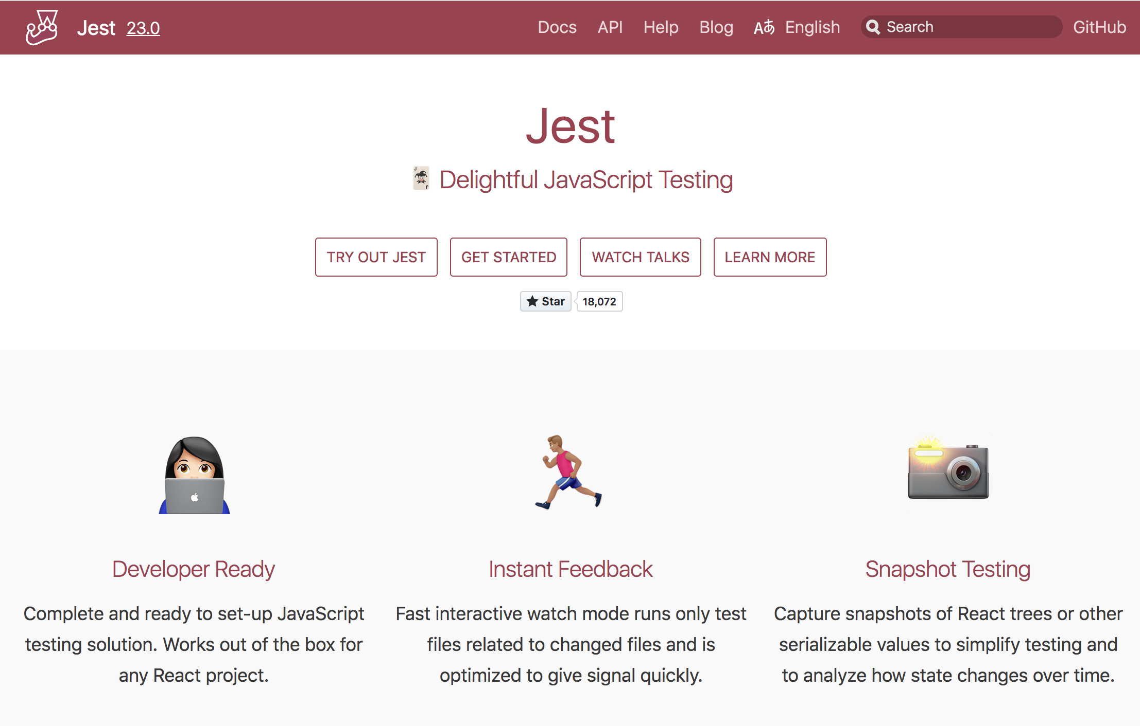

Slide 62
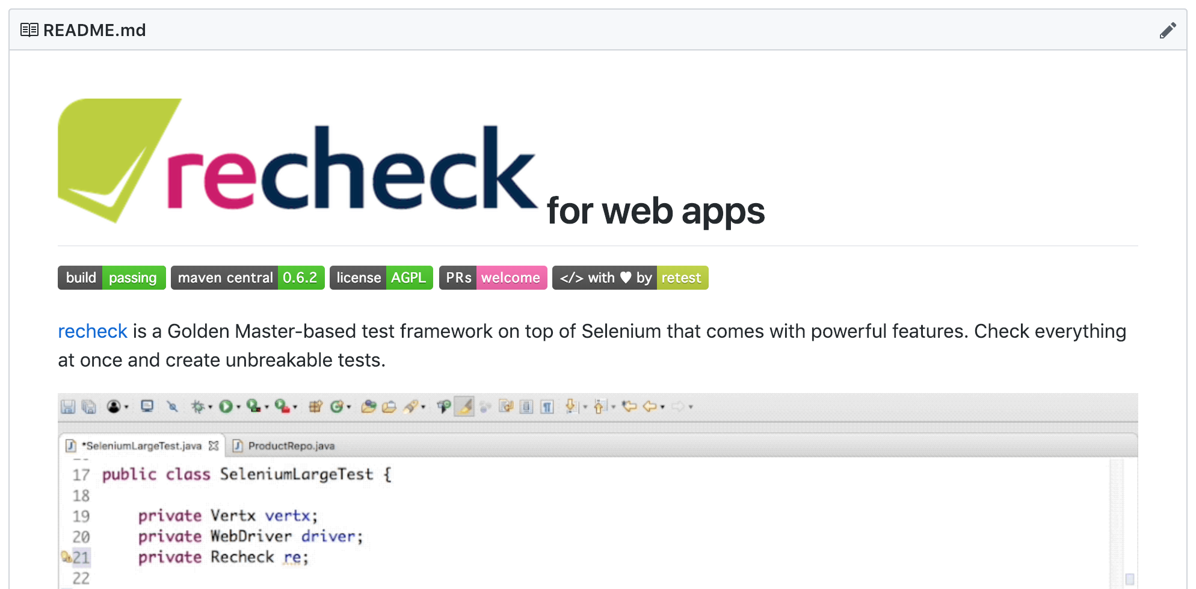
https://github.com/retest/recheck-web

Slide 63
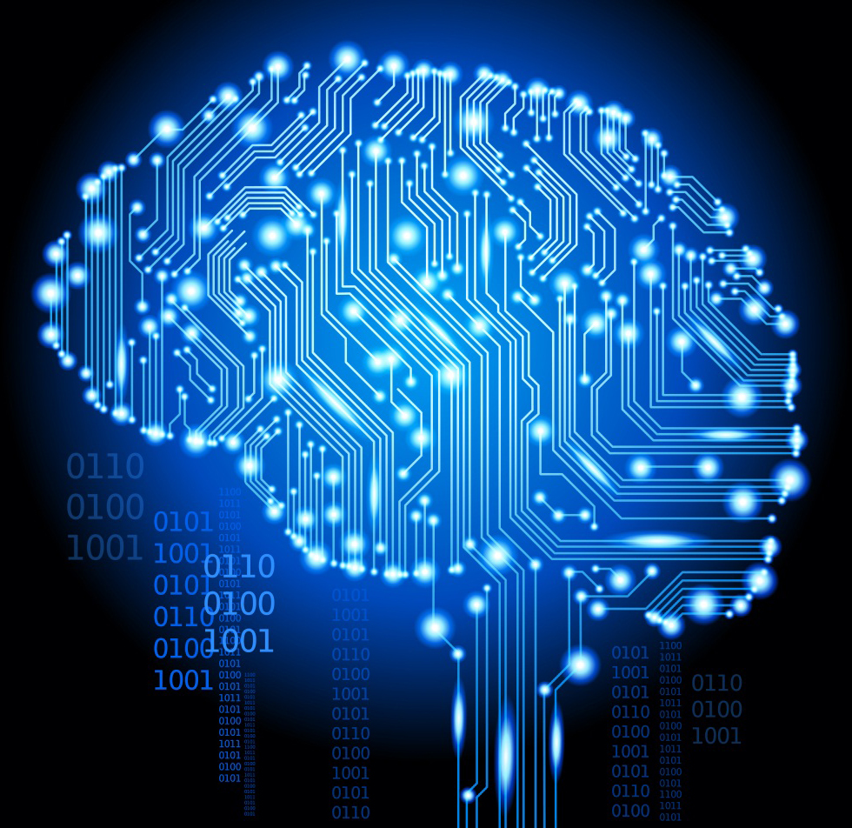
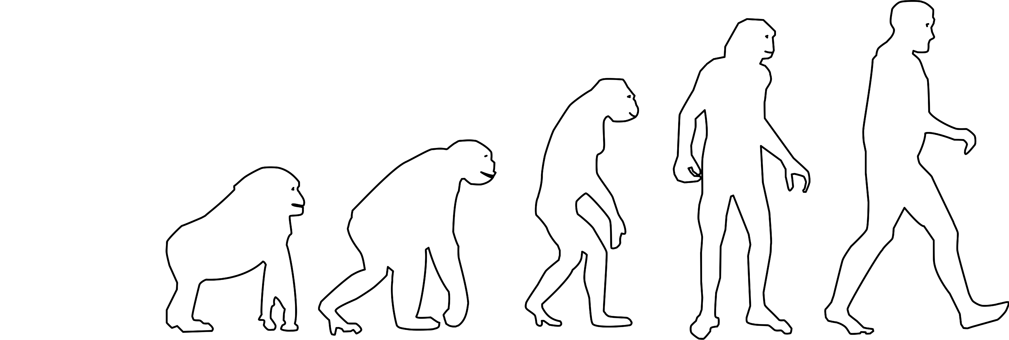
AI
train
AI
Artificial
Neural Net
Genetic
Algorithm

Slide 64
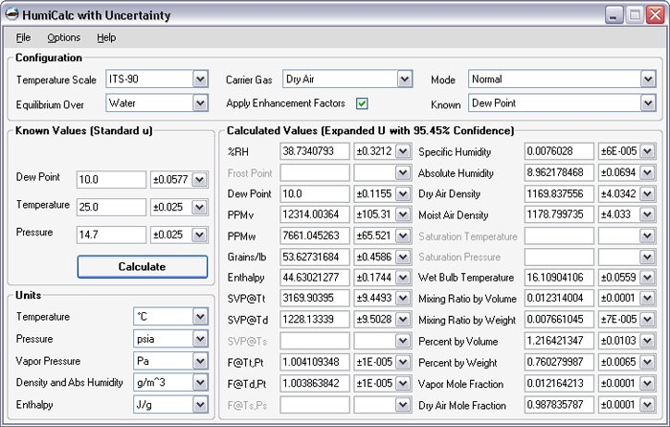
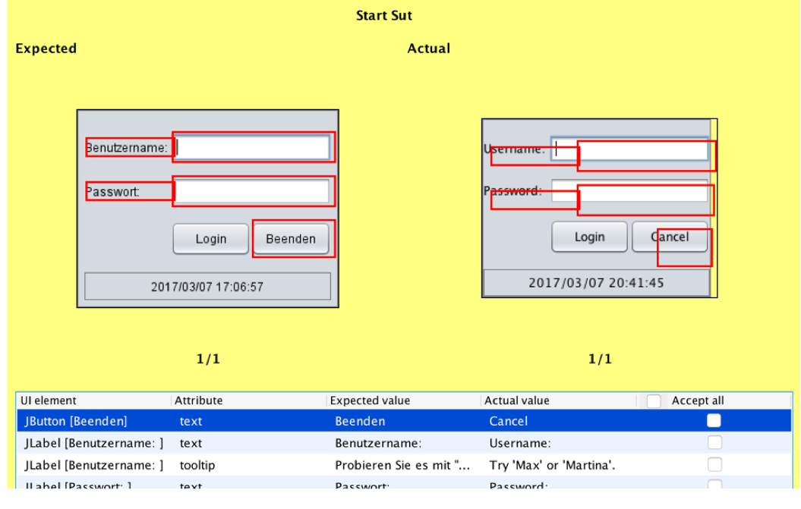
test
1.0
train
automate
user
diff
approve
1.1

Slide 65
How do we bring AI
into Coding?

Slide 66


?
Notes:
How can you come from that type of car (fully manual) to that type of car (soon to be autonomous)?
Answer: Not in one go.

Slide 67
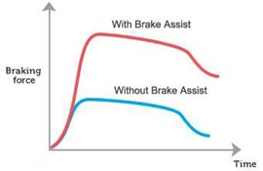
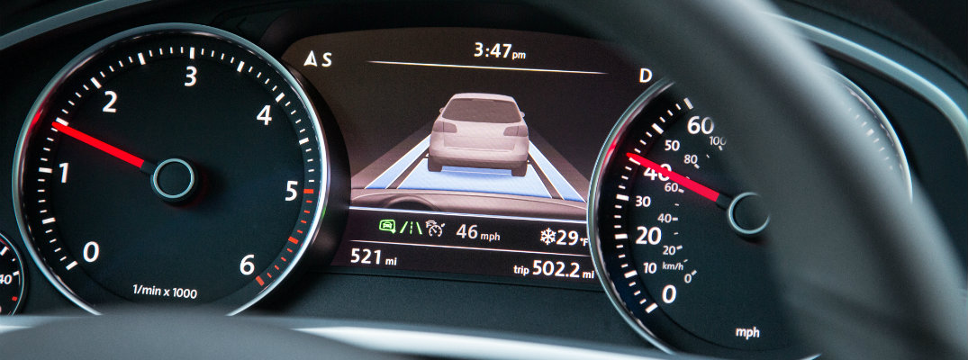
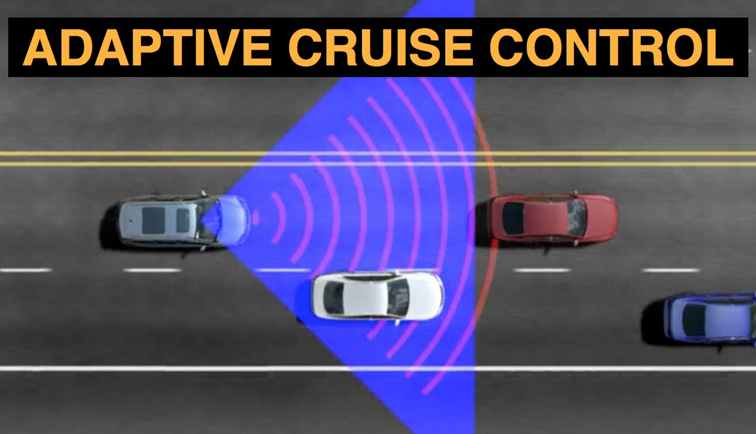
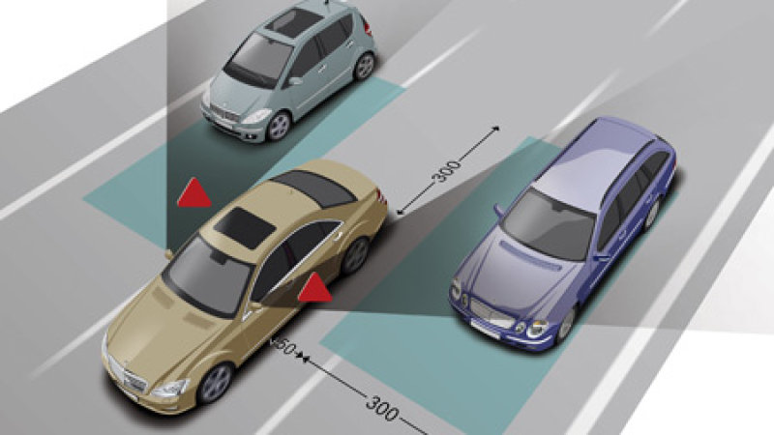
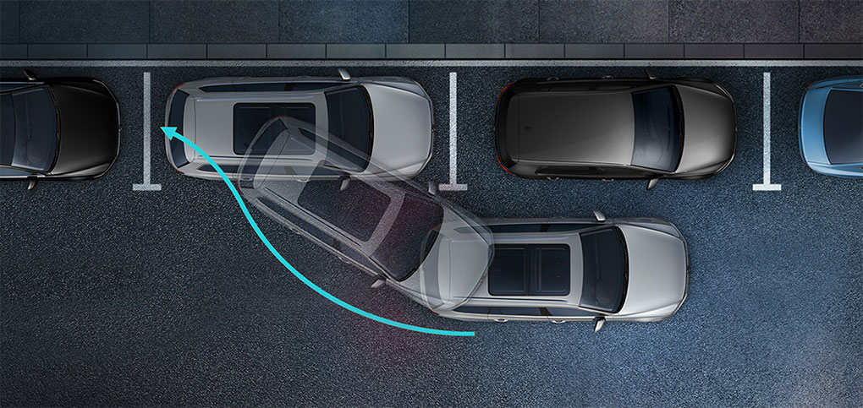
Notes:
We have nearly two decades of assists being developed.
Theres lane assist, that helps you keeping the lane.
Then brake assist, that tries to anticipate a braking event and prepares the brakes.
The park assist helps you park or even does it autonomously.
Blind spot assistance informs you about cars in your mirrors blind spot.
Adaptive cruise control keeps a safe following distance to the car ahead.
And many more. Now these 2 decades of development are being combined into

Slide 68
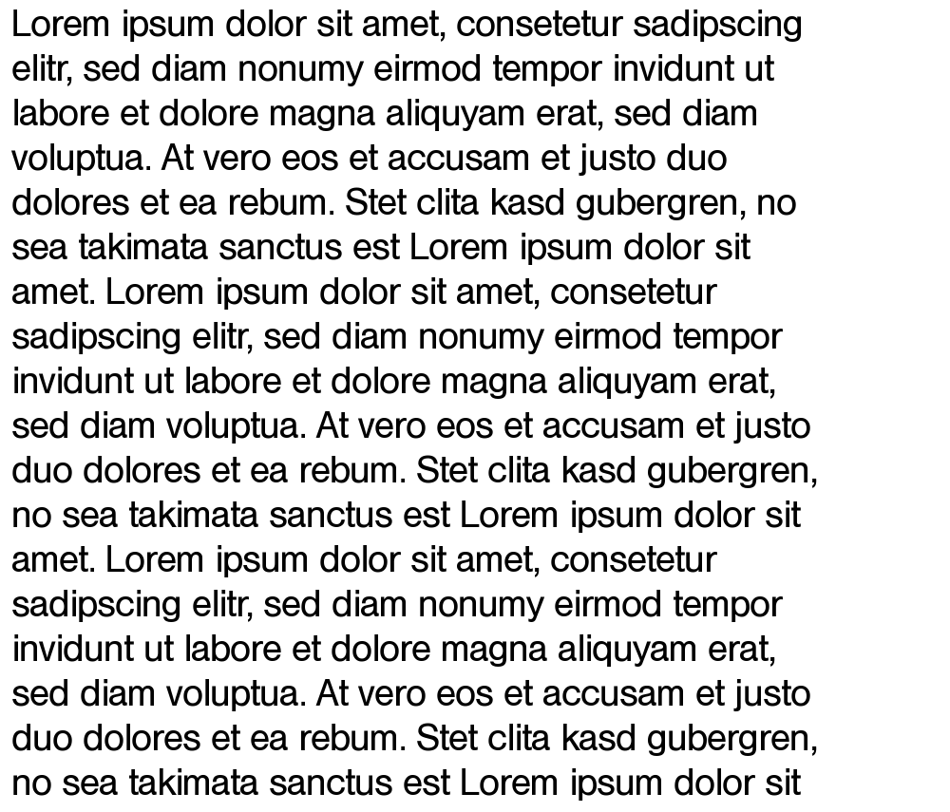

Compiler
Notes:
For software, we already have a program that generates code from a textual representation of the requirements.
It’s called “compiler”…

Slide 69

Compiler
Notes:
Of course, right now, the requirements have to have a certain form and structure. A very formalized representation. It’s called source code.
Did you know, that todays compilers are very mature, very sophisticated things? They can optimze code for performance, make complex analysis and find certain problems without ever executing the code.

Slide 70
AI
Compiler
Notes:
So essentially, this is what we want to get to. Create a least formal prose descrition, combined with some GUI sketches, and have the AI generate the source code for us. How do we get there?

Slide 71
AI
Compiler
simple
intuitive
easy-to-use
Notes:
Ironically, the easiest type of code to generate is test code. Because for that, you can use a very detailed specification … the existing GUI.

Slide 72

AI
simple
intuitive
easy-to-use
Notes:
Actually, what really happens is that AI creates an internal representation of the code.

Slide 73
AI
simple
intuitive
easy-to-use
read-back
Notes:
read-back hand-written / modified test cases

Slide 74
AI
read-back
Notes:
read-back hand-written / modified test cases

Slide 75

Automatically Fixing Bugs
https://code.fb.com/developer-tools/finding-and-fixing-software-bugs-automatically-with-sapfix-and-sapienz/
Notes:
generate patches / fix bugs / improve small parts of code

Slide 76

Notes:
This is how it starts. At first, it doesn’t look impressive. Like this was the start of the world wide web.
generate larger parts of the code
generate whole applications

Slide 77






Questions?
roessler@retest.de
http://retest.rocks

