Slide 1

How we bridged the gap between Manual
&
Automation Testing

Slide 2


Sunav Sodhani
Sr Android QA Engineer at Badoo

Slide 3
> 410 000 000
people all over the world use Badoo

Slide 4

Notes:
If you've ever caught the tube in London, the phrase 'Mind the gap' is probably carved into your brain.But if you think about it, the phrase can also be a real asset when it comes to working with professional teams. The ability to pick up on the gaps between teams and bring them closer can be one the most powerful weapons in your professional arsenal.

Slide 5



Automation Testers
Manual Testers
Notes:
Manual and Automation were separate ... they considered and had separate responsibility and work…
Separate Regression Testing
explain and glue the flow .. two different flows .. very discreet . . lifecycle of a task from eyes of both these people.

Slide 6
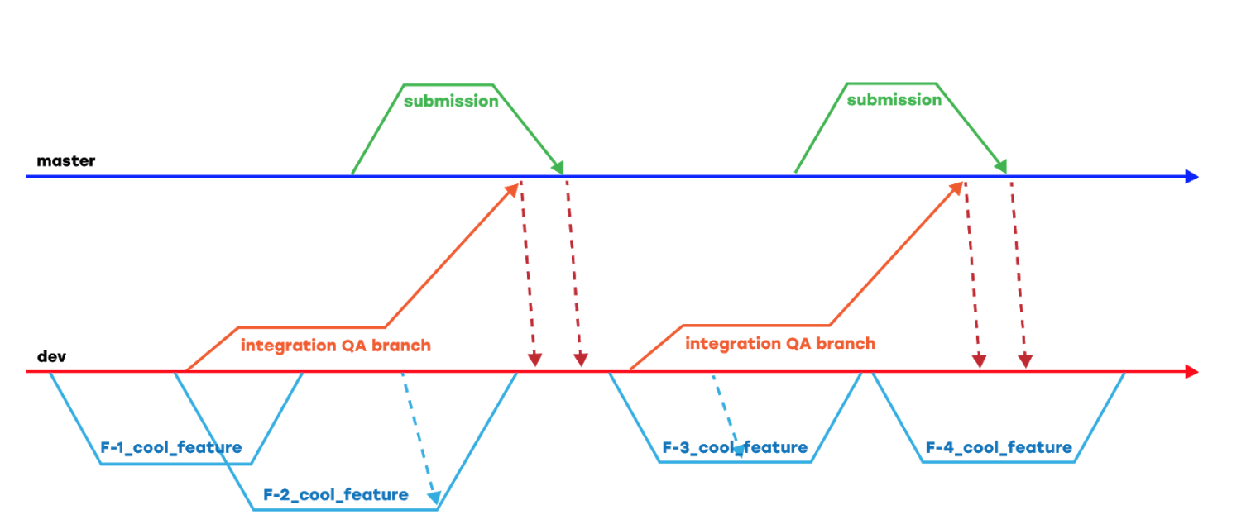
Our Development Flow
Notes:
its our usual development flow
release weekly for android and iOS and for all apps

Slide 7
Manual QA Flow
Exploratory Testing in 3 Stages
1
Branch QA
2
Integration
3
Release

Slide 8
No Involvement with Automation team
Notes:
so Automation is not included in any of these QA stages

Slide 9
Automation Test Flow
Responsible for Automation Tests
1
Tests Runs Nightly
2
Slow results
3
Long Time
Notes:
Automation Infrastructural problems
Automation nightly dev ( our stable branch) runs
Tests use to take quite a long time ...

Slide 10
WHICH tests to run & WHEN
Notes:
Automation guys take decision when to run auto tests and on which branch
- Whether automation is doing correct and which tests are needed tests and which are not. Was no clarity

Slide 11
No Involvement with Manual QA
Notes:
There was no review by any manual QA
end it similar way as no involvement was by automation team in previous case.

Slide 12

Notes:
what can go wring when no collaboration .. bridge fails…

Slide 13
Automation found the bug….. but didn’t prevent them
Notes:
—- Discovery of bugs was very later in stage ——
Output of automation was bugs... automation guy found a bug , logs in jira.. Problem was, this bug shouldn’t have come till release branch or our stable branch “dev”

Slide 14

Manual QA didn’t had any confidence in Automation
Notes:
Manual QA was not happy because bugs were getting detected quite late, and which would be found in early stages.

Slide 15
Problem was :
Automation was not able to use Manual QA’s expertise

Slide 16

Automation Testers
Developers
Manual Testers
Notes:
Moreover, we realised that there is a gap between developers and Automation as well.

Slide 17
Developers were blind towards Automation
Notes:
by the time Automation would give test results , developers ticket was already tested and deployed ….

Slide 18
Automation Team were blind towards Developers
Notes:
no one was interested and did not gave any feedback to automation..so automation also didn’t care

Slide 19

Vicious Circle
Notes:
So it was kind of a vicious circle , meaning an “endless circle “ or infinite loop situation.

Slide 20
How we Bridged the GAP
Notes:
We realised that we were getting value from automation… so we need to fill the gap

Slide 21
Alerted the Automation team about Infrastructural problems
Notes:
different tasks were involved in bridging the gap..1st is this

Slide 22
Improving Test Run time
1
Scaling Infrastructure

Slide 23
Improving Test Run time
1
Scaling Infrastructure
2
Moving tests from real device to emulator

Slide 24
Improving Test Run time
1
Scaling Infrastructure
2
Moving tests from real device to emulator
3
Creating Device Server

Slide 25
Test Execution time reduced from 4 hrs to
20 minutes

Slide 26
Using Manual QA’s expertise in Automation
Notes:
- manual qa know best what to test, as they know product much better than automation guys
- they know more in what conditions ap crashes , corner cases , putting app in background , killing app, push notifications, deeplink, pip mode.

Slide 27
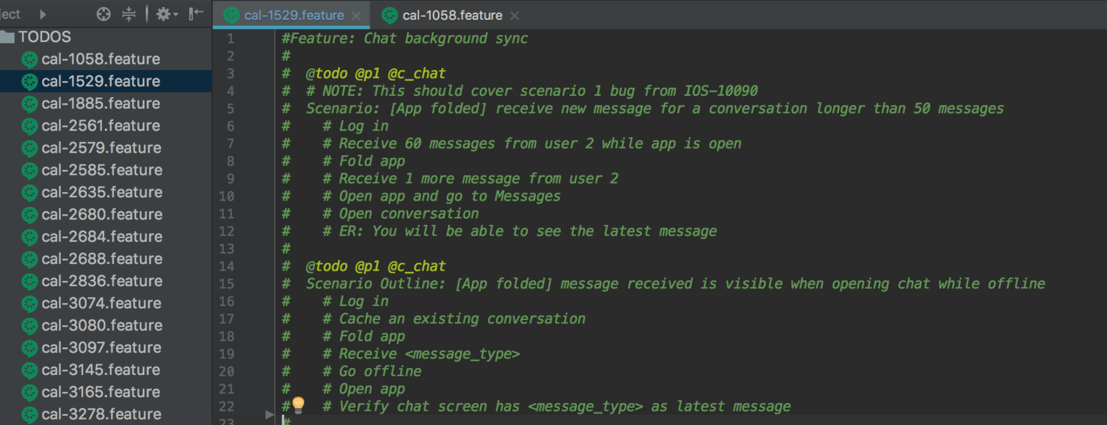
Manual QA Adding @ToDo Scenario
Notes:
manual qa know best what to test, as they know product much better than automation guys.

Slide 28
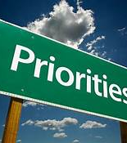
P1 = Must automate
P2 = Good to automate
P3 = After P1 / P2 are cleared

Slide 29
- Add missing tests as @ToDo
- Add ToDo for new features as well as bugs
Notes:
manual qa know best what to test, as they know product much better than automation guys.

Slide 30
Quality & Coverage of Tests

Slide 31
Automating the whole process to use more Automation
Making the Automation more usable for both Manual QA & Developers
Notes:
- manual qa know best what to test, as they know product much better than automation guys.

Slide 32
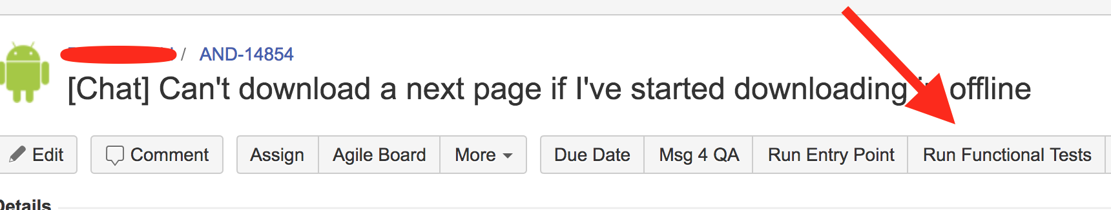
1
Buttons in Jira to Trigger Tests in 1 Click

Slide 33
2
Fire up tests Automatically
In-Progress to Resolved

Slide 34
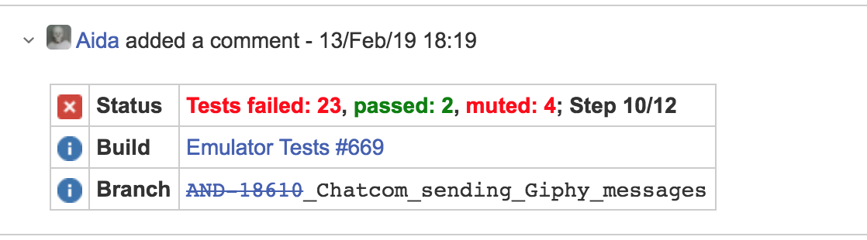
3
Test results visible in JIRA itself
Notes:
problems are isolated very easily now

Slide 35
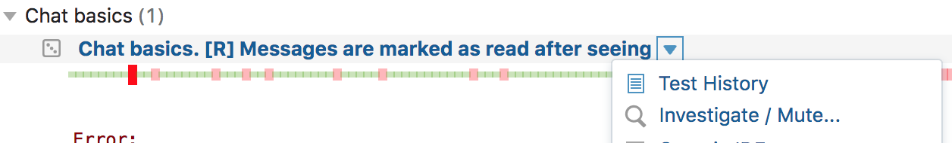
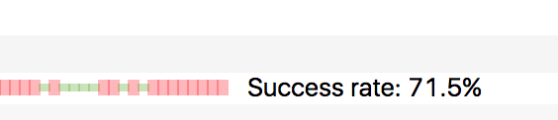
4
Test History is shown clearly
Notes:
problems are isolated very easily now

Slide 36
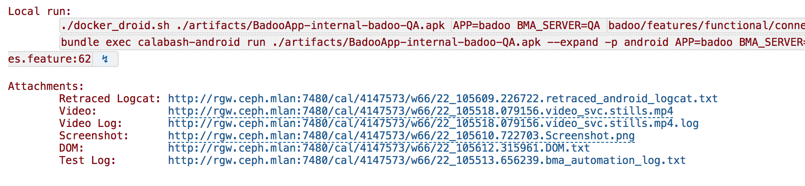
5
Provide information to analyse test failures
Notes:
problems are isolated very easily now

Slide 38
Manual QA currently
1
More Transparent & Confidence

Slide 39
Manual QA currently
1
More Transparent & Confidence
2
Manual QA
sharing equal responsibility for health of Automation tests
Notes:
- mentioned automation checker of the week here for point 2….

Slide 40
Manual QA currently
1
More Transparent & Confidence
2
Manual QA
sharing equal responsibility for health of Automation tests
3
Manual QA Analysing tests — Fixing them — making new features also

Slide 41
Manual QA currently
1
More Transparent & Confidence
2
Manual QA
sharing equal responsibility for health of Automation tests
3
Manual QA Analysing tests — Fixing them — making new features also
4
Full Involvement between both teams

Slide 42
Focus of Automation team now
1
Automation Team helps in building more tools

Slide 43
Focus of Automation team now
1
Automation Team helps in building more tools
2
Framework Improvement

Slide 44
Focus of Automation team now
1
Automation Team helps in building more tools
2
Framework Improvement
3
Complex tasks

Slide 45
Developers using more and more Automation
1
Confidence in Auto Tests now
Notes:
When major refactoring happens, devs rely on auto tests now.

Slide 46
Developers using more and more Automation
1
Confidence in Auto Tests now
2
“QA=NO” battles are won and automation is only weapon
Notes:
To change : change point 2 , explain more better about QA=NO . “QA=No battles are won and automation is only weapon—— explain it completely.. what was history> why we wanted it > all tests are reviewed already.”

Slide 47
Developers using more and more Automation
1
Confidence in Auto Tests now
2
“QA=NO” battles are won and automation is only weapon
3
Developer watches and trusts
Notes:
developer watches and trusts.

Slide 48
Future Plans

Slide 49
1
Lot of Tests now
Payments
tests
Real Device
tests
1700
tests
Emulator
tests
Badoo
Livestream
tests
Notes:
1- discuss on which level tests should be covered for tasks taken from @todo backlog
- to shape our pyramid of automation that how its done…. we make sure our pyramid is not broken

Slide 50

E2E Tests
Lack of Integration Tests
Unit Tests
Notes:
1- discuss on which level tests should be covered for tasks taken from @todo backlog
- to shape our pyramid of automation that how its done…. we make sure our pyramid is not broken

Slide 51
2
MANUAL QA= NO , AUTOMATION = YES
Notes:
2- Feature is ready when all tests ( at all levels) are ready. when it is covered by tests. because it helps to achieve having, no manual testing in later stages.
feature is chosen > dev and qa both sync > create test scenarios > chose which level they will be implement them > feature and tests implemented parallel

Slide 52
Takeaways

Slide 53
1
Automation helps everyone in the team

Slide 54
1
Automation helps everyone in the team
2
Manual QA have bigger roles to play towards Automation

Slide 55
1
Automation helps everyone in the team
2
Manual QA have bigger roles to play towards Automation
3
Change is not easy but demand of time

Slide 56
1
Automation helps everyone in the team
2
Manual QA have bigger roles to play towards Automation
3
Change is not easy but demand of time
4
Design your process as fault proof

Slide 57
Cheers!
References :
Evolution of mobile test automation at Badoo: from 0 to 45 hours of tests
Remote iOS device server: scaling iOS testing

Slide 58
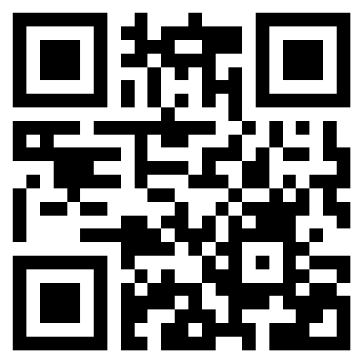
Join US !

