Slide 1





How to improve testing organization with TMMI
Karolina Zmitrowicz

Slide 2

Plan
Improvement – do we really need it?
Improvement – what options do we have?
TMMI – it’s not so terrible!
TMMI – does it work? Case study.

Slide 3

Do we need to improve things?

Slide 4

What we think we do…

Slide 5

What we actually do…

Slide 6
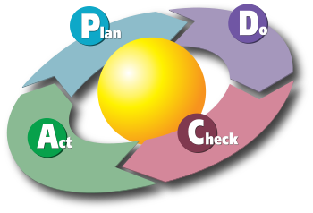
Attempt no. 1 – Deming cycle

Slide 7
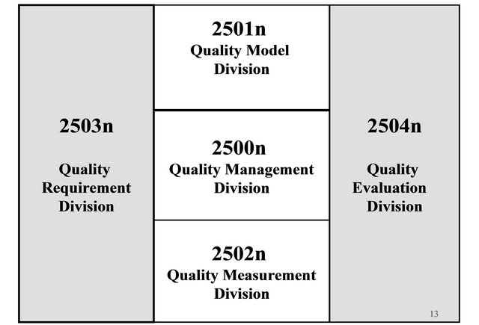



Attempt no. 2 – Standards

Slide 8




Attempt no. 3 – Maturity models

Slide 9

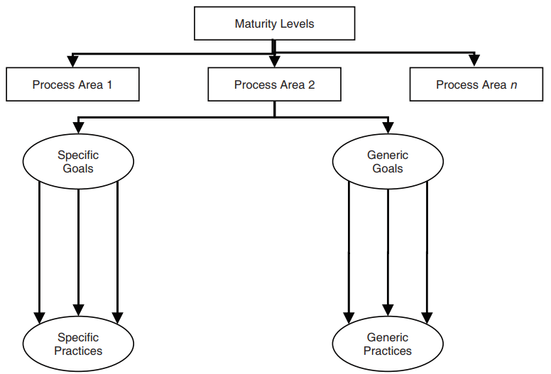
Model
Structure
Process area
Generic and specific goals
Generic and specific practices
Process framework

Slide 10
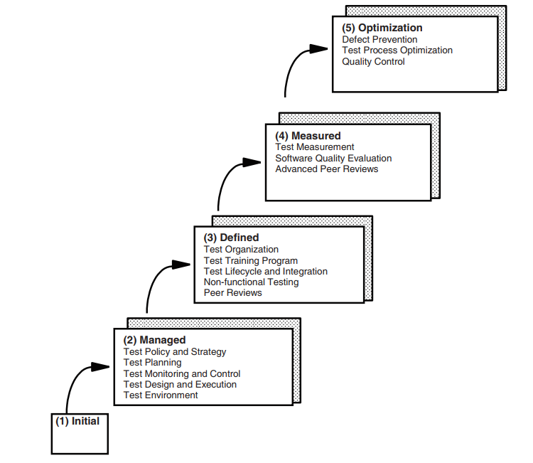
Model

Slide 11

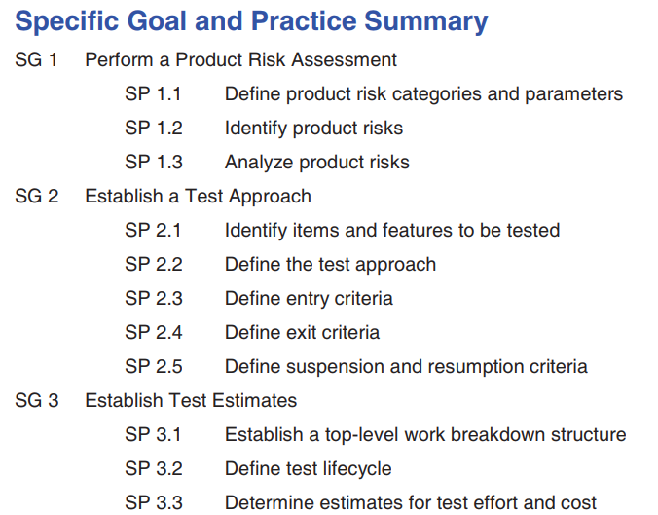
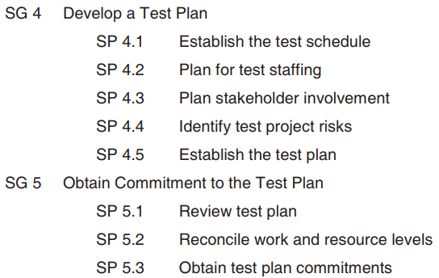
Model

Slide 12
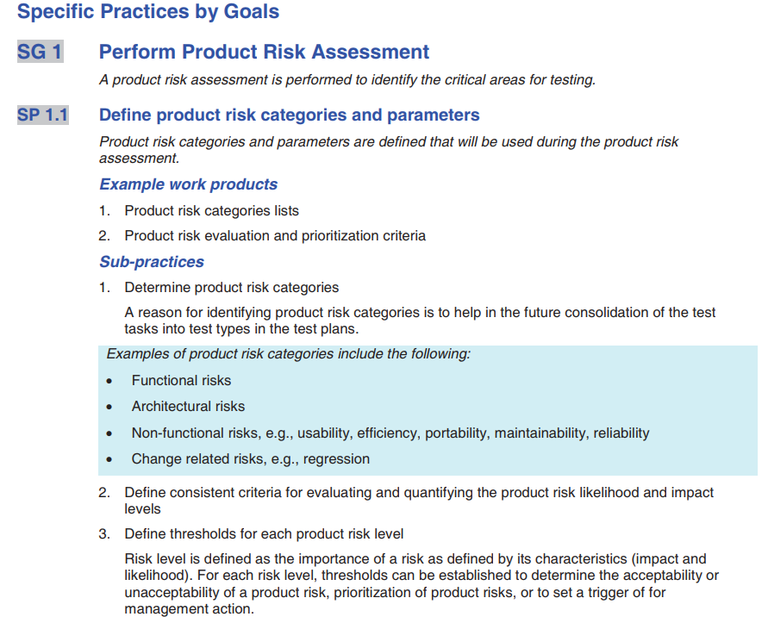
Model

Slide 13
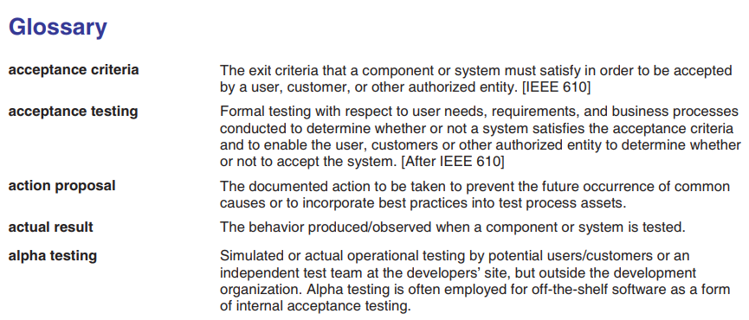
Model
Glossary

Slide 14
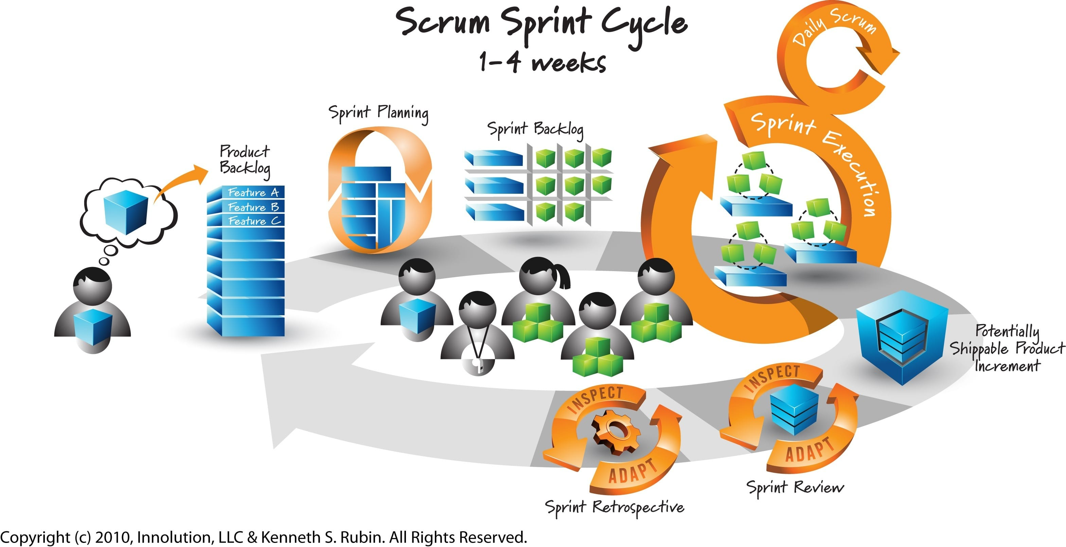
Model
Practical application

Slide 15

Model
Practical application
Challenges
Poor communication
No work standards
Problems with quality of artifacts
No consensus regarding testing scope and approach
Mindset: PO and SM: „What is QA”?

Slide 16
Model
Practical application
Solution
TMMI practices as a mean for building own approach

Slide 17


Model
Practical application
Solution
TMMI Level 2, 3 and 4
Tools: Confluence + JIRA (Zephyr)
Knowledge base – information architecture
DoR and DoD
Workflow
Test case management
Requirements management
Defect tracking
Test strategy
Test plan and scope
Monitoring and reporting
Knowledge base

Slide 18

Make it happen

Slide 19
Building better quality in IT
Stowarzyszenie Jakości Systemów Informatycznych ul. Poznańska 16 lok. 4 00-680 Warszawa
Karolina Zmitrowicz k.zmitrowicz@sjsi.org

