Slide 1

Linguistic Analysis Based Test Cases

Slide 2
***Nouns and Verbs, Adjectives and Adverbs
Some software systems exist to manipulate specific kinds of data
The kinds of data sets are the nouns
The manipulations are the verbs
Adjectives and adverbs affect the manipulation
Identify these items
Write test in sentences
Even trace coverage
***Rex Black: Effective and Efficient Testing Course
For example, an ATM system should
Accept deposits
Process withdrawals
Answer inquiries
Kinds of deposits, withdrawals, inquiries?
Quickly? Securely?
This test design technique comes from Elisabeth Hendrickson

Slide 3
Challenges with Noun-and-Verb
Challenges in using the technique
Often Requirements are not sufficiently detailed
Extracting enough Noun and Verbs is difficult
Writing complex scenario based tests from this technique is difficult
A more holistic approach will be to perform linguistic analysis of the requirements and extend the technique

Slide 4
Extension
Extract the nouns and verbs
Use 5W1H to extract adjectives, adverbs and more information
Use pre and post conditions to extract more nouns and verbs
Enumerate properties of every noun
Break down these properties to base elements
Use boundary values, equivalence classes on the base elements
Write tests for individual properties
Combine operations (verbs) to write scenario based test cases of arbitrary complexity
Create test cases using pre and post conditions

Slide 5
Applying the Extended Technique

Slide 6
Example: File Open
Requirement fragment:
  The <given> application allows users to open supported files.
With the given requirement fragment
  Very few meaningful test cases can be written using any test design technique
  Using our extension we plan to write extensive test cases
Let us
  Extract Nouns
  Extract Verbs
  Extract Adjectives and Adverbs

Slide 7
File Open…
Noun
  Look for properties of this noun
  Also ask What, Why, When, Where, Who, Which, How, How much/many
Verb
  Look for properties of this verb
  Also ask What, Why, When, Where, Who, Which, How, How much/many

Slide 8
File: Properties
Enumerate all the properties of FILE
File has
Name
Size
Location
Extension
Metadata
  Creation date
  Accessing date
  Modification date
State

Slide 9
File: Properties
Type
Access Control
Password protection
Attributes
Compression Support
Encryption Support
Creating application version

Slide 10
Breaking Down the Properties: Name
Name - is a string
  String - is a SEQUENCE of Characters
  Sequence = Length of string
Characters are elements of some valid character set
(THUS) Name
  Has a length
  Has a set of allowed characters
  And some characters are not allowed (/ or \ in file name on windows, spaces on Linux/Unix platforms)

Slide 11
Applying Boundary Values
Name/String
  Has a length (maximum and minimum)
  Has a set of allowed characters (valid equivalence class)
  And some characters are not allowed (invalid equivalence class)

Slide 12
Properties: Location
Location
  Is a string
  Has a length (maximum and minimum)
  Has a set of allowed characters (valid equivalence class)
  And some characters are not allowed (invalid equivalence class)
Also denotes physical location
  On a locally connected drive (HDD, CD, Floppy…)
  On the LAN
  Using UNC path
Other operating systems (e.g. Linux connected using samba)
On a web page as a link

Slide 13
Properties: State
State
  in use/not in use
  Saved/unsaved
In use/open
  Unmodified
  Modified
  New
New/Modified
  Without data
  With data

Slide 14
Properties: Type and Extension
Type:
  Supported/not supported by the application
  Binary or Text
  Valid/invalid (corrupt)
Extension
  With extension
  Without extension
  Correct extension
  Incorrect extension

Slide 15
Properties: Attributes
Read only
Writable
Archive
Hidden
…

Slide 16
Dealing with the Verb(s)
Applying 5W1H
Open What?
  File with various properties
  Supported and unsupported files
  …
Open Where?
  Supported Operating Systems
    Application under test
    Browser plug-ins, if supported

Slide 17
Dealing with the Verb(s)…
Open how?
Open in various ways
  double click
  drag and drop
  command line
  application menu
  open with
Open how many?
  Open one (minimum number of) file
  Many files
  Max. number of files that can be opened simultaneously…
How fast
  How much time does it take to open the file?

Slide 18
Some Simple Positive Test Cases
Open a (supported) file
  Minimum size
  Maximum size
  Minimum name length
  Maximum name length
  Located on a network drive/web
  With and without appropriate extension
  Created using older/newer version of creating application
  Password protected
  Read-only
  …

Slide 19
Some Simple Negative Tests
Open file(s) of
  Unsupported type
  Changed extensions
  Corrupt file
  Invalid/non-existent name
  …

Slide 20
Scenario-Based Tests
Open a new file. Open another existing but closed file.
Open an already open file.
Open an existing file. Modify it. Open the same file again.
Open an existing file. Modify it. Open another file.
Open a local file. Open another file on the web.
Open multiple files together. Check performance
Open a very large file on the network. Check performance.
Repeat the Open operation a number of times (repetitive tests for resource leaks…)

Slide 21
Pre-Conditions
Before the operation is performed on the nouns think what conditions should be satisfied?
For example, before file can be opened
  File should exists
  Application to open the file should be installed
  Activation of the software is required?
  Permissions need to be checked?
  Preprocessing needs to be done?
  Anything else?

Slide 22
Post-Conditions
OK, I have performed the action. Now what?

Slide 23
Expanding the Requirement
What (after file open)?
  File is opened
    Where
      in the application window
      What are properties of application window?
      Location on the screen
      Size of the window
      State of GUI elements such as menus/buttons (enabling/disabling etc.)
    What are the properties of OPEN FILE?
      Cursor location
      Zoom level
      …

Slide 24
Writing More Tests
What is the position of application once file is opened
What is the cursor position after opening the file
At what zoom level does the file open?
…

Slide 25
Food for Thought
A string needs to be displayed
  What is the encoding?
  What is the font for display?
  Default font?
  Size?
  Color?
Are Nouns related to each other?

Slide 26
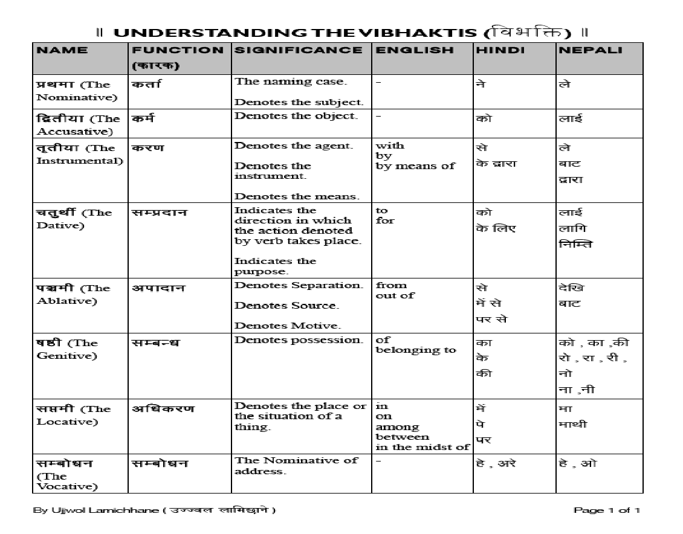
Example

Slide 27
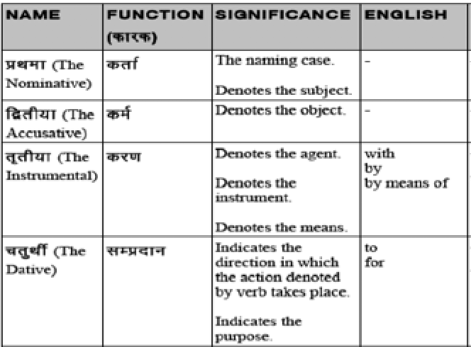

Slide 28
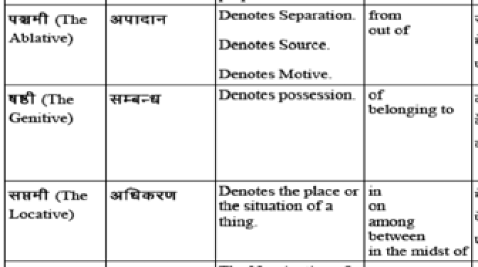

Slide 29
Explanation
(Karta)-Subjective or nominative
(Karma)-The objective
(Karan)-Means of that deed
(Sampradan)-The receiver of the action
(Apadan)-Producer and
(Adhikaran)-Base of the deed
Now imagine what can be done with this analysis if nouns and verbs could do so much...

Slide 30
Thanks
Questions

