Slide 1
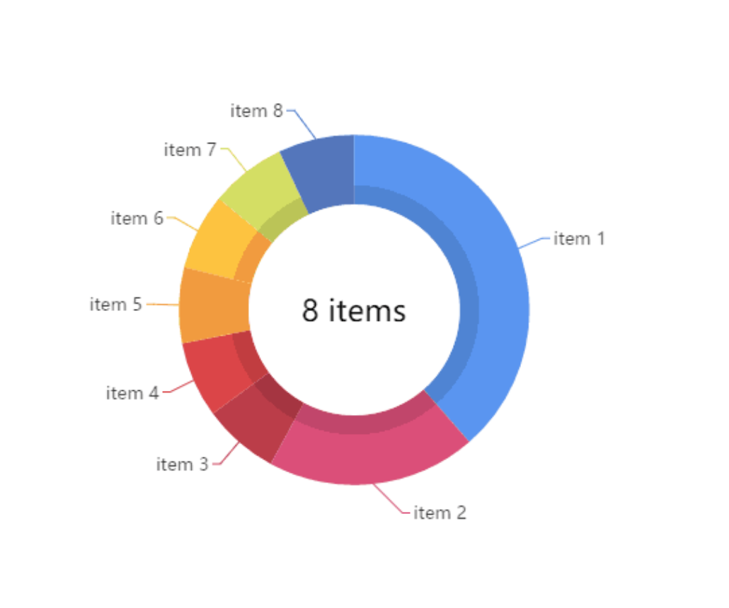
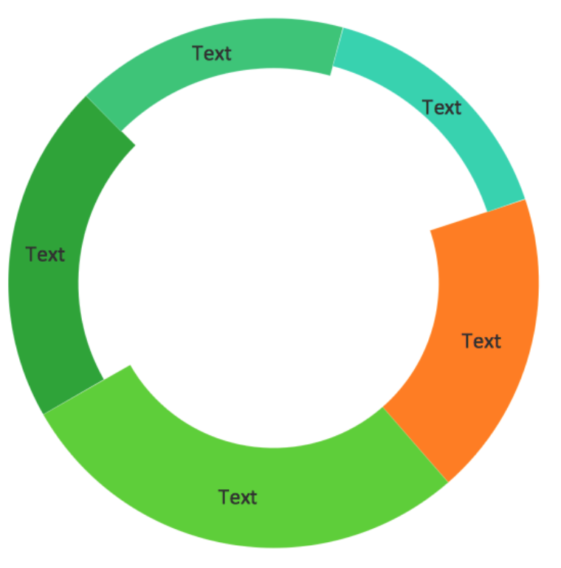

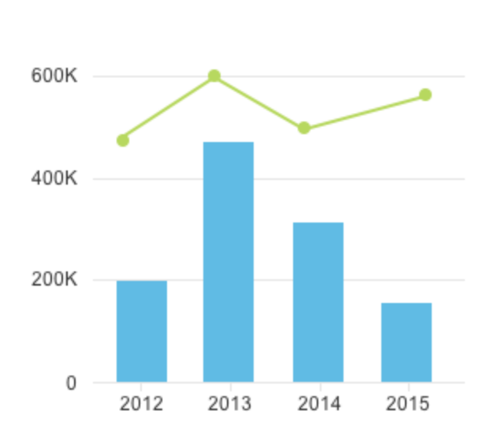

Analytics: How Your Users Can Help You In Testing
Hanna Kliachkovska
SQA Engineer @ Autodesk

Slide 2

More information:
Linkedin:
Hanna Kliachkovska
Email: hanna.kliachkovska@autodesk.com
SQA Engineer
Autodesk Tel Aviv

Slide 3
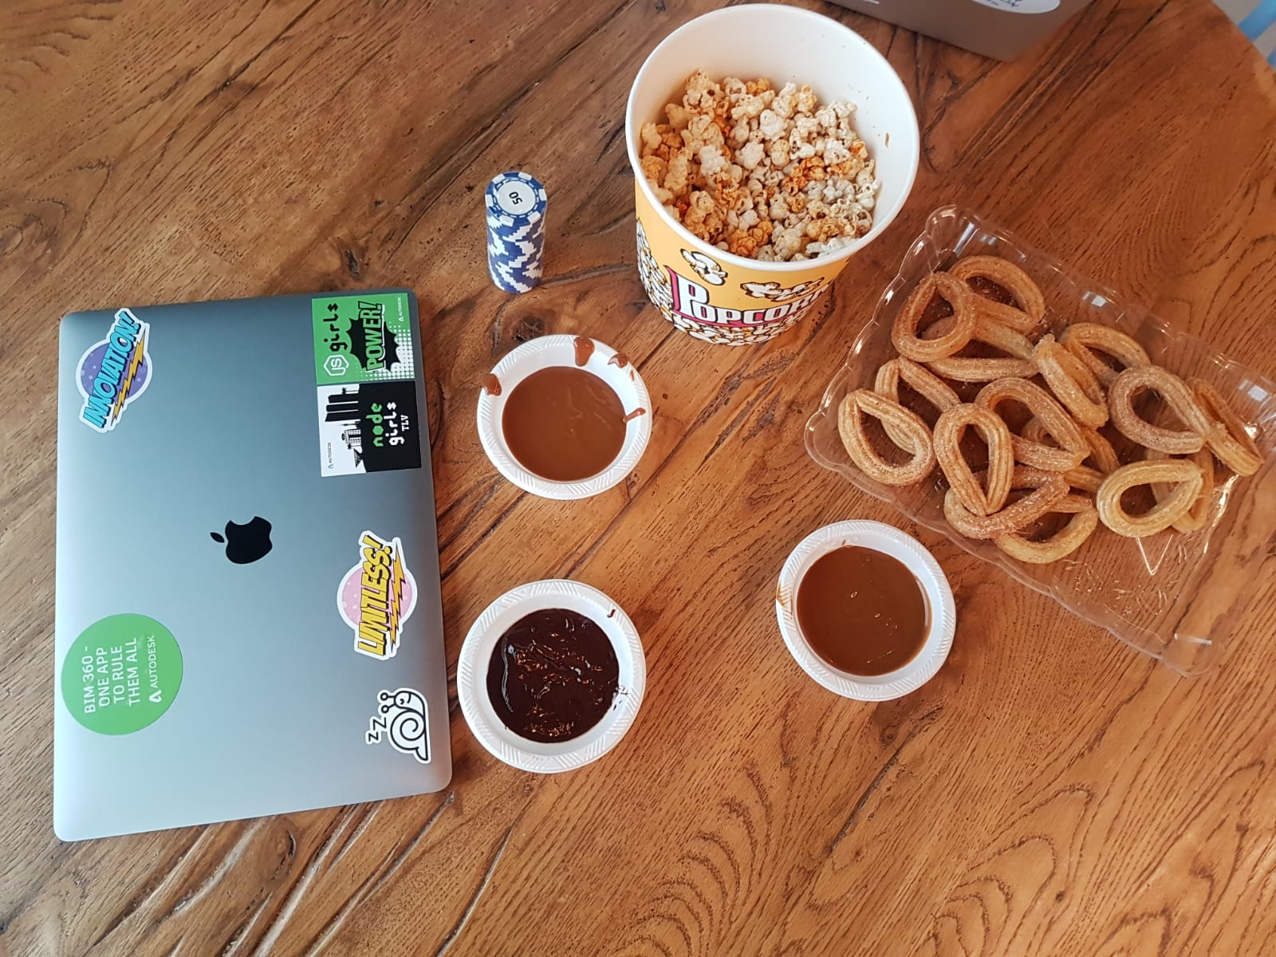
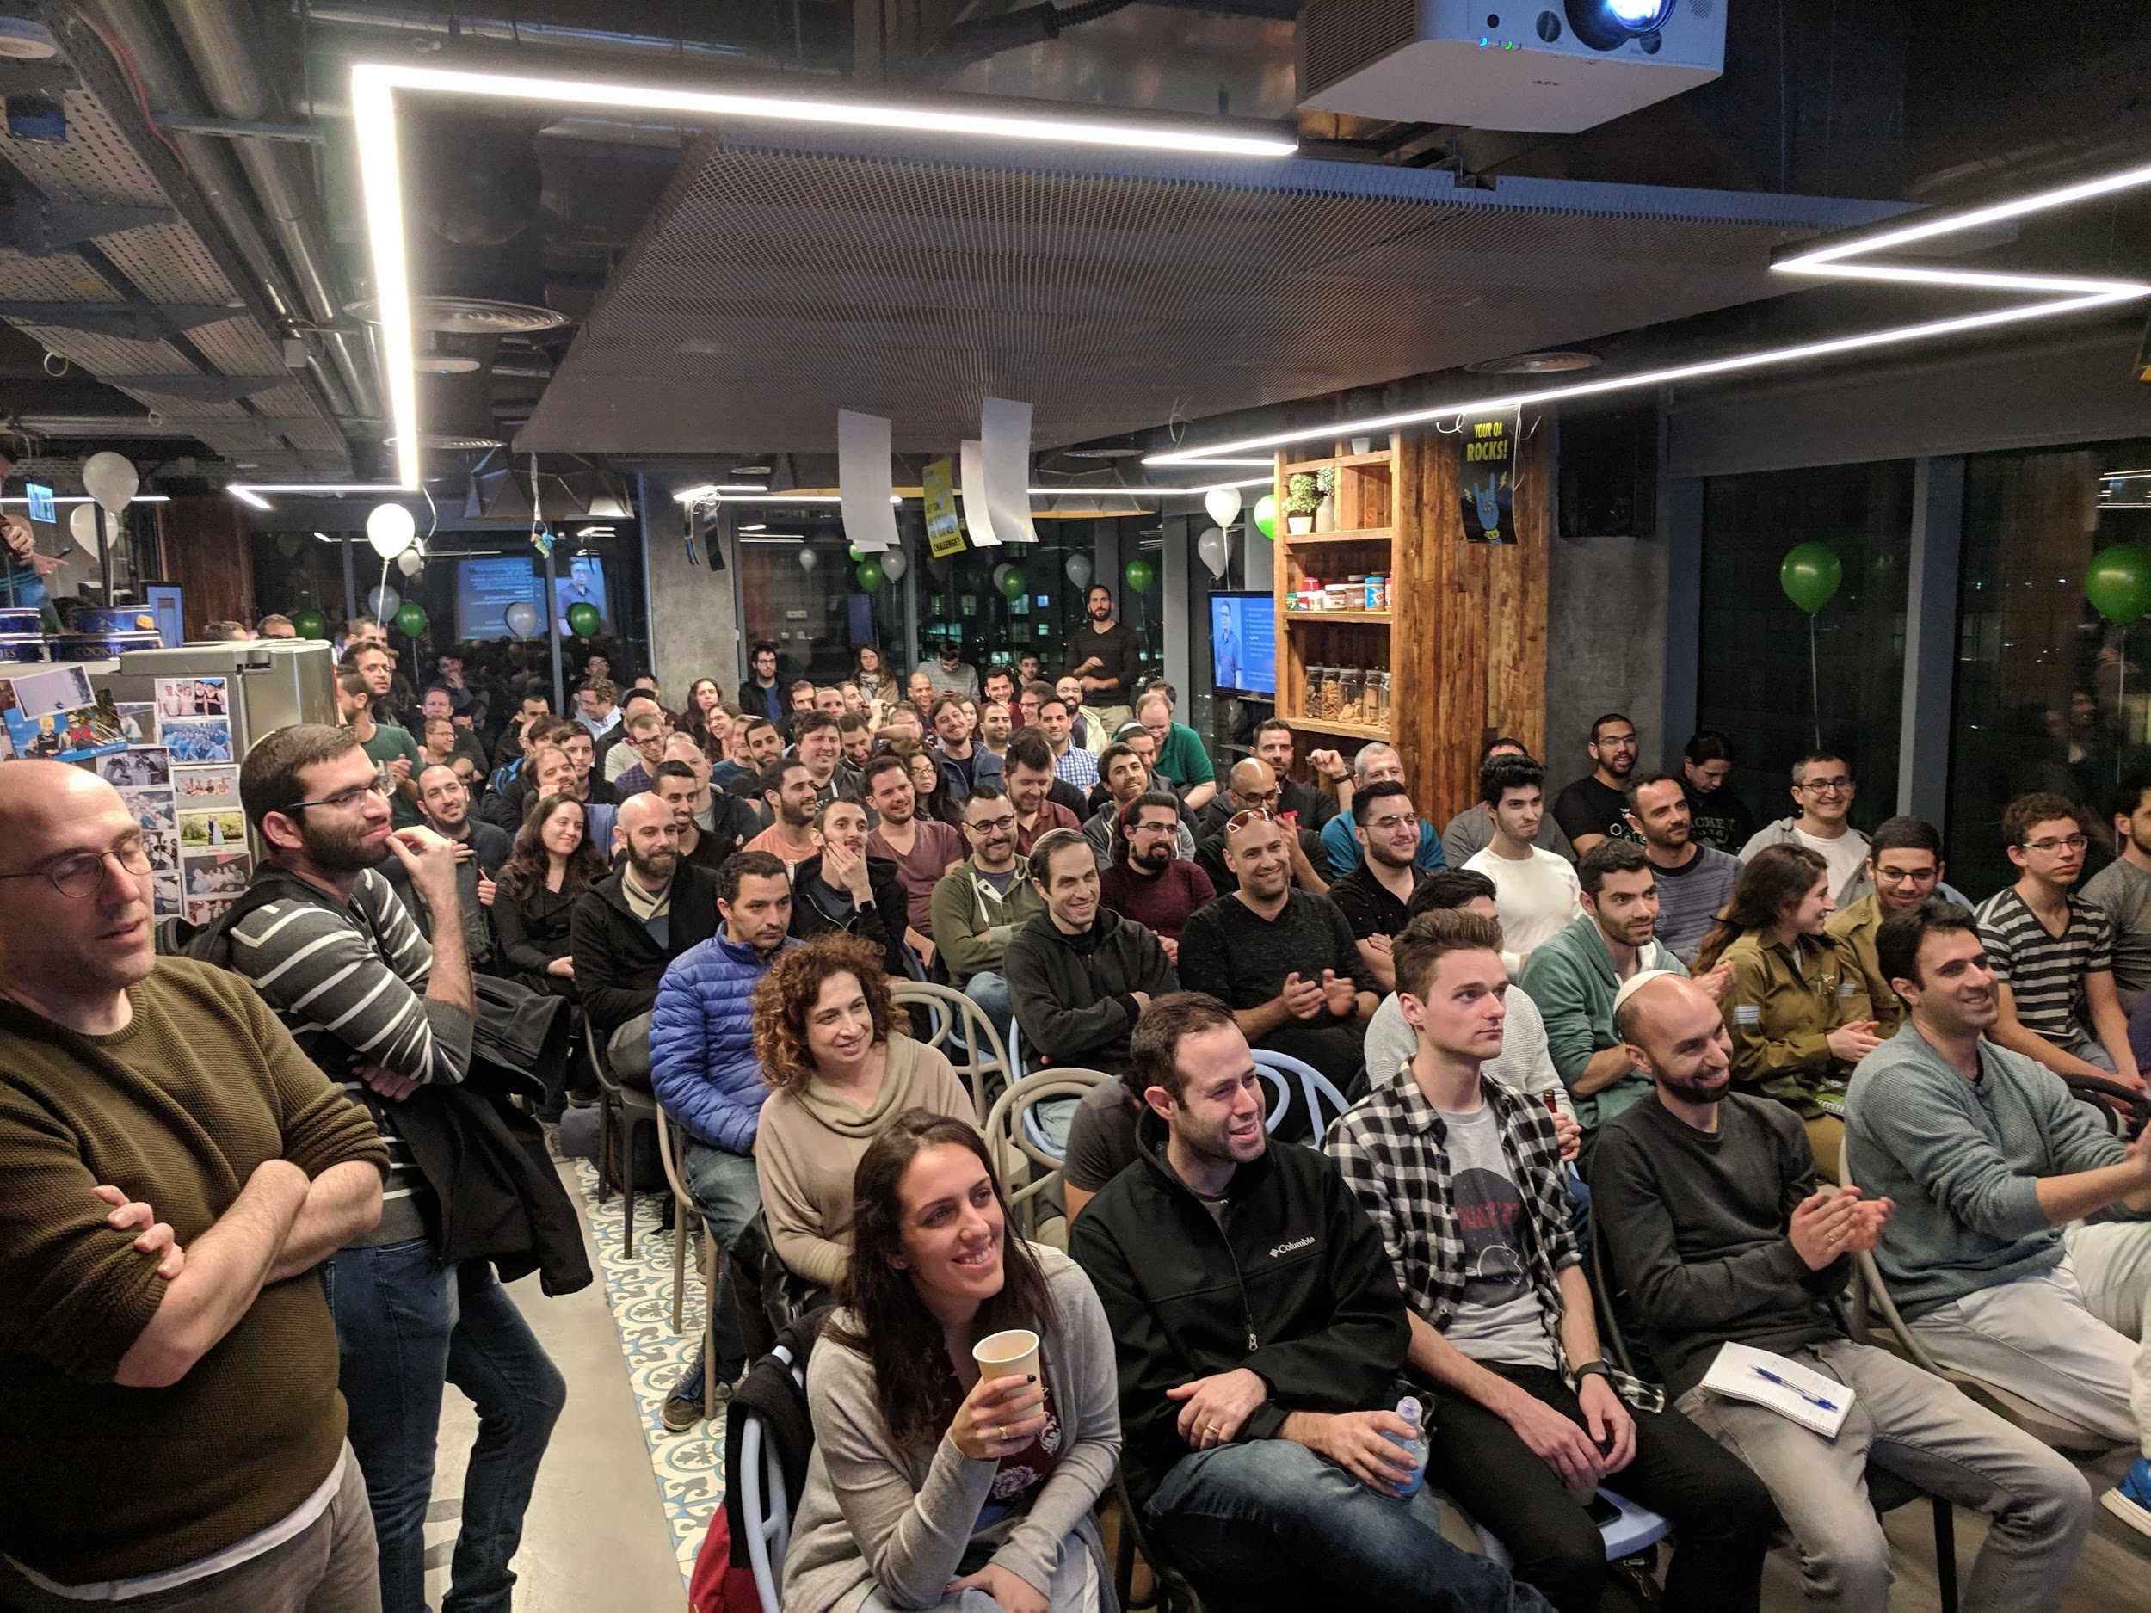


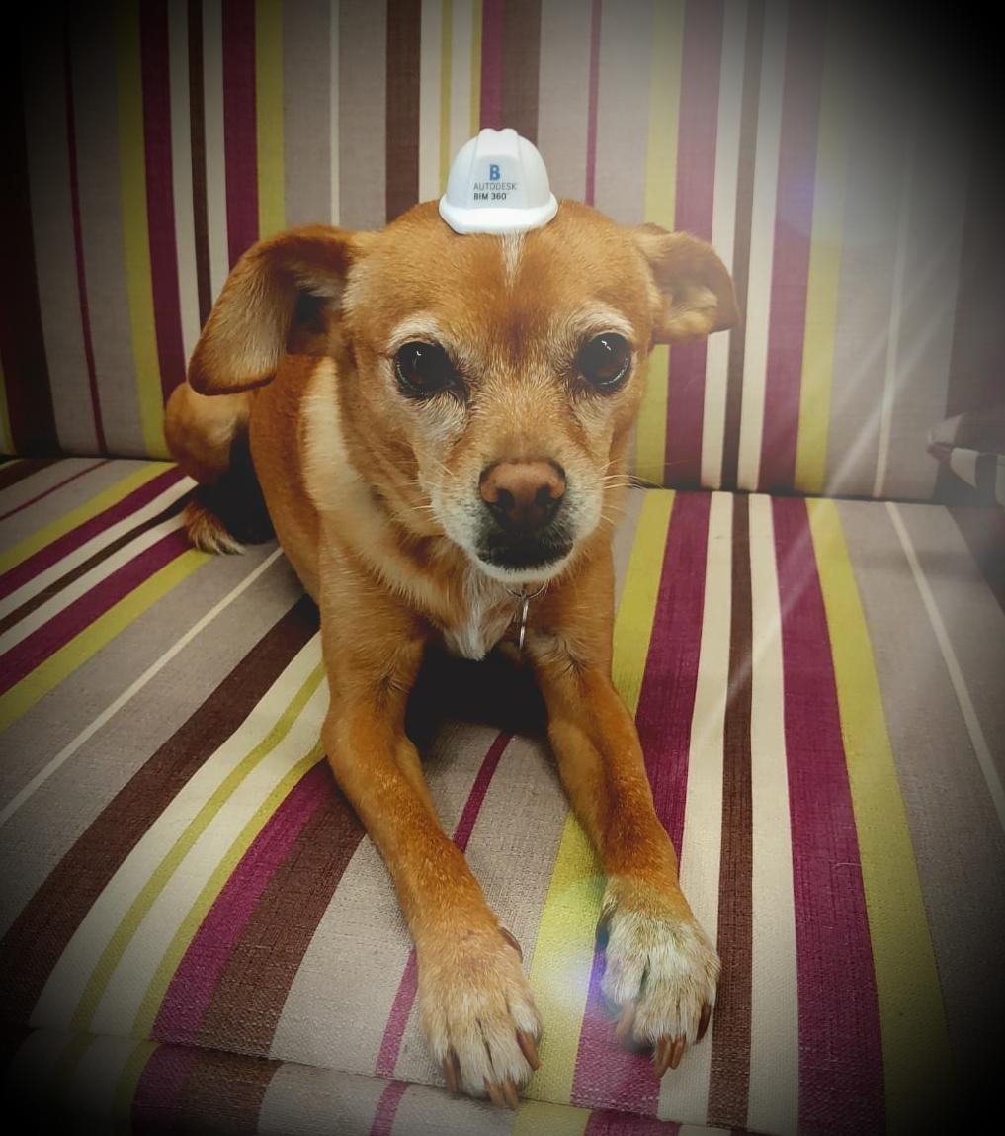


Slide 4

WHAT TO CHECK???

Slide 5

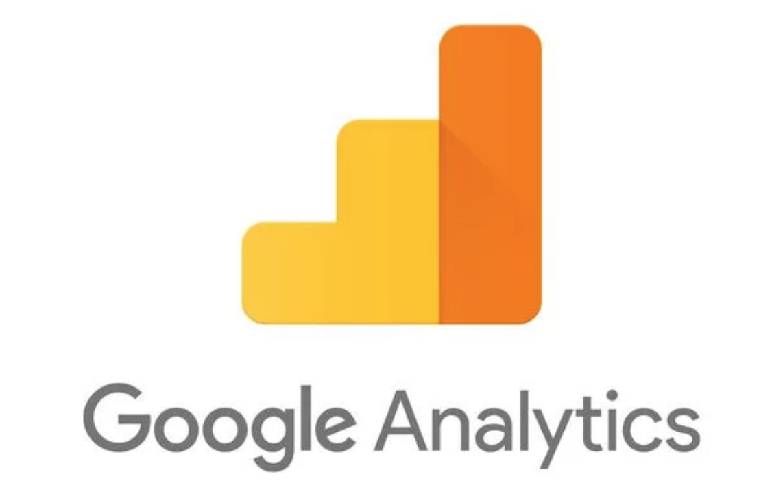


User’s perspective
Our analytics tools
Technical side

Slide 6
Let’s talk about Mixpanel

Slide 7
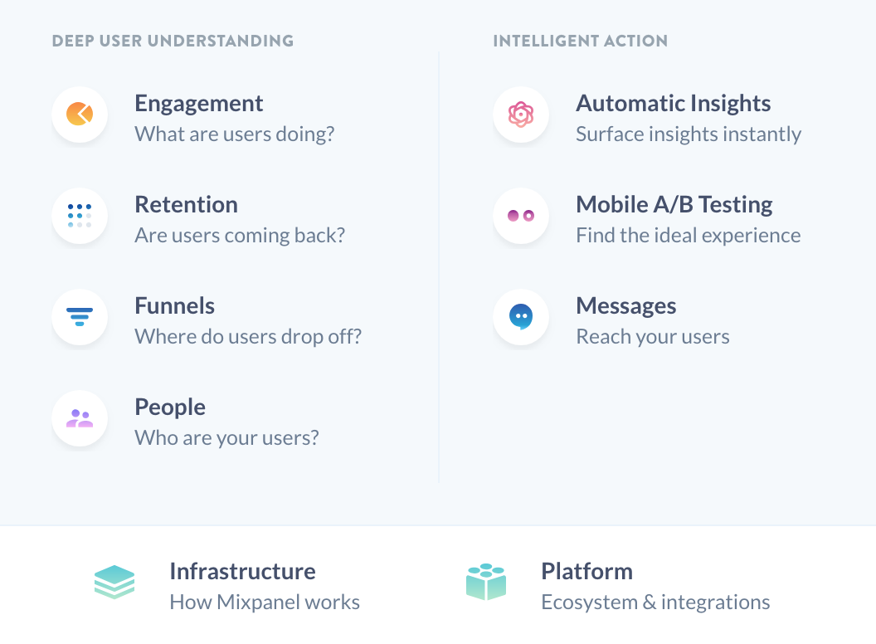
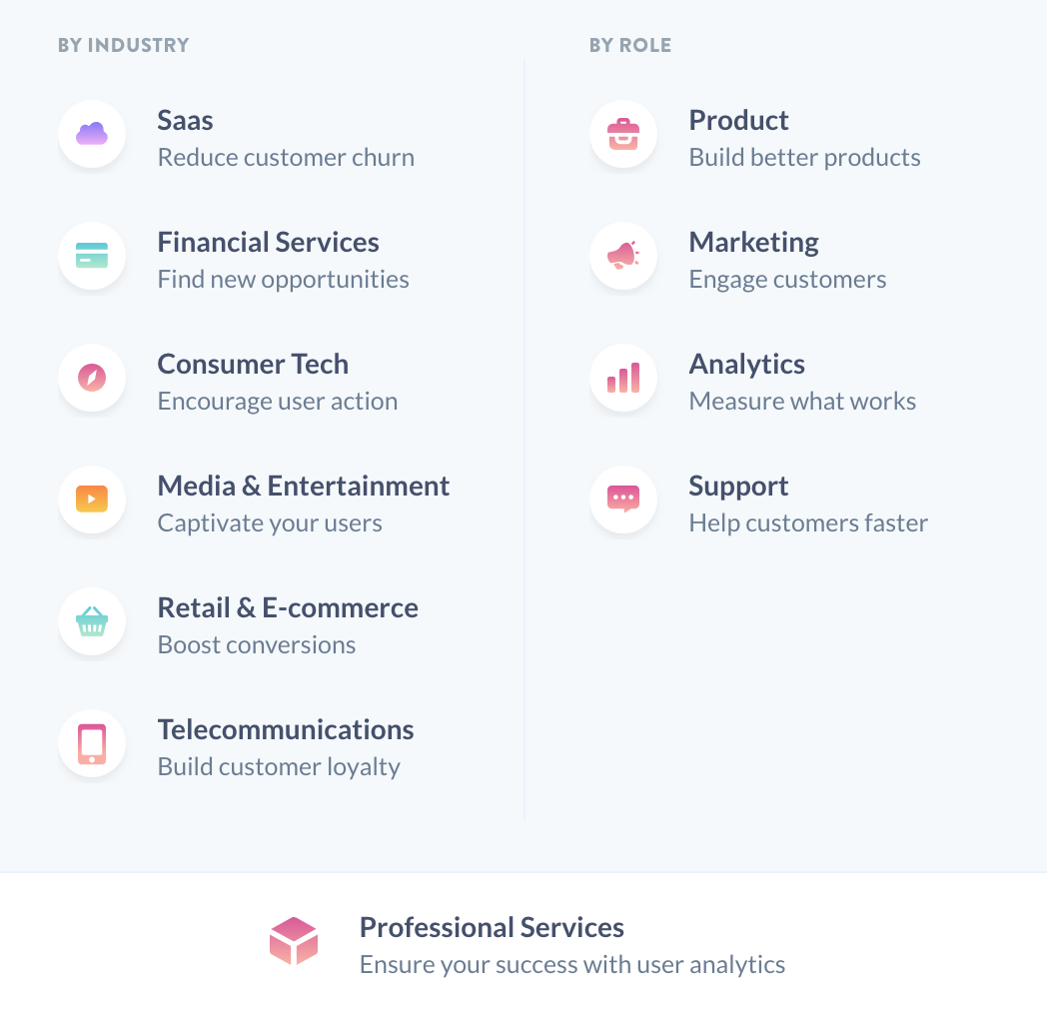
Features & Solutions

Slide 8
Examples of how we use it

Slide 9
Events
Parameters
Examples:
Session start
Login
Edit markup
The list of events which we want to monitor.
Examples:
Project
Status
Error code
The list of information which we want to receive with a chosen event.
And, of course, we need to decide on which moments we need to send the events

Slide 10
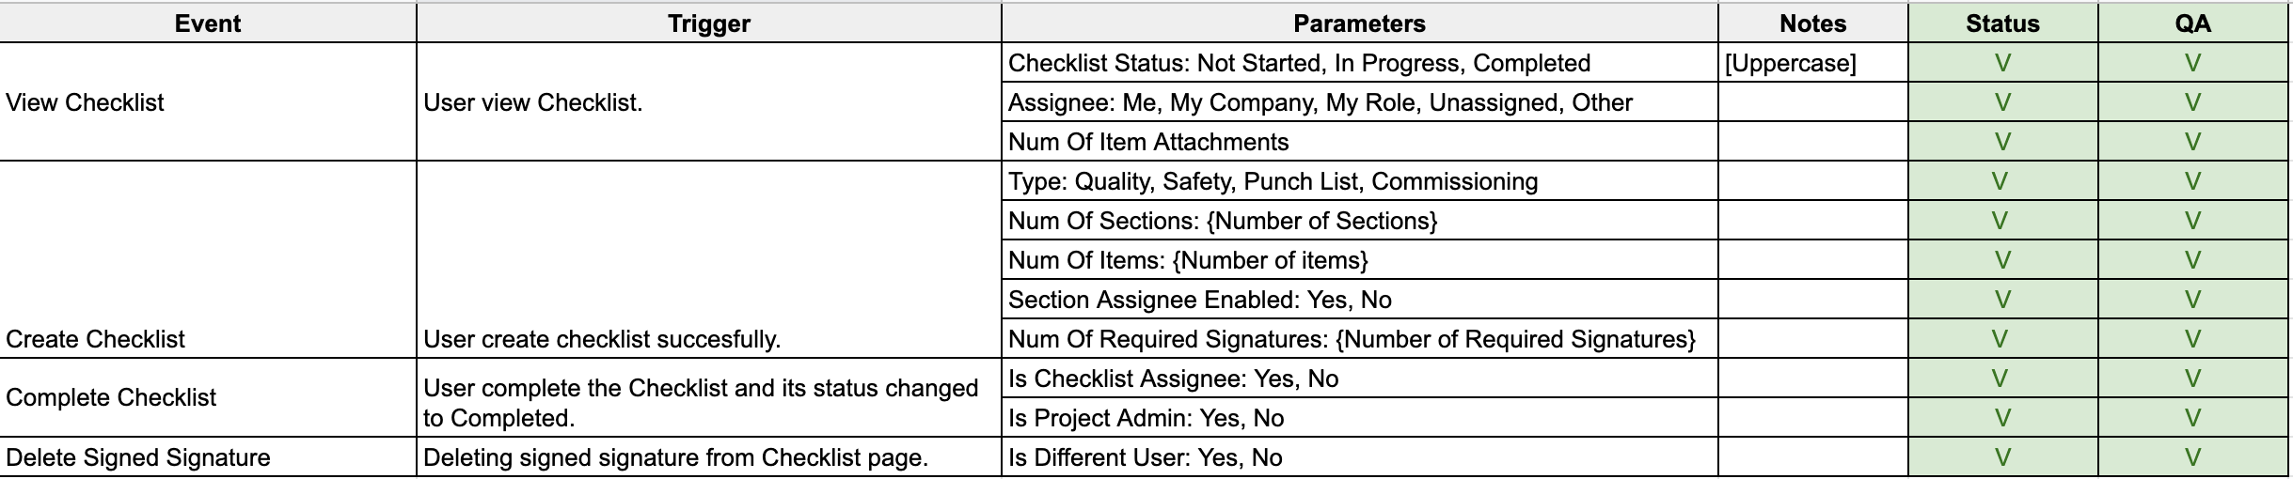
Analytics for one of the features

Slide 11
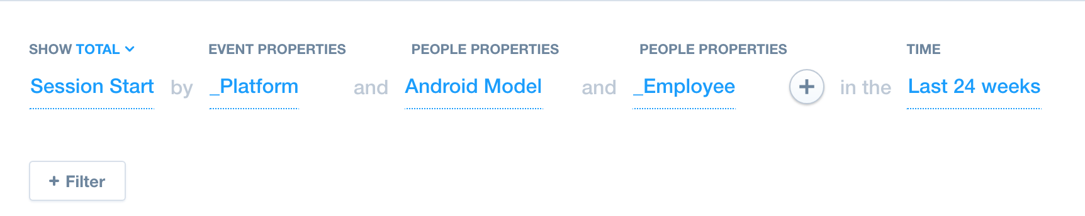
Top devices
We choose an event which means that user start to work with our application and add a few breakpoints:
P.S: You can filter by unique users or by your TOP customers

Slide 12
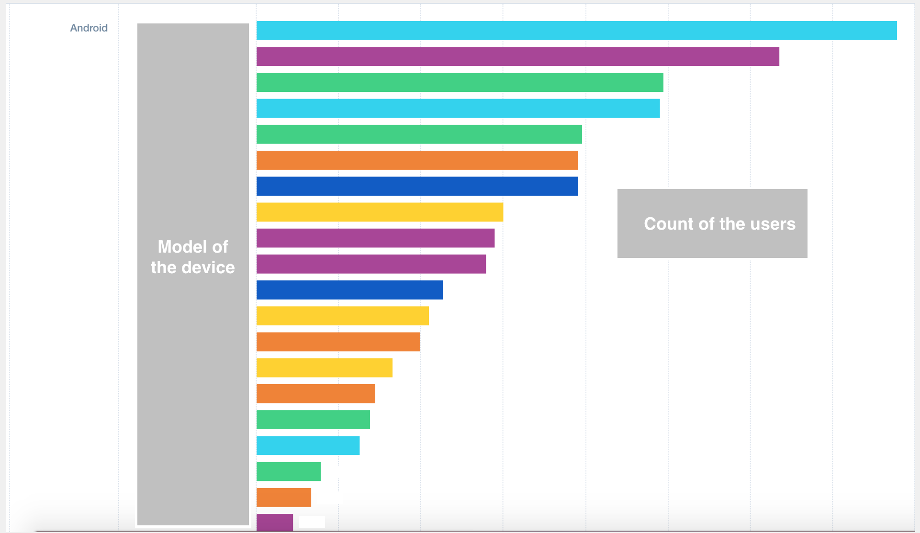
Top devices

Slide 13
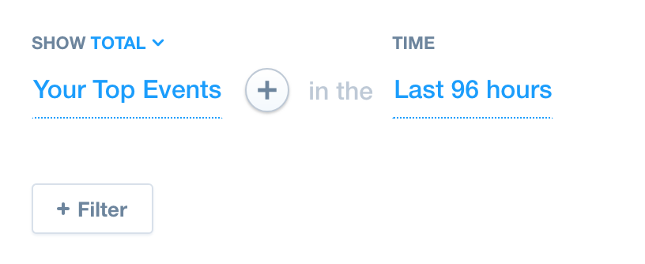
Developing automation based on Analytics
We choose Top Events and can see what is more popular from user’s side. They are more important for automation.

Slide 14
Understanding user’s struggles
Problem: User reports a bug
Solution: Find the user and track the history of the activities

Slide 15
Checking analytics of the new features after release
It’s possible to see if user starts to work with new features
If some features are not used we can check the reason and see the problem feature

Slide 16

Q&A

Slide 17
Summary:
Importance of Analytics
2. Some tools which can help you to gather data from technical and user’s side
3.Base information regarding Mixpanel: Features and solutions which they provide
4. Some cases when Mixpanel is very helpful

Slide 18
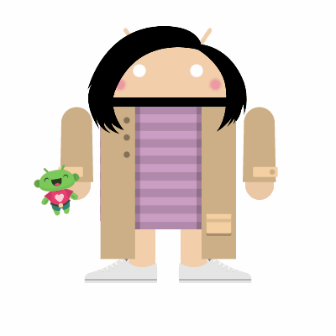
Thank you!

