Slide 1

The role of Software Quality Specialist in the modern environment
Aleksandr Gritsevski , Attack Structure, Estonia

Slide 2
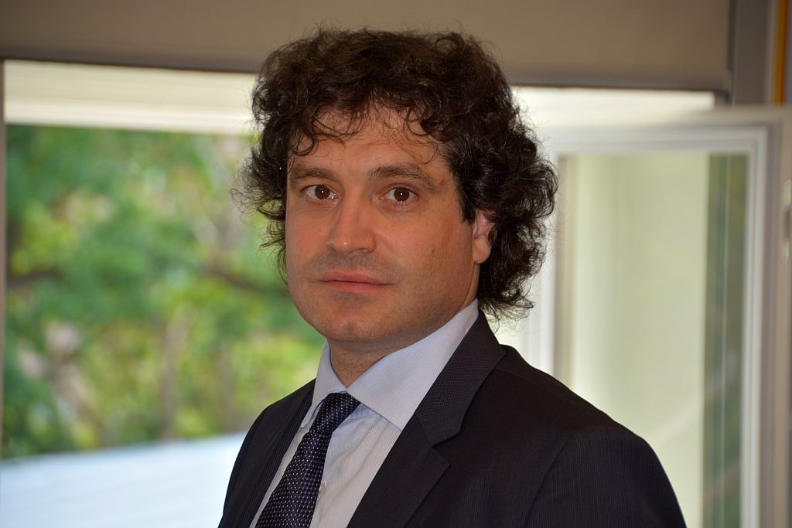
About the speaker
Aleksandr Gritsevski
Development Manager
Attack Structure
Estonia

Slide 3

Education
Tasks which can be assigned to Quality Specialist
Knowledge and Experience

Slide 4
Education
Minimum requirement : BS in Computer Science
Preferable : MEng or MS in Computer Science
Nice to have: PhD in Computer Science

Slide 5
List of disciplines Mathematics
Line Algebra
Theory of Calculus
First course of Probability
Discreet Mathematics

Slide 6
List of disciplines Programing
Functional Languages
Object Oriented Languages
Domain Specific Languages

Slide 7
List of disciplines Other…
Operation Systems
Databases
Networks
Security
Theory of Testing
…………………….
……………………

Slide 8
Tasks which can be assigned to Quality Specialist
Check quality of stories

Slide 9
Tasks which can be assigned to Quality Specialist
Check quality of stories
Creating documentation

Slide 10
Tasks which can be assigned to Quality Specialist
Check quality of stories
Creating documentation
Creating and support testing frameworks for automation process

Slide 11
Tasks which can be assigned to Quality Specialist
Check quality of stories
Creating documentation
Creating and support testing frameworks for automation process
Developers code review

Slide 12
Tasks which can be assigned to Quality Specialist
Check quality of stories
Creating documentation
Creating and support testing frameworks for automation process
Developers code review
Unit and Integration tests creating

Slide 13
Tasks which can be assigned to Quality Specialist
Check quality of stories
Creating documentation
Creating and support testing frameworks for automation process
Developers code review
Unit and Integration tests creating
UI test creating

Slide 14
Tasks which can be assigned to Quality Specialist
Check quality of stories
Creating documentation
Creating and support testing frameworks for automation process
Developers code review
Unit and Integration tests creating
UI test creating
Testing

Slide 15
Tasks which can be assigned to Quality Specialist
Check quality of stories
Creating documentation
Creating and support testing frameworks for automation process
Developers code review
Unit and Integration tests creating
UI test creating
Testing
Release Engineering

Slide 16
Knowledge and Experience Check quality of stories
All story components described
Story understandable from developers perspective
Story understandable from testing perspectives perspective
Business value of story is cleared
………..
………..

Slide 17
Knowledge and Experience Creating documentation
Test plans
Test cases
Test reports
Technical story documentation
Release notes
Quality reports
Bug reports
………

Slide 18

Knowledge and Experience Creating and support testing frameworks for automation process

Slide 19
Knowledge and Experience Developers code review

Slide 20
Knowledge and Experience Developers code review

Slide 21
Knowledge and Experience Unit and Integration tests creating

Slide 22
Knowledge and Experience UI test creating

Slide 23
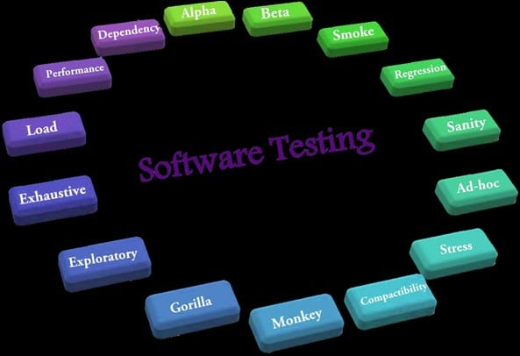
Knowledge and Experience Testing

Slide 24
Knowledge and Experience Release Engineering

Slide 25
Why Software Testing is Harder than Development ?

Slide 26
Thanks for you attention

Slide 27
Q&A

