Slide 1

Strategic Agile Thinking
21 MARCH, 2019 I Michaël Pilaeten

Slide 2

Agile in numbers
79%
43%
27%
11%
Agile
Sequential
Combination
Iterative
Notes:
Worldwide Software Testing Practices Report
79% Agile (SCRUM, Kanban or XP)
43% Sequential
27% Combination of Sequential and Agile
11% Iterative

Slide 3

Notes:
Agile is like a mirror
NOT easier NOT cleaner NOT prettyer
DOES NOT make you look better just by looking at it
DOES make visible where the problems are
IF you can’t deliver a releasable increment every sprint, you have a very foggy mirror, not showing the bottlenecks

Slide 4

Notes:
Why isn’t agile more succesfull?
Why are we experiencing so much resistence?
What makes agile so difficult? Or at least, makes something that looks so easy so difficult?

Slide 5

Problem 1
We start too late

Slide 6
Work start date
Process time
or Cost or FTE/MD
Work finish date
Notes:
We measure process time

Slide 7
Idea conception date
Lead time
Work start date
Process time
or Cost or FTE/MD
Work finish date
Notes:
Every minute / hour / day you start later, is a minute you get the possible benefit later
You might say that the time between the idea conception date and the work start date costs nothing (no FTE, no MD)
However, if the idea is good enough, you’re missing additional revenu and early adaptors

Slide 8

Problem 2
We don’t know when to stop
Notes:
We are always reluctant to stop an ongoing, non-finished project.
We should not be afraid to abandon, defer or pause on ongoing project to start a new one

Slide 9

Sunk Cost Fallacy
Notes:
Concorde
Even during development, it was clear that the cost would always be higher than the potential benefits.
2 projects A and B. A already costs € 2M, and market is declining
B is a new project, with huge potential.
The Sunk Cost Fallacy is the fallacy that you can’t stop an ogoing project due to the investment already made
A long story short: money you’ve invested is already spent. It’s gone. And any way to win it back is fine. Whether that’s with this project, or another. As long as it’s as efficient as possible.

Slide 10
The innovator’s dilemma
value
time
Notes:
Clayton Christensen
First iteration provides minimal value
Once the base is created, each iteration is drastically better
At one point, the most valuable improvements are created and the added value per feature are minimal

Slide 11

Problem 3
We don’t know what we want

Slide 12
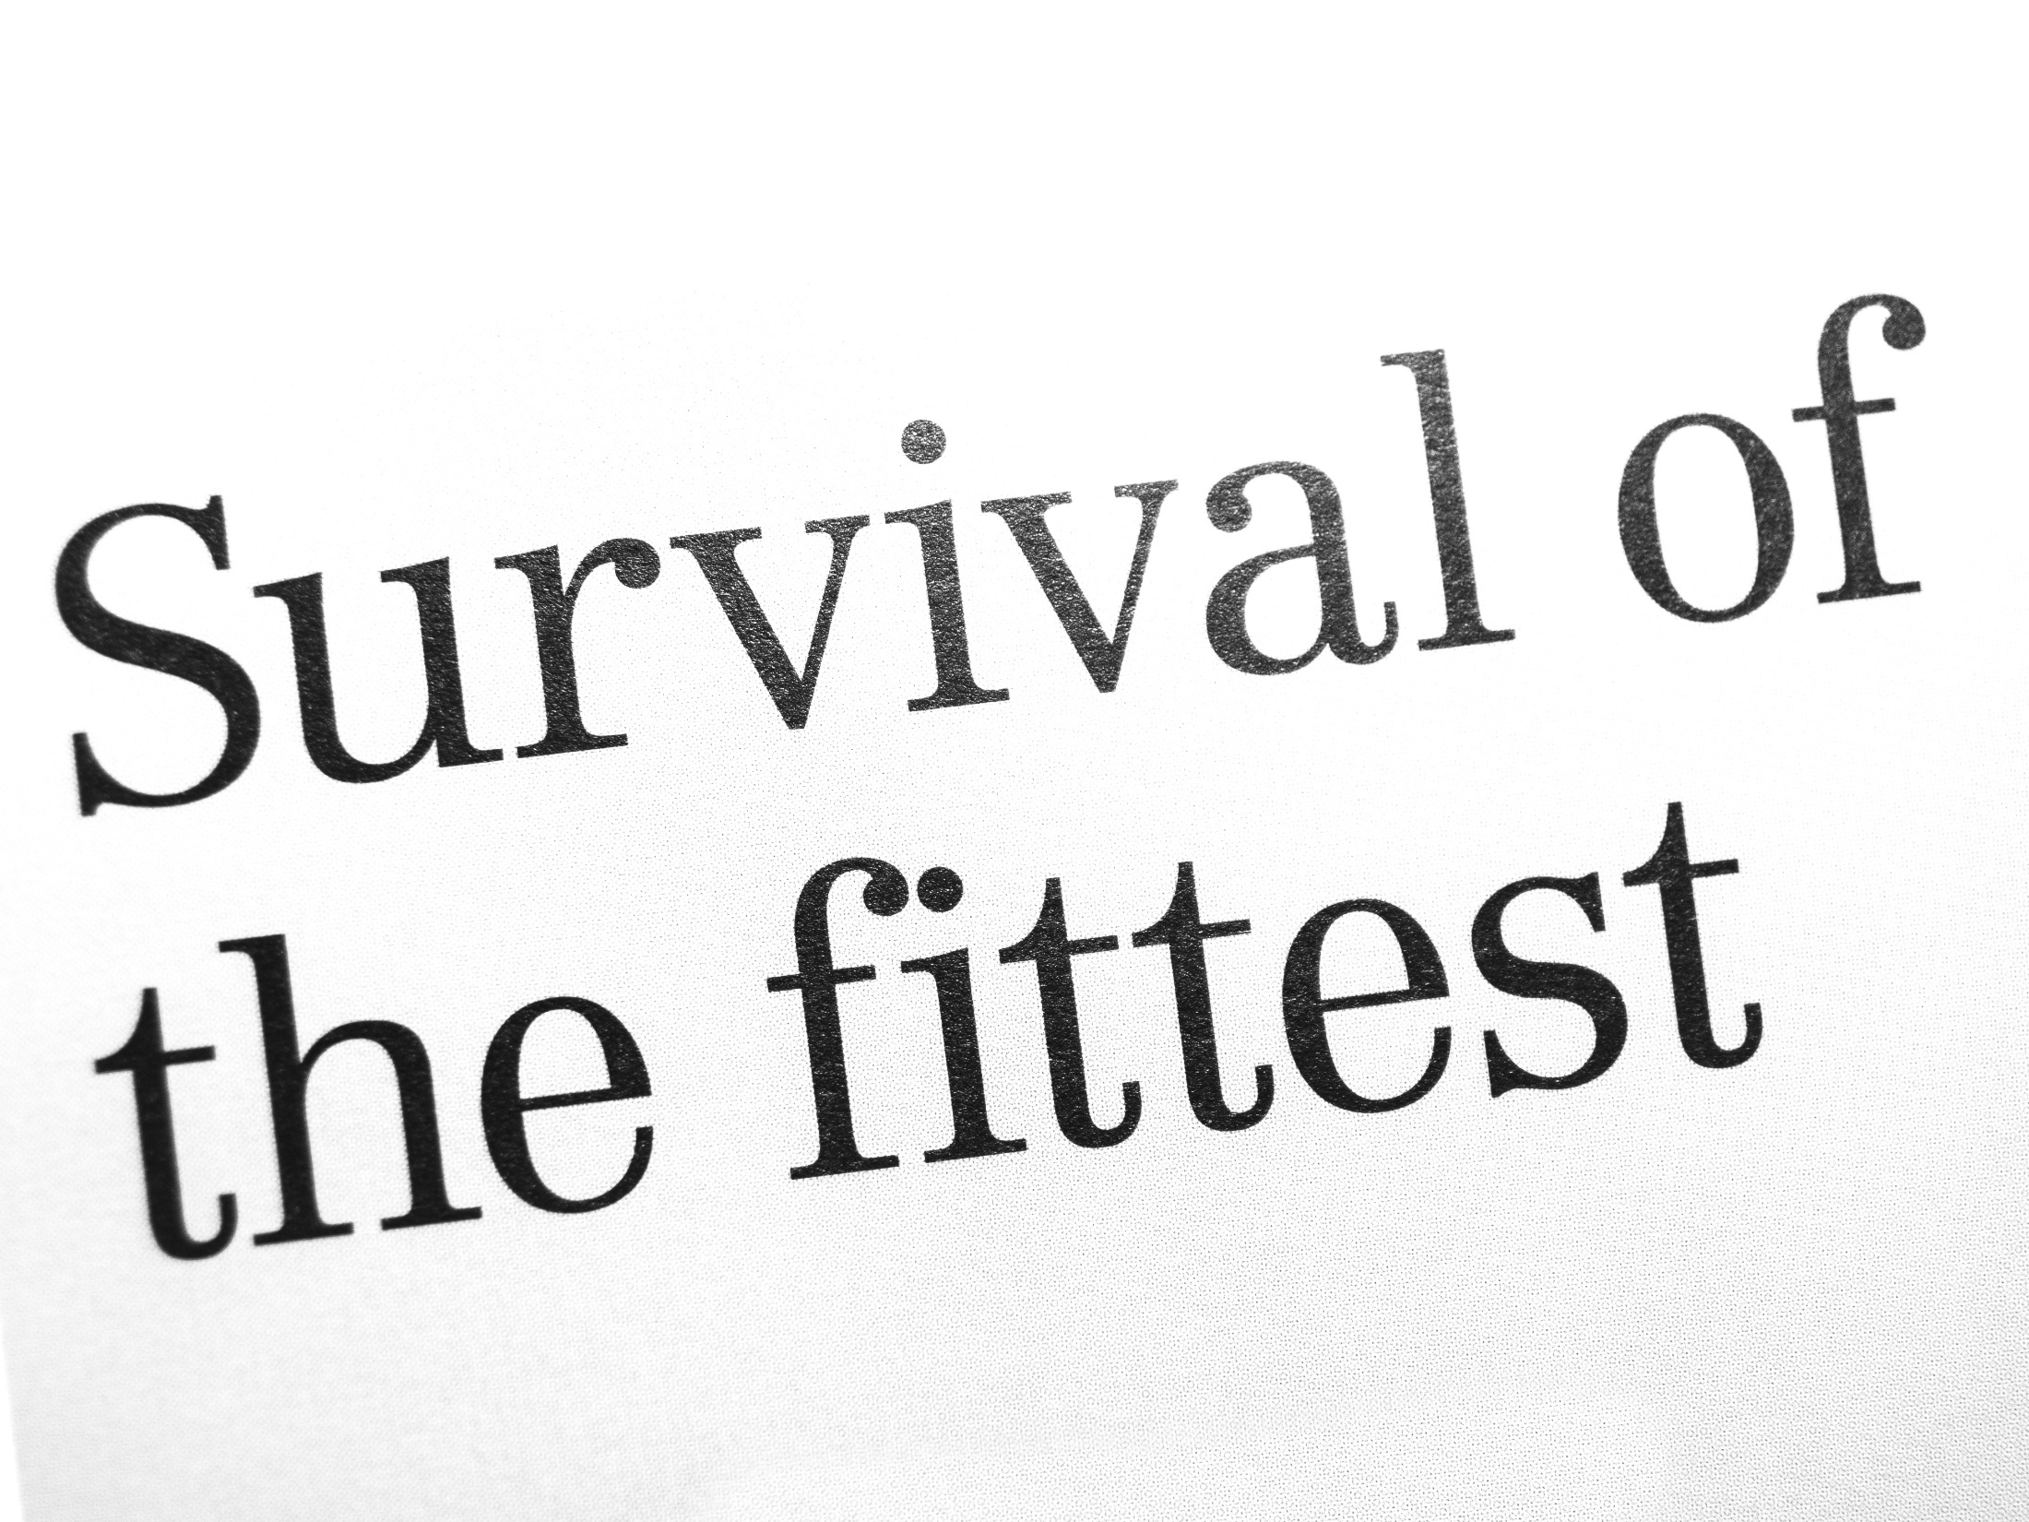
Notes:
It shouldn’t be that hard to decide what we want. Nature might help us a hand, doens’t it?
Laws of evolution predict that the species best equiped will further evolve.
However, recently, the model’s under a bit of stress…

Slide 13
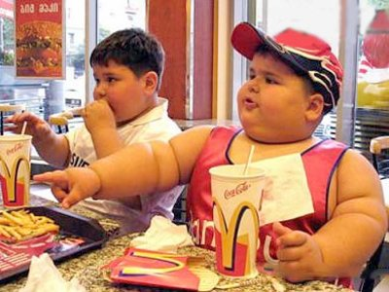
Picture fat hamburger eating man

Slide 14

Notes:
What is this guy doing in my presentation? Must be a mistake…

Slide 15
Minimum
Viable
MVP
Products
Notes:
Products that are not bringing the minimum or viability are WASTE
Products that only deliver the minimum are often not worth the original investment
Products that are viable but don’t offer the minimum are risky
The combination of all 3 is the MVP.

Slide 16

Notes:
I have a great business idea. Since I have the idea, I will act as a PO.
You’ll be my agile coach or agile team.
I want to create a device that can sell French fries, automatically. Take-away fries, from a vending machine.
What is, according to you, the MVP of this device?

Slide 17

Problem 4
We can’t predict quality

Slide 18

Notes:
Book from 2017
Ben Linders

Slide 19
REQUIREMENT
QUALITY
STABILITY
COMMITMENT

Slide 20
REQUIREMENT
QUALITY
From?
But…
COMMITMENT
Notes:
Commitment
By all stakeholders
But not on the entire backlog.

Slide 21
REQUIREMENT
QUALITY
STABILITY
What?
But…
Notes:
Stability
The inverse of the amount of changes to a requirement
But changes will, should and must happen

Slide 22

REQUIREMENT
QUALITY
fixed AND flexible
never commit
Notes:
Requirements are fixed in an iteration and flexible in a project
Commit as little as possible
Never commit early unless you know exactly why

Slide 23

Problem 5
We don’t know how to prioritize

Slide 24

Notes:
Prioritization: making choices.
That’s hard, because you might have a connection with one of the items.
Let’s say that you have 2 kids: A 3 year old daughter and a newborn son. Who do you love most?
Equally?

Slide 25
the endowment effect
value
value
mine
not mine
Notes:
Endowment effect

Slide 26

Problem 6
We’re reluctant to change

Slide 27


But...
Those testers should not touch my code!
My precious…
Notes:
Embrace change

Slide 28

But...
These developers shouldn’t test. Everything passes.
Notes:
Embrace change

Slide 29

Notes:
Change is a process with group dynamics.
People often think that for any change, you need a majority.
Change is not a constitutional or democratic process.

Slide 30

Notes:
SCIENCE (2018): the behavior, beliefs and preferences of a group do not require an absolute majority.
You have a board of directors consisting of 24 persons. You want to implement SAFe, but they need convincing.
How many of them do you need to convince to change the behavior, belief and preference of the entire group?
25%
6

Slide 31

Problem 7
We start too big

Slide 32




Little’s Law
L = current number of items
A = input / output flow
W = average time to process an item
L$=AW$
W$=\frac{L}{A}$
A
L = 100 liters
A = 20 liters / minute
W = $\frac{100 liters}{20 liters per minute}=5 minutes$
L
Notes:
Queuing formula

Slide 33

Little’s Law
L = current number of items
A = arrival rate of new items
W = average time to process an item
L$=AW$
W$=\frac{L}{A}$
A
L = 200 liters
A = 20 liters / minute
W = $\frac{200 liters}{20 liters per minute}=10 minutes$
L
Notes:
Queuing formula

Slide 34



Little’s Law in software
WIP = backlog size
TP = throughput (velocity)
LT = lead time
W$IP =TP x LT$
LT$=\frac{WIP}{TP}$
WIP = 500 story points
TP = 100 story points / day
LT = $\frac{500 story points}{100 story points per day}=5 days$
Notes:
Queuing formula

Slide 35

Little’s Law in software
WIP = backlog size
TP = throughput (velocity)
LT = lead time
W$IP =TP x LT$
LT$=\frac{WIP}{TP}$
WIP = 1500 story points
TP = 100 story points / day
LT = $\frac{1500 story points}{100 story points per day}=15 days$
Notes:
Queuing formula

Slide 36
Little’s Law in software
What do you want to do?
Increase velocity
Reduce lead time
Limit WIP
Limit WIP
Notes:
Queuing formula

Slide 37
Little’s Law in software
One last thing…
Context Switching

Slide 38

The end
a final takeaway

Slide 39

Any agile transformation
Notes:
Is like watching your kid grow up

Slide 40

Notes:
You make sure the roots are safe and sound
After which you gradually let it loose and give freedom

Slide 41


Notes:
In the end, you don’t want a 4 year old to prepare your dinner
But you also don’t want a 40 year old to stay in your house

Slide 42
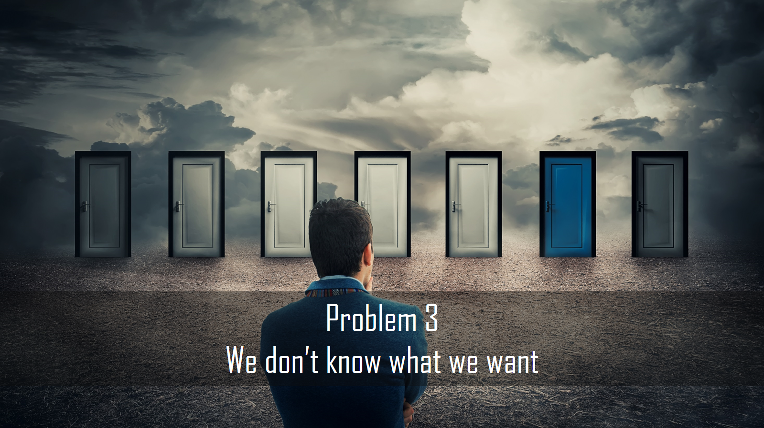

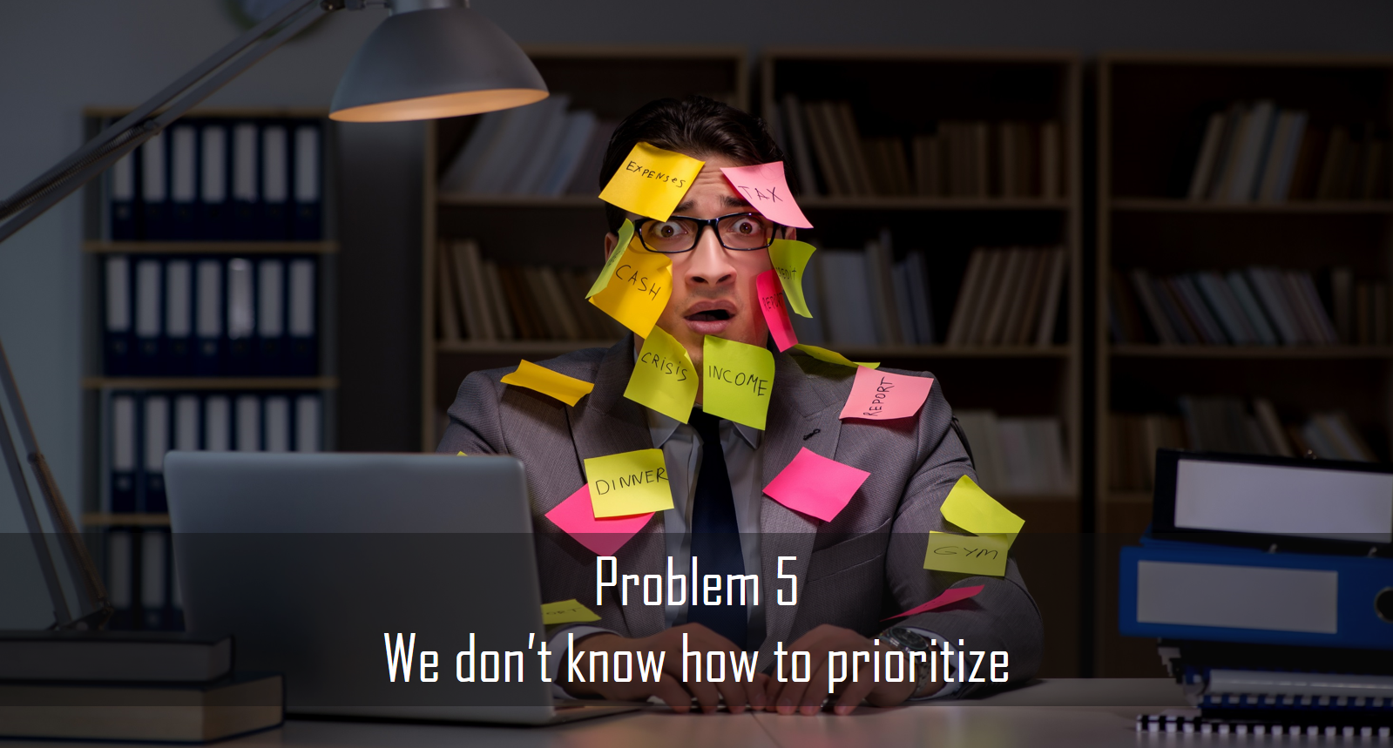

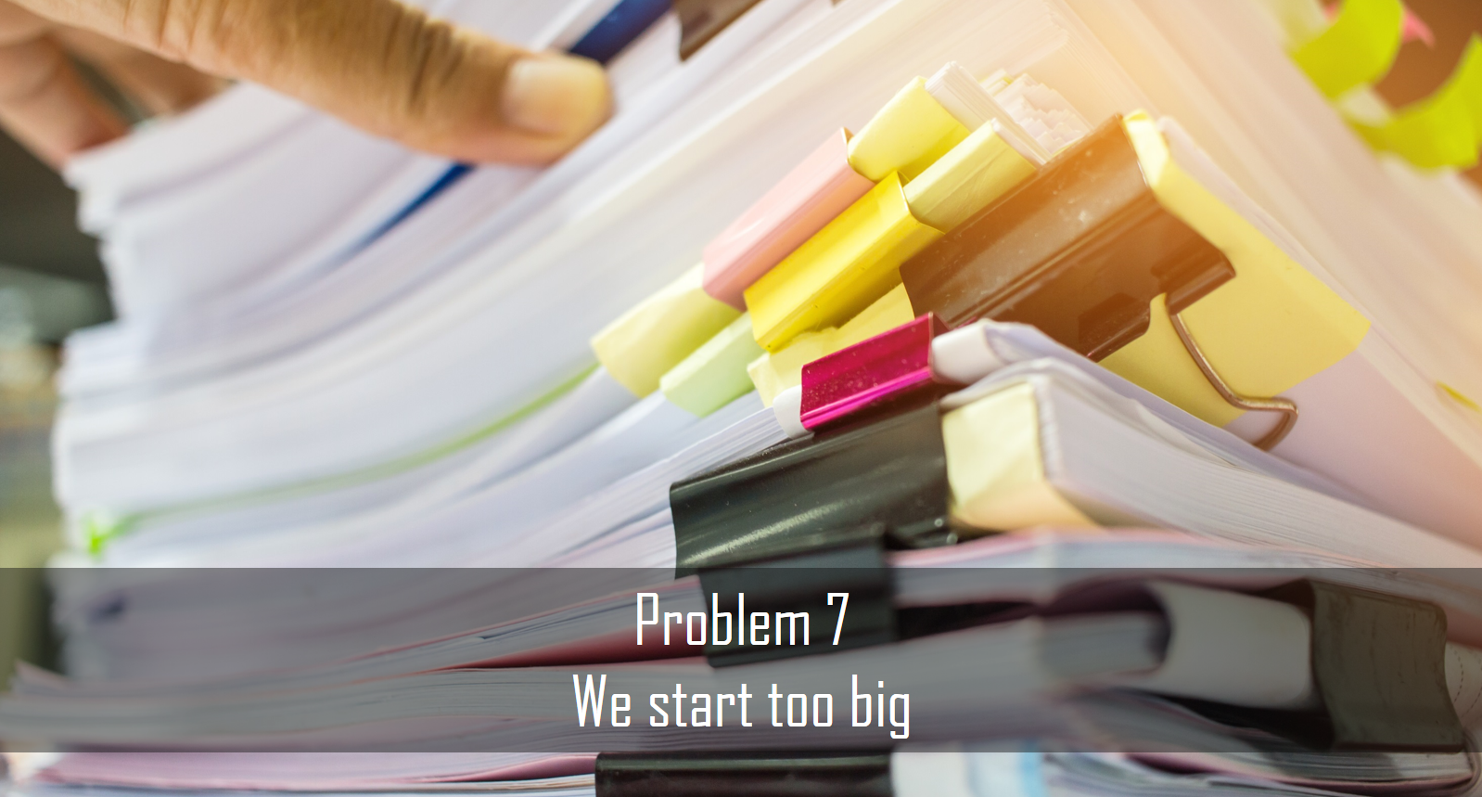
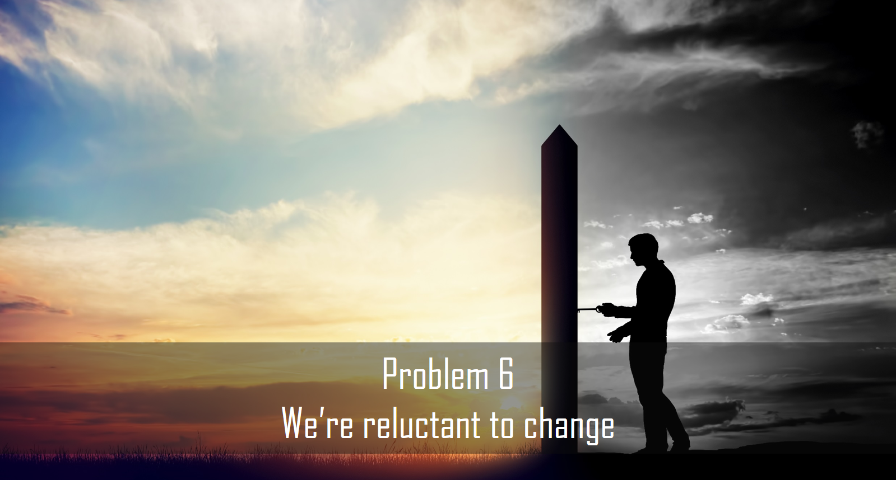
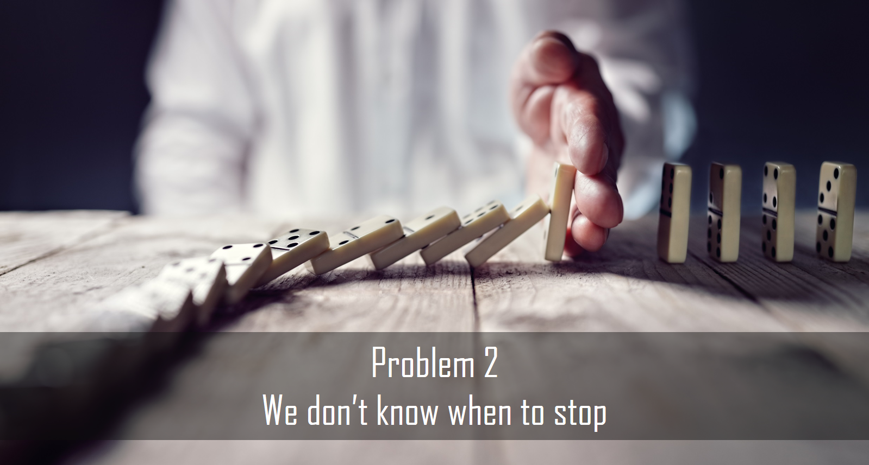
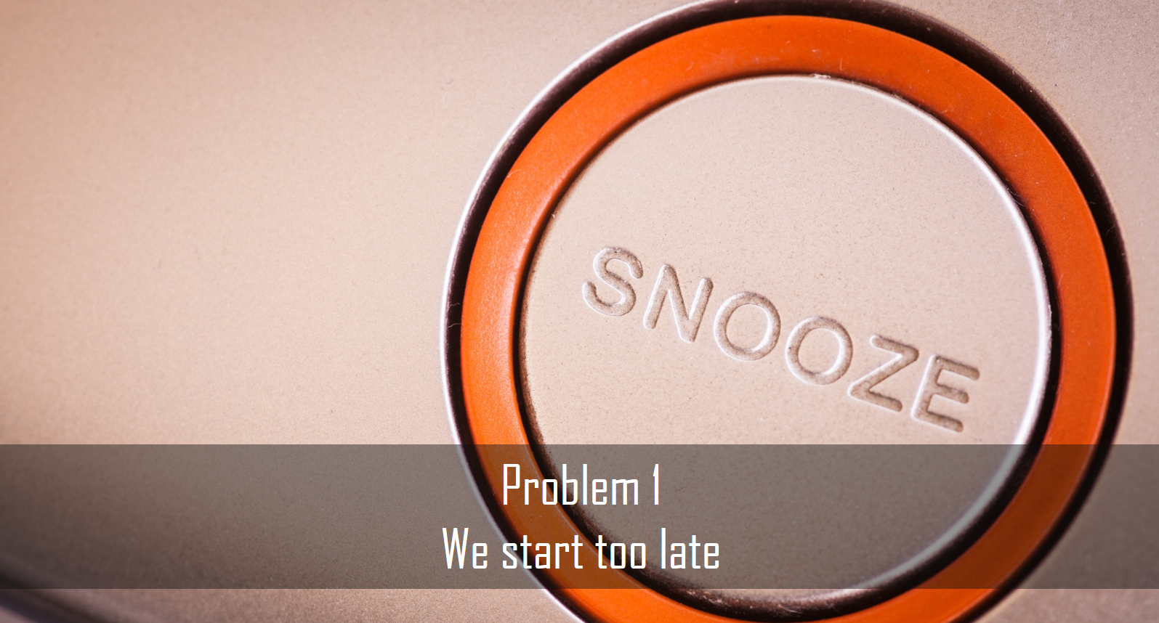



michael.pilaeten@ctg.com
@mpilaeten
linkedin.com/in/michaelpilaeten/

