Slide 1
Revolution in Page Object
ARTEM SOKOVETS
@SokovetsArtem
Notes:
Hello, everybody. Thank you for coming to my speech, I am very glad to see you. Hope you are all very well today. My name is Artem Sokovets and I am going to tell you about how java’s features can improve page object model.

Slide 2
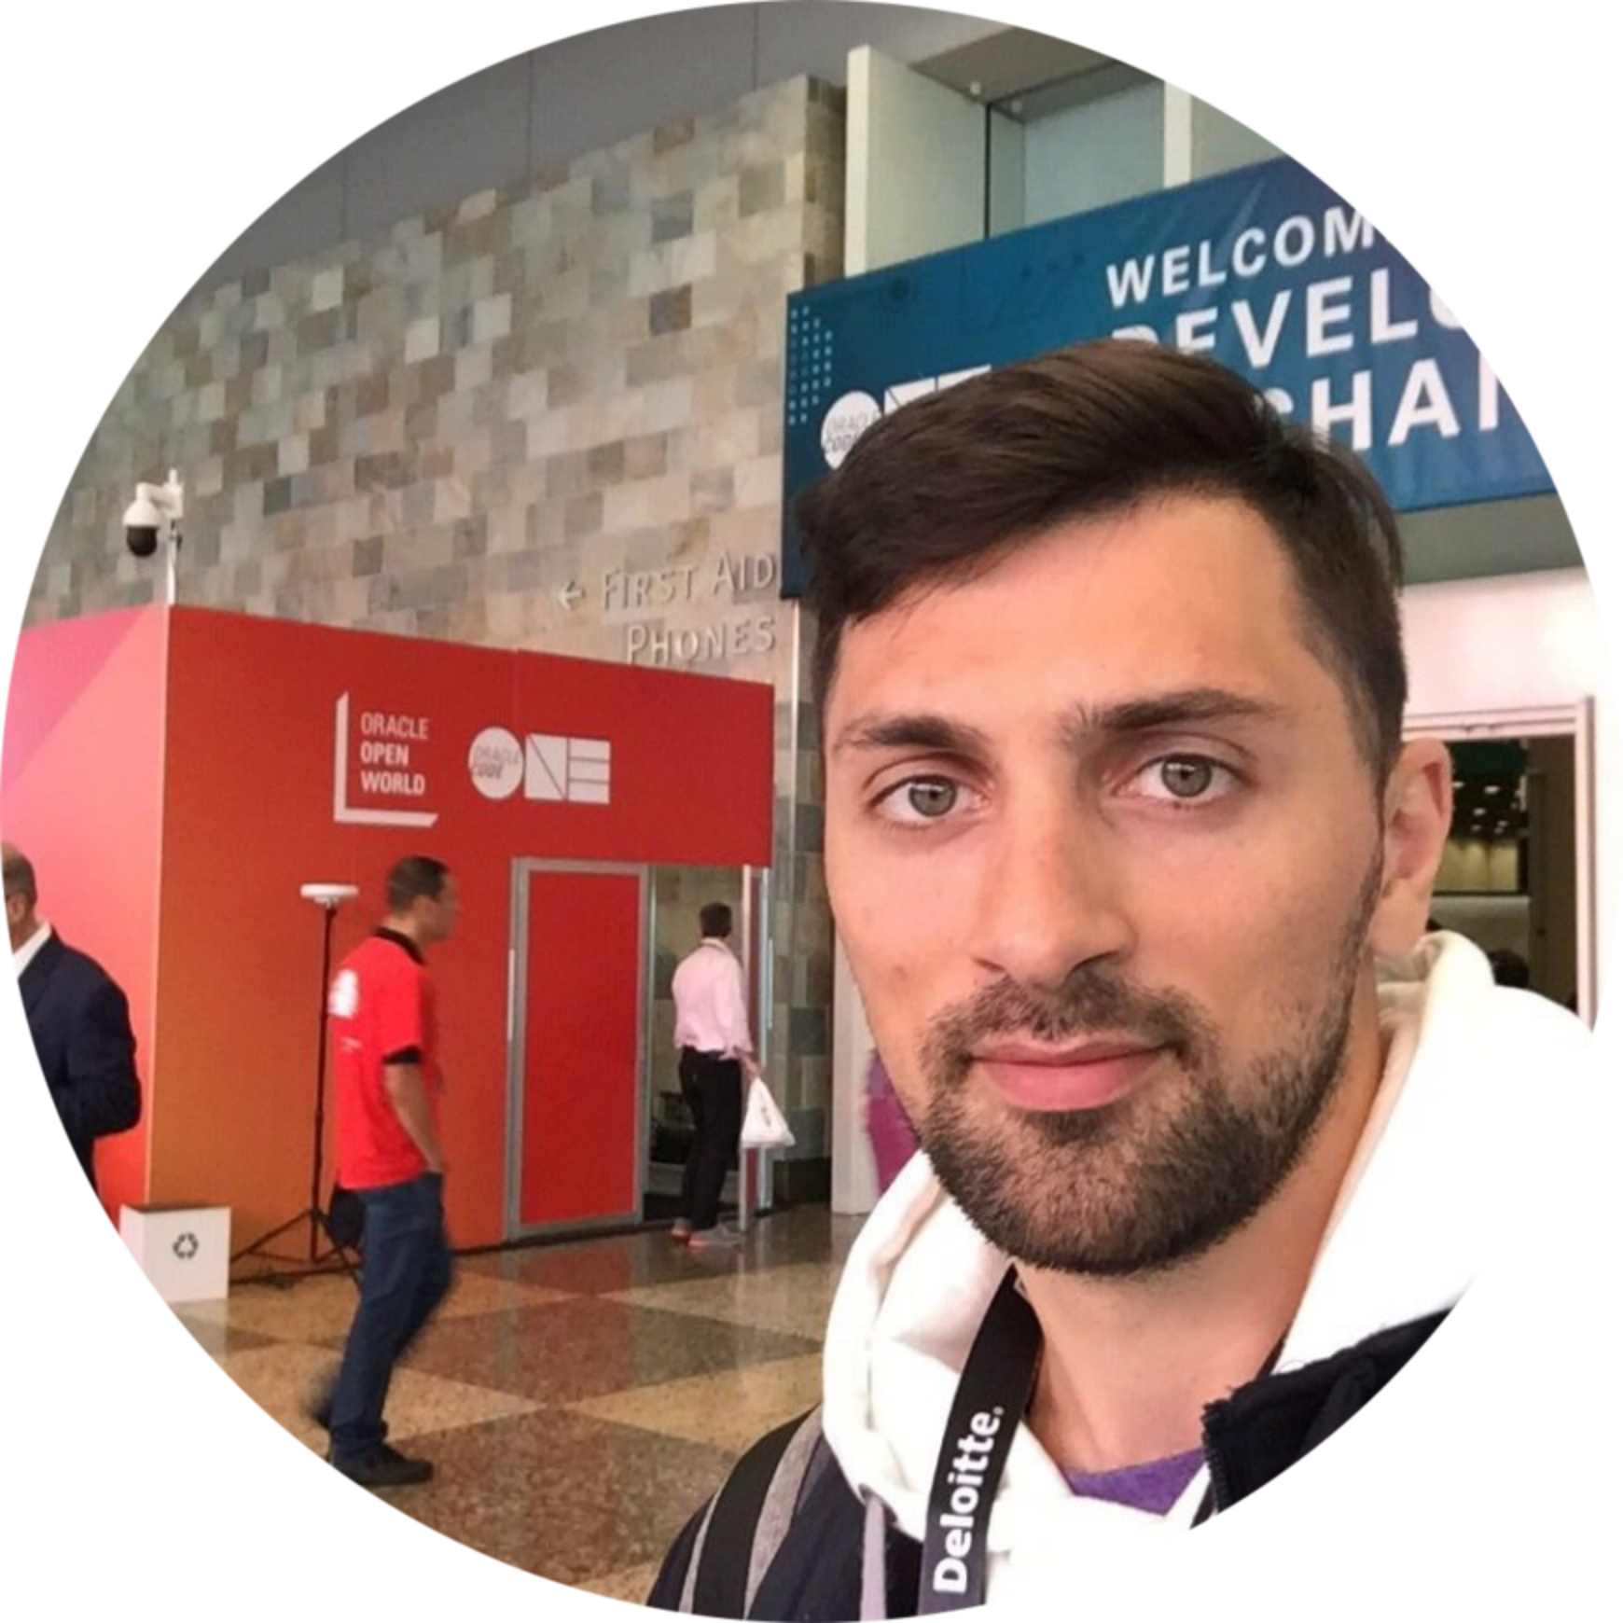
ABOUT ME
SOKOVETS ARTEM
TeamLeader of AutoQA @SberTech
Avsokovets.sbt@sberbank.ru
@SokovetsArtem
#java, #kotlin #autoQA
#java OCA&OCP
Notes:
I am a team leader at Sberbank-Technology. It is a company which develops a software for big Russian financial (файненшил) bank. My experience in automation industry about four years. I have to Oracle’s certificates by Java and last time I stadying Kotlin. Moreover (моровэ) I write different articles about automation testing free time. Last was how we built Selenium Cluster with Kuberneties.

Slide 3
Agenda
Page Object wrappers
Open questions in Page Object
Page Object through interface
Sample of implementation
Notes:
Okey. My plan will go throught (сру) four point. First I remind about current wrappers for page object, next I will show thing that I dislike. After that I will deep dive to page object based on interface and in the end of my speech i will tell for you about instrument which use this approach.

Slide 4
>> Let start to make automation
Yes, Boss! <<
Notes:
Imagine that you a quality engineer who has never automated before. For example it is WEB application. You have good time at your job but oneday your boss asks for you to do test automation of your project. You don't have another way with agree to him or you can try to find new job.

Slide 5
WEBDRIVER API
@Test public void simpeTest() { driver.get("https://github.com/"); driver.findElement(By.xpath("")).sendKeys(""); driver.findElement(By.xpath("")).submit(); List<WebElement> elementList =
driver.findElements(By.xpath("")); assertEquals(elementList.size(), 10); }
Notes:
After sleepless nights you find solution that helps for you. It is Selenium WebDriver API. You are happy and automate regression tests how you want. You use methods call of webdriver and each tests look like on this slide. It’s – driver – open our page, find element click, find el ement and text. You think that you cool engineer of test automation after that. Furthermore your boss also happy.
Boss is happy, that you have done what he wanted (что он хотел)

Slide 6

Page Object WRAPPERS
Fluent/Chain of invocations
Page Element
Loadable Component
ScreenPlay
Notes:
Soon I hope that your next step will refactoring of your automated tests. I think you find design pattern called Page Object or Page Object Model (It doesn't matter). Even my grandmother knows about it. In automated articles this pattern combines with different wrappers. On the slide you can see most used of them.
Chain of invocations – help to work with pages context which you need.
Page Element or HTML Wrapper. This wrapper represent a HTML components and encapsulates the logic for the interaction with this elements. This way we make reusable components for pages and reduced the time to develop tests.
Loadable Component – approach which help us to wait is page loads.
ScreenPlay – design pattern in Serenity framework. Add additional behavior to your tests.
You can find different kind of wrappers and choose one or mix each other together.

Slide 7
PAGE ELEMENT
@Name("Header") @FindBy(xpath = "//header[…]") public class Header …{ @Name("Search request input") @FindBy(xpath = ".//input[…]") private WebElement searchInput; public void search(String request) { searchInput.sendKeys(request); searchInput.submit(); } }
Notes:
In my test projects I prefer page element wrapper, which make reusable components for pages and reduced the time to develop tests. On the slide I describe github’s header. Some elements skipped, that size of text will be readable.

Slide 8
PAGE ELEMENT
public class MainPage { @FindBy(xpath = "//div[@class = 'header']") private Header header;
@FindBy(xpath = "//div[text() = 'Text_1']") private TextBlock textBlock;
@FindBy(xpath = "//div[@class = table']") private Table table; }
Notes:
I wrap different components of my website. And for each other implement logical methods. For example, if test needs to interact with table I have methods which return n-number of row or cell.

Slide 9
Notes:
When I use these different kind of wrappers mostly I become (бекам) disappointed. Why do I dislike it? How do you think?

Slide 10
QUESTION №1
public class MainPage { @FindBy(xpath = ".//div[@class = 'header']") private Header header; } public class AnyOtherPage { @FindBy(xpath = ".//div[@class = 'header']") private Header header; }
Notes:
First, when I need to communicate with different components in my tests, such as header or footer or something another block, I must to copy-paste this block to pages where I used it. Let us say, for different pages which call methods of header inside test I must to set this block to each other??.

Slide 11
QUESTION №1
public class MainPage { @FindBy(xpath = ".//div[@class = 'header']") private Header header; } public class AnyOtherPage { @FindBy(xpath = ".//div[@class = 'header']") private Header header; }
Duplicates elements
Notes:
In this way we get duplicate of elements.

Slide 12
QUESTION №2
public class UserPage {
@FindBy(xpath = "//div[text()='Text_1']") private TextBlock lastActivity; @FindBy(xpath = "//div[text()='Text_2']") private TextBlock blockReason;
}
Notes:
Second, there are many elements which contain similar locators, but text value of this locators is dissimilar. For example, you have two buttons on your page or block, but text value some different, in one case it is “sign in” and another “Sign Up”.
it 's the same but with a little difference.
undercore

Slide 13
QUESTION №2
public class EditUserPage { @FindBy(xpath = "//div[text()='Text_1']") private TextBlock lastActivity; @FindBy(xpath = "//div[text()='Text_2']") private TextBlock blockReason; }
No parameterization for elements
Notes:
It is no way to make parametrization for elements.

Slide 14
QUESTION №3
public class UserPage { @FindBy(xpath = "//div[text()='Телефон']/input") private TextInput innerPhone; @FindBy(xpath = "//div[text()='Email']/input") private TextInput email; @FindBy(xpath = "//button[text()='Сохранить']") private Button save; @FindBy(xpath = "//button[text()='Список']") private Button toUsersList; }
Notes:
When you have many identical (айдентикал) elements and getters methods on your page, you get…. (Потянуть?) What do you get??

Slide 15
QUESTION №3
public class UserPage { @FindBy(xpath = "//div[text()='Телефон']/input") private UfsTextInput innerPhone; @FindBy(xpath = "//div[text()='Email']/input") private UfsTextInput email; @FindBy(xpath = "//button[text()='Сохранить']") private UfsButton save; @FindBy(xpath = "//button[text()='Список']") private UfsButton toUsersList; }
Boilerplate code
Notes:
I think you are right? – It is boilerplate code. Wants to get rid of it (Хотелось избавиться от него).

Slide 16
JAVA
JDK 7
JDK 8
JDK 9
JDK 10
JDK 11
- A LOT OF SYNTACTIC SUGAR
- LAMBDA
- MODULES and G1 by default
- VAR
- CLEANUP
Notes:
If we look at Java – it does not stop. In each versions, Oracle introduces new features and release every three month now. But why we can improve our current design pattern Page Object? Maybe lambda that changes vision of standard GOF patterns can to help us?

Slide 17

The Next Generation of Page Object is
Coming…
Notes:
Now it time to deep dive to next generation of page object model, which use interface instead of class and methods instead of classes variables.

Slide 18
PAGE OBJECT BASED on interface
public interface MainPage {
@FindBy(xpath = "//a[contains(text(), 'trial')]") WebElement trial();
}
Notes:
How does page will look with interface?
First we use java keyword – interface and then as usual set interface name like as we do with class.
Теперь добавим наши элементы и для них локаторы. С первого взгляду кажется ничего нового, но давайте разберемся глубже, какие преимущества это нам даст.

Slide 19
PAGE OBJECT BASED on interface
public interface MainPage {
@FindBy(xpath = "//a[contains(text(), 'trial')]") WebElement trial();
}
Notes:
Next, add methods which describe webelements. On this slide method trial use annotation FindBy with xpath locator. You can describe element in usual way.
Теперь добавим наши элементы и для них локаторы. С первого взгляду кажется ничего нового, но давайте разберемся глубже, какие преимущества это нам даст.

Slide 20
differences and similarities
public class MainPage {
@FindBy(xpath = "//xpath1") private WebElement login; @FindBy(xpath = "//xpath2") private WebElement password; @FindBy(xpath = "//xpath3']") private WebElement submit; public MainPage() {…}}
public interface MainPage {
@FindBy(xpath = "//xpath1") WebElement login();
@FindBy(xpath = "//xpath2") WebElement password();
@FindBy(xpath = "//xpath3") WebElement submit(); }
Notes:
It you look at this two approaches, on the left side it is old way – I use class and classes variable and on the right side – it is new way, where I use interface and methods.
At first glance, nothing seems new. But let's take a deeper look at what advantages (эдвАнтейджес) this will give for us.
with one different – с одной разницы?
locator - Локэтер
Constractor (констрАктор)

Slide 21
Parameterization of elements
Notes:
For example, we have o login form with three elements. It is username text input, password text input and signin button.

Slide 22
Parameterization of elements
public class MainPage {
@FindBy("//div[text()='Username']/…/input") private WebElement login;
@FindBy("//div[text()='Password']/…/input") private WebElement password;
//Button and constructor }
Notes:
In old way I must describe each elements for this login form. On this slide, I describe login and password and button and constructor omited. The locators pretty much similar. Different only in text values. In first case it is Username and second Password.
it 's the same but with a little difference

Slide 23
Parameterization of elements
public interface MainPage {
@FindBy("//div[text()='{{ text }}']/input") WebElement input(@Param("text") String text);
}
Notes:
With interface we can make our elements parameterized. For this way use method with parameter. This we use text parameter, then when call with this method we set value which inject to red text in braces.

Slide 24
EXAMPLE
@Test public void simpleTest() { onMainPage().input("Login").sendKeys("*"); onMainPage().input("Password").sendKeys("*"); onMainPage().submit().click(); }
Notes:
Now, test will be like this test method – simpleTest.
First go to context our page, next call parametrized method with values and after that make actions which we need.

Slide 25
multiple inheritance (layers)
public class MainPage { private Header header; }
public class AnyPage { private Header header; }
public class Header { @FindBy(xpath = ".//input…") WebElement search; //Getter }
Notes:
Our web application has various layers, which depend on layout. Here i describe header in main page and any other pages where I need this block. Remember, that we need copy-past headers variable to each pages.

Slide 26
multiple inheritance (layers)
public interface WithHeader { @FindBy("//header[contains(.,'Header')]") Header header(); }
public interface Header { @FindBy(".//input…") WebElement searchInput(); }
Notes:
On this slide, describe same header, but use interface. Same thing as before. Describe header block which contains input and then set layer WithHeader.

Slide 27
EXAMPLE
public interface MainPage extends WithHeader
public interface AnyPage extends WithHeader
public interface MainPage extends WithHeader,
WithFooter,
WithSidebar
Notes:
We can include this layer where it is needed.
Also we can combine pages with another layers, such as footer, sidebar and so on. This approach offer for us to set one layer, one block without copy-past classes variable to each pages as I showed sometime ago.
Вы автоматом получите на нужной странице, нужный элемент. Таких элементов может быть много Header, Footer, какое пользовательское меню, может какая-то реклама. Все эти элементы можно подключить extends к вашей странице.
Чекбоксы, селекты и инпуты можно описать с помощью отдельных интерфесов и подключить их в наш фильтр. public interface WithSelectButton { ... } public interface WithCheckBox { ... } public interface WithInput { ... } И каждый фильтр будет выглядет, как конструктор из каких то общих элементов, ну и плюс для каждого фильтра будут какие-то свои уникальные элементы.

Slide 28
multiple inheritance (ELEMENTS)
public interface Button { @FindBy(".//a[contains(., '{{ value }}')]") WebElement button(@Param("value") String value); }
Button
Notes:
We can use multiple inheritance (инхеритонс) with parametrized element and when it need to extend from this button. That is (to wit) on this github header there are for buttons and in your code we can make one element that describe all this button.
A button can majorly be divided in three types. A submit button, radio button and a check box.
https://webkul.com/blog/performing-events-selenium-webdriver.

Slide 29
multiple inheritance (ELEMENTS)
public interface Header extends Button { … }
public interface Footer extends Button,Input { … }
Notes:
After that our layer for example Header or Footer, extend this button. We can describe different elements (Button, Input, CheckBox) and then extends from in in our layers.

Slide 30
EXAMPLE
@Test public void simpleTest() { onMainPage().header().button("Prise").click();
onMainPage().header().input("Search").sendKeys("*"); }
Notes:
How does it look? - как это выглядит
Вы автоматом получите на нужной странице, нужный элемент. Таких элементов может быть много Header, Footer, какое пользовательское меню, может какая-то реклама. Все эти элементы можно подключить extends к вашей странице.
Чекбоксы, селекты и инпуты можно описать с помощью отдельных интерфесов и подключить их в наш фильтр. public interface WithSelectButton { ... } public interface WithCheckBox { ... } public interface WithInput { ... } И каждый фильтр будет выглядет, как конструктор из каких то общих элементов, ну и плюс для каждого фильтра будут какие-то свои уникальные элементы.

Slide 31
Element’s TREE
Notes:
Website consist (состоит из) of
To contain somethind перчисляем без предлогов
one to many relationship
Вы автоматом получите на нужной странице, нужный элемент. Таких элементов может быть много Header, Footer, какое пользовательское меню, может какая-то реклама. Все эти элементы можно подключить extends к вашей странице.
Чекбоксы, селекты и инпуты можно описать с помощью отдельных интерфесов и подключить их в наш фильтр. public interface WithSelectButton { ... } public interface WithCheckBox { ... } public interface WithInput { ... } И каждый фильтр будет выглядет, как конструктор из каких то общих элементов, ну и плюс для каждого фильтра будут какие-то свои уникальные элементы.

Slide 32
DEFAULT METHOD
onMainPage().header().withInput("GitHub").clear(); onMainPage().header().withInput("GitHub").sendKeys("*");
Notes:
Плюс в Java 8, появились default методы, которые используются, чтобы заранее описать какую-то функциональность, которая нам нужна. Допустим у нас есть вредный элемент, например чекбокс, он то включен, то выключен, но у нас очень много проходит сценариев, через этот чекбокс и мы его хотим зачекивать, для этого мы пишем специальный метод, который выполняет спецальные операции над этим элементом: if (onMainPage().rentFilter().checkbox("Кирпич").getAttribute("class").contains("disabled")) { onMainPage().rentFilter().checkbox("Кирпич").click(); } Чтобы не хранить весь код этот в классе шагов, мы можем поместить этот код прямо рядом с элементом функционального, ввиде дефолтного метода. public interface Checkbox extends AtlasWebElement { ... AtlasWebElement checkBox(@Param String value); default void selectCheckbox(String value) { if (checkBox(value).getAttribute("class").contains("disabled")) { checkBox(value).click(); } } } И теперь в тесте мы можем использовать это метод как метод элемента. onMainPage().rentFilter().selectCheckbox("Кирпич");

Slide 33
DEFAULT METHOD
public interface Input { @FindBy("//….") WebElement withInput(@Param("value") String value); default WebElement withClearInput(String value) { withInput(value).clear(); return withInput(value); } }
Notes:
Плюс в Java 8, появились default методы, которые используются, чтобы заранее описать какую-то функциональность, которая нам нужна. Допустим у нас есть вредный элемент, например чекбокс, он то включен, то выключен, но у нас очень много проходит сценариев, через этот чекбокс и мы его хотим зачекивать, для этого мы пишем специальный метод, который выполняет спецальные операции над этим элементом: if (onMainPage().rentFilter().checkbox("Кирпич").getAttribute("class").contains("disabled")) { onMainPage().rentFilter().checkbox("Кирпич").click(); } Чтобы не хранить весь код этот в классе шагов, мы можем поместить этот код прямо рядом с элементом функционального, ввиде дефолтного метода. public interface Checkbox extends AtlasWebElement { ... AtlasWebElement checkBox(@Param String value); default void selectCheckbox(String value) { if (checkBox(value).getAttribute("class").contains("disabled")) { checkBox(value).click(); } } } И теперь в тесте мы можем использовать это метод как метод элемента. onMainPage().rentFilter().selectCheckbox("Кирпич");

Slide 34
EXAMPLE
@Test public void simpleTest() { onMainPage().header()
.withClearInput("GitHub")
.sendKeys("Atlas"); }

Slide 35
Benefits
Parametrized Element
Reduce boilerplate code
Multiple inheritance
Default methods
Notes:
What benefits we are get from page object based on interface?
Get rid of - Getter an copy-past
Multiple inheritance - one to many relationship

Slide 36

Notes:
Where can you try this approach? - You can find a implementation of this mechanism in one instrument about which I will tell a little next?.

Slide 37
ATLAS
Atlas (Application test layouts) - flexible framework for multiplatform products.
https://github.com/qameta/atlas
Notes:
ATLAS – it is open source framework where you can try new vision of page object based on interface. Moreover this instrument has another cool features which I will show you. If you are intrested? - check github link and try it.
Down below – Внизу
Approaches which includes

Slide 38
architecture
Core
Atlas-WebDriver
Atlas-Appium
Notes:
Atlas architecture consists of three modules. It are “Core”, where handler our pages proceed, next ”Atlas-WebDriver” it’s a wrapper for Selenium WebDriver and last one Atlas-Appium, it’s a wrapper for Appium. I remind that Atlas-WebDriver you should use when automate Web UI and Atlas-Appium for Mobile UI.
Is used(т)

Slide 39
SAMPLE TEST
@Test public void simpleWebSiteTest() { onSite().onMainPage().open(); onSite().onMainPage().header().searchInput().sendKeys("Atlas") onSite().onMainPage().header().searchInput().submit(); onSite().onSearchPage("Junit 5")
.repositories().waitUntil(hasSize(10)); }

Slide 40
ATLAS Page OBJECT
1
@Before public void setUp() { atlas = new Atlas(new WebDriverConfiguration(driver));
}
@Test public void simpleTest() {
onMainPage().open("YOUR_SITE"); onMainPage().login().sendKeys("login"); onMainPage().password().sendKeys("pass"); onMainPage().submit().click(); }
private MainPage onMainPage() { return atlas.create(driver, MainPage.class);}
Notes:
When we develop our tests with atlas, first point which we need to do, setup atlas instance and set what configuration we want to use. There are two configuration – one of it WebDriverConfiguration and another AppiumDriverConfiguration.
The first thing that we need to do - ..
There two way ways of configu…

Slide 41
ATLAS Page OBJECT
1
@Before public void setUp() { atlas = new Atlas(new WebDriverConfiguration(driver));
}
@Test public void simpleTest() {
onMainPage().open("YOUR_SITE"); onMainPage().login().sendKeys("login"); onMainPage().password().sendKeys("pass"); onMainPage().submit().click(); }
private MainPage onMainPage() { return atlas.create(driver, MainPage.class);}
2
Notes:
Second, we should initialize page what we need. On the slide I create MainPage.class.
Ютилити!

Slide 42
ATLAS Page OBJECT
1
@Before public void setUp() { atlas = new Atlas(new WebDriverConfiguration(driver));
}
@Test public void simpleTest() {
onMainPage().open("YOUR_SITE"); onMainPage().login().sendKeys("login"); onMainPage().password().sendKeys("pass"); onMainPage().submit().click(); }
3
private MainPage onMainPage() { return atlas.create(driver, MainPage.class);}
2
Notes:
Third point, you should get context of page, call method that describe webelemet and make actions with this element. On this example, I get MainPage, get login webcomponent and type text.

Slide 43
EMBEDDED RETRY
NotFoundException
StaleElementReferenceException
OtherElementWouldReceiveTheClick
onMainPage().header().withClearInput("GitHub").sendKeys("Atlas");
Repeat again
Notes:
One on the main feature is embedded retry. When we get various exception, like this ElementNotFoundException, StaleElementRederenceException, OtherElementReceiveTheClick that we use try and catch block or WebDriverWait in our test projects. But in atlas as I said, it is embedded retry and if one of these methods will be broken all method chain will start over.
we meet this
If ione of the methods is broken, the chain will be repeted again! (Должны использовать пассивный залог)

Slide 44
GLOBAL RETRY
new Atlas(…).timeouts(15000L).polling(1000L);
Notes:
Конфигуруте
how second do we need to wait while retry operation?
how often do we refer to the item = how often do we call out action
Sleep in meels

Slide 45
ELEMENT RETRY
@Retry (timeout = 30000L, polling = 500L) @FindBy("//…") AtlasWebElement button();
Notes:
Все элементы ищуться в течение 5-ти секунд, а вот этот плохой элемент ищеться 30 секунд!
If this element is long reflected – we use…
У нас появились перепопытки. Вот у нас на странице может каждый раз, что-то пойти не так: NotFoundException, StaleElementReferenceException, OtherElementWouldReceiveTheClick каждый раз тест ломается, хотя по факту ничего страшного не произошло. Цепочка событий: mainPage().header().rentLink().click(); Если на каком-то этапе пойдет, что не так, то мы каждый раз повторяем ту фазу, где что-то пошло не так.
Все элементы ищуться в течение 5 секунд, а вот один элемент ищеться 20 секунд с помощью аннотацией @Retry mainPage().header().rentLink().click();
Если на каком-то этапе пойдет, что не так, то мы каждый раз повторяем ту фазу, где что-то пошло не так.

Slide 46
ASSERTIONS
should(Matcher matcher);
waitUntil(Matcher matcher);
Notes:
Atlas has two main assertions. There are should and waitUntil. Both take Matcher Object that Hamcrest library introduces.
How do you think – why does atlas has two methods of assertions?
Появилось два типа проверок у элементов, should and waitUntil, чем они отличатся.

Slide 47
SHOULD
should(Matcher matcher);
waitUntil(Matcher matcher);
AssertionError
Notes:
Should throws AssertionError.

Slide 48
WAITUNTIL
should(Matcher matcher);
waitUntil(Matcher matcher);
RuntimeException
Notes:
waitUntil throws RuntimeException.

Slide 49
group by issueS
Notes:
Answer for question before. In test scripts the main functional checks can be in the end of tests. This checks more interesting for quality engineers. But test automation engineers have interest for all things which go before this checks. On the slide you see example of allure report where red is product defects – this issues interesting for functional testers and orange is test defects.
Last one are interesting for test automation engineers. By this way, you can separate responsibilities when view test reports.
Фанкшинал – функциональный
Продак дифектс
сЕперате – на первый слог ударение
Вот смотрите у нас есть большой сценарий, и функциональная часть сценария в конце и в конце нужно использовать проверку Should, чтобы этот тест в отчете пометился красненьким, потому-что это ошибка assertion error и этот тест идет напрямую к ручному тестировщику который отвеает за функциогнальность продукта, Если сценарий длинный то все промежуточные проерки делаем через вэйт антил, если что то там сломалось тест пометиться оранжевым, такие тесты сразу идут на разбор автоматизаторам.

Slide 50
EXAMPLE
onMainPage().header().searchInput().waitUntil(displayed(), 5);
onMainPage().header().searchInput().should(tagName("input"));
Notes:
Look at example, where should and waitUntil use.
Get page context
Call method that describe webelemtns
Again
And should which has Matcher Object as parameter
Мэтчер!
The second line of code is similar

Slide 51
Extension MODEL
MethodExtension
Base
Functional
Custom
Functional
Overrides
Notes:
There is extension model exists in atlas. The way is same as you can see in Junit 5. With extensions you can overrides base functional and inject your own behavior.

Slide 52
OVERRIDE of behavior
public interface MainPage extends WebPage { @FindBy("//…") AtlasWebElement trial(); }
onMainPage().header().button("EN").click(); onMainPage().header().input("RU").clear(); onMainPage().header().input("LV").sendKeys(".");
Notes:
We can override behavior of how to find webelements (set custom annotation instead of FindBy). Moreover we can override deferent actions of your web elements. For example, we can set our handler for actions such as click, clear, sendKeys and other.

Slide 53
MY EXTENSION
public class MyExtension implements MethodExtension { @Override public boolean test(Method method) {…} @Override public Object invoke(…) throws Throwable {…} }
Notes:
What steps should you do?
First, create your class and extend it from MethodExtension interface.
Second, override two methods – test and invoke. Test method check that it is correct handler for your action and invoke inject your behavior.

Slide 54
SETUP EXTENSION
atlas = new Atlas(…)
.extension(new MyExtension())
Notes:
To apply extension we should set it to method which is red on the slide when initiate (инишиэте) atlas instance.
Пробигаемся по всем ектеншинам и смотрим если метод удовлетворяет условиям тогда его применить!

Slide 55
CORE EXTENSIONS
Notes:
All behavior of module Atlas-Webdriver and Atlas-Appium based on extensions. There are main of it. For example, FindByExtension use to find webelement, SwipeDone and SwipeUpExtension use to do swipe on mobile simulators or emulators. WaintUntilmethod and ShouldMethodExt use to process waitunil and should methods. About which I told before. You can look on this extensions and implements your own.
Uset!
Each of these extensions

Slide 56
Notes:
Imagine you want to override method click. Because in many a time click from Selenium API does not work correctly in Internet Explorer.
Корректли – коректный!

Slide 57
CUSTOM CLICK
onMainPage().header().button("en").click()
Notes:
What want we do? – Override click.

Slide 58
EXAMPLE
@Override public boolean test(Method method) { return method.getName().equals("click"); } @Override public Object invoke(Object p, MethodInfo m, Configuration c){ final WebDriver driver = c.getContext(WebDriverContext.class); final JavascriptExecutor js = (JavascriptExecutor) driver; js.executeScript("arguments[0].click();", p); return p; }
Notes:
Create extension which implements MethodExtension. Override two methods.
Check that we override only click
Inject your own behavior. On this example I use JavaScript click. Get WeBdriver, get JavaScriptExecutor and make JS click. It’s not good way, but sometime it usefully.
Коррект месод

Slide 59
SETUP
atlas = new Atlas(…)
.extension(new JSClickExtension())
Notes:
After that, we active JSClickExtension and all click in test project use JavaScript click. That is all.
That is my java script …

Slide 60
GRADLE
dependencies { сompile 'io.qameta.atlas:atlas-appium:1.+' }
dependencies { сompile 'io.qameta.atlas:atlas-webdriver:1.+' }
Notes:
All Jar available in maven central and you can try it are now. You can use deferent build tools if you want.
You can try in your project

Slide 61






THIRD-PARTY LIBRARIES
Notes:
Altal framework can integrate with popular instruments such as junit 5, testing, cucumber, jbehave and other.

Slide 62
INTEGRATE WITH YOUR FRAMEWORK
Loader;
Decorator;
Your Custom Page.
Notes:
Do you like new approach where you can use interface instead of class, but you don’t want to use atlas? Okey. You can setup your own loader and decorator. These things are main when we used page factory from selenium. At last introduce your custom page.
What do you need to do? – советую первый
What you need to do is .. И продолжать то что перечисляли

Slide 63

QA
SOKOVETS ARTEM
Leading Engineer of AutoQA @SberTech
Avsokovets.sbt@sberbank.ru
@SokovetsArtem
https://github.com/artsok/training/tree/master/sqadays-eu-2019
Telegram channel of Atlas Support: t.me/atlashelp
Notes:
Thank you for attention! Subscribe to my twitter - @(at) SokovetsArtem. You are welcome with a questions.
Tnak you for your time!
My slides for SeleniumCamp Conference #seleniumcamp #atlas #nextgeneration #pageobject

