Slide 1
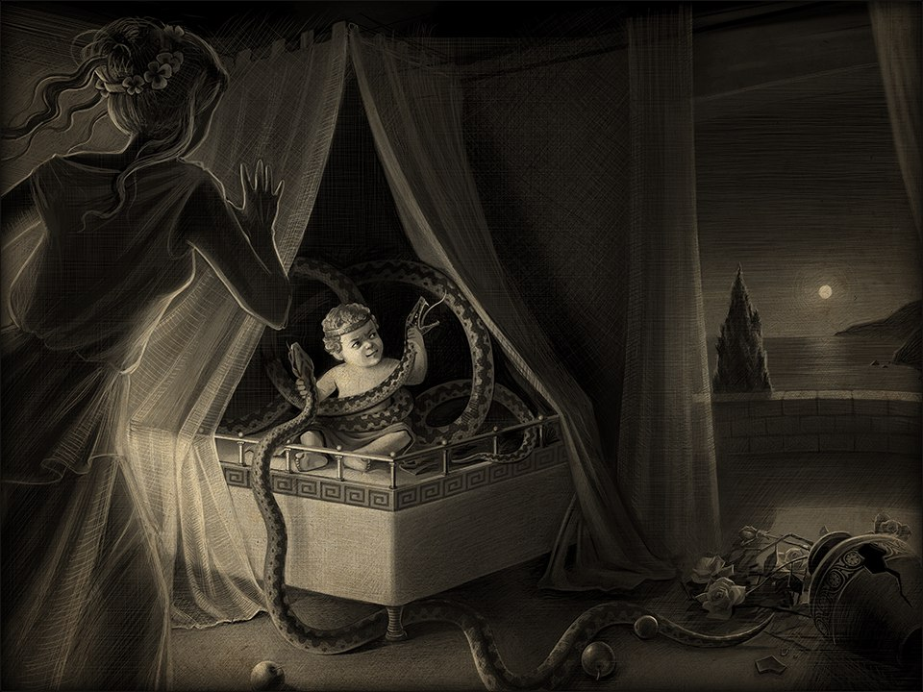

13 labours challenge
How to become Hercules
in Test Automation

Slide 2

1. Make it easy
Nemean Lion

Slide 3
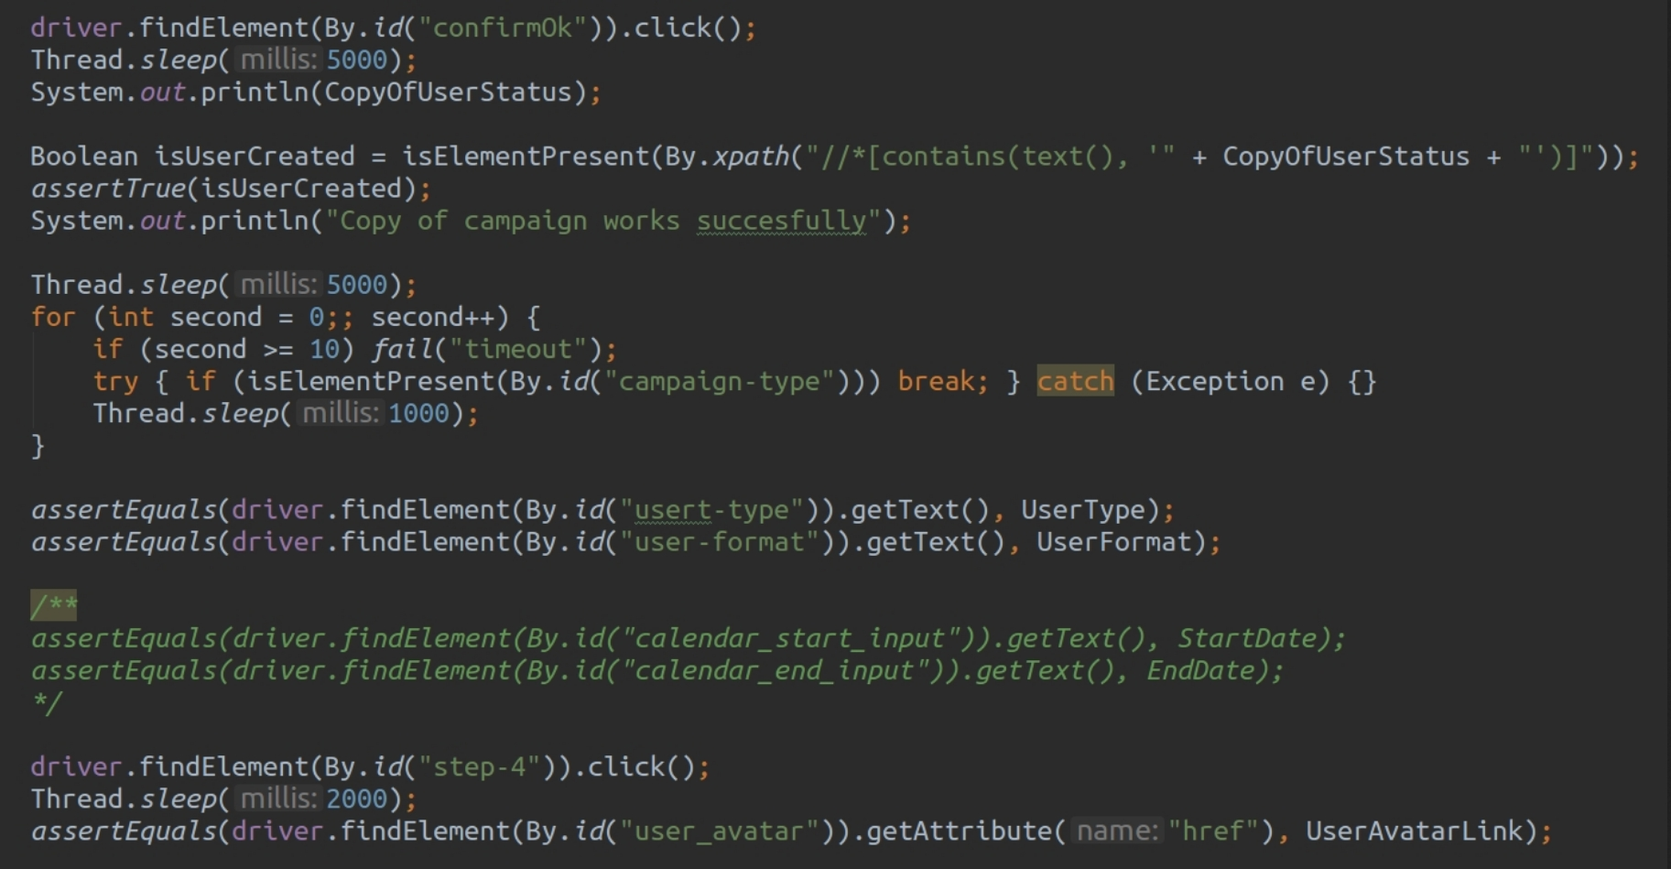

Slide 7
1. driver.findElement(By.id("confirmOk")).click();
2. driver.findElement(By.id("step-4")).click();
3. Boolean isUserCreated = IsElementPresent
(By.xpath("//*[contains(text(), '" + CopyOfUserStatus + "')]"));

Slide 11
1. Thread.sleep(5000);
2. Thread.sleep(5000);
3. Thread.sleep(2000);
Total = 12 sec.

Slide 15
1. assertTrue(isCampaignCreated);
2. assertEquals
(driver.findElement(By.id("user-type")).getText(), userType);
3.assertEquals
(driver.findElement(By.id("user-format")).getText(), userFormat);
4.assertEquals
(driver.findElement(By.id("user_image")).getAttribute("href"),
userImageLink);

Slide 20
driver.findElement(By.id("confirmOk")).click();
Thread.sleep(5000);
System.out.println(CopyOfUserStatus);
Boolean isUserCreated = isElementPresent(By.xpath("//*[contains(text(), '" + CopyOfUserStatus + "')]"));
assertTrue(isUserCreated);
System.out.println("Copy of campaign works succesfully");

Slide 27


Slide 28
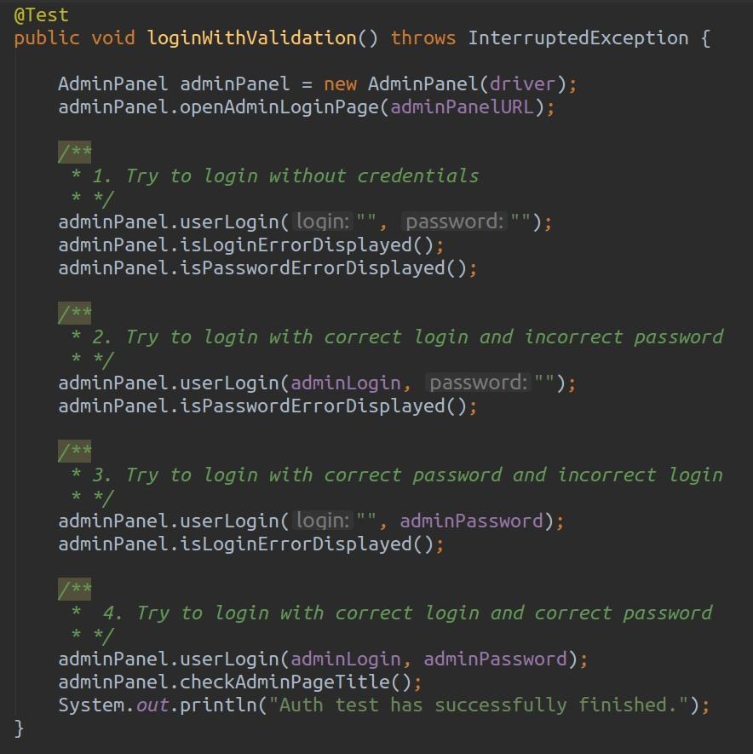

Slide 29
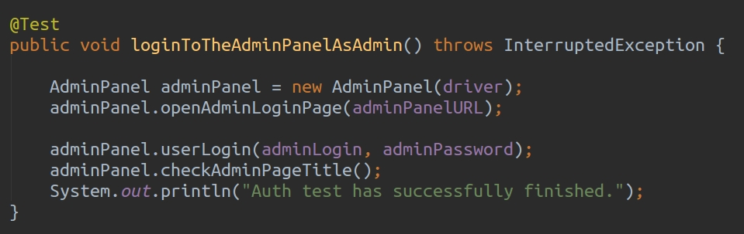

Slide 30
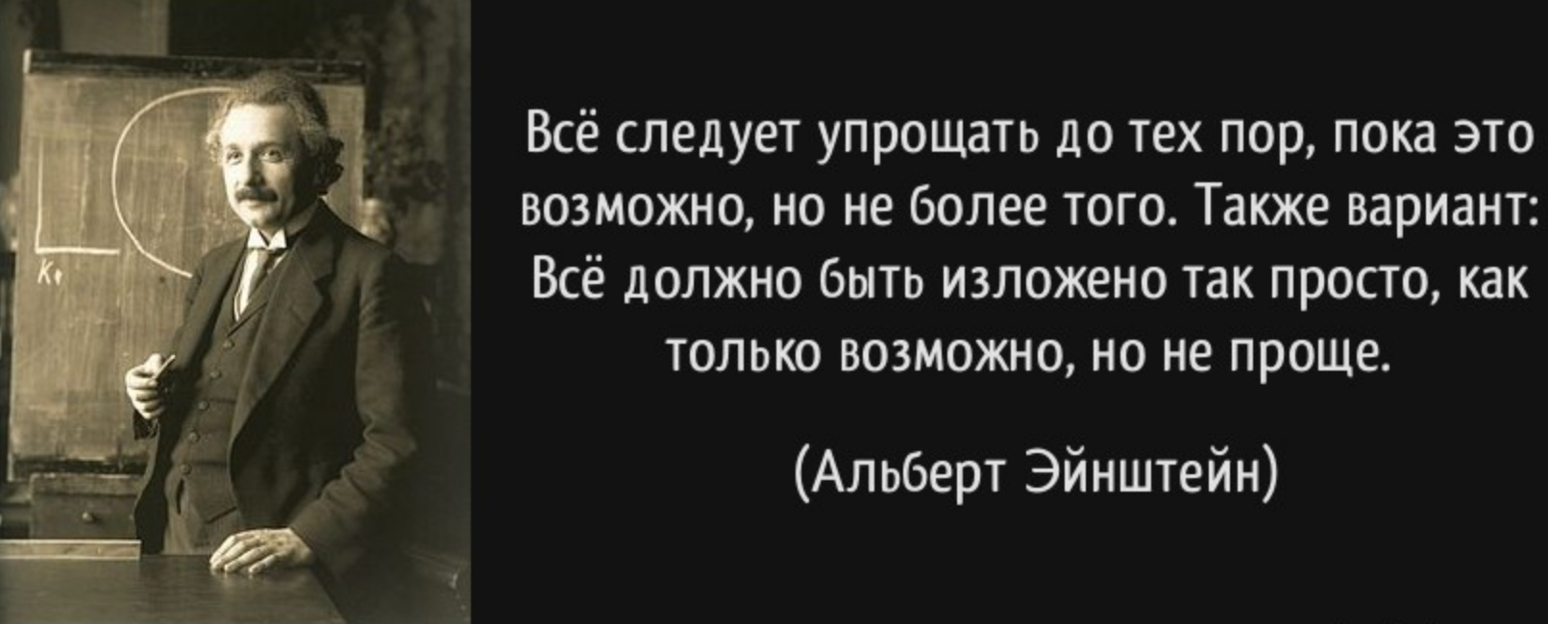

Slide 31

1. Make it easy
Nemean Lion

Slide 32
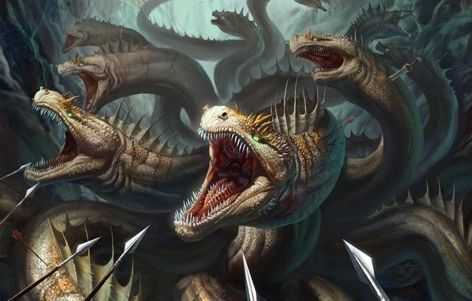
2. Make it necessary
Lernaean Hydra

Slide 33
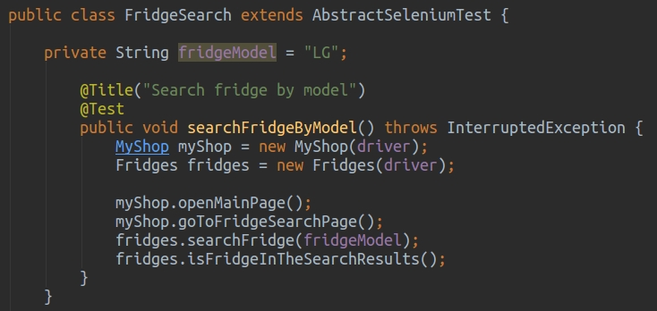

Slide 34
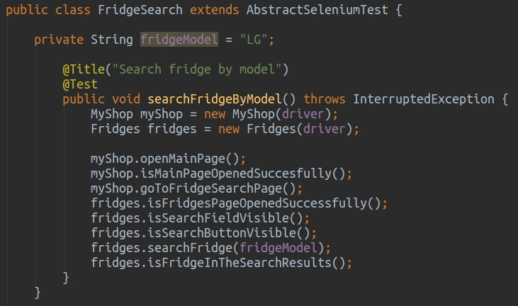

Slide 36
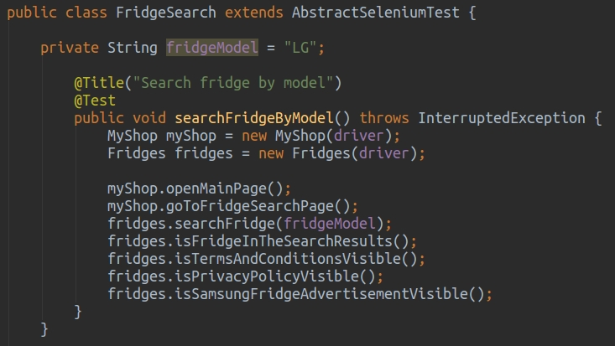

Slide 37
2. Make it necessary
Lernaean Hydra

Slide 38
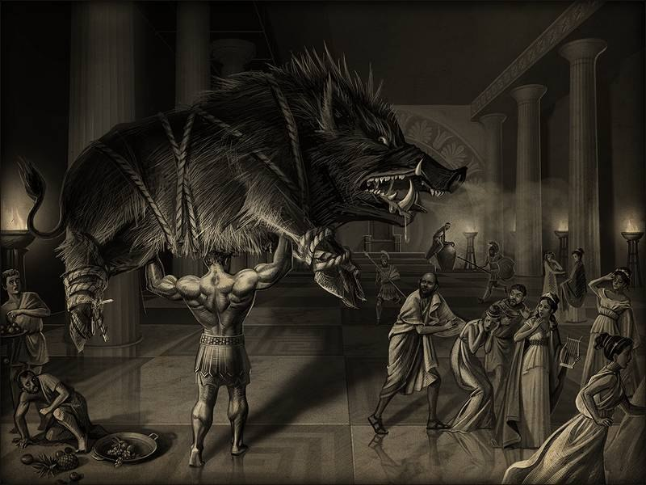
3. Make it reliability
Erymanthian Boar

Slide 39
Reasons of flaky tests
- waiting

Slide 41
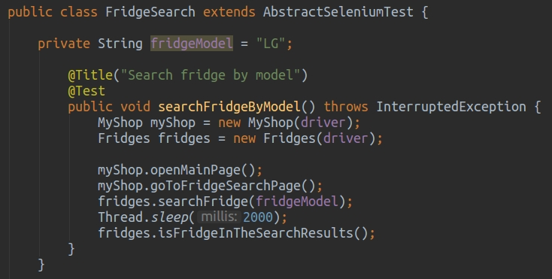

Slide 42
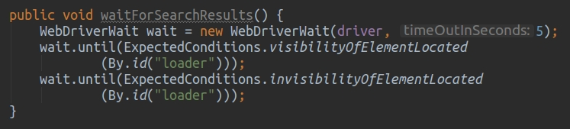

Slide 43


YouTube

Slide 44
3. Make it reliability
Erymanthian Boar

Slide 45
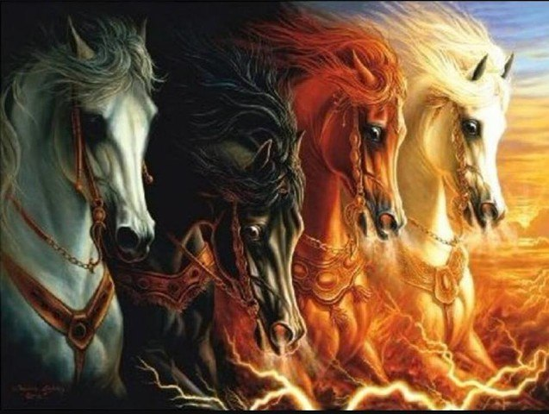
4. Separate
Mares of Diomedes

Slide 46
Dependencies

Slide 47
Dependencies
- human factor (Civilization);

Slide 48
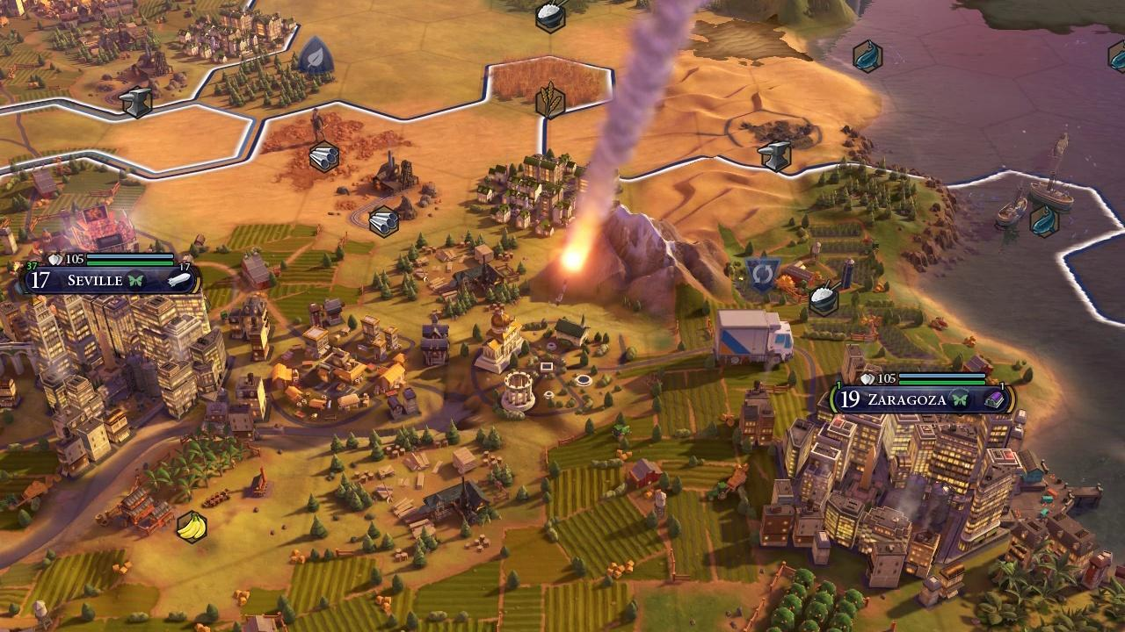
Civilization

Slide 49
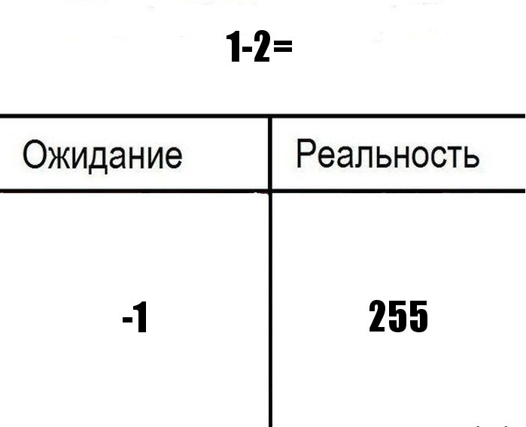
Civilization
Expectation
Reality

Slide 50
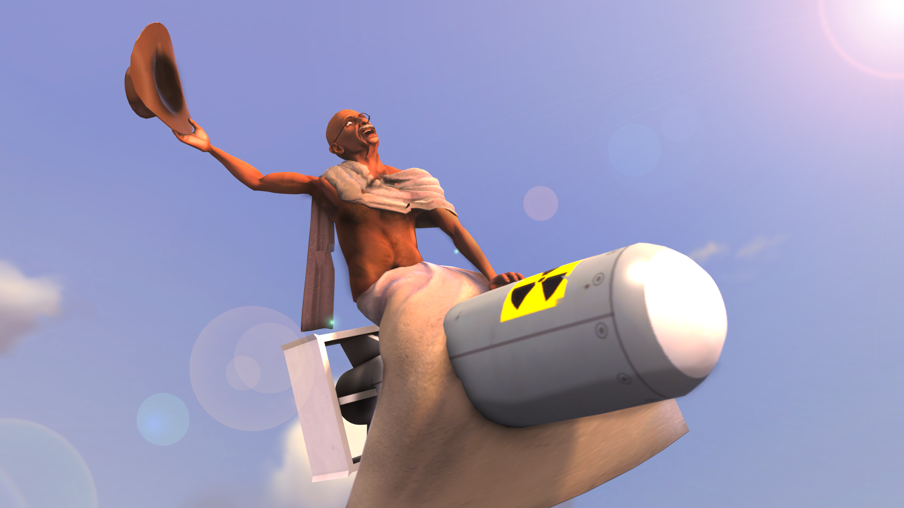
Civilization

Slide 51
Dependencies
- human factor (Civilization);
- human factor #2 (Amazon);
- services (The spider of Doom);
- distance (500 miles e-mail bug);
- settings (F*ck this shit);
- position (Air Force);
- specific person
(Checkered shirt, 7 A.M. bug)
- Moon phase (Wednesday, September XX, 2008);
- etc.

Slide 52
4. Separate
Mares of Diomedes

Slide 53
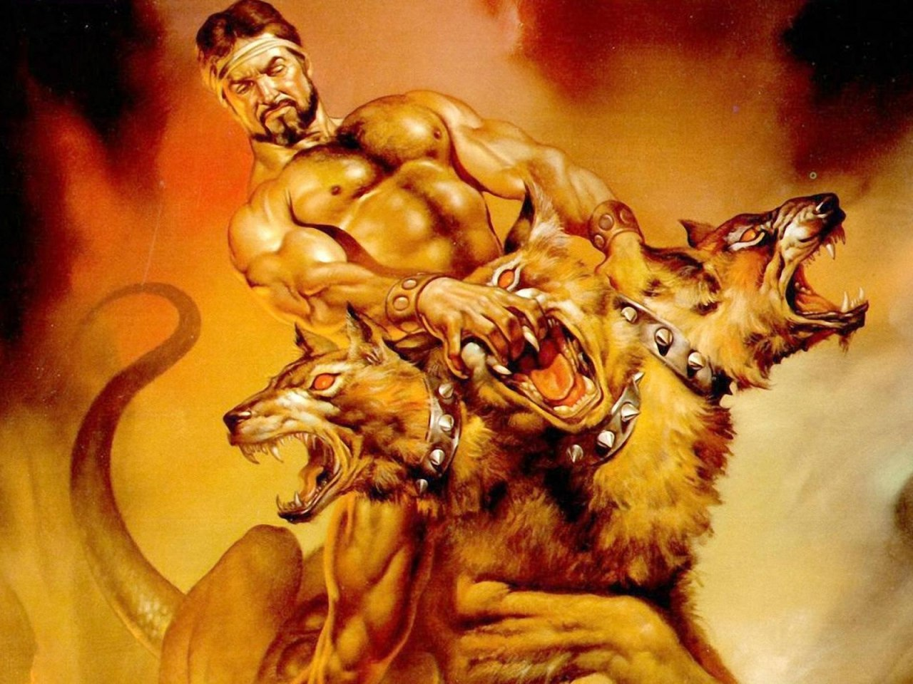
5. Integrate
Cerberus

Slide 54
Jenkins

Slide 55
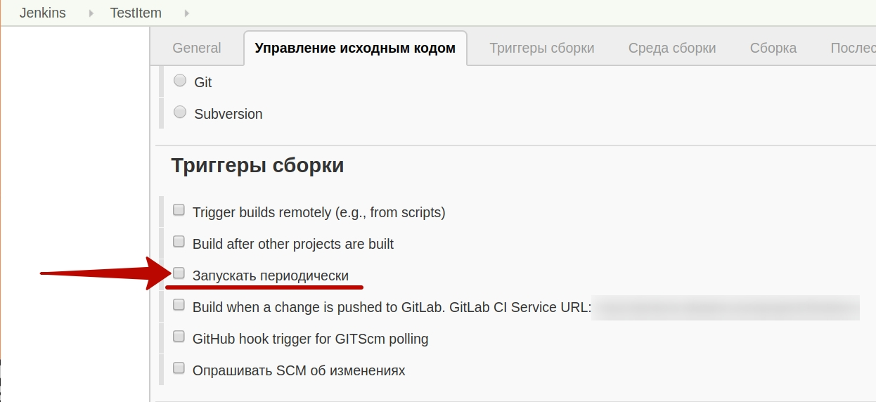
Jenkins

Slide 56
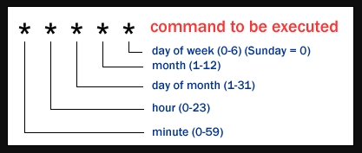
Jenkins

Slide 57
Jenkins
MINUTE Minutes within the hour (0-59)
HOUR The hour of the day (0-23)
DOM The day of the month (1-31)
MONTH The month (1-12)
DOW The day of the week (0-7)

Slide 58
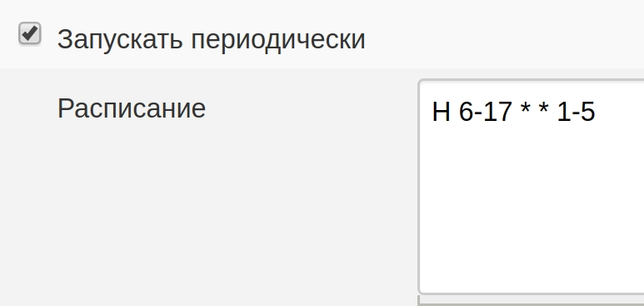
Jenkins

Slide 59
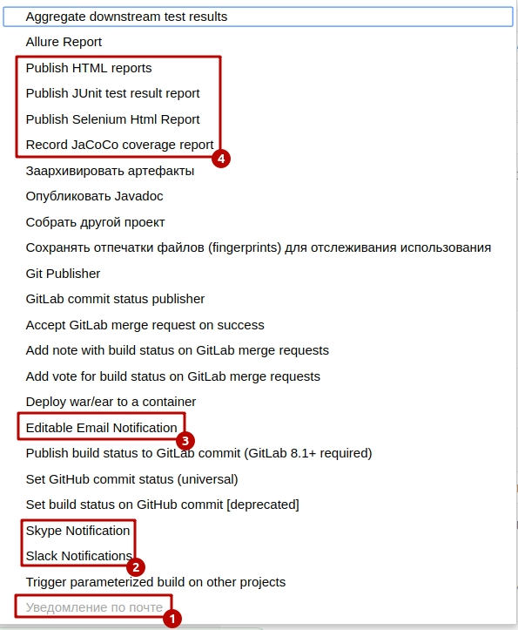
Jenkins

Slide 60
Jenkins
'@yearly', '@annually',
'@monthly', '@weekly', '@daily',
'@midnight' and '@hourly'.

Slide 61
Jenkins
* */1 * * * - for every min
0 * * * * - for every hour
0 */3 * * * - for every 3 hours
0 10 * * * - for every day at 10AM
5 * * * *
will only execute the job every 5min past every hour
* */5 * * * - for every 5 min

Slide 62
5. Integrate
Cerberus

Slide 63
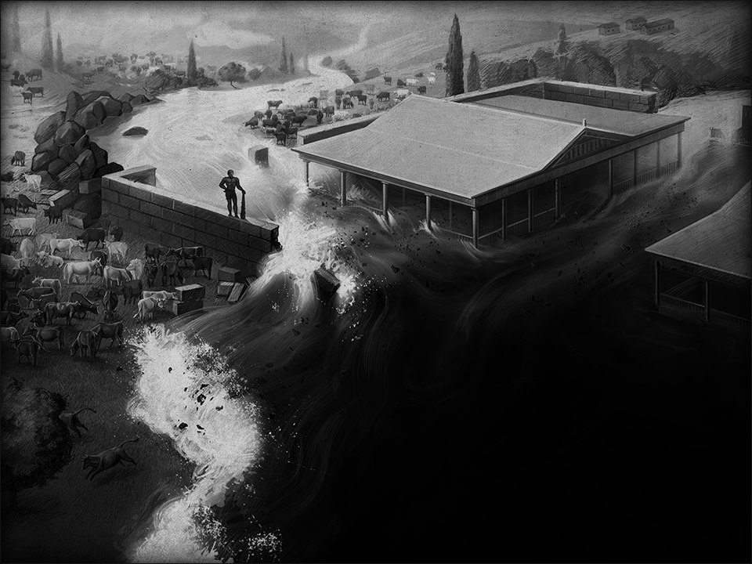
6. Inform
Augean stables

Slide 64
6. Inform
1. Console output

Slide 65
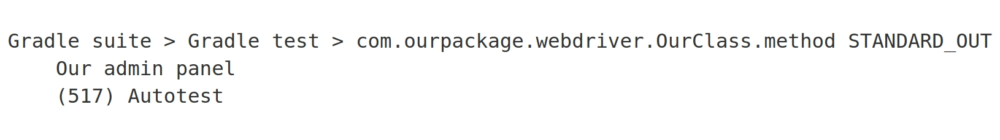
Console output

Slide 66
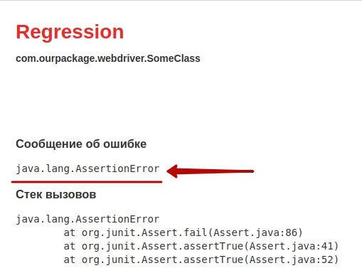
Console output

Slide 67
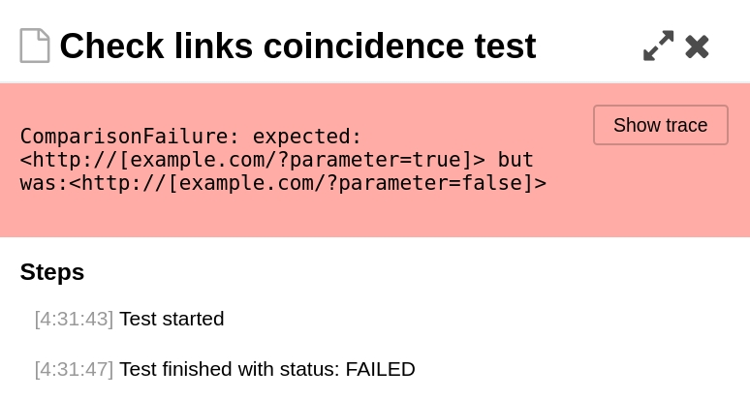
Console output

Slide 68
6. Inform
1. Console output
2. Comments

Slide 69
Comments
return 1; # returns 1

Slide 71
Comments
// I dedicate all this code,
// all my work,
// to my wife, Darlene,
// who will have to support me
// and our three children
// and the dog
// once it gets
// released into the public.

Slide 72
Comments
const int TEN = 10;
// As if the value of 10 will fluctuate...
–---------------------------------------------------------
// drunk, fix later
----------------------------------------------------------
// Magic. Do not touch.
----------------------------------------------------------
#define TRUE FALSE
//Happy debugging suckers

Slide 73
6. Inform
Augean stables

Slide 74
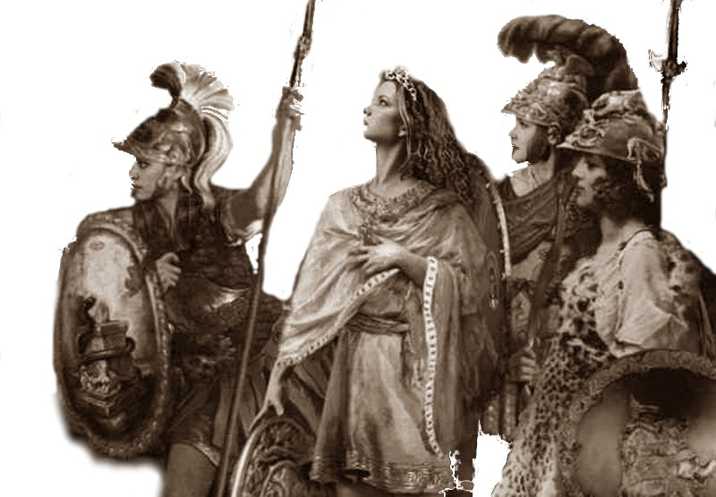
7. Communicate
Belt of Hippolyta

Slide 75
Communicate
1. Development Team

Slide 76
Communicate
1. Development Team
2. QA Team

Slide 77
7. Communicate
Belt of Hippolyta

Slide 78
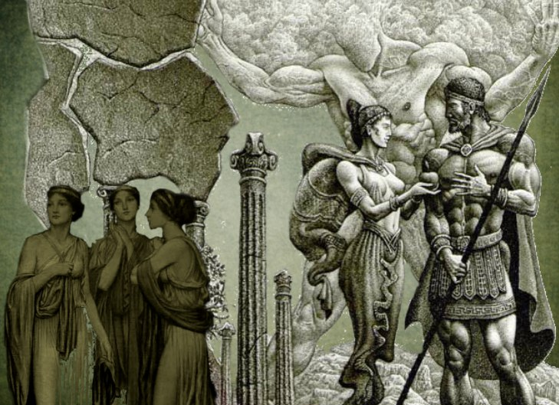
8. Delegate
Apples of the Hesperides

Slide 79
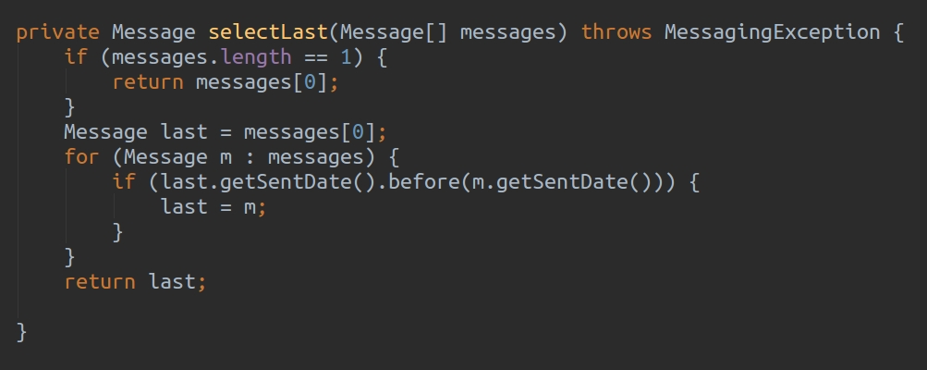
Delegate

Slide 80
8. Delegate
Apples of the Hesperides

Slide 81
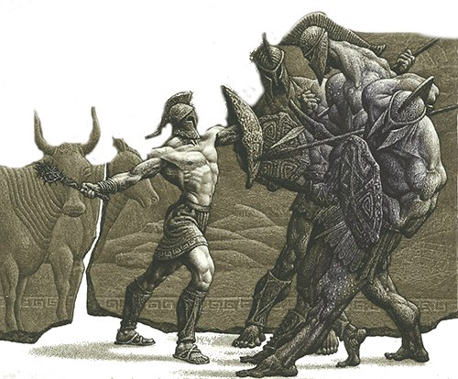
9. Actualize
Cattle of Geryon

Slide 82
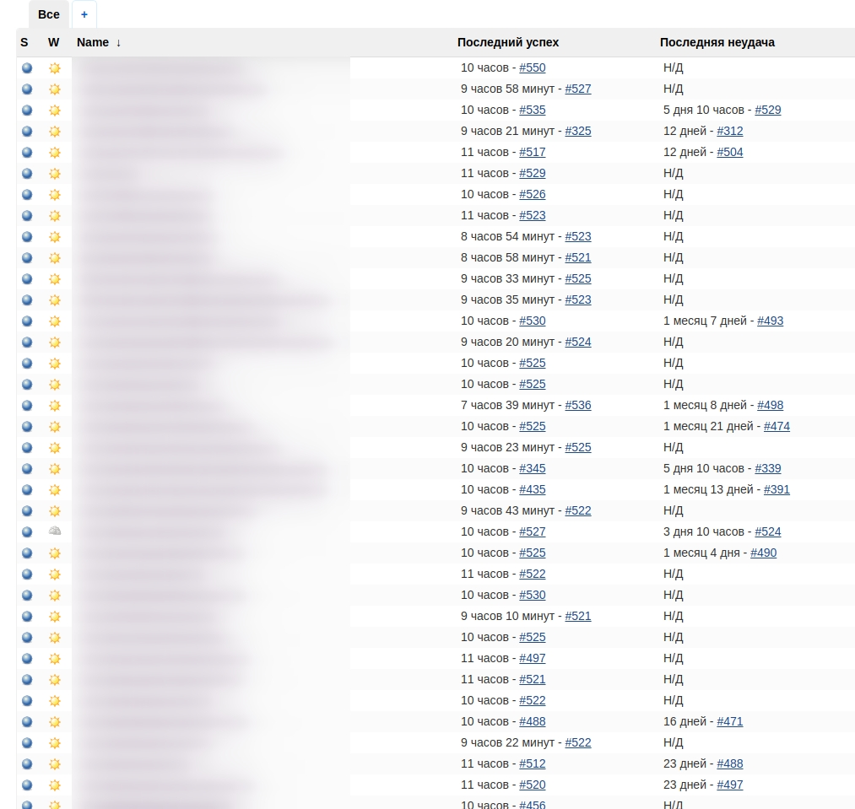

Slide 83
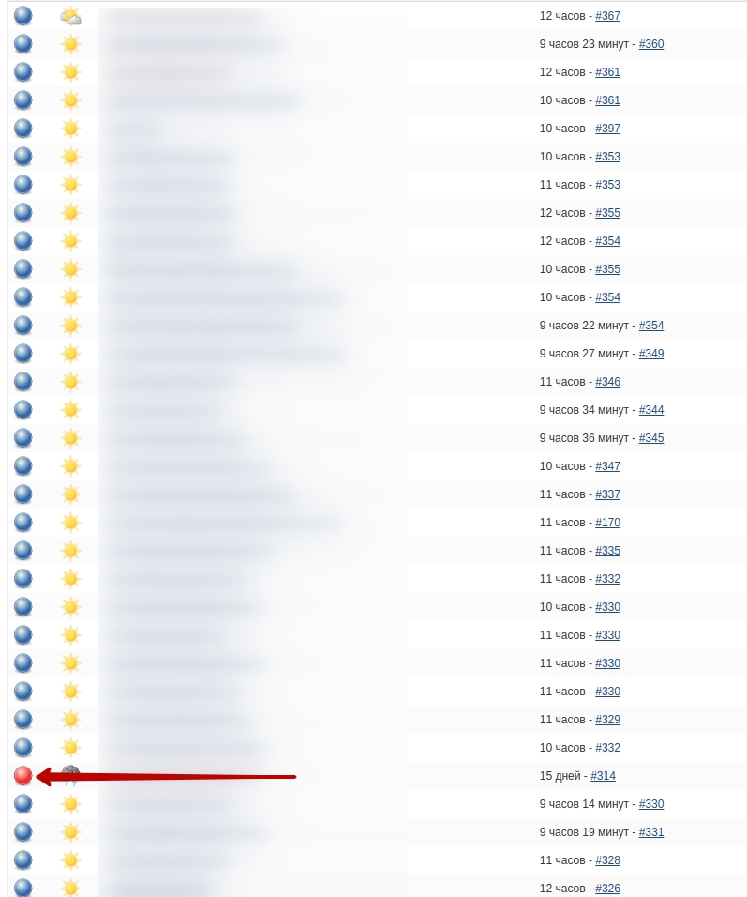

Slide 84
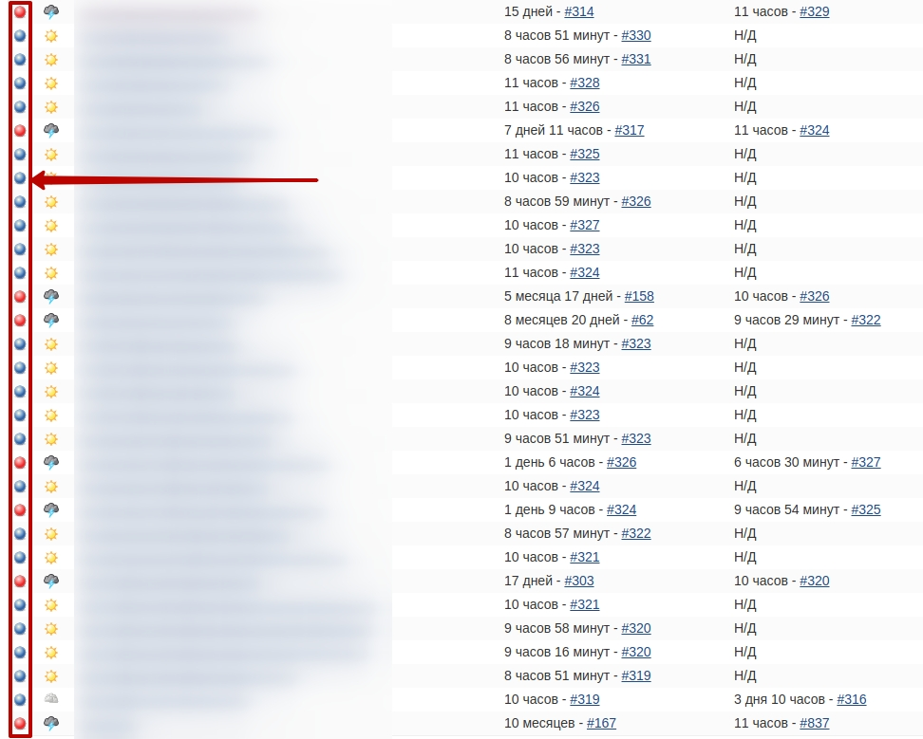

Slide 85
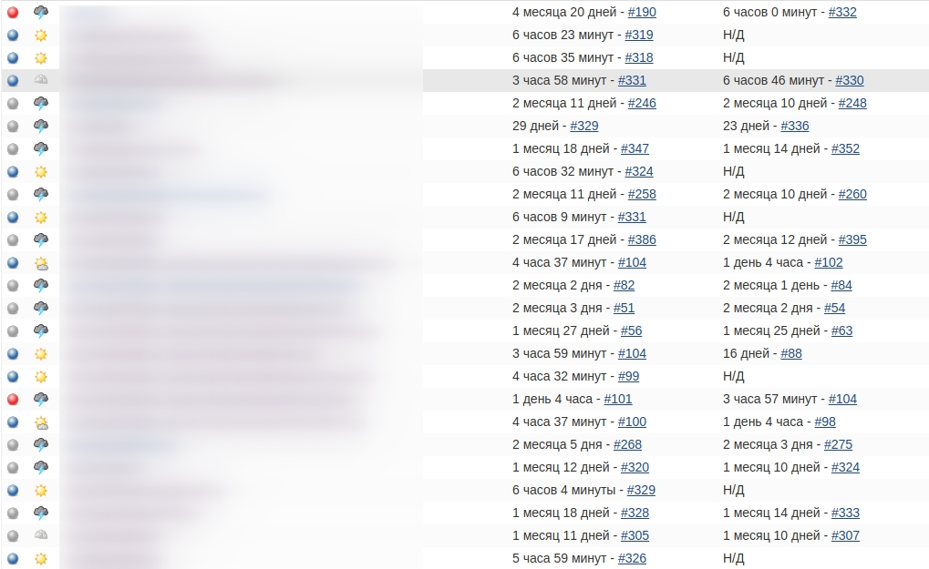

Slide 86


Slide 87
9. Actualize
Cattle of Geryon

Slide 88
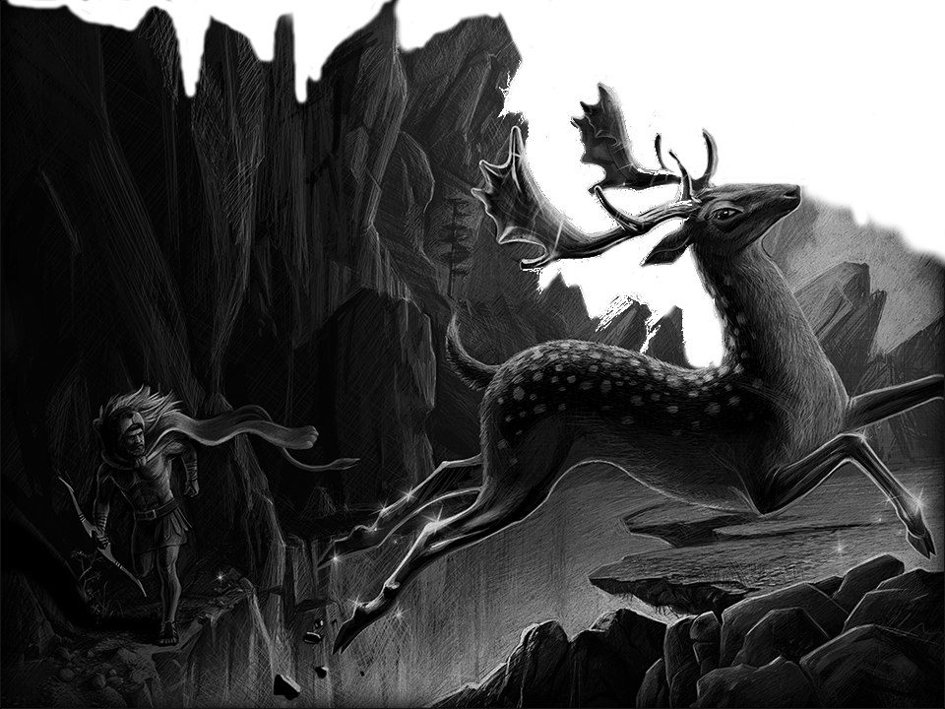
10. Start it ASAP
Ceryneian Hind

Slide 89
Start it ASAP
1. Framework

Slide 90

Framework

Slide 91
Framework
Rule 10,000 hours
“Achieving a high level
mastery in complex types
activity impossible
without a certain amount
practice. ”
M. Gladwell
"Geniuses and Outsiders"

Slide 92
10. Start it ASAP
Ceryneian Hind

Slide 93
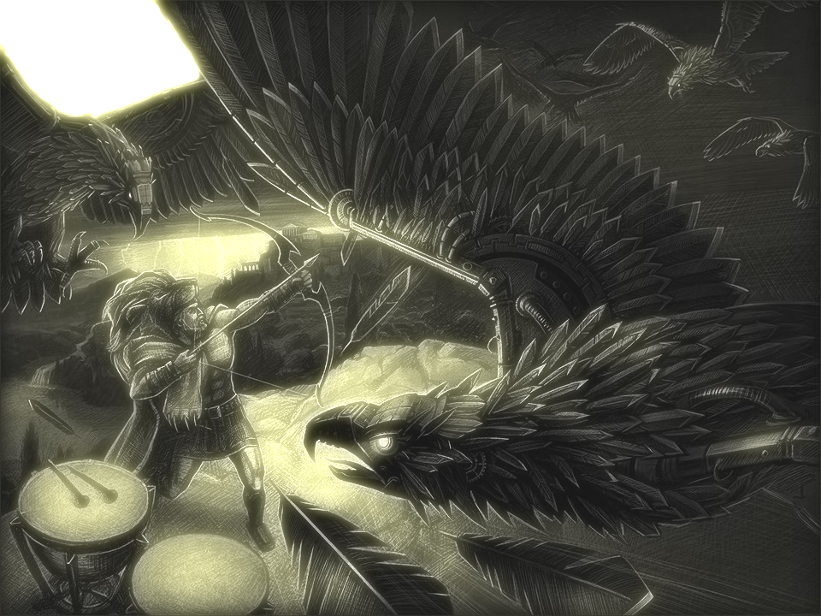
11. Review it
Stymphalian birds

Slide 94
Review it
1. Soap UI (RegExp)

Slide 95
Review it
Phone number:
- 555-1212
- (888)555-1212

Slide 96
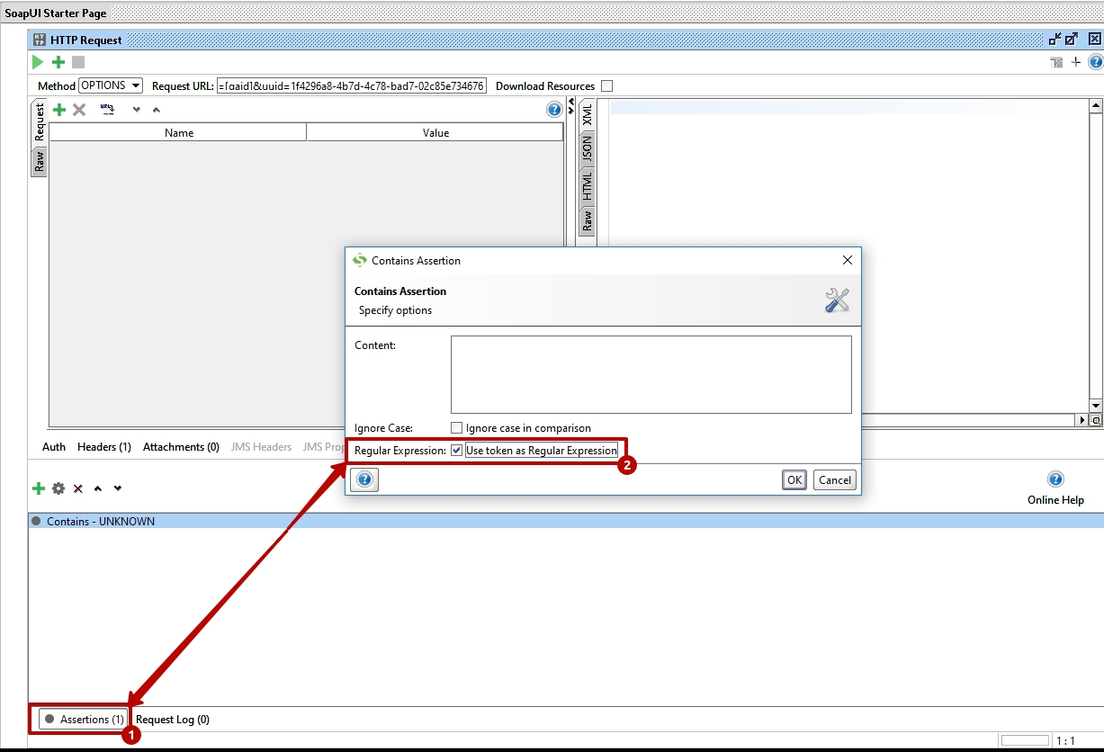
Review it

Slide 97
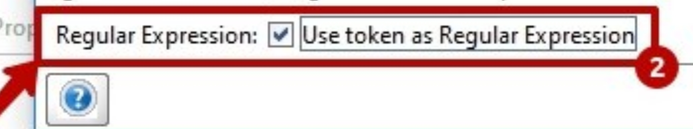
Review it

Slide 98
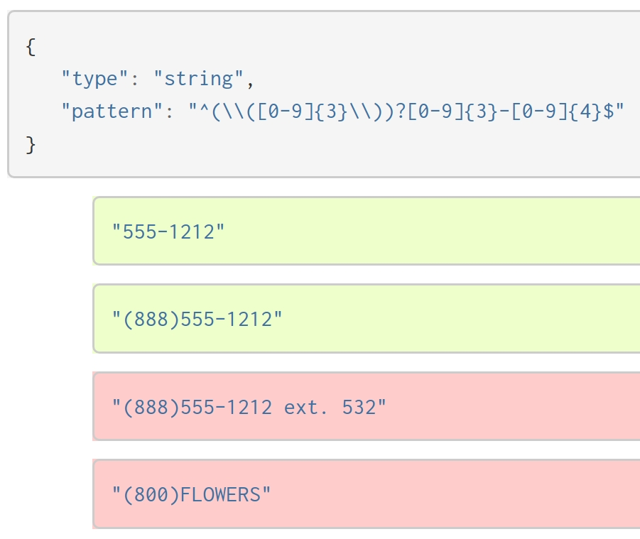
Review it

Slide 99
Review it
1. Soap UI (RegExp)
2. Load Testing
(Jmeter VS Xenu)

Slide 100
11. Review it
Stymphalian birds

Slide 101
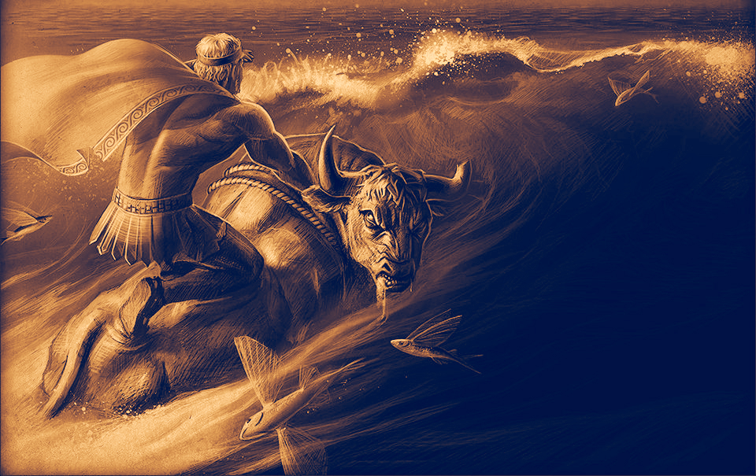
12. Develop:
- yourself
- others
Cretan Bull

Slide 102
13. Enjoy =)
harem_without_censorship.jpg
Just enjoy the process

Slide 103
1. Make it easy
2. Make it neccessary
3. Make it reliability
4. Separate
5. Integrate
6. Inform
7. Communicate
8. Delegate
9. Actualize
10. Start it ASAP
11. Review it
12. Develop yourself and others
13. Enjoy

Slide 104
Thanks for attention!
Contacts:
E-mail:
john.klymenko@gmail.com
Skype: john.klymenko
Telegram: @timlidos

