Slide 1



How to fill up
automation on Gherkin
Bad Advices
Saint-Petersburg, Russia

Slide 2

About me
IT specialist from 2001
QA engineer from 2002
Currently working for eCommerce projects as a QE Automation Lead

Slide 3

Why Bad Advices?

Slide 4
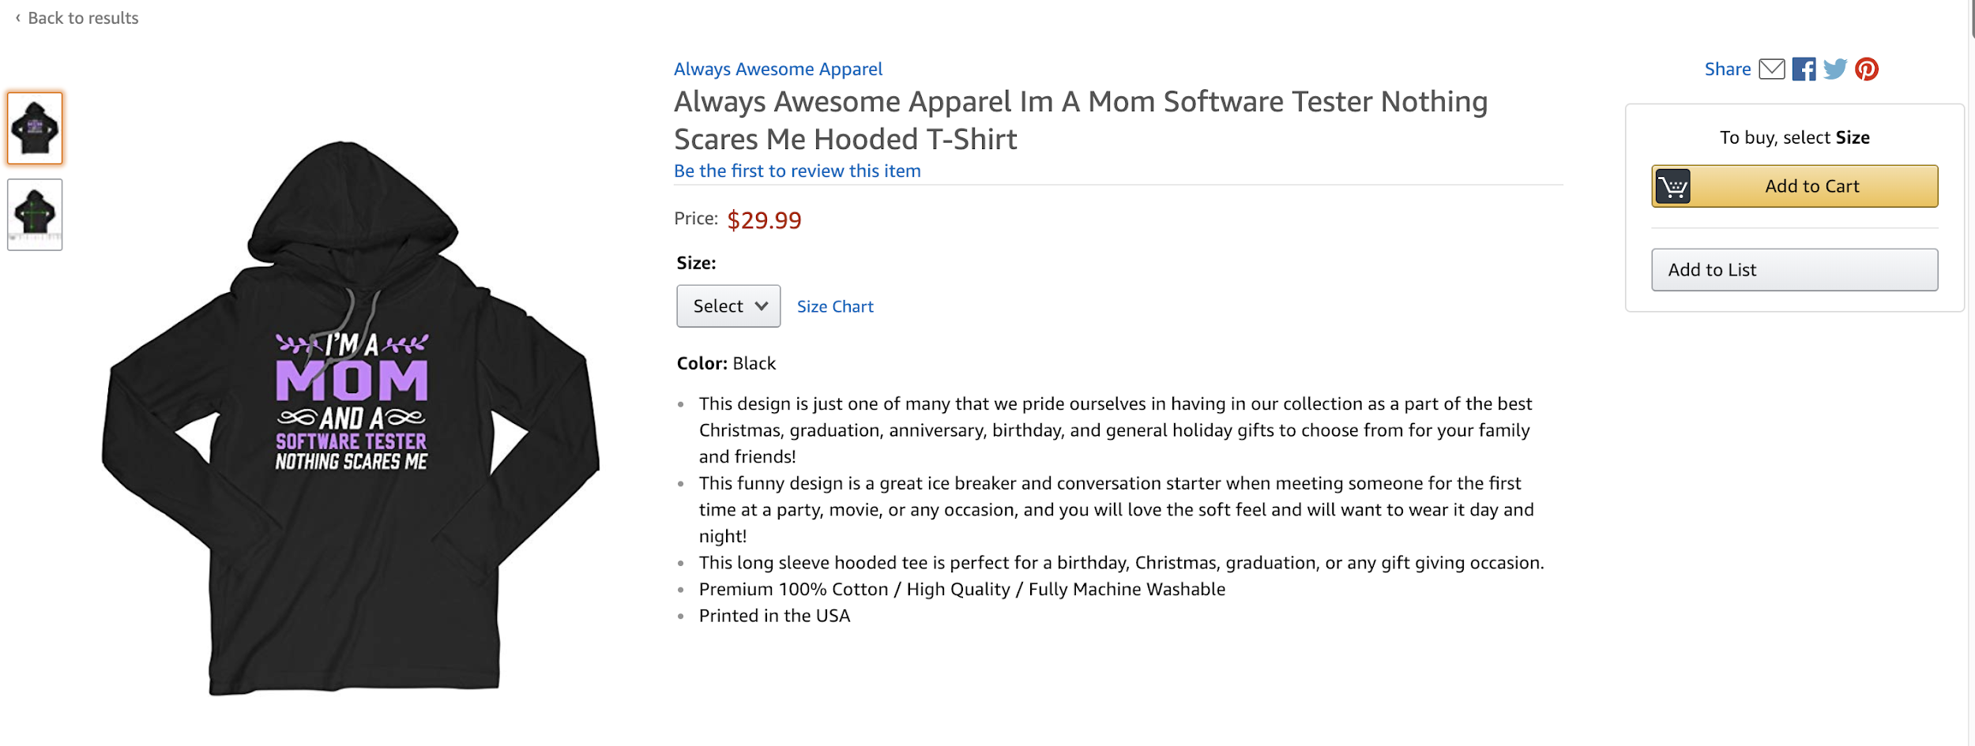
Functionality to be tested: Search a product > Add to Cart
eCommerce: adding product to the cart

Slide 5
How to keep your automation red: one bad advice per each level
Scenario level
Steps level
Methods level
Test data level

Slide 6
Bad Advice: Scenario level
Scenario: check correct order information
When user searches a product ‘calvin_clein’ on home page
Then result contains 0 items
When user searches a product ‘dress’ on home page
Then result contains 5 items
When user chooses the first item
And user adds the first item to cart
Then price is correct
When user goes to checkout page
…
And order tracking page contains correct information
50 steps

Slide 7
Bad Advice: Steps level
Scenario: order price is correct in the cart
  Given customer goes to home page
  And customer does nothing for 10 seconds
  Then I see the information about product search
  When Search product and add to cart
  Then Its price should be correct
  And customer does nothing for 10 seconds

Slide 8
Bad Advice: Methods level
@When("user clicks Add to Cart button")
public void clickAddToCartButton() {
//some code about clicking Add to cart button on product page
}
@When("user clicks $buttonName button")
public void clickButtonOnPageWithManyButtons(String buttonName) {
//some code about clicking on PageWithManyButtons
}

Slide 9
NEVER do it to fill your project up
Scenario: add regular product to cart
and check the cart price
  Given user is on home page
  And product found by keyword ‘jeans’
  When I click ‘Add to cart’ button
  Then product is added to cart
  Then product price should be correct in the cart
clear scenario name
short enough scenario
parameter is framed by apostrophes
No unneeded steps

Slide 10
Bad Advice: Test Data Management level

Slide 11
Hardcode: Could we fill up the project?
Scenario: check price counting in the cart
Given user is on product page
When I add <quantity> product with SKU <sku_id>
Then price in the cart is <product_price>*<quantity>
Examples:
|Meta |currency|sku_id |quantity |product_price |
|@country US|$ |123456 |2 |12,25 |
|@country EU|eur |234347 |3 |9,75 |

Slide 12
Database: Could we still fill up the project?
Database rights: access rights could be changed, and all the automation could be out-of-date.
Database updates: if your data is only in one database, it is ok. But what about several databases?
Even if the previous 2 are ok, pulling the data from a database takes a long time.
SELECT price
FROM products
WHERE prod_id = $prod_id

Slide 13
Json/xml: Could we still fill up the project?
Obvious thing: our json could not be up-to-date with database
Inventory (or some other critical property) could be changed, and we will know it after nightly run only
"NORMAL_PRODUCT": {
"productId": "1234_3456_134",
"productName": "Jeans with some super property",
"isGift": "false",
"newArrival": "false",
"onlineOnly": "true",
}

Slide 14

NEVER do it to fill your project up
Negotiation with customer about the data that should never be changed
Separate team that looks after this data
Issues to this team if something goes wrong
Data pool you can dynamically choose your data from

Slide 15
Never do it to fill your project up
Scenario Level: Make it simple and readable
Steps Level: Use needed steps only
Methods Level: Remember about your teammates
Test Data Management Level: Take every way disadvantages into account

Slide 16
Questions?

