Slide 1


Automation testing
For mobile application in the context of unstable internet connection

Slide 2
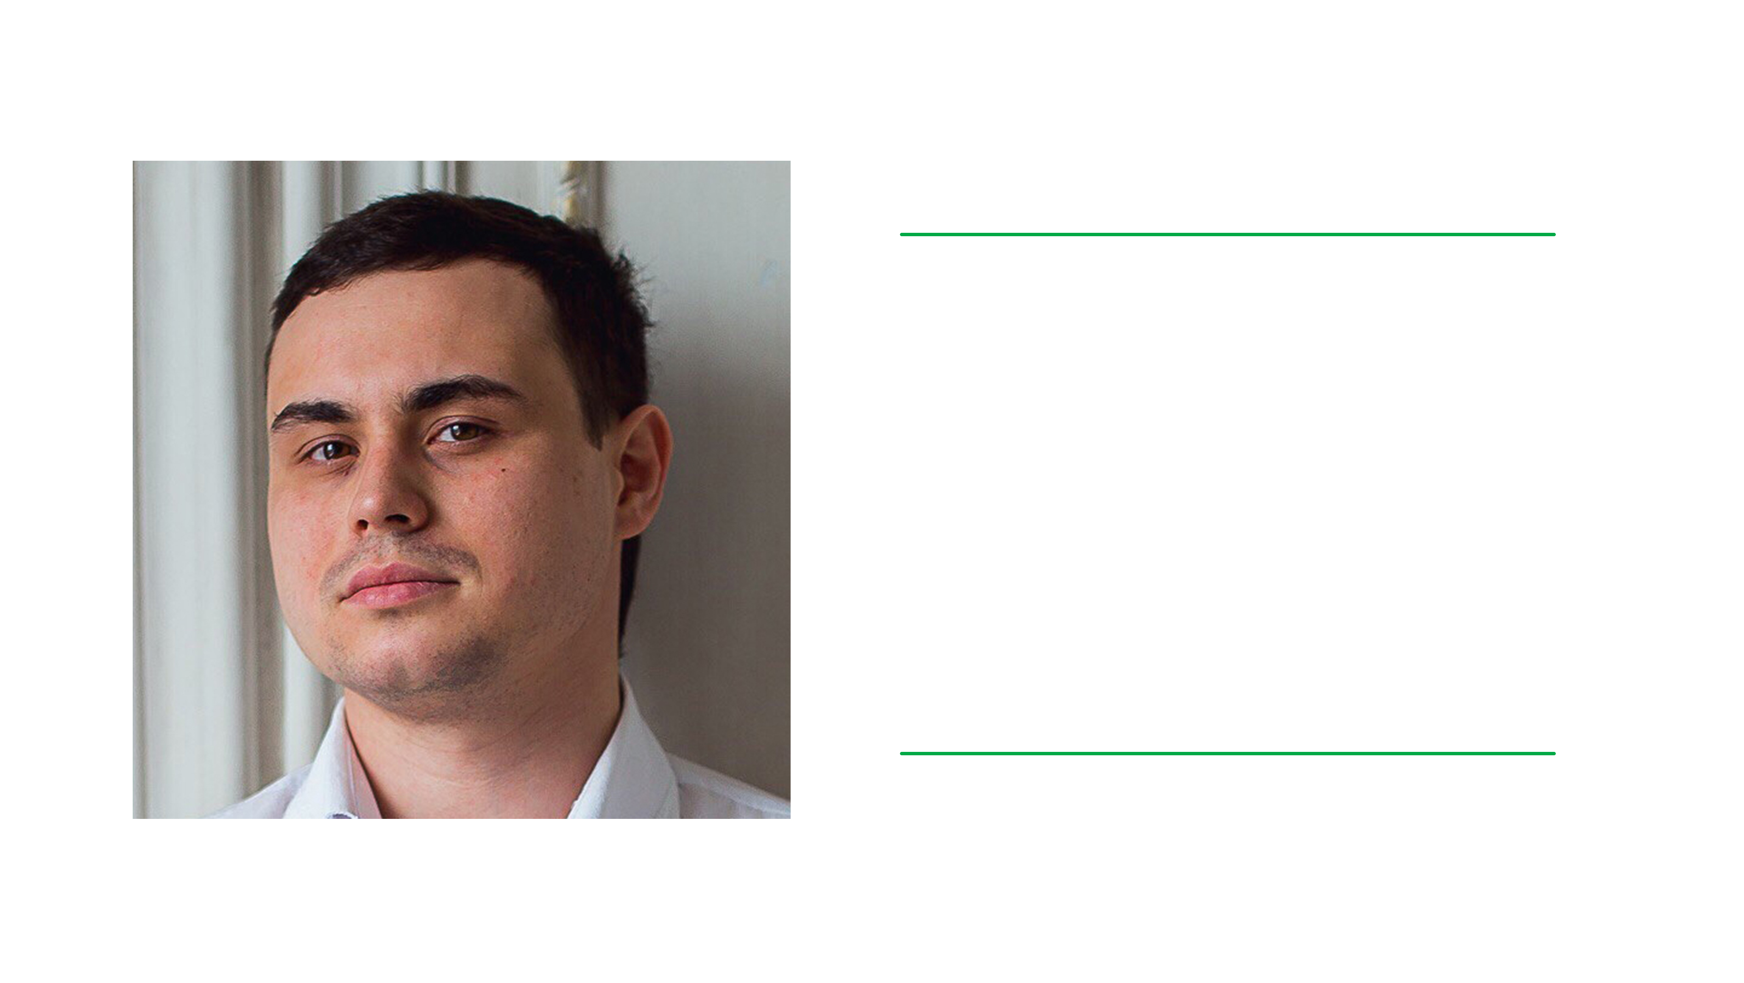
Nikanorov Valeriy
Sberbank
SDET
nikanorov.v.va@sberbank.ru

Slide 3

Content
1
2
3
Cases
to consider
The initial point
Functional tools
4
Sberbank today
7
Instruments
10
Application results
5
Issues to mention
8
Fault
injection
11
Automation testing
6
Developer Assitst
9
Cases

Slide 4

Sberbank today
140mln
2mln
500mln
Customers
individuals
Customers
legal entities
Relevant
transactions daily
500Tb
>5Pb
№1
Actively
changing data
Archival
data
State
significance

Slide 5
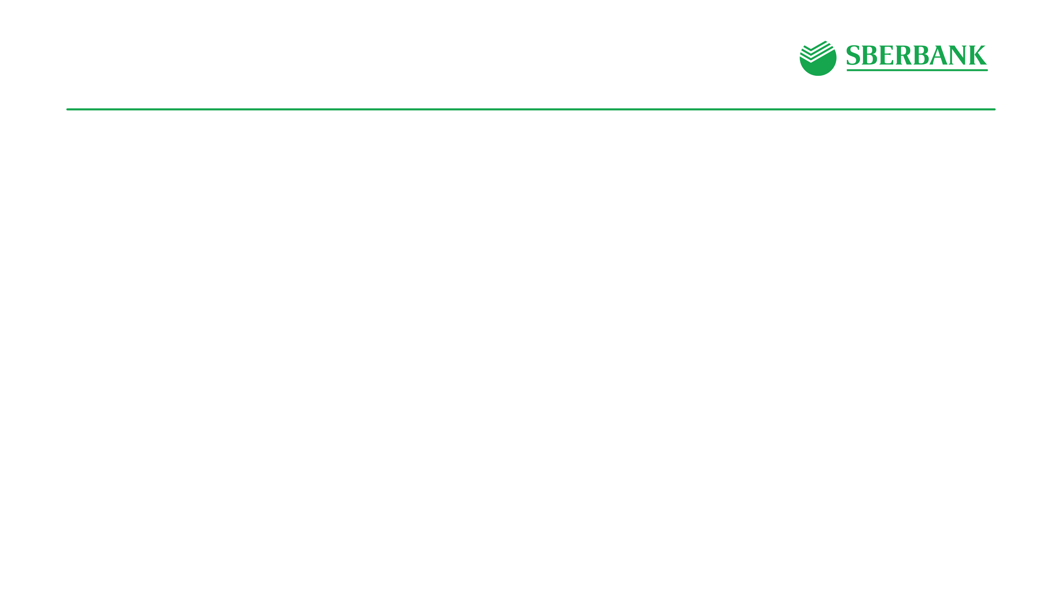

Issues

Slide 6

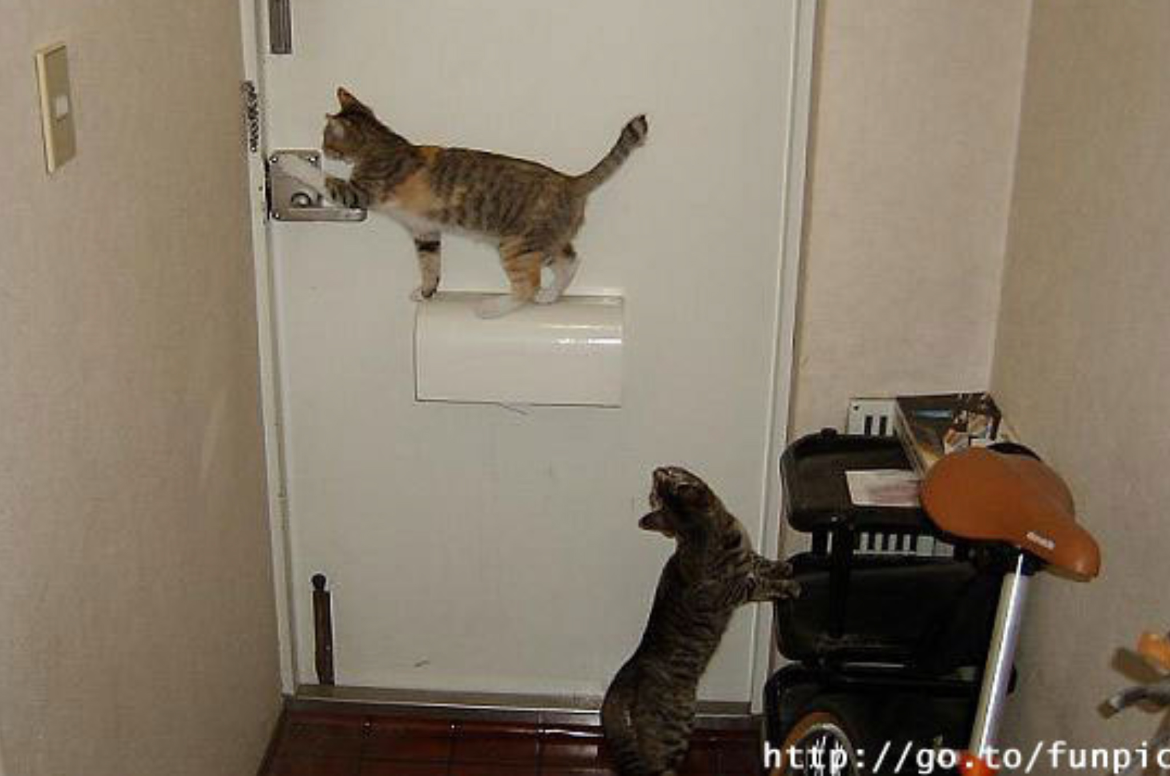
To help the developer
Data streaming system
System repeated requests
Error classification

Slide 7

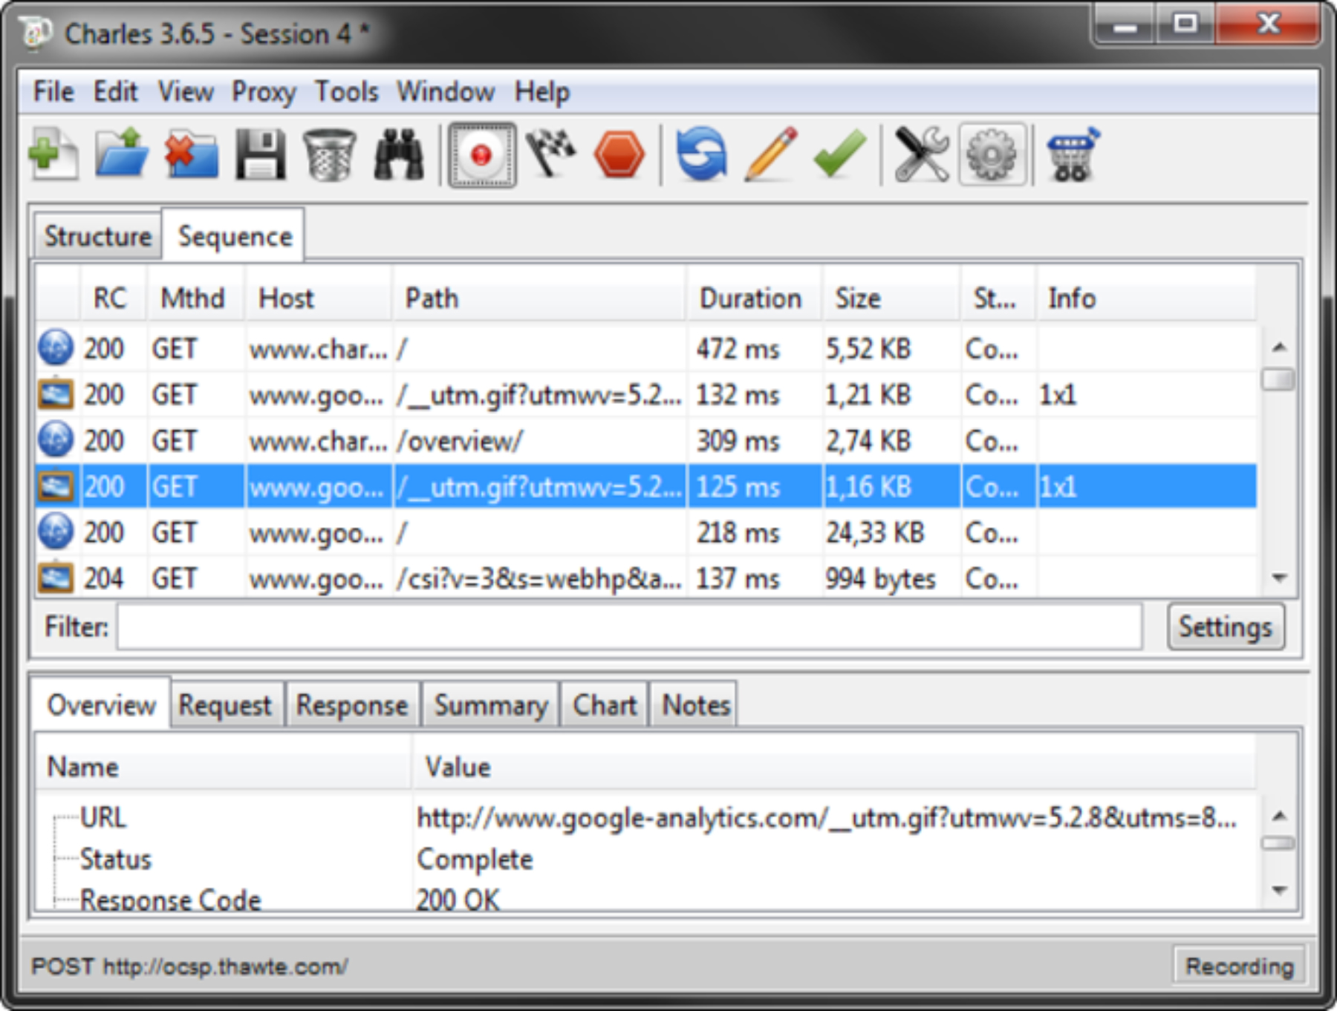


Instruments
Breakpoint
Substitution of request / response data
Throttling
Control of content size and content

Slide 8


Fault injection
Without explicitly forcing a system to fail,
it is unreasonable to have any confidence
it will operate correctly in failure modes
Caitie McCaffrey
The Verification of a Distributed System

Slide 9

Cases
Network mode switching
Interruptions: long and short ones
Low connection speed
The size of data in the stream
Spoiled/invalid requests
Re-downloading after failed request
Sleep cases / close application in unstable connection conditions

Slide 10
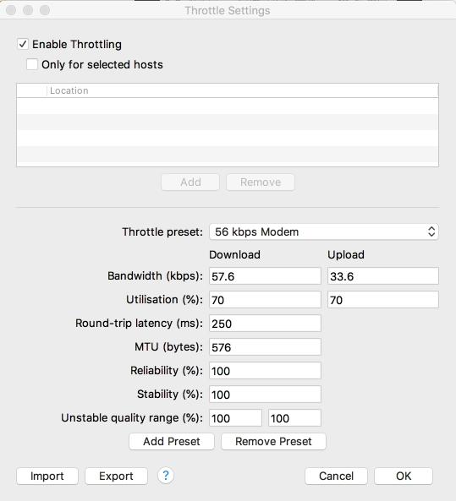
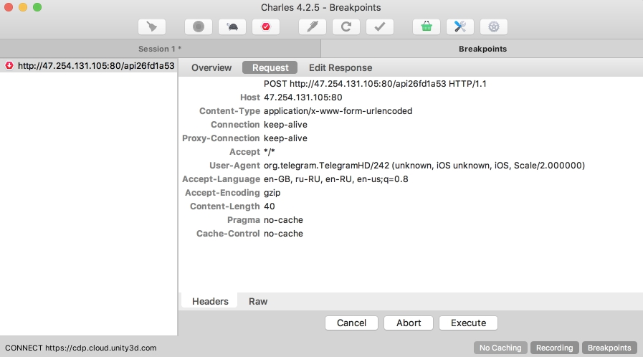
Application results
Reduction of defects in prod ~20%
30% more statistical data has a clear definition
Growth of audience

Slide 11
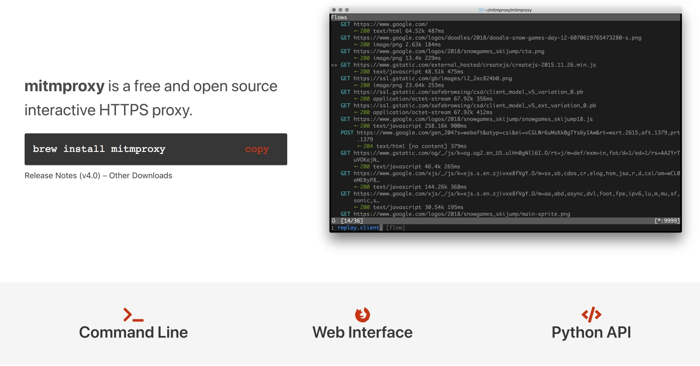
Automation

Slide 12
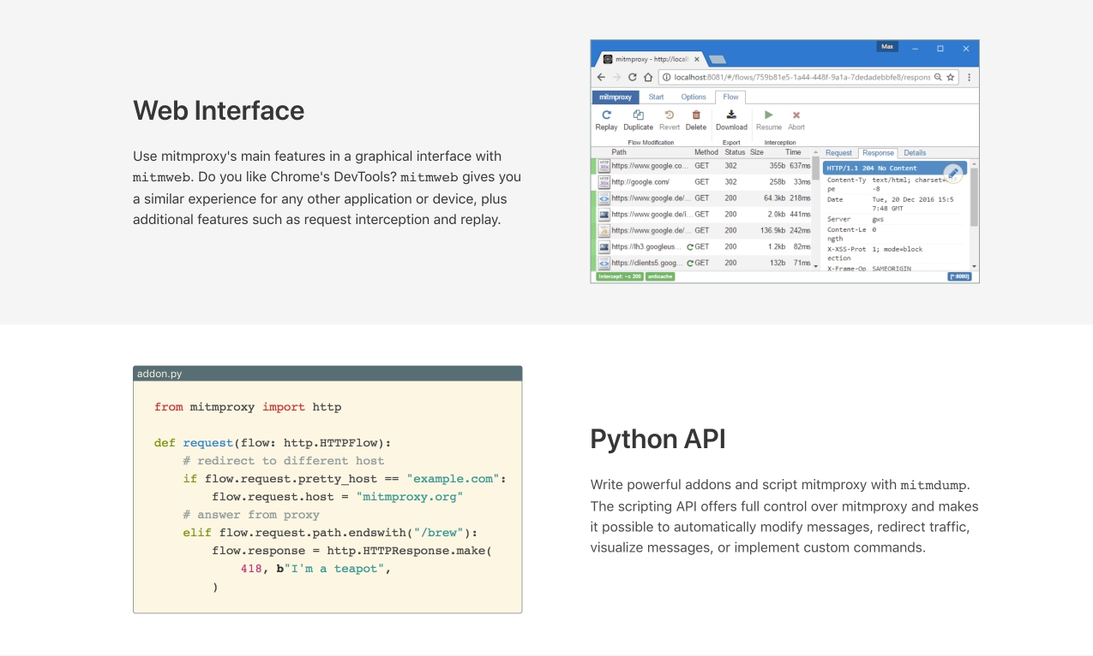
Automation

Slide 13
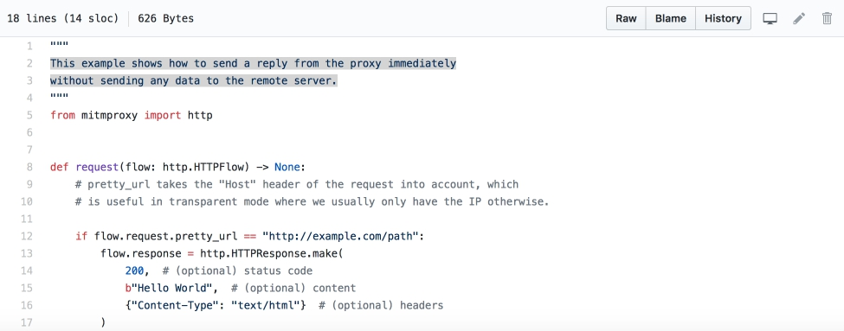
Automation

Slide 14
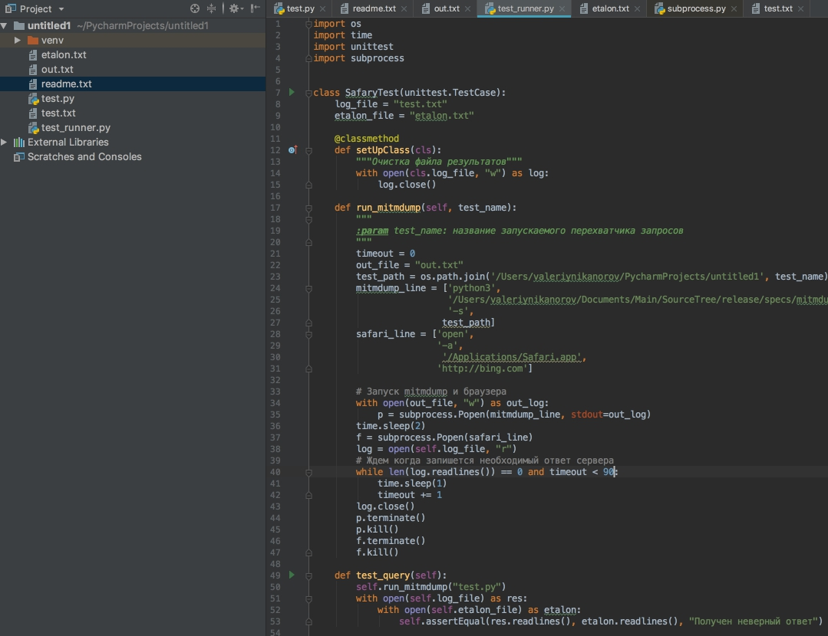
Automation

Slide 15
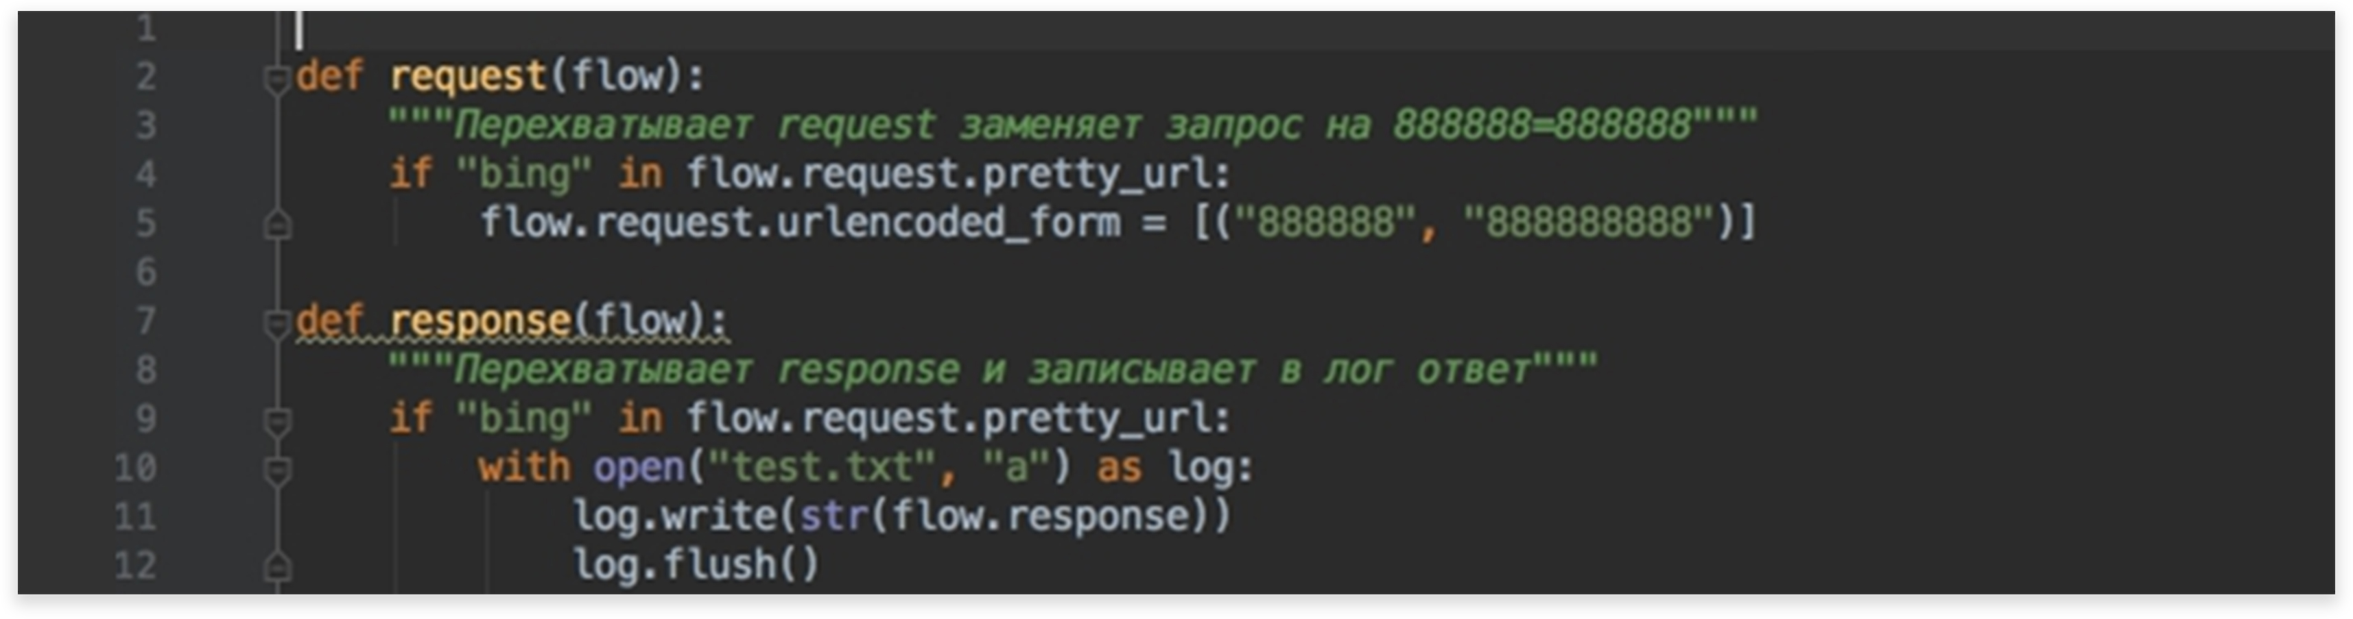


Automation
Request interceptor
The response received is being automatically recorded in ”test.txt”
The standard is being compared with ”test.txt”

Slide 16

Conclusion
Determine all possible scenarios
Re-enact the situation as much as possible in a production environment
Compose and improve system with error control, streams of download, make accurate cases
Use Automation
Learn from the experience of others

Slide 17
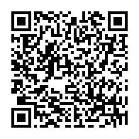
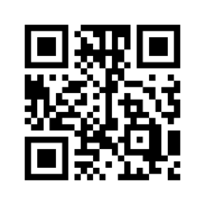
Documentation
Sample of complete cases
Automation testing
with mitmproxy

Slide 18

Questions

