Slide 1



HOW TO BREAK
THE SOFTWARE
BY ATTILA FEKETE

Slide 2









20
Financial

Slide 3
HOW TO BREAK
THE SOFTWARE
BY ATTILA FEKETE

Slide 4

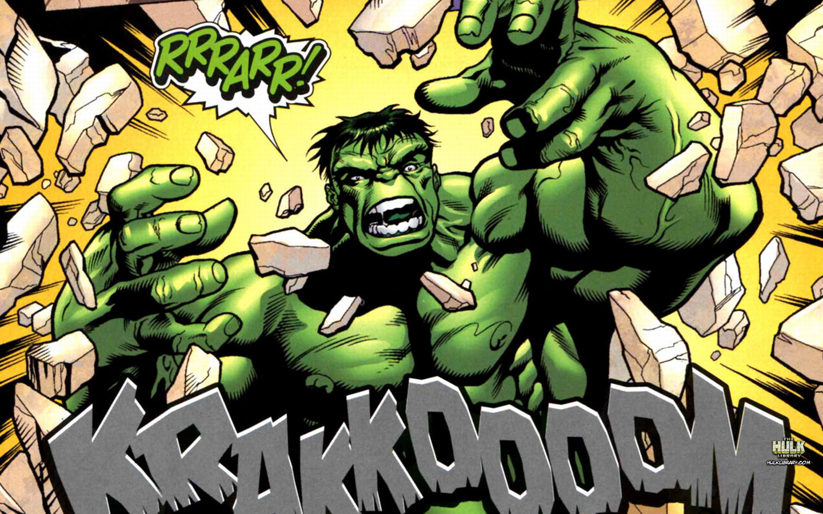

FAST
STRONG
FLY

Slide 5

WE ALL HAVE SUPER POWER

Slide 6


Slide 7
01
INFORMATION SOURCES

Slide 8
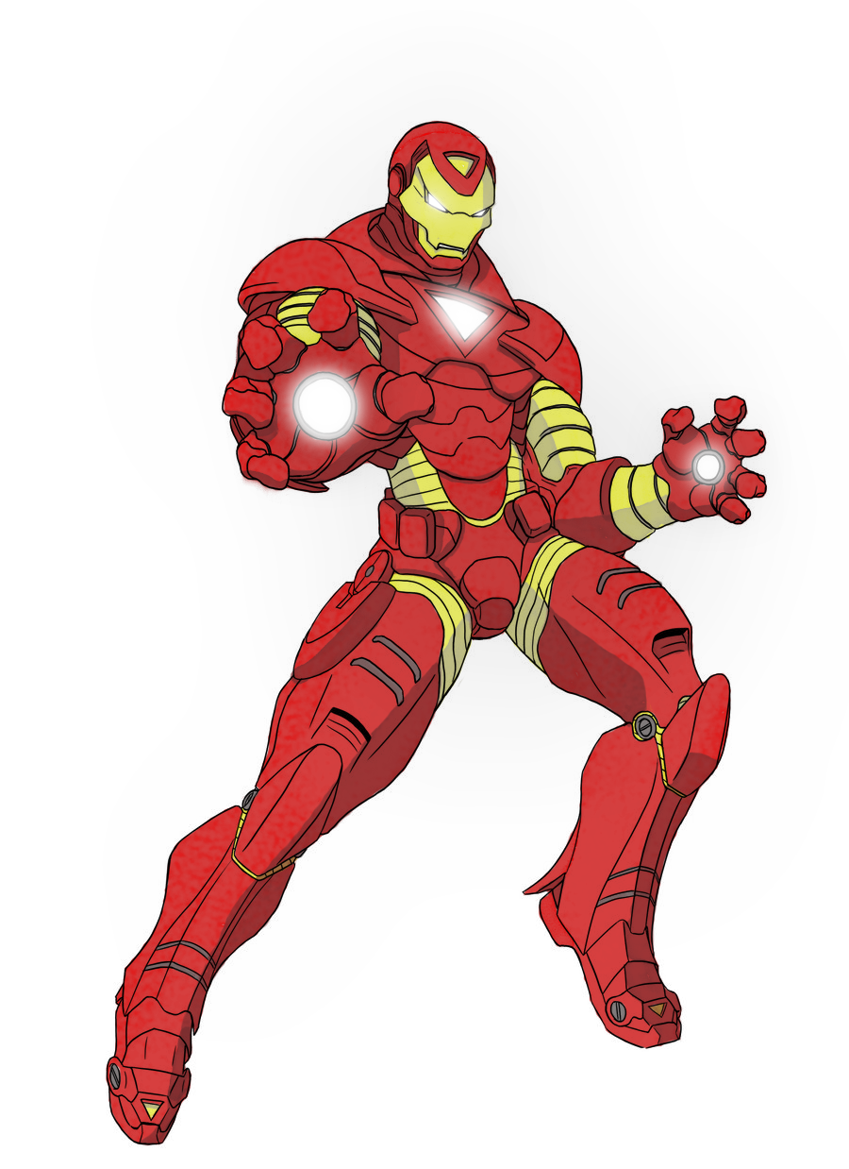


INFORMATION SOURCES
Software
Domain
Technology
Architecture
User Group

Slide 9




KNOW THE SOFTWARE
Areas with lot of bugs
Tricky interactions
Project
issues

Slide 10




KNOW THE DOMAIN

Slide 11

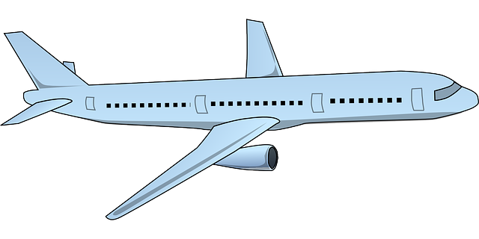





KNOW THE TECHNOLOGY

Slide 12

KNOW THE ARCHITECTURE

Slide 13


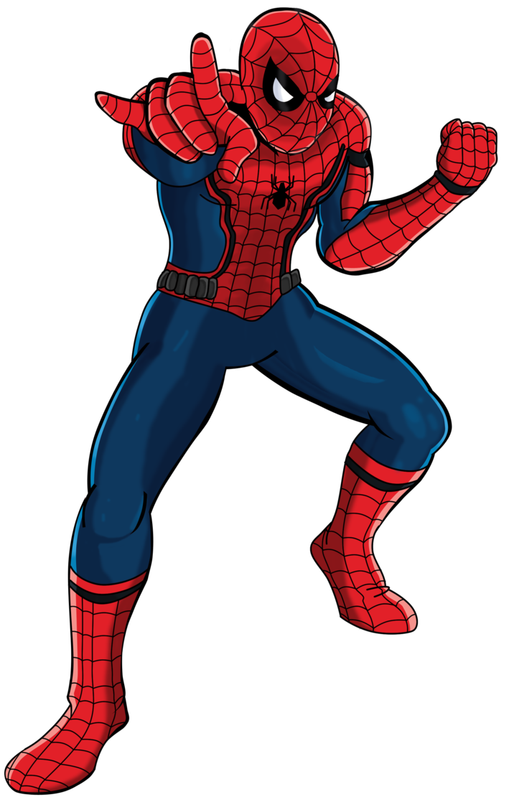
KNOW THE USERS

Slide 14
INFORMATION SOURCES
Software
Domain
Technology
Architecture
User Group

Slide 15
02
FAULT MODEL
3 PERSPECTIVES

Slide 16
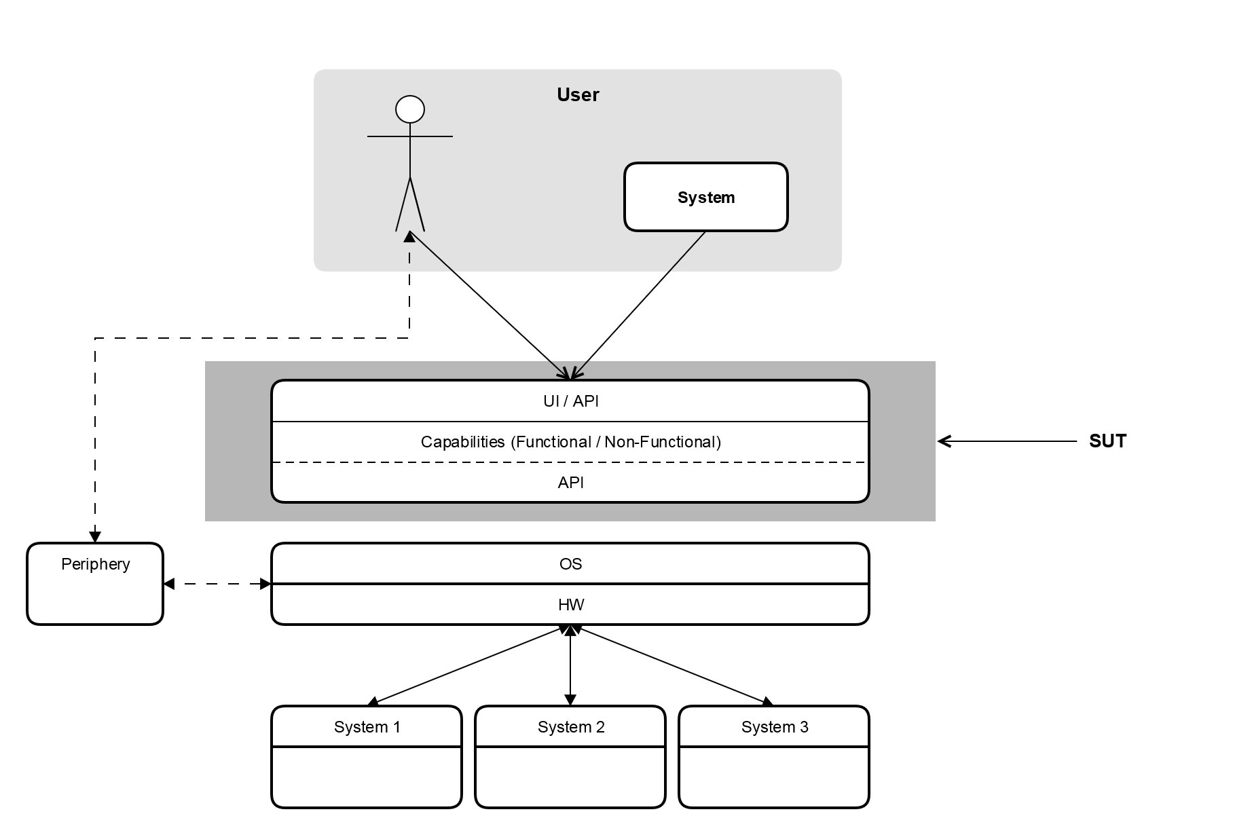


FAULT MODEL

Slide 17
02/1
OPERATIONAL ENVIRONMENT

Slide 18








DIVERSITY
Hello
Szia
Android

Slide 19
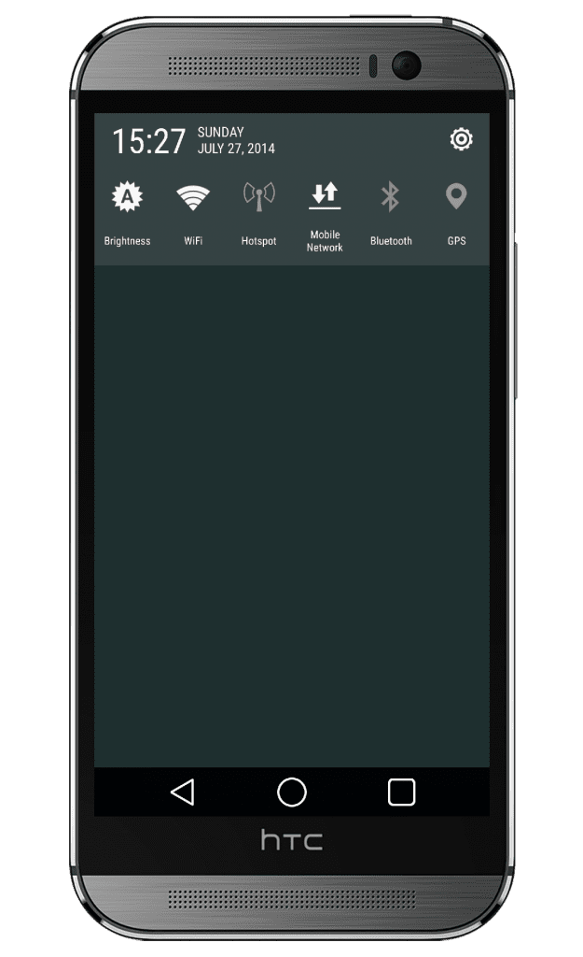
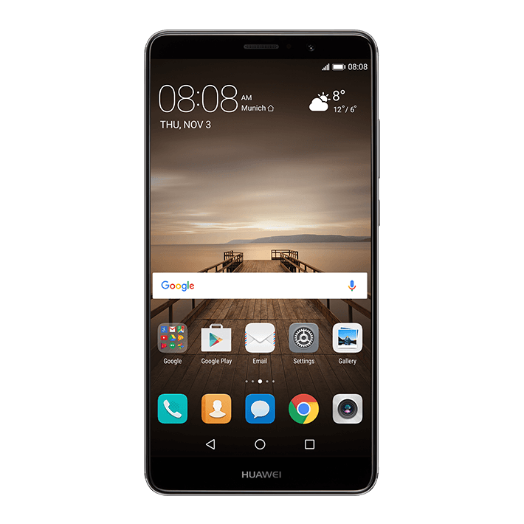
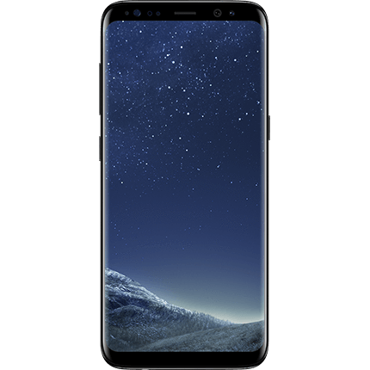
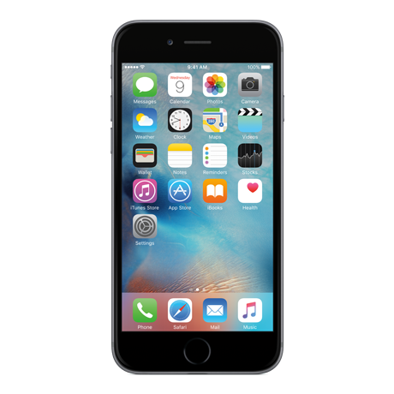
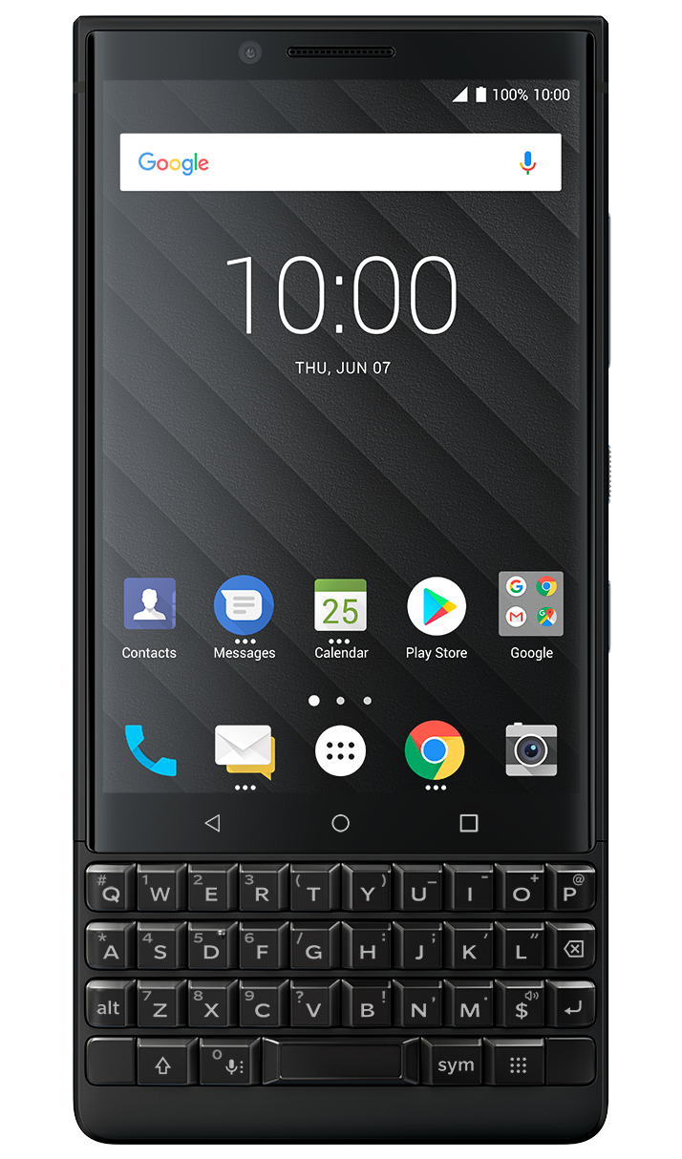
DIVERSITY

Slide 20

DIVERSITY
5.0 Lollipop
5.1 Lollipop
6.0 Marshmallow
6.1 Marshmallow
7.0 Nougat
7.1 Nougat
8.0 Oreo
8.1 Oreo
9.0 Pie
2.0 Eclair
2.2 Froyo
2.3 Gingerbread
4.0 Ice Cream
4.2 Jelly Bean
4.1 Jelly Bean
4.3 Jelly Bean
4.4 KitKat
Android

Slide 21
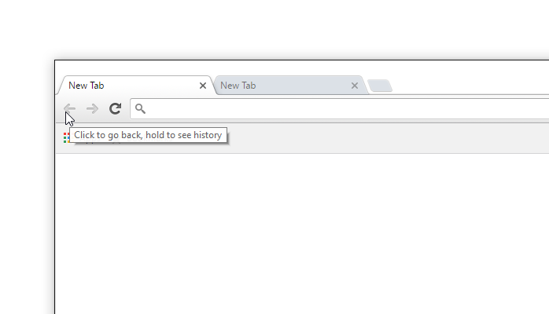
DIVERSITY
User name
Password
Login

Slide 22
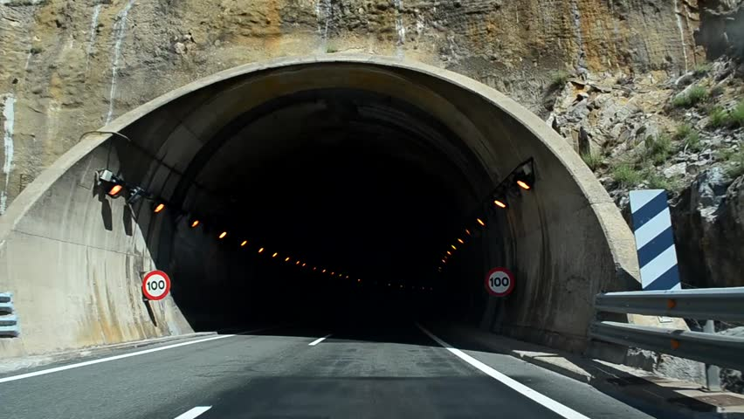
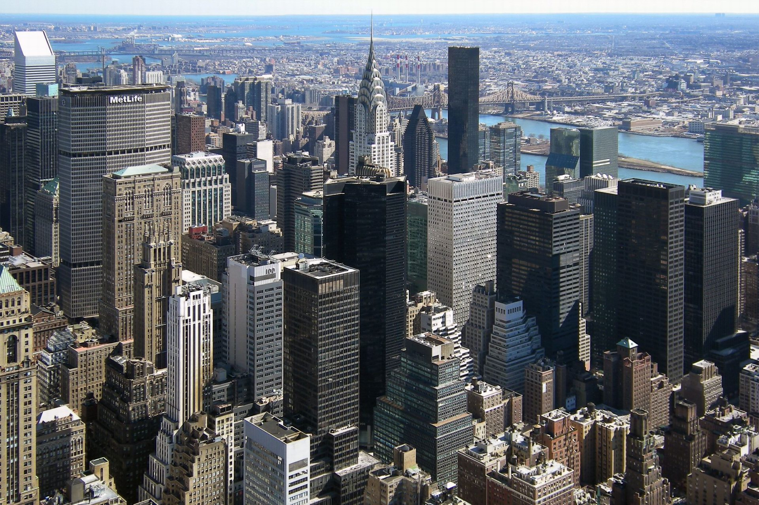
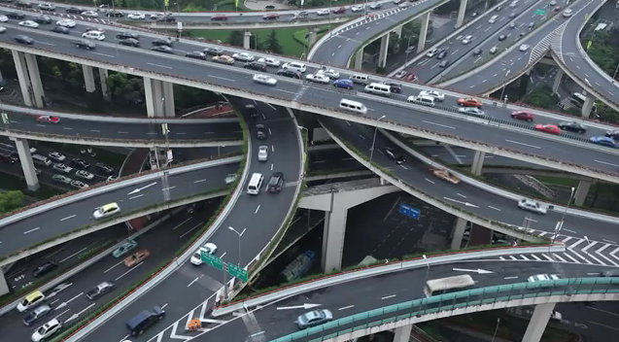
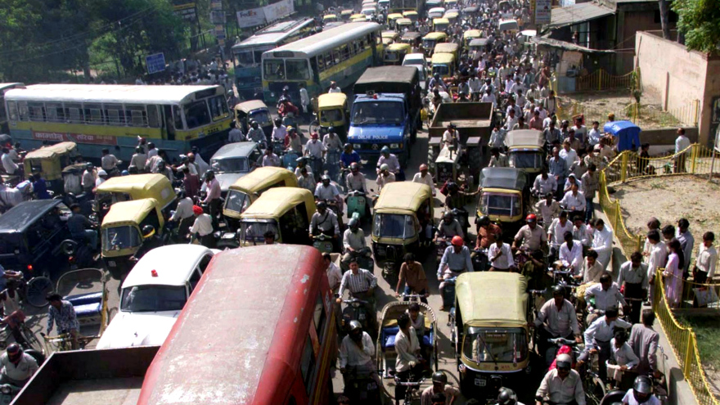
DIVERSITY

Slide 23

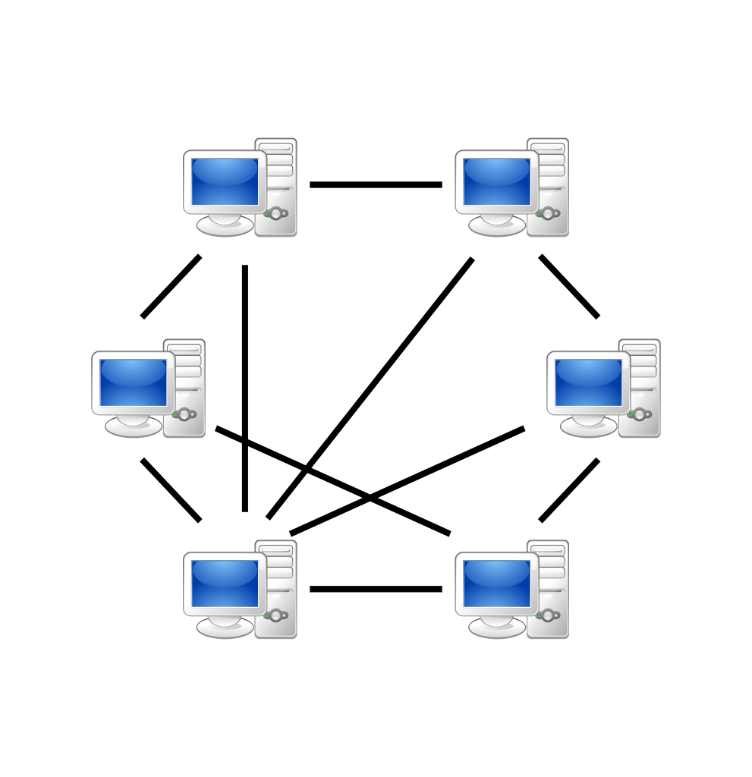


INTEROPERABILITY

Slide 24
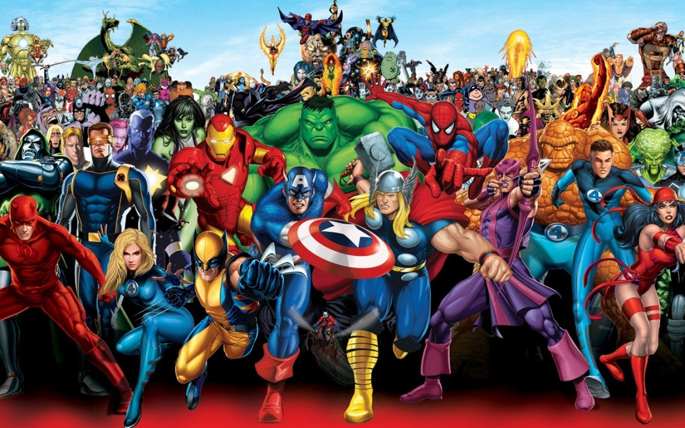
USERS

Slide 25



DEFINITION OF QUALITY

Slide 26
RESOURCES
Memory
CPU
Remote Resources
File Storage

Slide 27

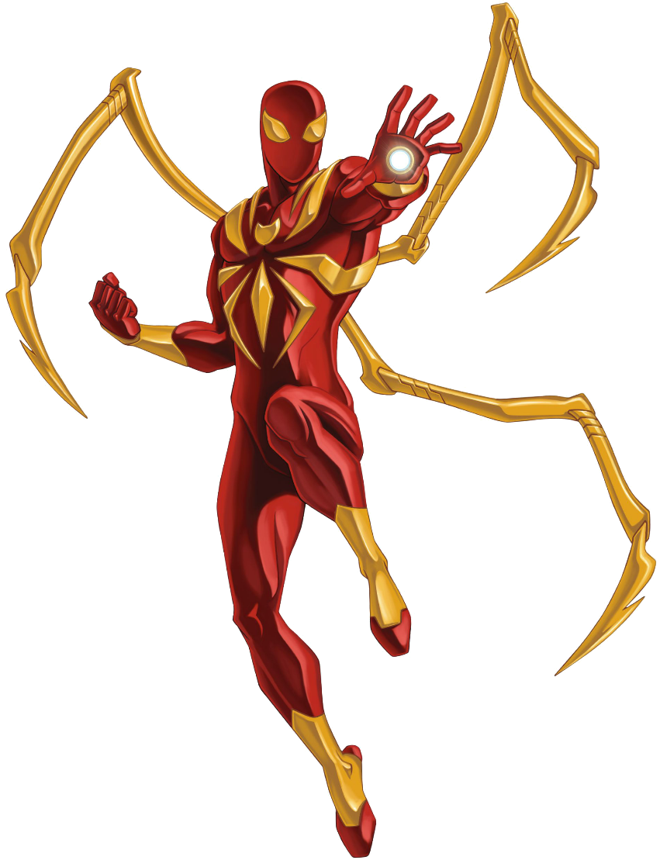
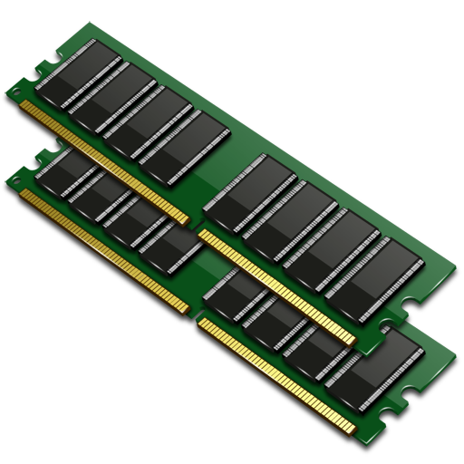

MEMORY AND CPU
HW FAILURE
LOW

Slide 28

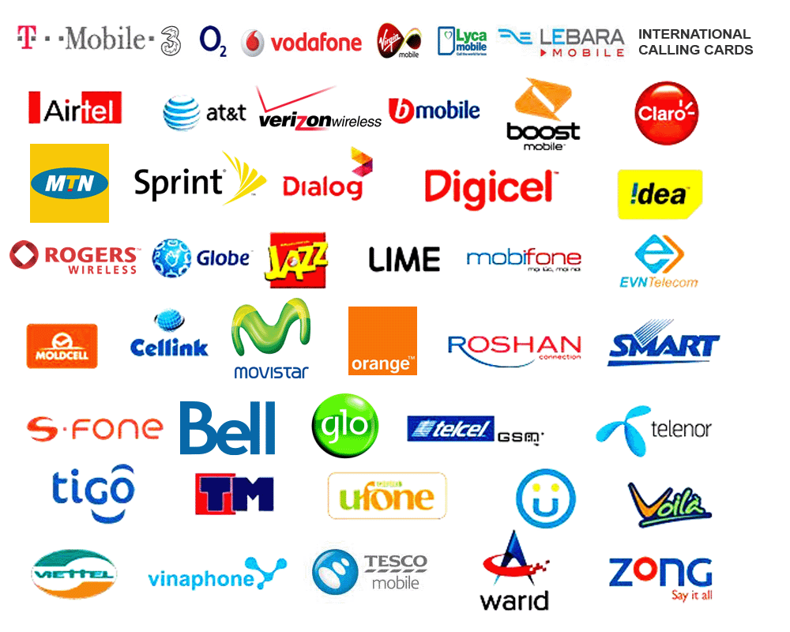

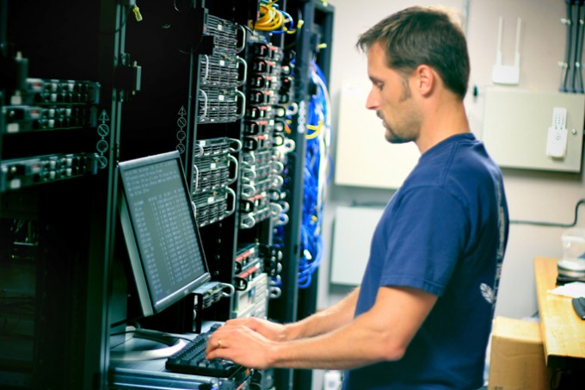


FILE STORAGE

Slide 29
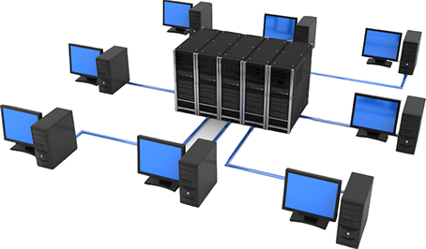
REMOTE RESOURCES
LOW
NOT RESPONDING
DELAYED RESPONSE

Slide 30
FAULT MODEL

Slide 31
02/2
CAPABILITIES

Slide 32

CAPABILITIES
FUNCTIONAL
NON- FUNCTIONAL
ACCEPT INPUT
PRODUCES OUTPUT
COMPUTE
STORES / USE DATA

Slide 33
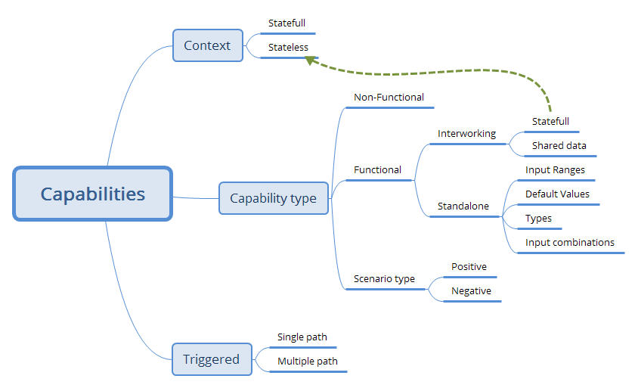
CAPABILITIES
INPUT →COMPUTE →OUTPUT

Slide 34
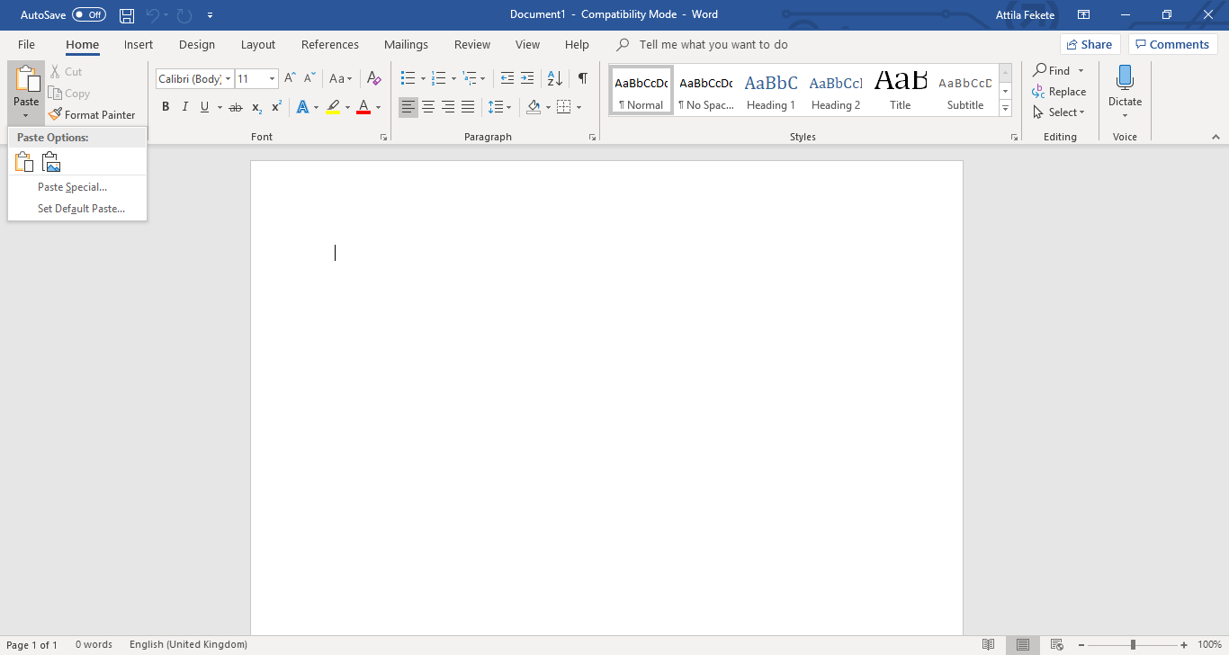
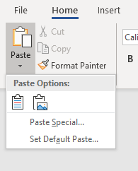
ACCESS FEATURE
CTRL + V

Slide 35


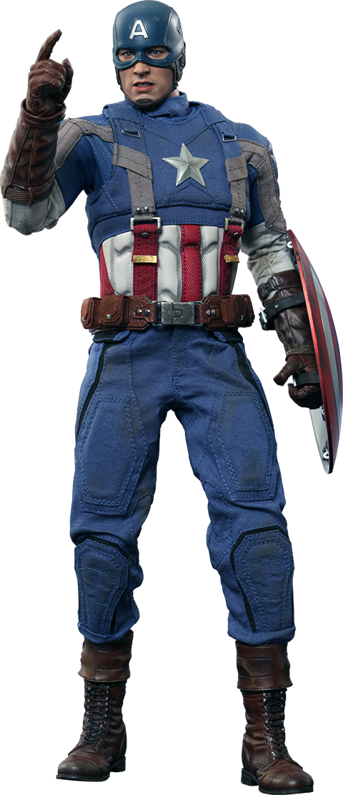
INTERWORKING
Shared Data
Stateful

Slide 36
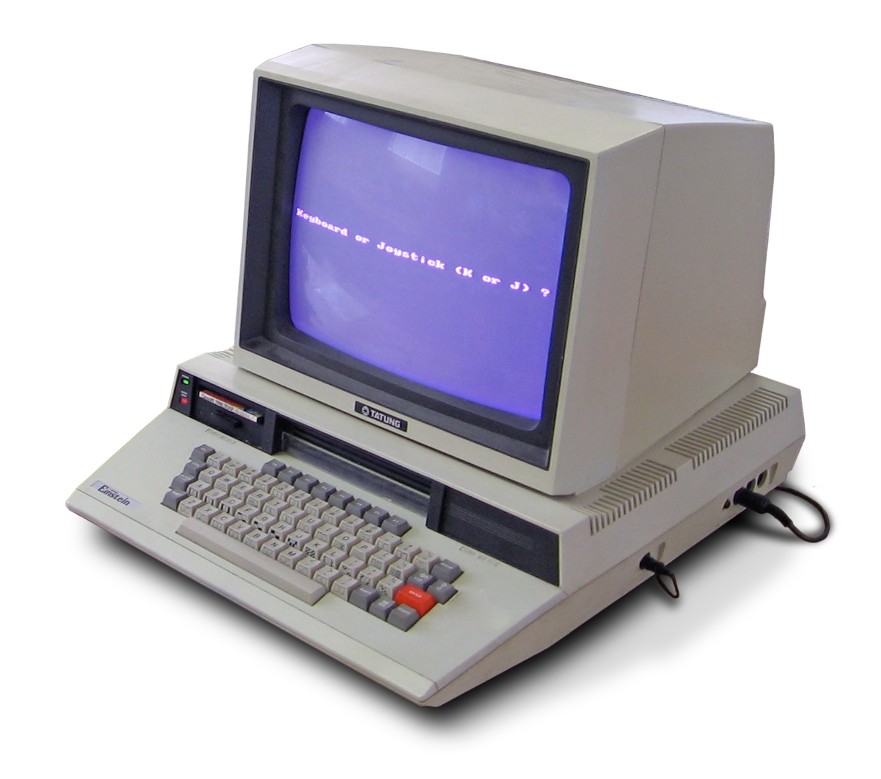

COMPLEX ALGORYTHM

Slide 37
02/3
SOFTWARE ARCHITECTURE

Slide 38
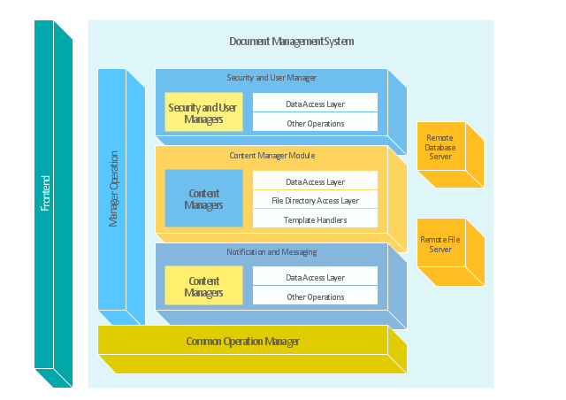

ARCHITECTURE

Slide 39
ARCHITECTURE
SW Upgrade
OLD
SW
NEW SW
TRANSFER DATA

Slide 40
ARCHITECTURE
SYSTEM PROCESSES
Front End
Front End
Communication
Protocol
Back End
Back End
OAM

Slide 41
SUMMARY
INFORMATION SOURCES
Software
Domain
Technology
Architecture
User Group

Slide 42
SUMMARY
OPERATIONAL ENVIRONMENT
CAPABILITIES
ARCHITECTURE

Slide 43


Slide 44

Attila Fekete
www.linkedin.com/in/attilafekete
attila.fekete@iqaconcepts.com +36 30 210 9372

