Slide 1

I European international
Software quality assurance conference
Gjore Zaharchev
Seavus. Skopje, Macedonia
Reinvented Regression Testing
Riga. March 22–23, 2019
sqadays.eu

Slide 2

Gjore Zaharchev
Quality Assurance Coordinator at Seavus Group
Software Testing Consultant
12+ Years hands on experience
Teach Software Testing
Conference and Testing Meetup's Speaker
Test Automation and Agile Testing Evangelist
Riga. March 22–23, 2019
sqadays.eu

Slide 3
Agenda
How We Do A Regression Testing?
What Is Regression Testing?
Reinvent The Regression Testing
Summary And Recommendations
Reinvented Regression Testing
sqadays.eu

Slide 4
How We Do A Regression Testing?
Riga. March 22–23, 2019
sqadays.eu

Slide 5
Traditional Environment
Year 1
Year 2
Regression Testing
Regression Testing
Reinvented Regression Testing
sqadays.eu

Slide 6
“Agile” Environment
Week 1
Week 2
Regression Testing
Reinvented Regression Testing
sqadays.eu

Slide 7
“Even More Agile” Environment
Week 1
Week 2
Week 3
Regression Testing
Reinvented Regression Testing
sqadays.eu

Slide 8




How Do They Do It?
Code Freeze
Long Execution Period
Non-Functional Focus
Test Suite Increased And Not Revised
Reinvented Regression Testing
sqadays.eu

Slide 9
What Is Regression Testing?
Riga. March 22–23, 2019
sqadays.eu

Slide 10
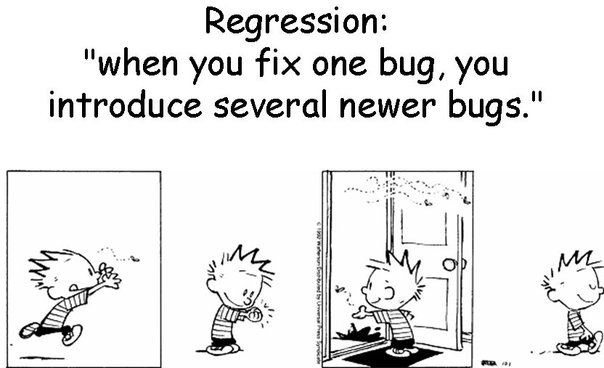
Regression Testing
Reinvented Regression Testing
sqadays.eu

Slide 11
Definition
Regression testing is a type of software testing that ensures that previously developed and tested software still performs the same way after it is changed or interfaced with other software. Changes may include software enhancements, patches, configuration changes, etc. During regression testing, new software bugs or regressions may be uncovered. Sometimes a software change-impact analysis is performed to determine which areas could be affected by the proposed changes.
Reinvented Regression Testing
sqadays.eu

Slide 12
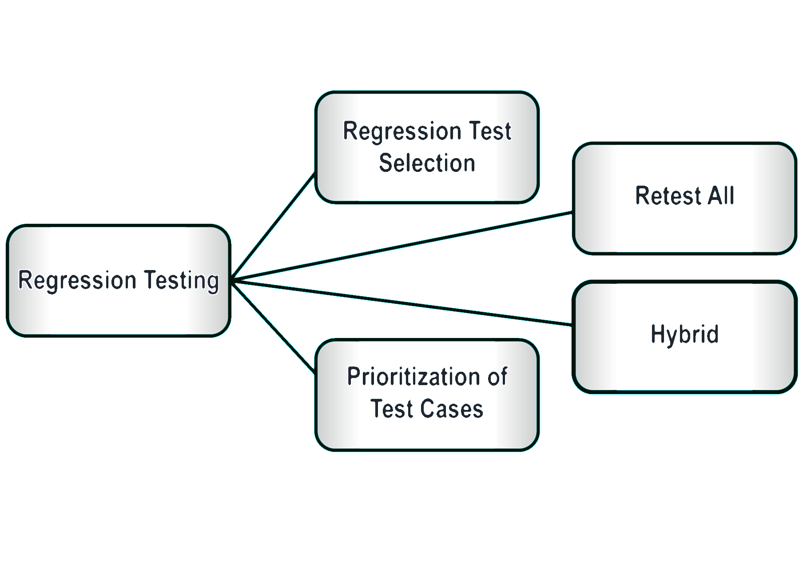
Techniques
Reinvented Regression Testing
sqadays.eu

Slide 13
“Pesticide Paradox”
If the same tests are repeated over and over again, eventually the same set of test cases will no longer find any new defects.
Reinvented Regression Testing
sqadays.eu

Slide 14
Facts
Regression testing is performed when changes are made to the existing functionality of the software or if there is a bug fix in the software.
Regression testing can be achieved through multiple approaches, if a test all approach is followed, it provides certainty that the changes made to the software have not affected the existing functionalities, which are unaltered.
In an agile project management process where the software development life cycles are very short, resources are scarce, and changes to the software are very frequent regression testing might introduce a lot of unnecessary overhead.
Performing regression testing on a third-party component is difficult, because it is an unknown entity.
Reinvented Regression Testing
sqadays.eu

Slide 15
Reinvent The Regression Testing
Riga. March 22–23, 2019
sqadays.eu

Slide 16
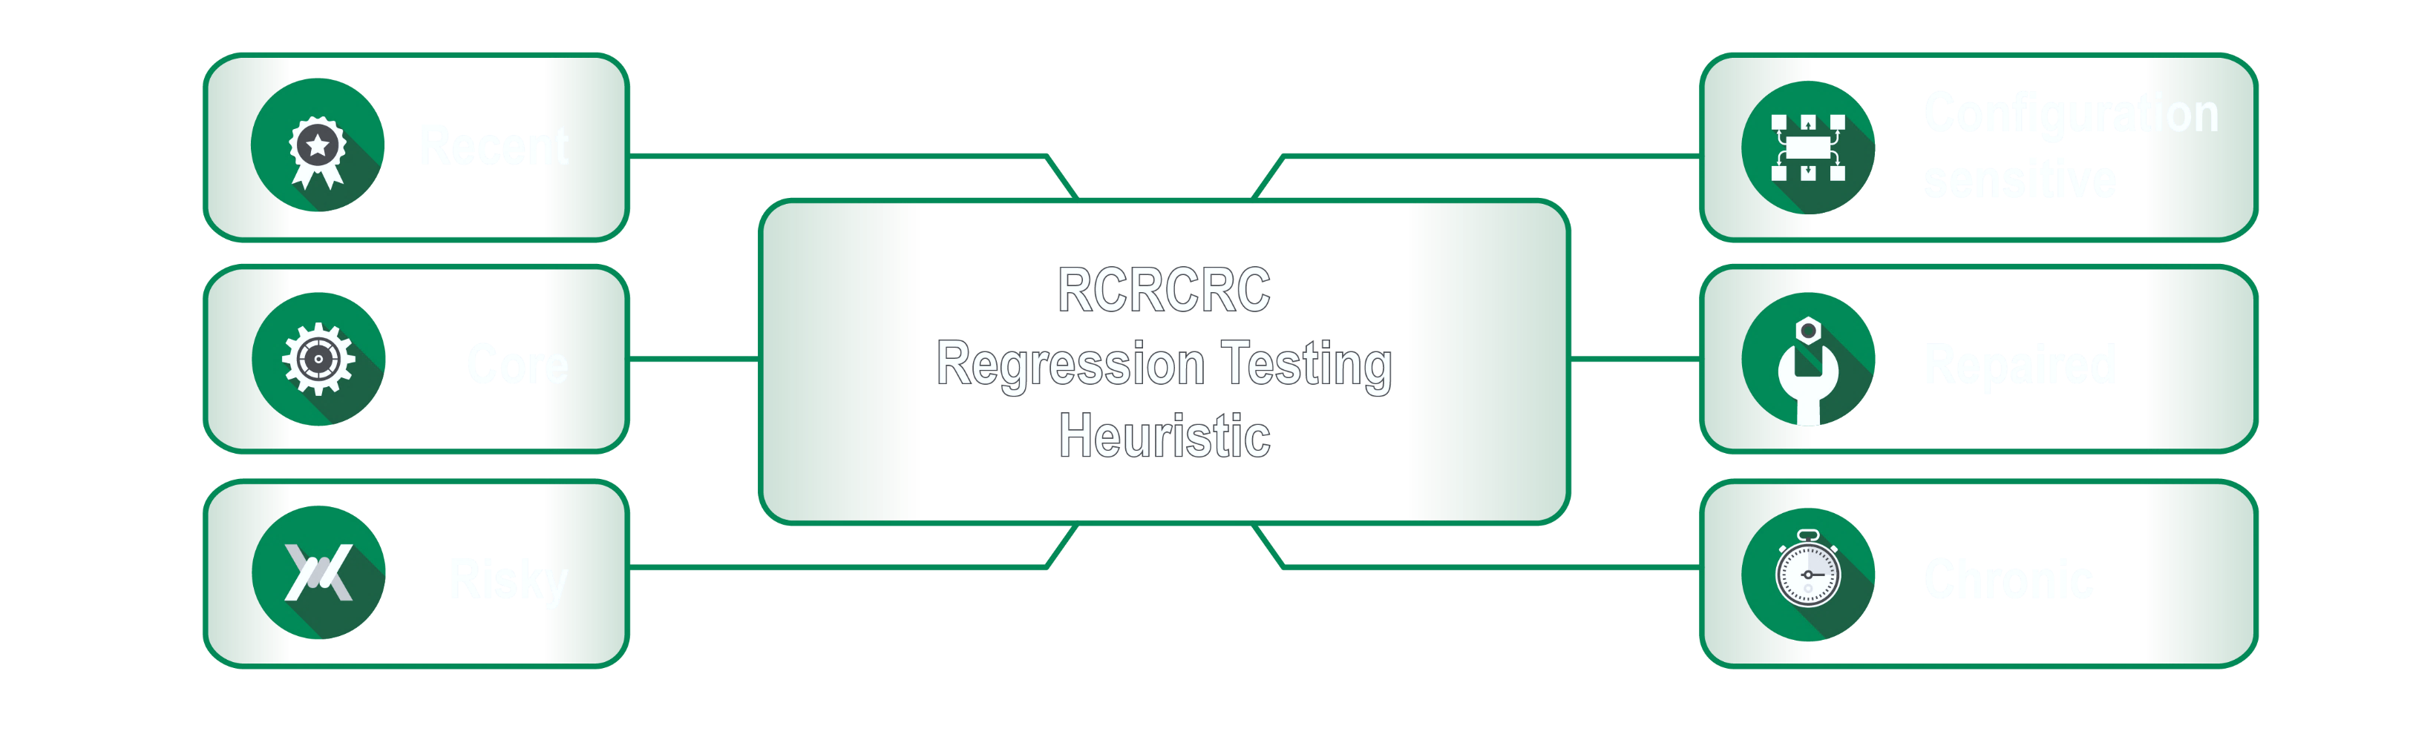
Reinvented Regression Testing
sqadays.eu

Slide 17
Recent
What new features or a new areas of code has been added?
What Changed Recently?
What testing around this changes should I think about?
Reinvented Regression Testing
sqadays.eu

Slide 18
Core
What essential or critical functions or features must continue to work?
What does this application primarily do?
Reinvented Regression Testing
sqadays.eu
Notes:
Instead of thinking about edge cases, think in the box. Instead of thinking far out conditions, think middle of the road. For a refreshing change, instead of hunting for the dark corners and ugly spots in the product, think happy path and include testing that makes sure the happy path is still a smooth road.

Slide 19
Risky
Risk / Risky – meaning – what features or areas of code are inherently more Risky?
What features of the application do I want to safeguard?
Reinvented Regression Testing
sqadays.eu
Notes:
Consider features that rely on other services or components to be started or running. If you're testing a website with secure pages, are site certificates in place? If you know where production issues have cropped up in the past, you can identify risk areas in a product. Use your defect tracking software to pinpoint areas of the product that historically had more defects.

Slide 20
Configuration
Meaning what code is dependent on environment settings?
What testing do I want to plan based on the environment?
This testing might include planning a subset of tests production after go live.
Reinvented Regression Testing
sqadays.eu
Notes:
Code that's dependent on configuration tweaking seems to be a bit like the copy and paste errors we make in documents. We believe we're found every reference and updated material but it doesn't take much to miss one reference and viola, a mistake is introduced. Emails generated and sent out from an application are often an example of code that depends on environment or configuration-specific changes to be made in order to function properly.

Slide 21
Repaired
How often should a defect be retested?
What code has been changed to address defects and therefore may have created issues?
What testing do I want to do based on defects fixed?
Reinvented Regression Testing
sqadays.eu

Slide 22
Chronic
Meaning some code may seem to be chronically breaking or having issues.
This letter remembers me to test features that seem to break often.
Reinvented Regression Testing
sqadays.eu
Notes:
Ask yourself; are there features of the product where your sense of confidence isn't strong? Are there areas of the product that frequently have issues? Would it be reassuring to step through a few regression tests?

Slide 23
Data Migrations
Don’t forget on data migrations!
Without proper testing there is no warranty that the system will behave on the same way with the old data too.
Extend the Regression testing with tests performed with migrated Data.
Reinvented Regression Testing
sqadays.eu

Slide 24
Infrastructure Related Tests
Focus is mostly given on functional testing or UI / UX as non-functional testing.
What about Infrastructure related Tests?
Reinvented Regression Testing
sqadays.eu

Slide 25
Time
How frequent are our releases?
How often we are getting late change requests?
Are developers still delivering even on the last day?
Are my testing colleagues available at the time dedicated for regression testing?
Is my previous story testing quality enough?
Reinvented Regression Testing
sqadays.eu
Notes:
How much time is enough?

Slide 26
Documentation
Maintain simple checklists!
Track Results!
Use MindMap’s!
Easy to use / Easy to update!
Reduce waste to zero!
Avoid Excel, Word and / or similar tools.
Reinvented Regression Testing
sqadays.eu

Slide 27
Automate
But not only the UI!
Automate Data Creation!
Automate the WebServices!
Automate the UI! But not in details!
Automate some performance Tests!
Reinvented Regression Testing
sqadays.eu

Slide 28
Summary And Recommendations
Riga. March 22–23, 2019
sqadays.eu

Slide 29
Recap
Regression testing with the current traditional approach is to long and very often useless.
Regression testing should focus on testing changed or impacted areas of the systems.
Having Clear and Reliable criteria for the regression testing can help you a lot to deliver high quality product in faster time.
Reinvented Regression Testing
sqadays.eu

Slide 30
Recap
Regression testing in Agile environment should be testing performed in reasonable time.
Adopting some positive experiences should be the step one but you need to Adapt it according to your current needs in order to benefit.
Using heuristics such as RCRCRC will help you to accomplish faster regression testing and focus on the impacted areas.
Reinvented Regression Testing
sqadays.eu
Notes:
My best regression test planning stems from knowing an application well but in order to prevent a bias or a pattern of always testing some areas and overlooking other areas, I use the heuristic RCRCRC to help me think through all of an application. And then at the end of testing, I write another list; I write what I didn't test. This list is helpful when I might be asked: did you test X? By writing a "did not test" list, I'm stopping to make myself aware of what I chose not to test.

