Slide 1
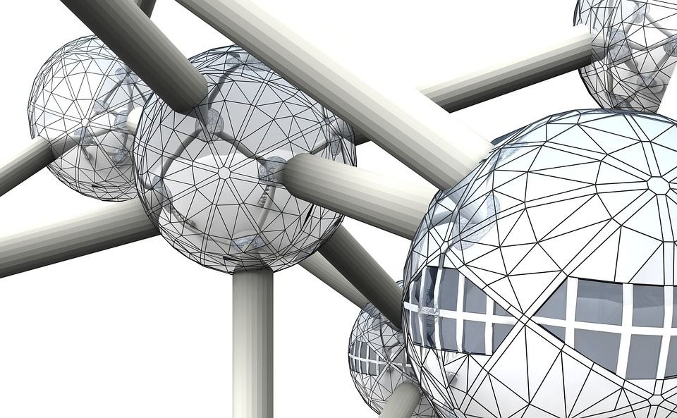
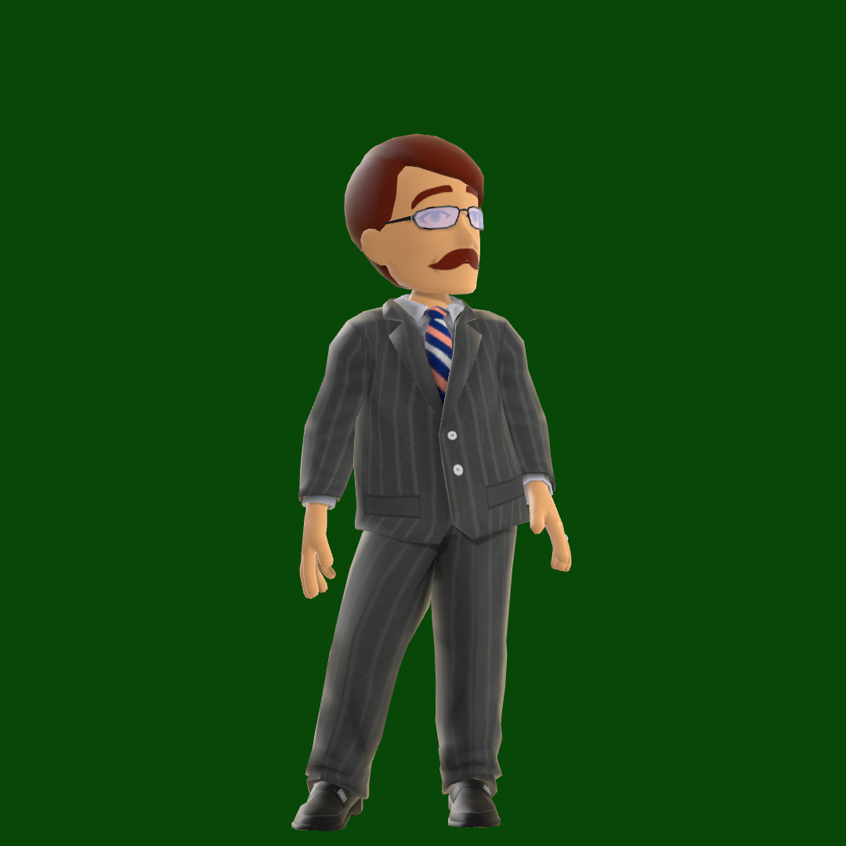










Me, myself and I…So nice to meet you

Slide 2



Teamwork Survival Toolbox

Slide 3



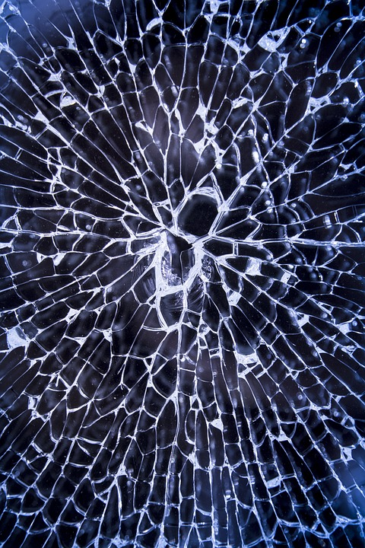



FROM: Unknown
Your mission if you accept it:
Make the whole project team collaborate efficiently
This phone will self-destroy in 10 sec.

Slide 4
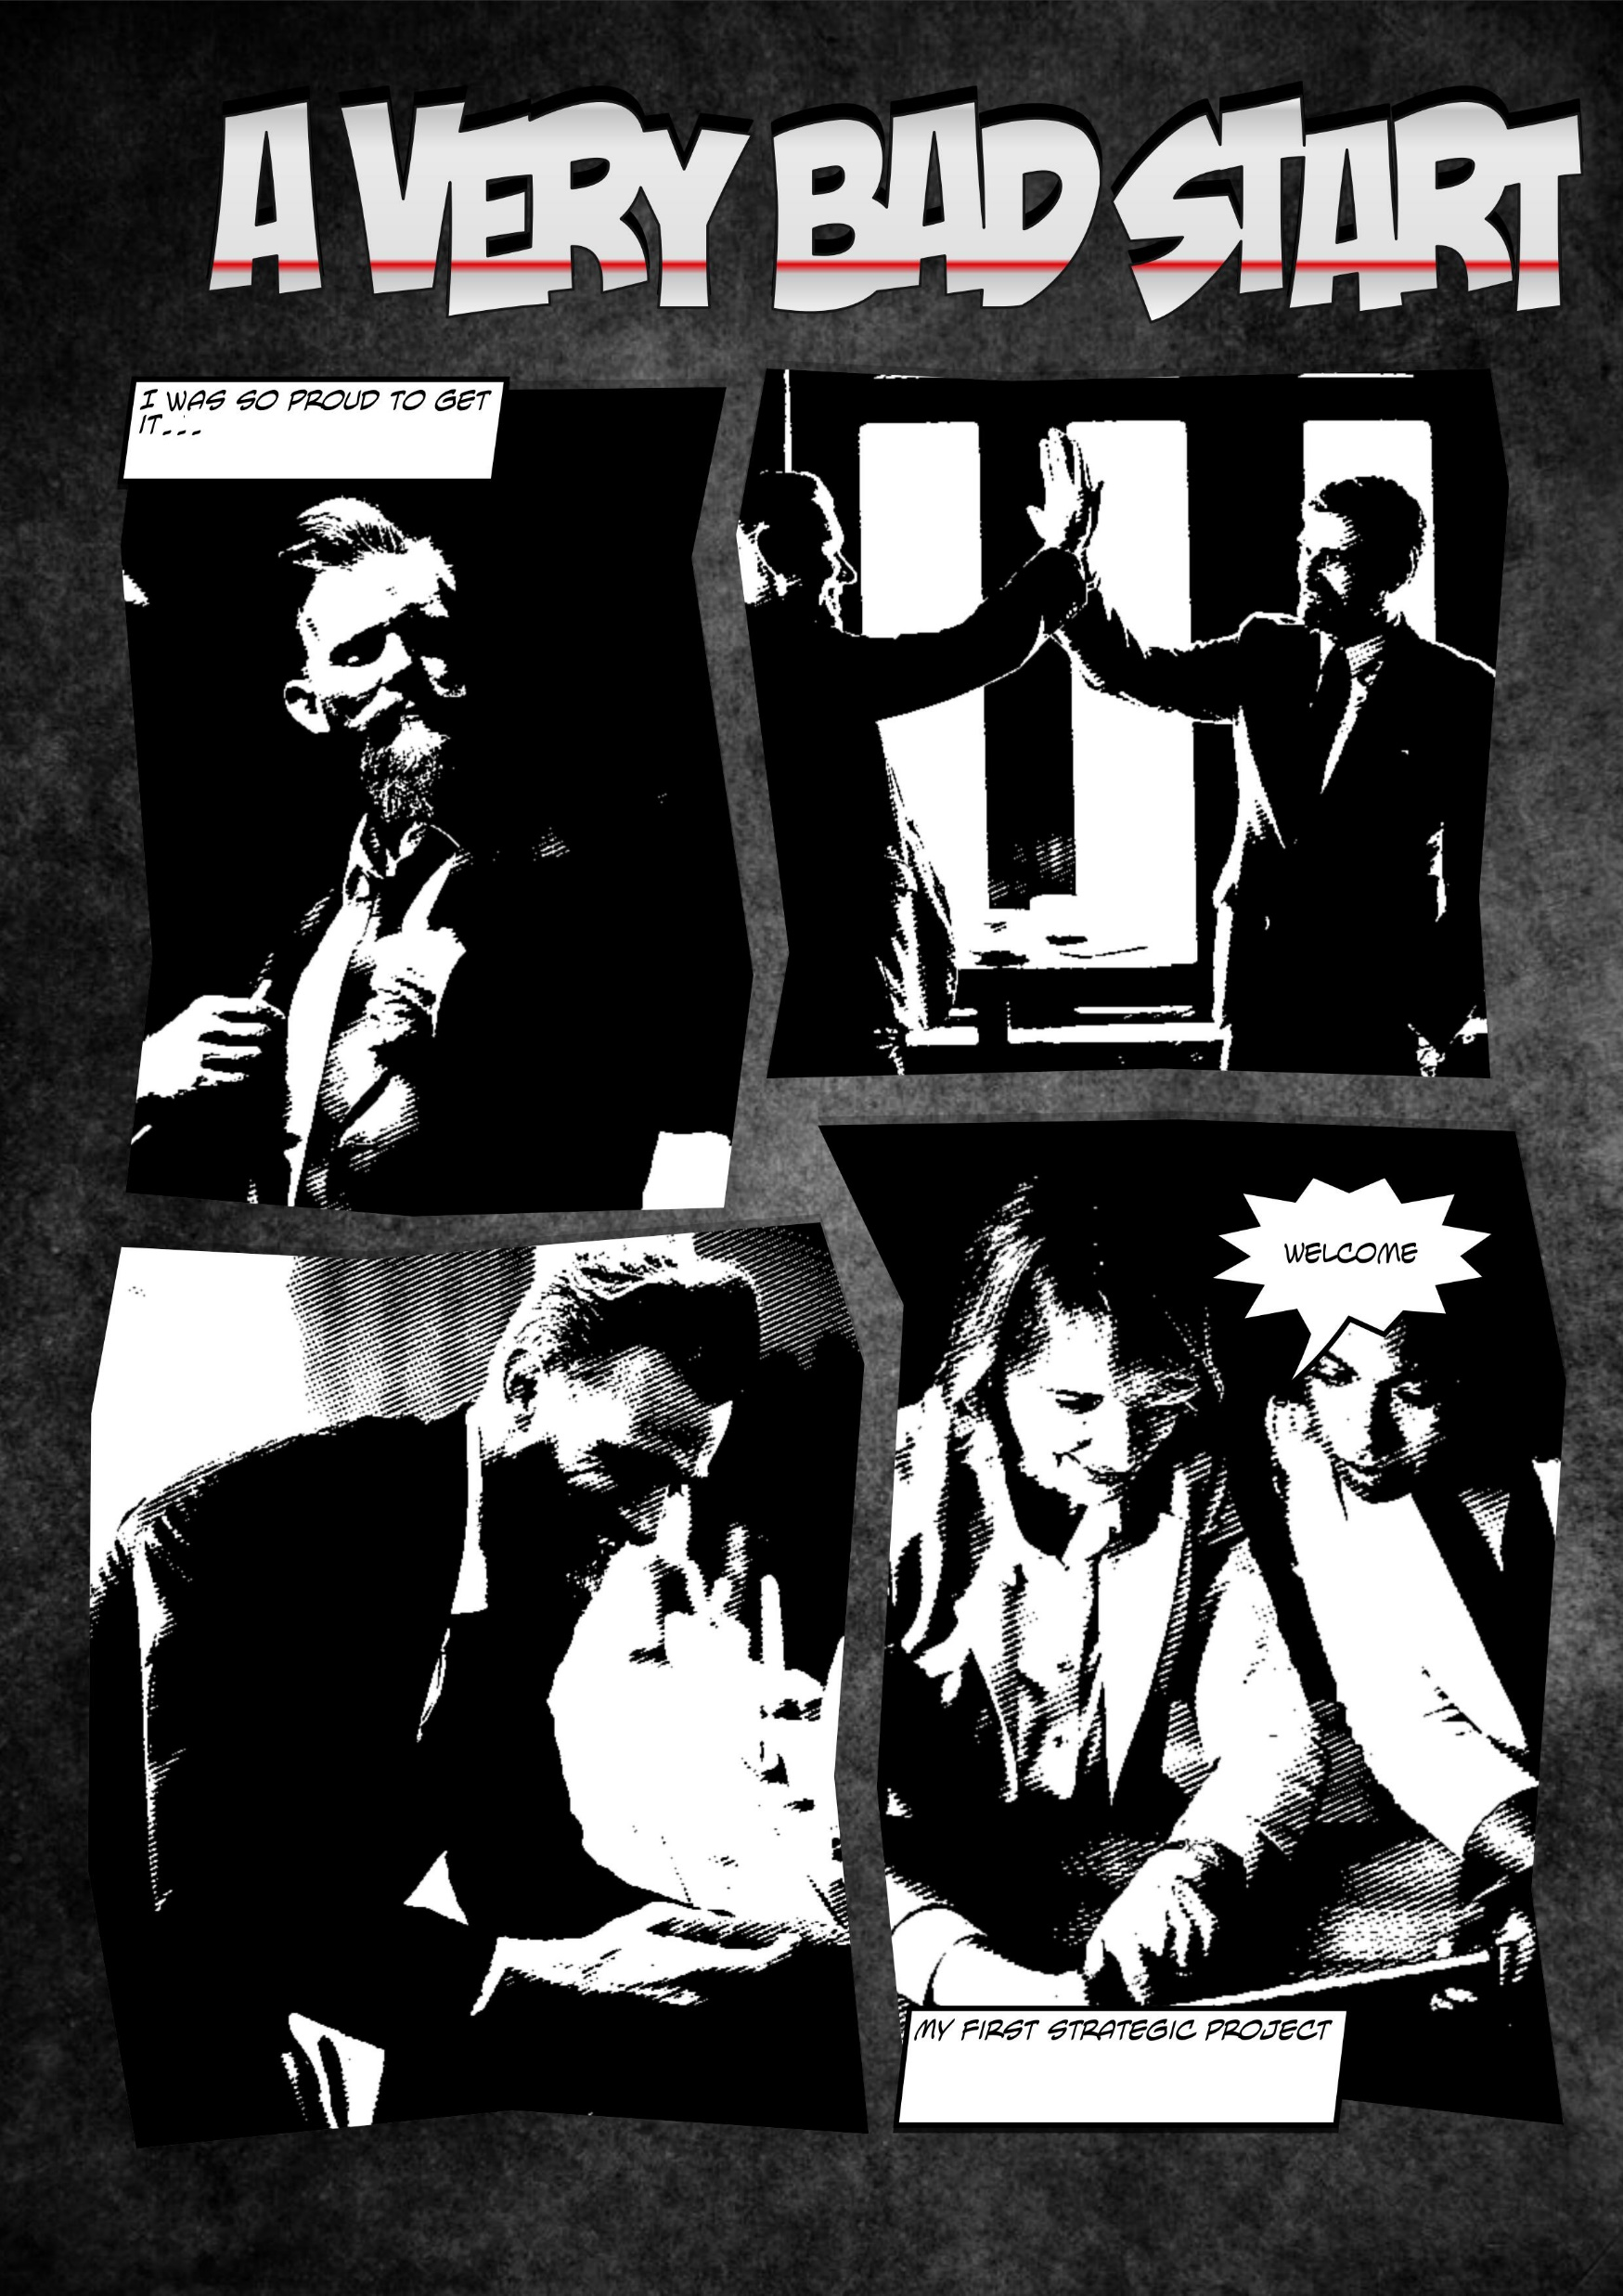
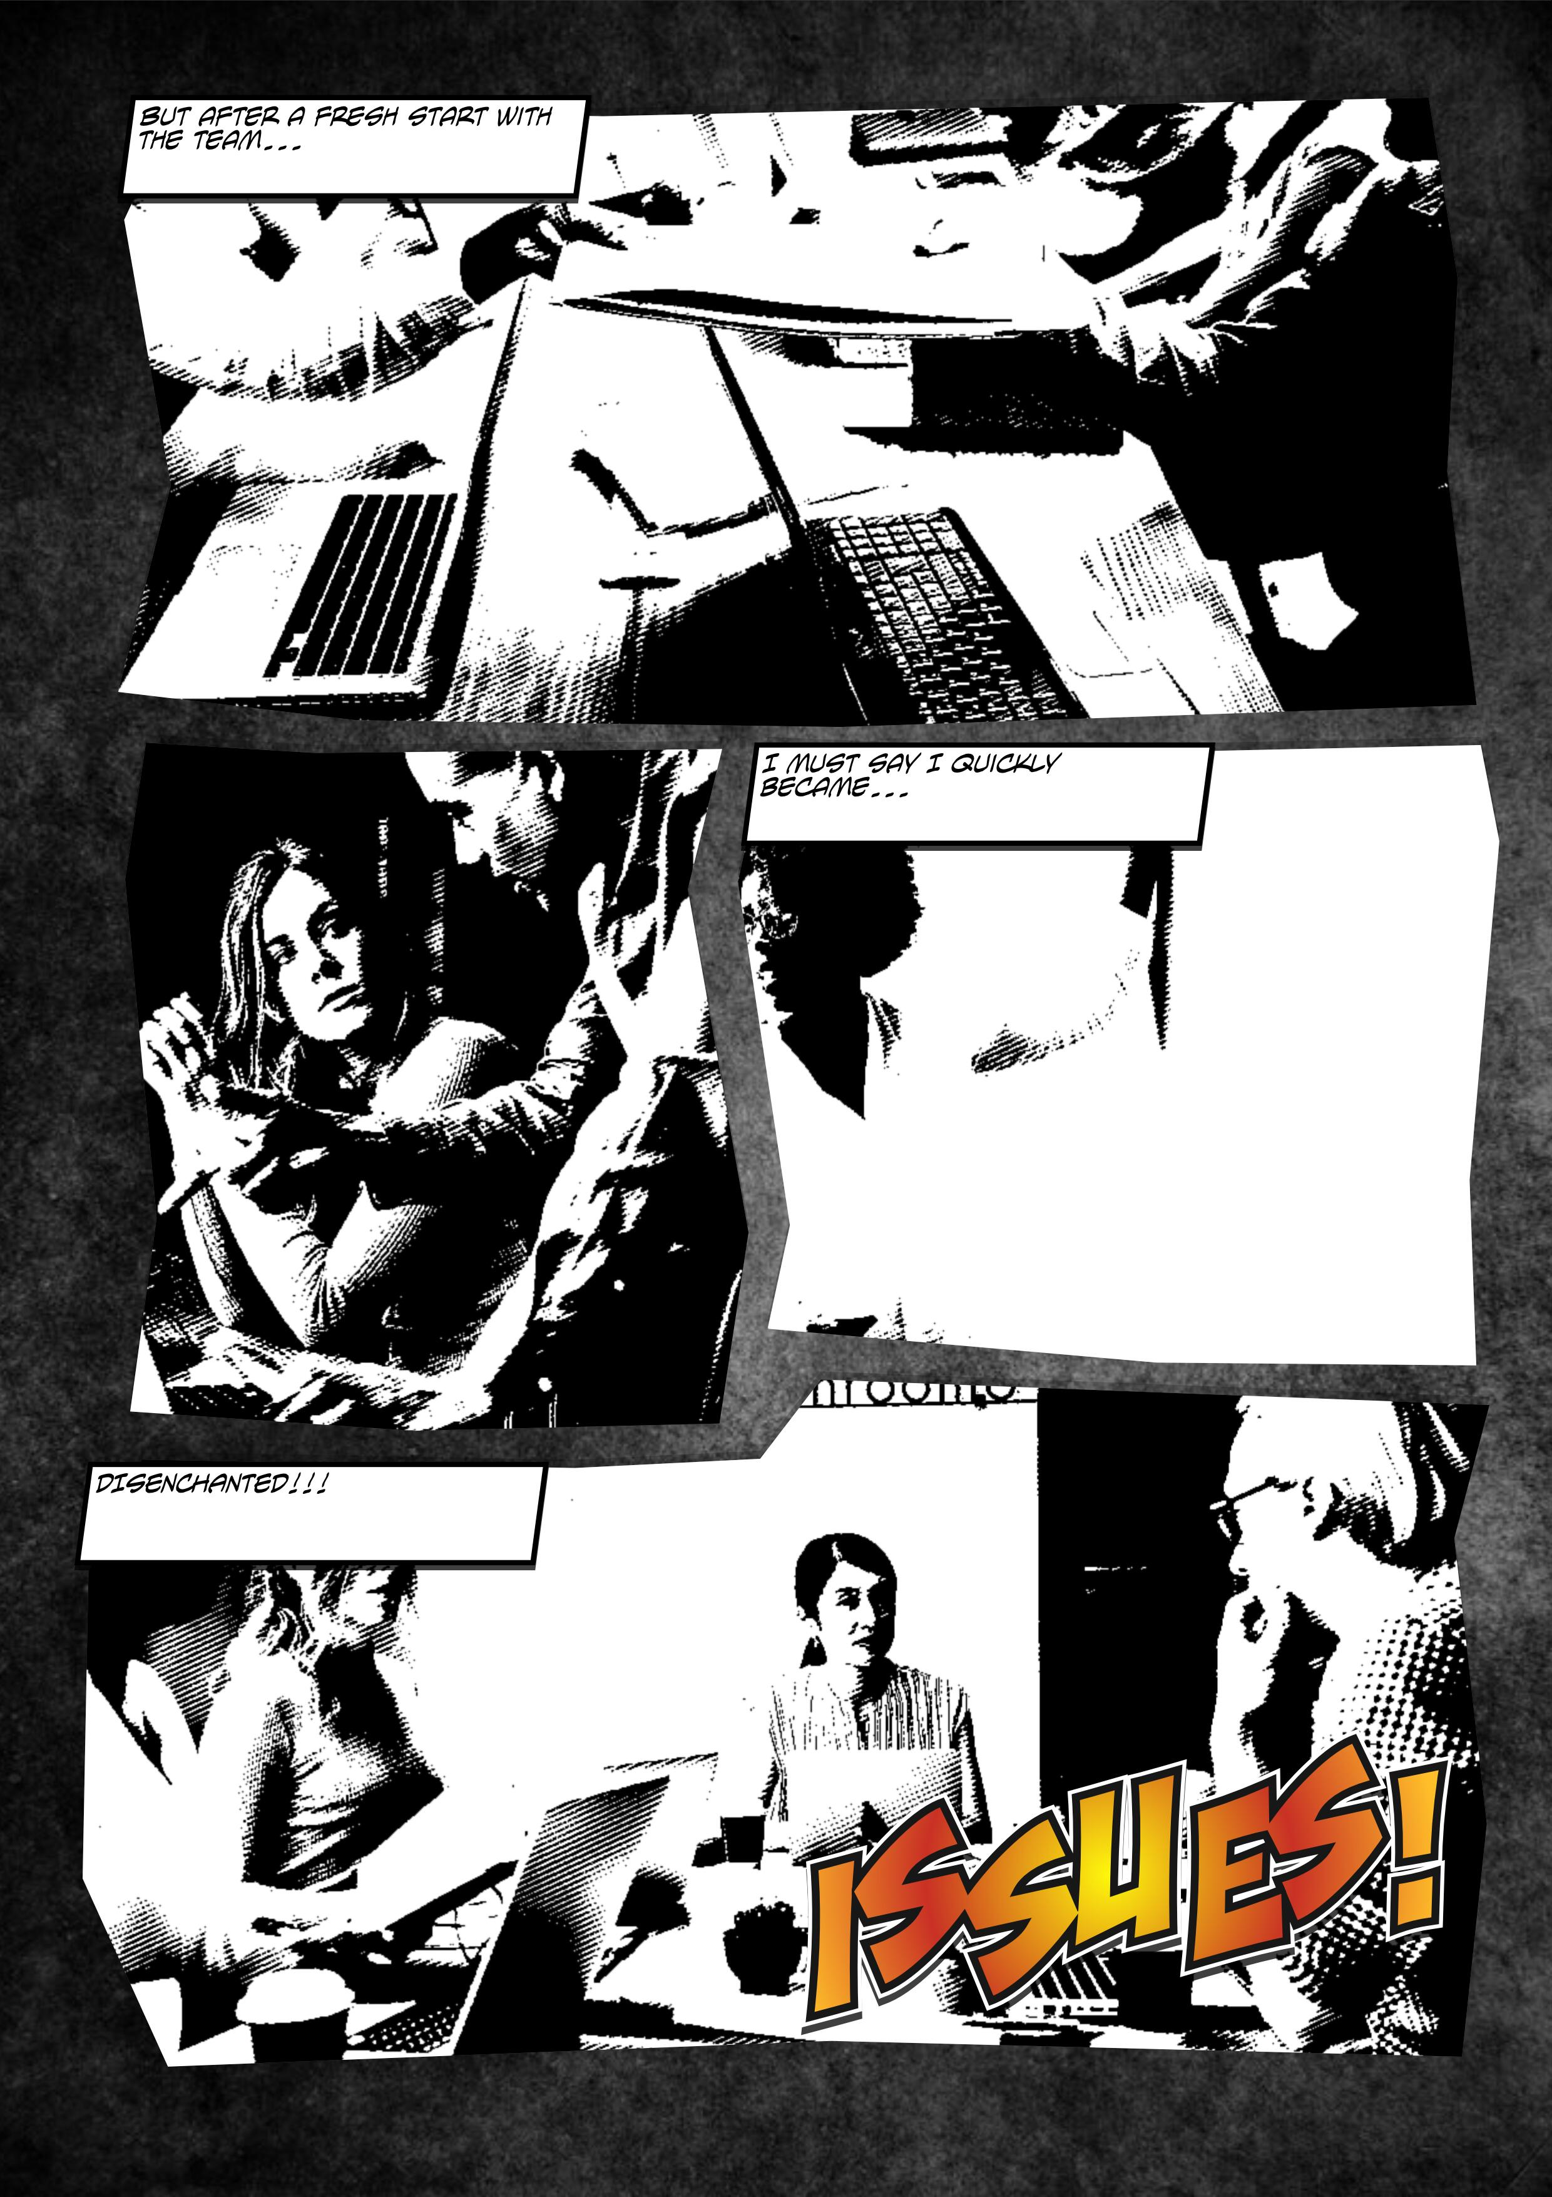

Slide 5

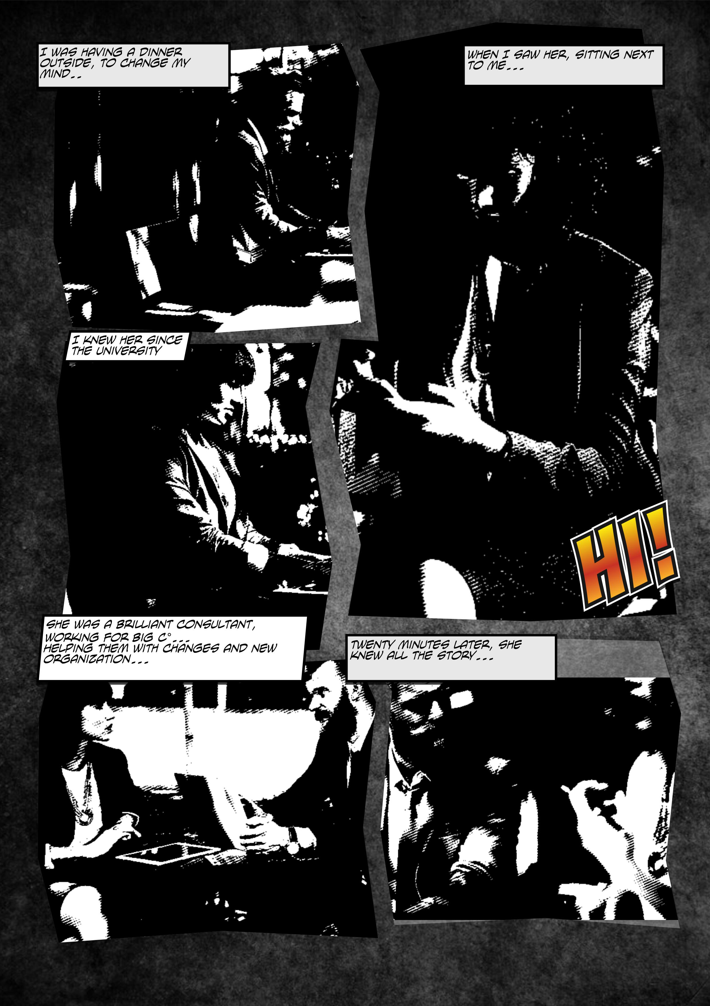

Slide 6
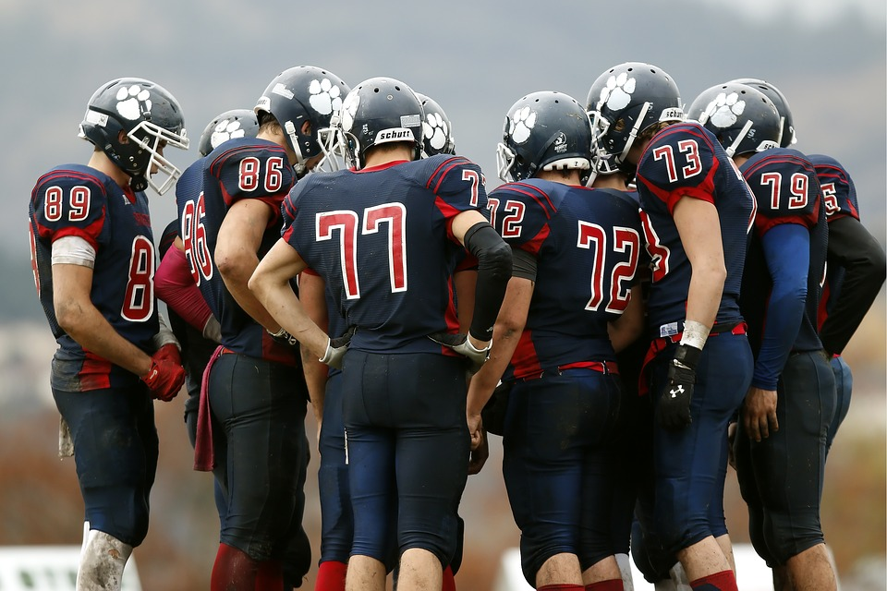
WE ARE A TEAM
The job is done by people
Give their role back to them
socialize before / during work
Society, mentalities evolve
Change meeting dynamic
More ideas, different ideas, innovation
Make more sense
Encourage differences, disruptive thinking, out of the box
More agile
Validate strategic choices
More support and engagement
More performance (part of it, understand)

Slide 7
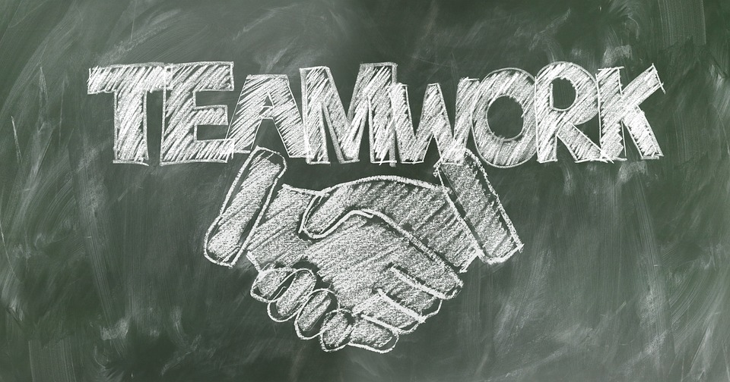
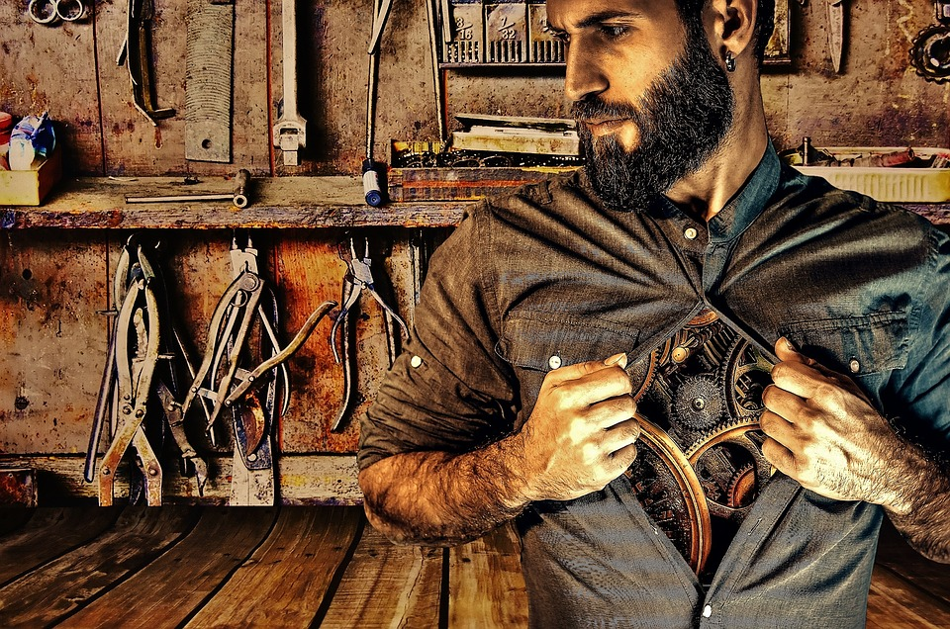
Let’s build a toolbox!
[Brainstorming, mind mapping…] & workshops

Slide 8
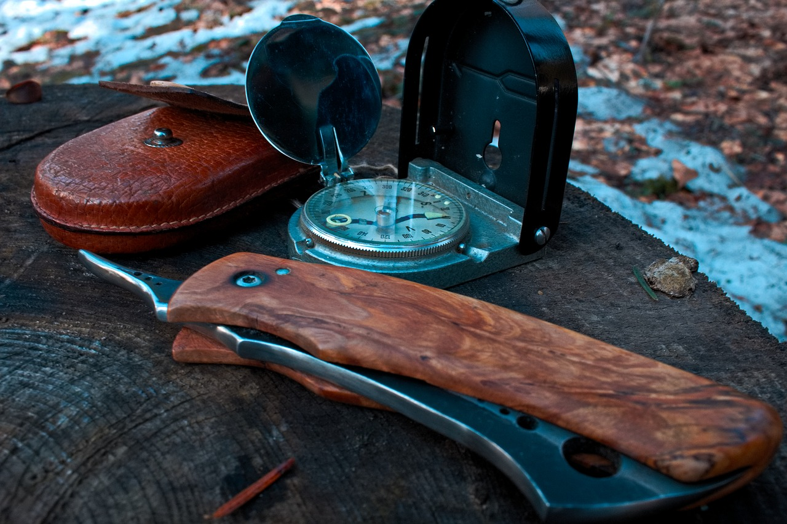
GOALS
Communicate openly (taboo-free)
Allow catharsis (what needs to be told)
Integrate perceptions (because they are « real » too)
Use a twist of humor (makes the medicine go down)
Stimulate creativity (think different)
Stay coherent (group cohesion)
Learn the message (roadmap, plan, steps...)
Envision the future (and plan it)
Alternate and combine workshops

Slide 9
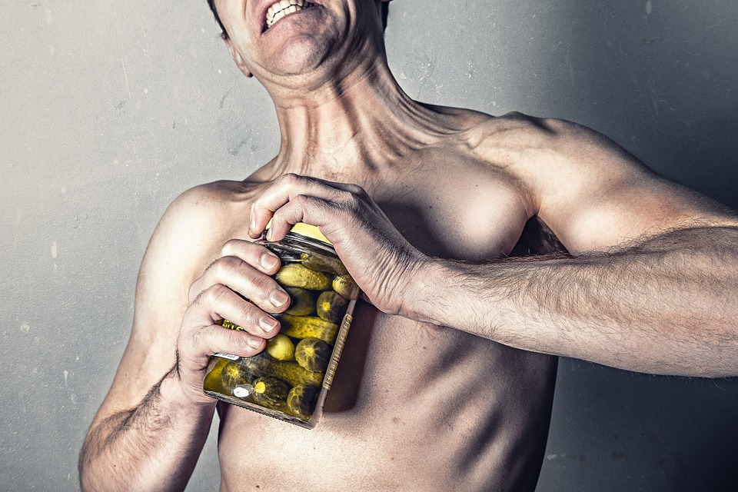

Be prepared!
Before you start…

Slide 10

COGNITIVE BIASES
Confirmation: I only consider information that reinforce my views
Attention: I only see what I like most and consider it more
Self-satisfaction: I own my success, others are to blame for my failures
Knowledge: I only trust my knowledge and don’t look for other elements or views to understand a situation
Ambiguity: I tend to ignore options for which I lack information
Notes:
If it is a failure, it is my failure. If it is a success, it is their success

Slide 11
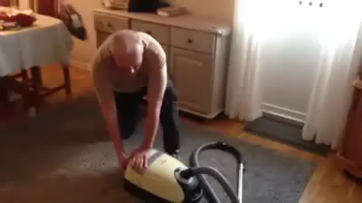
Notes:
O

Slide 12
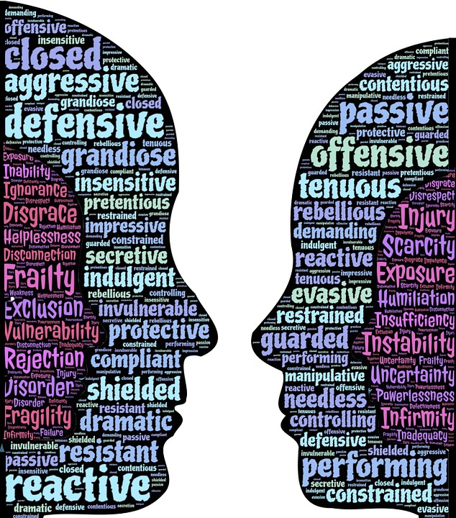
RESISTANCE
Active / passive disapproval
Rejection, help refusal
Tensions, asking for help, withdraw
Depressive, disillusioned people
Opposition, blame, bashing
Ego-tripping, egocentric, selfish people
Might be encountered…BUT their opposite (more often) too…
It is YOUR responsibility to manage it as a Moderator
but THEIR success is so good.
Notes:
If it is a failure, it is my failure. If it is a success, it is their success

Slide 13


A workshop?
Open communication
Positive understanding
Future vision
Group coherence
About what exactly?
‘

Slide 14
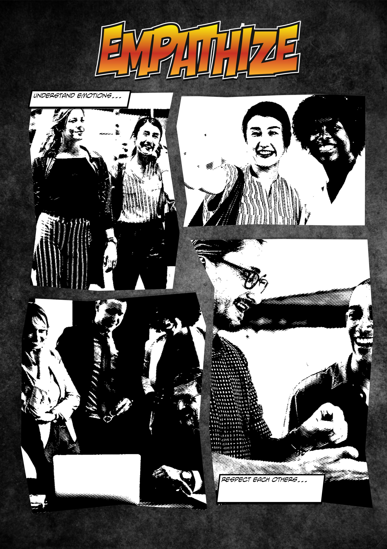





Slide 15

Communicate Openly
Moody Woodpecker
Catch the peanut
Like it or Not
News or Fake News

Slide 16

Moody Woodpecker
Everyone choses one toon-man on the picure that fits the best with him / his mood in the given context (project, company, team…). They put a pin or sticker on the spot
In turns, people describe and explain their choice and eventually how things might change / improve.
The Moderator notes the positive and negative aspects and communicate how / when feedback and actions will eventually take place.
!
This mainly is a projective workshop
- RESPECT others
- Comments or discussion may be optional
- Limit the allocated time per person
- Play along (start in order to break the ice)

Slide 17


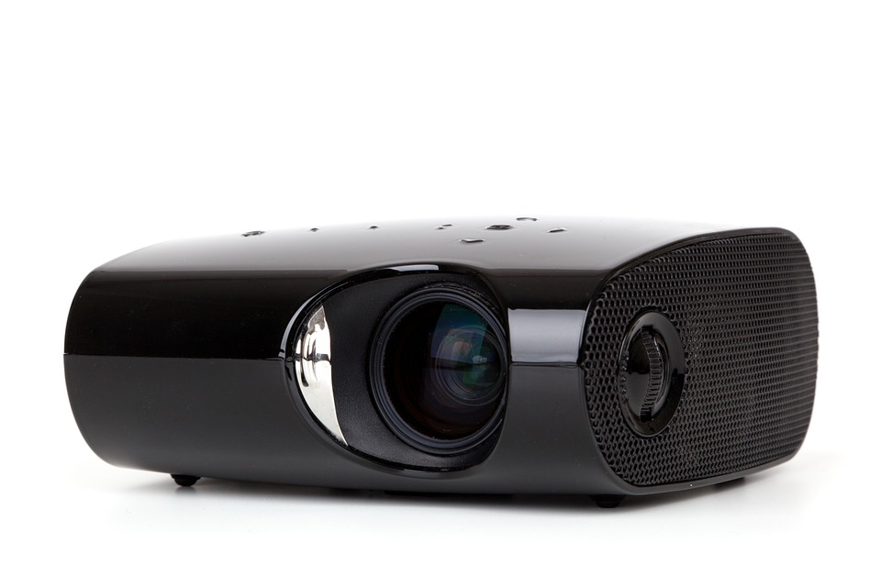




Material etc.
Pretty easy but…
30 min – 60 min
Give them enough time (5 min) to discover the tree
Ask for the first volunteer instead of going around the table
- describe and explain their choice
- elaborate (are they on the tree, outside, why…)
Keep an eye on the timing (5-10 min / p.p. is generally enough)
Moderator needs a good psychology / social background (framing…)
Tree can be projected (overhead) or printed out
Opening: explain the rules (respect…)
Closure: Make sure feedback and actions will be done when possible
(possibly taken care upfront with decision makers)
5 – 10 people
Emotional / timing / psycho-trip

Slide 18


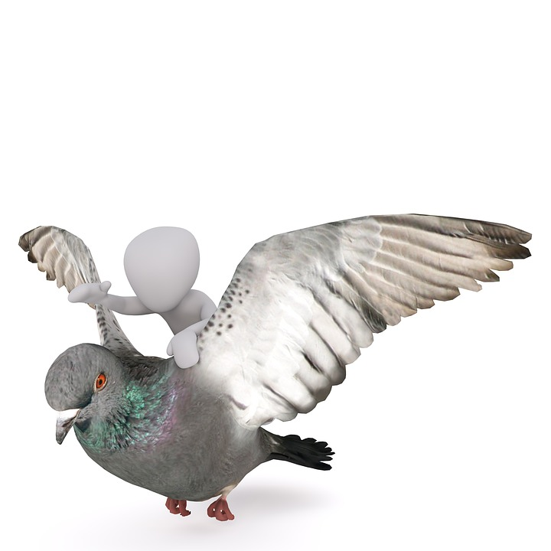



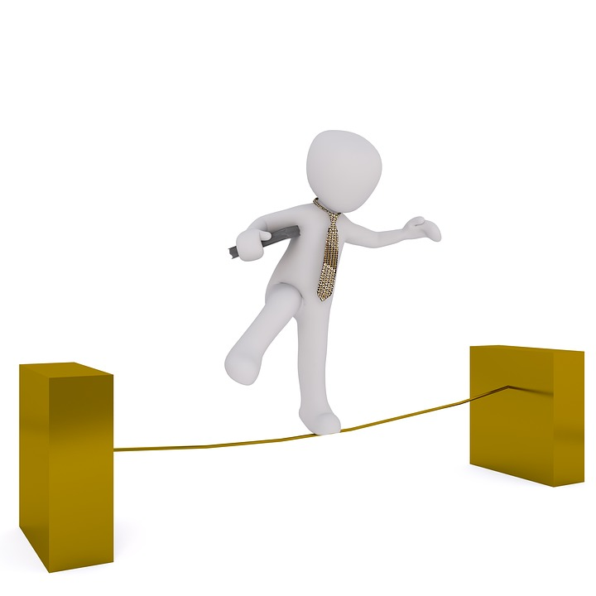



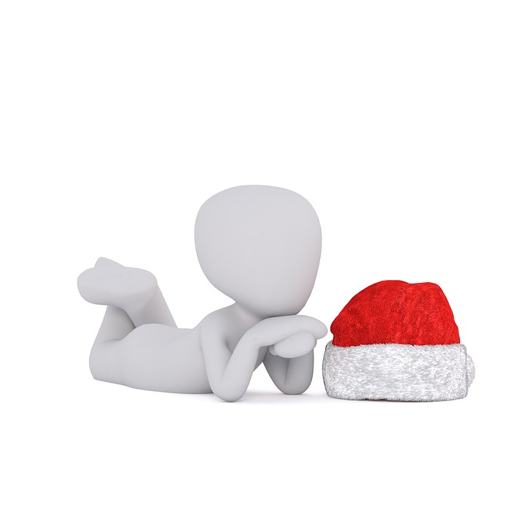




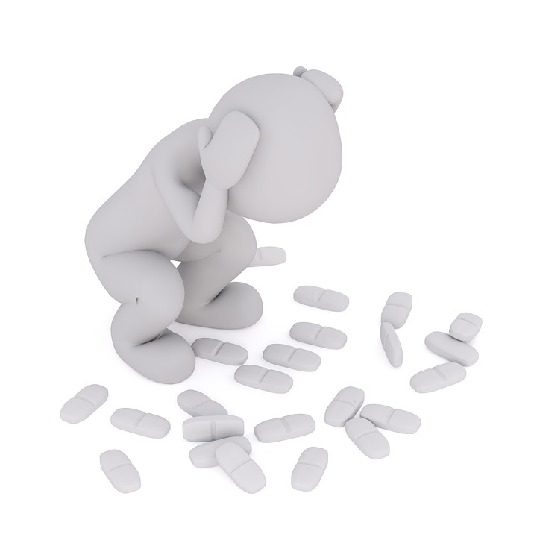





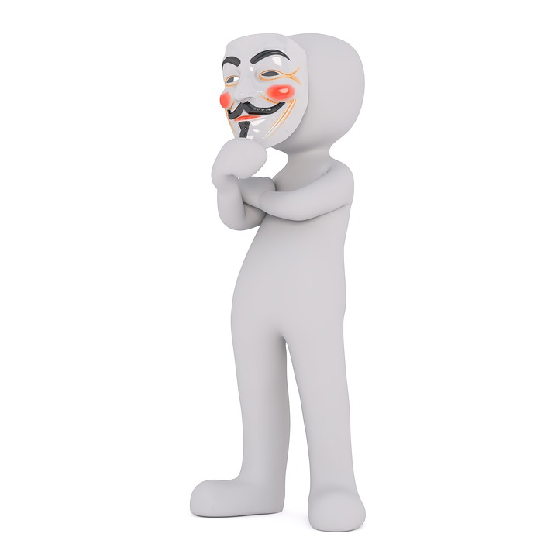


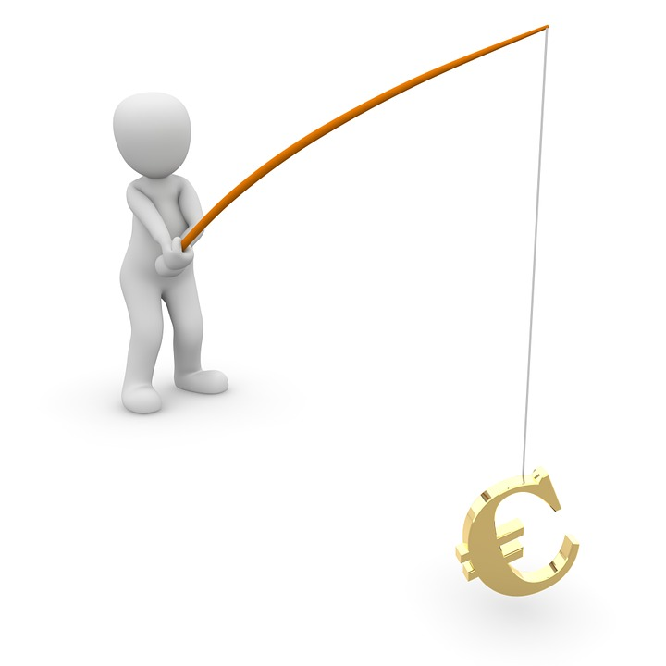


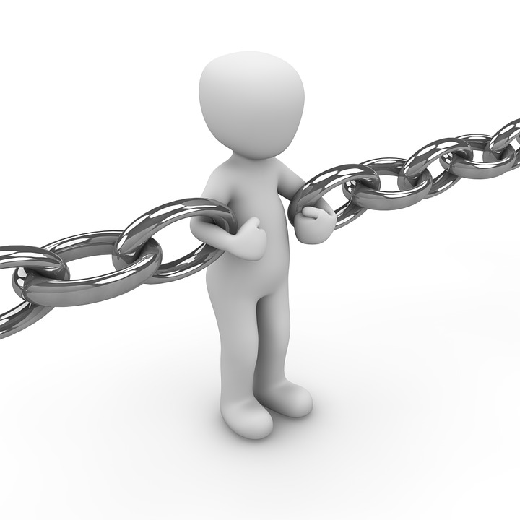


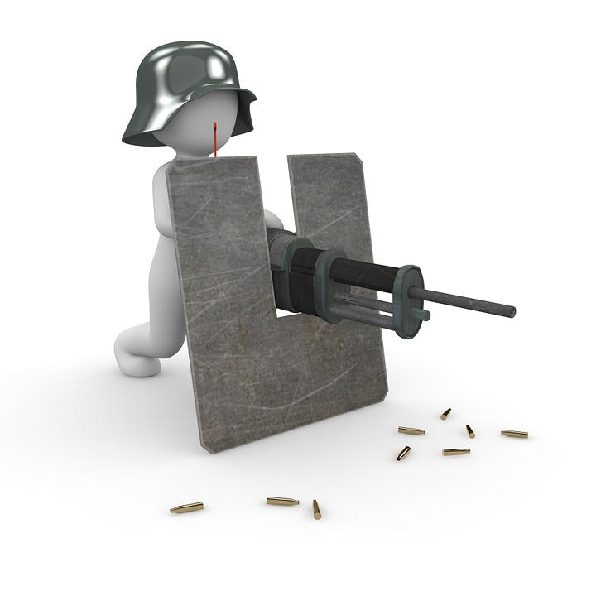

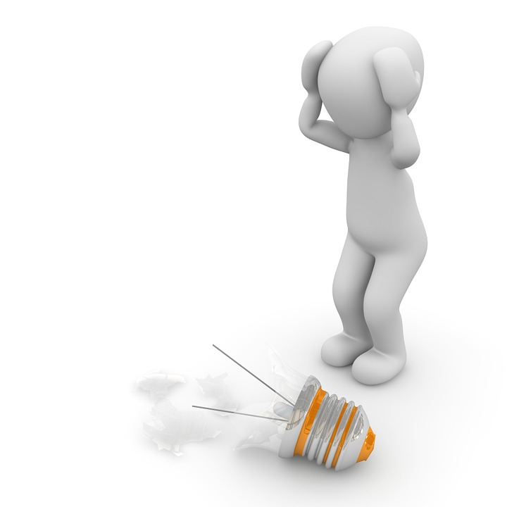





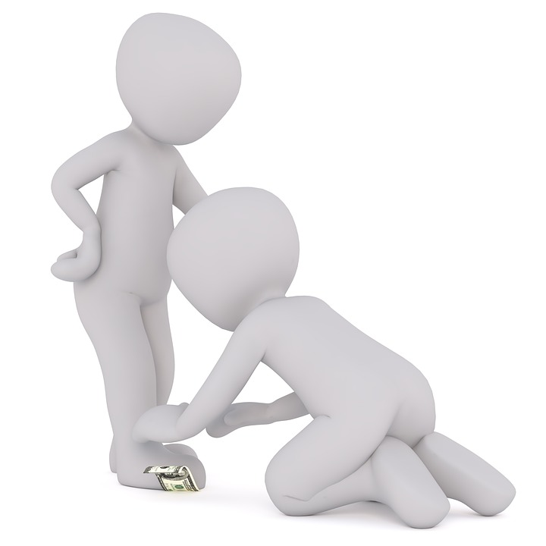
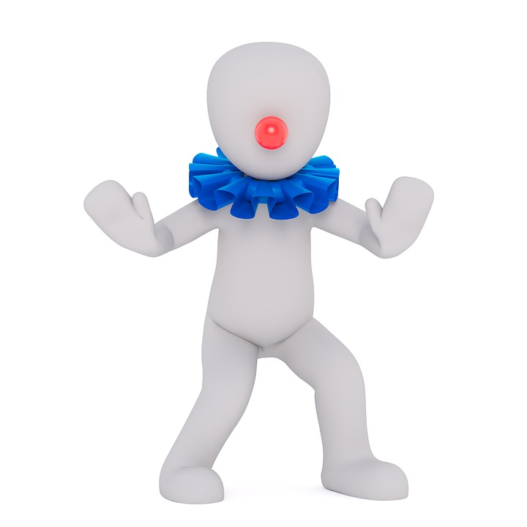
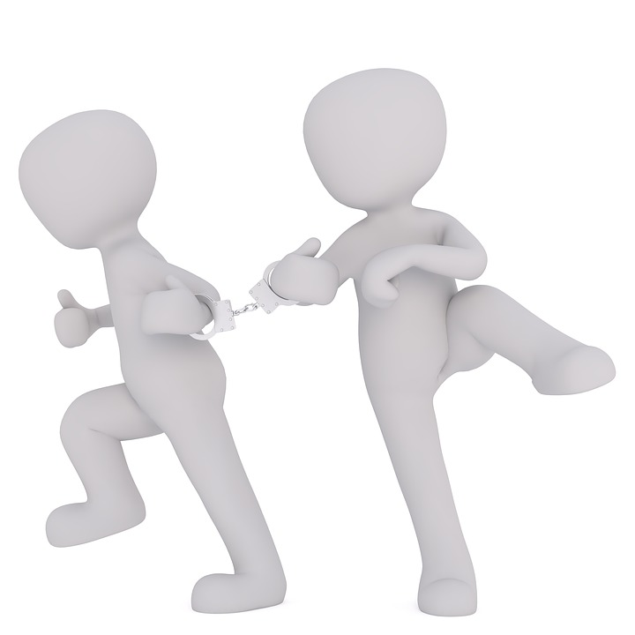


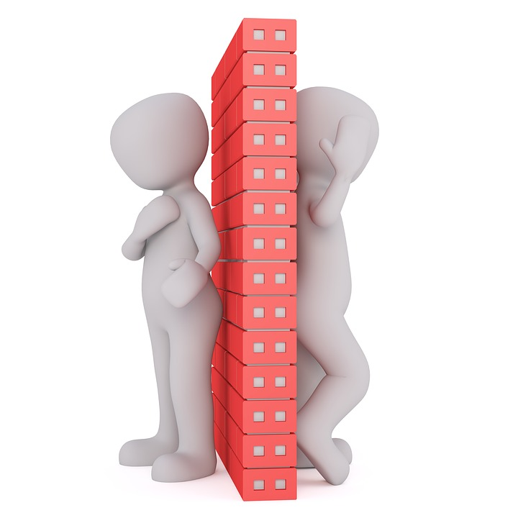



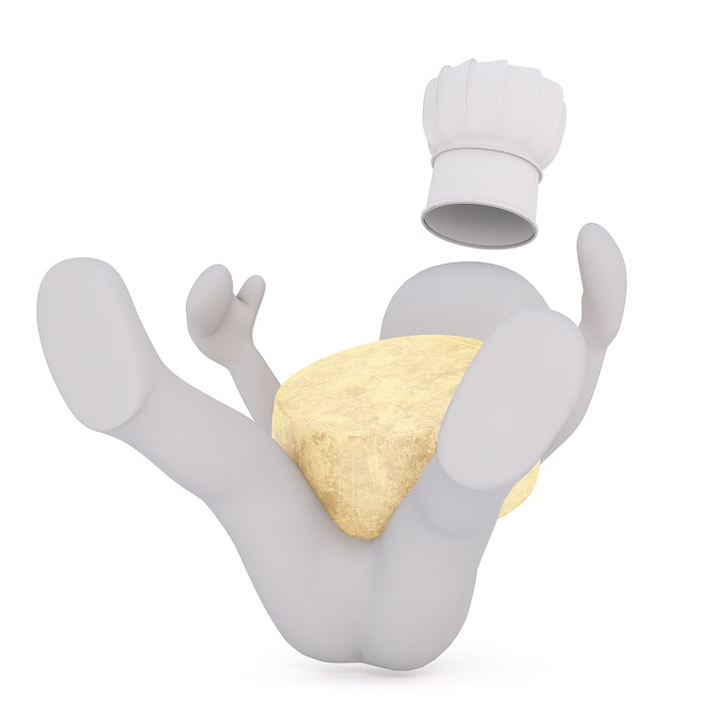



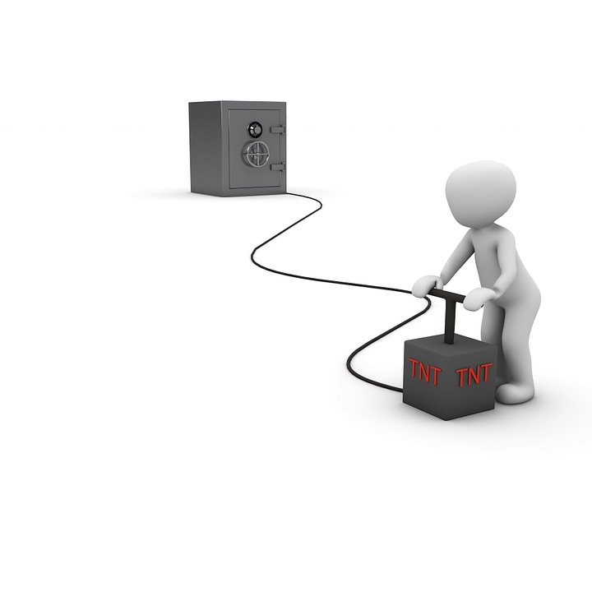

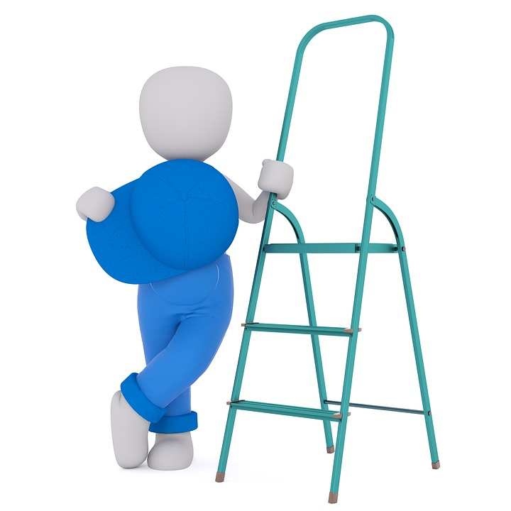



Slide 19

Like it or Not
Everyone writes 3 things he/she likes and 3 things he/she dislikes on colored post-its and fix them in the respective columns on the dedicated wall.
Topics are prioritized with the help of colored stickers (1,2,3)
The group reviews the topics on the wall and infers a synthesis and possible improvements / action points.
!
Group dynamics is key
- RESPECT others’ viewpoints, benevolent attitude
- PARK if too emotional
- Perceptions are NOT people
- Let the group decide

Slide 20






Material etc.
Easy
45-60 min
Independent or neutral moderator may help
Do not guide or decide – just moderate
Rephrase, ask for elaboration, active listening
Do not allow critics – just explanations
Ensure topics are general enough
Ensure the list is not too long so that it can be managed
Opening: remind them the rules (respect, open-minded…)
Closure: summarize and draw conclusions together with the group
2
1
3
4 – 15 people
Criticize / Debate

Slide 21


News / Fake News
Everyone writes 3 – 5 news and 3 – 5 fake news on color post-its (e.g. news are green and fake news are orange) and post them on the dedicated wall
The moderator picks news and fake news in turns and reviews them with the group.
The group decides (after the discussion) which ones are real news and which ones are fake news.
The Moderator summarizes and « rebuilds » the wall with real news only. A clear « News » header is affixed and the wall is shared.
!
Moderation is key
- RESPECT others
- PARK if too emotional
- News are NOT people
- Limit the allocated time per topic

Slide 22

Material etc.
Somewhat Difficult
120 min
Independent or neutral moderator may help
Moderator needs to know the business / context
Moderation is required for the discrimination phase (choosing news)
Ask people why they think fake news are spread and how to limit them
Opening: give them examples of news and fake news (out of context)
Closure: summarize and clarify
4 – 15 people
Discrimination phase / politics / propaganda

Slide 23

Understand each other’s
Geopolitics
If I were U
Personas

Slide 24
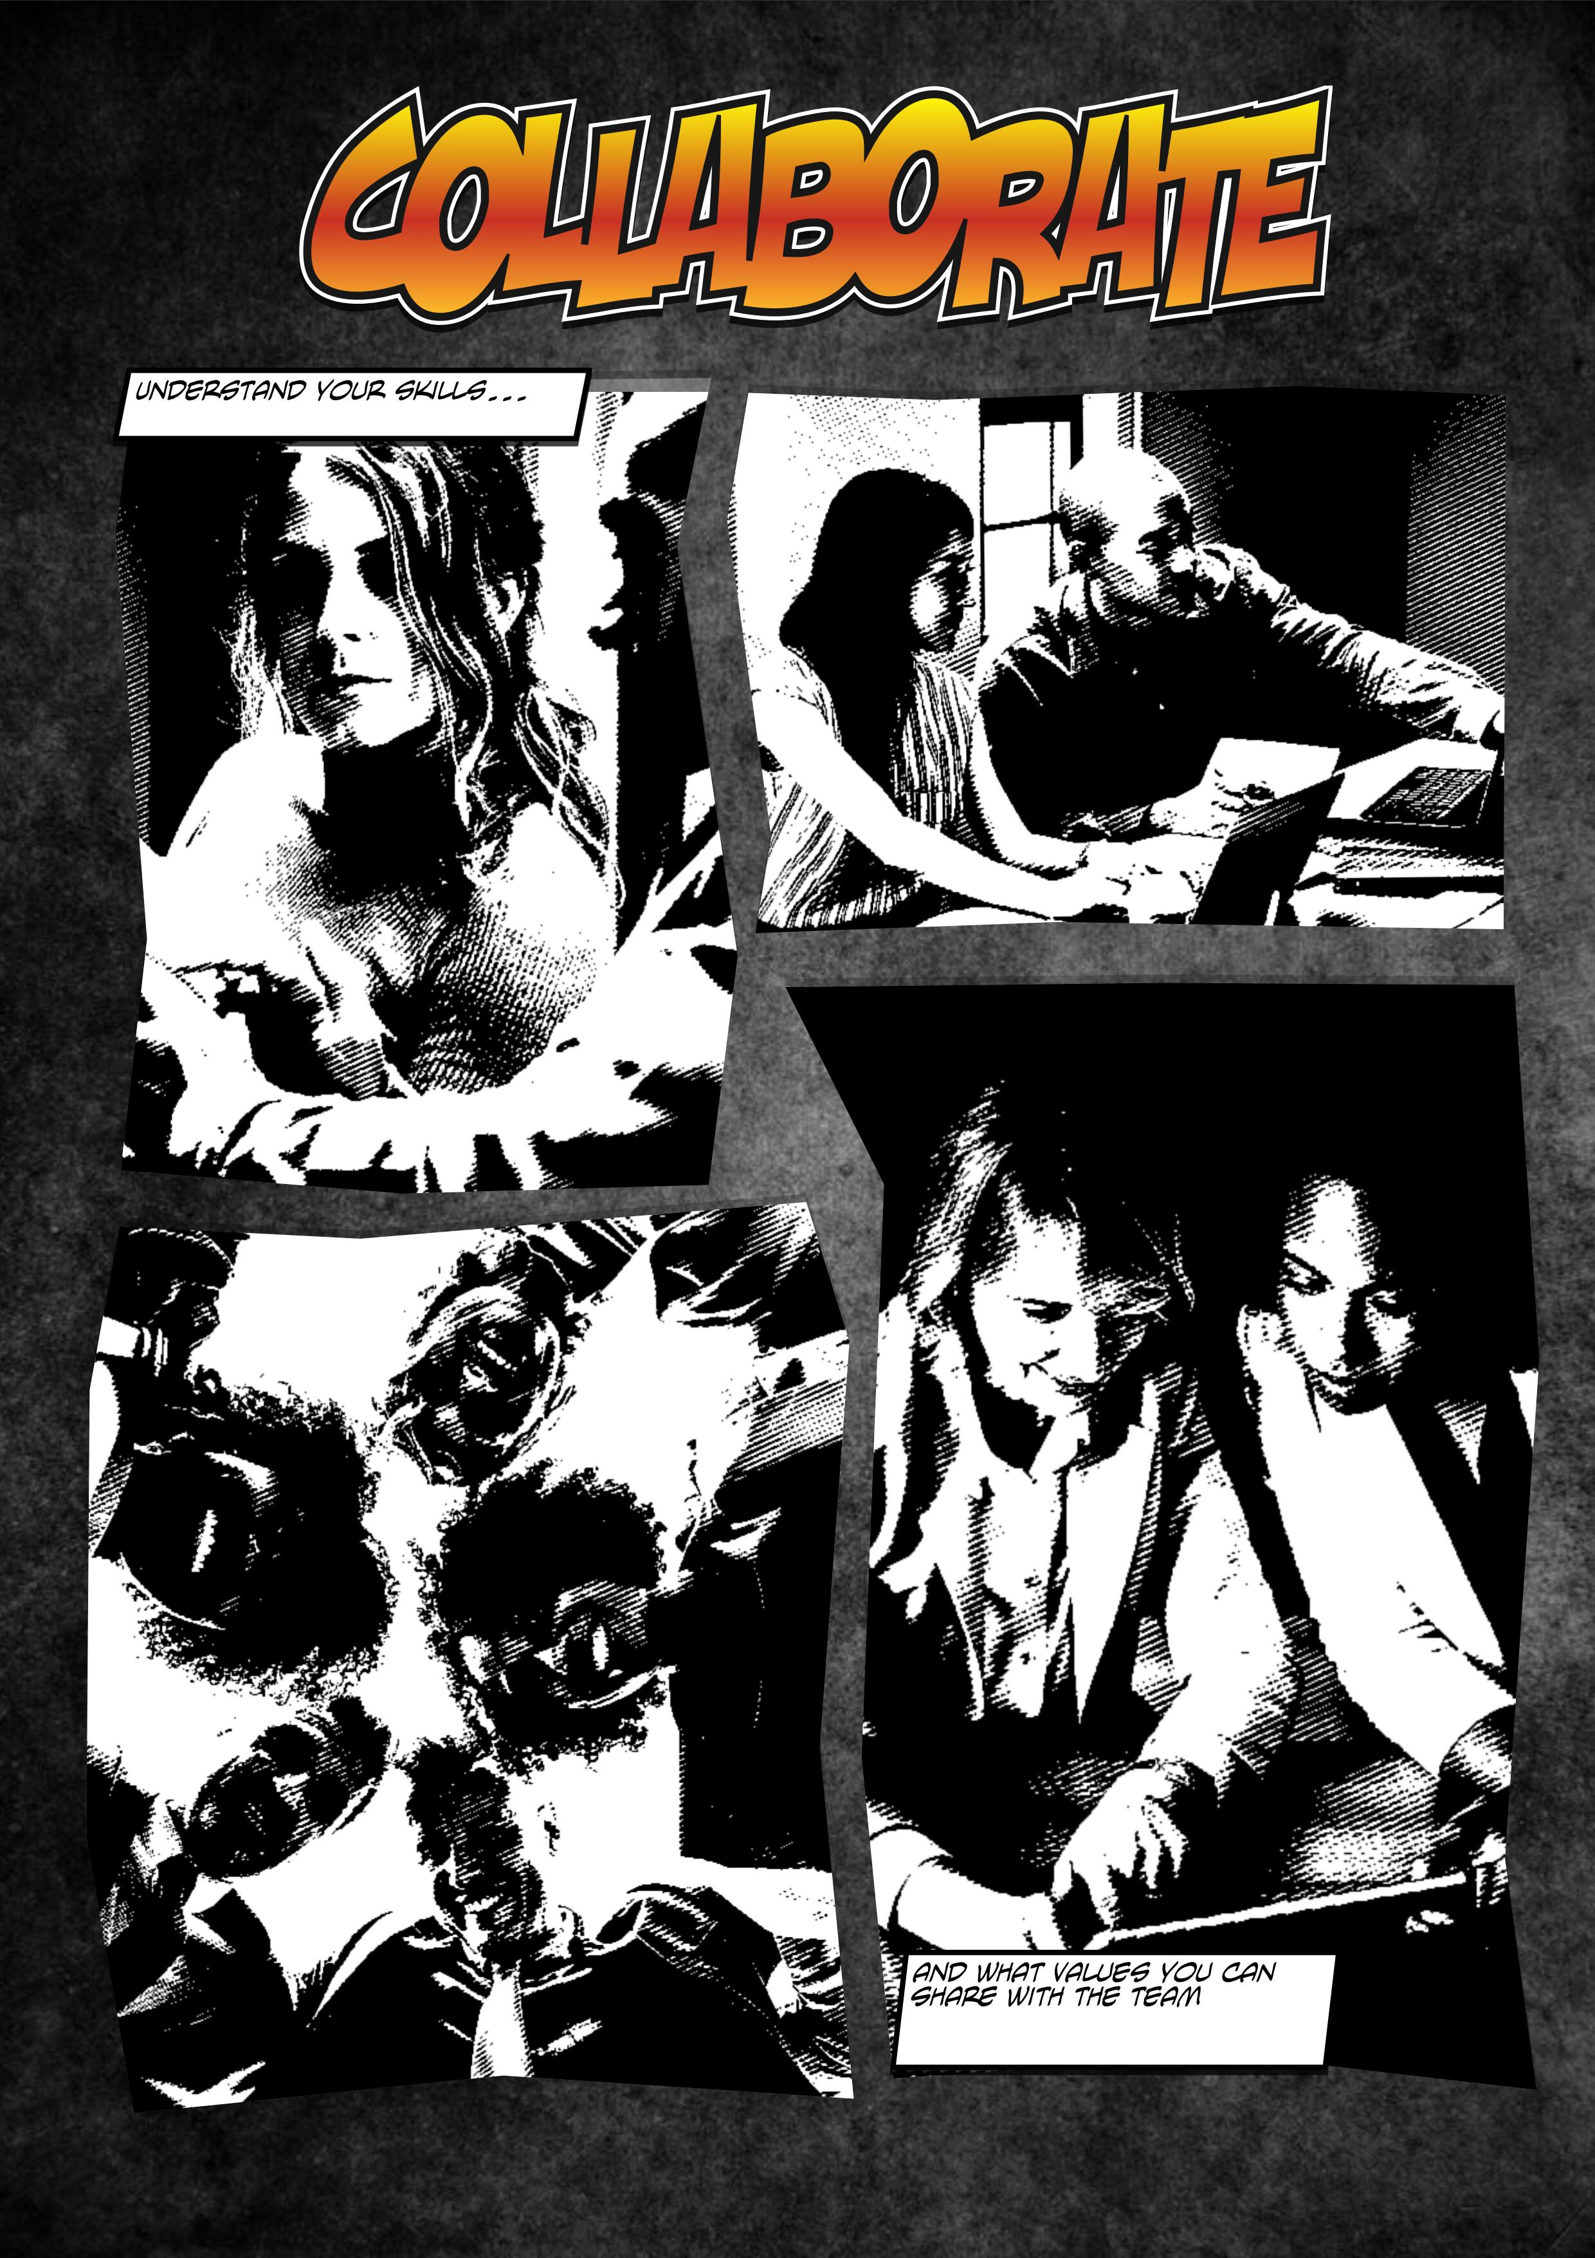


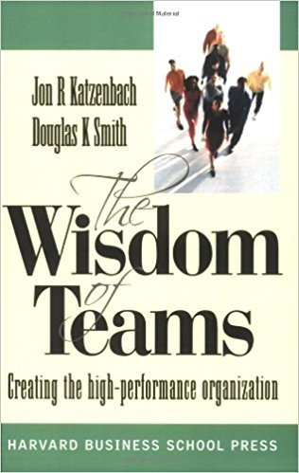
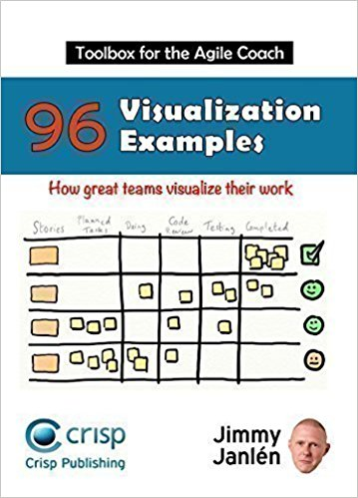

Slide 25
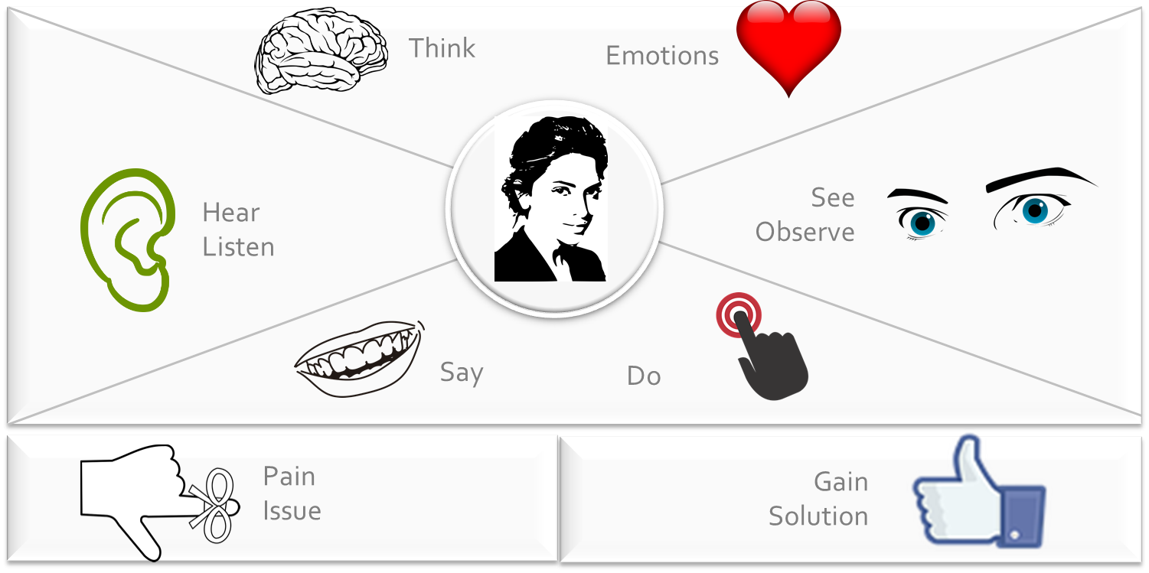
Empathy map

Slide 26
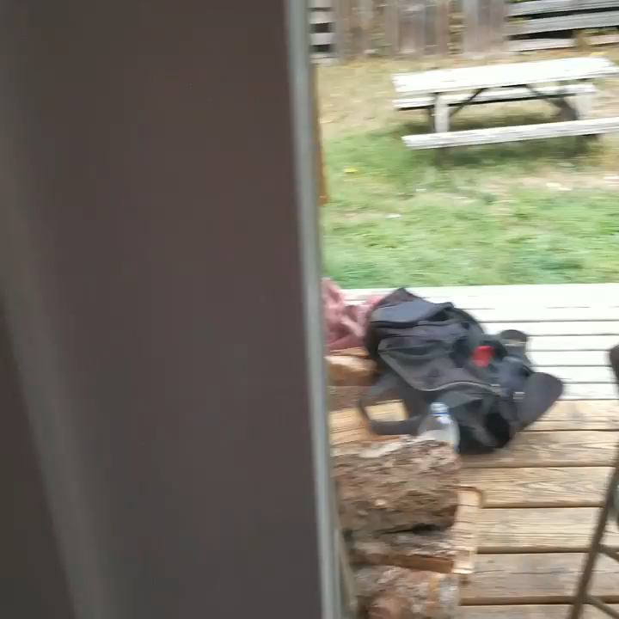

Put yourself into their shoes

Slide 27
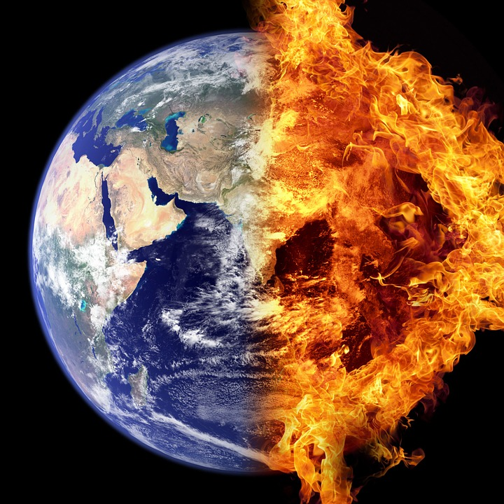
Geopolitics
Several team representatives involved in the same project / organization are invited. They all get a map
Each team indicate on their map the key elements that define them
Main resources / activities / responsibilities
Exchanges with other teams
Needs / Requirements
Maps are progressively put in common and discussed with the whole group, then explained to the whole teams (outside)
!
Moving from step 2 to step 3 is key
- No communication before in common
- Perception + learning what others do
- Ensure transmission after the workshop

Slide 28
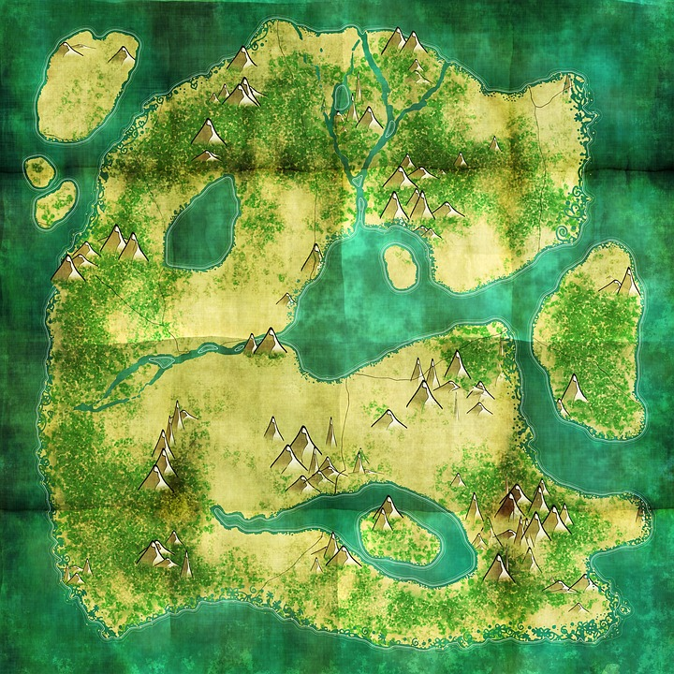
Material etc.
Somewhat Difficult
90 – 120 min.
Moderator must know about the context and organization
No communication allowed between teams before maps are compared (distance)
Final understanding and agreement is key in the end to ensure support and transmission
Not too many participants (reconciliation becomes long / difficult)
Opening: introduce the exercise – set the expectations
Closure: summarize & ensure further transmission (e.g. done by the Moderator in the different teams)
4 – 10 people
Politics / Propaganda / Transmission

Slide 29

If I were U
Everyone (preferrably one per team) is invited to describe, on a schedule what are the tasks / activities he / she is usually doing.
The Moderator collects all schedules and read them aloud, one by one, while the group is trying to guess whose schedule it is.
People get to know each other’s, Group is more coherent
!
Keeping it interesting is key
- Interaction (during the writing)
- Pedagogy, rephrasing
- Encourage active listening
- Ask precisions / questions

Slide 30

Material etc.
Somewhat Difficult
40-60 min.
Moderator must know about the context and organization
Moderator should ensure he/she understands the tasks / schedule
No communication allowed between people before schedules are read
People whose schedules are read must not react
Not too many participants (long / boring)
Opening: introduce the exercise – set the expectations
Closure: summarize & ensure further transmission
4 – 10 people
Politics / Propaganda / Transmission

Slide 31
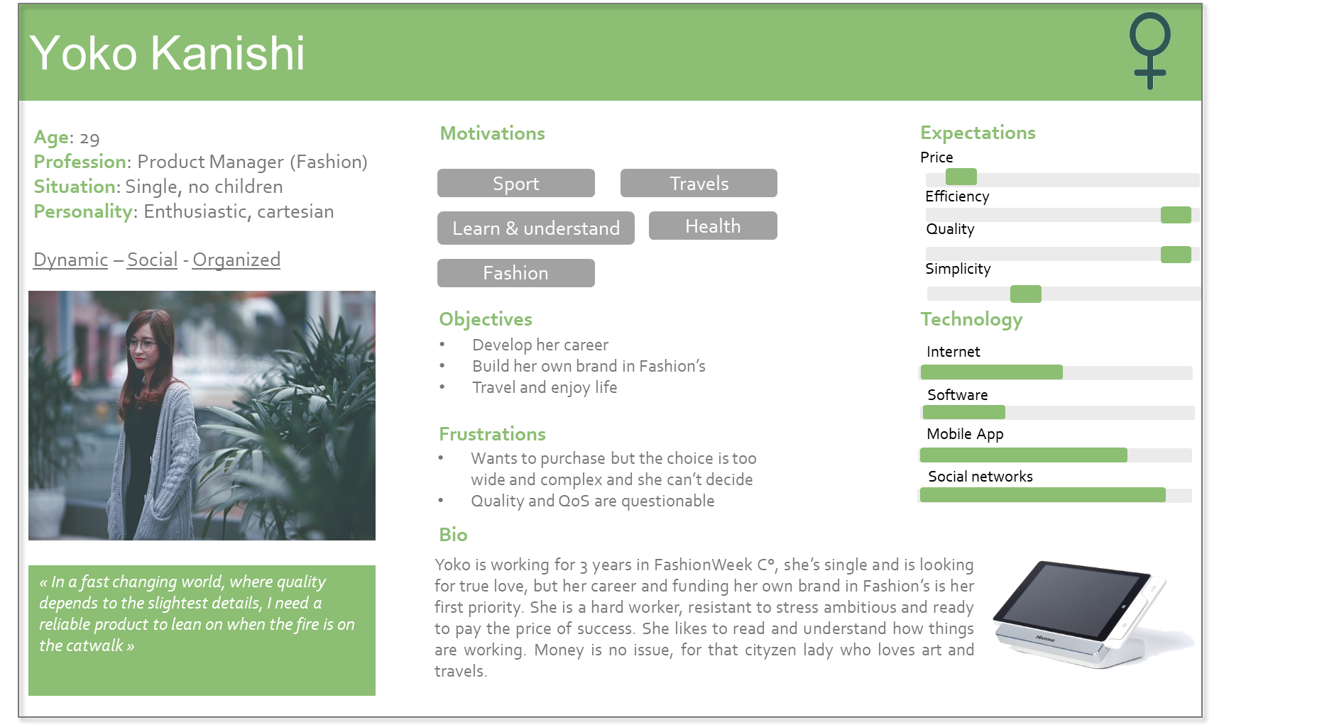

PERSONAS
Whom are we designing for?
Who are our users?
Who are our customers?

Slide 32
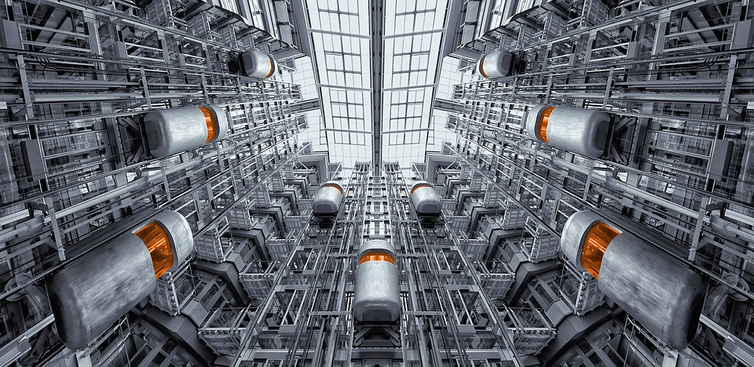
Envision the Future Envision the product/project
Magic Wand
Roses & Chrysanthemums
Stairway to Heaven

Slide 33

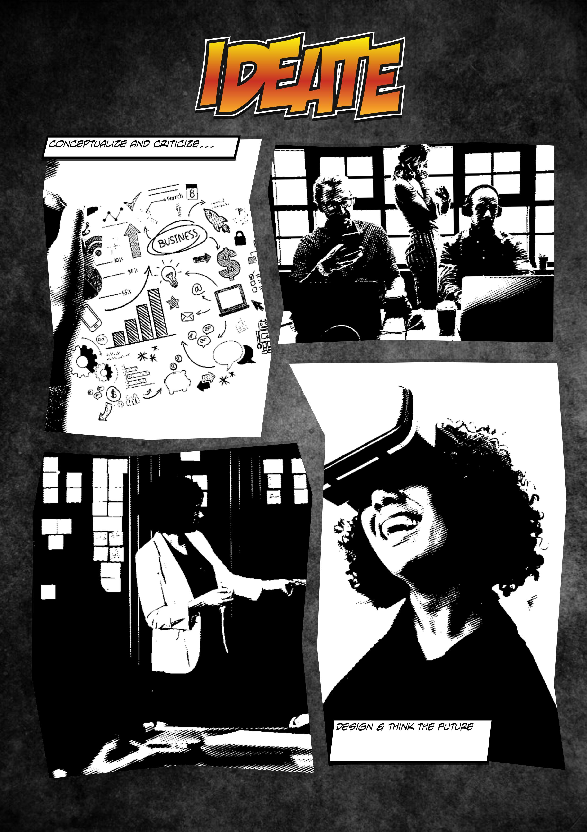

Slide 34

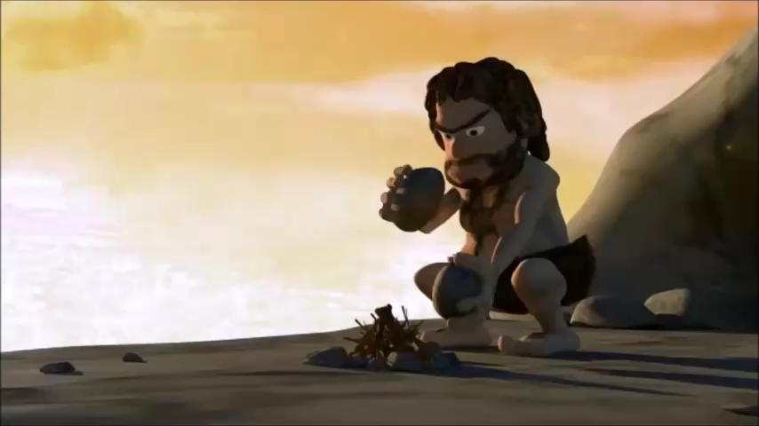
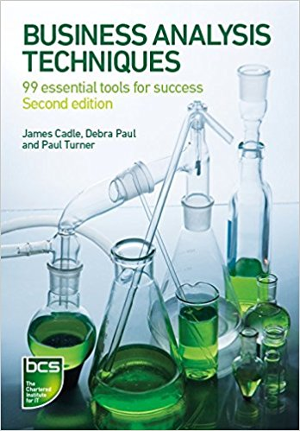

Slide 35

Magic Wand
The group defines a topic / problem that they want to get solved but don’t know how
In turn, everyone takes the wand and expresses one thing he / she would change if he/she were a wizzard. « If I were a Wiz, I’d change… »
The group chooses for the preferred spell amongst those proposed. Moderator reformulates the objective and make it atteinable.
They identify what they need to build the spell / wand (people, resources, knowledge, time…) and transpose these to their context (problem). A step-by-step action plan is inferred.
Moderator formulates the initial problem and the final spell
!
Problem complexity and action plan are key
- Timing (40 min.)
- Respect other’s ideas
- Great freedom

Slide 36
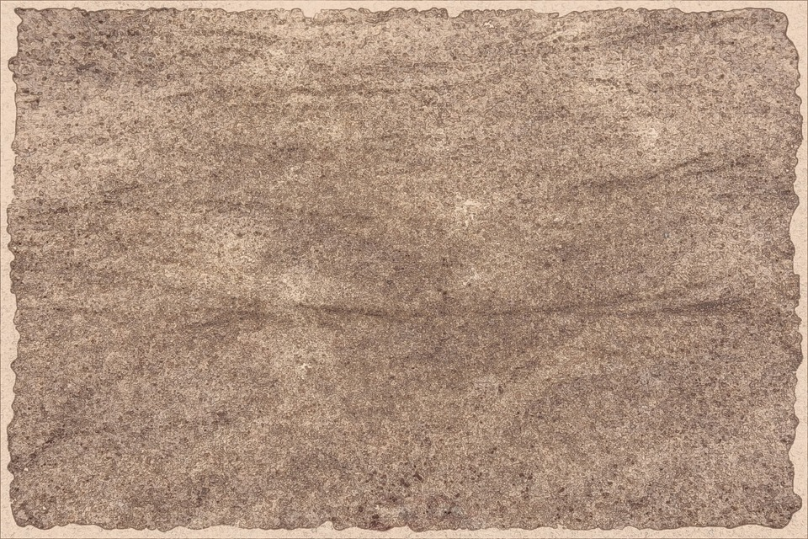




Material etc.
Fairly Difficult
90-120 min.
Moderator must know about the context and organization
Problems should not be too complex – manage ambitions & expectations
An action plan should result from the exercise but make sure participants use the spell / wand semantic
Opening: introduce the rules – set the expectations
Closure: summarize & ensure further transmission
Spell
(goal)
Wiz needed (support, knowledge)
Magic ingredients
(resources, money)
Magic recipe (action plan)
6 – 10 people
Too ambitious / Believe in magic (not realistic)

Slide 37

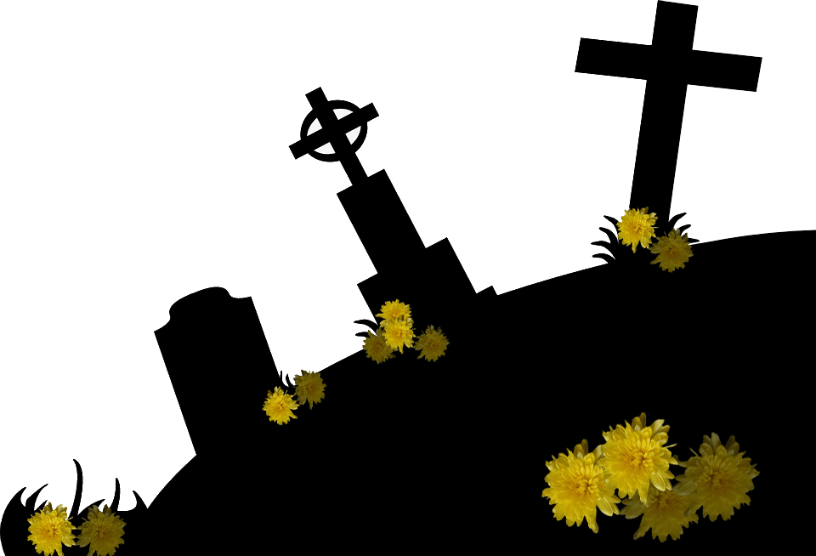
Roses & Chrysanthemums
The group is divided into 2 teams: Roses & Chrysanthemums. Both teams are asked to envision the future 3 years ahead
Roses are assigned to listing actions (key success factors) that will make the project succeed. Chrysanthemums are doing the same but with key failure factors that will make the project fail.
In turn 1 representative of each team presents their vision of the future
Visions are compared, lessons are learnt
Moderator summarizes
!
Actions are key in both teams
- Chrysanthemums should NOT limit to actions not done
- Scenarios / Actions must be realistic
- Prejudice & bias

Slide 38




Material etc.
Fairly Difficult
90-120 min.
Moderator must know about the context and organization
Moderator must be able to detect / defuse prejudices and biases
Actions and their consequences should be realistic
Actions are narrated in the past tense
Atmosphere reinforcement (rose / skulls stickers) optional
Opening: introduce the rules – set the expectations
Closure: summarize & merge. Conclude.
4 – 20 people
Not realistic / Passive Chrysanthemums

Slide 39
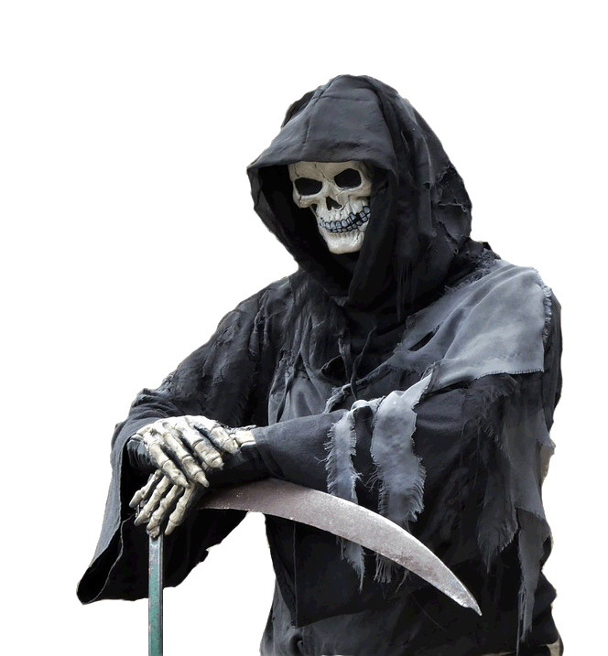
Worse than Death
Not really a workshop – rather a way to get rational
Goal: Take distance, streamline
Moderator asks to formulate fears (e.g.: if he doesn’t cope with his teacher, he will end as a junkie)
Moderator ask on every step of the reasoning what the worst can be to get / help the person question how rational his/her arguments are and how likely they are going to occur (Ref: « the bat » of Bigard)
!
The person should come to the conclusions that his/her fears are irrational by him/herself
No judging, no immediate confrontation
Wait for the best moment to confront & reframe
Notes:
Il ne s’entend pas avec son prof > il est renvoyé > on ne lui trouve pas d’autre école > il n’a pas de diplôme > il ne trouve pas d’emploi > il est exclu du système > il finit à la rue et doit voler pour assurer sa subsistance

Slide 40


Material etc.
Rather easy
20 min.
Moderator should have an active listening
Moderator should be able to detect biases and shortcuts
Moderator should be creative, facilitate the story telling and reframe
Apply some « routine » (e.g. « OK, and now imagine the worst…which is? »)
Opening: Formalize fears
Closure: synthesis and conclusions
1 person
Realistic / Benevolent reframing

Slide 41

Stairway to Heaven
The group / persons must define their current situation (bottom) and the desired situation (Heaven on top) (Alt. Past is at the bottom, Present is somewhere in between)
They must identify 12 steps separating bottom to top
Moderator can either animate the discussion (group) or invite everyone (people) in turn to present their own Stairway to Heaven
Steps are discussed / reconciliated so that they match with the team objectives
4 possibilities: (team vs. individuals) x (Past vs. Present at the bottom)
!
Steps are key
- Realistic
- Reconciliation for the whole team if individuals
- Prejudice & bias

Slide 42

Material etc.
Fairly Difficult
60 min.
Moderator must know about the context and organization
Moderator must be able to detect / question prejudices and biases
Steps and their descriptions should be realistic
Starts at present (Alt. From Past to Future – shows team / people progress)
Make objective attainable and desireable
Focus on positive aspects / progress
Applicable to teams / projects / people / organization
Opening: introduce the rules – set the expectations
Closure: Summarize & eventually derive an action plan
4 – 12 people
Not realistic / Biases

Slide 43
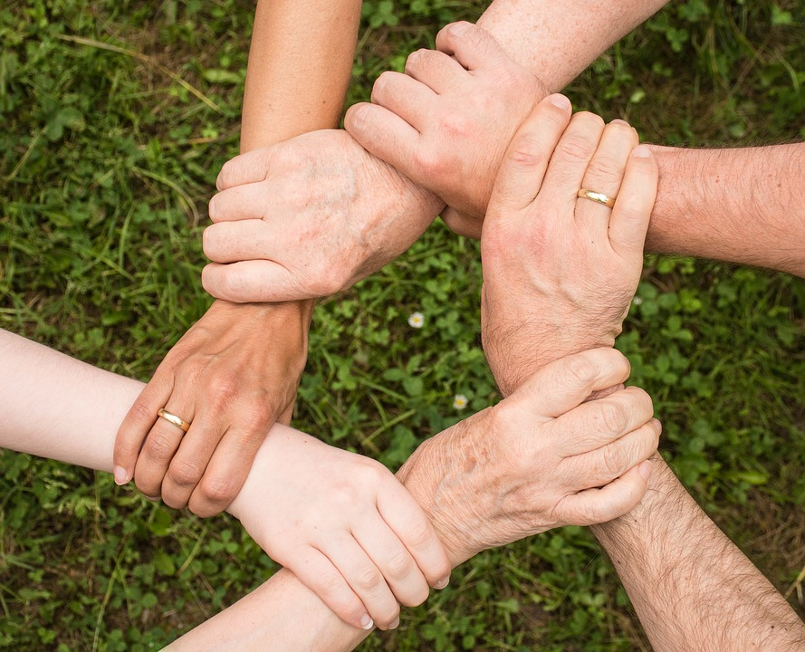
Together
Break an egg
Our coat of arm
We are a team

Slide 44
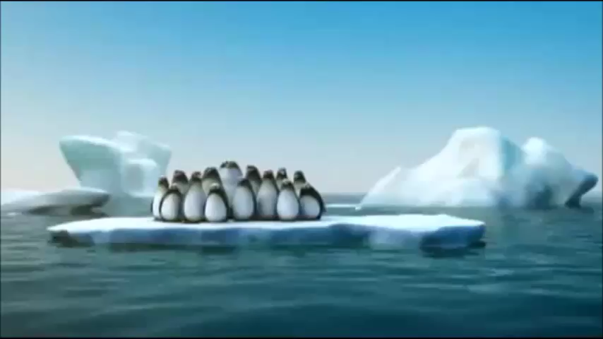

Slide 45

Break an egg
The group is divided into sub-teams of 3-5 people. Each team is given:
One (raw) egg
20 plastic straws
2 meters of string
The moderator explains the goal: the egg must be able to sustain a fall of several meters (e.g. one floor).
Teams must design and test their solution
!
Capturing group interaction is key
- Observe and note
- Restitute observations

Slide 46

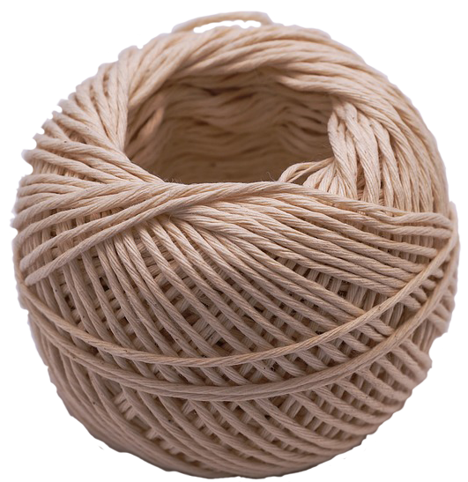
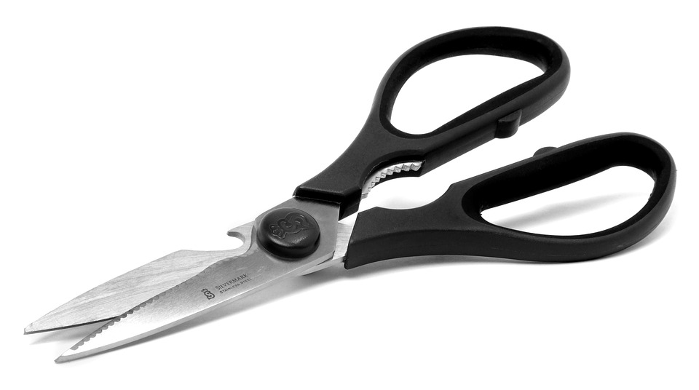

Material etc.
Fairly Easy
60-90 min
Workshop organization / management
Capacity / capability to capture group interaction & dynamic
Manage to communicate group success / failures (no face loss) to perform better in the future
Monitor time
Foresee some « spare » eggs in case of accidents during the conception phase
Opening: present them the rules
Closure: summarize and draw conclusions (works, works not, interactions…)
5 - 15 people
Location / Cleaning / Ego-tripping and tensions

Slide 47


Our Coat of Arm
The Moderator presents an empty coat of arm with the following quadrants: VALUES – BELIEFS – GOALS – TASKS with a banner space reserved for a MOTTO
The project team is then invited to fill in their coat of arm starting from their historical experience / how they project into the future
Individually: My best / worst moments
As a team: Team’s best / worst moments
Complementary drawings are allowed
The group build his final coat of arm & motto
(optional high quality finish / post-processing)
!
Sincerity is key
- Playing the game is essential
- It’s everyone’s coat of arm & motto
- Ask precisions / questions

Slide 48

Material etc.
Fairly Easy
120 min
Moderator should know about the context & organization
Capacity / capability to transform facts into concepts
Rephrasing and turning into positive values
Not too many – prioritize / straight
Allow everyone to discuss and express his / her opinion
Suits well for new teams, new roles, new projects, new missions
Opening: Explain the concept
Closure: summarize and get the final coat of arm & motto
VALUES
GOALS
TASKS
BELIEFS
MOTTO
4-12 people
Big-picture / Summarizing / Conceptualizing

Slide 49


DIY
Build your own tool!

Slide 50

What’s your quest?
What do you intend to do? What is your goal? What is your target? How will you reach it? What are the steps? (stairways to heaven)
Who is your audience? Who exactly? How many? What level? Individuals? Groups? Teams?
What is your budget? Material, time to design, goodies etc.
How much time do you have? One workshop? Several? Hours? Days? Minutes?
How difficult could it be? Expertise required? Social skills required? Social risk? Personal risk?
How will you engage them? Fun? Art? Social activities? What skill / characteristic do you want to activate?
Is there a history (them / you)? Things that worked? Things that failed? Trends? Habits? Style?
How sustainable should it be? One single problem? A long-term vision? A transformation?
Notes:
If it is a failure, it is my failure. If it is a success, it is their success

Slide 51

What’s your name?
Game opening phase: goal, rules, objectives, what not
Execution phase: let them do, support, comment, note, observe, act, help
Lessons learning phase: compare, gather, discuss, confront, comment
Finishing & Polish phase: re-build, improve, plan actions
Game closure & transmission phase: summarize, transmission & synthesis, next steps, feed back
Notes:
If it is a failure, it is my failure. If it is a success, it is their success

Slide 52

What’s your favorite color?
It won’t be perfect the first time
Go to point 3 if you have no chance for a second trial here
Get feedback and improve until it works fine
Prepare some feedback forms
Be subtle with your doubts and fears
Be benevolent with yourself, you can only do your best…but do it!
Get a free trial
Friends, family, good & understanding colleagues
Get a ready-made solution (book, workshop)
Get return of experience (Book, web, blog)
Notes:
If it is a failure, it is my failure. If it is a success, it is their success

Slide 53



