Slide 1

Groovy API-Testing with Spock
Alexander Henze
MaibornWolff GmbH
SQA Days Riga 2019

Slide 2





Who Am I?
Born 1987 in Germany
Works with MaibornWolff GmbH in Munich
In Testing since 2013
Started testing manually
Shifted down the testing pyramid
Now a tester in development
Main areas: Java & Test Automation

Slide 3
1.
I got an API. What does it do and how can I test it?
2..
Why do common API-Test Tools have disadvantages?
4..
Today‘s
Outline
3..
Let‘s see how it works (live demo)
How can Groovy and Spock overcome these drawbacks?

Slide 4


My example API – Bookingham Palace
A booking platform that brings hotels and travellers together
Hotel owners can register their hotels and manage all of their bookings
Travellers can search for hotels, make bookings and rate their hotels
Written in Java with SpringBoot 1.4
Has a Rest API
Available under: https://github.com/reAlHe/bookingham_palace

Slide 5



What should my tool look like?
Testing is teamwork – use a technology that everyone is ok with
Keep it simple – Must be easy to use in terms of test data definition & repeatabilty
Make your customer happy - the business must be able to understand what you are actually testing

Slide 6
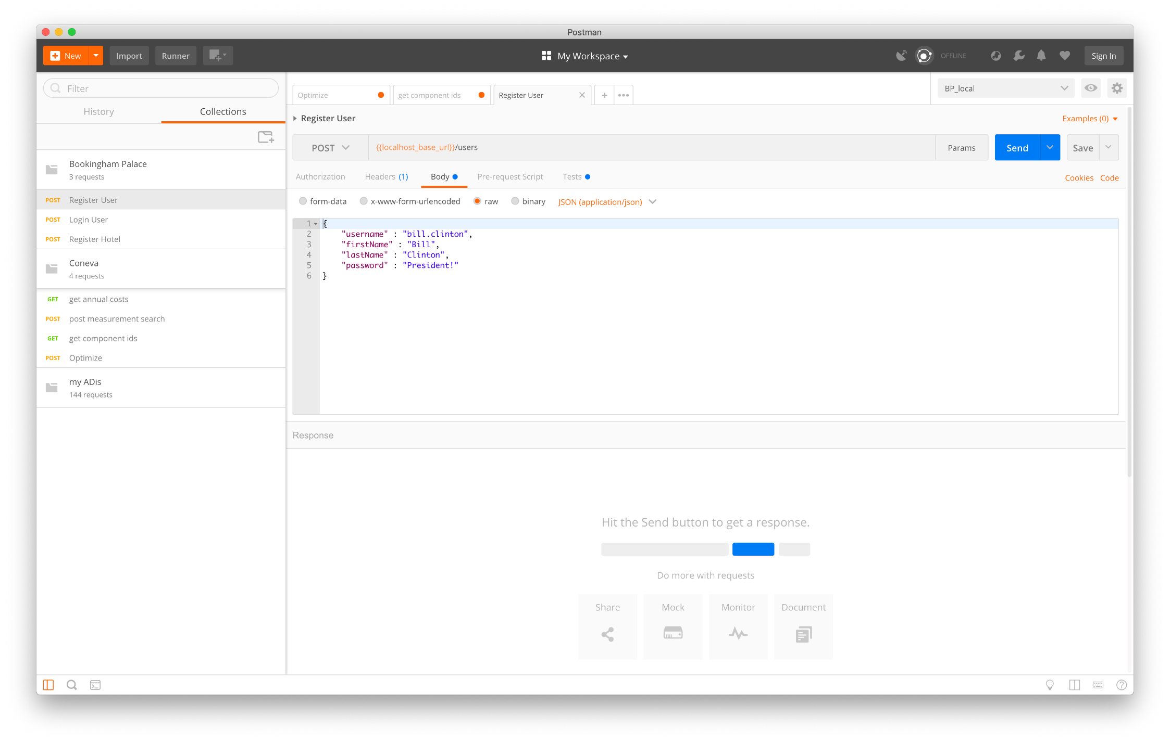
Let‘s try Postman

Slide 7


Postman has its advantages – but also cons
Leightweighted JSON definition
Easy to use
Small setup needed
Test section is well hidden
Requires Javascript knowledge
Takes a while to create test suites
Pretty reporting needs a bit of preparation

Slide 8
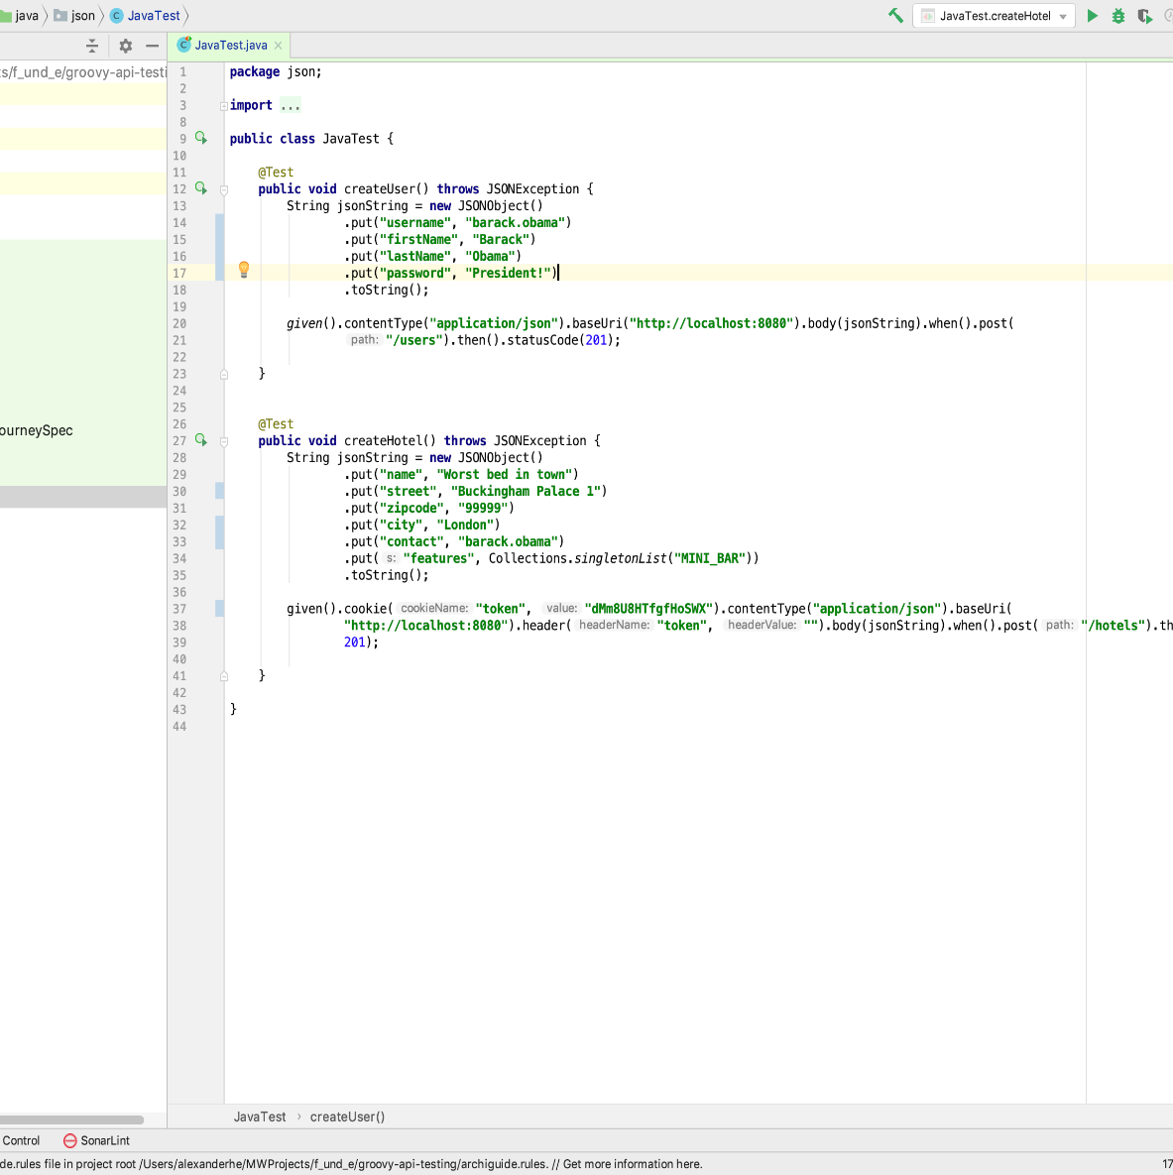
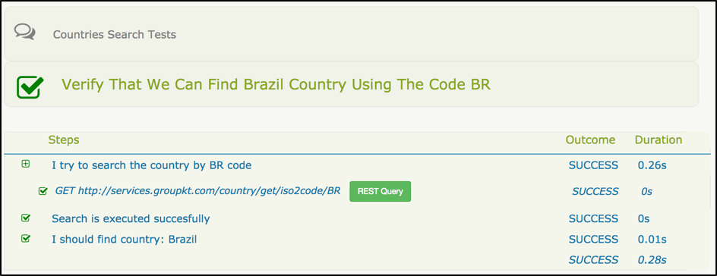
And what about RestAssured?

Slide 9

It solves some problems, but creates new ones
Tests can be written in Java
Easy to write first testcases
Pretty reporting out of the box
Setup is a bit more complicated
Define JSON with Java is hell
Creating test suites might be a bit complicated

Slide 10
Groovy for the rescue
A scripting language on top of JVM
Gradle scripting language
Comes with convenient Test Framework Spock

Slide 11

Let‘s see how it works

Slide 12
Groovy combines the best of two worlds
Leightweighted JSON definition
Easy to use
Pretty reporting, easy to read
Small setup needed
Time till first test is bigger than with Postman
Not pure Java

