Slide 1
Improving Quality Using Strategic Retrospectives
By
Mette Bruhn-Pedersen
SQA European Days #1
22-03-2019
Radisson BLU Latvija, Riga, Latvia

Slide 2
Agenda
Introduction to retrospectives
Input from the audience
Introduction to strategic retrospectives
Experiences using strategic retrospectives
How to introduce strategic retrospectives
Conclusion

Slide 3
The Purpose of the Sprint Retrospective*
Inspect how the last Sprint went with regards to people, relationships, process, and tools;
Identify and order the major items that went well and potential improvements; and,
Create a plan for implementing improvements to the way the Scrum Team does its work.
* The Scrum Guide™ , Ken Schwaber and Jeff Sutherland, November 2017

Slide 4
How Might We Improve Quality Using Retrospectives?
Product
Process
Organisation
Quality
People
Measurement
Tools

Slide 5
Your Situation in your Team/Project
Go to www.menti.com and use the code 18 52 22

Slide 6
Common Challenges with Team Retrospectives
Short term focus - next iteration
Improvement efforts are too big to fit into an iteration
Lots of talking - very little action
No clear measurement of the effect of the improvement
No input from leaders and stakeholders
Difficult for leaders to understand how they can and must help the team

Slide 7
The Strategic Retrospective

Slide 8
Purpose of the Strategic Retrospective
Provide a strategic, helicopter view of the team’s health and growth opportunities
Measure improvements and growth regularly
Focus on most important improvements
Structured way to gather feedback from leaders and stakeholders
Align teams’ and leaders’ improvement efforts
Supplement to normal team retrospectives

Slide 9
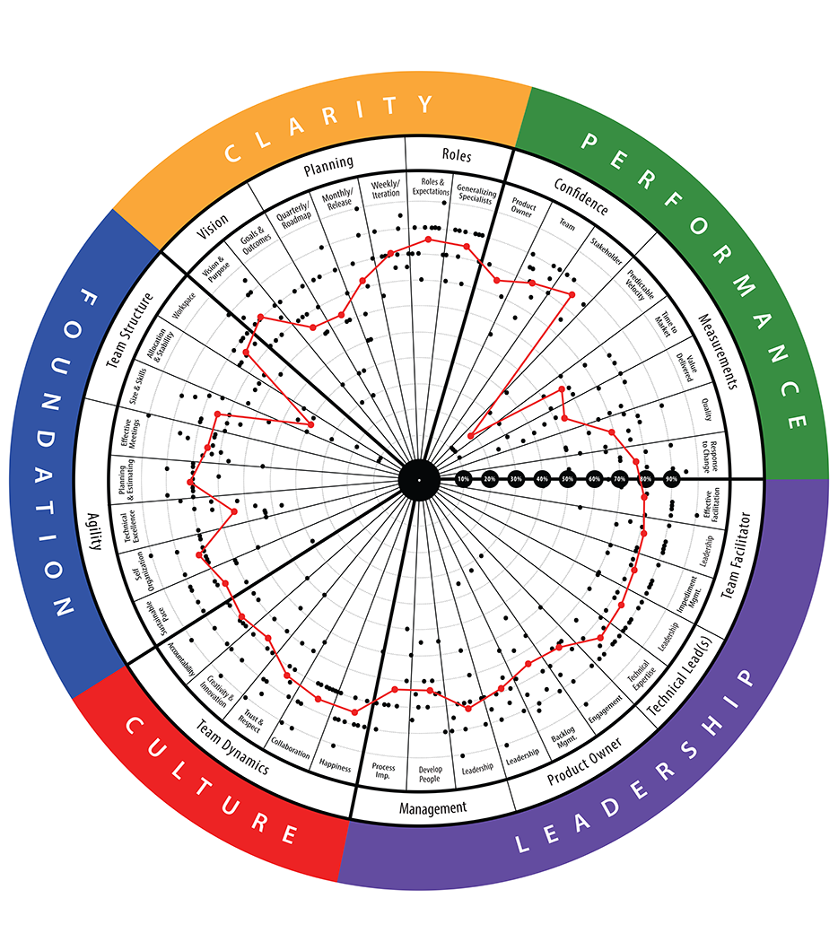
Frequency of Strategic Retrospectives
Business Milestone/
Major Release
Business Milestone/
Major Release
Business Milestone/
Major Release
Team Iterations
Team Iterations
Team Iterations
Time
Pictures used with permission from Agile Transformation Inc.

Slide 10
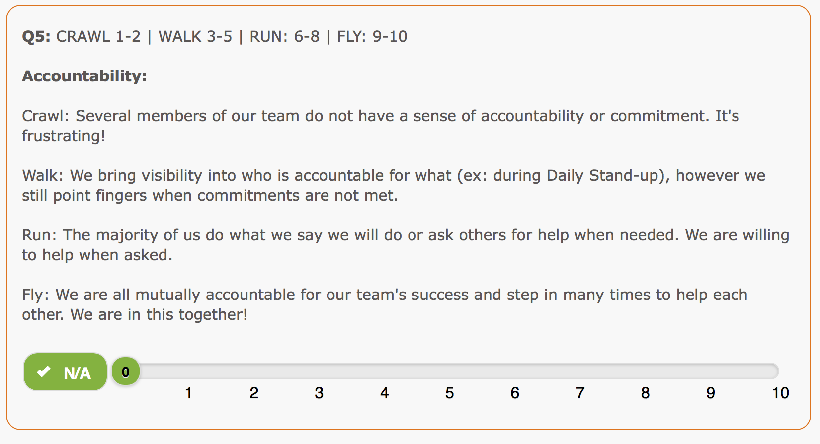
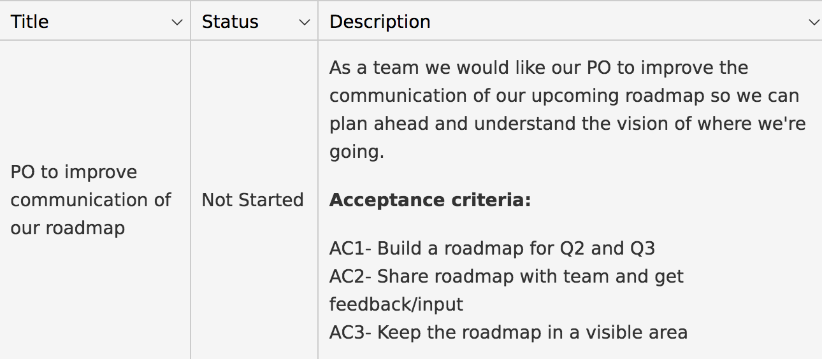
Basic Process for Strategic Retrospectives
Self-Assessment Survey
Analysis of the Result
Growth Items
Walkthrough of questions
The team members answer the questions individually
Input from leaders and stakeholders is collected before the retrospective
Development since last retrospective and over time
Cause-effect and root cause analysis
Improvement opportunities and impediments
Define and prioritise the team’s growth items
Estimate business impact
Identify organisational growth items and impediments
Pictures used with permission from Agile Transformation Inc.

Slide 11
Experiences from Alka Forsikring
Read the full case study on our website:
www.safejourney.dk/case-study-alka-forsikring-pilots-agilityhealth/

Slide 12
Background
The company had worked with agile methodologies for a couple of years
The agile team was created by splitting a larger team approx. half a year before the first strategic retrospective
The team felt quite mature but with room for improvements
First time the Scrum master had the role of Scrum master

Slide 13
Process at Alka Forsikring
Decision to pilot strategic retrospective
Strategic retrospective
Introduction and tool setup with scrum master
Debriefing with leaders
1
Introduction to the team
Follow-up with scrum master
Repeat strategic retrospective again
2
Evaluation of the pilot

Slide 14
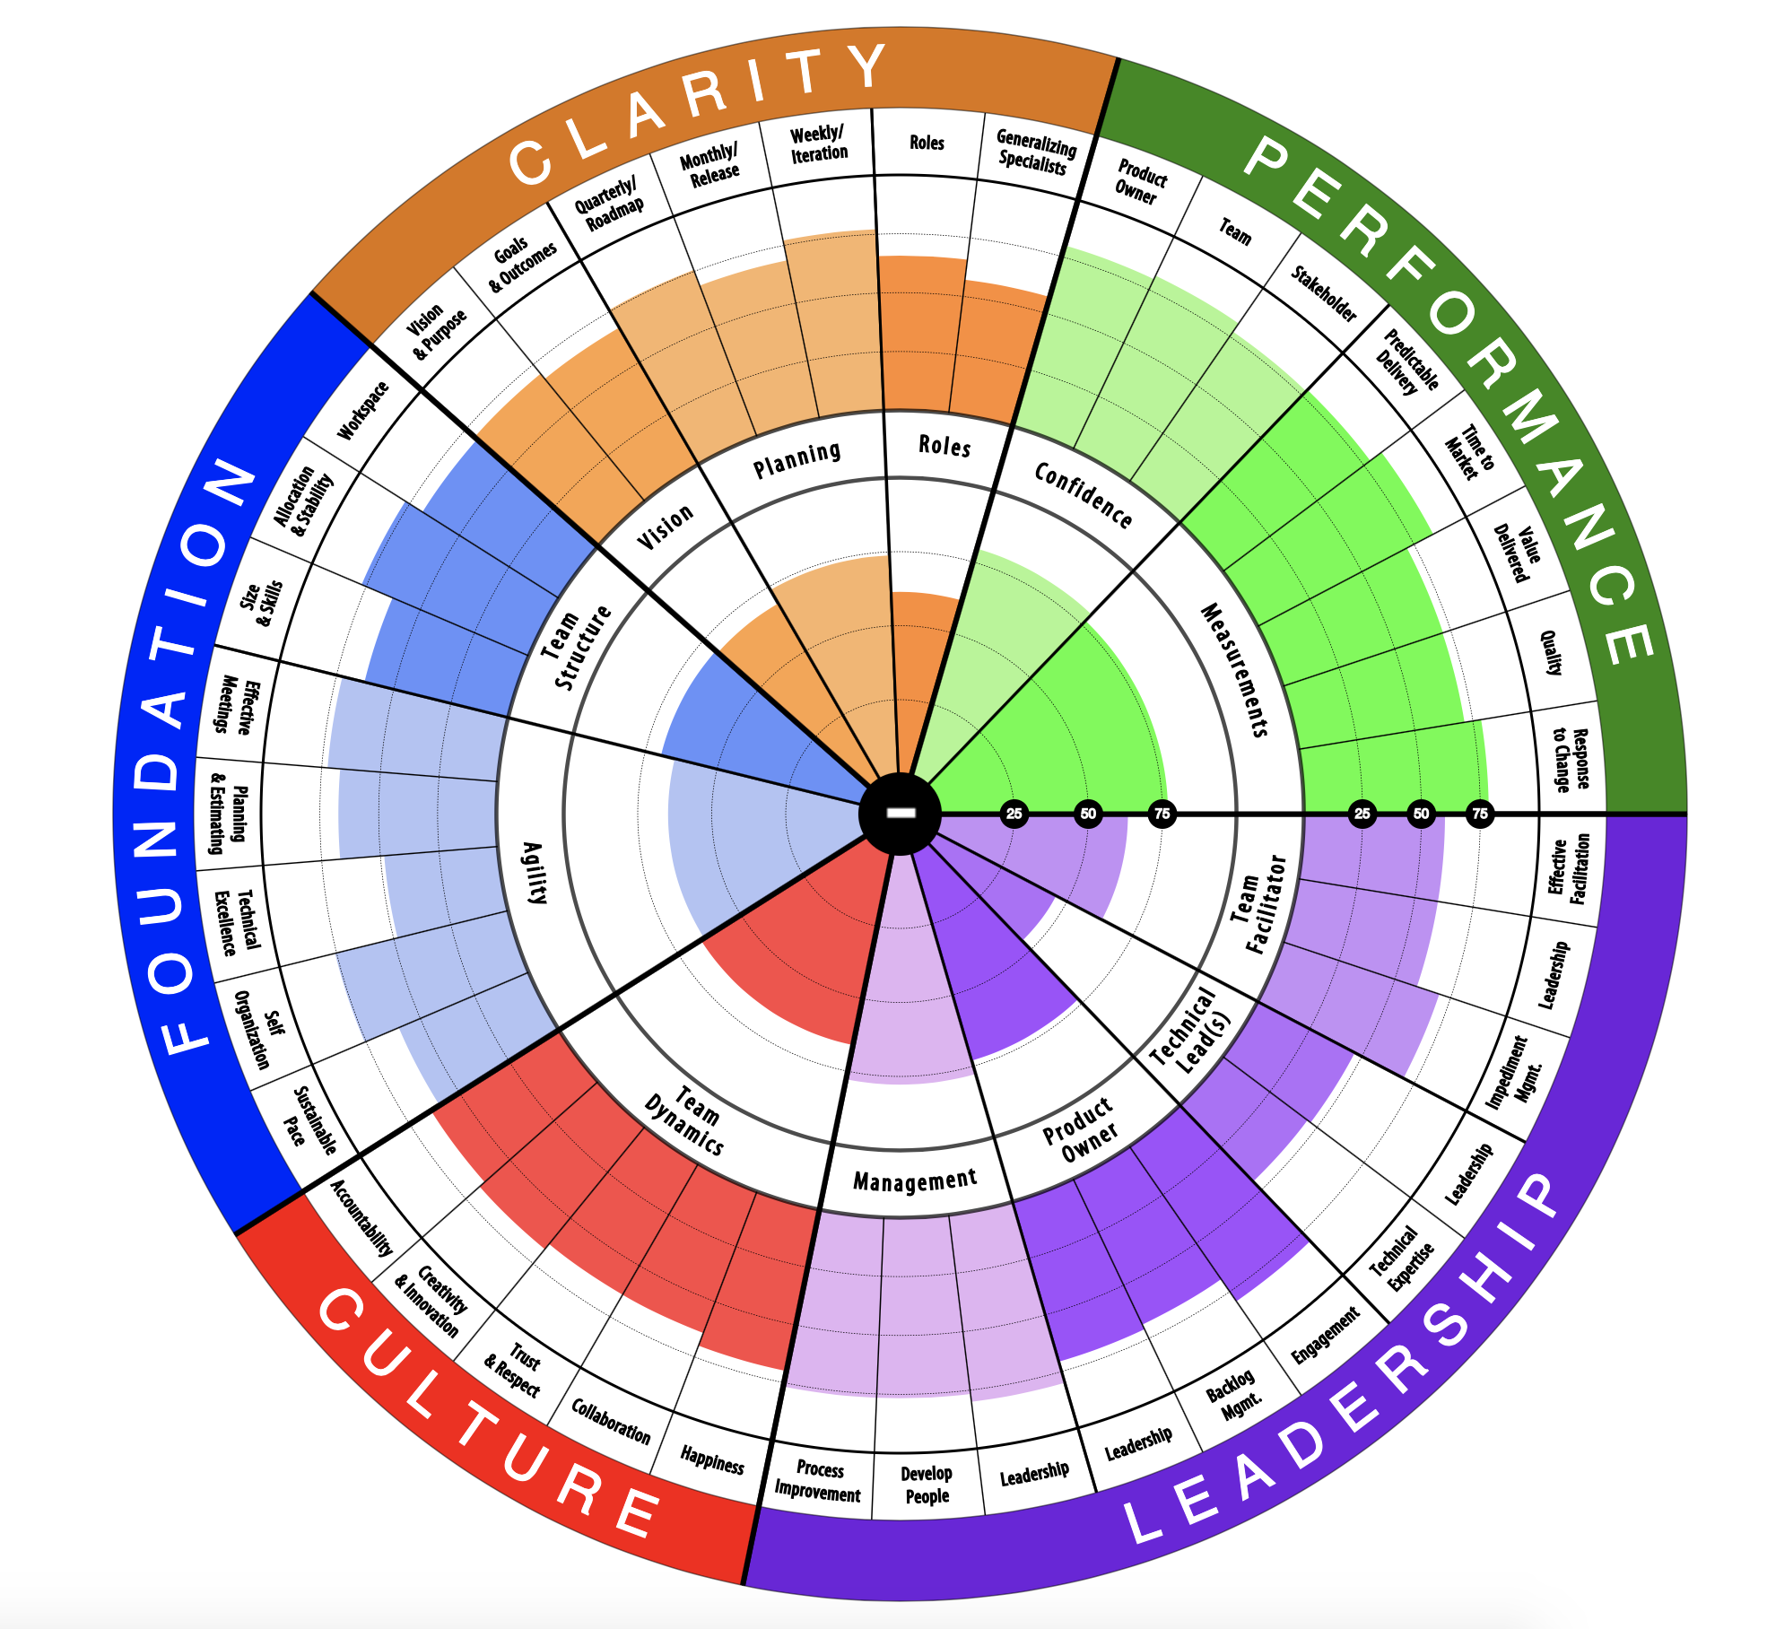
1st Baseline Self-Assessment
The team assessed five dimensions:
Clarity
Performance
Leadership
Culture
Foundation
AgilityHealth® TeamHealth® radar

Slide 15
Analysis of Key Topics
Identified most important topics to discuss
Analysed topics in two groups
Continued in one group and selected the most important problem
Conducted root cause analysis
Defined improvement story (growth item)

Slide 16
Growth Items of the First Strategic Retrospective
The team members identified lack of improvement based on team retrospectives as the strategic problem they wanted to address during the next four sprints.
The team did not identify any organisational improvement items for the organisational leaders.

Slide 17
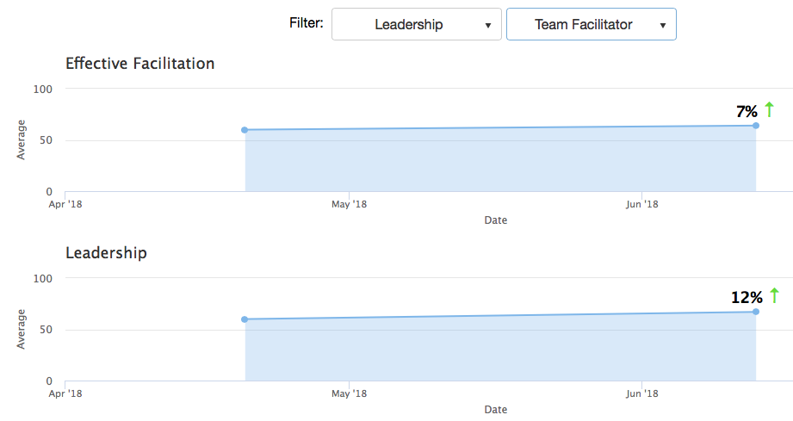
Comparison between 1st and 2nd Strategic Retrospective
AgilityHealth® Platform

Slide 18
Benefits of the Strategic Retrospectives in Alka Forsikring*
The result of the TeamHealth radar “hit the nail”. The team members recognised the result and thought it reflected their actual challenges.
All team members had been engaged and contributed to the work related to the improvement story. They felt that they were doing it together.
Compared with the previous agile maturity measurement method, the team members felt that AgilityHealth® resulted in more concrete actions.
* Read the full case study on our website: www.safejourney.dk/case-study-alka-forsikring-pilots-agilityhealth/

Slide 19
How to Introduce Strategic Retrospectives

Slide 20
Considerations
Current challenges with effective team retrospectives
Number of teams
Value of aggregating team self-assessments
Usage of results
Leadership support for a growth mindset

Slide 21
Balancing Investments, Efforts and Results
Experience developing a light-weight approach
Created survey in simple tool consisting of 5-7 questions
Conducted survey 3 times
Pros
Good management support
Initially gave some good indications
Cons
Manual analysis of data across surveys to spot trends
Not possible to use results for individual teams
Big difference in people answering which made it difficult to spot trends over time

Slide 22
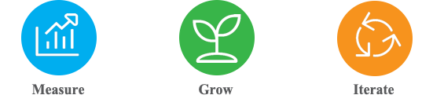
A Scalable Approach: AgilityHealth® Platform
AgilityHealth® is the world’s leading measurement & continuous growth platform that enables visibility into your teams, their health, performance and alignment to outcomes.
Pictures used with permission from Agile Transformation Inc.

Slide 23
Conclusion
Improving quality using team retrospectives can be challenging
Strategic retrospectives can help teams:
Get clarity on the biggest challenges spanning multiple iterations
Focus on a few, significant improvements (growth items)
Measure the effect of their improvement efforts
Align challenges and improvement focus with leaders
There are several approaches introduce strategic retrospectives
If you need to scale, consider using a professional platform

Slide 24
Contact Details
Mette Bruhn-Pedersen
Agile Transformation Leader and Partner
E: contact@safejourney.dk
W: safejourney.dk
in: www.linkedin.com/company/safe-journey-ww

