Slide 1

Testers, while you
were sleeping:
The
DevOps
Tsunami
Johan Steyn

Slide 2

Hello!

Slide 3

Hello!

Slide 4

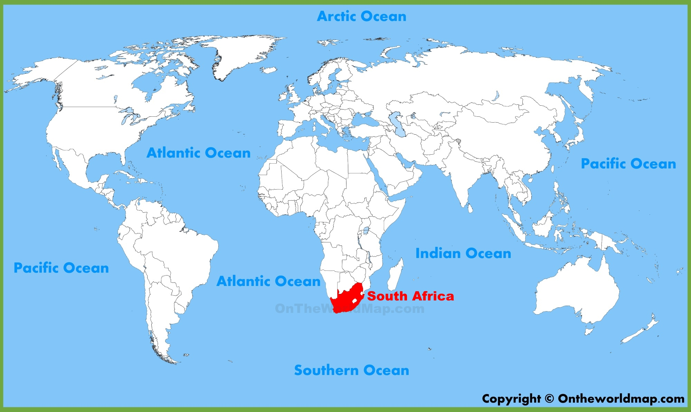
Hello!

Slide 5



Hello!

Slide 6

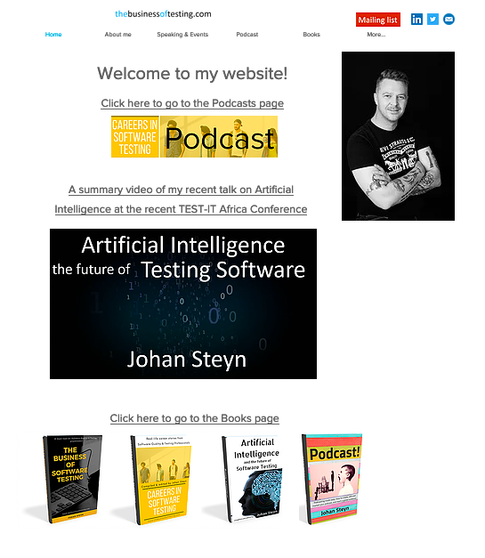




About me

Slide 7


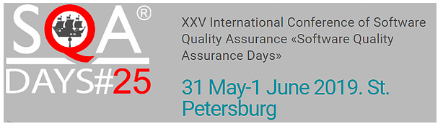
Speaking events

Slide 8


The cocktail party

Slide 9
Testing

Slide 10
Testing
Functionality

Slide 11
Testing
Quality Engineering
Functionality

Slide 12
Testing
Quality Engineering
Functionality
Customer Experience

Slide 13
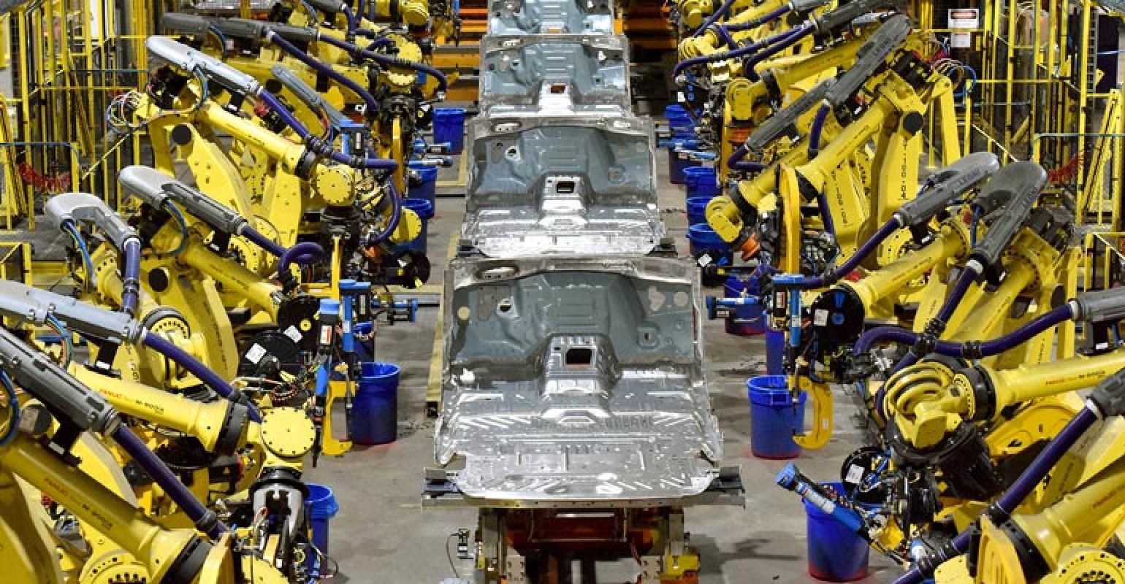
Manufacturing / Engineering

Slide 14
The last slide…

Slide 15
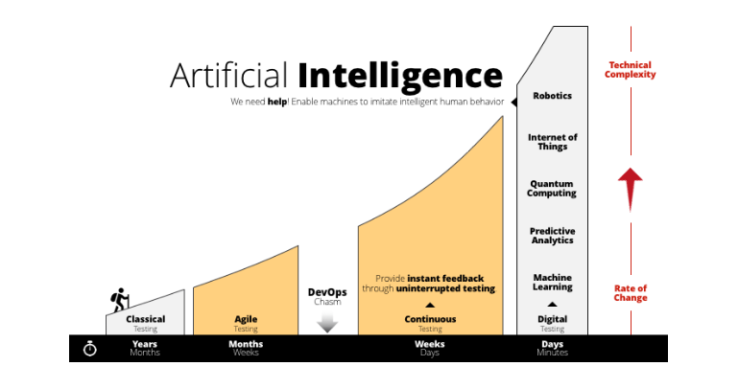
Source: https://www.tricentis.com/artificial-intelligence-software-testing/

Slide 16
Standing on the shoulders of giants

Slide 17
What is DevOps?
Dev
Ops

Slide 18
What is DevOps?
Dan Ashby: Continuous Testing in DevOps
https://danashby.co.uk/2016/10/19/continuous-testing-in-devops/

Slide 19
What is DevOps?
Dan Ashby: Continuous Testing in DevOps
https://danashby.co.uk/2016/10/19/continuous-testing-in-devops/

Slide 20
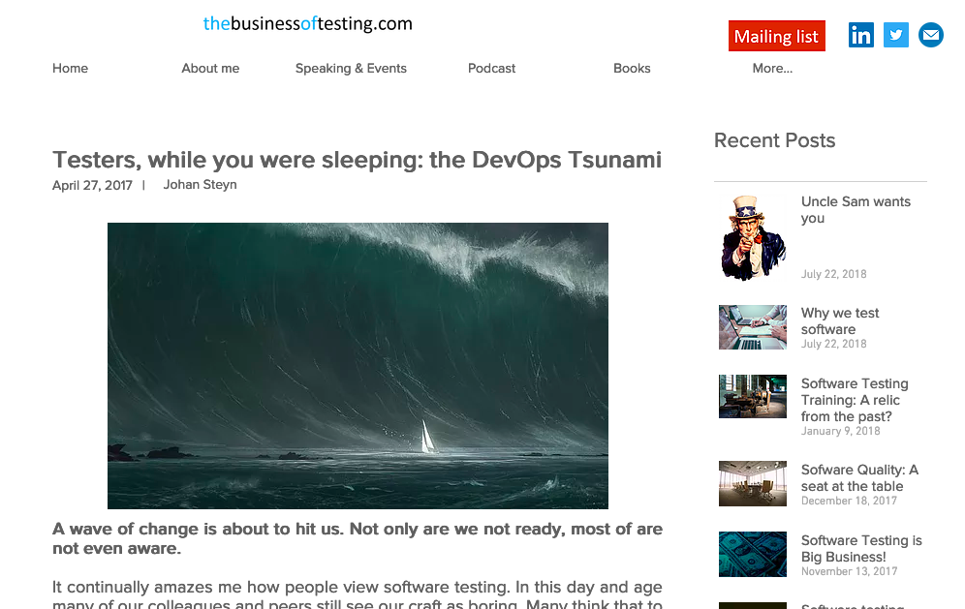
“That” article…

Slide 21

Japan 2011

Slide 22

Japan 1945

Slide 23

William Deming
1900-1993

Slide 24
William Deming
20th century – Quality Movement
Japanese manufacturing
Impact on “Lean” and “Six Sigma”
Principles of DevOps
“If you follow my ideas, within five years you will be a world economic power.”

Slide 25
Deming’s 14 points
1. Create a constancy of purpose
2. Replace the top-down, command-and-control structure. Cooperative leadership models.
3. Cease dependencies on inspection to achieve quality. Don’t wait until it’s done to test it. Build quality in from the start.

Slide 26
Deming’s 14 points
4. End the practice of awarding business on the basis of a price tag. It’s how much money you’re gonna make if you make it.
5. Improve constantly and forever the system of production and service. Amplifying feedback loops.
6. Institute training on the job. Create a system for thinking. Become a learning organisation.

Slide 27
Deming’s 14 points
7. Help people and machines and gadgets do a better job.
8. Drive out fear so that everyone may work efficiently for a company. Blameless postmortems.
9. Break down barriers between departments. High-trust cultures are high performing. Cross-functional collaboration. Just shared responsibilities.

Slide 28
Deming’s 14 points
10. Stop management by slogans.
11. Supervisors must change sheer numbers to quality. Make workers feel pride in what they do.
12. Abolishment of the annual or merit rating of management by objectives.

Slide 29
Deming’s 14 points
13. Institute a vigorous program of education and self-improvement.
14. The transformation is everybody’s job.

Slide 30

Taiichi Ohno
1912-1990
Father of the Toyota Production System, which became Lean Manufacturing in the U.S.
"The Seven Wastes"
Delay, waiting or time spent in a queue with no value being added
Producing more than you need
Over processing or undertaking non-value added activity
Transportation
Unnecessary movement or motion
Inventory
Defects in the Product

Slide 31

Eliyahu M. Goldratt
1947-2011
“The Goal”
Theory of Constraints
Five steps
Identify the system’s bottlenecks
Decide how to exploit the bottlenecks
Subordinate everything else to the above decision
Elevate the system’s bottlenecks
If, in a previous step, a bottleneck has been broken go back to step

Slide 32

Martin Fowler
1963-
Agile Manifesto
Individuals and Interactions over processes and tools
Working Software over comprehensive documentation
Customer Collaboration over contract negotiation
Responding to Change over following a plan

Slide 33
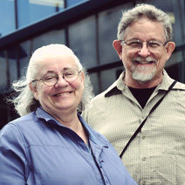
Mary and Tom
Poppendieck
“Lean Software Development”
Lean principles:
Eliminate waste
Amplify learning
Decide as late as possible
Deliver as fast as possible
Empower the team
Build integrity in
See the whole

Slide 34

Eric Ries
1978-
“The Lean Startup”
Minimum viable product (MVP)
Continuous deployment
Actionable metrics
Pivot
Build-Measure-Learn

Slide 35


Simon Sinek
1973-
“Start with Why”
“Leaders Eat Last”

Slide 36

Patrick Debois
The father of DevOps movement
Coined the name

Slide 37
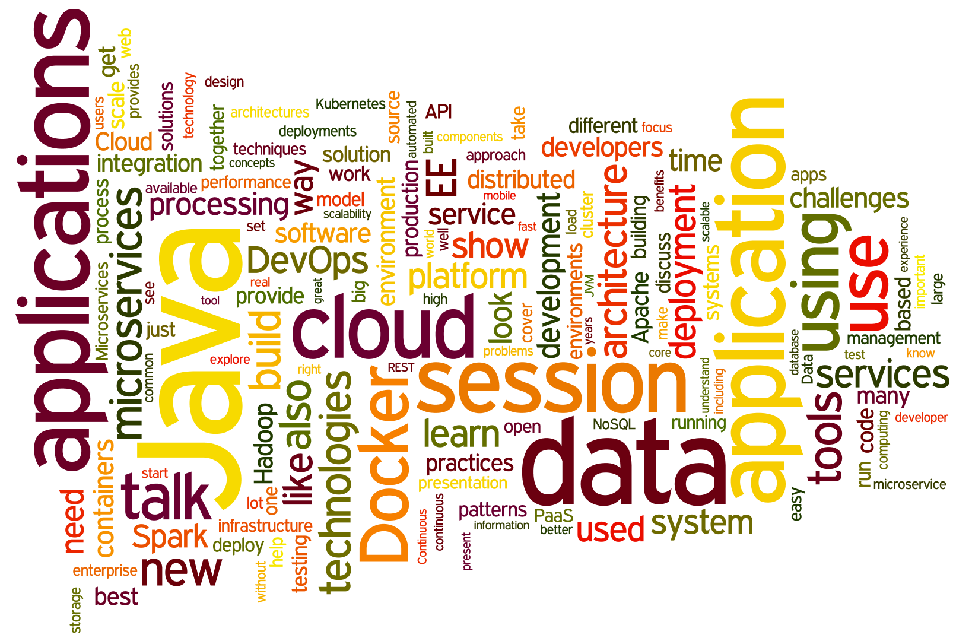
Testing in DevOps

Slide 38
Testing in DevOps
Dan Ashby: Continuous Testing in DevOps
https://danashby.co.uk/2016/10/19/continuous-testing-in-devops/

Slide 39
Testing in DevOps
DevOps: top-down approach
Massive culture shift
Culture before technology
No longer at the end of the cycle
Learning new skills: technical, business

Slide 40

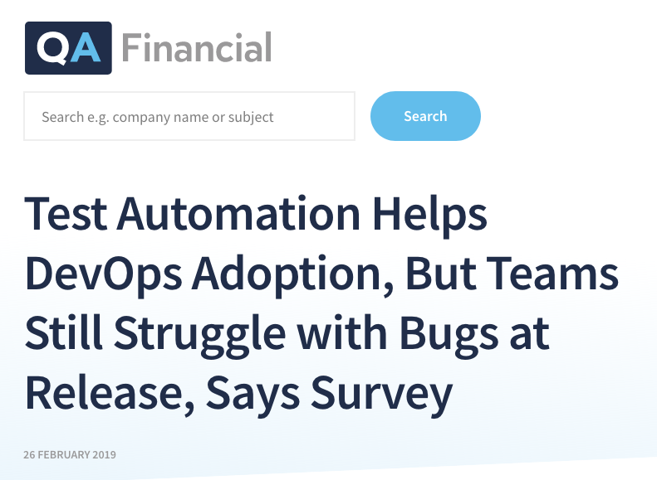
Testing in DevOps

Slide 41
Testing in DevOps
A new survey of 500 software and IT professionals, conducted by Atlassian, found that companies implementing DevOps are seeing mixed results. Insufficient automated test coverage, additional manual processes or a lack of automation in the build/deployment pipeline are key hindrances to DevOps, with 62% of respondents citing these as the reasons they resort to manual testing.
Source: https://www.qa-financial.com/articles/test-automation-helps-devops-adoption-but-teams-still-struggle-with-bugs-at-release-says-survey

Slide 42
Testing in DevOps
An additional problem is the lack of clarity around metrics of success, with 93% of respondents citing “customer satisfaction” as the most important metric, but 60% admitting it is difficult to measure customer satisfaction with the newly developed features.
Source: https://www.qa-financial.com/articles/test-automation-helps-devops-adoption-but-teams-still-struggle-with-bugs-at-release-says-survey

Slide 43
Testing in DevOps
The platforms and tooling companies use also impacts their success in implementing DevOps, according to the survey. For example, after deploying a CI/CD platform, 57% of organisations surveyed encountered fewer bugs and outages. Similarly, 47% report making changes and receiving customer feedback faster when using a platform. Adoption of microservices is also a boon to DevOps, with 71% of respondents using the technique reporting that they find it easier to test and deploy new features.
Source: https://www.qa-financial.com/articles/test-automation-helps-devops-adoption-but-teams-still-struggle-with-bugs-at-release-says-survey

Slide 44
Testing in DevOps
Adoption of DevOps by itself is not a guarantee of quality, nor speed, it turns out, with 75% of teams facing issues with bugs, defects and delays at release, while 73% report spending 10% to 50% of their time on updates and upgrades to self-hosted software.
Source: https://www.qa-financial.com/articles/test-automation-helps-devops-adoption-but-teams-still-struggle-with-bugs-at-release-says-survey

Slide 45
Books worth reading

Slide 46



Slide 47
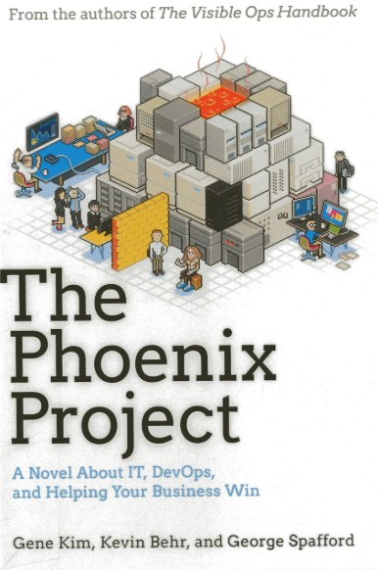


Slide 48
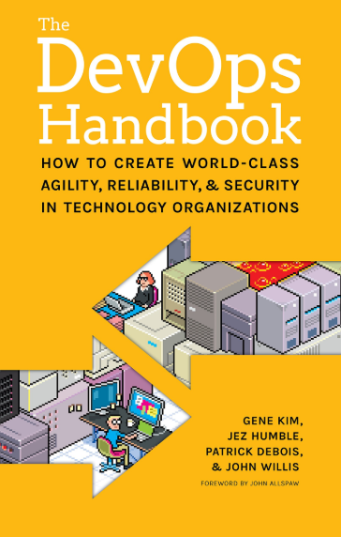
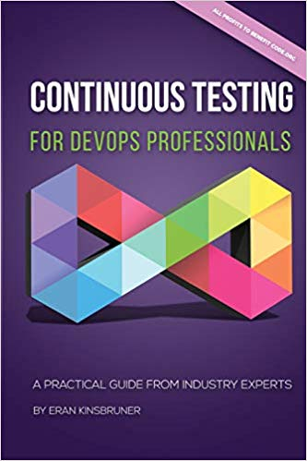


Slide 49
The last slide…

Slide 50
Source: https://www.tricentis.com/artificial-intelligence-software-testing/

