Slide 1


Building on Success
Beyond the Obvious
Erik van Veenendaal
www.erikvanveenendaal.nl

Slide 2

No More Testers!
No More Testers!
No More Testers!
No More Testers!

Slide 3


Common Testing Challenges
Increasing business importance
Increasing code size and complexity
Technology advancement
Systems-of-systems
Variety of devices and OS’s
Security vulnerabilities
Outsourcing
Time-to-market critical
Number of defects hardly decreases

Slide 4
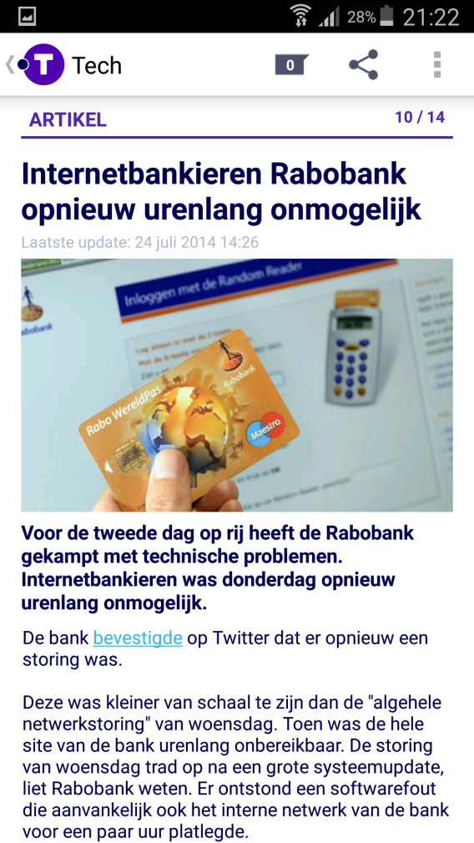
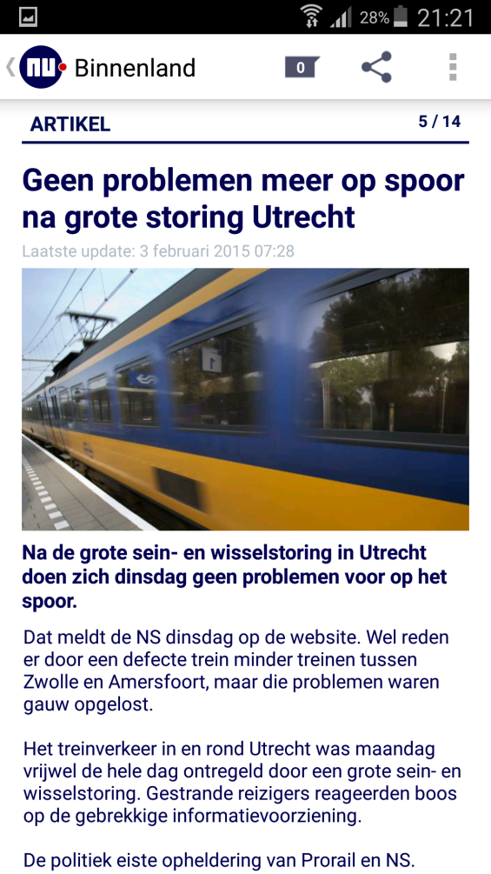
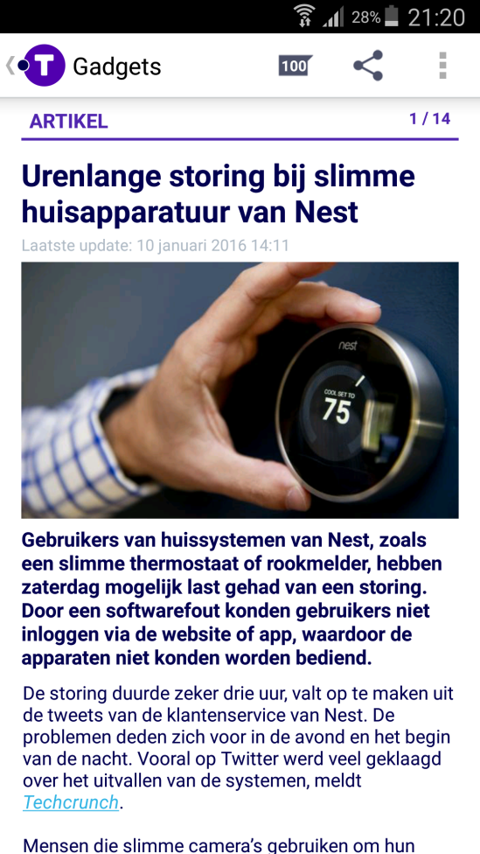
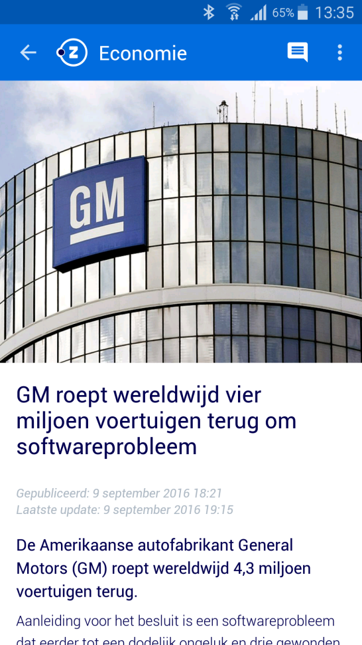
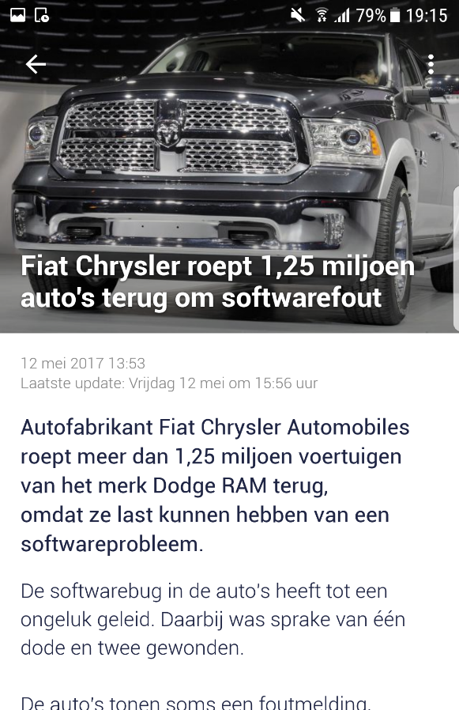
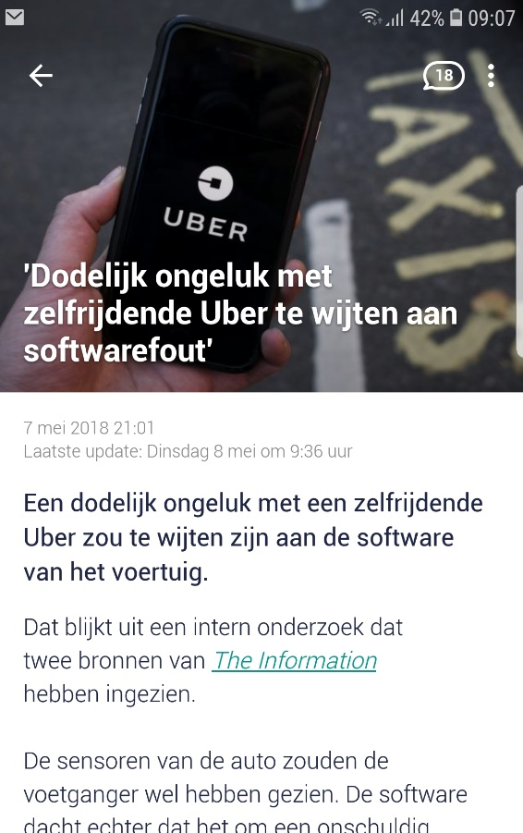
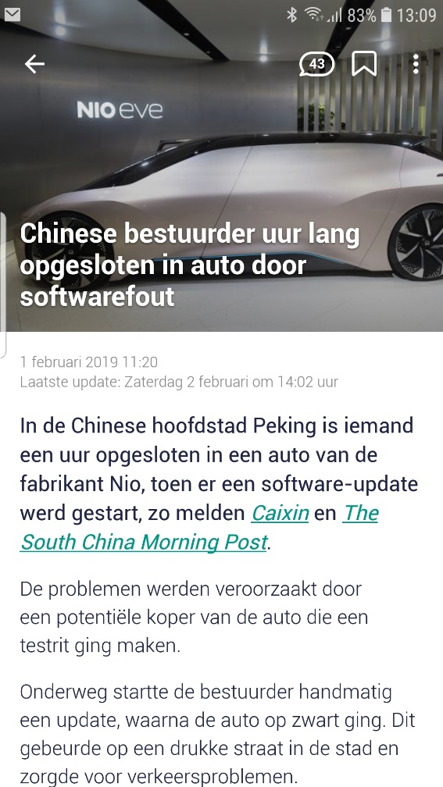
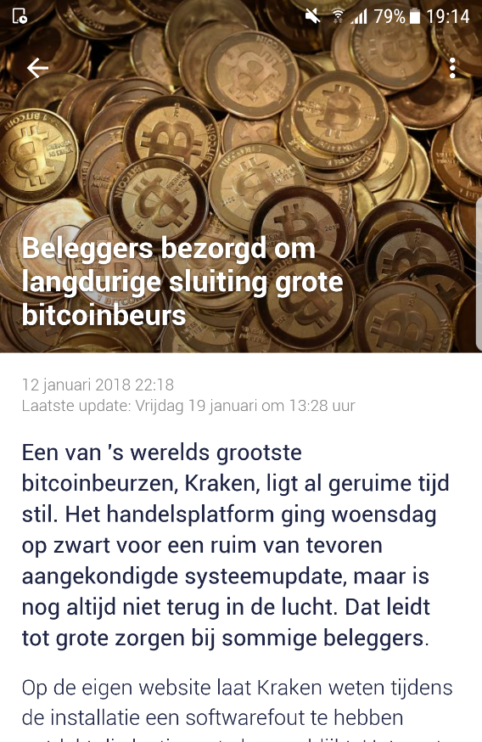
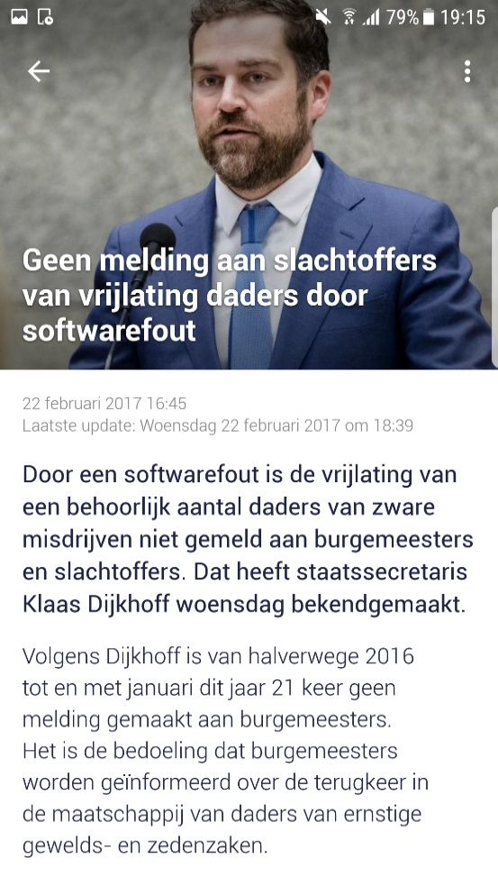
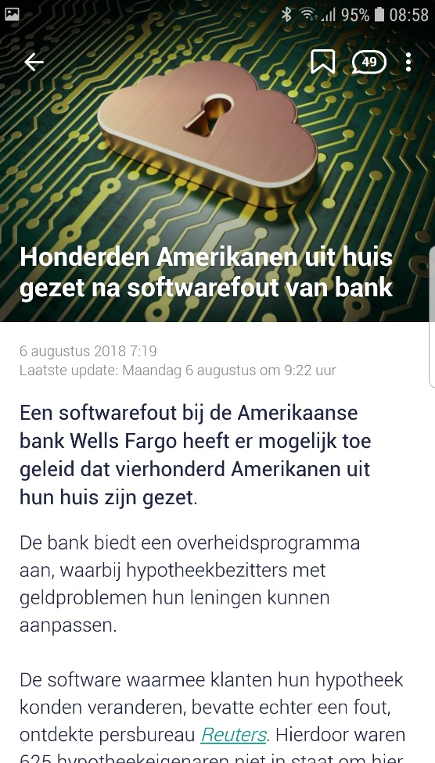
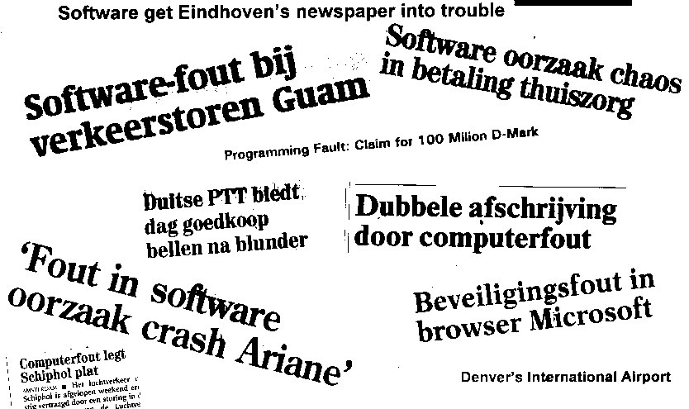
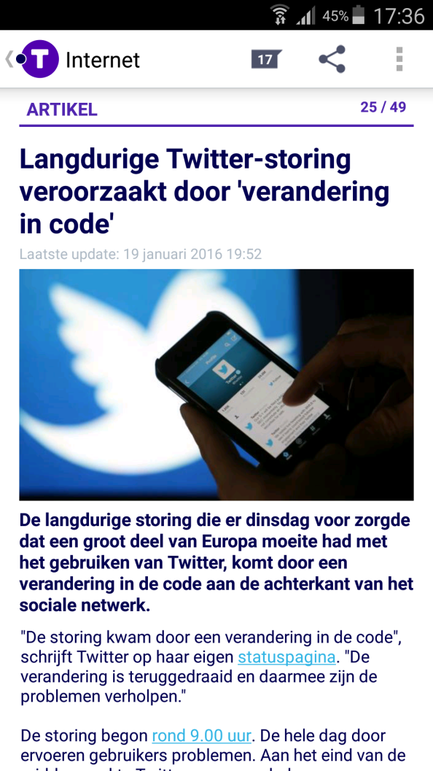
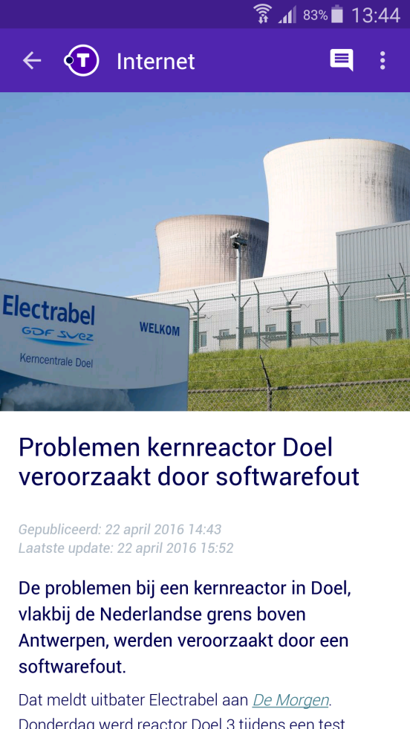
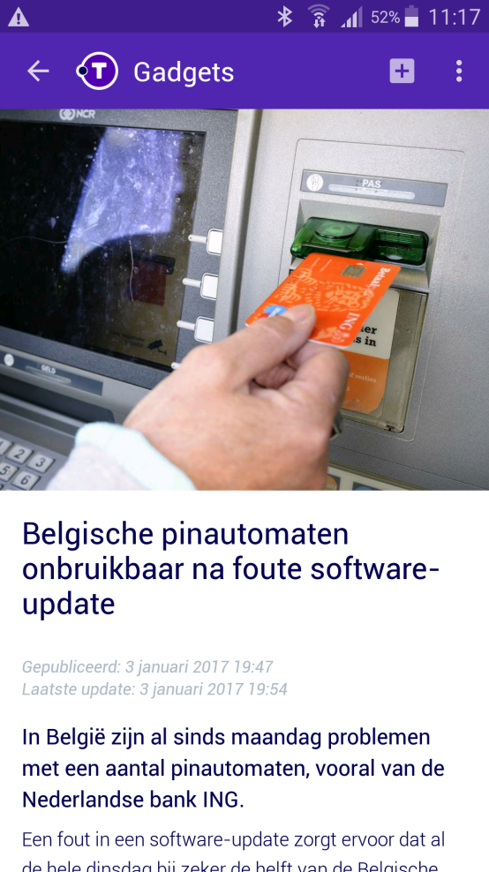
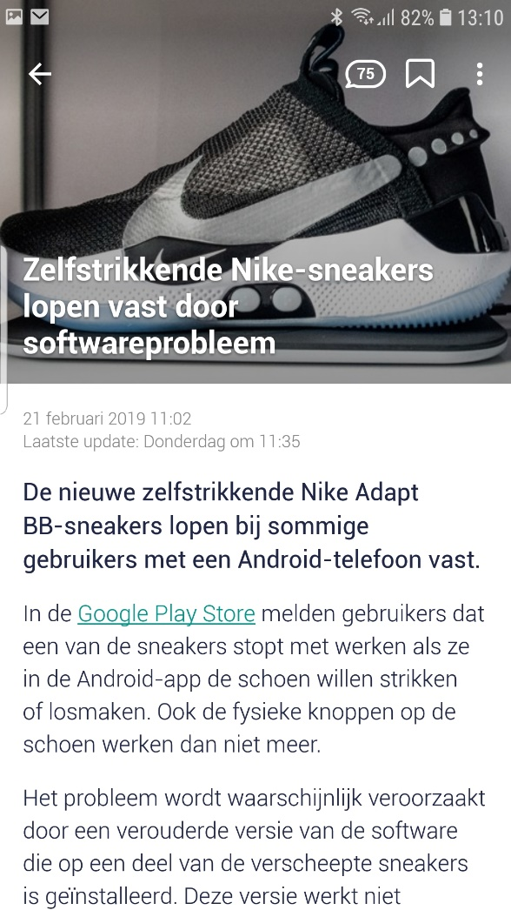
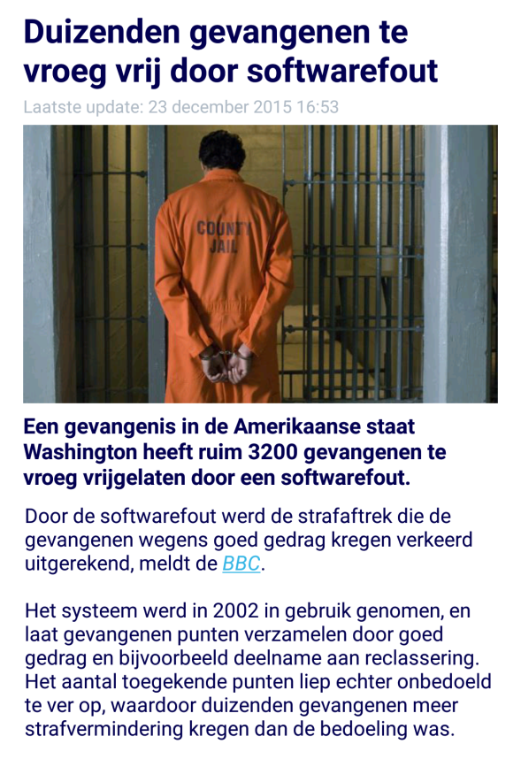
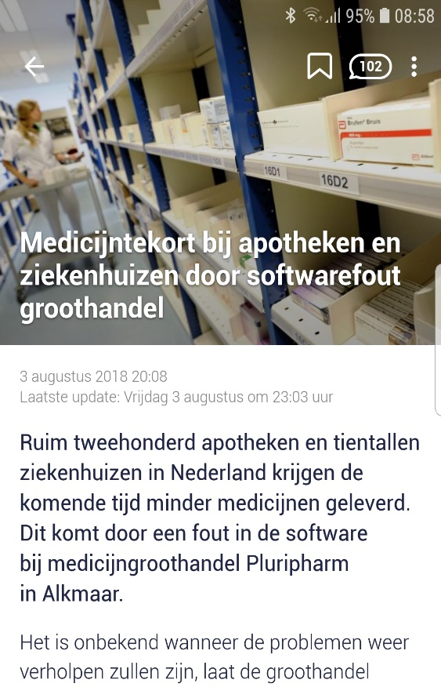
Proof….

Slide 5
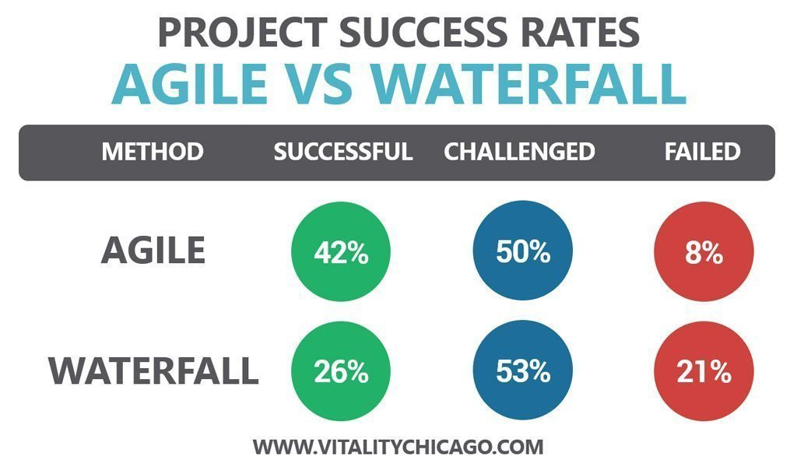
Agile ≠ Silver Bullit
Defects
Project Size (KLOC)
“despite continuous growth in adoption of agile, many organizations are still facing the the same challenges as in previous years”, World Quality Report

Slide 6
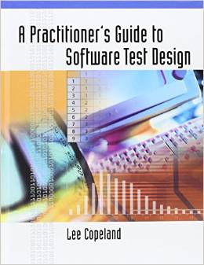


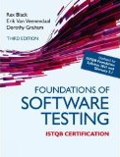
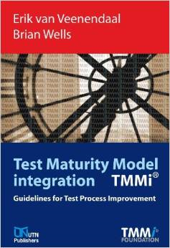

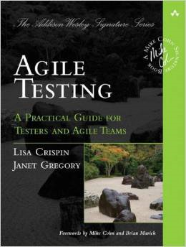

Common Testing Practices
Many organizations
No test strategy
Useless test plans
No test techniques applied
Few have effective reviews
Test automation not successful
Re-usable testware hard to find
“Testers” not trained for the job
6
Notes:
The answers:
We do ET
We do agile development and testing
We do scrum
We do lean sw development
84% of organizations at TMMi level 1

Slide 7


Paradox
Systems are still released!
How to be “good enough” and “survive”
A tool box for agility / lean in testing!
Notes:
IBM survey with 1500 projects finds 40% is successfull

Slide 8

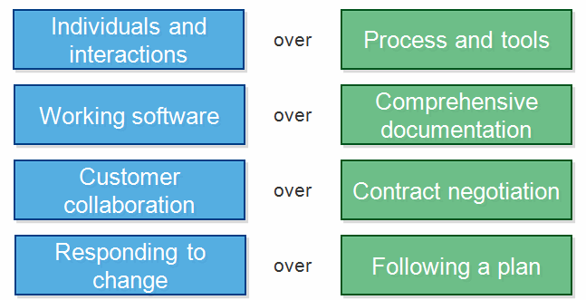



Manifesto and Values
Communication Simplicity Feedback

Slide 9

Core Practice # 0

Slide 10
Core Practice # 1: Risk-Based
Testing is risk-based
Define Clear Testing Priorities
Communication, Customer Collaboration
Working software & Responding to change
Product Risk Session
Risk-Based Test Approach
Risk-Based Tracking (business language)

Slide 11

Setting Priorities
Risk identification
  Requirements (user story) based,
  Brainstorming, failure history
Risk analysis
  Risk = Impact x Likelihood
  Much better …… Risk = f (Impact, Likelihood)
Safety
Usage intensity
external visibility
New technology
Complexity
Interfacing
Notes:
The two questions, from subjective to objective
PRISMA and RiskPoker light weight methods, many many are much too difficult

Slide 12
Product Risk Matrix
Medium
High
Low
Medium
Risk
5
Technical Risk
1
2
Likelihood
3
4
Business
Risk
Impact

Slide 13
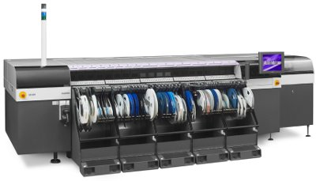
Test Approach
Test design techniques
Review software design
Support unit tests
Review unit tests
Exploratory testing
Support unit tests
Review unit tests
Medium
High
Low
Medium
Risk
5
1
2
Likelihood
3
4
Exploratory testing
Test design techniques
Review software design
Impact

Slide 14

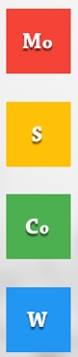
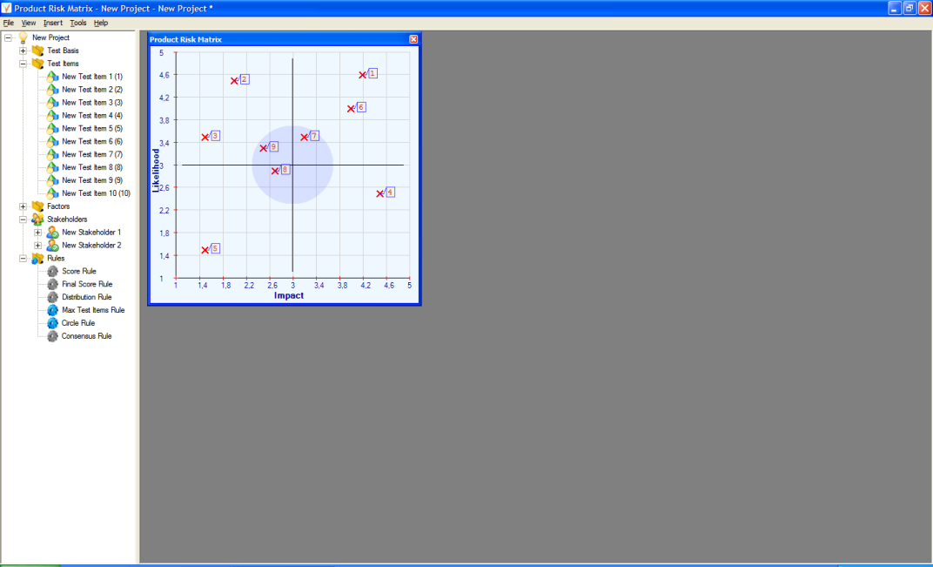
Test Plan
Test Appr
Test Approach
Test Approach
Test Approach

Slide 15
Core Practice # 2: Reviews
Testing is preventing defects
Perform Limited Effective Reviews
Communication & Feedback
Customer collaboration
Priority to risk
Review practices that make the difference
“Agile Inspection”

Slide 16

It’s Simple but Not Easy
Different review types for different objectives
Trained moderators
Apply roles, checklists and kick-off
Entry check
Not too many pages (± 20)
Good logging rate (2 per min.)
Reasonable checking rate (± 10 pages)

Slide 17
Core Practice # 3: Unit Testing
Testing requires independence
Get Developers doing Unit Testing
Working software over
comprehensive documentation
Code Coverage
Buddy Testing (XP)
Test Driven Development
?
Notes:
Buddy testing, pair programming also delivers continuous implicit code reviews.

Slide 18


Unit Testing Process
most high level testing will only
achieve 30 - 40% code coverage
test
code
design
Functional
Check !
code
TEST
Coverage
Check !
Notes:
18
Show model
Show Black-box technique
Show Coverage technique

Slide 19
Continuous Integration

Slide 20

Core Practice # 4: Test Design
Testing is finding defects
Use Test Techniques as Tools
Responding to change, Customer
collaboration and No comphrehensive doc’s
Apply Test Design (start-up)
Classification Tree Method / Use Cases
Exploratory Testing

Slide 21

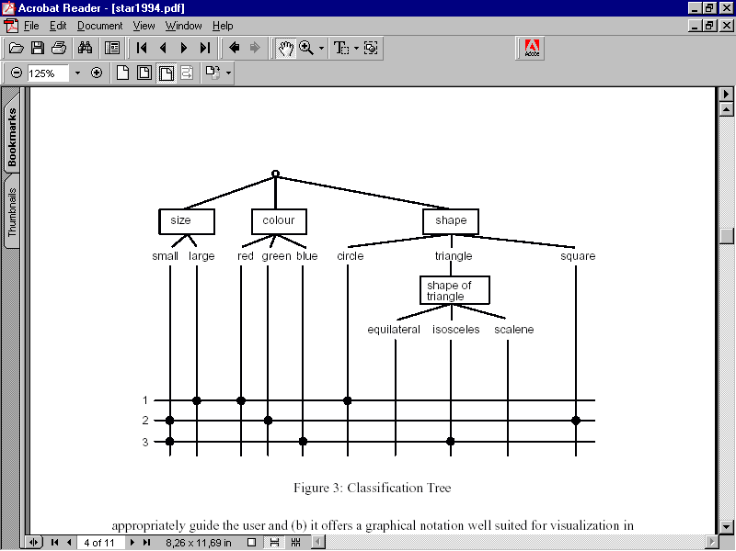
Apply Test Design
Identification test conditions
Establish traceability to requirements
Terms | Valid values | Invalid values
Input voltage (Vin) | Default, real (unit / engineering notation), >=0 | Empty, not numeric, <0
Input resistance (Rin) | Default, real (unit / engineering notation), >=0 | Empty, not numeric, <0
Coil inductance (Lcoil) | Default, real, >0 | Empty, real, not numeric, <=0

Slide 22


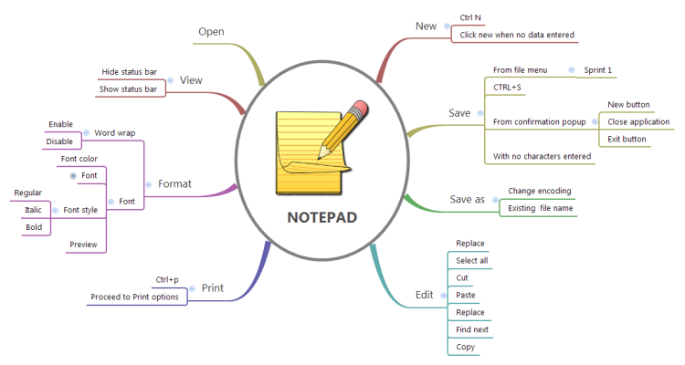
Test Design Start-up

Slide 23



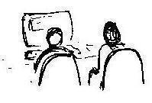
Exploratory Testing Process
Session-Based Testing
Keep track of
bug vs. fix ratio!
Charter
Sessions
- Exploration
- Design
- Execution
Debriefing
Heuristics
- Boundaries
- CRUD
- configurations
- Interruptions
- ....

Slide 24
Core Practice # 5: People
Testing is an extremely complex, intellectually challenging task
Build Experienced & Skilled Testers
Individuals and interactions
over processes and tools
Training (on-the-job)
Team Dynamics
Not only for Testers!!

Slide 25
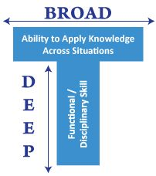
People Skills
not only for testers
Testing
Development
Domain
Soft Skills

Slide 26


More People Factors
Job satisfaction
  - Getting respect & feeling valued, adequate rewards
  - …
Test guild
  Test meetings, best practices
  …
Career paths
  - Job description & training, promotion
  - …
Team Dynamics
  Effective teams don’t just happen
  Correct skills, Correct attitude, Common goals

Slide 27



Lean Testing Tool Box
Clear Testing Priorities
Effective Reviews
Developers doing Unit Testing
Test Techniques as Tools
Experienced & Skilled Testers

Slide 28
No More Testers, or ….
There has never been a time when software testers were needed more!

Slide 29



Slide 30



www.erikvanveenendaal.nl
erik@erikvanveenendaal.nl
@ErikvVeenendaal

