Slide 1



Performance testing in an agile context,
what is below the iceberg?
23 MARCH 2019 I Wim Demey

Slide 2


Slide 3
T . B . D .
U . C .
S . O . D .

Slide 4
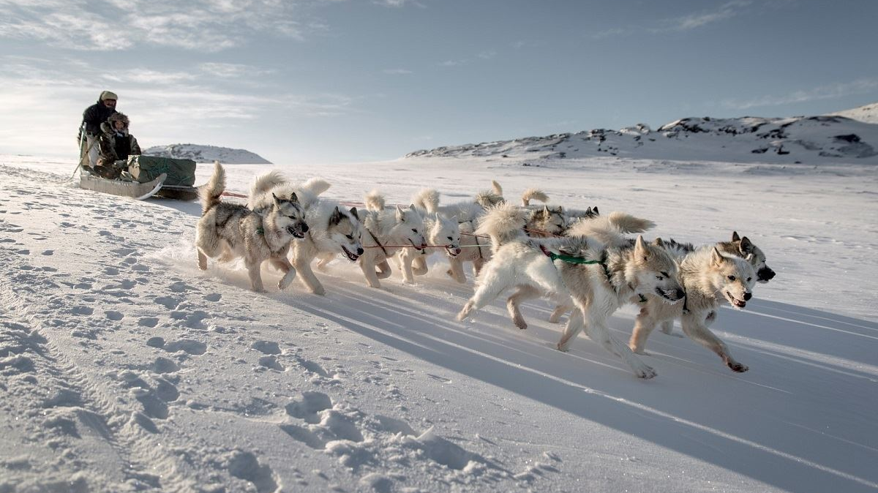
Performance matters
1
Brand reputation
2
Revenue
3
Customers
4
Competition

Slide 5

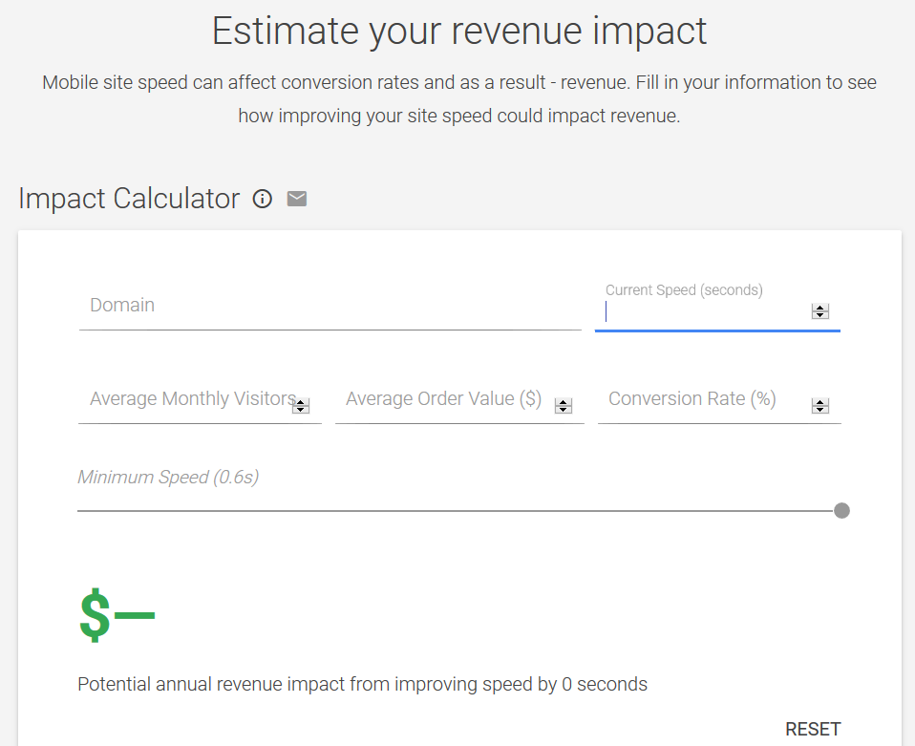
Source: www.thinkwithgoogle.com/feature/mobile

Slide 6
The domino effect

Slide 7
126 million €/hour

Slide 8
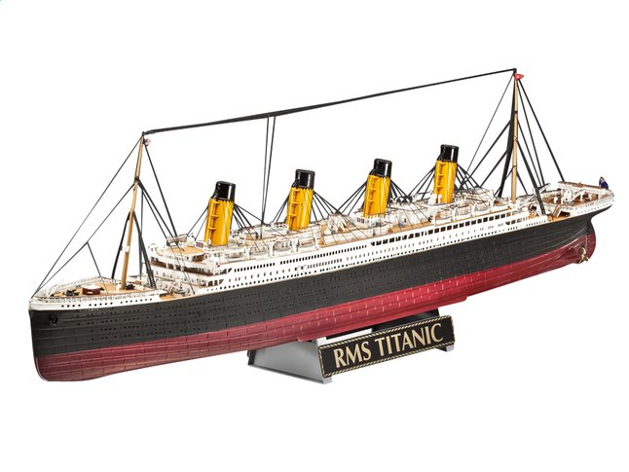
Revell Model Kit – R.M.S. Titanic
2.8 million boxes

Slide 9
By 2021, organizations that have embraced
a performance engineering approach for application development
will outperform the competition that has not,
in both customer satisfaction and business results
Source: Gartner - Adopt a Performance Engineering Approach for DevOps (published: 18 June 2018)

Slide 10
“Customers don’t judge you
on how hard or on how many times you have tried,
they measure you on what you have delivered”

Slide 11
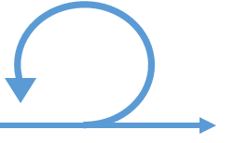
Design
Build
Test
PT
Test
PT
PT
CPT
What if . . . ?

Slide 12

Non-functional
requirements
Planning
Team
What is below
the iceberg?

Slide 13
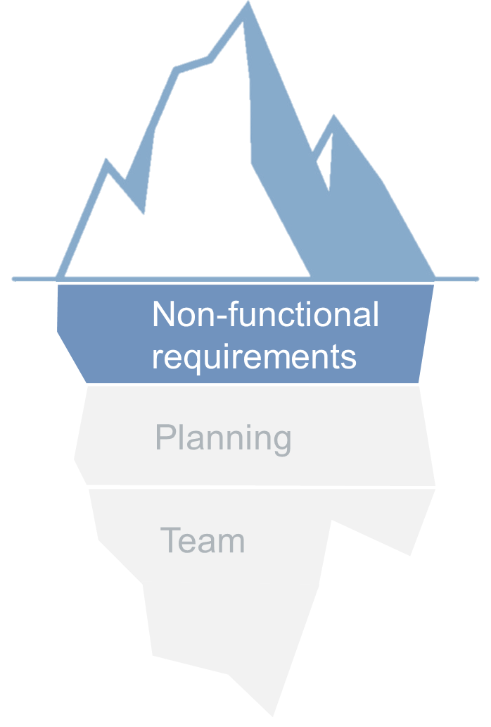
The application should be fast
The application should be able to process 100 pages per second for 5.000 concurrent users submitting 20 orders per second with page-level response times of:
>> Less than 0.5 seconds for simple pages
>> Less than 1 second for medium-complexity pages
>> Less than 5 seconds for very complex pages
>> Less than 0.5% error rate
input
throughput
server capacity
response time
fault tolerance

Slide 14
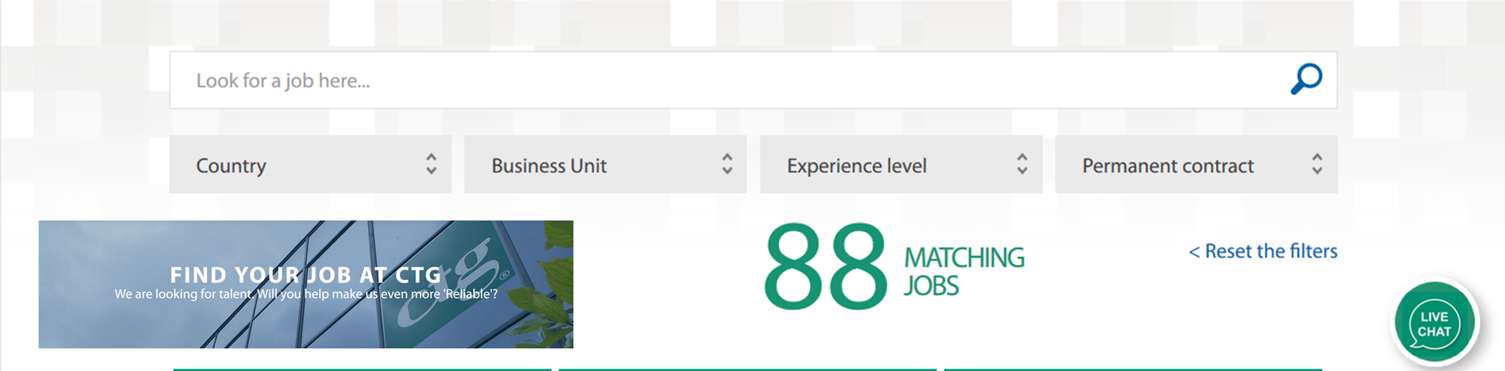
As a user, I want to search a job using key words and filters so that I can find
the suitable job

Slide 15

As a user, I want to search a job using key words and filters so that I can find
the suitable job
Result with max. 10 results/page is displayed with a 90% percentile response time of max. 2 seconds when
- max. 2 filters are applied
- between 2 and 200 users are concurrently searching
In all other cases, a response time of max. 5 seconds is expected

Slide 16
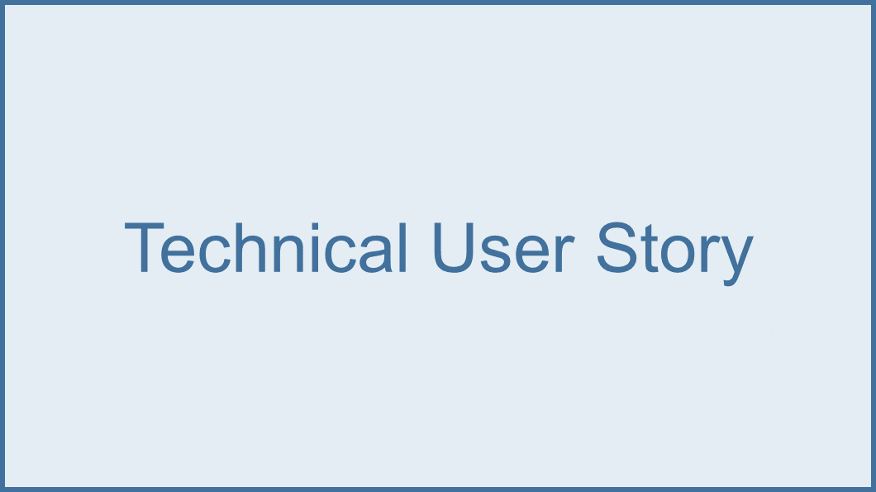
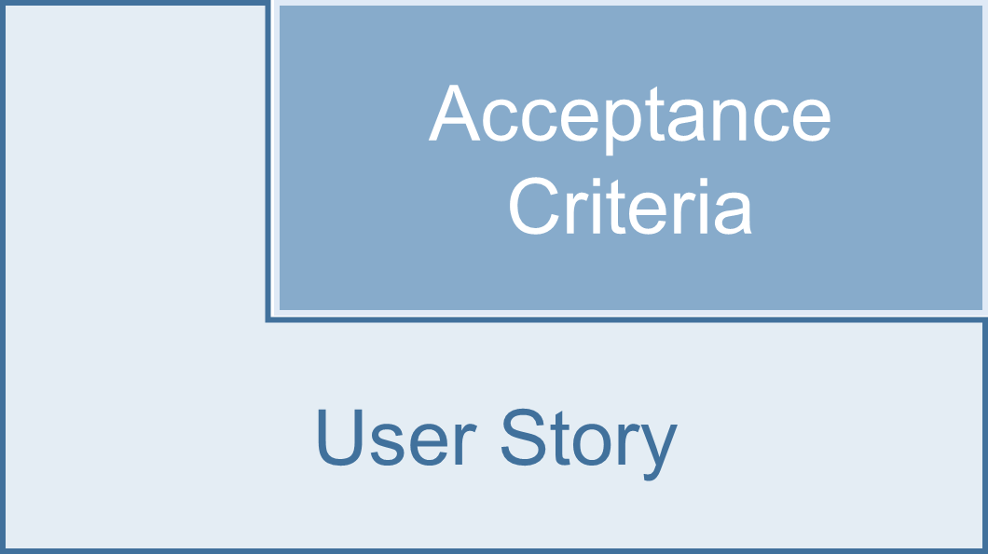
Definition Of Done
Constraint

Slide 17
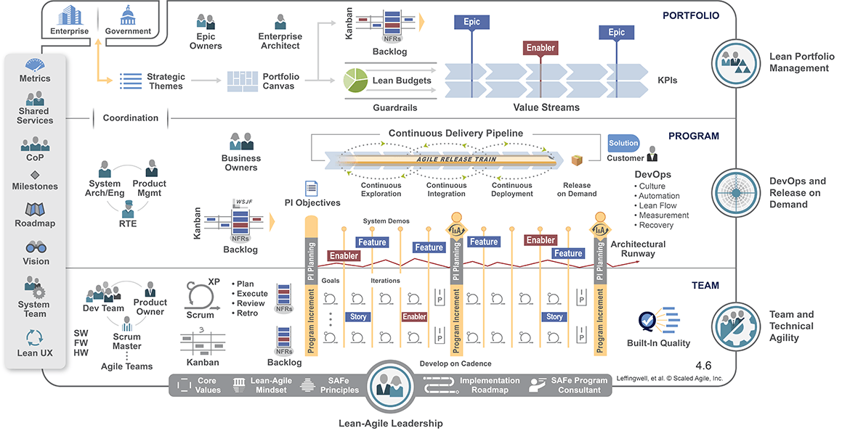
Scale Agile Framework (SAFe) (portfolio configuration)

Slide 18
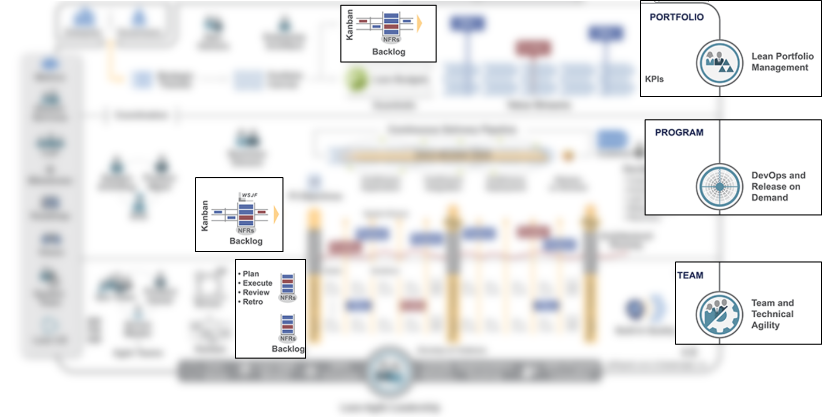
Non-functional requirements in SAFe (portfolio configuration)

Slide 19
Non-functional
requirements
Planning
Team
What is below
the iceberg?

Slide 20
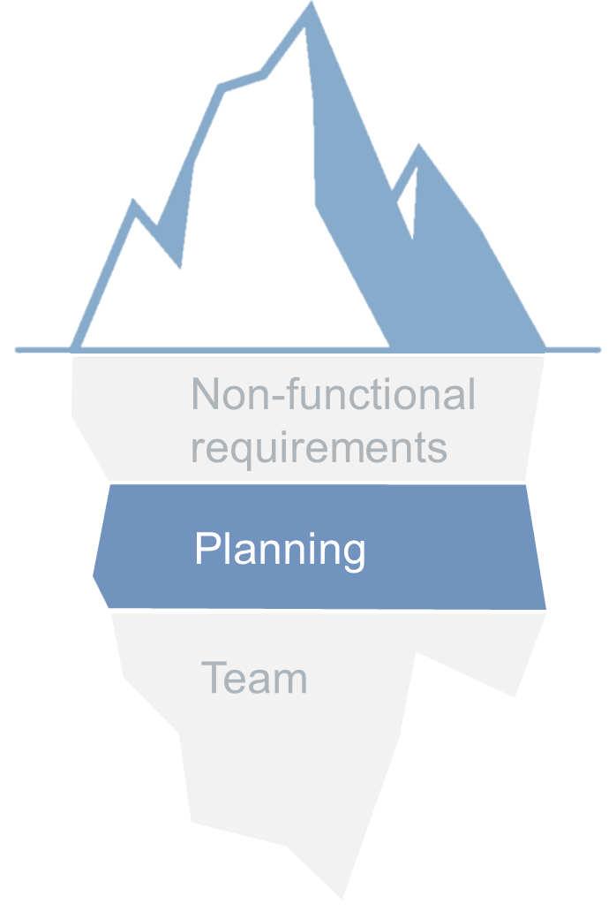


2 wks
2 wks
2 wks
2 wks
Sprint 1
Sprint 2
Sprint 3
Hardening
Roll the dice or think wise . . .

Slide 21
2 wks
2 wks
2 wks
2 wks
Sprint 1
Sprint 2
Sprint 3
Hardening
API level
Code profiling
sprint 1 activities
Component integration
sprint 1 & 2 activities
System integration
E2E- flows
. . . start small from the Left

Slide 22
2 wks
2 wks
2 wks
2 wks
Sprint 1
Sprint 2
Sprint 3
Hardening
API level
Code profiling
sprint 1 activities
Component integration
sprint 1 & 2 activities
System integration
E2E- flows
. . . automate where relevant

Slide 23

2 wks
2 wks
2 wks
2 wks
Sprint 1
Sprint 2
Sprint 3
Hardening
API level
Code profiling
sprint 1 activities
Component integration
sprint 1 & 2 activities
System integration
E2E- flows
. . . monitor from the Right

Slide 24
Non-functional
requirements
Planning
Team
What is below
the iceberg?

Slide 25

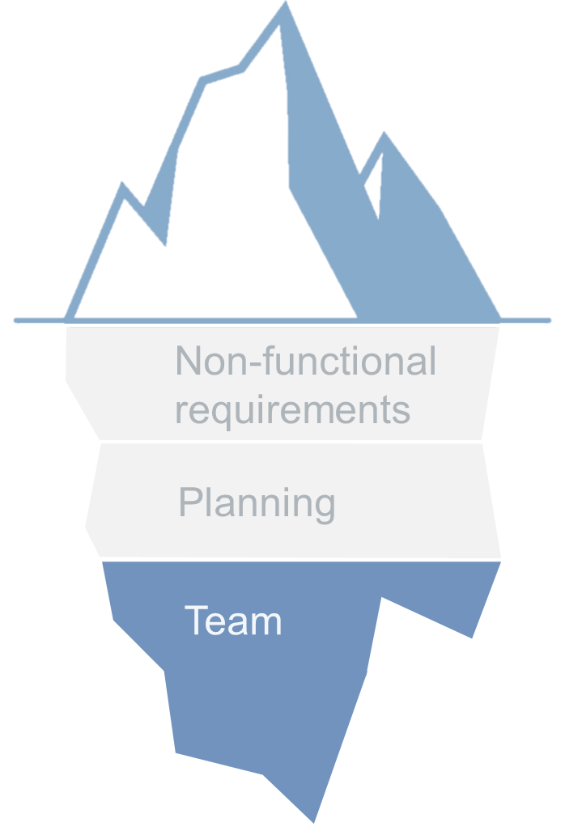
Squad 1
Squad 2
Squad 3

Slide 26
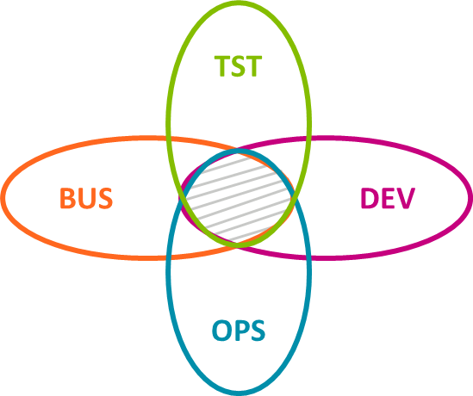
Squad 1
Squad 2
Squad 3
Who should be in?

Slide 27


Embedded
Squad 1
Squad 2
Squad 3
Transversal
External
Center of Excellence

Slide 28
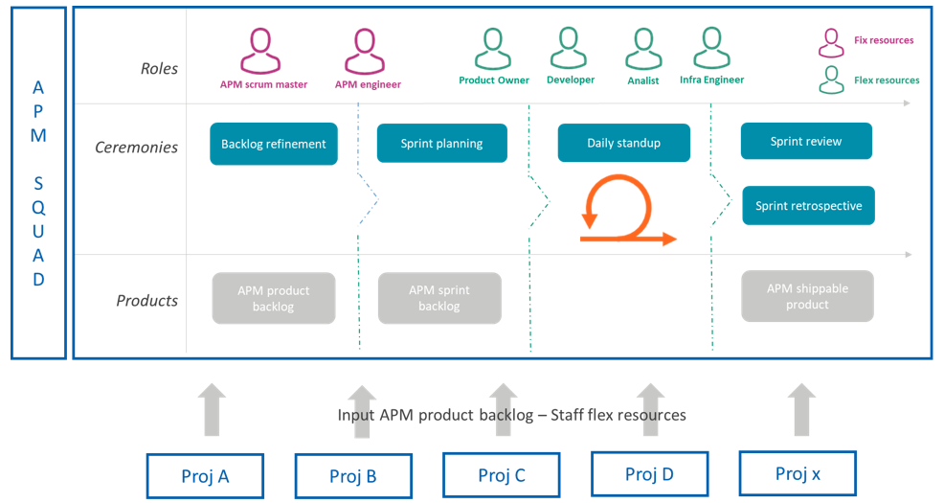
Transversal squad

Slide 29
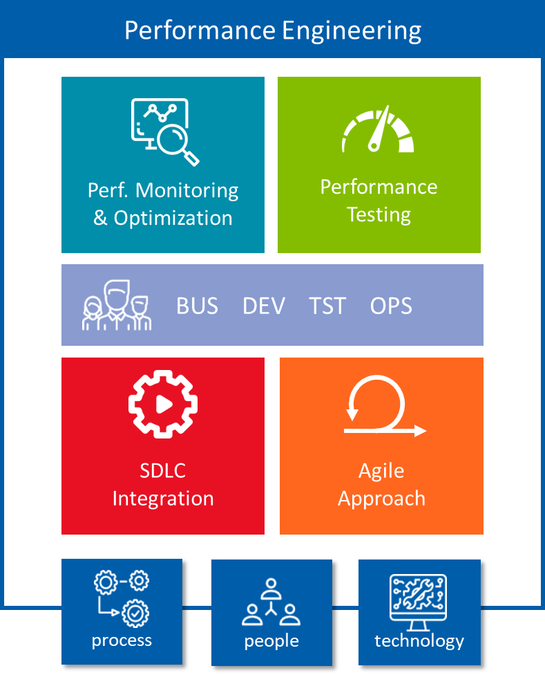
Non-functional
requirements
Planning
Team

Slide 30
Application
Squad 1
Squad 2
Squad 3
Infrastructure

Slide 31
.iceberg {
display: block;
color: ice-blue;
}
#titanic {
position: absolute;
bottom: 0;
}

