Slide 1


Test Management in Agile World
Umakanth Ravirala
Quality Engineering Manager, Elsevier.
u.ravirala@elsevier.com
https://www.linkedin.com/in/uravirala/

Slide 2





Who are Elsevier?
An information and analytics company and one of the world's major providers of scientific, technical, and medical information.
Established in 1880 as a publishing company.
Part of the RELX Group
Market capitalisation $14bn
Customers in 180+ countries
Offices in 40+ countries
30k+ employees

Slide 3
Focus…
Test Management in Agile World
Common myths about Test Management in Agile transformation
Test Manager
Tester
Documentation
Automation
Metrics
QE Vision
End to End Integration
Automation
Metrics
Challenges

Slide 4

Test Management in Agile world
Analysis
Design
Build
Deploy
Test
Structured planning phase
Dedicated QE/QA team
Planned Execution & reporting
Accountability
Quality Assurance > Quality Engineering

Slide 5
Myth #1 : Test Manager
Scrum
Kanban
DSDM
SAFe
We are Agile!
No “Test Manager” in Agile!!!

Slide 6
Myth #2 : Tester
We are Agile!
Cross functional teams > testing can be done by anyone!!!

Slide 7
Myth #3 : Documentation
We are Agile!
Documentation is not necessary!!!

Slide 8

Myth #4 : Automation

Slide 9
Myth #5 : Quality Metrics
What are they?
Scope changes in sprint
No of lines of code
Code coverage
Committed Vs Delivered items
Sprint burn down
Release/Epic burn down
Velocity
Defects
Automation test reports
Number of user stories

Slide 10
QE Vision

Slide 11
Enterprise End to End integration
Multiple Agile Squads > Complex Integration

Slide 12
Test Automation
Commercial test automation tools proved to be challenging with the complex business and technical landscape at enterprise level. A tailored automation framework with open source automation tools needed to support continuous integration & continuous testing.

Slide 13
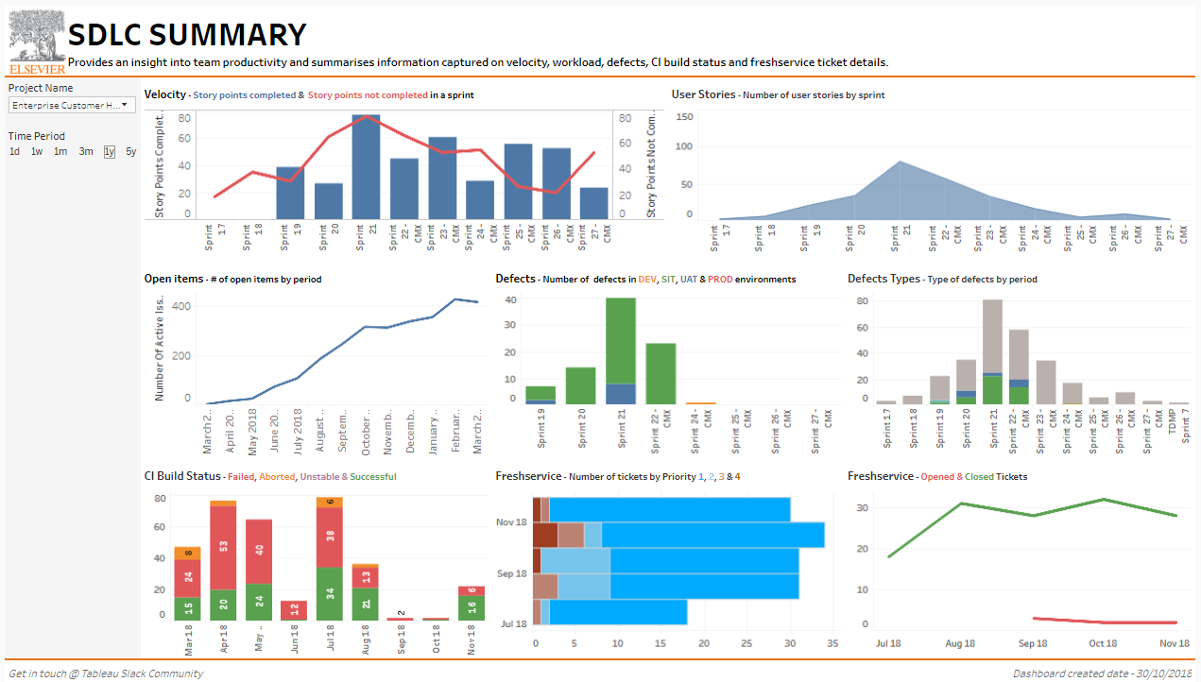
Metrics
Identify key metrics that drive quality improvement
Automate metrics gathering
Consolidate metrics from multiple tools/systems
Make metrics accessible to all stakeholders
Identify milestones for improvements and act

Slide 14



Challenges
Multiple teams & people involved in Enterprise level
Lack of E2E business process understanding
Conflicting timelines & priorities
Complex test environments & timelines
Complex test data requirements
No automation tool fits end to end testing

Slide 15
Take away…
Test Management function is one of the key factors for Enterprise level applications quality delivery
Test management principles must add value to agile delivery processes
Empower Quality Engineering teams (or Engineers) in implementing right tools for better quality. Build world class QE teams
Mentor and train QE teams in embracing latest tools and technologies
Measure necessary metrics that drive real improvements
Embed accountability and transparency in development life cycle
Inspecting Quality to Influencing Quality

Slide 16

U.RAVIRALA@ELSEVIER.COM
LinkedIn Umakanth Ravirala

