Slide 1

Help ! We have a
QA Problem !
Niels Malotaux
niels@malotaux.nl
www.malotaux.eu/conferences
www.malotaux.eu/booklets - booklet#8

Slide 2
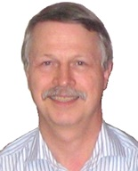
Niels Malotaux
Independent Team, Project, Organizational Coach
Expert in helping optimizing performance
Helping projects and organizations very quickly to become
  More effective – doing the right things better
  More efficient – doing the right things better in less time
  Predictable – delivering as predicted
Project rescue
Result Management
Notes:
Niels Malotaux
Graduated Electronics at Delft University of Technology in 1974
Army service at the Dutch Laboratory for Electronic Developments for the Armed Forces, designing computer systems
Philips Electronics – Application support for microcomputer systems design (1976-1980)
Malotaux - Electronic Systems Design - : developing electronic systems for clients products (1980-1998)
Now: N R Malotaux - Consultancy: coaching projects to deliver successfully and much faster (1998- )

Slide 3
We have a QA problem !
Large stockpile of modules to test
(hardware, firmware, software)
You shall do Full Regression Tests
Full Regression Tests take about 15 days each
Too few testers (“Should we hire more testers ?”)
Senior Tester paralyzed
Can you help us out ?

Slide 4
The essential ingredient: the PDCA Cycle
(Shewhart Cycle - Deming Cycle - Plan-Do-Study-Act Cycle - Kaizen)
!
Notes:
The essential technique for continuous improvement is the Deming or Plan-Do-Check-Act cycle. We Do all the time, Planning we do more or less, usually less and for Check and Act we don’t have time.
Many people think they know the Deming cycle, but let’s see how it really starts working for us.
The intuitive cycle, how we normally work, is the Pl-Do-cycle. I can’t call it Plan, so I call it only Pl. “What was the next thing we are supposed to do?” and we are already doing it. If intuition would be perfect, everything would be perfect. Not everything we do is perfect, so apparently our intuition sometimes points us into the wrong direction.
So, let’s first Plan what Result we want to achieve and how we think we can most efficiently achieve that (Planning is twofold: the product and the project). Then we Do according to the Plan. This is the first pitfall: the Plan must be doable and we must follow the Plan. Let’s assume we did that, then in the Check phase we can Check (Deming also called it Study phase) whether the Result was according to Plan. If it was according to the Plan, we can think: “Can we do it even better the next time?”. If it wasn’t according to Plan, we can think: “How can we do it better the next time?”. Then comes the Act phase: “What are we going to do differently the next time, because if we don’t do anything differently, the result will be the same. If we want to improve we have to decide to do something differently, then Plan and Do accordingly and then Check whether the change actually was an improvement. If yes, can we do it better the next time. If not, can we do it better the next time. In the Act phase we introduce a “mutation” in our way of working, hence we call it the “Evolutionary” approach.
This way, we are continuously improving on the Result (the product), the way we realize the Result (the project) and even how we organize all of this (the process). Actually we can stop now, because using the PDCA technique, you can start from scratch and very quickly find out how to continuously do things better. Because we have been doing this already for a long time, we can save you time and give you a flying start.

Slide 5
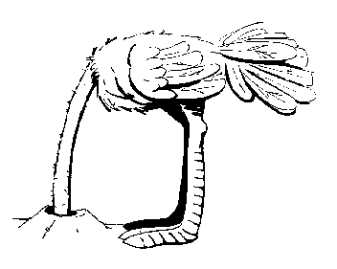
Instead of complaining about a problem …
(Stuck in the Check-phase)
Let’s do something about it !
(Moving to the Act-phase)

Slide 6
Objectifying and quantifying the problem is a first step to the solution
 |  | Estim
 |  | 17
 |  | 8
 |  | 14
 |  | 11
 |  | 9
 |  | 17
 |  | 4
 |  | 26
 | totals | 106
Line | Activity
1 | Package 1
2 | Package 2
3 | Package 3
4 | Package 4 (wait for feedback)
5 | Package 5
6 | Package 6
7 | Package 7
8 | Package 8
 |  |  |  |  |  | Customer | Will be done ? (now=22Feb)
 |  |  |  |  |  | HT
 |  |  |  |  |  | Chrt
 |  |  |  |  |  | BMC
 |  |  |  |  |  | McC?
 |  |  |  |  |  | Ast
 |  |  |  |  |  | ?
 |  |  |  |  |  | Cli
 |  |  |  |  |  | Sev
 |  |  |  |  |  | ?
 |  |  |  |  |  | Chrt
 |  |  |  |  |  | Chrt
 |  |  |  |  |  | Yet
 |  |  |  |  |  | Yet
 |  |  |  |  |  | Cli
 |  |  |  |  |  | Ast
Line | Activity
1 | Package 1
2 | Package 2
3 | Package 3
4 | Package 4 (wait for feedback)
5 | Package 5
6 | Package 6
7 | Package 7
8 | Package 8.1
9 | Package 8.2
10 | Package 8.3
11 | Package 8.4
12 | Package 8.5
13 | Package 8.6
14 | Package 8.7
15 | Package 8.8
 | totals
 |  | Estim
 |  | 17
 |  | 8
 |  | 14
 |  | 11
 |  | 9
 |  | 17
 |  | 4
 |  | 1
 |  | 1
 |  | 1
 |  | 1
 |  | 1.1
 |  | 3
 |  | 0.1
 |  | 18
 |  | 106
 |  |  | Alternative | Junior tester | Developers
 |  |  | 2 | 17 | 4
 |  |  | 5 |  | 10
 |  |  | 7 | 5 | 4
 |  |  | 3 |  | 5
 |  |  | 3 | 10 | 10
 |  |  | 1 |  | 3
 |  |  | 1
 |  |  | 1
 |  |  | 1
 |  |  | 1
 |  |  | 1.1
 |  |  | 3
 |  |  | 0.1
 |  |  | 18
 |  |  | 47 | 32 | 36

Slide 7
TimeLine
wk
9
10
11
12
13
14
15
16
17
13
start
delivery
cust a
delivery
cust b,c
delivery
cust a,d
(all done)
Selecting the priority order of customers to be served
  “We’ll have a solution at that date … Will you be ready for it ?”
  Another customer could be more eagerly waiting
  Most promising customers

Slide 8
Can we make an important customer happy the next day ?
 |  |  |  |  |  |  | 28 Feb
 |  |  |  |  |  |  | 24 Mar
 |  |  |  |  |  |  | after 8.5 OK
 |  |  |  |  |  | Customer | Will be done ? (now=22Feb)
 |  |  |  |  |  | HT
 |  |  |  |  |  | Chrt
 |  |  |  |  |  | BMC
 |  |  |  |  |  | McC?
 |  |  |  |  |  | Ast
 |  |  |  |  |  | ?
 |  |  |  |  |  | Cli
 |  |  |  |  |  | Sev
 |  |  |  |  |  | ?
 |  |  |  |  |  | Chrt
 |  |  |  |  |  | Chrt
 |  |  |  |  |  | Yet
 |  |  |  |  |  | Yet
 |  |  |  |  |  | Cli
 |  |  |  |  |  | Ast
 |  |  |  |  |  |  | Will be done (now=22Feb)
 |  |  |  |  |  |  | 24 Feb
Line | Activity
1 | Package 1
2 | Package 2
3 | Package 3
4 | Package 4 (wait for feedback)
5 | Package 5
6 | Package 6
7 | Package 7
8 | Package 8.1
9 | Package 8.2
10 | Package 8.3
11 | Package 8.4
12 | Package 8.5
13 | Package 8.6
14 | Package 8.7
15 | Package 8.8
 | totals
 |  | Estim
 |  | 17
 |  | 8
 |  | 14
 |  | 11
 |  | 9
 |  | 17
 |  | 4
 |  | 1
 |  | 1
 |  | 1
 |  | 1
 |  | 1.1
 |  | 3
 |  | 0.1
 |  | 18
 |  | 106
 |  |  | Alternative | Junior tester | Developers
 |  |  | 2 | 17 | 4
 |  |  | 5 |  | 10
 |  |  | 7 | 5 | 4
 |  |  | 3 |  | 5
 |  |  | 3 | 10 | 10
 |  |  | 1 |  | 3
 |  |  | 1
 |  |  | 1
 |  |  | 1
 |  |  | 1
 |  |  | 1.1
 |  |  | 3
 |  |  | 0.1
 |  |  | 18
 |  |  | 47 | 32 | 36

Slide 9

Result
Tester empowered
Done in 9 weeks
So called “Full Regression Testing” was redesigned
Customers systematically happy and amazed
Kept up with development ever since
Increased revenue
Later:
Tester promoted to product manager
Still coaching successors how to plan

Slide 10
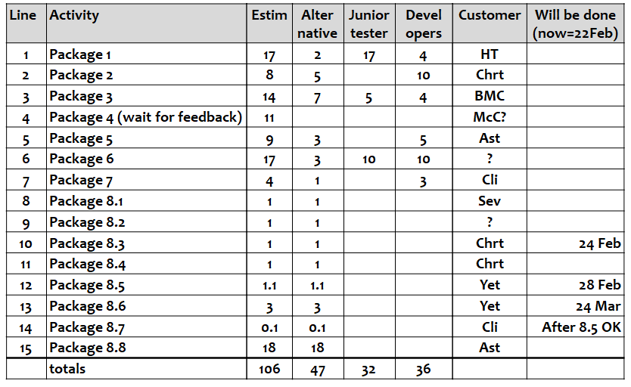
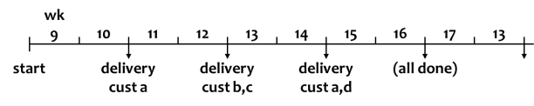
TimeLine principles
Cutting the work into chunks
Estimating
Adding up (this averages the uncertainties !)
Usually doesn’t fit in the available time
Find strategies to solve the dilemma
Select ‘best’ strategy
Predict what will happen when
Learn and repeat every week, keeping predictions up-to-date

Slide 11
TimeLine: Predicting what will be done when
 |  |  |  |  |  | Calibr factor
 |  |  |  |  |  | 1.0
 |  |  |  |  |  | 1.0
 |  |  |  |  |  | 1.0
 |  |  |  |  |  | 1.4
 |  |  |  |  |  | 1.4
 |  |  |  |  |  | 1.4
 |  |  |  |  |  | 1.4
 |  |  |  |  |  | 1.4
 |  |  |  |  |  | 1.4
 |  |  |  |  |  |  | Calibr still to
 |  |  |  |  |  |  | 1
 |  |  |  |  |  |  | 2
 |  |  |  |  |  |  | 1
 |  |  |  |  |  |  | 4.2
 |  |  |  |  |  |  | 1.4
 |  |  |  |  |  |  | 4.2
 |  |  |  |  |  |  | 5.6
 |  |  |  |  |  |  | 7.0
 |  |  |  |  |  |  | 9.8
 |  |  |  |  | Ratio real/est
 |  |  |  |  | 1.0
 |  |  |  |  | 1.2
 |  |  |  |  | 3.0
 |  |  |  |  | 2.5
 |  |  |  |  | 1.0
 |  |  | Spent | Still to spend
 |  |  | 2 | 0
 |  |  | 5 | 1
 |  |  | 3 | 0
 |  |  | 3 | 2
 |  |  | 4 | 1
 |  | Estim
 |  | 2
 |  | 5
 |  | 1
 |  | 2
 |  | 5
 |  | 3
 |  | 1
 |  | 3
 |  | 4
 |  | 5
 |  | 7
Line | Activity
1 | Activity 1
2 | Activity 2
3 | Activity 3
4 | Activity 4
5 | Activity 5
6 | Activity 6
7 | Activity 7
8 | Activity 8
↓ | ↓
16 | Activity 16
17 | Activity 17
18 | Activity 18
 |  |  |  |  |  |  |  | Date done
 |  |  |  |  |  |  |  | 30 Mar 2009
 |  |  |  |  |  |  |  | 1 Apr 2009
 |  |  |  |  |  |  |  | 2 Apr 2009
 |  |  |  |  |  |  |  | 9 Apr 2009
 |  |  |  |  |  |  |  | 10 Apr 2009
 |  |  |  |  |  |  |  | 16 Apr 2009
 |  |  |  |  |  |  |  | 2 Jun 2009
 |  |  |  |  |  |  |  | 11 Jun 2009
 |  |  |  |  |  |  |  | 25 Jun 2009
21/15 = 1.4

Slide 12
What do we do if we see we won’t make it on time ?
Value Still to Earn ←versus→ Time Still Available
If it doesn’t fit ... count backwards
If the match is over, you cannot score a goal
Earned Value
Value Still to Earn

Slide 13
Deceptive options
Hoping for the best (fatalistic)
Going for it (macho)
Working Overtime (fooling ourselves)
Moving the deadline
  Parkinson’s Law
    Work expands to fill the time for its completion
  Student Syndrome
    Starting as late as possible, only when the pressure of the FatalDate is really felt

Slide 14
The Myth of the
Man-Month
lower cost
14
Economic
optimum?
13
12
reality
(Putnam)
11
10
shorter time
9
project
duration
8
7
nine
mothers
area
6
5
4
intuition
people x time = constant
Man-Month Myth
Brooks’ Law (1975)
Adding people
to a late project
makes it later
3
2
1
1
2
3
4
5
6
7
8
9
10
11
12
13
14
15
16
number of people

Slide 15
Saving time
Continuous
elimination of waste
We don’t have enough time, but we can save time
without negatively affecting the Result !
Efficiency in what (why, for whom) we do - doing the right things
  Not doing what later proves to be superfluous
Efficiency in how we do it - doing things differently
  The product
    Using proper and most efficient solution, instead of the solution we always used
  The project
    Doing the same in less time, instead of immediately doing it the way we always did
  Continuous improvement and prevention processes
    Constantly learning doing things better and overcoming bad tendencies
Efficiency in when we do it - right time, in the right order
TimeBoxing - much more efficient than FeatureBoxing

Slide 16
Even more important: Starting Deadlines
Starting deadline
  Last day we can start to deliver by the end deadline
  Every day we start later, we will end later
starting deadline
minimum time to finish the job

Slide 17
Evolutionary Project Management elements (Evo) – Tom Gilb
Plan-Do-Check-Act
  The powerful ingredient for success
Business Case
  Why we are going to improve what
Requirements Engineering
  What we are going to improve and what not
  How much we will improve: quantification
Architecture and Design
  Selecting the optimum compromise for the conflicting requirements
Early Review & Inspection
  Measuring quality while doing, learning to prevent doing the wrong things
Weekly TaskCycle
  Short term planning
  Optimizing estimation
  Promising what we can achieve
  Living up to our promises
Bi-weekly DeliveryCycle
  Optimizing the requirements and checking the assumptions
  Soliciting feedback by delivering Real Results to eagerly waiting Stakeholders
TimeLine
  Getting and keeping control of Time: Predicting the future
  Feeding program/portfolio/resource management
Why
Right Result
Zero
Defects
Attitude
What
How much
Are we done
How
Check as early
as possible
Quality On Time
Evo Project Planning - Niels
Efficiency
of what we do
Right Time
Effectiveness
of what we do
What will happen, and
what will we do about it ?
Malotaux – Help QA
17

Slide 18
Help !
We have a QA Problem !
Problem Solved
Niels Malotaux
niels@malotaux.eu
www.malotaux.eu/conferences
www.malotaux.eu/booklets - booklet#8

Slide 19
Help !
We have a QA Problem !
Niels Malotaux
niels@malotaux.nl
www.malotaux.eu/conferences
www.malotaux.eu/booklets - booklet#8

Slide 20
More
www.malotaux.eu/booklets
  1 Evolutionary Project Management Methods (2001)
  Issues to solve, and first experience with the Evo Planning approach
  2 How Quality is Assured by Evolutionary Methods (2004)
  After a lot more experience: rather mature Evo Planning process
  3 Optimizing the Contribution of Testing to Project Success (2005)
  How Testing fits in
  3a Optimizing Quality Assurance for Better Results (2005)
  Same as Booklet 3, but for non-software projects
  4 Controlling Project Risk by Design (2006)
  How the Evo approach solves Risk by Design (by process)
  5 TimeLine: How to Get and Keep Control over Longer Periods of Time (2007)
  Replaced by Booklet 7, except for the step-by-step TimeLine procedure
  6 Human Behaviour in Projects (APCOSE 2008)
  Human Behavioural aspects of Projects
  7 Evolutionary Planning, or How to Achieve the Most Important Requirement (2008)
  Planning of longer periods of time, what to do if you don’t have enough time
  Help ! We have a QA Problem ! (2009)
  Use of TimeLine technique: How we solved a 6 month backlog in 9 weeks
  Predictable Projects - How to deliver the right results at the right time
  RS Measurable Value with Agile (Ryan Shriver - 2009)
  Use of Evo Requirements and Prioritizing principles
www.malotaux.eu/insp
Inspection pages
Notes:
20

