Slide 1

Bug Hunting in practice
Szilard Szell,
DevOps Agent, SAFe SPC, Test Coach, NOKIA

Slide 2
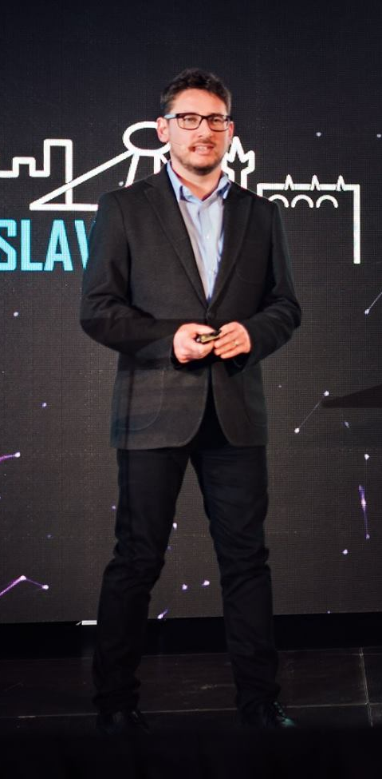
Introduction Szilárd Széll – DevOps Evangelist, Test Coach, NOKIA
Responsibilities
Test Coach and DevOps Evangelist in NOKIA with 19 years experience
Former President of the Hungarian Testing Board
Processes Management and Compliance Work Group Chair of ISTQB
Program Committee Chair and Member of UCAAT and HUSTEF
Certifications
DevOps DASA Foundation, SAFe SPC, Certified Scrum Master
ISTQB CTEL-ITP-Full, CTAL-TM, CTFL-Agile Tester
IREB CPRE
Lean Six Sigma Green Belt

Slide 3
My goal is…
…that YOU start DOING Bug Hunting from tomorrow!

Slide 4
Agenda for today
1
Exploratory Testing
2
Bug Hunting
3
Fit to DevOps and SAFe
4
Summary

Slide 5
Nokia as a house of Testing
Cornerstones of System Verification
Well defined Testing Processes at Company level
Well defined, standardized Requirements as input
ISO9001 and TL9000 compliant processes
Lean Six Sigma
Complex, Highly available (99.999%), Robust Products on IT Cloud and Telco HW

Slide 6
Test Case Design Techniques as educated by ISTQB
Many of them are used during Product Development
Defect-based techniques
Taxonomies
Specification-based or Black-box techniques
EP
Structure-based or White-box techniques
Experience-based techniques
BVA
Decision table testing
State transition testing
Orthogonal arrays / all pairs tables
Use case testing
Statement testing
Decision testing
Condition / Multiple condition / Condition determination testing
Path testing
LCSAJ
Error guessing
Checklist-based testing
Exploratory testing
Attacks
Notes:
according to the description: - the presentation will not describe in detail the differences between experience-based, exploratory and bug hunting testing → Yes it DOES - it will not provide metrics to show how the new technique was 'better' - has this use case general application? - what other test methods were used? → All BOLD - how is this method superior to non-exploratory? → Non Superior, just Complementary - what were the preconditions - for example, the requirements?

Slide 7
Explaining Exploratory test
(One) Definition
Exploratory Testing can be described as a goal oriented wandering
There is a mission/goal described in a charter, but there is no planned route, just wander from the selected starting point
Create a charter describing what and how and which way you want to test
Describe duration of your test
”Exploratory Testing is an interactive process of concurrent product exploration, test design and test execution. To the extent that the next test we do is influenced by the result of the last we did, we are doing exploratory testing.”
James Bach, Satisfice

Slide 8

Exploring Barcelona
ET is a goal oriented wandering

Slide 9
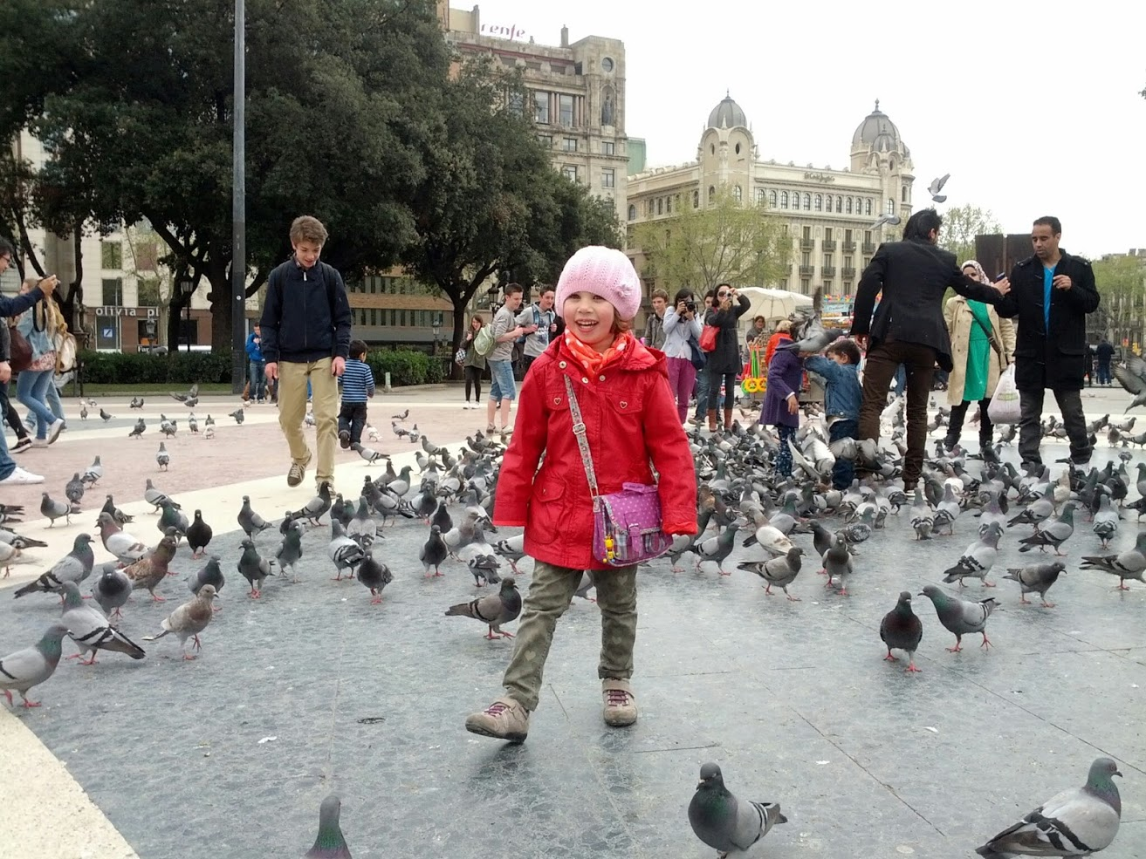

Slide 10
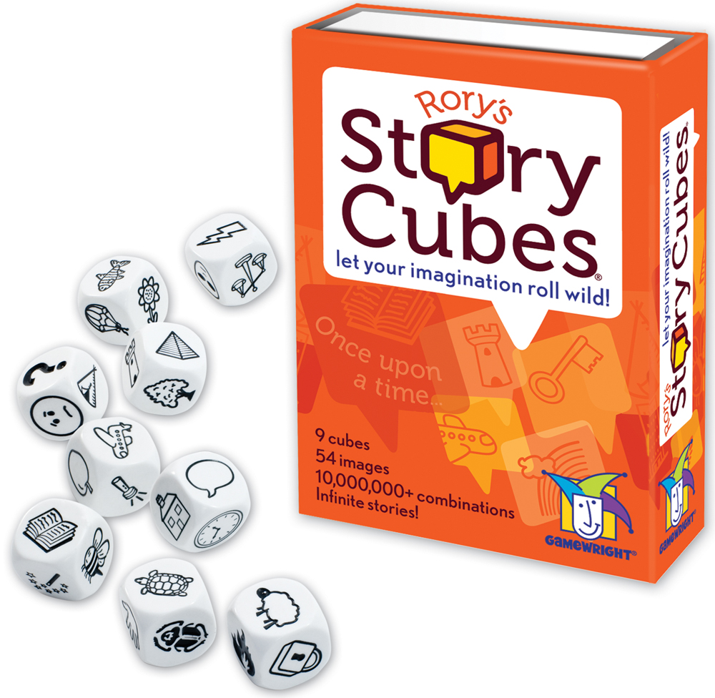
Explaining Exploratory test
Do you know what is the Story Cubes game?
“Once upon a time there was a flash, into who a fish has moved in (to live). The fish has asked the flash - Why is there a pyramid behind you? Why are you striking it? He (the flash) said - because an airplane is just going to fly by 200.000 millimeters below (us). Then, the passengers in the plane has asked the pilot - Why are we turning all around (left and right?)? The pilot said - Because I am reading a book. Then they (the passengers) asked the waitresses - Why don’t we get something to eat? Because (the waitresses said) a tortoise jumped into the soup. And then the tortoise said: Look, the sheep is parachuting out there!”
Szonja, 7 years
Notes:
Egyszer volt, hol nem volt, volt egyszer egy villam, akibe belekoltozott egy hal. Megkerdezte a hal a villamot: Miert van mogotted egy piramis? Miert csapsz bele a piramisba? Azt mondta, azert mert mindjart eluszik lent ketszazezer milimeterrel odebb egy repulo. Aztan a repuloben az utasok megkerdeztek a pilotat: Miert kanyargunk ide oda? Mondta apilota: Azert mert olvasgatok. Aztan megkerdeztek a pincernoket, hogy miert nem kapnak ennivalot? Azert, mert a levesbe beleugrott egy teknos. A teknos pedig azt mondja, - Hajj, hogy a birka ejtoernyozik odakint.

Slide 11
Explaining Exploratory test
Do you know how to use the Story Cubes in testing?
Gather Developers, Testers, Customers, Business people to the same table
Show them a Story Cube pack
Start collecting 9x6 areas of the system that is important
Make Cubes for your own
Play the game, roll the dice and tell a story by reading the pictograms
You just created an exploratory test case!

Slide 12
Explaining Exploratory test
A set of example cubes “created” by experts
 | Cube 1 | Cube 2 | Cube 3 | Cube 4 | Cube 5 | Cube 6 | Cube 7 | Cube 8 | Cube 9
Theme | Unit | State Change | Load Balancer | “CRUD” | Output | Transaction | Analysis | Attribute Anal. | Inter- face
Side1 | STU | WO RE | H.248 MSS | Create / Add | Log | LocUp | Barring | Routing | A/Iu
Side2 | CHU | SP RE |  | Read / Interrogate | Alarm | HandOver | User plane | CHA | Mc
Side3 | VLRU | CSWO | SIP | Update / Modify | ErrorLog | MO | Digit | EOS | MAP
Side4 | CM | FSWO | M3UA | Delete / Remove | ClearCode | MT | EOS | Service | Nc, BICC/SIP
Side5 | SU | DISK | H.248 MGW |  | Measurement | Forward | Function | AIF | ISUP
Side6 | IPDU | POWER |  |  | CHA Ticket | SS | Pre./Ext. | IN | CAMEL

Slide 13
Explaining Exploratory test
A testing story by an expert
Rolled cubes: CMM -> Faulty SWO -> ClearCode -> A/Iu interaface
Test Case scope: CMM faulty switchover during traffic
Pre-requisite: MSS is running with traffic. WO/SP-CMM are running smoothly.
Execution: Issue faulty CMM switchover for WO-CMM (simulate hw failure)
ExpRes: CMM is 2N redundant unit, CMM is the heart of the system (main DB copies are stored in its memory). If WO-CMM goes faulty switch over should happen without any traffic outage. SP-CMM should take over the traffic and the tasks smoothly

Slide 14
Explaining Exploratory test
from scripted testing
exploratory path
traditional path
TEST CASE
Abnormal setup to SUT
Test setup for SUT
Test setup for SUT
misconfigure feature X
Use of abnormal conditions in variables
Simultaneous test event
Test execution
Test execution
Test execution
15
Distracting the SUT
OK result
NOK result
OK result
Modify configuration
minor fault
major fault
critical fault
Notes:
Mindset of exploratory tester
Makes unusual decisions and actions. Tries to think potential scenarios what might be there when something goes wrong.
Owns “Test to make it crash” attitude. Tries not only get required steps and tests to pass, but tries to make the system fail
Is like a child who plays with the toy, except the toy is the SUT
Makes silly actions, don’t even try to follow the rules.
Thinks: “what is particularly not forbidden should be allowed”

Slide 15
Agenda for today
1
Exploratory Testing
2
Bug Hunting
3
Fit to DevOps and SAFe
4
Summary

Slide 16
Bug Hunting
When can you apply Bug Hunting - Based on “Go on Bug Hunt” – from Klaus Olsen, FiSTB Testing Assembly, 2013
When a new release of software is ready for test, a Bug Hunt will very clearly read the temperature ~ quality of the software.
As an entry-criteria for new phases. View it as a ”smoke test” executed by people, instead of automated test
As team-motivation, when test execution becomes day to day work, and the auto-pilot is taking over, a Bug Hunt can be what you need to add extra adrenalin to your test.

Slide 17
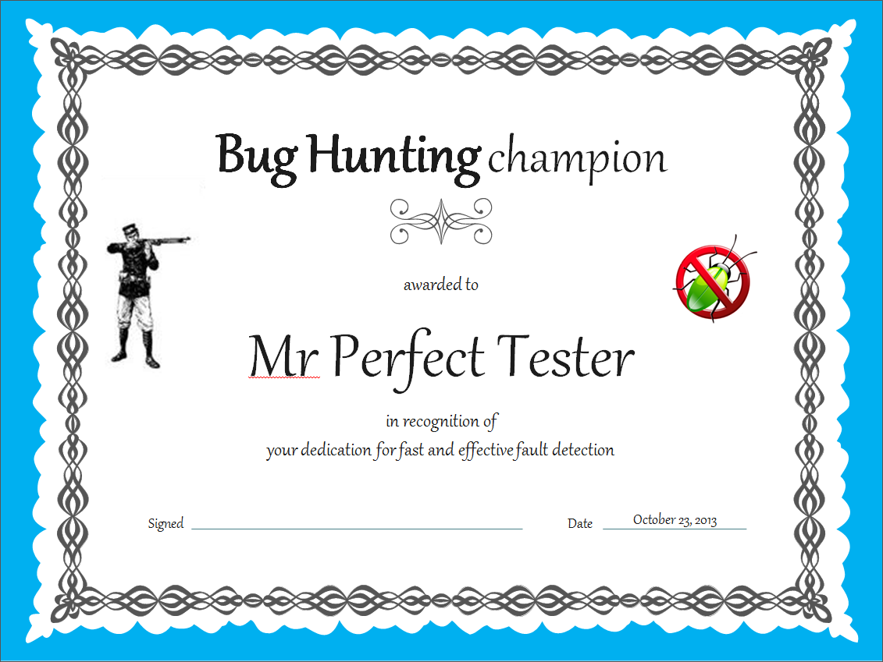

Bug Hunting
The simple ingredients you need
Test system 1
Test System 2
Test System 3
Test System 4
4 dissimilar test systems
4x test teams (pair or small group)
4 x 45 minutes testing rounds
Scope of Hunting
Exploratory Testing applied
Chat tool
Referee, Coach
Prize

Slide 18
Bug Hunting
Your step-by-step guide
1) Define
Pre-conditions for bug hunting: scope, environments, duration, boundaries, known issues
2) Go for Hunting
Use all the possible methods and scenarios. Do fault attacks, error guessing, pair working, parallel testing..
3) Inform
Briefly report all findings to referee. Do not pause hunting for fault investigation
4) Judge
Referee makes notes of all issues and informs if issue is duplicate. Announce winner/award prize
5) Analyze
Categorize issues. Investigate more for unclear issues
6) Report
All clear faults reported
Notes:
All issues analyzed and categorized
Further investigation of issues and reporting clear faults
Winning team recognized with certificate
Small prize for winners

Slide 19
Bug Hunting
You can use Bug hunting session as the practice part after a coaching/workshop
2 days workshop to educate software robustness
Building in robustness at every phase of the life cycle
Testing for software robustness from unit test through to solution level test
Run a 2x45 minute bug hunting session to apply the learnings from the workshop
 | Workshops | Participants | Critical | Major | Minor
Total | 8 | 112 | 15 | 43 | 32
Notes:
Would emphasise here that bug hunting can also be applied to development phase testing, not just SV. Also, it is worth saying we had 50% testers and 50% dev teams.
Examples in speech:
Capitalization is ignored while log on NE via SSH, i.e. password is accepted as valid if you use lower case or upper case characters
After graceful shut down request, all the ongoing sessions are dropped immediately
Logging in with the same administrator (same user and password) at the same time is allowed (security issue)
After clicking on System Reload there is no message if it was successful or not
Operator could lock out itself from the network element by disable critical interfaces or dispatchers

Slide 20
Bug Hunting
Misuse – to be avoided
Negative scoring as a punishment for not following rules
“Hunting session” takes a month
Using only Pre-Automated test cases
Connect Real Incentive to results
Collecting Bugs beforehand and keep them in your pocket until the Bug Hunting Event

Slide 21
Agenda for today
1
Exploratory Testing
2
Bug Hunting
3
Fit to DevOps and SAFe
4
Summary

Slide 22
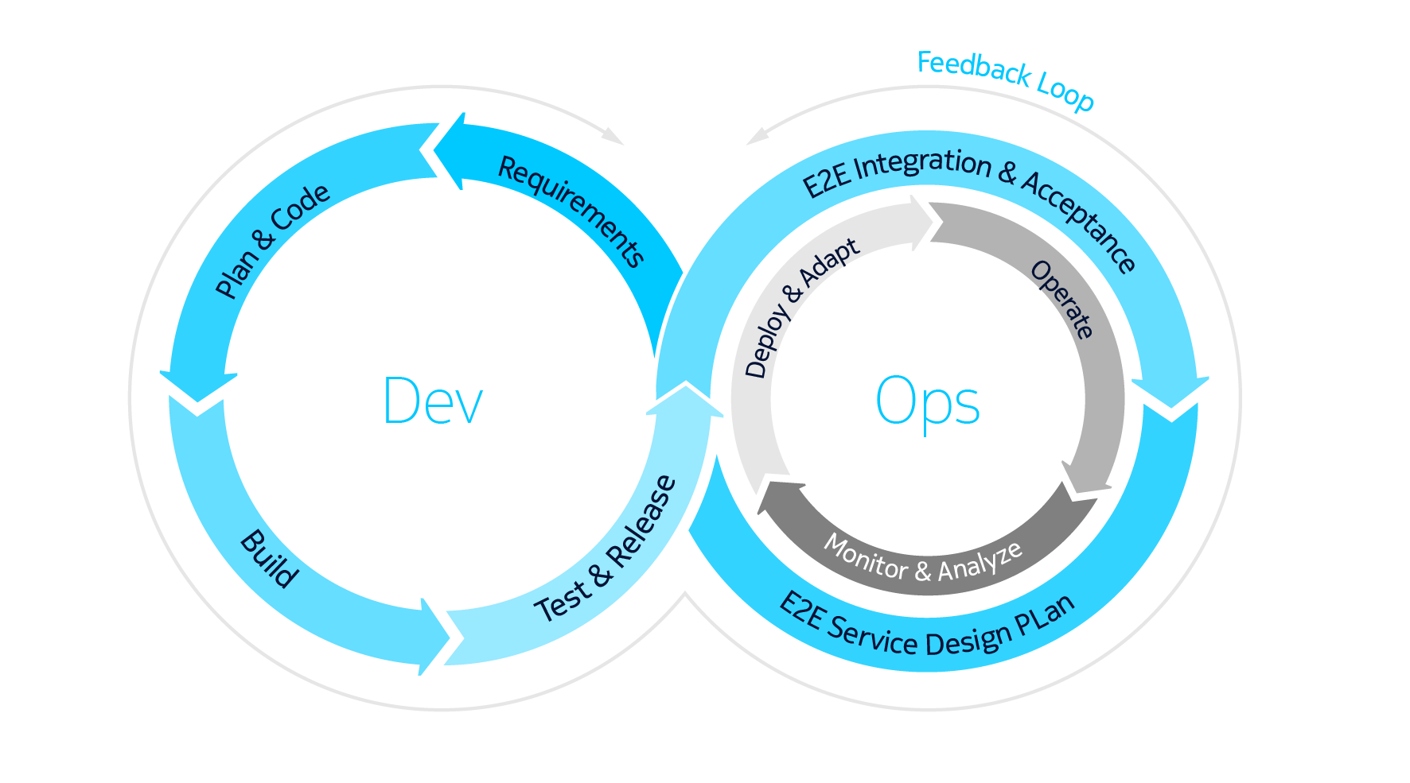
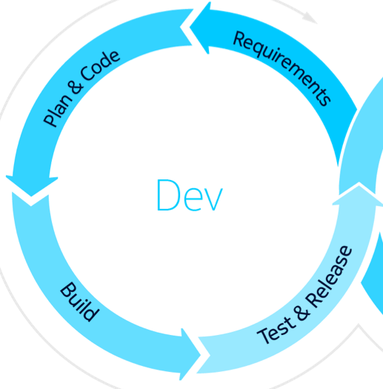
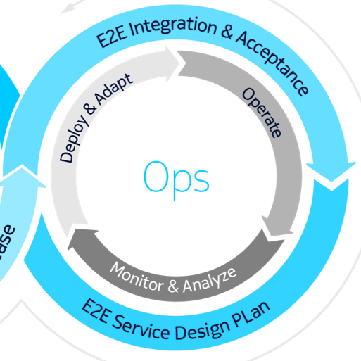
DevOps
Notes:
DevOps is the combination of cultural philosophies, practices, and tools that increases an organization's ability to deliver value at high velocity: evolving and improving products at a faster pace DevOps methodology utilizes elements of Kaizen, Lean and Agile.
DevOps is an ethos centered around integration and communication between software developers and operations professionals who manage production operations.
Compared to the traditional Gantt, this is how DevOps can be represented, as an infite loop of planning, building, delivering and operating of SW applications, and most importantly this is surrounded by continuous feedback, providing the needed information to the Plan-Do-Check-Act cycle.

Slide 23

DevOps – Automated everything
But how Exploratory Testing and Bug Hunting fits in then?
Culture for quality and transparency
Microservices & containers
Feedback
Business agility
Dev
Ops
Automated workflows
PLAN
CODE
BUILD
TEST
RELEASE
DEPLOY
OPERATE
Full automation
Agile development
Continuous SW delivery
Continuous integration
Continuous delivery
Simplify operations
Continuous deployment
Digital delivery:
Core AppStore
DevOps
Fewer failures
Faster time
to market
Operational efficiency
Notes:
Exploratory Testing can be also used in DevOps, even it is stating to Automate everything. While Automated Tests serve as a Quality Gate, exploratory testing is serving learning as well. It can give feedback on defect clusters, or simple give the opportunity to learn about how the Product behaves.
BugHunting session can also be organized at any point of time, serving as a good learning possibility for the cross-functional team.
As a special occasion, we have also organized Robustness Bughunting events together with out customers in mixed teams, happeining in their Laboratory (Staging environment). This transparency was very much appreciated by the customer, not to hide any faults, while it gave us a good opportunity to learn the priorities and high risk topics for our customers. In a multitousand development organization direct information might be hard to gather. Based on feedback the Automated Tests can be extended and finetuned, and even new features/functionality can be planned.

Slide 24
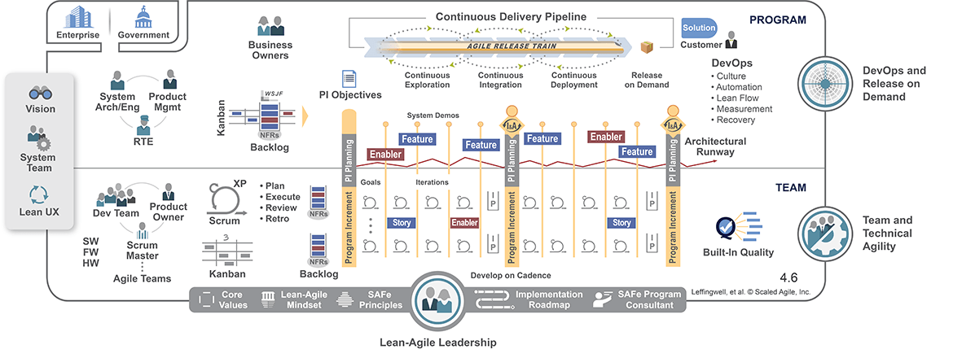
Scaled Agile Framework
Does ET and BH it fit here?
ET
ET
ET
ET
BH
© Scaled Agile, Inc. Include this copyright notice with the copied content.

Slide 25
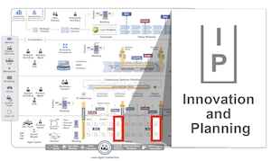
Scaled Agile Framework
Play Bug Hunting during Innovation and Planning Iteration!
…and provides dedicated time for innovation, continuing education…
…exploration
…cross training to develop skills in new domains
team building
pair working
© Scaled Agile, Inc. Include this copyright notice with the copied content.

Slide 26
Agenda for today
1
Exploratory Testing
2
Bug Hunting
3
Fit to DevOps and SAFe
4
Summary

Slide 27
Lessons Learned
…is FUN
A Bug Hunting event …
helps tester to think out of the box
improves team spirit and expertise
need to be planned up-front in Project Plan, not an ad-hoc event
the event needs preparation and time to analyze issues found
complements requirement based testing
can even fit into Automating Everything concepts and Scaled Agile

